Slide 1
RISING INSIGHTS
Lesson 10
Box Plots and Better Charts
Steam Data Stories
Notes:
Today we meet the box plot, then learn the small changes that turn a first-draft chart into one we can show an audience. About 60 minutes: 5 min hook, 15 min box plots, 5 min choosing a chart, 20 min making a chart better, 15 min Your data story.

Slide 2
In this lesson we will learn
Learning intentions
​how to draw and read a box plot
​how to choose the right chart for our question
​how to write a headline title that tells the finding
​how to make charts clearer with labels, colours and order
Notes:
Read the intentions aloud. The last three are about the audience: a chart is only useful if someone else understands it.

Slide 3
Terminology
New terms
​box plot – a chart that shows the median, the middle half and the spread of a group's values as a box with whiskers.
​outlier – a value much further away from the rest of the values than most.
​headline title – a chart title that states what the chart shows, rather than what it is.
Notes:
Three new terms. Outliers come back in detail when we look for them; today we just need to recognise them as dots on a box plot.

Slide 4
REMEMBER
​The right chart can make a difference obvious. The wrong one can hide it.
​Our bar chart made Indie and other games look the same. Our split histogram showed the difference, but it was crowded.
Notes:
Ask: what was hard to read about the split histogram? (Two sets of bars on top of each other.) Today's box plot shows the same comparison more simply.

Slide 5
Box plots
​A box plot squeezes a whole histogram into one box, so we can compare the spread of several groups side by side.
Notes:
Start marimo with marimo edit steam_story.py and press Ctrl+Shift+R (Cmd+Shift+R on a Mac) to run the earlier cells.

Slide 6
When to use a box plot
When to use it
​we want to compare the spread of a number across groups
​not just which median is higher, but whether the middle half sits higher
​and which group has more unusual values
​tidier than overlapping histograms, especially with three or more groups
​not for an audience that has never seen one, unless we explain it first
Notes:
The last point matters for students' own stories: if they use a box plot, they need to tell their audience how to read it.

Slide 7
Our first box plot
Why
steam_story.py — new cell
​A box plot shows the same comparison as our split histogram more simply, with one box per group. So Group goes on the x-axis and Review score on the y-axis.
1 px.box(
2 scored,
3 x="Group",
4 y="Review score",
5 )
Predict
​What will the chart look like? Which box will sit higher?
Notes:
PRIMM: predict, run, investigate. Line 1 starts a box plot with px.box; line 2 uses every game in scored.

Slide 8
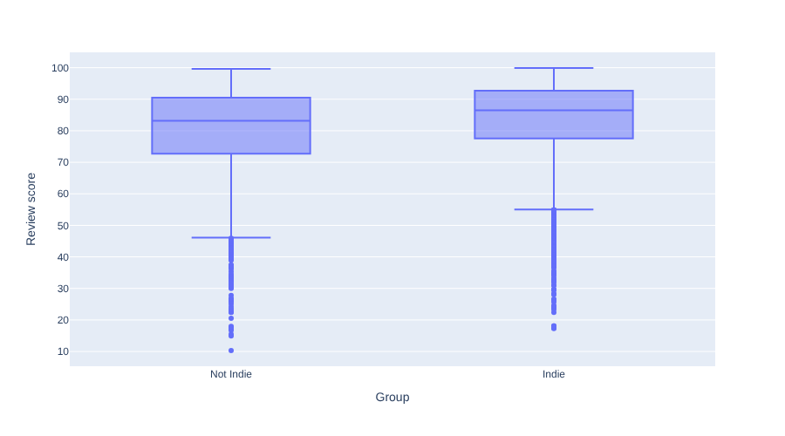
How to read a box plot
​the line inside the box is the median
​the box holds the middle half, from the 25% value to the 75% value
​the whiskers reach the most extreme values that aren't outliers
​the dots are outliers: much further away than the rest
Notes:
Point to each part on the chart as you read it. We'll work out how Plotly decides what counts as an outlier when we look for outliers.

Slide 9
HOVER OVER EACH BOX
​The whole Indie box sits higher, not just its median
​Indie box: 77.6 to 92.7. Not Indie box: 72.7 to 90.5.
Notes:
Have students hover over each box to find these numbers. The key point: not just the Indie median is higher, the whole box is.

Slide 10
Modify: a box plot of prices
PRIMM
​Change "Review score" to "Price".
​What do the boxes tell us about prices?
Notes:
Students should see lots of dots above the boxes: the expensive games. That sets up the outliers lesson.

Slide 11
Choosing a chart
​Different charts answer different kinds of questions.
Notes:
Students will use this table in Your data story to choose a chart for their own question.

Slide 12
Which chart answers our question?
Our question | Chart | Plotly Express function
​how does one number compare across groups? | ​bar chart | ​px.bar
​how are values spread out? | ​histogram | ​px.histogram
​how does the spread compare between groups? | ​box plot | ​px.box
​how does something change over time? | ​line chart | ​px.line
​are two number columns related? | ​scatter plot | ​px.scatter
Notes:
We've met the first three. Line charts and scatter plots come when we look at trends and relationships. Ask students which row matches their own question.

Slide 13
Making a chart better
​Our box plot works, but it's not ready for an audience yet.
Notes:
Ask students to spot problems with the chart before showing the next slide.

Slide 14
What's wrong with our box plot?
​it has no title, so the audience doesn't know what it's about
​the y-axis says Review score, which our audience hasn't heard of
​the x-axis label Group doesn't add anything
​both boxes are the same colour, and Not Indie comes first
Notes:
Indie games are the focus of our story, so they should come first. Ask students to rank the problems: which would confuse an audience most?

Slide 15
One fix for each problem
Fix | What it does
​color | ​gives each group its own colour
​category_orders | ​puts Indie first, because it's the focus of our story
​labels | ​swaps column names for words our audience understands
​title | ​states the finding
Notes:
Each fix matches one problem on the previous slide. Students change the existing cell next, not add a new one.

Slide 16
Make the box plot ready for an audience
steam_story.py — change existing cell
1 px.box(
2 scored,
3 x="Group",
4 y="Review score",
5 color="Group",
6 category_orders={"Group": ["Indie", "Not Indie"]},
7 labels={"Group": "", "Review score": "Positive reviews (%)"},
8 title="Indie games get a higher share of positive reviews",
9 )
​Why: Lines 5 to 8 fix our four problems: colour, order, labels and title.
Notes:
PRIMM: predict, run, investigate. Line 7: the empty text for Group removes the x-axis label. Point to the title: change existing cell.

Slide 17
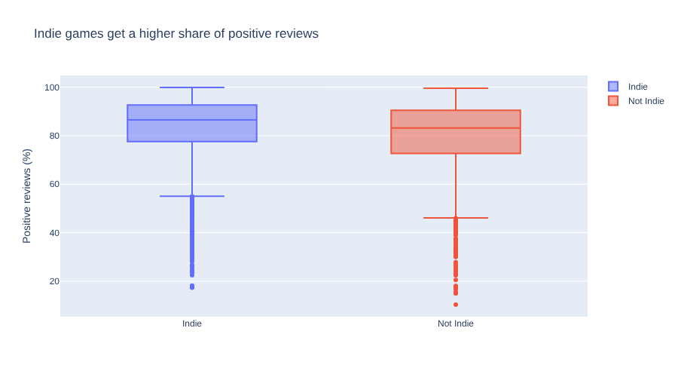
A chart ready for an audience
​Indie first and in blue, a clear y-axis label, and a title that states the finding.
Notes:
Put the before and after side by side if you can. Ask: which would you rather show your audience, and why?

Slide 18
TITLES THAT TELL
​Indie games get a higher share of positive reviews
​This headline title says what the chart shows, not what it is ("Review scores by group"). Our audience gets the finding before they even read the axes.
Notes:
A headline title is exactly what a data story needs. Ask students to turn a describing title into a headline, e.g. Review scores of all games.

Slide 19
Keep colours the same
Tip
​With category_orders, Indie is always first, so Plotly always gives it the first colour: blue. If we use the same order on every chart, Indie stays blue throughout our story, and our audience doesn't have to read the legend each time.
Notes:
Consistency is a gift to the audience. Students should use the same category_orders on every chart in their story.

Slide 20
A headline must be true
Watch out
​A headline title is a claim, so it has to match the data. Before we write one, we check the numbers behind it. Ours is true for the medians and the middle half of each group, but there are still plenty of Indie games with low scores.
Notes:
Ask: what would be an untrue headline for this chart? (All Indie games get better reviews.)

Slide 21
Modify: write your own headline
PRIMM
​Write a different headline title that still states the finding.
Notes:
Share a few aloud. Check each one is true for the data, as the warning says.

Slide 22
CHECK YOUR UNDERSTANDING
​What does the box in a box plot show?
​Which chart would we use to see whether two number columns are related?
​What is the difference between a headline title and a normal title?
​Why do we use category_orders on every chart?
Notes:
Cold-call or use mini whiteboards.
Answers:
1. The middle half of the values, from the 25% value to the 75% value. The line inside it is the median.
2. A scatter plot, px.scatter.
3. A headline title states what the chart shows (the finding), not what it is.
4. So Indie always comes first and always gets the same colour, and the audience doesn't have to read the legend each time.

Slide 23
Your data story
​Choose the best chart for your question, using the chart table. Write down why it suits your question.
​Draw it, then improve it with a headline title, clear labels and colours. Record the title.
​Show your chart to someone else for ten seconds, then ask them what it shows. Did they get your finding? Write down what they said.
In my_data_story.md, add the heading
## Better charts
Notes:
Pair students up for the ten-second test. If the partner can't say the finding, the chart or title needs work.

