Slide 1
RESOLUTION
Lesson 15
Publishing Our Data Story
Steam Data Stories
Notes:
The first Resolution lesson: we write the words of our story, tidy the notebook for the app view and hand it in for the class server. About 60 minutes: 5 min hook, 20 min mo.md and f-strings, 10 min limitations, 10 min tidying and app view, 10 min class server and hand-in, 5 min Your data story.

Slide 2
In this lesson we will learn
Learning intentions
​how to write the words of our story with mo.md
​how to put numbers from our data into our text
​how to be honest about the limitations of our story
​how to tidy our notebook and check it in app view
​how to hand in our story for the class server
Notes:
Read the intentions aloud. By the end of the lesson every student should have a story that runs on the class server.

Slide 3
Terminology
New terms
​app view – a way of showing a marimo notebook with the code hidden, so only the outputs and controls appear.
​class server – a computer at school that runs everyone's notebooks so anyone on the school network can open them in a web browser.
Notes:
Before the lesson, have the class server address ready and know how students will hand in their files.

Slide 4
WELCOME TO THE RESOLUTION
​Our audience needs the story, not our working
​The Resolution answers our question, says what the answer means, and is honest about what our data can't tell us.
Notes:
Ask: who could follow our notebook right now? (Only us: it's full of code and working tables.) Today we write the story in words, with only the charts that matter.

Slide 5
Writing with mo.md
​marimo can turn Markdown into formatted text in our notebook, using mo.md.
Notes:
Students have been writing Markdown in my_data_story.md since they started their data story: # for headings, ** for bold, - for lists.

Slide 6
What our Hook needs
​We start with the Hook, because it's the first thing our audience reads.
​a title that asks our question
​a short paragraph that explains why the question is interesting
​one sentence that says what data we used: that's our whole Behind the Scenes
​three quotation marks let the text go over several lines
Notes:
Our audience needs to know where the evidence came from, but not every cleaning step. Start marimo with marimo edit steam_story.py and press Ctrl+Shift+R first.

Slide 7
Write the Hook
steam_story.py — new cell
1 mo.md(
2 """
3 # Do Indie games review better?
4
5 Indie games are made by small teams, often just a few people. Big
6 studios have hundreds of staff and much bigger budgets. So do players
7 like Indie games as much, and do Indie games cost less?
8
9 To find out, we looked at 10,250 Steam games with at least 500 reviews.
10 """
11 )
​Why: mo.md shows Markdown as formatted text; three quotation marks let it run over several lines.
Notes:
PRIMM: predict, run, investigate. Line 1 shows the text as formatted Markdown. Lines 2 and 10 start and end the three-quote string. Line 3 is a level 1 heading, our title. Lines 5 to 7 hook the audience; line 9 says what data we used.

Slide 8
Modify the Hook
PRIMM
​Rewrite the introduction so it hooks our audience in a different way.
​For example, start with a surprising number.
Notes:
The cell shows a large title and two paragraphs, with no code in sight. Share a few rewritten openings with the class.

Slide 9
Move the Hook to the top
Cell order doesn't change our code
​Hover over the cell and drag the dots on its left edge to the very top. marimo works out which cells need which variables and runs them in the right order, so we can put our cells in whatever order tells our story best.
Notes:
Demonstrate the drag handle. Students used to Jupyter may worry that moving cells breaks things; in marimo it doesn't.

Slide 10
Putting numbers in our text
​Typed numbers go wrong when our data changes. Instead we give each number a clear name, then put it inside { } in an f-string.
Notes:
Ask: what happens to a typed number if we fix a mistake in our data or get a newer copy? (The text is now wrong.) We take indie_score and other_score out of per_group, then put an f in front of the string.

Slide 11
Numbers from our data
steam_story.py — new cell
1 indie_score = per_group["Median review score"][0]
2 other_score = per_group["Median review score"][1]
3 mo.md(
4 f"""
5 ## Players like Indie games more
6
7 The typical Indie game gets **{indie_score}%** positive reviews,
8 compared with **{other_score}%** for other games.
9 """
10 )
​Why: We give each number a clear name, then the f lets us put those names inside { }.
Notes:
PRIMM: predict what the text will say. Lines 1 and 2 take the first and second values of the Median review score column and give them clear names. Line 4 starts the f-string with an f. Lines 7 and 8 put the values into the text, in bold.

Slide 12
Modify the text
PRIMM
​Add a sentence that uses the median prices from the prices table.
​Say that they're in US dollars.
Notes:
Students need to take the prices out of the prices table with their own clear names first, the same way as indie_score.

Slide 13
If our data changes, the text changes with it
​the text says 86.5% and 83.2%, the same as our per_group table
​drag this cell just above the chart that shows the same finding
​each insight gets its own mo.md cell: a heading that states the insight
​then a sentence or two with the numbers, then the chart
Notes:
This heading, sentence, chart pattern repeats for every insight in their story.

Slide 14
Why [0] and [1]?
Tip
​When we made per_group, we sorted it by Group, so Indie is always the first row, [0], and Not Indie is always the second, [1]. Without sorting, the rows could come out in a different order and our text could swap the two numbers.
Notes:
Students using their own groups must check their table is sorted, and which group comes first.

Slide 15
Being honest about limitations
​Our answer and our limitations go in the same cell: the answer says what we found, the limitations say how far to trust it.
Notes:
Being honest about limitations makes our story more trustworthy, not less. We write the answer in plain words without new numbers, because our audience has already seen the evidence, and give each limitation its own dot point.

Slide 16
What we found, and our limitations
steam_story.py — new cell
1 mo.md(
2 """
3 ## What we found
4
5 Indie games get a higher share of positive reviews than other games,
6 and they cost less. The review gap has lasted every year since 2017,
7 and the price gap has grown since 2020.
8
9 ### Limitations
10
11 - a game counts as Indie if Steam lists Indie in its genres, so our
12 other group isn't exactly the same as big studios
13 - we only used games with at least 500 reviews, which leaves out most
14 small games and many games from 2025
15 - our data is a snapshot of Steam from 5 October 2026
16 - our charts show that being Indie is related to better reviews, not
17 that it causes them
18 """
19 )
Notes:
PRIMM: predict, run, investigate. Lines 3 to 7 are the answer. Line 9 is a level 3 heading for the limitations, and lines 11 to 17 are four list items. This is the end of our story, so leave it at the bottom of the notebook.

Slide 17
Where each limitation came from
Limitation | Where we found it
​how we chose our groups | ​when we made new columns
​only games with at least 500 reviews | ​checking our prediction
​related to, not caused by | ​our scatter plot
Notes:
Ask students to find the matching notes in their own my_data_story.md. Every limitation in their Resolution should already be written down somewhere.

Slide 18
Limitations aren't excuses
Watch out
​A limitation explains what our audience should keep in mind, not why our story might be wrong. Write it as a fact ("we only used games with at least 500 reviews"), then say what it means ("which leaves out most small games").
Notes:
Common mistake: "our data might be wrong" or "we didn't have enough time". Push for a fact, then its meaning.

Slide 19
Tidying for our audience
​In the app view, every cell that shows an output appears on the page, including every working table.
Notes:
For example, the scored.select(...) table we used to check our new columns. Our audience doesn't need those.

Slide 20
Put our cells in story order
Story stage | What our audience sees
​Hook | ​our title and question, in a mo.md cell
​Behind the Scenes | ​one sentence about our data, in the Hook's mo.md cell
​Rising Insights | ​for each insight, a mo.md cell with a heading and the numbers, then its chart
​Aha Moment | ​our Aha chart, then our UI elements and explore chart
​Resolution | ​what we found and our limitations, in a mo.md cell
Notes:
Students work through their notebook from top to bottom, dragging cells into this order.

Slide 21
Does our audience need to see this?
​For every other cell, ask that question. If not, delete the last line, the one that shows the output.
​e.g. end the cell that makes per_group at the closing bracket
​delete the per_group line underneath
​the variable is still made, so every cell that uses it still works
​it just isn't shown
Notes:
Model this on one cell before students do it themselves.

Slide 22
Delete the line, not the cell
Watch out
​Only delete the line that shows a table. If we delete the whole cell, its variable disappears, and every cell that uses it stops with an error.
Notes:
If a student's story suddenly fills with errors, check whether they deleted a whole cell.

Slide 23
Checking the app view
​Let's see our story the way our audience will.
Notes:
Students need to stop marimo edit first, so they have a free terminal.

Slide 24
Open our story in app view
Why
Terminal
​First click in the VS Code terminal, press Ctrl+C, type y and press Enter to stop editing. The (.venv) prompt comes back. Then run this command.
1 marimo run steam_story.py
​A new browser tab opens with our story, and no code.
Notes:
On a Mac it's still Ctrl+C in the terminal. If students forget to stop marimo edit, the terminal is busy and nothing happens.

Slide 25
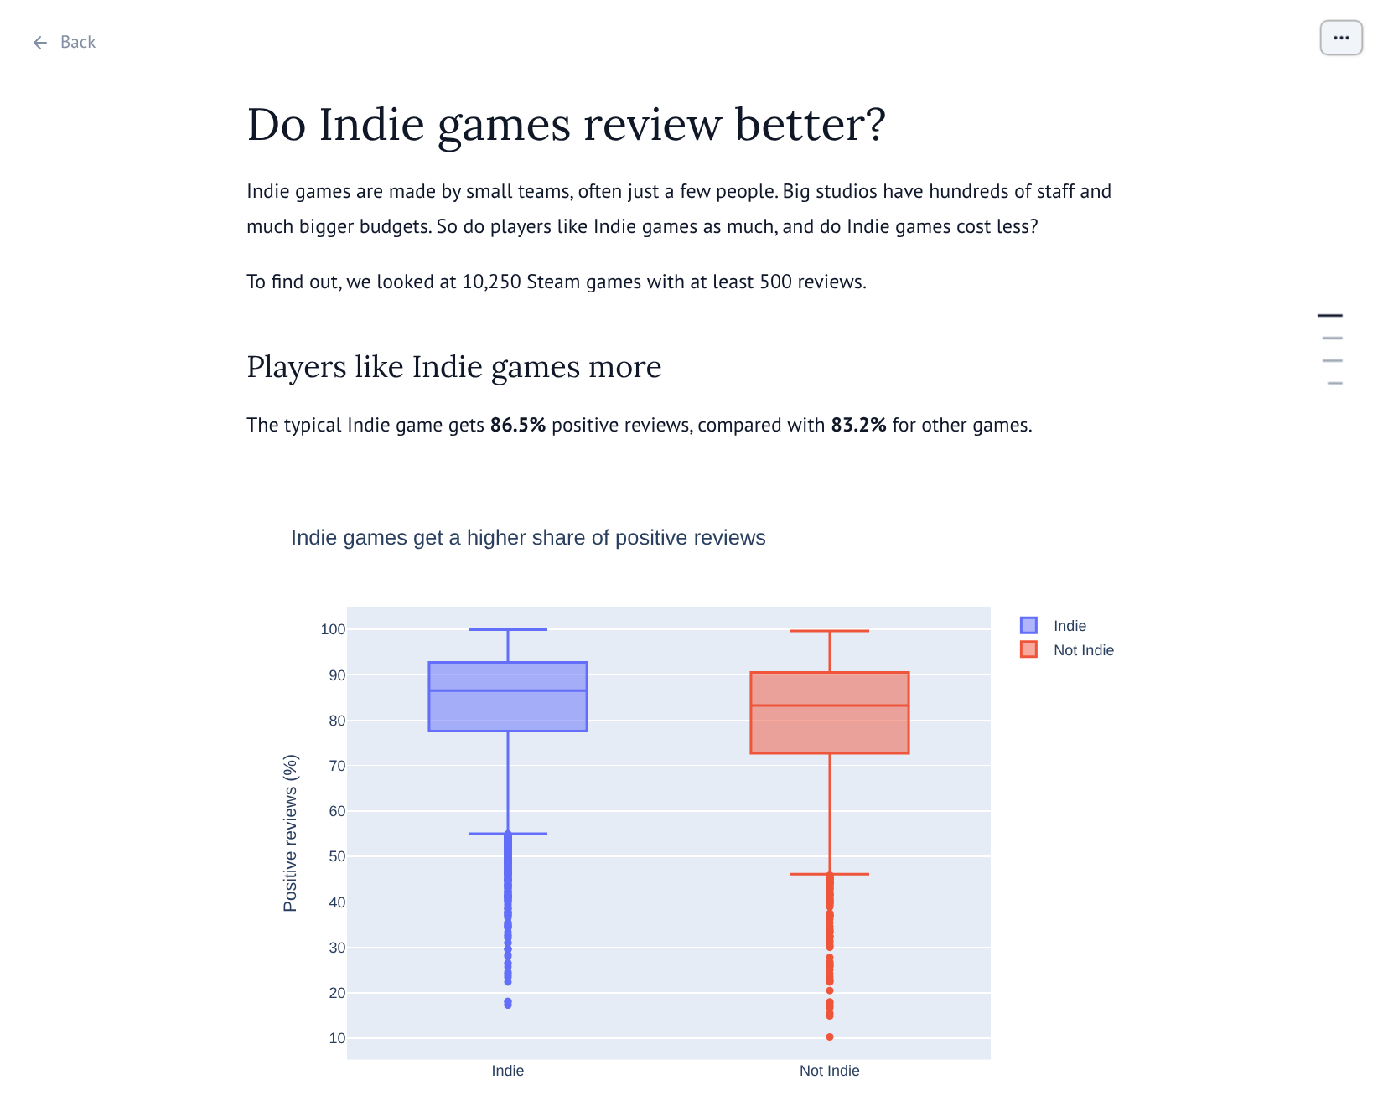
Our story in app view
​read it top to bottom as if we've never seen it
​try the slider and the dropdown
​out of order, confusing or a working table? Stop with Ctrl+C, fix it in marimo edit, check again
Notes:
Pair students up to read each other's app view if time allows: fresh eyes catch more.

Slide 26
Getting ready for the class server
​"data/clean_games.parquet" is found from the folder marimo was started in. The class server starts marimo in a different folder.
Notes:
On our computer, marimo starts in our project folder, so it works. On the class server it can't find our data, and our story would show a blank page.

Slide 27
Load our data from next to our notebook
steam_story.py — change existing cell
1 games = pl.read_parquet(mo.notebook_dir() / "data" / "clean_games.parquet")
2 games
​Nothing seems to change: games still has 10250 rows and 10 columns.
​Why: mo.notebook_dir() gives the folder our notebook is saved in, wherever that is, so this works on any computer.
Notes:
The difference only shows up when the notebook runs somewhere else. While they're here, students delete the games line too, because the audience doesn't need the raw table.

Slide 28
Handing in our story
​The class server needs two files, in the same folders as on our computer.
Notes:
Tell students exactly how to hand in their files for your class.

Slide 29
The two files to hand in
Why
Folders
​Our teacher will tell us how to hand them in. Then we get an address for the class server, such as http://192.168.1.50:2718.
1 steam_data_stories/
2 steam_story.py
3 data/
4 clean_games.parquet
Notes:
The notebook must still be called steam_story.py, and the Parquet file must be inside the data folder.

Slide 30
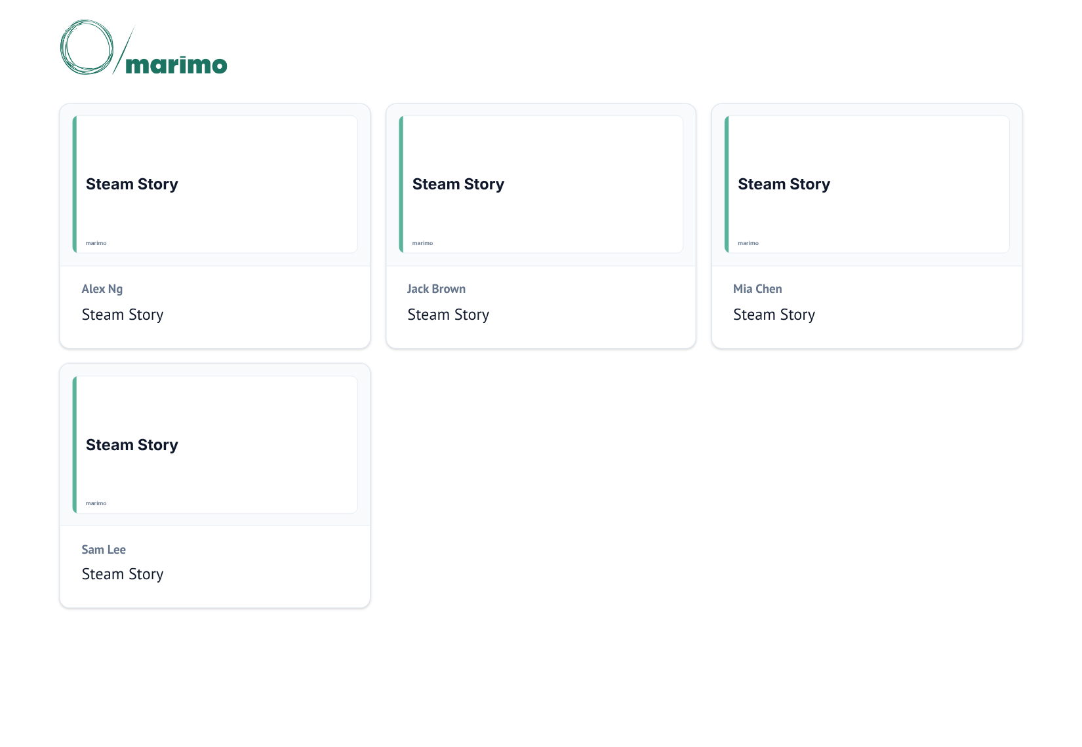
Everyone's stories on the class server
​open the address in a web browser
​there's a card for each person's story, labelled with their name
​click ours to open it in app view
Notes:
Open the class server on the projector and click into one or two stories once they're uploaded.

Slide 31
Check before handing in
Watch out
​our story opens with marimo run steam_story.py and shows no errors
​the notebook is still called steam_story.py
​clean_games.parquet is inside the data folder
Notes:
If the class server can't find the data, the story shows an empty page.

Slide 32
CHECK YOUR UNDERSTANDING
​Why do we use an f-string instead of typing the numbers into our text?
​Why does per_group["Median review score"][0] always give the Indie score?
​A table is cluttering our app view. What do we delete, and why not the whole cell?
​Why does our story need mo.notebook_dir() on the class server?
Notes:
Cold-call or use mini whiteboards.
Answers:
1. The numbers come straight from our data, so if our data changes the text changes with it.
2. We sorted per_group by Group, so Indie is always the first row.
3. Only the last line that shows the table. Deleting the cell removes its variable, so every cell that uses it stops with an error.
4. The class server starts marimo in a different folder, so the plain path can't find our data. mo.notebook_dir() finds the folder the notebook is saved in.

Slide 33
Your data story
​Write the mo.md cells for your story: a Hook, a heading and sentence for each insight, and a Resolution with your limitations. Use an f-string for at least two numbers.
​Check your story with marimo run, then ask someone else to read it in app view. Could they follow it without you explaining? Record what they said, and what you changed.
​Change the cell that loads your data to use mo.notebook_dir(), then hand in your story. Record its address on the class server.
In my_data_story.md, add the heading
## Publishing
Notes:
Most students will need part of next lesson to finish task 1. The class server address matters next time, when they present from it.

