Slide 1
Will Customers Churn?

Slide 2
Our Team
Adedamola Adedoyin
Role: Presenter 1
Kenneth Mambo
Role: Presenter 2
Project Lead
Name: Adedamola Adedoyin
Assistant Project Lead
Name: Kenneth Mambo
Query Analyst
Name: Elijah Fagbohun
Role | Name
Member | Bakare Olajumoke
Member | Gyang Paul Pam
Member | Ramesh Vhanamane

Slide 3
Problem Statement
Every year, companies lose a significant portion of their customers. This can be costly in terms of lost revenue and the resources required to acquire new customers.
By predicting which customers are at risk of churning, companies can take proactive steps to retain these valuable customers and improve their overall retention rate.
In this presentation, we will introduce a predictive model that can accurately forecast which credit card customers are likely to churn and how to target them with retention-enhancing interventions

Slide 4
Existing solutions
Acquisition of new customers which is costly

Slide 5
Our approach
Analyze customer demographics and transaction data to identify churn risk factors.
Build a predictive model to accurately forecast churn likelihood.
Target at-risk customers with retention-enhancing interventions.
Data Gathering
Data Cleaning
Model Deployment
Exploratory Analysis
Model Training
Model Evaluation and Validation
Notes:
For point one it will be important to consider a range of different factors that might influence their behavior.
This model will be based on machine learning algorithms or other statistical techniques, and will be trained using the historical data to identify patterns or trends that are indicative of churn.
Once we have identified which customers are at risk of churning, we will target them with interventions designed to improve retention. These interventions might include offering additional rewards or benefits, providing personalized customer service, or implementing other strategies to address the specific needs and concerns of at-risk customers.

Slide 6
Dataset description
Credit card customers dataset
Sourced from Kaggle
10,000 customers with the following features
age, gender, dependent count, education level, income category,
marital status, card category, months on book, total relationship count,
months inactive, total revolving balance, average open to buy,
total transaction amount, average utilization ratio, etc.

Slide 7
Dataset description
Unnecessary columns were dropped
Unknown entries were dropped
7,081 entries were left after data cleaning
Most customers earn between 60 – 80k US dollars
Blue card category is the highest
Platinum card category is the least
About 16% of customers churned
Columns were transformed for model training

Slide 8
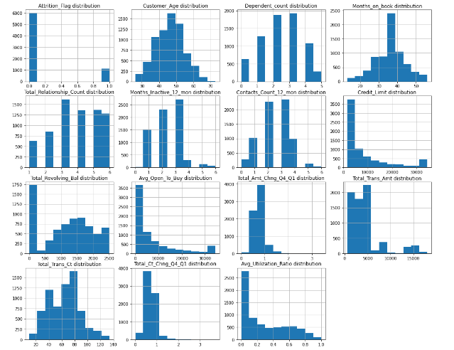

Slide 9
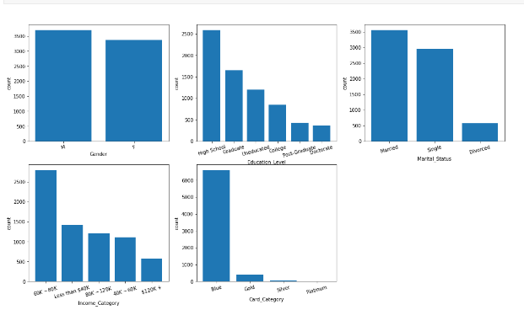
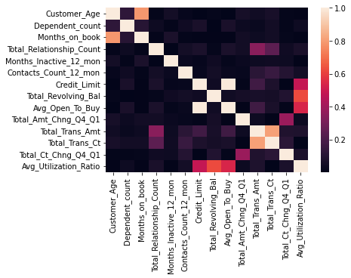

Slide 10
Model
To develop our predictive model, we used the Light Gradient Boosting Machine (LGBM) classifier, a powerful and efficient machine learning algorithm.
We split our dataset into a training set (80%) and a test set (20%), Before training the model, we performed some preprocessing on the data.
Our original model achieved an overall accuracy of 97.24% on the test set, indicating that it was able to correctly classify the majority of customers as either churners or non-churners.
The model's recall score, which measures its ability to capture churners, was 0.86.
These results suggest that our model is able to accurately identify at-risk customers and could be a valuable tool for improving customer retention
Notes:
Split Data- using the training set to fit and tune the model, and the test set to evaluate its performance.
Preprocessing - , including imputing missing values and scaling numerical features.

Slide 11
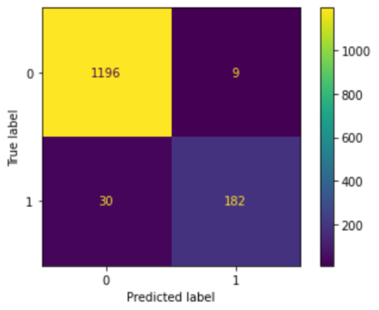
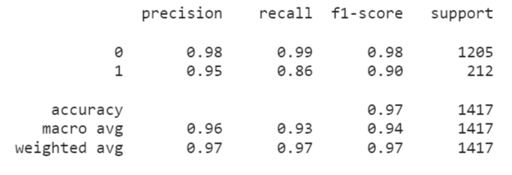
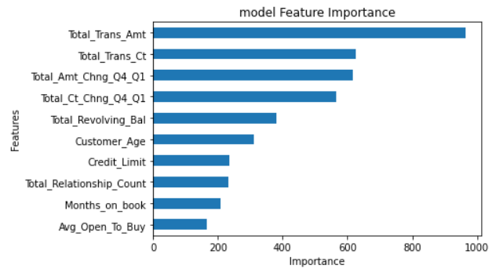
Untuned Model

Slide 12
Hyperparameter Tuning
After the model evaluation, hyperparameter tuning was done to improve the reliability of the model which had a recall score of 0.86 for the LGBMClassifier model.
After tuning the hyperparameters, the recall score for our model (for the target/label) increased from 86% to 91% even though the precision score dropped from 95% to 88%
For this project, according to the aim, a recall score is more important than a precision score. This is because we are more interested in capturing all the customers that are more likely to churn/attrite, even though we incorrectly include those that are less likely to churn.

Slide 13
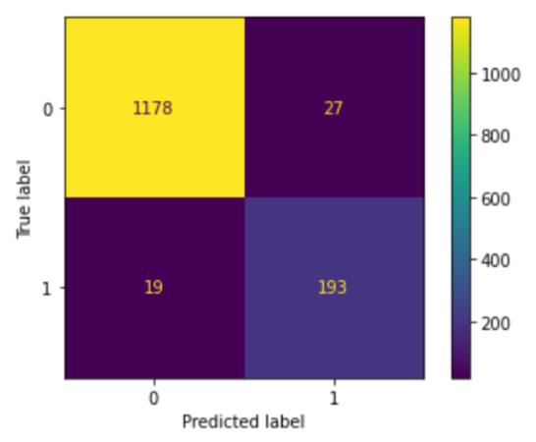
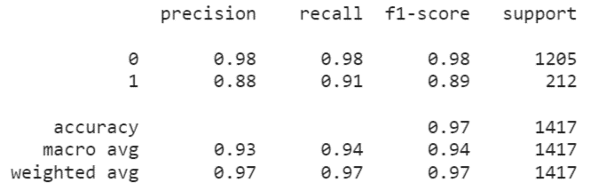
Tuned Model

Slide 14
Model Deployment
Sometimes, communication means sharing visualizations (as seen above). Other times, it means sharing the actual model.
The model was saved to a Pickle binary file (model-team-azure.pkl) that can be deployed in production

Slide 15
Summary
In summary, our predictive model was able to achieve strong performance in terms of accuracy and recall, and has the potential to be a valuable tool for improving customer retention.
Tuning the hyperparameter increased the accuracy of the model
Most customers are on blue card category
Unknown entries in original dataset was a challenge
Recommend a dataset with more entry to have more train data

