Slide 1


FindOne
Reporter：HAOWU YU
Date：2022.10.14

Slide 2
01
Introduction
CONTENTS
02
Significance
03
Functions
04
Conclusion

Slide 3

01
PART
Introduction

Slide 4
Introduction
The communication system is the implementation vehicle in the current instant messaging technology application, including server, client, database and other components. The APP is designed using Single structure. The specific operational database requests generated by the Android client are migrated to the integrated server and sent to the client in data format via XMPP protocol, and to reduce the pressure of accessing the database. The application uses SQLite database to store information about the user's friends locally in Android. The OpenFire server is used to embed the chat real-time functionality into the database. At the same time, FindOne software also has the functions of real-time communication chat and multi-expression data sending processing. Through the design and implementation of FindOne software, the most direct purpose is to provide users with a convenient information sharing, the realization of the friends circle and other functions of the dating system.

Slide 5
02
PART
Significance

Slide 6
Significance
Based on the current social actual business needs and conditions, combined with the structure, working characteristics, working methods and basic business needs of modern instant messaging, FindOne application analyzes the basic functions and performance requirements of instant messaging software system, combined with the successful experience of the current instant messaging software system. The development of a universal social friends instant messaging software. Due to the relatively limited installation of the required client, in order to facilitate safe management, this design adopts the Single model. The project adopts Android client and OpenFire integrated server side as the main design, where the data storage is realized by SQLite database and server-side embedded database, and the storage related to the information of friends realized by the software is stored by SQLite database, and the function of real-time chat communication is mainly managed by server-side embedded database information.

Slide 7
03
PART
Functions

Slide 8
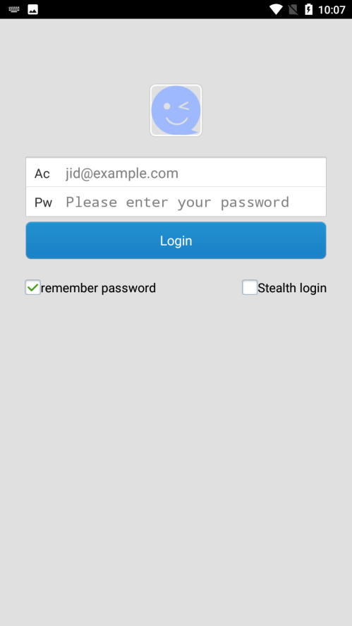
Login
When the Android application runs on the relevant Android virtual machine device or the relevant simulator, the MainActivity page will be entered first, and the login interface will be set for implementation. The login interface mainly includes the user's mobile phone number and password. In addition, for a more humanized design, the button jump permission of remembering password and stealth login other functions is added.

Slide 9

FriendsList
The list of friends is distinguishable from the online status of friends, while a long press on a friend will pop up an action alert box, the page is implemented mainly through the ListView and the rendering of the drop-down box to achieve. User data from the local server built by openFire server to generate friend data.When a user adds a friend, the user completes the search for the relevant friend account through the search box. After the search is completed, the user sends a friend request to the friend. At the same time, the relevant friend list information is updated in real time after the friend receives the friend request.

Slide 10
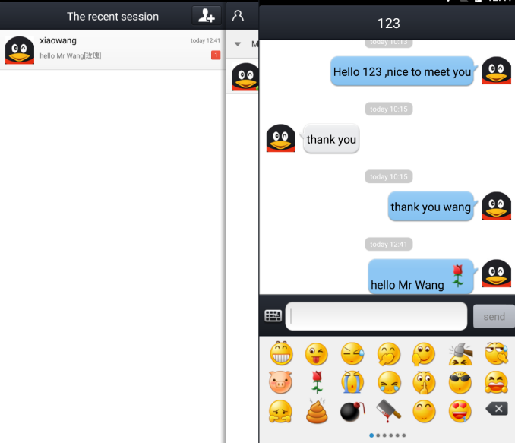
Session List
This page is the display page of the recent chat history of the current friend. It mainly includes contents such as user avatar, user name, first half of the message compressed information, message sending time and other information. If the message is received in online status, the relevant voice prompt driver will be called first, and the relevant message message box prompt will be completed and set. In terms of implementation, the recent chat log information on this page is based on SharedPreferences to save data. Using this method for data storage is mainly represented by the local storage records, and the data is stored completely in the local machine.

Slide 11
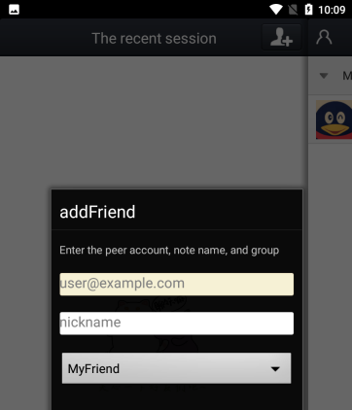
AddFriends
The implementation of this page is based on the user's personal information page, and the About option is called from the user's personal page to complete the display of relevant Android application-related information. The display includes information such as application icon, version number, author and email address.

Slide 12
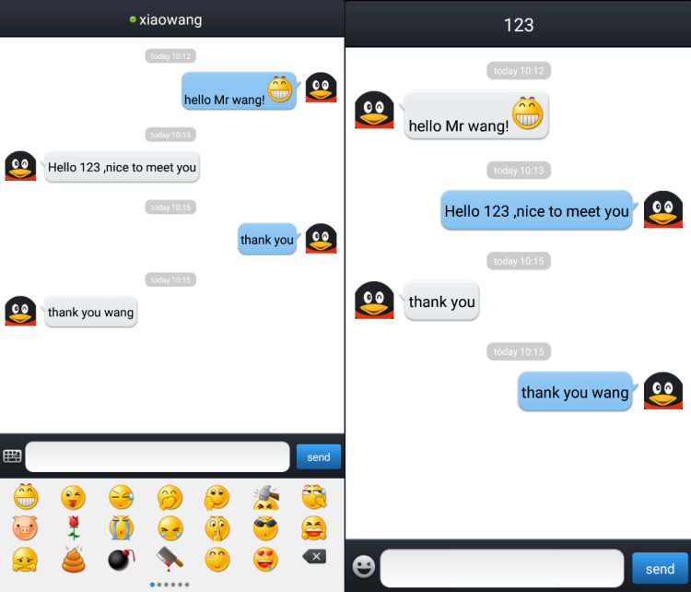
FriendsChatting
After adding friends, users can click on the list of friends to choose friends to chat or delete friends. During the chat, Socket and XMPP protocol will constantly search between the server and the client, so as to realize the operation of real-time information push.Here I use two Android emulators for the experiment, by configuring the static network parameters related to the two Android emulators to help complete the synchronization of the emulators' ip information, and by installing the APK file generated by them to the corresponding emulator, to test, by one side to the other side to add friends on the completion of the communication work, and to ensure the implementation of real-time communication technology.

Slide 13
04
PART
Conclusion

Slide 14
Conclusion
The development of the FindOne application has been positive on a user as well as social level.Instant messaging in the traditional context is mainly realized by server-side processing of requests and real-time client-side response. In the process of actual deployment, this approach needs to be realized with the focus on server building, and a more stable server needs to be integrated in order to achieve the most stable operation. The server to build the server side of the way is relatively cumbersome, so based on this demand currently produces a variety of scenarios to build the SDK tools and integrated build server, the project uses an integrated server to openFire-based, the server only requires a key local installation can be used, by configuring the embedded database, and open the current port can be achieved. In the development phase, the client completes the storage of relevant user registration information and friend information through the SQLite database, and in the message chat interface, remote client calls are made through the asmack client interface of the XMPP protocol, while realizing the relevant instant messaging online chat request operations.

Slide 15
THANKS

