Slide 1
EcoSort AI - Smart Waste Segregation Assistant
1M1B AI for Sustainability Virtual Internship
In Collaboration with IBM SkillsBuild & AICTE
Submitted by: Pawan Tiwari
Ambalika Institute of Management & Technology
AICTE STU ID : STU6a4f981e559f11783601182

Slide 2
SDG Alignment & Problem Statement
Primary SDG: SDG 12 (Responsible Consumption & Production - Target 12.5).
Secondary SDG: SDG 11 (Sustainable Cities and Communities).
Problem: Commingling of wet, dry recyclable, and hazardous waste at source causes recyclable materials to rot in landfills.
HMW Question: How might we use AI to guide users in segregating waste at the exact point of disposal to maximize recycling?

Slide 3
Target Users & The Need for AI
Target Users: College students, campus cafeteria staff, residential societies, and municipal waste workers.
Speed & Real-time Precision: Instantly resolves ambiguity for composite items (e.g., plastic-lined paper tea cups).
Multimodal Scalability: Supports text and vision-based item verification without requiring complex manuals.
Behavioral Impact: Encourages pre-disposal preparation (rinsing, crushing, separating components).

Slide 4
AI Solution & System Architecture
Input Layer: User enters waste item name or uploads photo.
Processing Engine: IBM Granite / Multimodal LLM extracts material properties (PET, Paper, Organic, Hazardous).
Rules Engine: Maps material against municipal color-coded bin standards (Green, Blue, Red/Black).
Output Generation: Delivers specific bin color, cleaning steps, and sustainability impact.

Slide 5
Responsible AI Considerations
Fairness: Calibrated for Indian household and campus waste (e.g., kulhad, coconut husks, snack pouches).
Explainability: Explains the Why behind bin allocation to build user habits.
Privacy: Operates strictly on object data; captures zero user faces or personal identifiers.
Safety: Flags sharp glass, chemical containers, and batteries with explicit handling warnings.

Slide 6
Prototype Demonstration
Demo Interface: Interactive Streamlit Web Application (EcoSort AI).
Tested Case 1 (Plastic Bottle): Blue Bin (Dry Recyclable) -> Action: Rinse & Crush.
Tested Case 2 (Banana Peel): Green Bin (Wet/Compost) -> Action: Dispose without plastic bag.
Tested Case 3 (Lithium Battery): Red/Black Bin (Hazardous E-Waste) -> Action: Tape terminals.

Slide 7
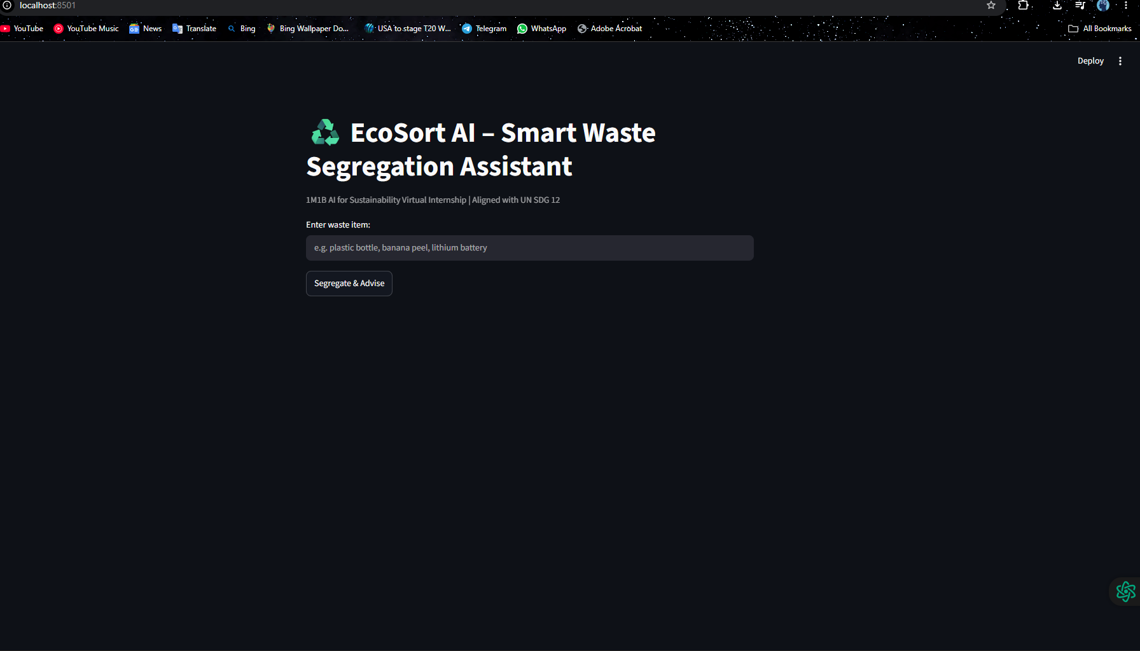

Slide 8
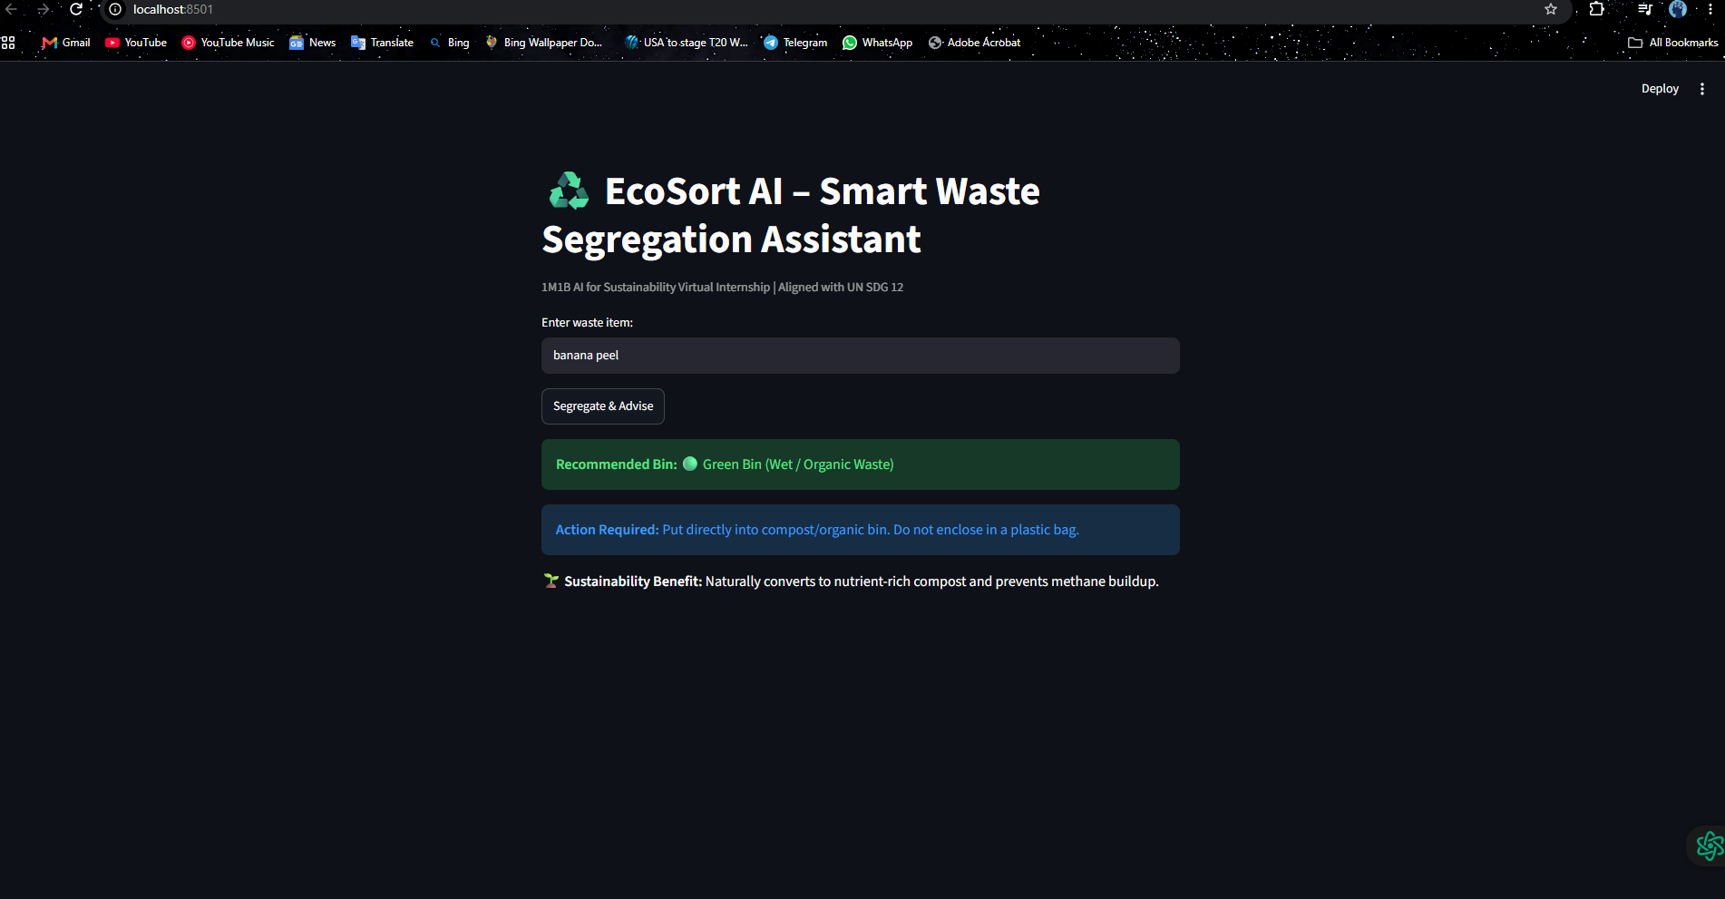

Slide 9
Expected Impact & Future Scope
Environmental: Significant reduction in landfill burden and methane generation from mixed piles.
Social Dignity: Shields sanitation workers from manual contact with broken glass and toxic cells.
Campus Metric: Enables colleges to meet Green Audit and Swachh Campus benchmarks.
Future Scope: IoT integration with camera-equipped smart dustbin lids for automatic mechanical sorting.

