Slide 1
1M1B • IBM SKILLSBUILD • AICTE INTERNSHIP
EcoSort AI
Smart Waste Segregation & Circular Recovery Assistant
AI-powered source-level waste classification guiding users to achieve UN SDG 12 targets.
SUBMITTED BY
Pawan Tiwari
B.Tech Computer Science & Engineering
Ambalika Institute of Management & Technology
AICTE STU ID: STU6a4f981e559f11783601182
PROJECT METRICS
• Primary SDG: SDG 12 (Target 12.5)
• Core Engine: IBM Granite / LLM Logic
• Interface: Reactive Streamlit UI
• Mode: Real-time Multi-factor Triage

Slide 2
CONTEXT & MANDATE
SDG Alignment & The Ground Reality Problem
Overcoming contamination at source through intelligent triage.
THE PROBLEM STATEMENT
Commingled Waste Streams
• Source Mixing: Wet organic food, dry recyclables, and toxic cells are dumped into single bins.
• Landfill Burden: Over 70% of recyclables get ruined and degrade into methane in open dumps.
• Occupational Risk: Exposes sanitation workers to sharp glassware and chemical battery leaks.
SDG ALIGNMENT
UN Sustainable Goals
• Primary: SDG 12 (Responsible Consumption & Production - Target 12.5).
• Secondary: SDG 11 (Sustainable Cities and Communities - Target 11.6).
• Objective: Preventing recyclables from ending up in open dumps through source-level AI precision.
HOW MIGHT WE (HMW) STATEMENT
"How might we use AI to guide users in segregating waste at the exact point of disposal so that waste segregation and material recovery can become accurate, scalable, and habitual?"

Slide 3
STAKEHOLDERS & JUSTIFICATION
Target Users & The Need for AI
Bridging the gap between static signage and active segregation habits.
WHO BENEFITS
Target Users
• Students & campus faculties
• Cafeteria & food court staff
• Residential housing societies
• Municipal sanitation teams
WHY POSTERS FAIL
Static Poster Limits
• Ignored passive signage
• No help on composite items
• Zero pre-disposal guidance
• No habit reinforcement loop
HOW AI TRANSFORMS
The AI Advantage
• Instant real-time precision
• Multimodal text/image triage
• Prep guidance (rinse/crush)
• Measurable sustainability tips

Slide 4
ENGINEERING PIPELINE
AI Solution Architecture & Data Flow
From user query to color-coded municipal action.
01
USER INPUT
Query / Capture
User enters item name (e.g. 'banana peel') or submits an image frame.
02
AI ENGINE
Granite / LLM
Extracts material profile: Organic pulp, PET #1, laminates, or heavy metals.
03
TRIAGE RULES
Municipal Logic
Maps contamination level against standard color bins (Green, Blue, Red/Black).
04
OUTPUT
Actionable Output
Delivers exact bin, mandatory preparation steps, and environmental benefits.

Slide 5
GOVERNANCE & ETHICS
Responsible AI Considerations
Aligned strictly with IBM SkillsBuild ethical AI frameworks.
INCLUSIVE MODEL
Fairness & Localization
Calibrated for Indian and regional waste types (tea kulhads, coconut husks, snack pouches) to prevent classification bias.
HABIT FORMATION
Explainability
Explains the 'Why' behind bin allocation so users learn the mechanics of recycling instead of relying on a black box.
ZERO BIOMETRICS
Privacy by Design
Operates exclusively on object data. Zero facial imagery, personal telemetry, or identifiable data is captured or saved.
PHYSICAL SAFETY
Safety & Hazard Flags
Detects toxic items (lithium batteries, broken bulbs, solvents) and triggers bold visual safety warnings instantly.

Slide 6
IMPLEMENTATION
Prototype Demonstration & Test Cases
Verified interactive Streamlit assistant in live operation.
ACTIVE STREAMLIT GUI
Live Execution Result
VALIDATED TEST CASES
Inference Verification
🍌 Banana Peel
🟢 Green Bin (Wet/Compost)
Discard directly without plastic bag.
🧴 Plastic Bottle
🔵 Blue Bin (Dry Recyclable)
Rinse residual liquid and crush body.
🔋 Lithium Battery
🔴 Red/Black Bin (Hazardous)
Insulate terminals with tape before dropoff.

Slide 7
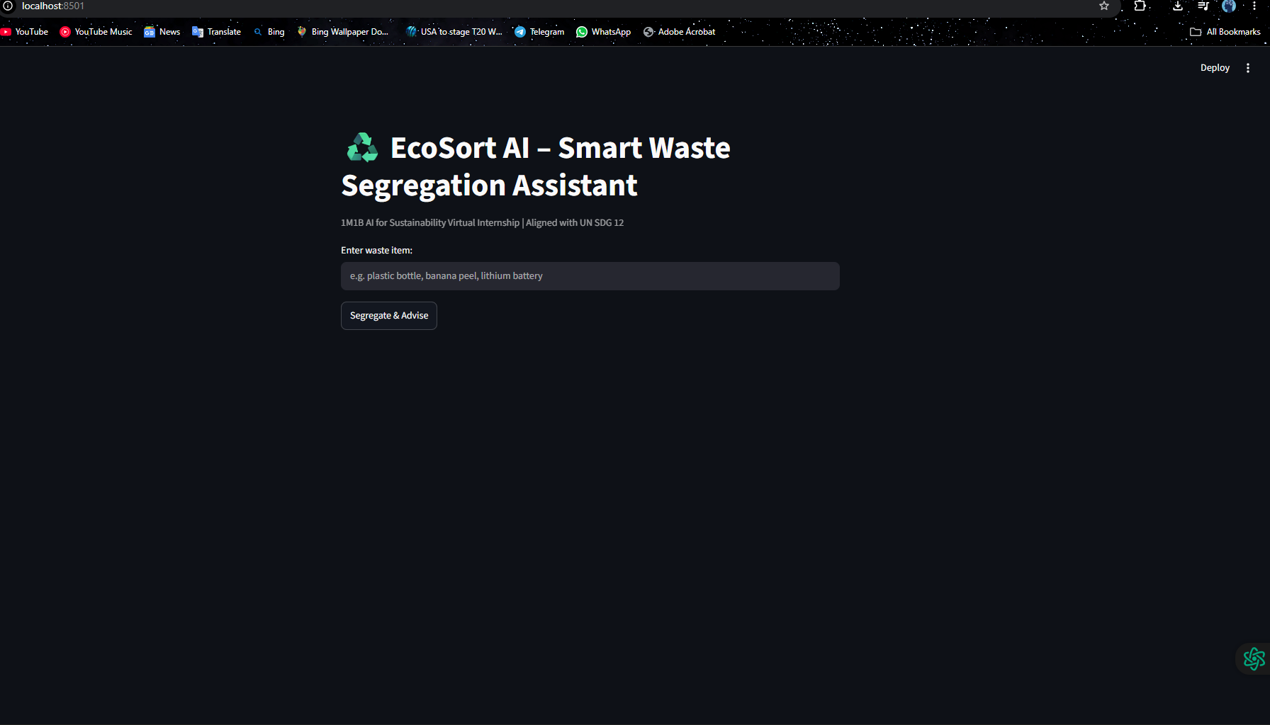

Slide 8
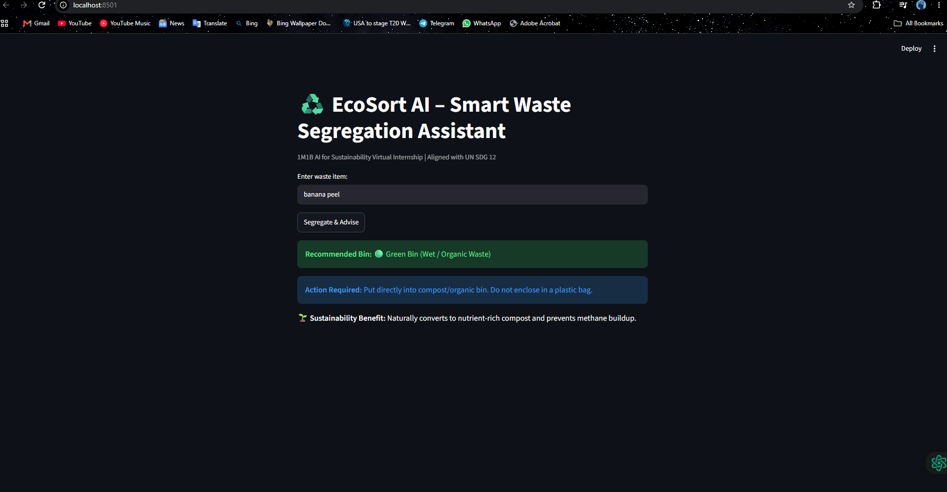

Slide 9
OUTCOMES & ROADMAP
Expected Impact & Future Scope
Quantifiable environmental progress and technological roadmap.
PLANET
Environmental Impact
• Significant reduction in landfill burden
• Eliminates anaerobic methane production
• Protects recyclables from wet damage
• Maximizes circular plastic recovery
PEOPLE
Worker Dignity
• Protects waste staff from sharp cuts
• Eliminates toxic chemical contact
• Lowers manual segregation burden
• Instills responsible campus civic habits
ROADMAP
Campus Metric & Future
• Helps campus meet Green Audit scores
• Swachh Campus ranking benchmark
• IoT smart dustbins with camera lids
• Automatic mechanical sorting flap triggers

