Slide 1
THE HUMAN FIREWALL AUDIT
Cybersecurity Project – Social Engineering Awareness & Defense
Pawan Tiwari | B.Tech CSE | Ambalika Institute of Management & Technology

Slide 2
Project Objective
Simulate a fictional multi-vector social-engineering attempt.
Use public-information exposure to identify human and workflow risks.
Build awareness material and a layered defense strategy.
Demonstrate defensive controls through a working application.

Slide 3
Target Organization
StreamZone Studios
Fictional online entertainment /
streaming company
~85 employees
Mumbai
Sensitive Data
Sponsorship contracts
Upcoming content
Unreleased media
Exposure
Public social content
Job postings
Workflow & tool oversharing

Slide 4
OSINT / Reconnaissance Findings
Behind-the-scenes content can reveal screens and work activity.
Job listings reveal tools and workflow patterns such as Canva, Google Ads and Slack.
Personal/company boundaries may be visible through references to personal cloud storage.
Travel or availability posts can provide contextual information.
Public workflow references can make social-engineering pretexts more believable.

Slide 5
Threat Model
Human Layer
Trust, urgency, ambition and
cross-channel confirmation.
Information Layer
Public posts, job listings and
workflow details.
Technical Layer
Email links, redirects, identity
/access and account security.

Slide 6
Multi-Vector Scenario
Vector 1: a fictional phishing message presents a high-value opportunity and points to a simulated login/upload flow.
Vector 2: a fictional influencer-style account contacts the PR function to reinforce the same opportunity.
The simulation demonstrates how two channels can make one request appear more credible.
No real credentials are collected and no real organization is targeted.

Slide 7
Awareness Material
Poster theme: “Don’t Let Fame Fool You!”
Verify attractive opportunities through an established company contact method.
Do not trust pressure, secrecy, unexpected links, or social-media verification alone.
Report suspicious collaboration and partnership requests.

Slide 8
Social-Engineering Red Flags
Unexpected partnership or collaboration request.
Urgency, pressure, or secrecy.
Domain mismatch or unusual redirect.
Request for passwords, codes, sensitive files, or unreleased content.
Verification through an unrelated social-media account.

Slide 9
Defense Strategy
People
Awareness training
Verification drills
Reporting culture
Technology
DMARC
Zero-Trust access
OAuth restrictions
Protection
Digital watermarking
Monitoring
Incident response

Slide 10
Working Application
Streamlit-based defensive demonstration.
Dashboard: project overview and threat model.
Phishing Analysis: sample-message heuristic inspection.
Password Security: basic password-strength characteristics.
Login Security: limited attempts and lockout demonstration.
Awareness Center + Activity Log.

Slide 11
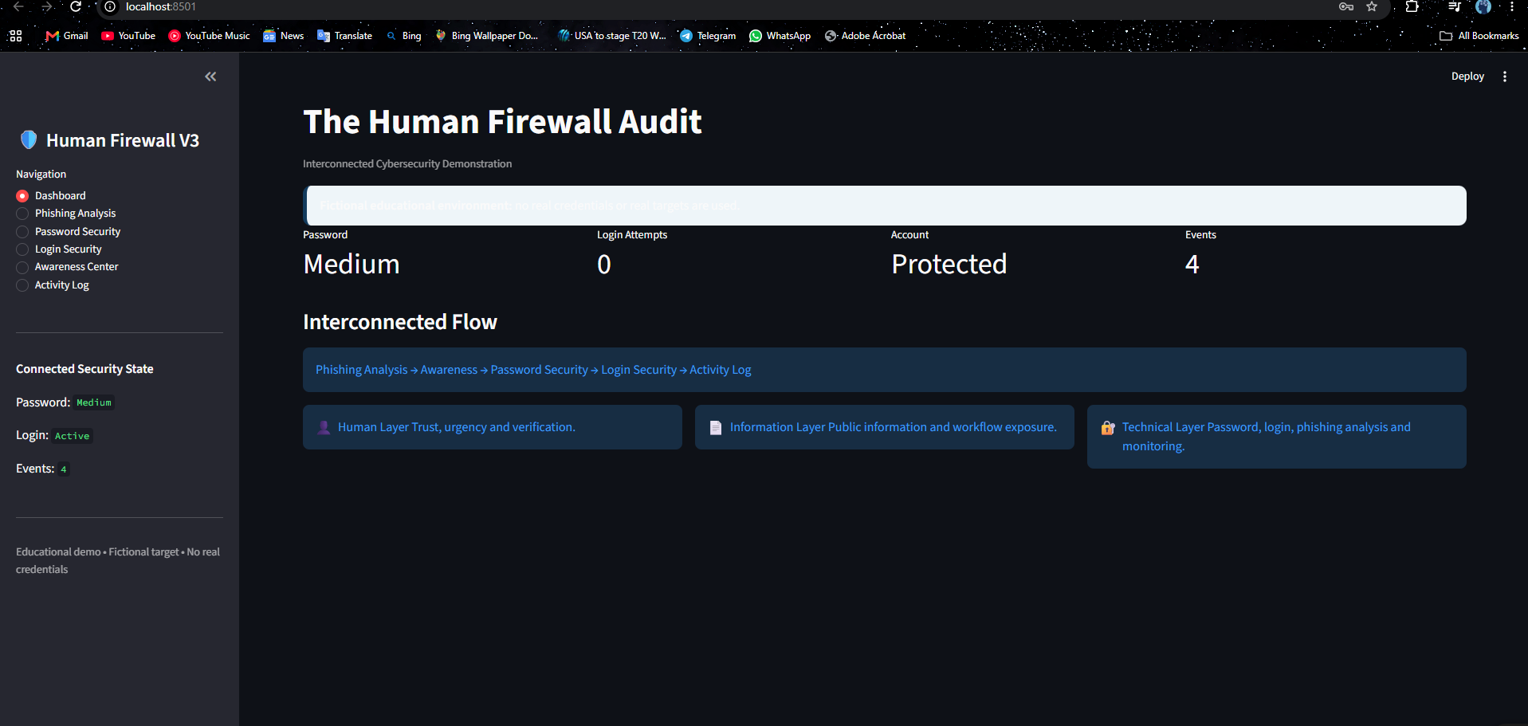
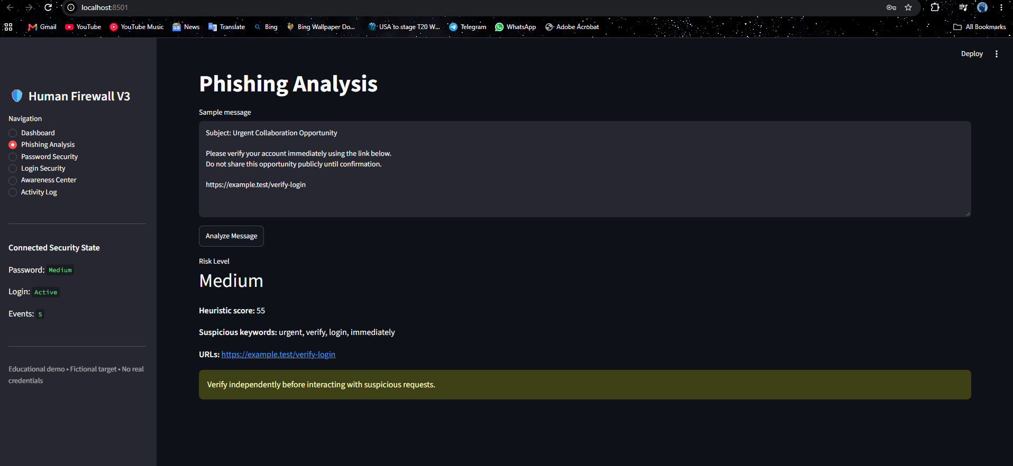
Working Application

Slide 12
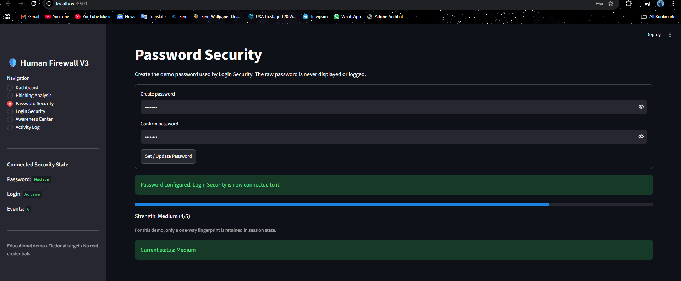
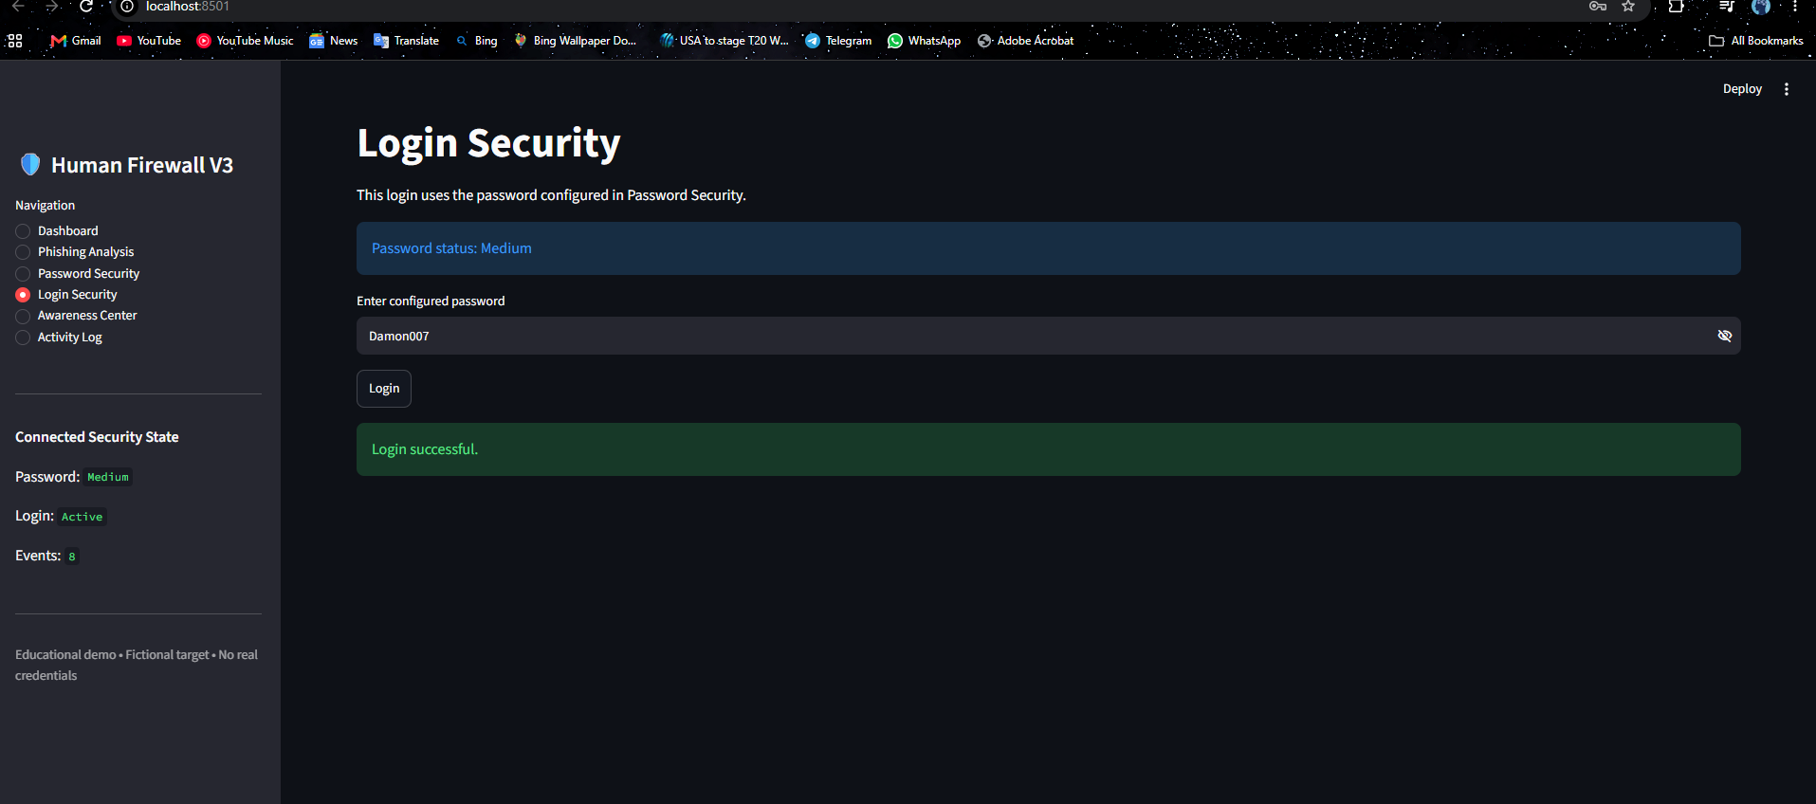
Working Application

Slide 13
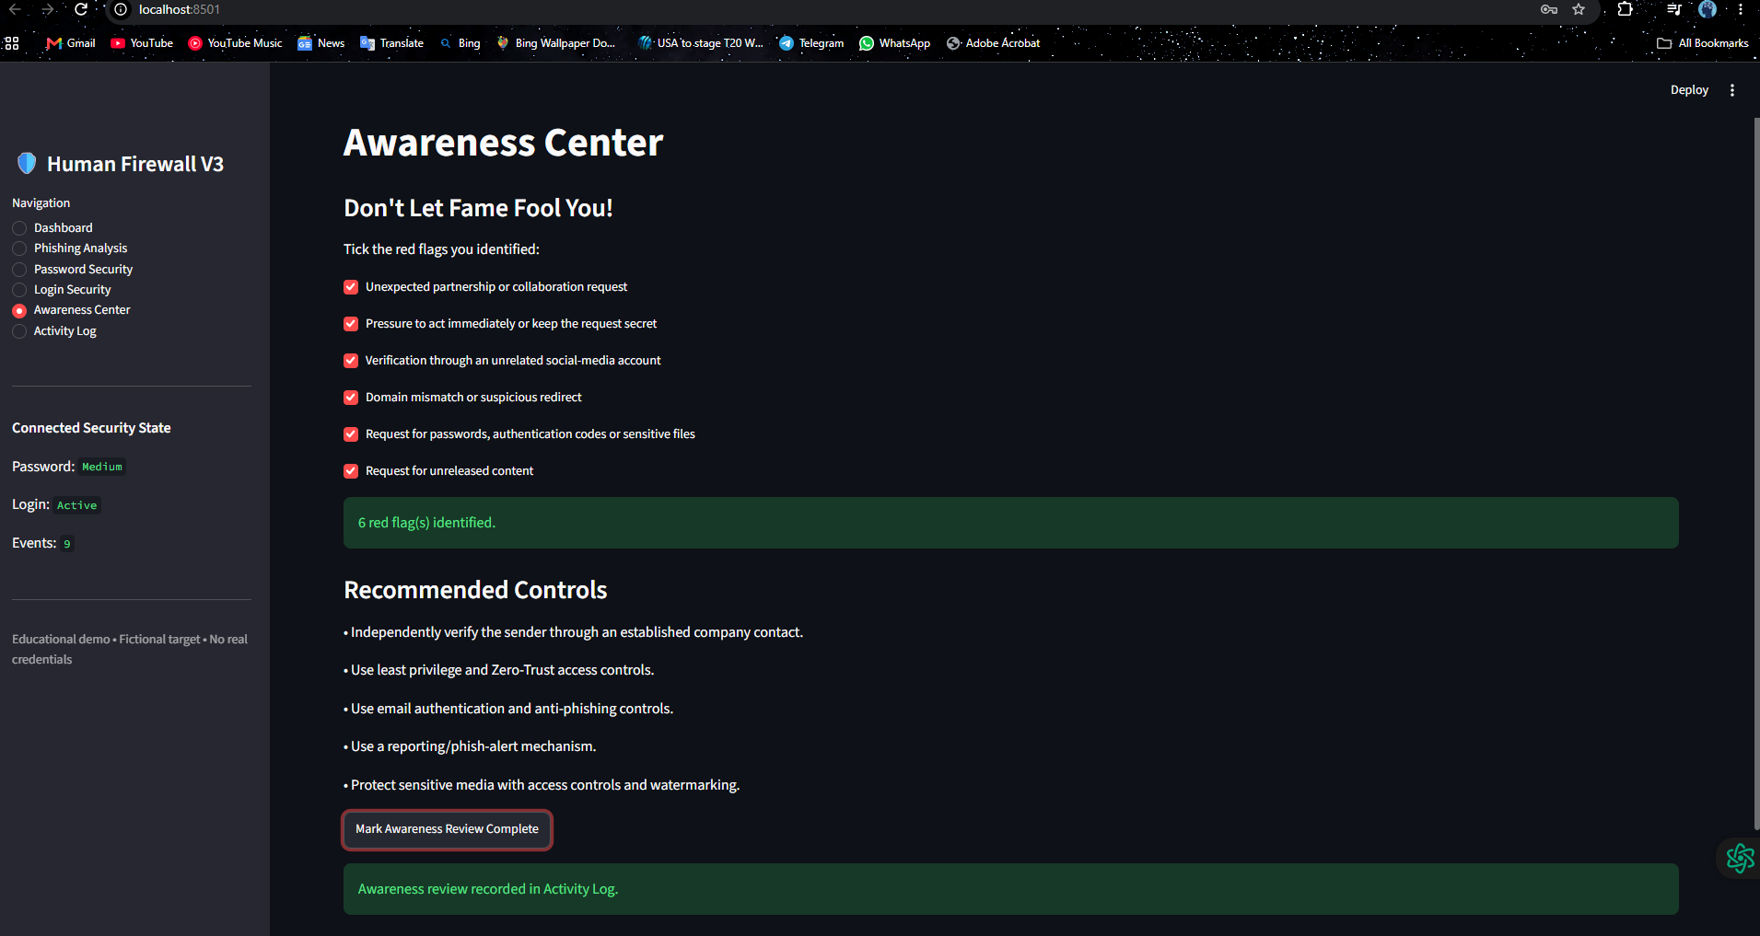
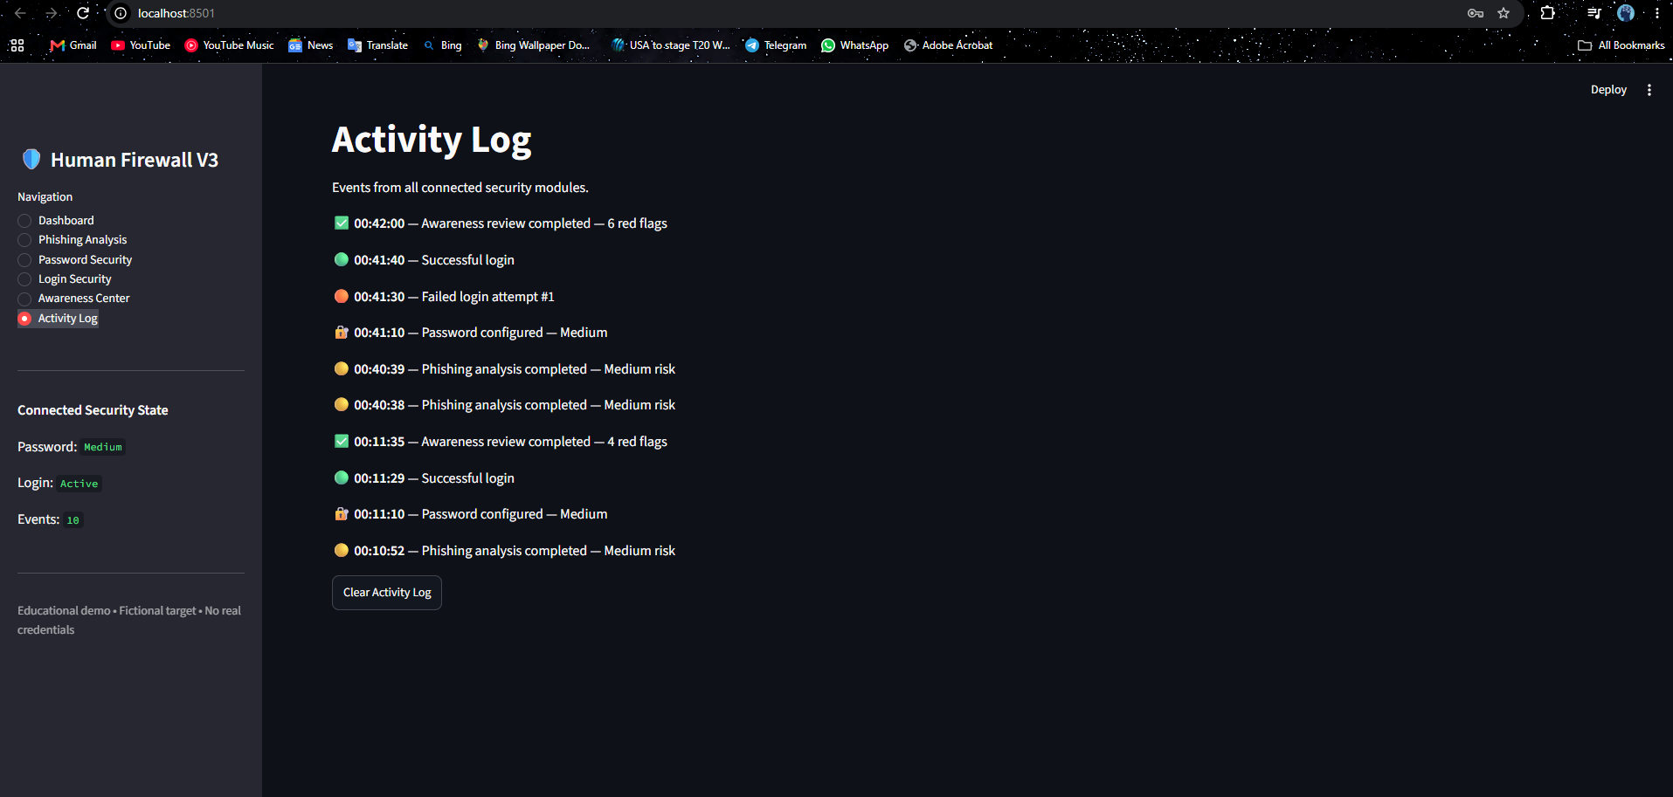
Working Application

Slide 14
Phishing Analysis Demo
Checks suspicious keywords and URLs in a sample email.
Produces a simple risk indication for educational demonstration.
Designed to teach recognition rather than replace enterprise email-security systems.

Slide 15
Password & Login Security
Password checker evaluates length, uppercase/lowercase, digits and special characters.
Login monitor demonstrates a three-attempt limit.
After the limit, the demo locks the login flow.
Concepts illustrated: rate limiting, account protection and defensive monitoring.

Slide 16
Results / Benefits
Connects human behavior with technical security controls.
Shows how public information can increase social-engineering credibility.
Provides practical red flags for employees and PR teams.
Demonstrates defensive concepts in a working application.

Slide 17
Future Scope
Database-backed activity and incident logging.
Role-based access and configurable training scenarios.
Richer phishing classification and analytics.
Controlled security-awareness campaign management.
Integration with safe enterprise training environments.

Slide 18
Ethical Statement & Conclusion
Fictional organization only.
No real impersonation, phishing, credential collection, or real-world targeting.
Core lesson: Think like an attacker, but defend like a strategist.
A strong human firewall combines awareness, verification, access control, monitoring and response.

