Slide 1

Project Title -Seasonal Agriculture Performance Analysis
Student Name –Pawan Tiwari
College Name- Ambalika Institute Of Management &Technology
AICTE STU ID : (its available in your offer letter)- STU6a4f981e559f11783601182

Slide 2

PROBLEM STATEMENT
(Agricultural activities are influenced by seasonal variations in environmental conditions, farming practices, resource availability and market conditions. As a result, agricultural performance may differ from one season to another. However, raw agricultural data does not clearly explain how agricultural performance changes across seasons or what patterns can be observed in different seasonal conditions. The problem is to analyze the given agricultural dataset and investigate seasonal differences in agricultural performance by identifying meaningful patterns, trends, relationships and variations within the available data.

Slide 3
Project Description
Seasonal Agriculture Performance Analysis uses a 4,000-row, 28-column agricultural dataset to study how farm performance changes across Kharif, Rabi and Zaid seasons. The project combines yield, production, revenue, cost, profit, environmental conditions, crop patterns and resource usage. Exploratory analysis, grouped comparisons, correlations, outlier analysis and statistical tests are used to identify meaningful patterns and support data-driven agricultural planning.

Slide 4

WHO ARE THE END USERS?
Farmers / Farm Managers
Agricultural Analysts
Agricultural Planning Teams
Farmers / Farm Managers
Seasonal crop planning, resource optimization and profitability-focused decisions.
Crop, season and state comparisons; outlier detection and evidence-based reporting.
Regional performance assessment and support for seasonal resource planning.
Agricultural Analysts
Agricultural Planning Teams

Slide 5

Technology Used
Python
Pandas
Matplotlib / Seaborn
Core language for data analysis and statistical processing
Data cleaning, grouping, aggregation and pivot tables
Exploratory data visualization and comparison charts
SciPy
Jupyter Notebook
ANOVA and Welch t-tests for statistical analysis
Interactive analysis environment used in VS Code

Slide 6
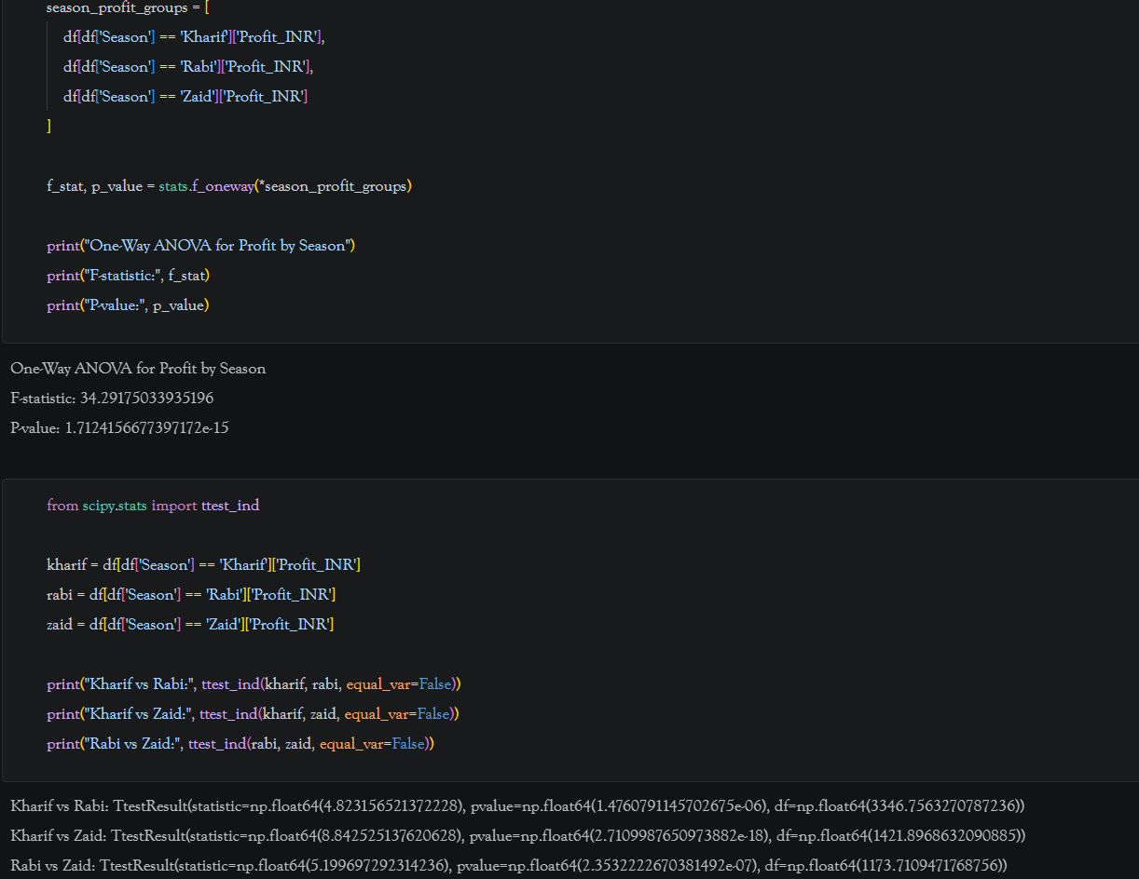
Code 1 — Data Preparation / Analysis Setup

Slide 7
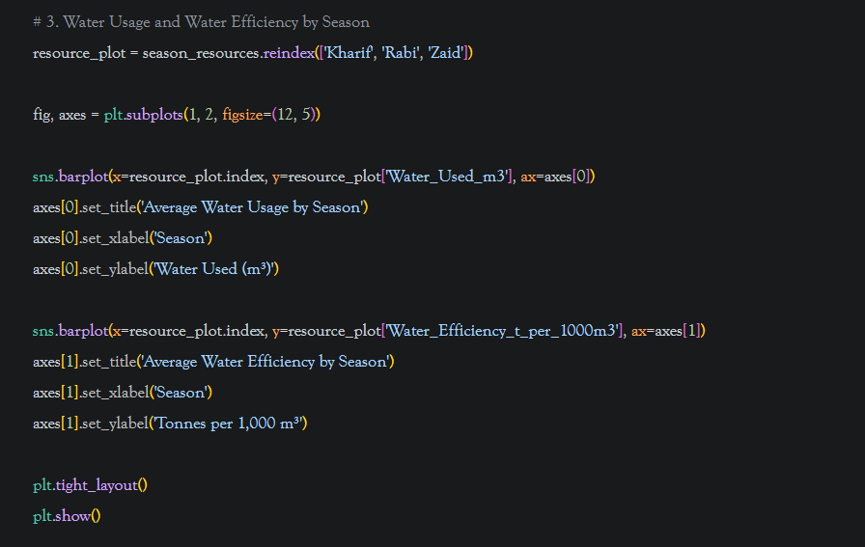
Code 2 — Resource Usage & Water Efficiency

Slide 8
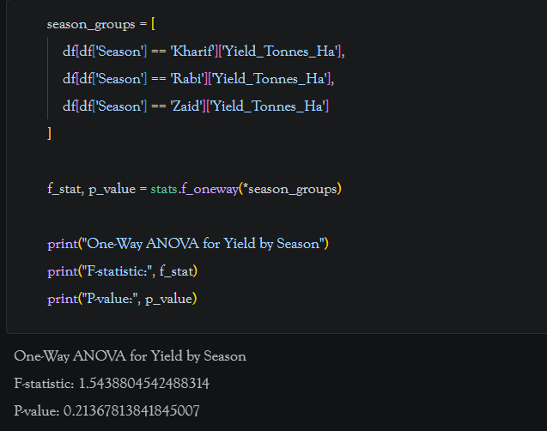
Code 3 — ANOVA: Yield by Season

Slide 9
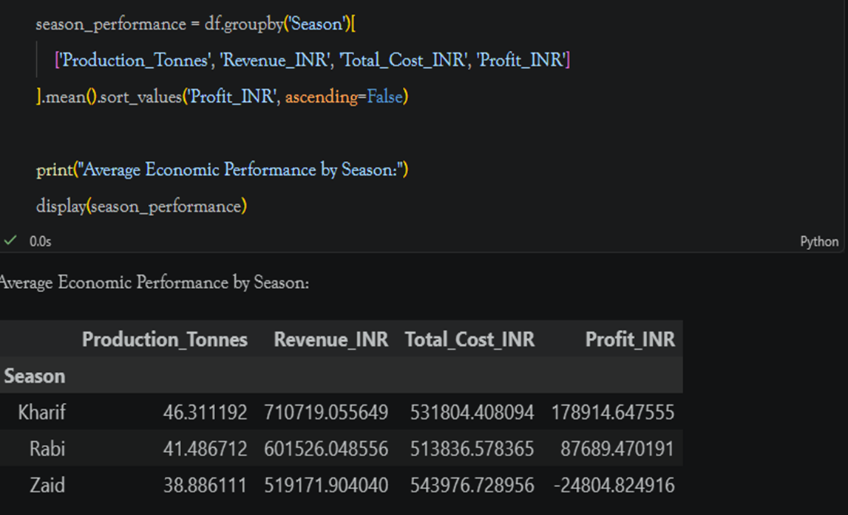
RESULTS
Result 1 — Average Economic Performance by Season
Key findings from notebook analysis
Key Insight
Kharif records the highest average profit: ₹178,914.65.
Rabi remains profitable with ₹87,689.47 average profit.
Zaid shows an average loss of ₹24,804.82.
Kharif also has the highest average production and revenue.

Slide 10
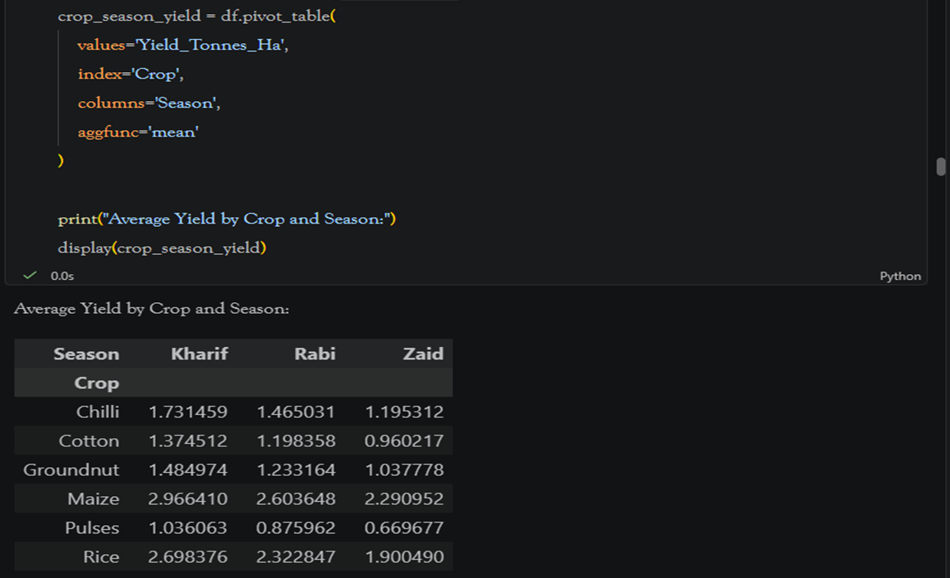
RESULTS
Result 2 — Average Yield by Crop and Season
Key findings from notebook analysis
Key Insight
Sugarcane has the highest average yield in the dataset.
Kharif yield is higher than Rabi and Zaid for every analyzed crop.
Kharif Sugarcane averages 53.46 t/ha.
Maize and Rice are among the stronger non-sugarcane crops.

Slide 11
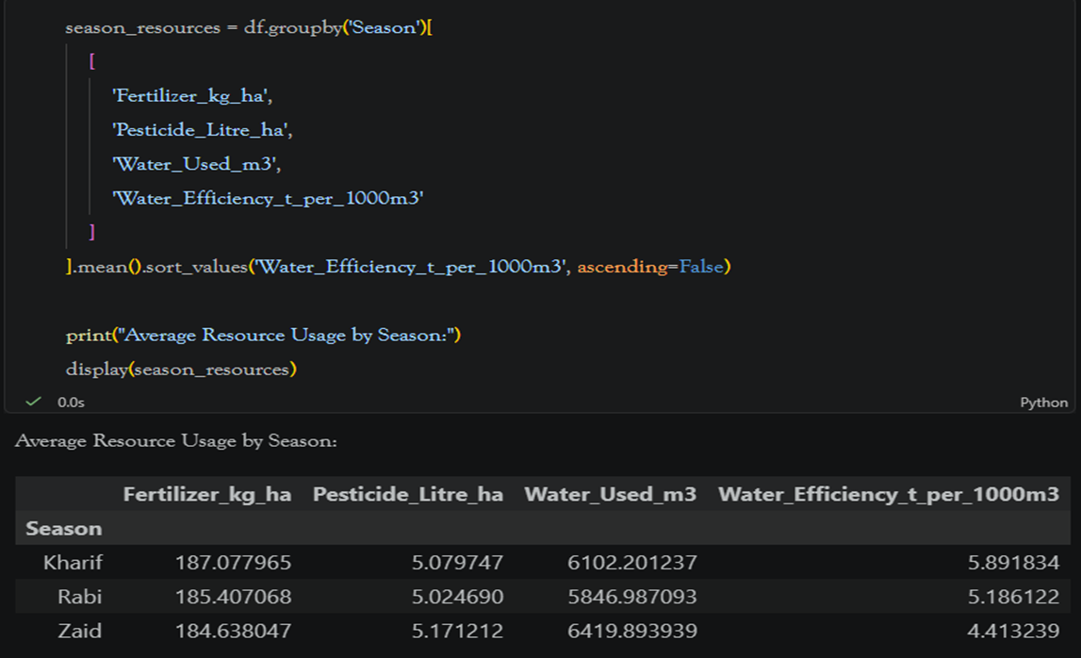
RESULTS
Result 3 — Average Resource Usage by Season
Key findings from notebook analysis
Key Insight
Kharif has the highest water-use efficiency: 5.89 t/1000 m³.
Zaid has the lowest efficiency: 4.41 t/1000 m³.
Zaid also has the highest average water usage: 6,419.89 m³.
Resource efficiency should therefore be considered with yield and profit.

Slide 12
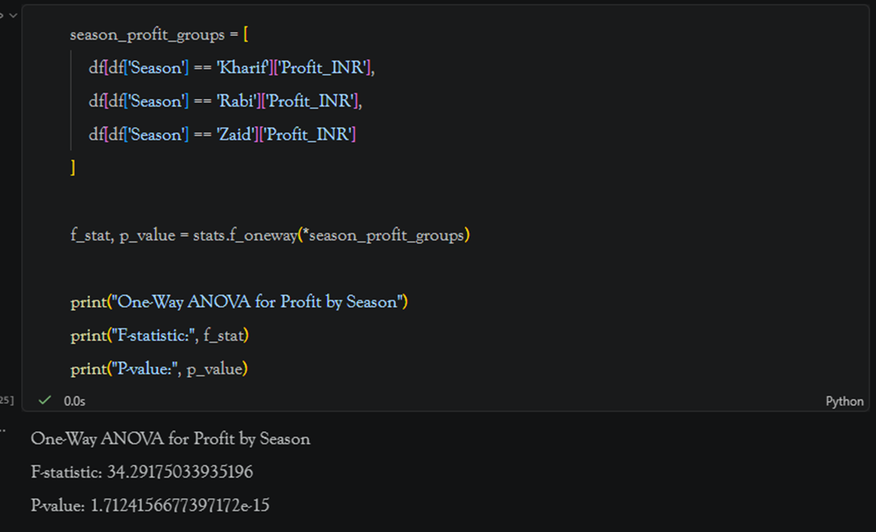
RESULTS
Result 4 — Statistical Analysis: Profit by Season
Key findings from notebook analysis
Key Insight
ANOVA F-statistic = 34.2918.
p-value = 1.71 × 10⁻¹⁵, below the 5% significance level.
Therefore, seasonal differences in profit are statistically significant.
Pairwise Welch tests also show significant profit differences between each season pair.

Slide 13
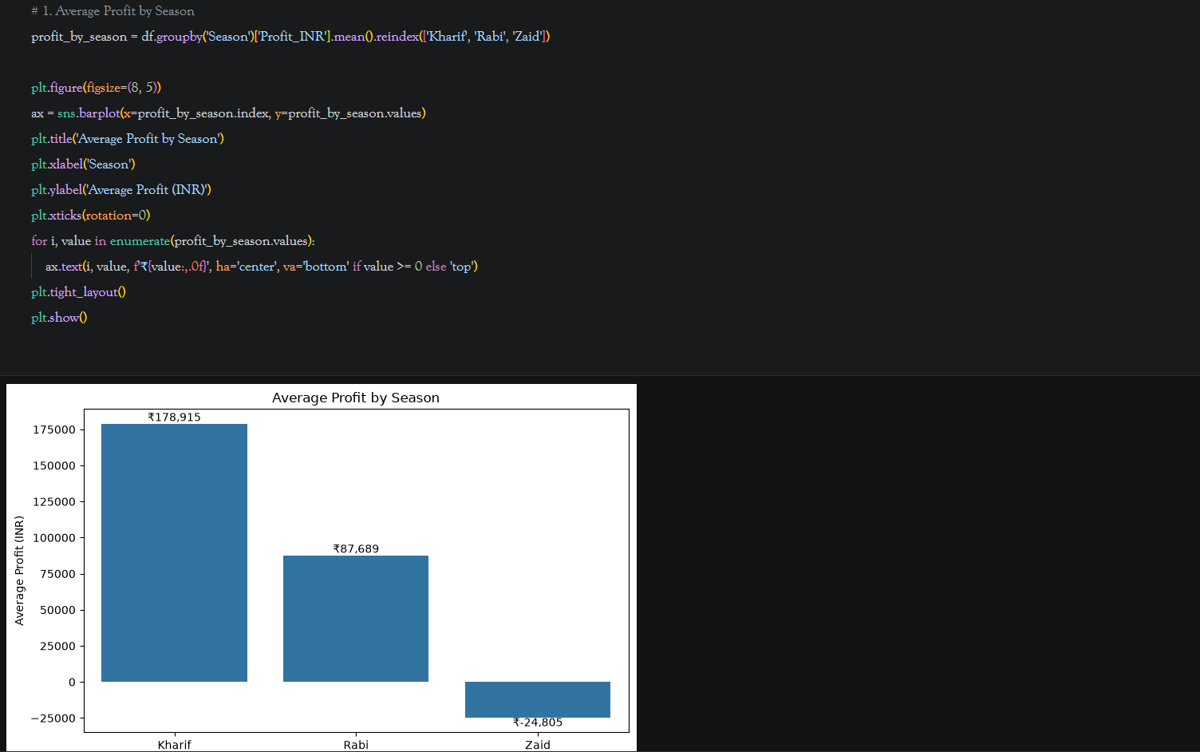
Chart 1 — Average Profit by Season

Slide 14
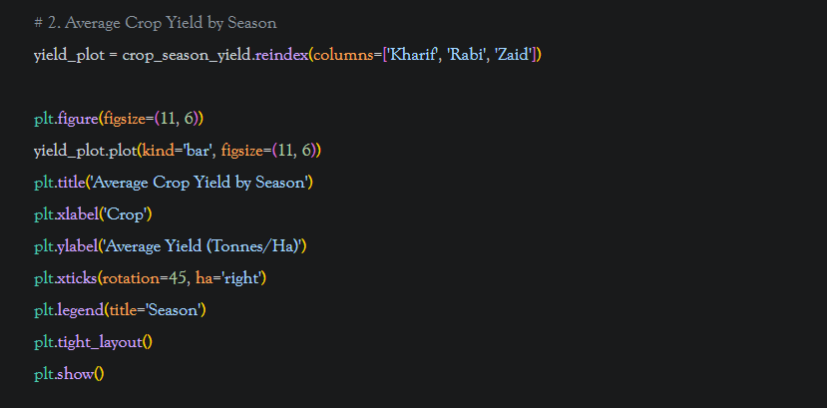
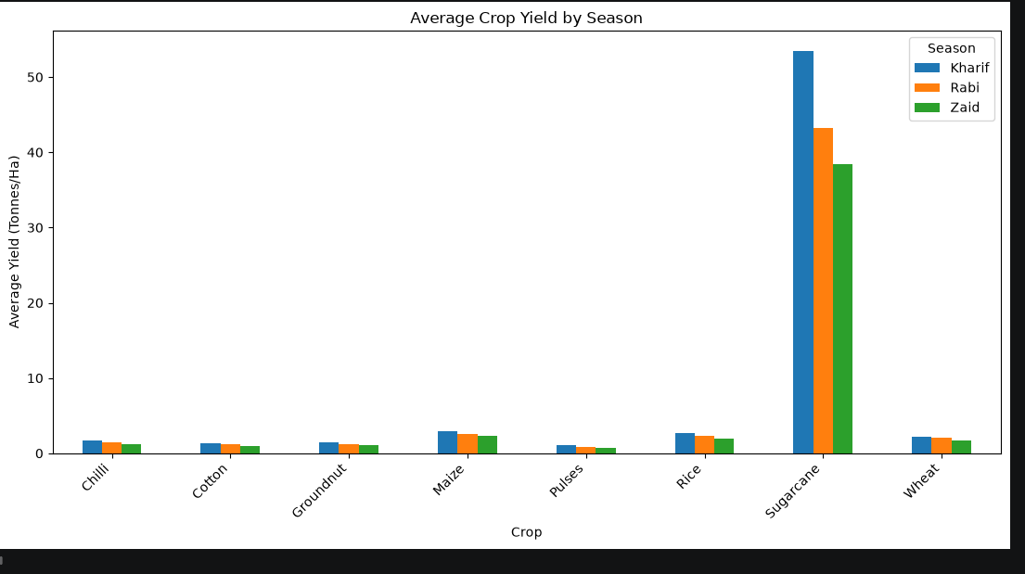
Chart 2 — Average Crop Yield by Season

Slide 15
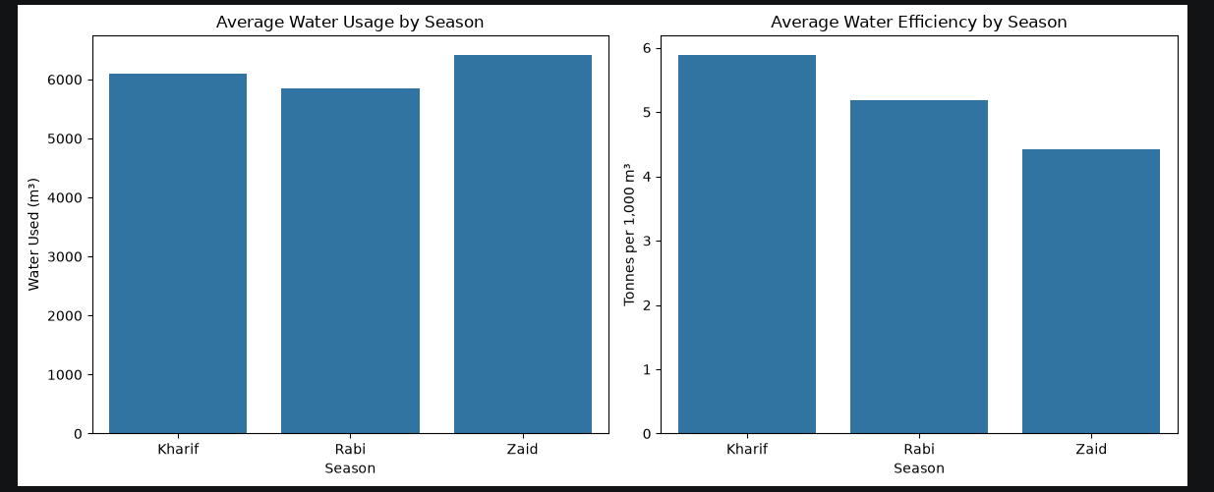
Chart 3 — Average Resource Usage by Season

Slide 16
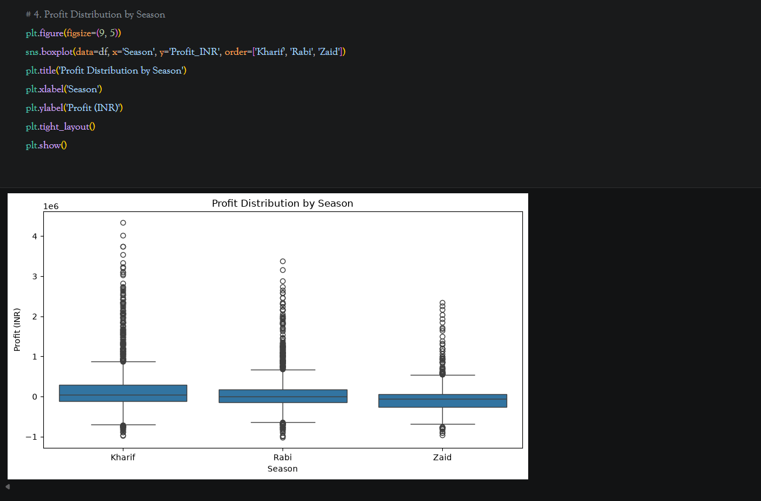
Chart 4 — Profit Distribution by Season

Slide 17
Future Scope
Advanced Analytics
Decision Support
Predictive models for yield and profitability.
Crop- and region-specific recommendation systems.
Time-series analysis using multi-year agricultural data.
Geospatial mapping of district/state performance.
Integration of weather forecasts and real-time farm data.
Interactive dashboard for farmers and agricultural planners.

Slide 18
GitHub Link-
https://github.com/Damon00007/Seasonal-Agriculture-Performance-Analysis

Slide 19

VOIS Course completion certificate -
Course name- Data Visualization

Slide 20
Thank you
Thanking You For Your Time And Attention.
Questions & Discussions
.
.

