Slide 1
INTERACTION PRIMITIVES
DISPLEX usability study
on low fidelity prototypes

Slide 2
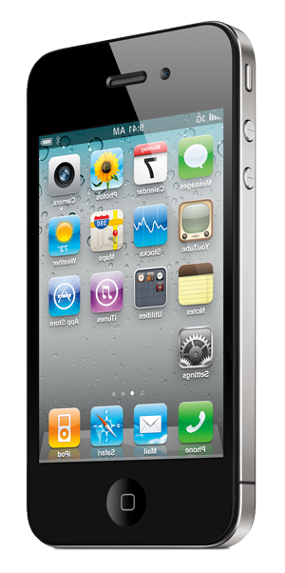
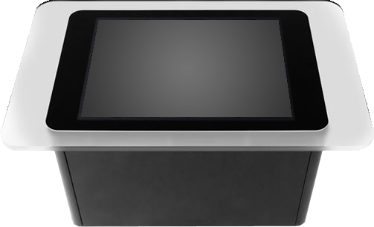
PAIRING

Slide 3
PAIRING

Slide 4
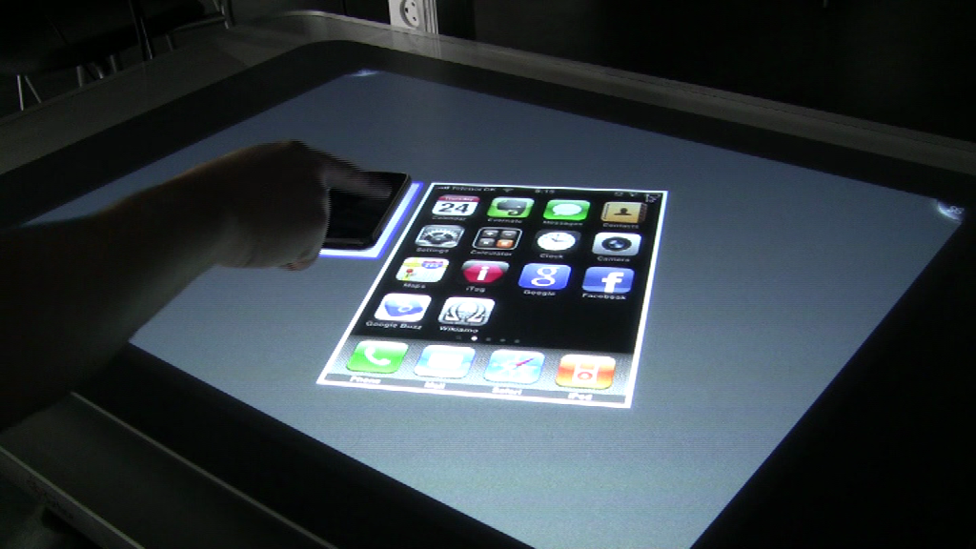
PAIRING

Slide 5
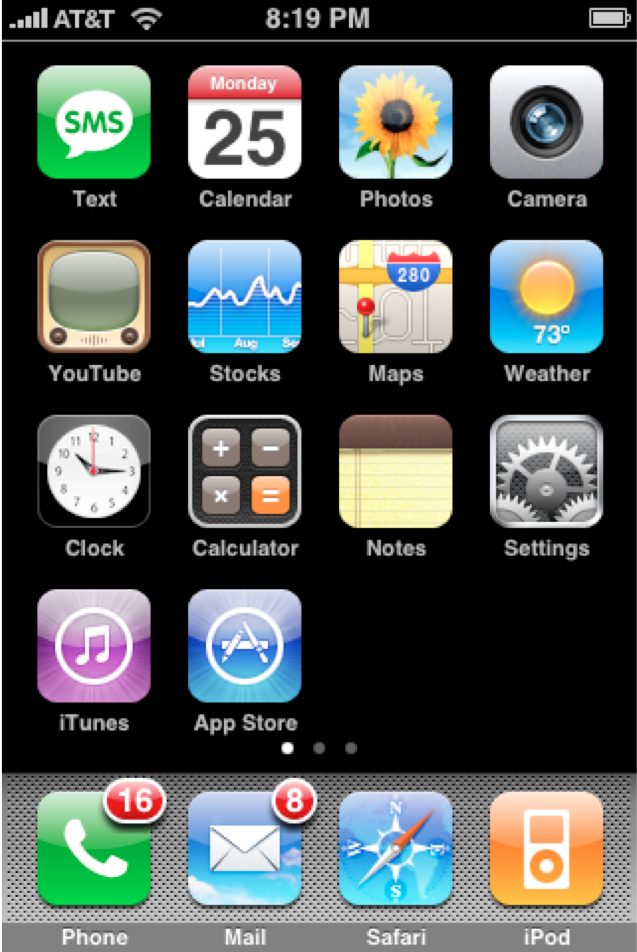
DRAGGING

Slide 6
DRAGGING

Slide 7
ROTATING

Slide 8
RESIZING

Slide 9
MINIMIZING

Slide 10
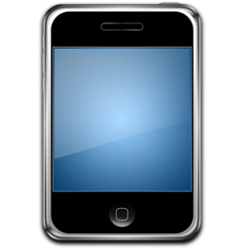
MINIMIZING

Slide 11
HIDING

Slide 12
EXITING

Slide 13
The End (Thank You)

