Slide 1
Y4: CO2, PV, IoT!
What a Mouthful!
w opentrv.org.uk
t @opentrv
Damon Hart-Davis
Notes:
OpenTRV are leading an Innovate UK funded project to sense footfall in bus shelters and buildings, and will demonstrate the impact of IoT when it becomes ubiquitous, easy to use and produces real world results.
15m
“How do we generate enough connectivity and data to develop a truly “smart” built environment? Pioneers in this field discuss how IOT technology is increasingly being embedded in our built environment. The benefits to be gained from this data will be explained– from energy efficiency, to remote maintenance to better health. How is the data brought together and made sense of? Are there security risks?”

Slide 2
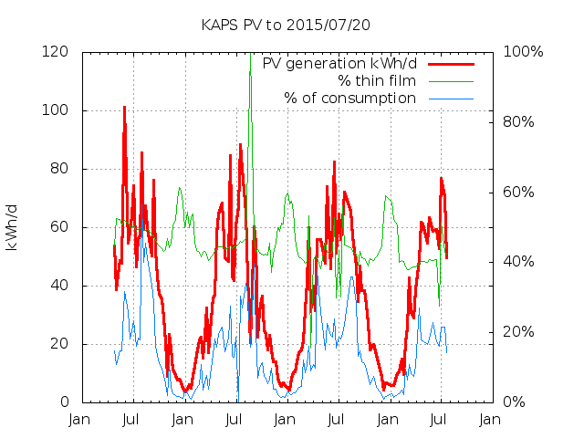

SOLAR PV
Solar PV: about 10% of the school's electricity use

Slide 3
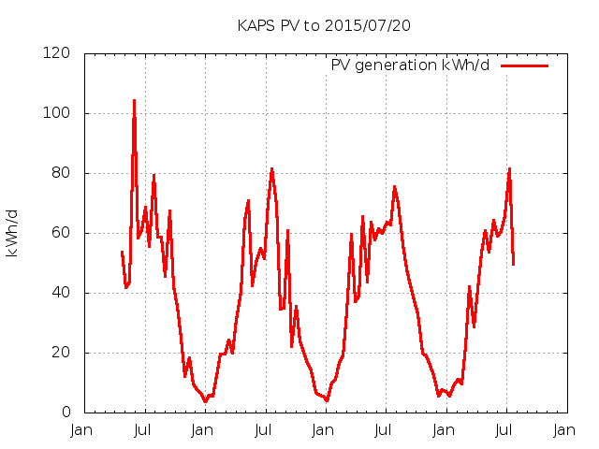
SOLAR PV
Solar PV: about 10% of the school's electricity use

Slide 4
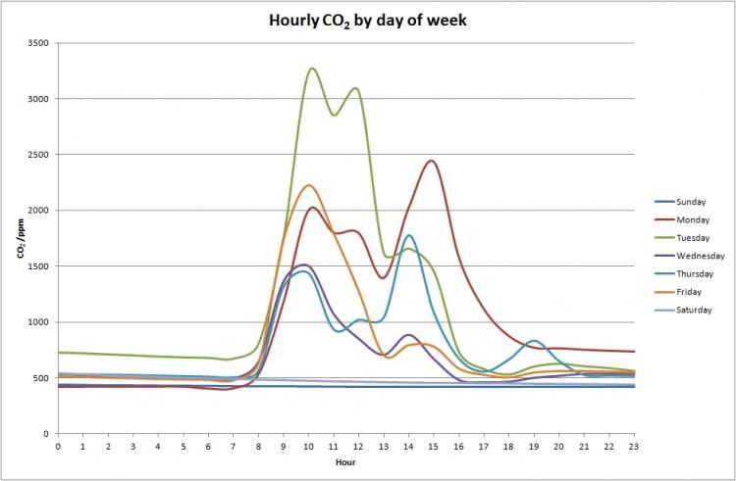
SNOOZING
Problem: falling asleep because of high CO2 levels?

Slide 5


PROBLEM
?
Problem: operator knows where buses are, but what about the people waiting?

Slide 6
PROBLEM
UK carbon emissions
20%
home heat
Problem: UK carbon emissions from domestic space heat 20%, gas bill £10bn/y, 50% wasted.

