Slide 1

IoT in Green and Beige:
saving the planet one boring box at a time!
2015/06/22
Jon Lewis, Director of Strategy, Telensa
Andrew Phillips, CTO, Gliide
-
Interactive workshop
-
Matthew Fox, Connected Home Consortium
Joe Fay, Group Editor, The Register

Slide 2

http://www.makersacademy.com/
Many Thanks!

Slide 3
What is Cleanweb?
Cleanweb is the use of
connected IT to address
resource and sustainability challenges
#cleanweb
@cleanwebUK

Slide 4
#cleanweb
@cleanwebUK

Slide 5
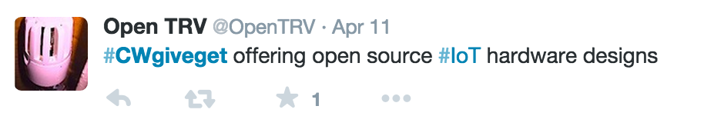
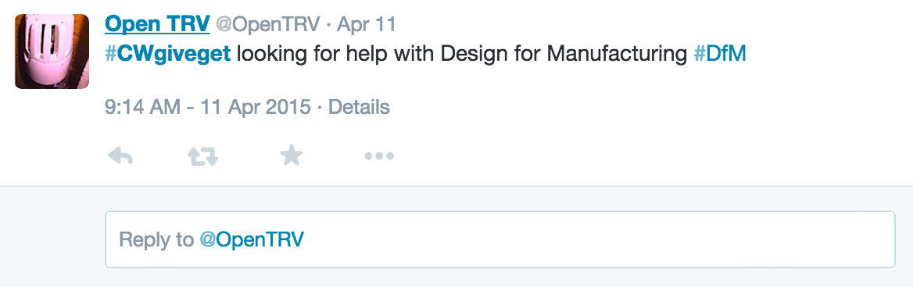
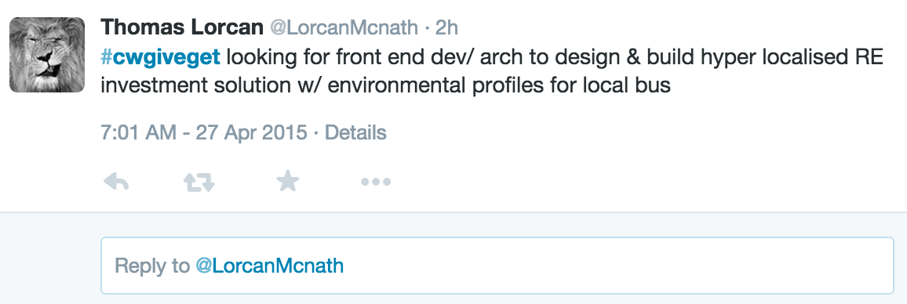
#CWgiveget

Slide 6
Community Announcements

Slide 7

Interactive Workshop
During the workshop please complete the survey at:
http://bit.do/cleanweb

Slide 8

Pub
Next Event
Web for Environmental Sustainability
2015/08/24
Waterpoet
9-11 Folgate St, Spitalfields E1 6BX

