Slide 1
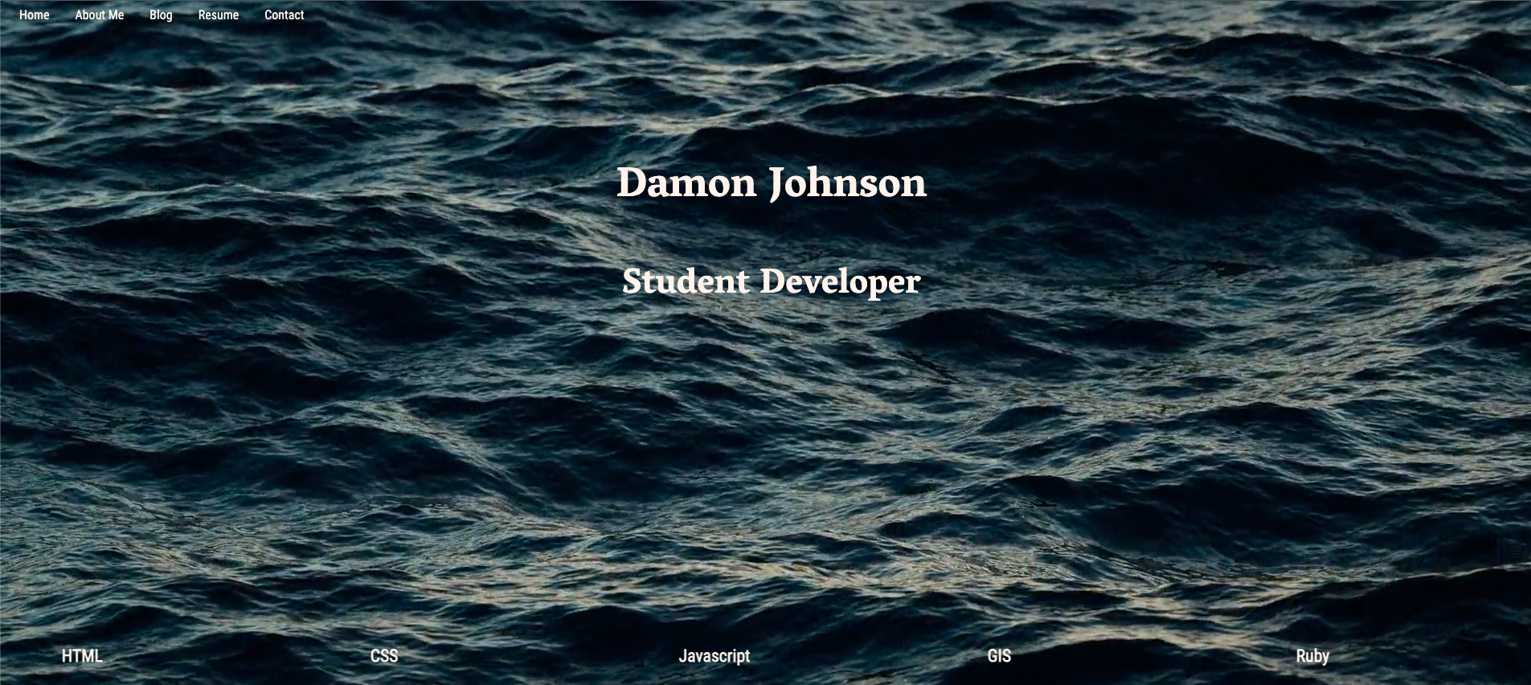
T1A2 - Portfolio Website

Slide 2
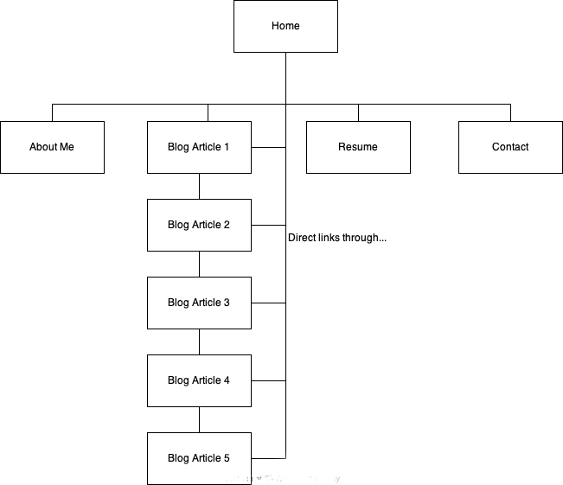
Site Map

Slide 3
Wireframes and
Decision Making Process
Goals:
Clean minimalist design
Engaging features
Simple structure that can be easily modified in the future
Challenge: incorporate a video element

Slide 4
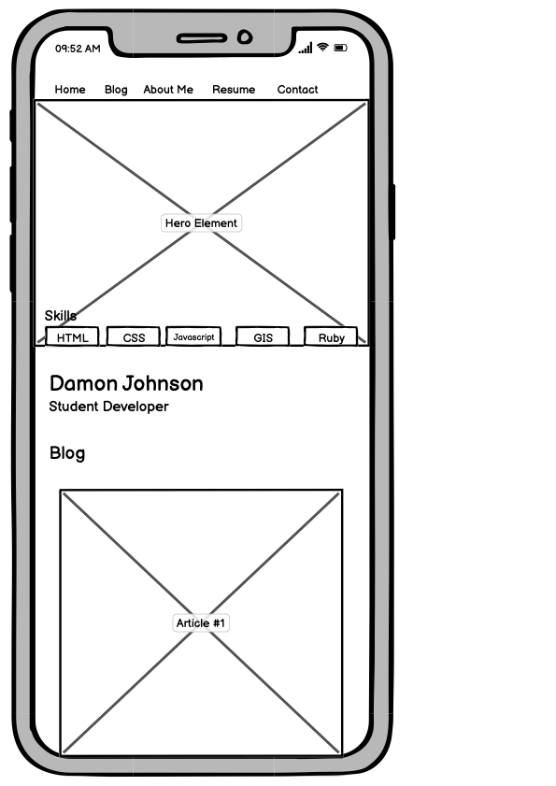
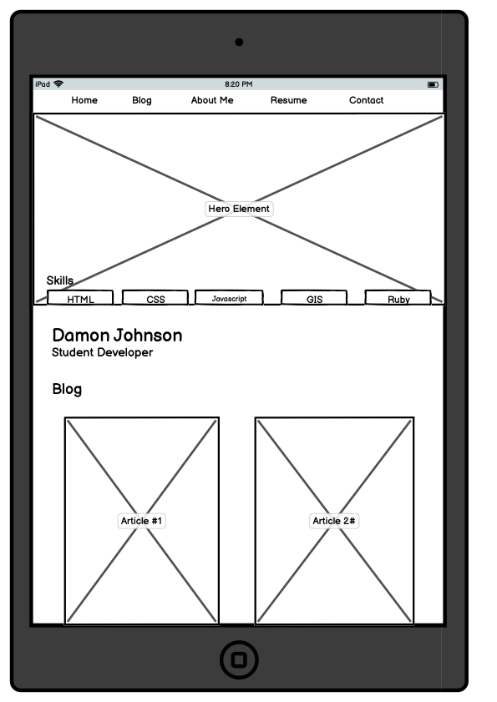
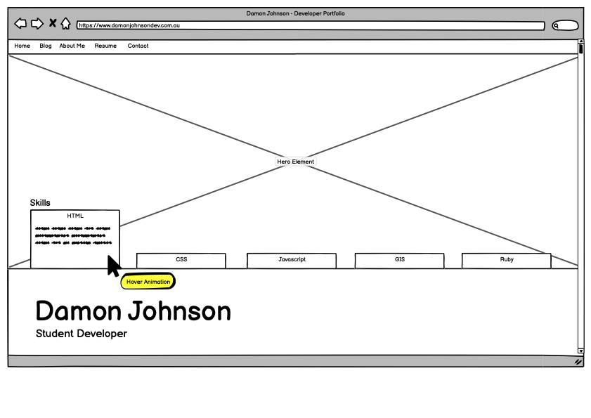
Home - Top of Page
Process:
Flexbox for layout
Hover Pseudo-class for text animation

Slide 5
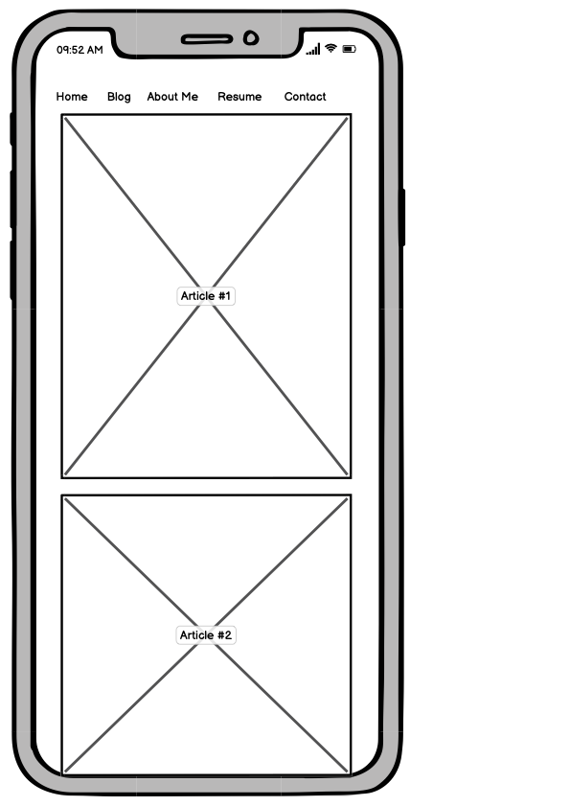
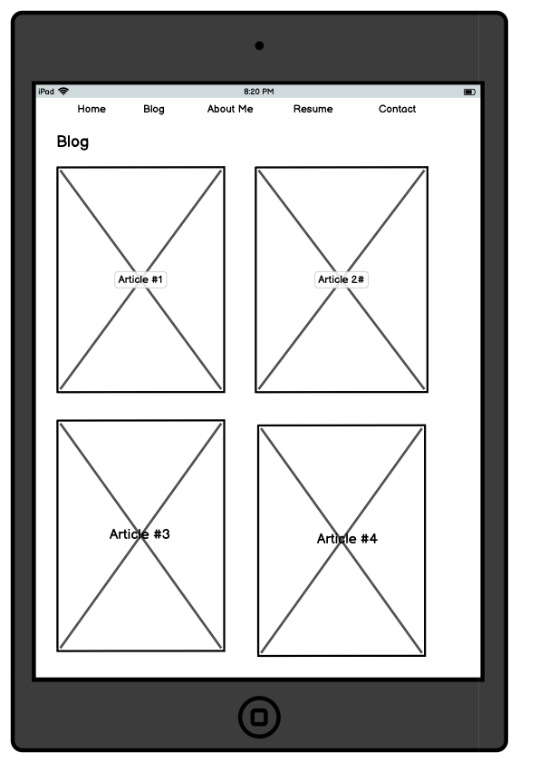
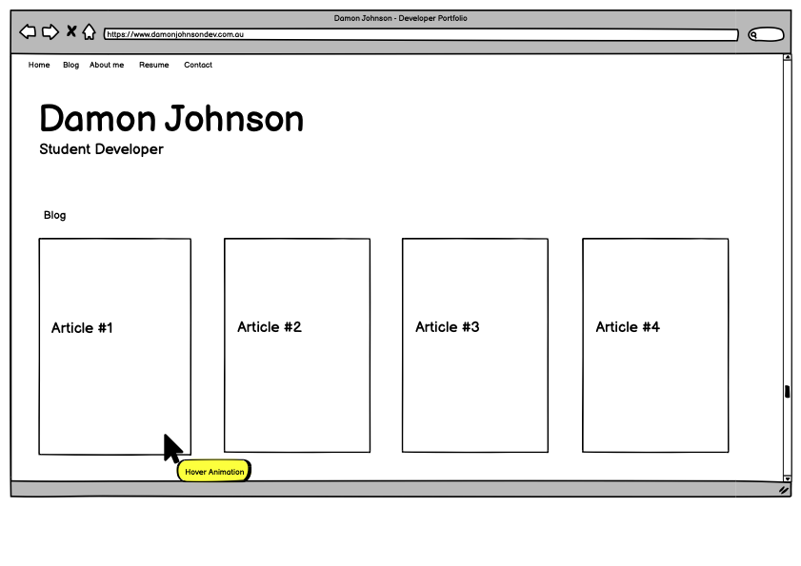
Home - Bottom of Page
Process:
Flexbox for layout
Image nested with anchor for blog cards
Hover pseudo-class to enlarge cards

Slide 6
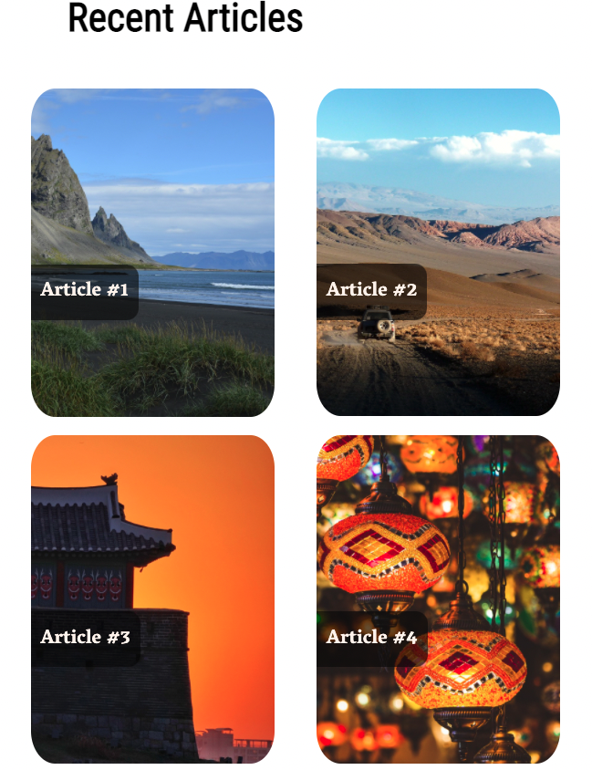
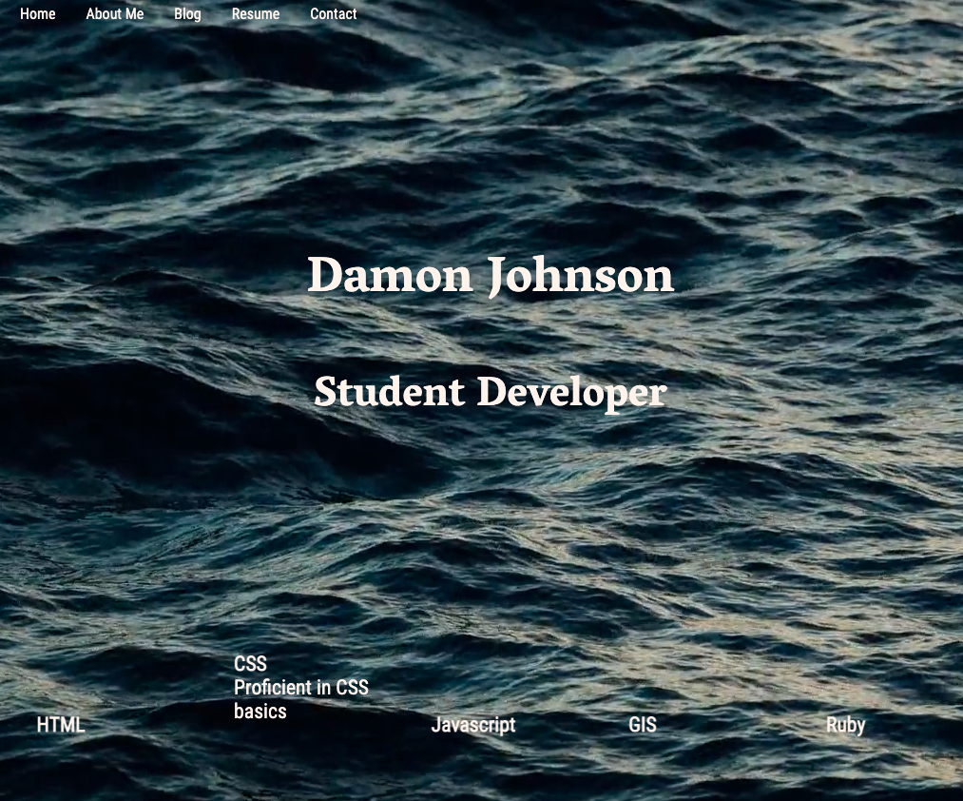
Homepage
Features:
Engaging hero video at landing screen
Animated skills component at bottom of hero video
Animated picture cards previewing blog articles with direct links to article
Simple nav-bar – consistent across whole site

Slide 7
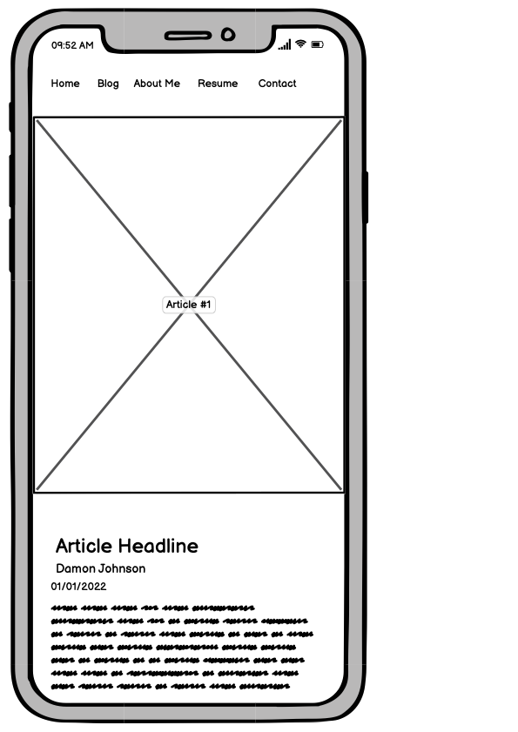
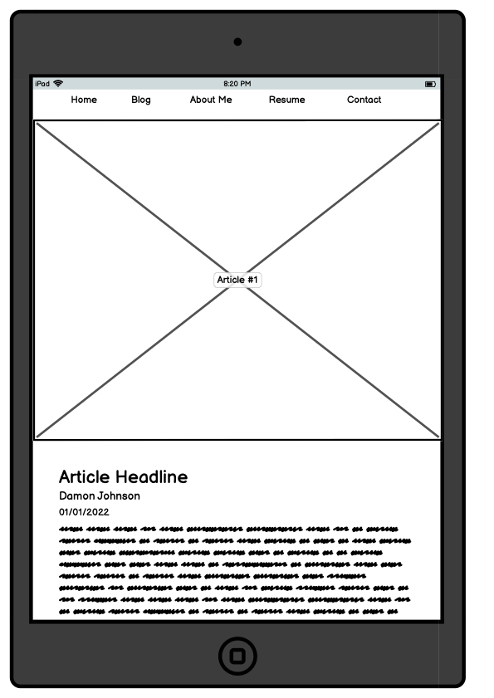
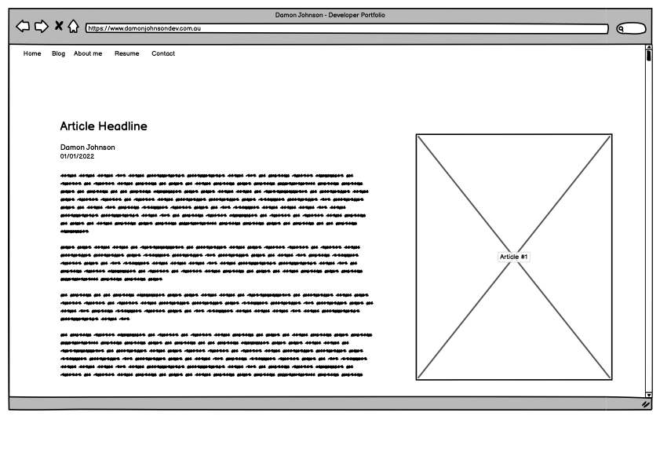
Blog Page
Process:
Image for background
Image embedded within article
Dark overlay around text for readability

Slide 8
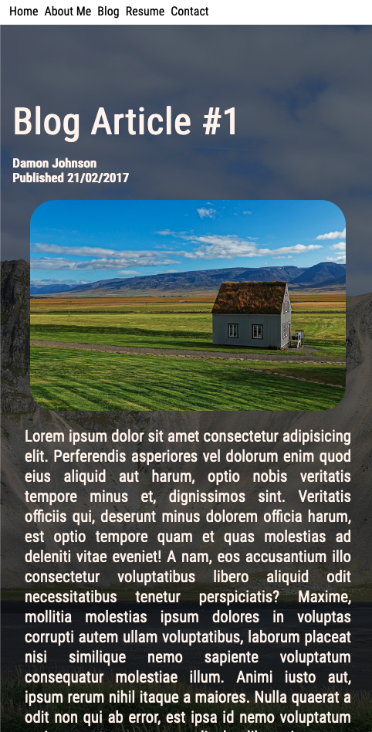
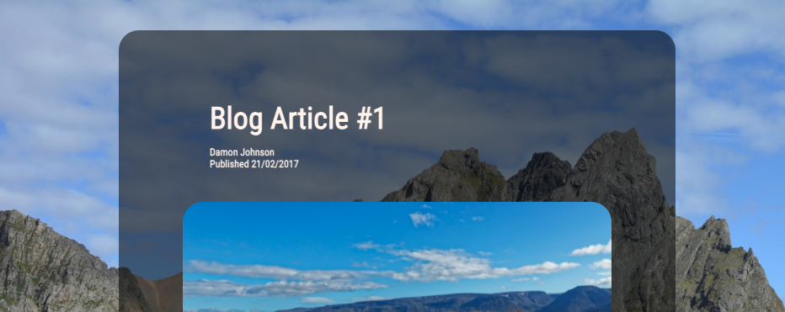
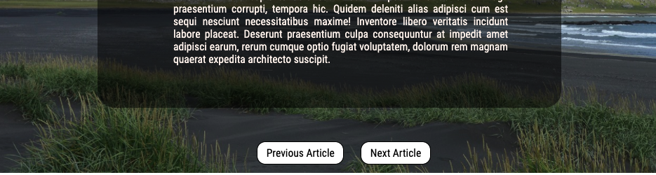
Features:
Main Image as background
Engaging picture at top of article
Text section with dark overlay for readability
Border radius consistent with image and overlay elements
Previous and next article button for simple navigation

Slide 9
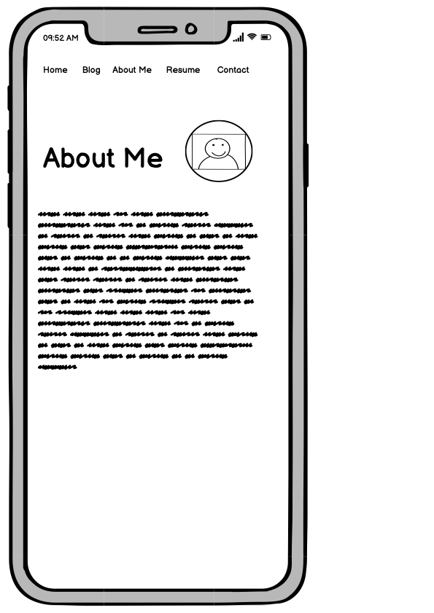
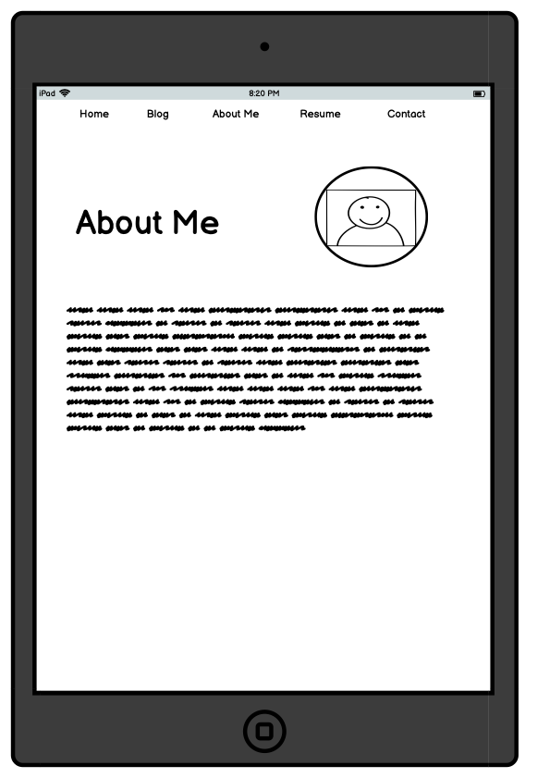
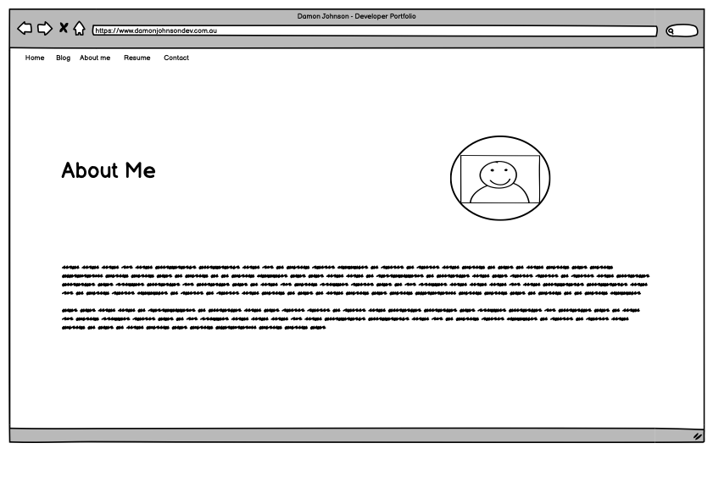
About Me
Process:
Border radius of profile picture to match blog photo cards

Slide 10
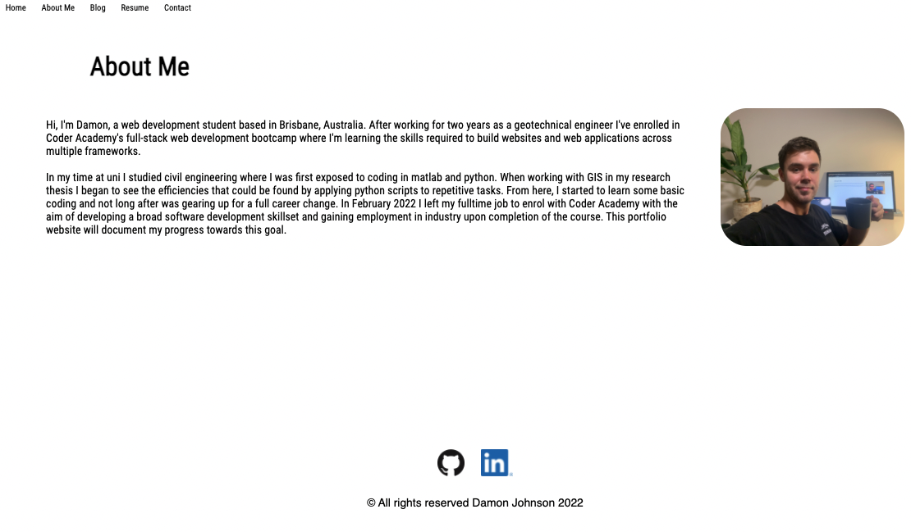

Features:
Easily readable text
Concise paragraph structure
Profile picture with border radius to match other images across the site
Footer for all pages with copyright information and links to github and linkedin

Slide 11
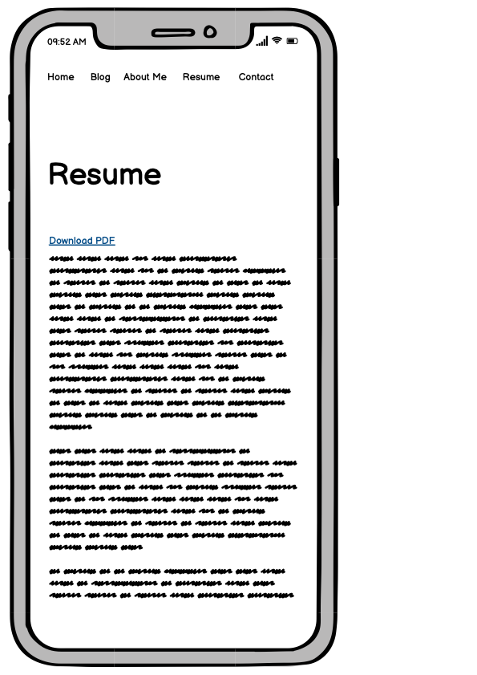
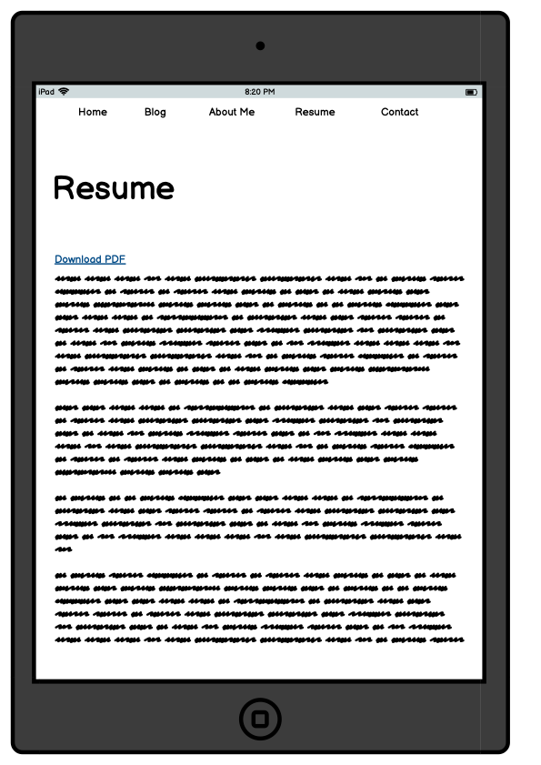
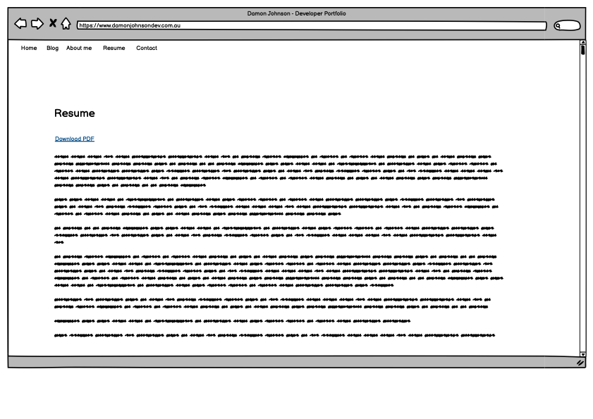
Resume Page
Process:
Embedded PDF scroller using <iframe> tag
Direct anchor link to PDF download

Slide 12
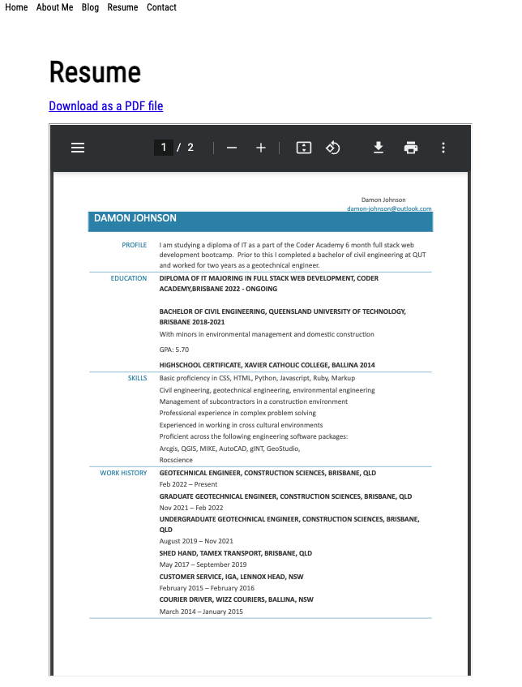
Features:
Link to direct PDF download
Embedded scrollable PDF reader
Plain background to match professionalism of resume

Slide 13
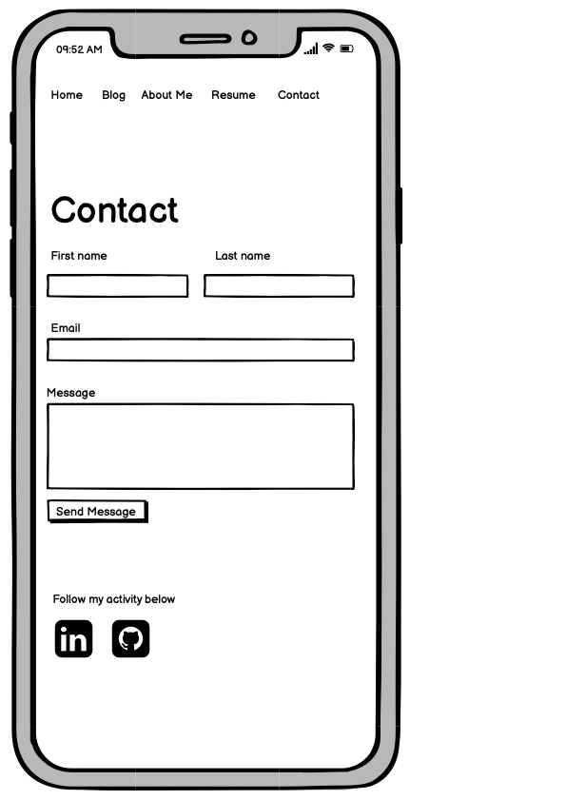
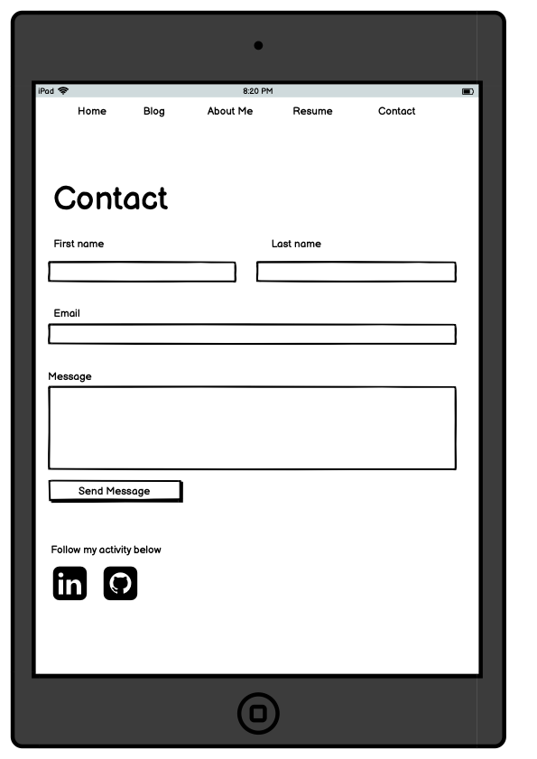
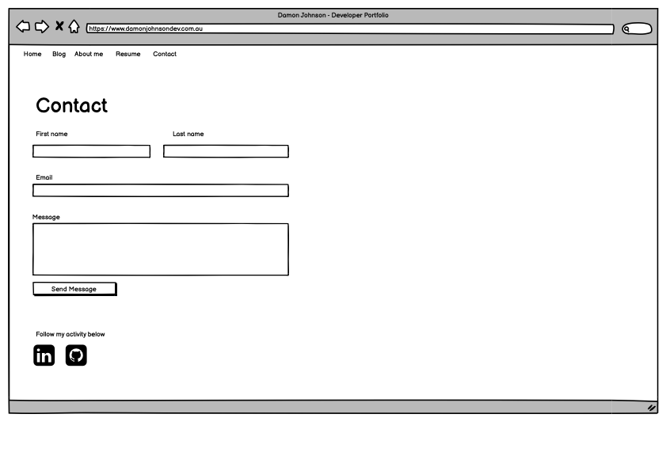
Contact Page
Process:
Input boxes for contact form
Social links as anchors

Slide 14
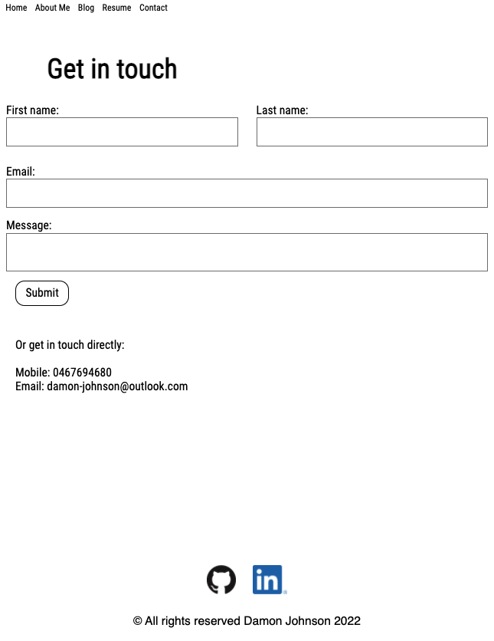
Features:
Simple contact form to encourage use from visitors
Requires minimal personal information from site visitor
Message input box sized to dictate length of messages
Direct contact details below

Slide 15
Challenges
Flexbox
Video compression
Responsive Animations
Balancing aesthetics and readability in design
Ethical issues:
Image copyright
Accessibility for video content due to high file size

Slide 16
Thanks for listening

