Slide 1
FILE COURIER
Code Marathon mini project
Team: Unique
Kevin
＋
Damon
＋
Niq

Slide 2

Here For Code
Code Not Only For Here
＋
＋
01
02
03
Background
Solution
Benefit

Slide 3
Background
Outlook
FileZilla
DO NOT try to send a file over than 10M.
Installation
Account
Access
SharePoint
Share Folder
Slow, very slow
Access, access again.
Long Folder Path
RMS, long time wait.
Access, access again and again.
Public.

Slide 4


Solution
EASY
It is easy to use, no role control
QUICK
Quick to share files.
SECURITY
Files will be removed after a certain of days
NON-INSTALLATION
It is B/S software, no need to install it.
FREE
yes, It is FREE!

Slide 5
Solution
这里放架构图
Front
Server
Database

Slide 6
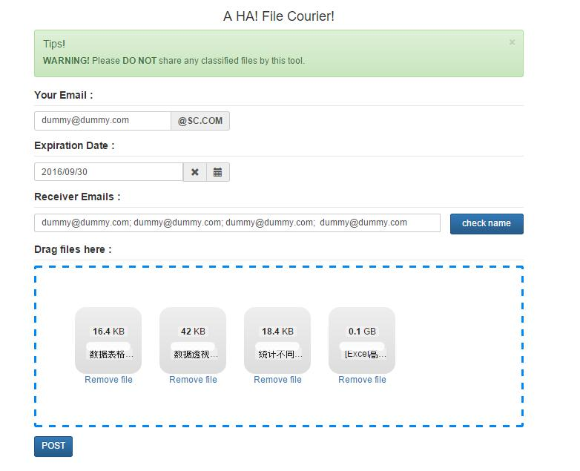
Solution
Your Email
Receive the confirmation email and report email.
Expiration Date
When to remove the files from server.
Receiver Email
Who will be shared with these files.
Check Name
Find user email by his ID.

Slide 7
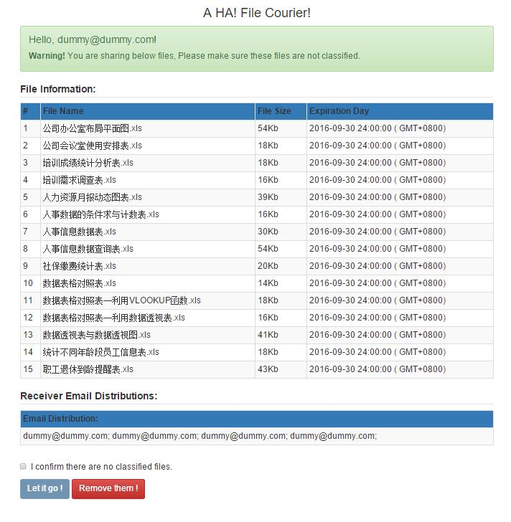
Solution
Let it Go!
Receivers will receive the email notification.
Remove them!
Files will be deleted.

Slide 8
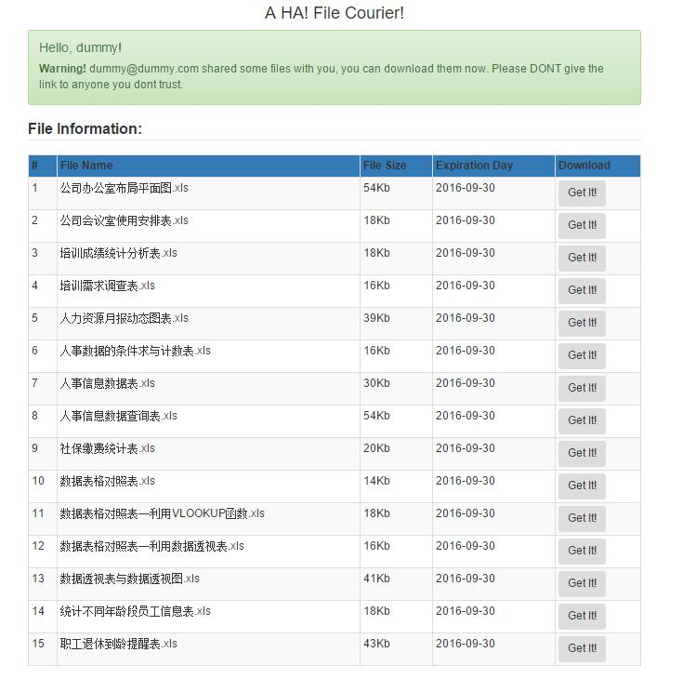
Solution
Get It!
Download the file.

Slide 9
Solution

Slide 10
Solution
Future
Integration with LDAP
Stable
Speed
Deployment

Slide 11

Benefit
Quick
Sharable
Security
SCB Staff: more than 100,000
Every one: 1 hour per year
Total: 100,000 hours.
How many people in the world?
SAVE YOUR TIME

Slide 12
Thank You
Question?

