Slide 1
Getting Started with Deep Learning
Seth Juarez
@sethjuarez
Microsoft

Slide 2


Slide 3
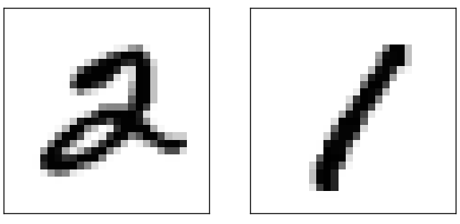

Slide 4
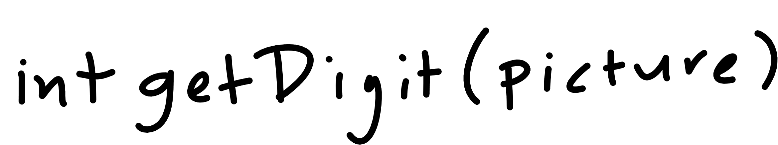

Slide 5
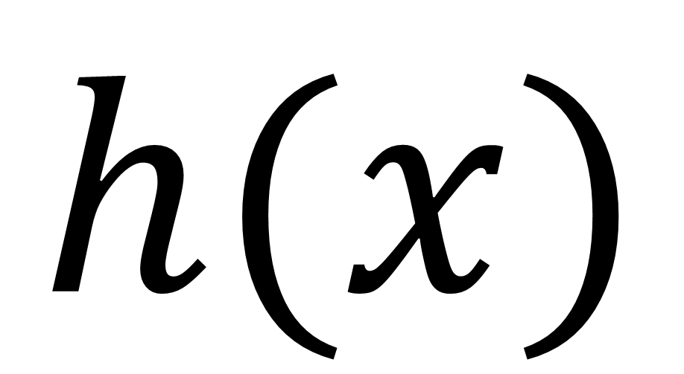
$$h(x)$$
Notes:
Cover the fact that ML uses data to make its own functions

Slide 6
Machine Learning
How much / How many
Which class does this belong to?
Are there different groups? Which does it belong to?
Is this weird?
Which option should I choose?

Slide 7
Machine Learning
(Regression) How much / How many
(Classification) Which class does this belong to?
(Clustering) Are there different groups? Which does it belong to?
(Anomaly Detection) Is this weird?
(Recommendation) Which option should I choose?
supervised
learning
unsupervised
learning

Slide 8
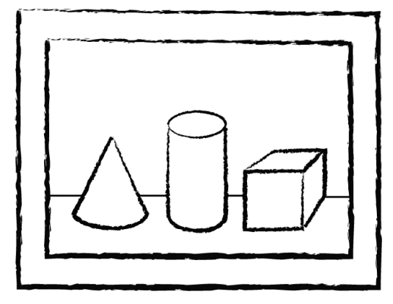
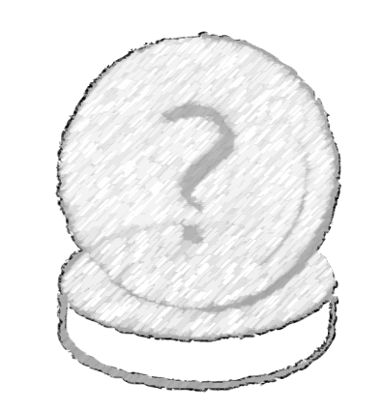
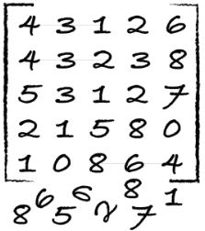
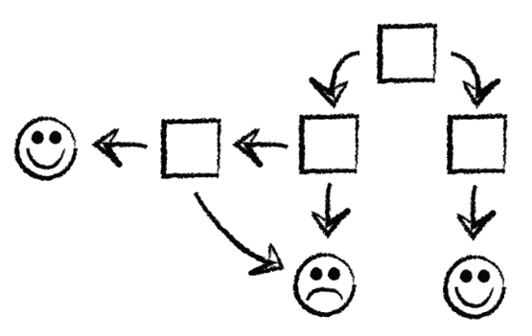
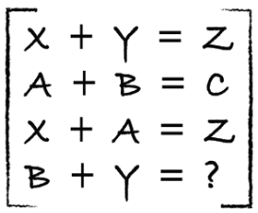
process
identify
predict
1
4
explore
analyze
model
2
3

Slide 9
identify data
Class | Outlook | Temp. | Windy
Play | Sunny | Low | Yes
No Play | Sunny | High | Yes
No Play | Sunny | High | No
Play | Overcast | Low | Yes
Play | Overcast | High | No
Play | Overcast | Low | No
No Play | Rainy | Low | Yes
Play | Rainy | Low | No
? | Sunny | Low | No
label (y)
play / no play
features
outlook, temp, windy
values (x)
[Sunny, Low, Yes]

Slide 10
explore / analyze / clean
Class | Outlook | Temp. | Windy
Play | Sunny | Lowest | Yes
No Play | ? | High | Yes
No Play | Sunny | High | KindOf
Play | Overcast | Low | Yes
Play | Turtle Cloud | High | No
Play | Overcast | ? | No
No Play | Rainy | Low | 28%
Play | Rainy | Low | No
? | Sunny | Low | No
yak shaving
Any apparently useless activity which, by allowing you to overcome intermediate difficulties, allows you to solve a larger problem.
I was doing a bit of yak shaving this morning, and it looks like it might have paid off.
wikipedia

Slide 11
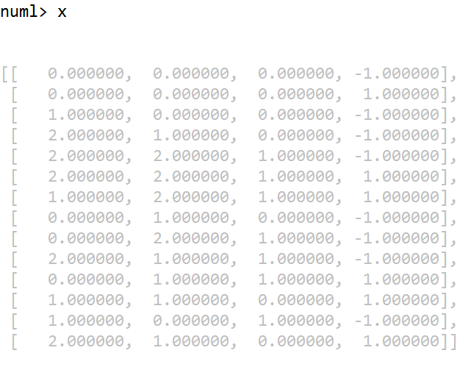
explore / analyze / clean
Class | Outlook | Temp. | Windy
Play | Sunny | Low | Yes
No Play | Sunny | High | Yes
No Play | Sunny | High | No
Play | Overcast | Low | Yes
Play | Overcast | High | No
Play | Overcast | Low | No
No Play | Rainy | Low | Yes
Play | Rainy | Low | No
? | Sunny | Low | No

Slide 12
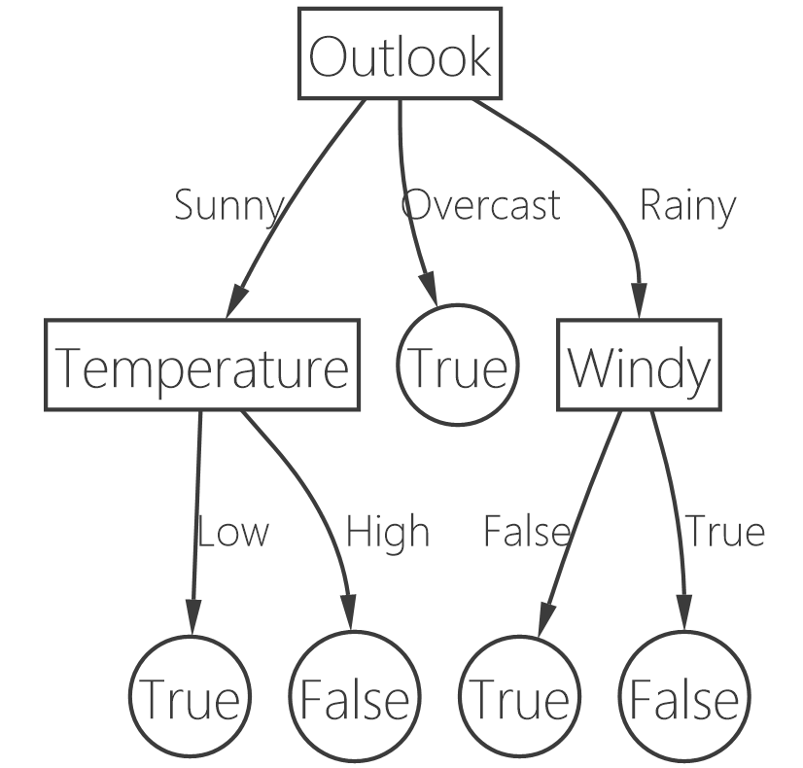
model
Class | Outlook | Temp. | Windy
Play | Sunny | Low | Yes
No Play | Sunny | High | Yes
No Play | Sunny | High | No
Play | Overcast | Low | Yes
Play | Overcast | High | No
Play | Overcast | Low | No
No Play | Rainy | Low | Yes
Play | Rainy | Low | No
? | Sunny | Low | No

Slide 13
predict
Class | Outlook | Temp. | Windy
? | Sunny | Low | No
PLAY!!!

Slide 14
how well is it doing?
Train
Test
Use ~80%
Use ~20%

Slide 15
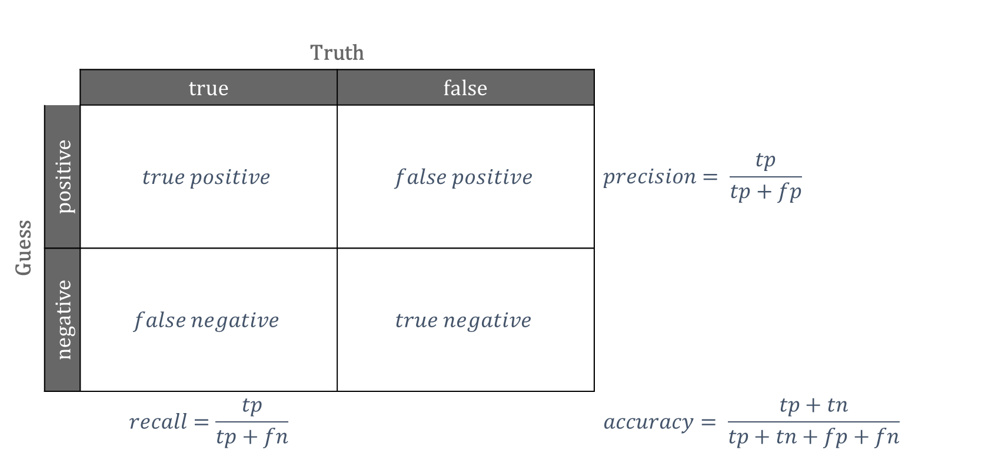
confusion matrix
 |  | Truth
 |  | true | false
Guess | positive | $$true positive$$ | $$false positive$$ | $$precision= \frac{tp}{tp+fp}$$
 | negative | $$false negative$$ | $$true negative$$
 |  | $$recall=\frac{tp}{tp+fn}$$ |  | $$accuracy= \frac{tp+tn}{tp+tn+fp+fn}$$

Slide 16

Building $h(x)$
Notes:
Look at mnist data

Slide 17
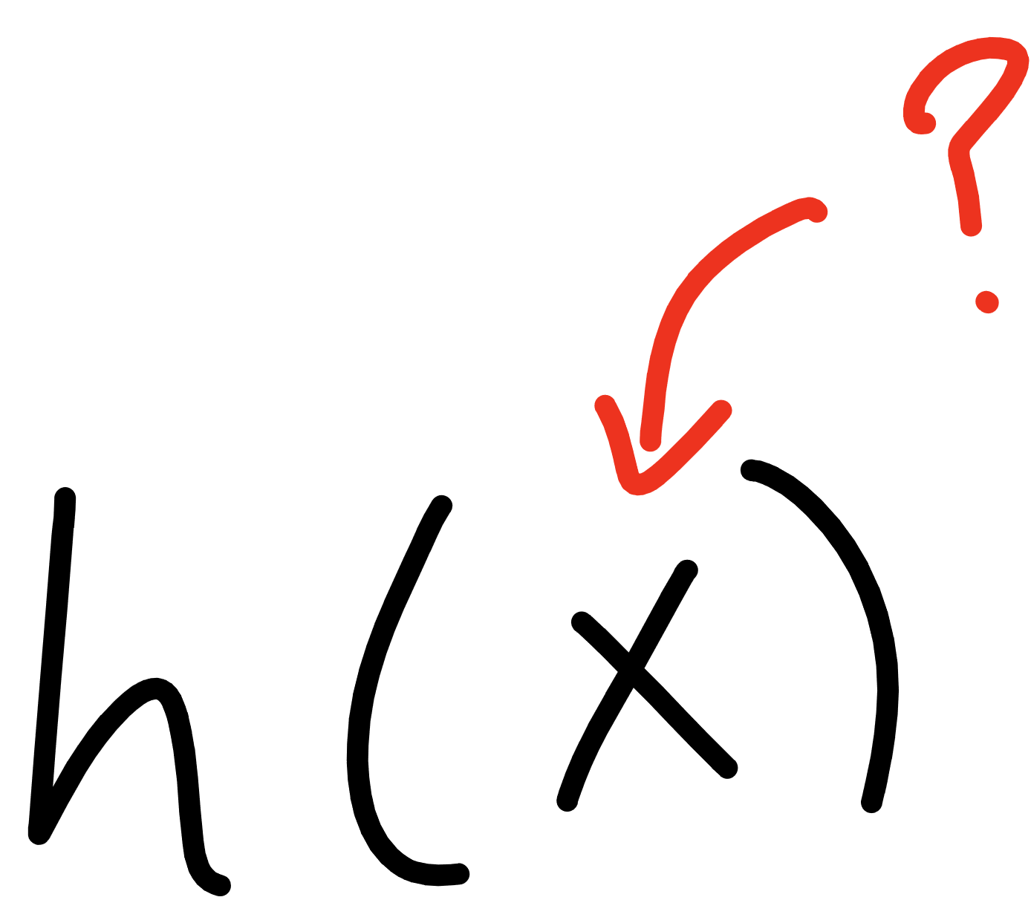

Slide 18
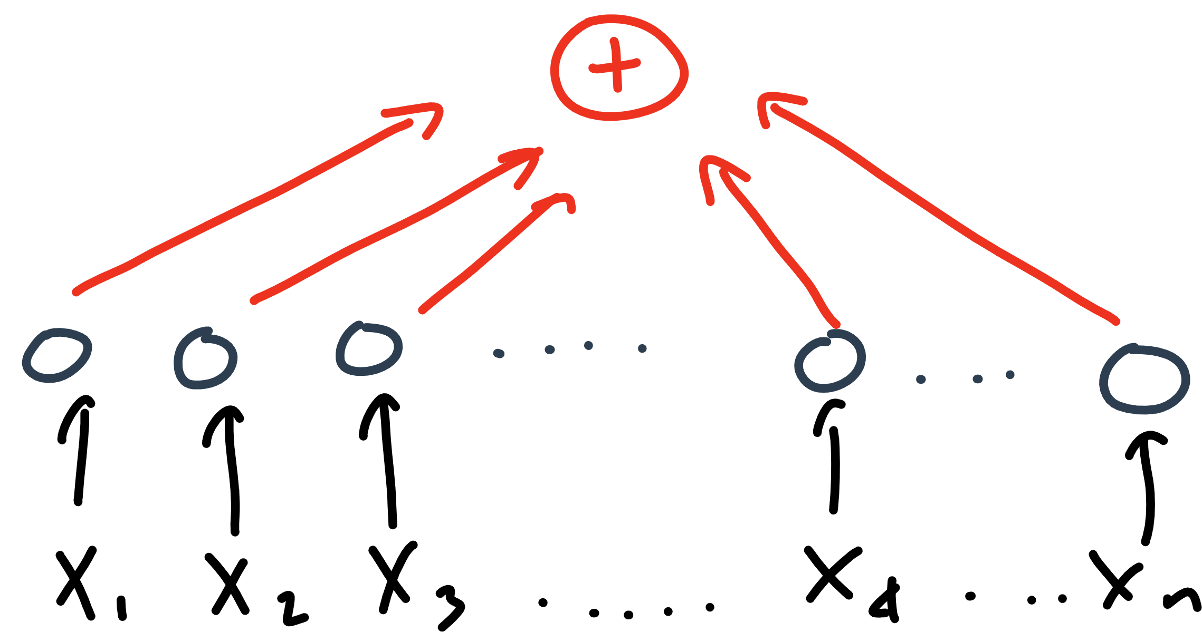

Slide 19
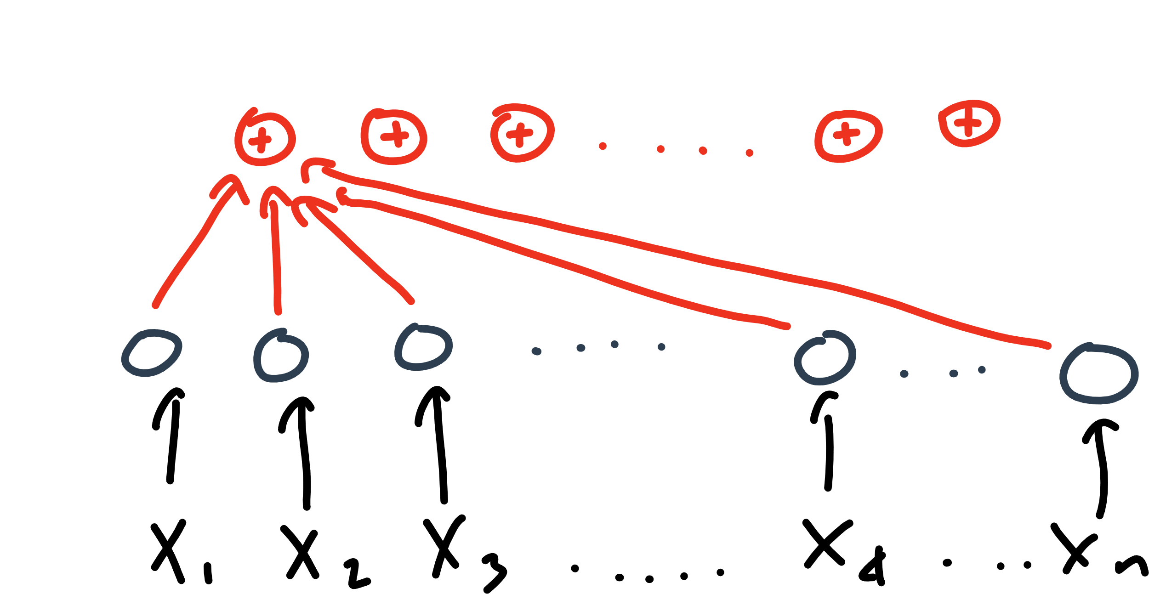

Slide 20
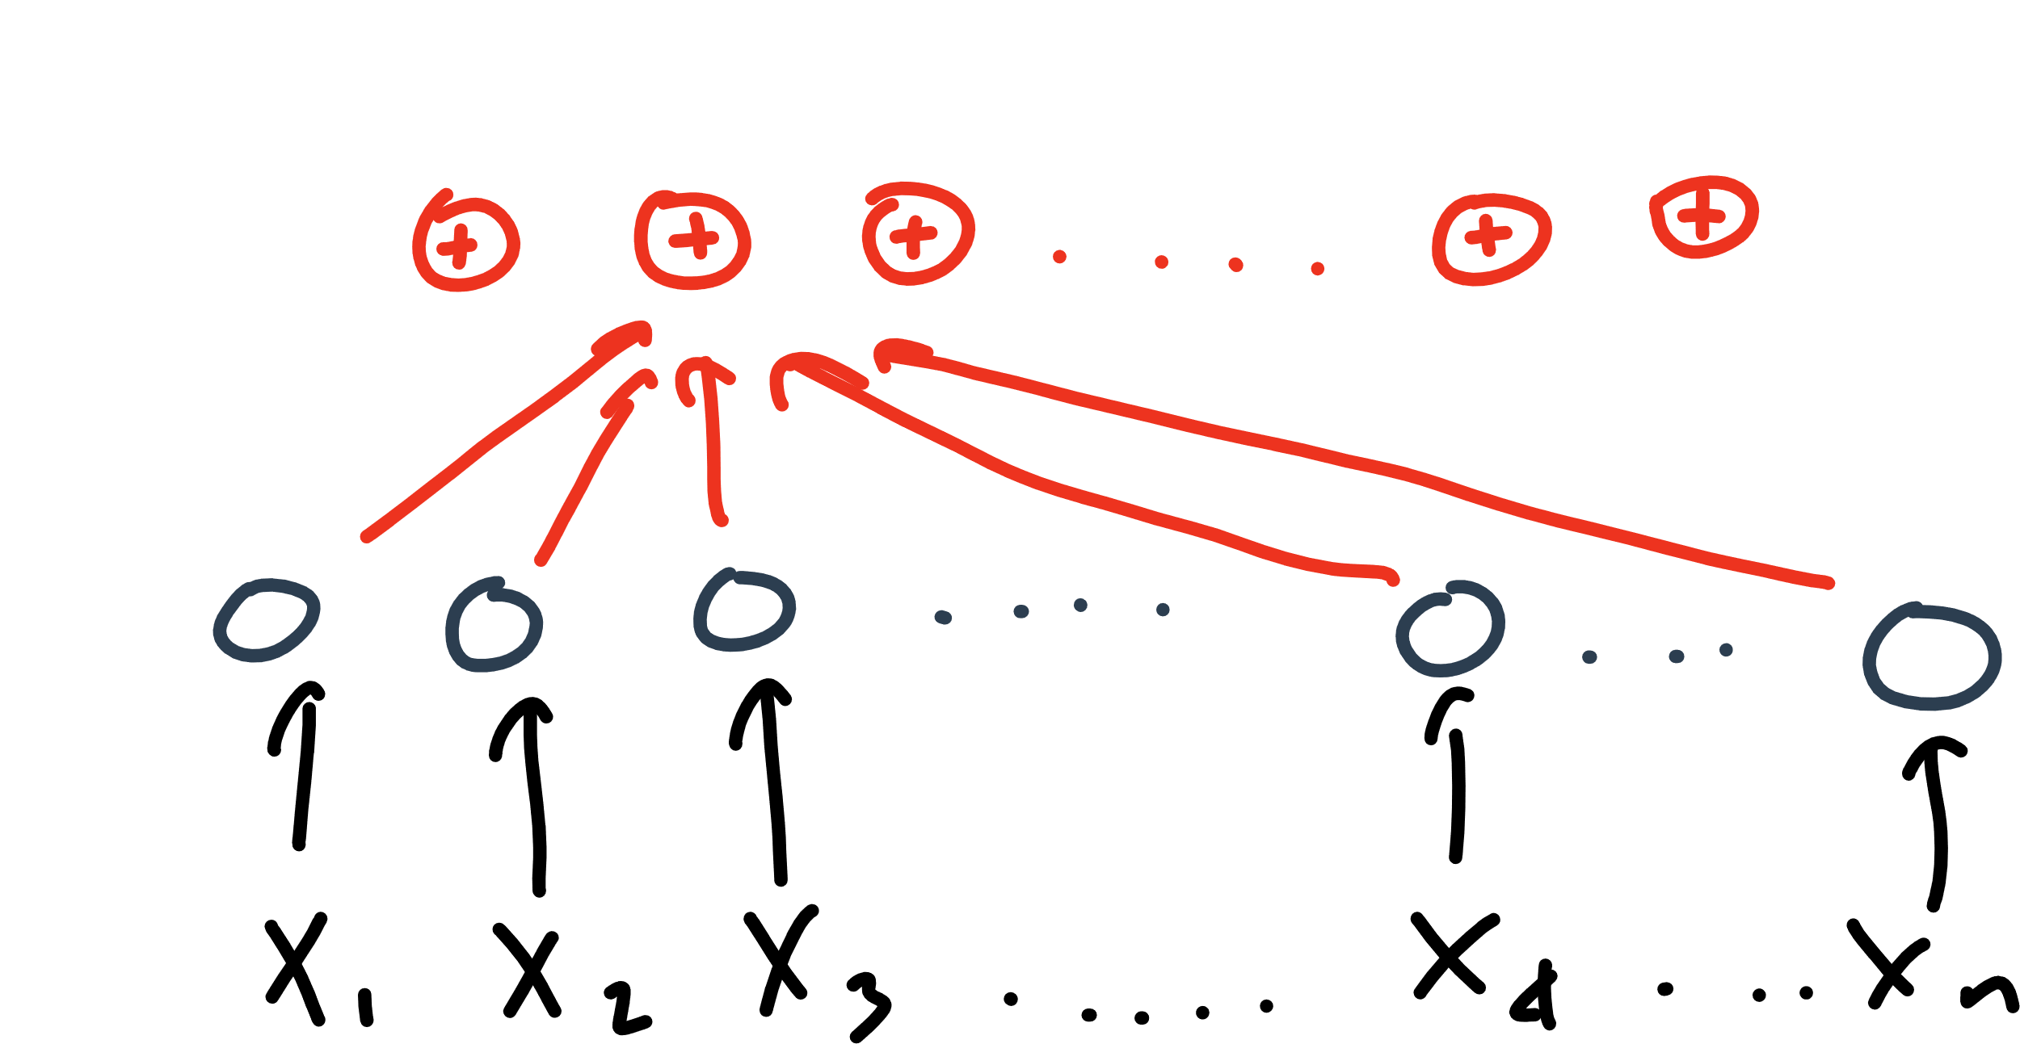

Slide 21
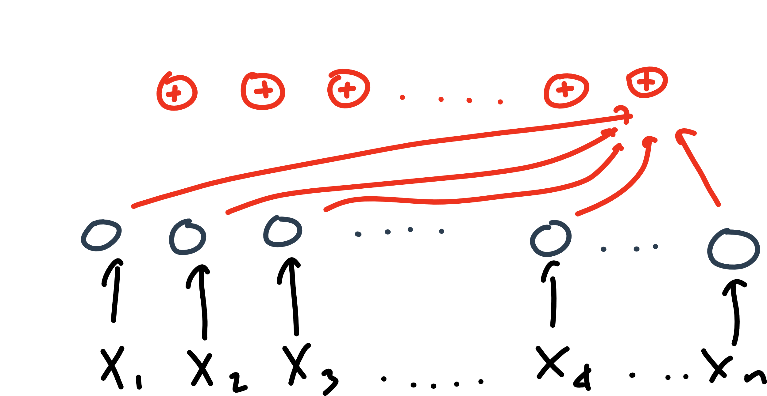

Slide 22
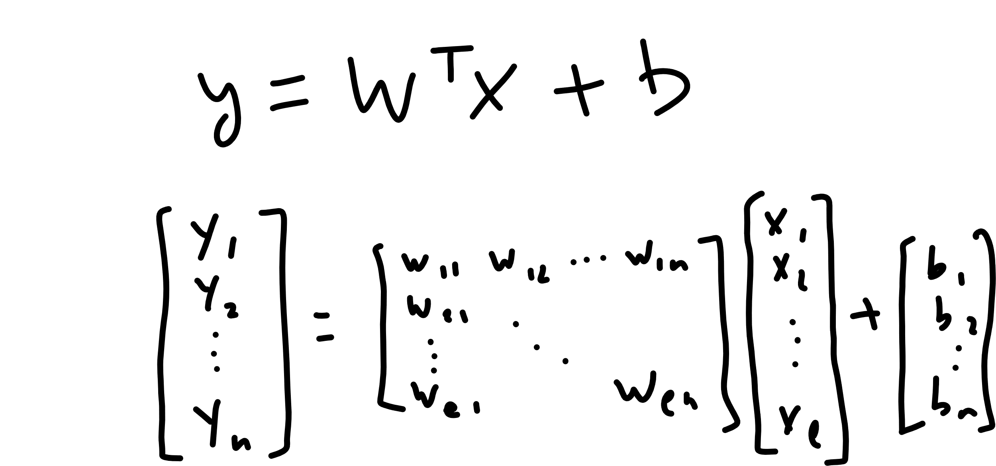

Slide 24
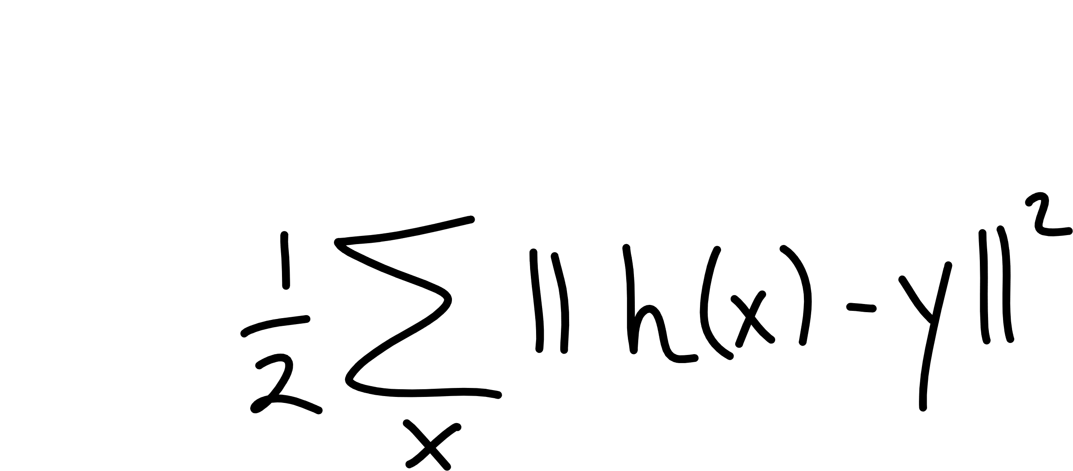

Slide 25
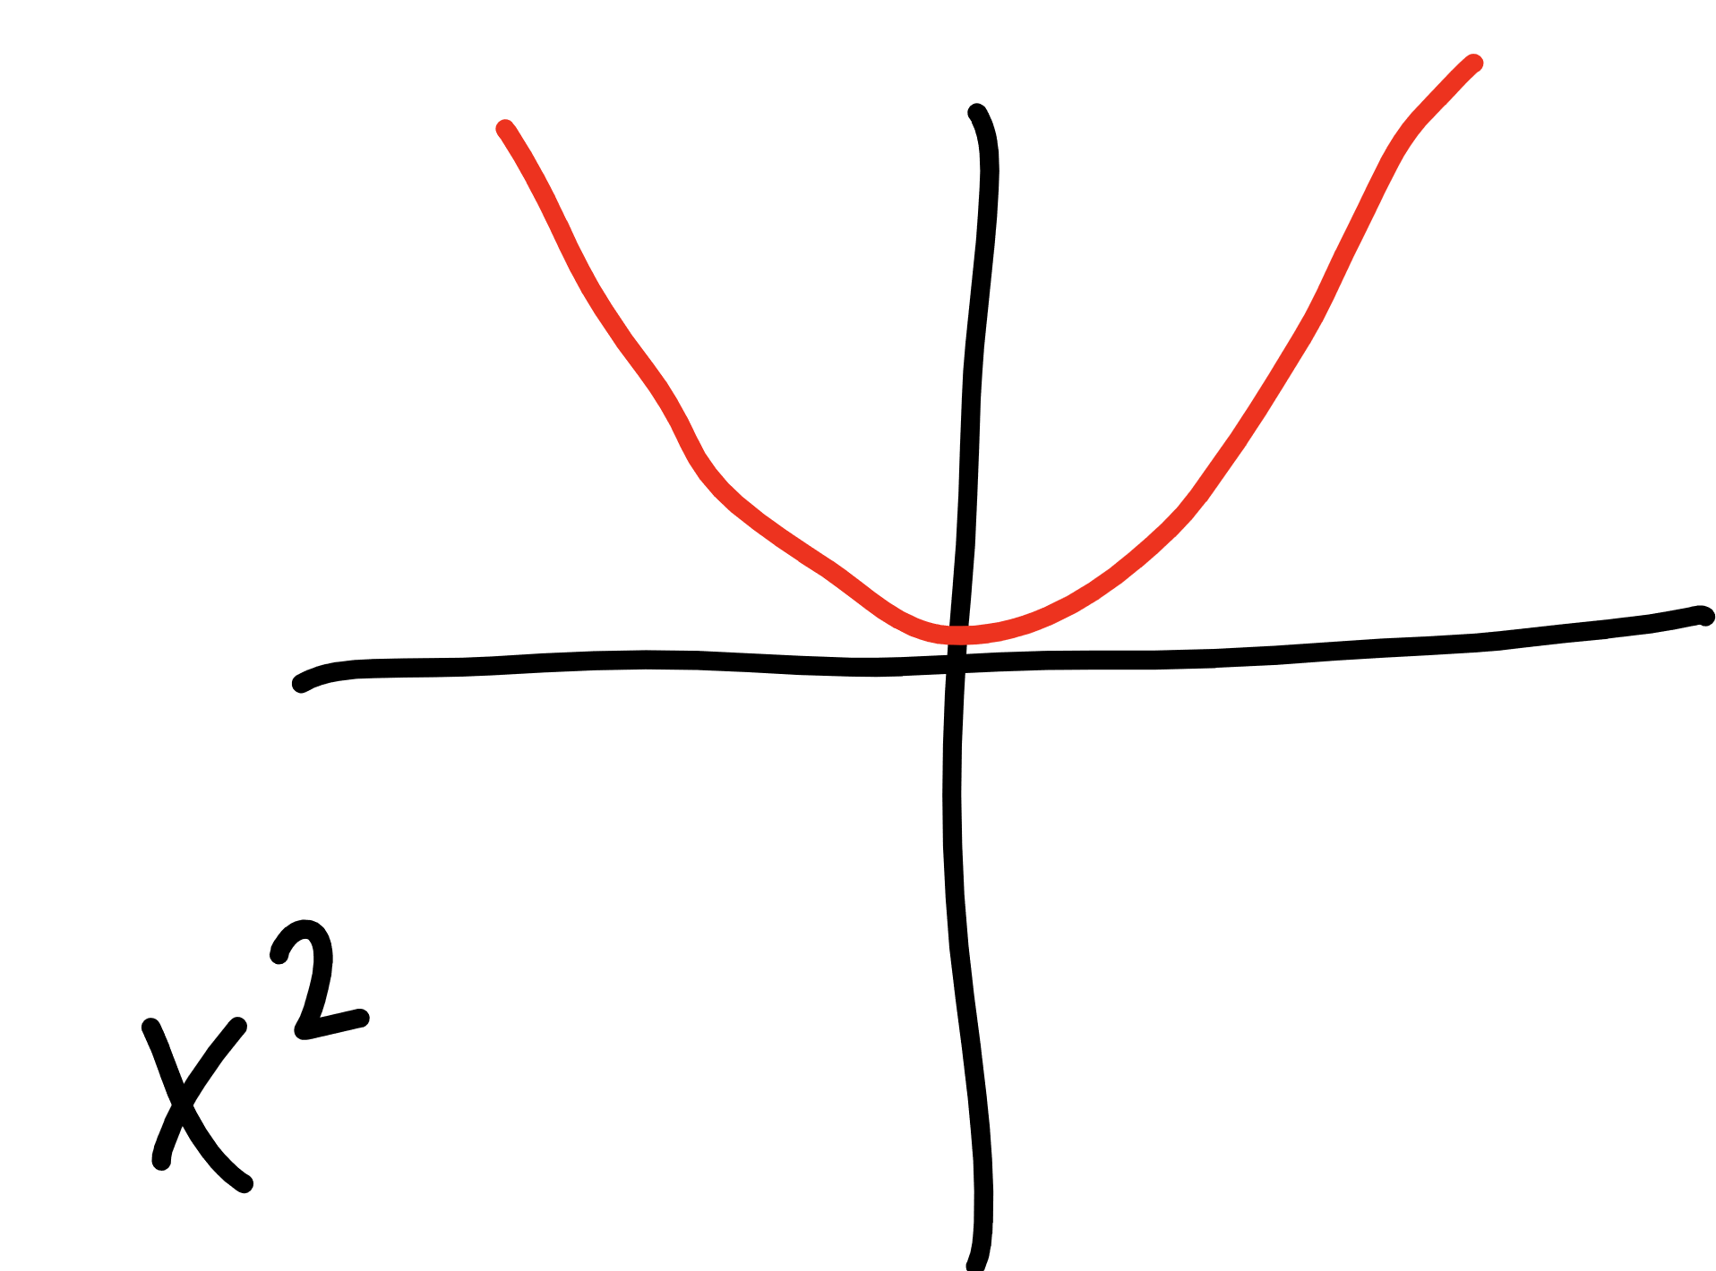

Slide 26
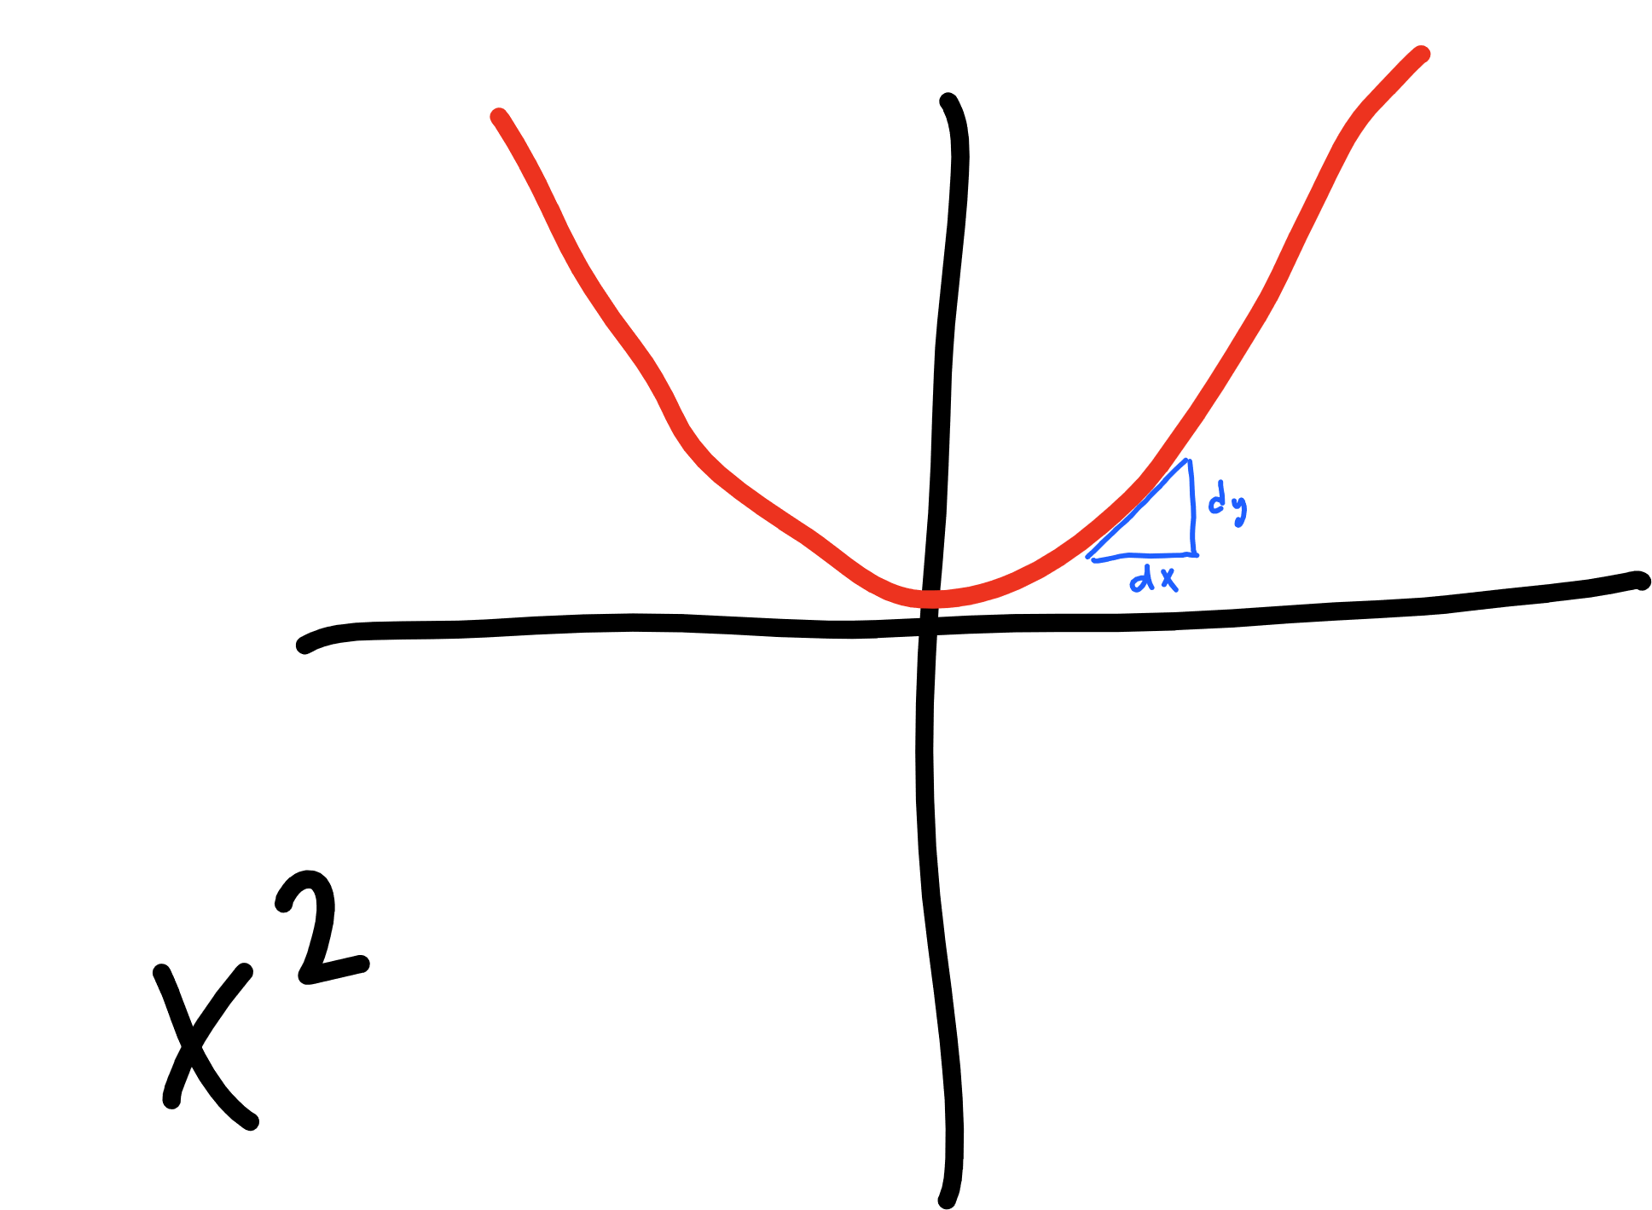

Slide 27
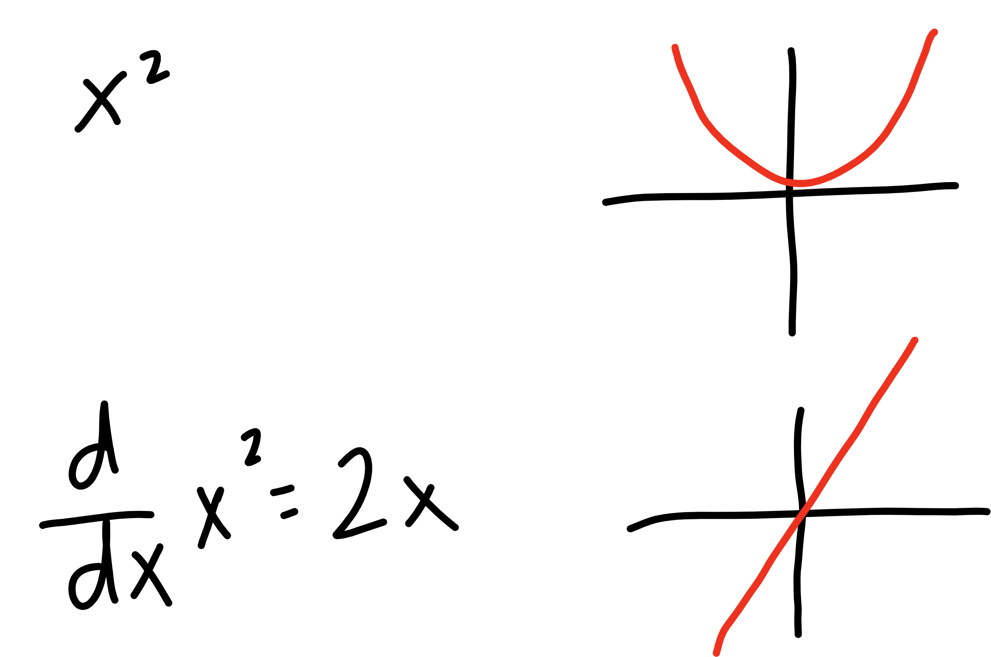

Slide 28
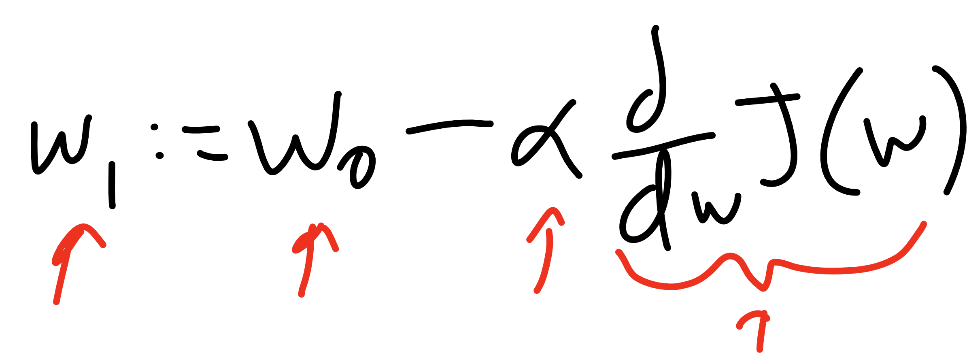
Current W
Learning Rate
Updated W
Derivative of
Cost Function

