Slide 1
Graph scattering Convolutional Network WCAI/Earth Networks Check-in 3
Damian Owerko, Fernando Gama, Alejandro Ribeiro

Slide 2
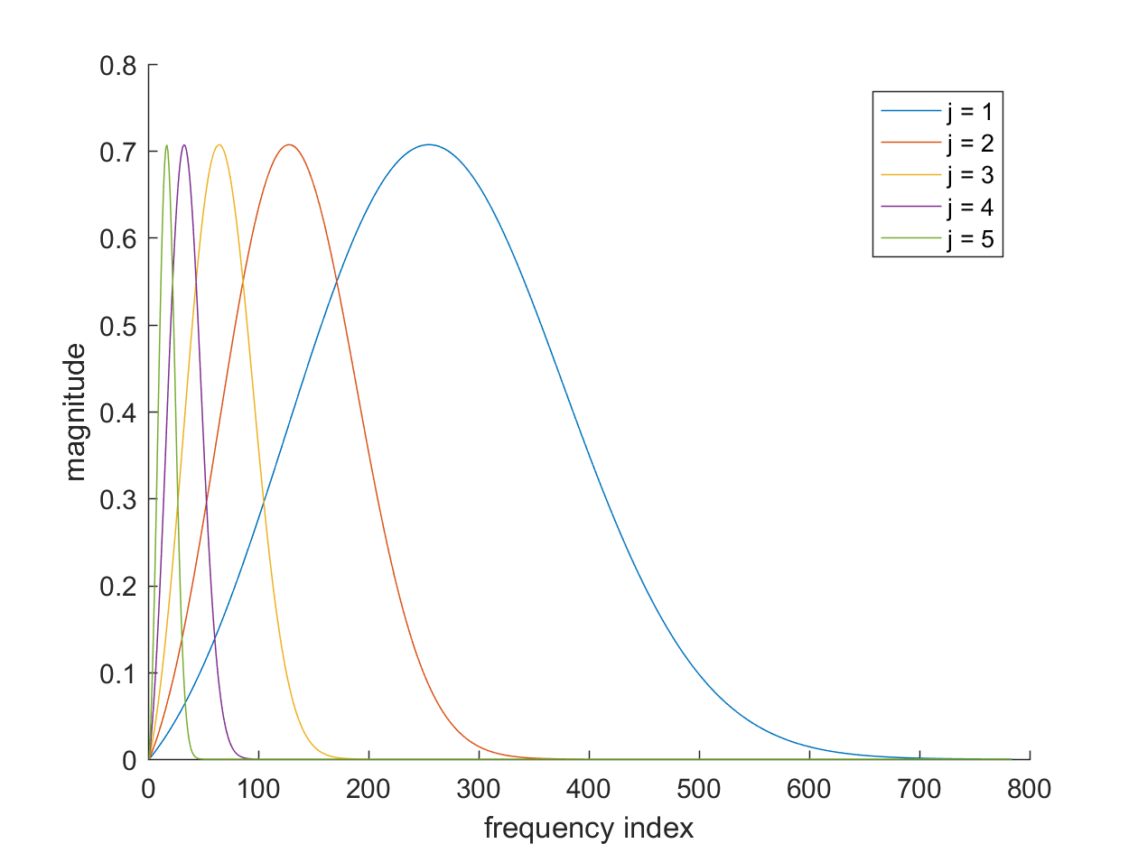
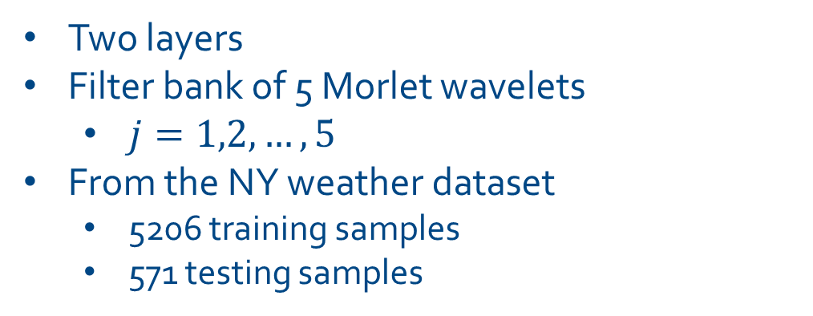
Best results so far
 | Missed detection rate | False alarm rate | Average error rate
Pressure | 0.0000 | 0.0501 | 0.0250
Pressure, Temperature, Wind Speed | 0.0690 | 0.3203 | 0.1946
Pressure | 0.0000 | 0.055755 | 0.0279
PCA w/o SCN | 0.0000 | 0.0388 | 0.0139
Two layers
Filter bank of 5 Morlet wavelets
$j=1,2,…,5$
From the NY weather dataset
5206 training samples
571 testing samples
Morlet wavelet family

Slide 3
Progress since last check-in
Debugged and Tested implementation with multiple fields
The results were not satisfactory
Using multiple fields reduces classification accuracy
Pressure continues to be the best predictor of outage
Compared results with and without transforming the data
Compared against classification using PCA
PCA performed slightly better than our classifier (96.22% vs 96.11% accuracy)
Reminder: so far the architecture of the network was decided a priori not learnt
The Scattering Transform architecture is fixed $→$ It is not learned from data

Slide 4
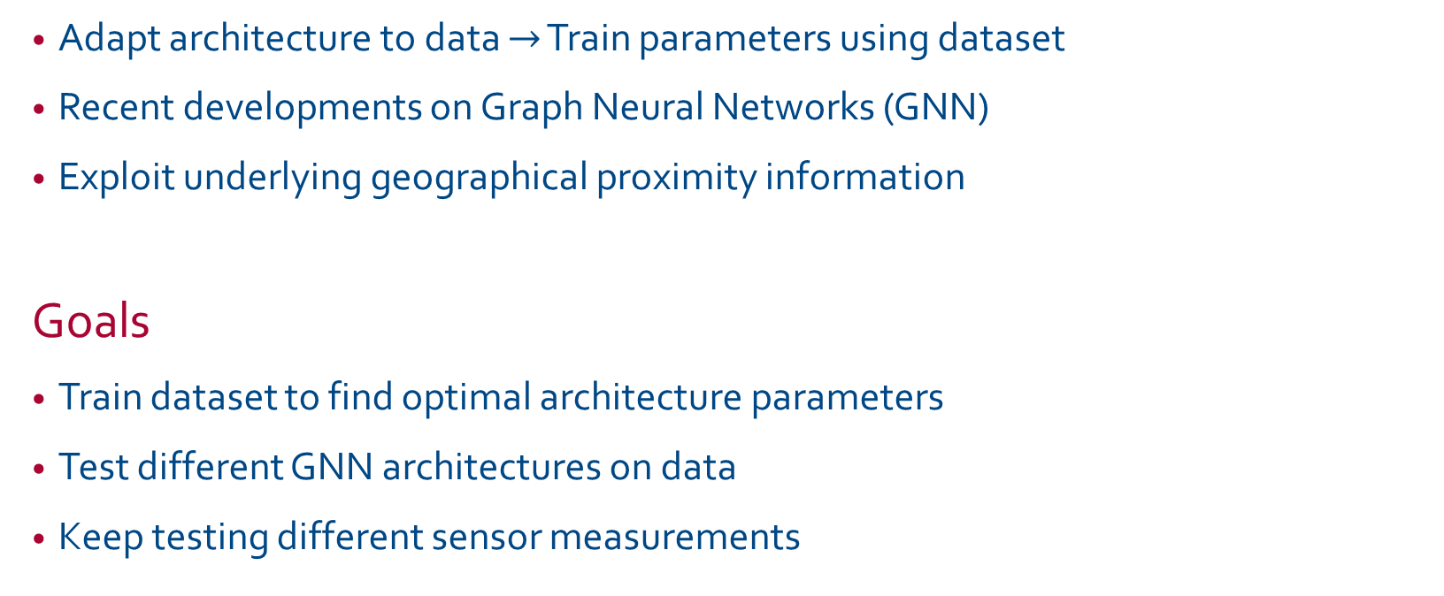
Graph Neural Networks
Adapt architecture to data $→$ Train parameters using dataset
Recent developments on Graph Neural Networks (GNN)
Exploit underlying geographical proximity information
Goals
Train dataset to find optimal architecture parameters
Test different GNN architectures on data
Keep testing different sensor measurements

