Slide 1
Graph Scattering Convolutional Network
Damian Owerko, Fernando Gama, Alejandro Ribeiro

Slide 2
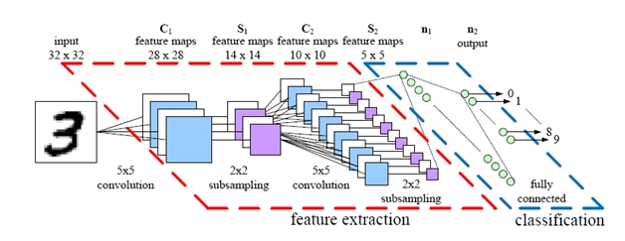





Motivation
Convolutional neural networks have demonstrated outstanding image processing performance
Modern signals have an irregular structure (unlike images) ⇒ graph signals
Sensor networks, weather measurements
Extend CNNs to operate on graph signals
Generalize the convolution operation
Determine power grid brownout using weather measurements
Yan Xu, PhD, Scientist at PROS Follow. "Convolutional neural network." LinkedIn SlideShare. May 20, 2017. Accessed October 22, 2017.
$$x_{3}$$
$$x_{4}$$
$$x_{1}$$
$$x_{5}$$
$$x_{2}$$
Notes:
CNNs
Feature extraction – convolution by set of kernels followed by nonlinearity (pool)
Levarage knowledge from CNNs on graph signals
Explain why graph signals are useful for weather data
Geography between stations

Slide 3
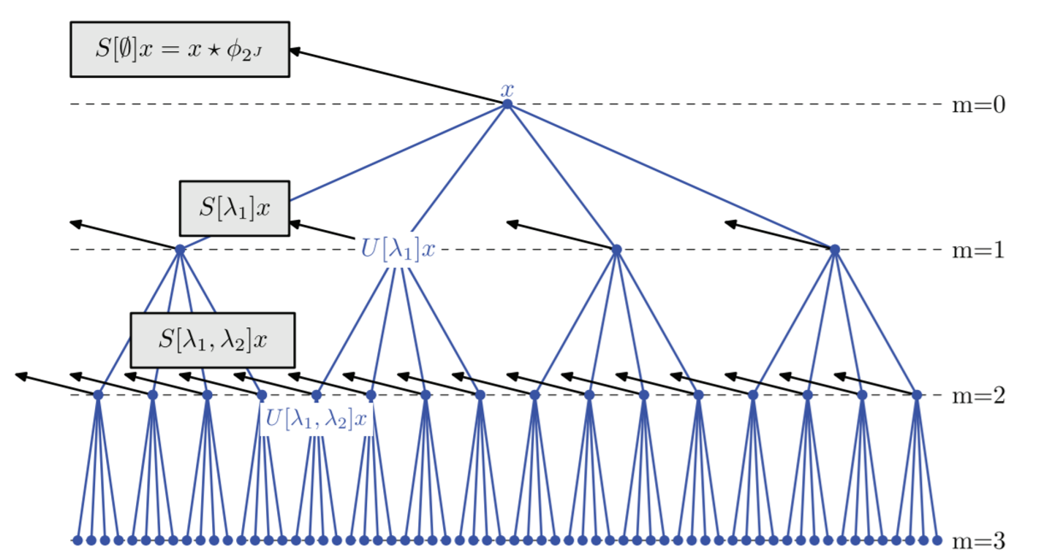
Scattering convolutional network
There are many CNN architectures ⇒ we choose the SCN
Filters pre-specified = no training
Wavelet filters between layers
Tune the degree of translation invariance
State of the art results on MNIST
J. Bruna and S. Mallat, "Invariant Scattering Convolution Networks," in IEEE Transactions on Pattern Analysis and Machine Intelligence, vol. 35, no. 8, pp. 1872-1886, Aug. 2013.
Notes:
Move between layers using a band pass filter and extract outputs from each layer using a low-pass filter
Use all outputs for classification (a vector per node)

Slide 4
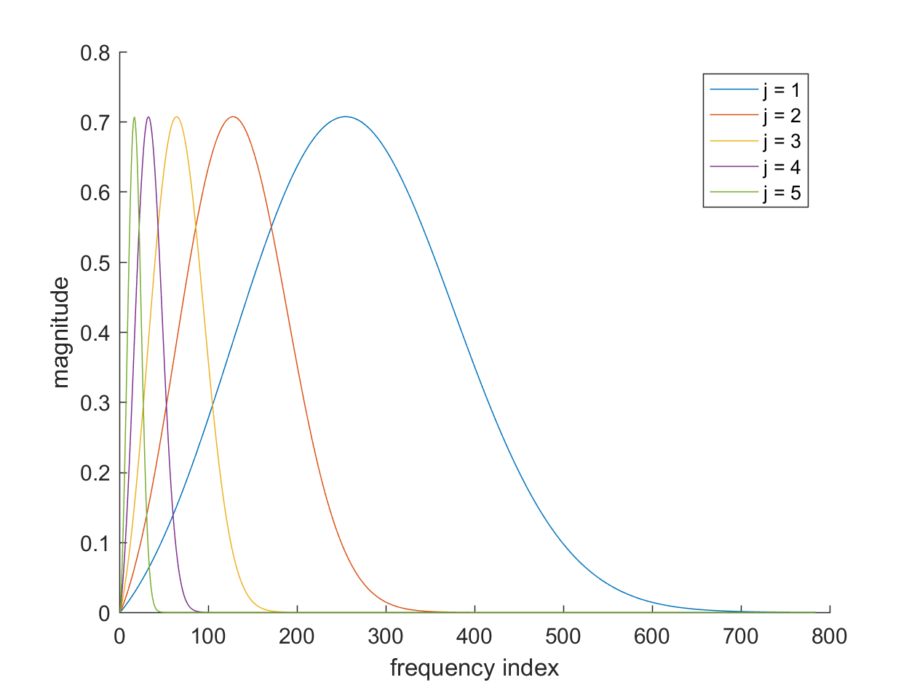
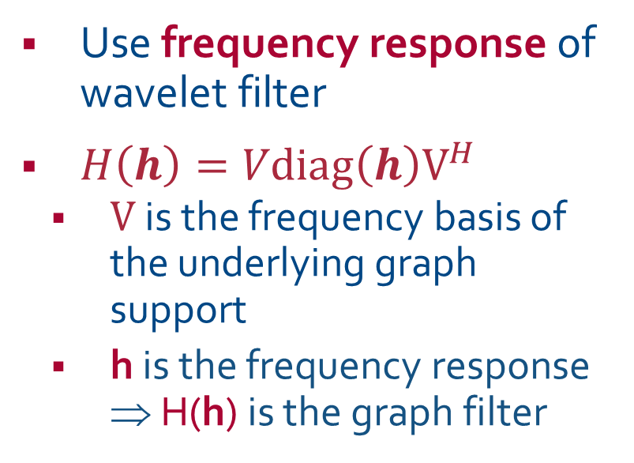
Filters can be defined on a graph
Use frequency response of wavelet filter
$H\left(h\right)=Vdiag\left(h\right)V^{H}$
$V$ is the frequency basis of the underlying graph support
h is the frequency response ⇒ H(h) is the graph filter

Slide 5
Building the graph support
Graph support that relates the data values
Weather measurements
Nodes in the graph are weather stations
Compute distances between stations
Nearby stations have similar measurements
Apply gaussian kernel to great-circle distance
Use 25 nodes (stations)

Slide 6
Preliminary results and future work
Using Earth Networks NYC weather data and EIA reliability data for NY between 2011-2013
Used two Earth Networks dataset fields
1. temperature – 84.2% accuracy
2. sea-level pressure – 94.56% accuracy
Much better performance with pressure data
Likely a better storm predictor
Optimally combine different weather measurements
Try other graph CNN architectures

Slide 7





We extend the SCN to graph signals
SCN
graph SCN
$$u$$
$$u$$
$$u∗φ_{J}$$
$$H\left(\tilde{φ_{λ} }\right)u$$
$y_{1} … y_{n}=|u∗ψ_{j}| … y_{J}$
$y_{1} … y_{n}=|H\left(\tilde{ψ_{j} }\right)u| … y_{J}$

