Slide 1

Segments Intersections
FORNALI Damien - BENZA Amandine

Slide 2
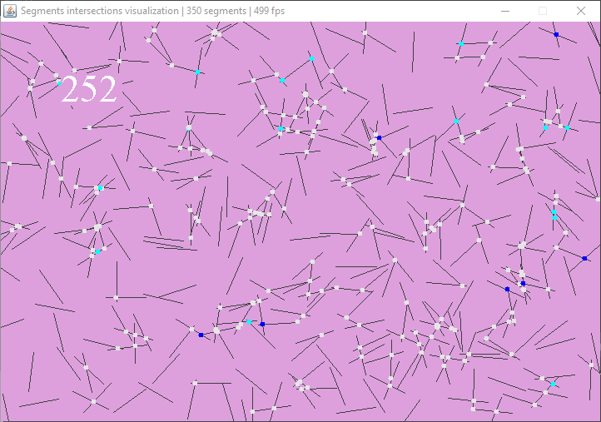

Graphic Library

Slide 3
Modeling
Segment model: object
Using center and extremities
Knows who it is colliding with
Contains its collisions positions
Rebounds
Checking each segment extremity position

Slide 4
Segments & Rebounds
Modelisation
Blablabla

Slide 5
Segments Collision

Slide 6
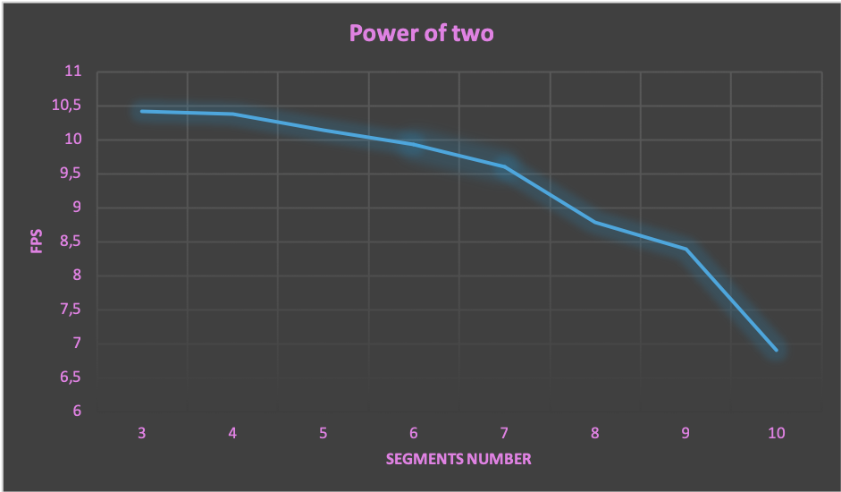
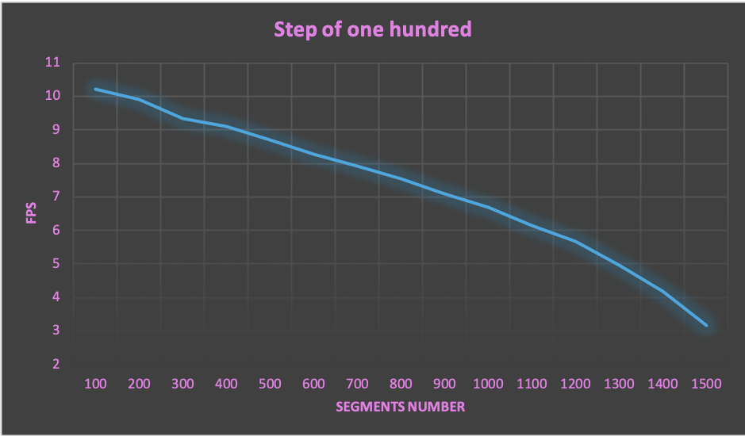
Benchmarks
FPS

Slide 7
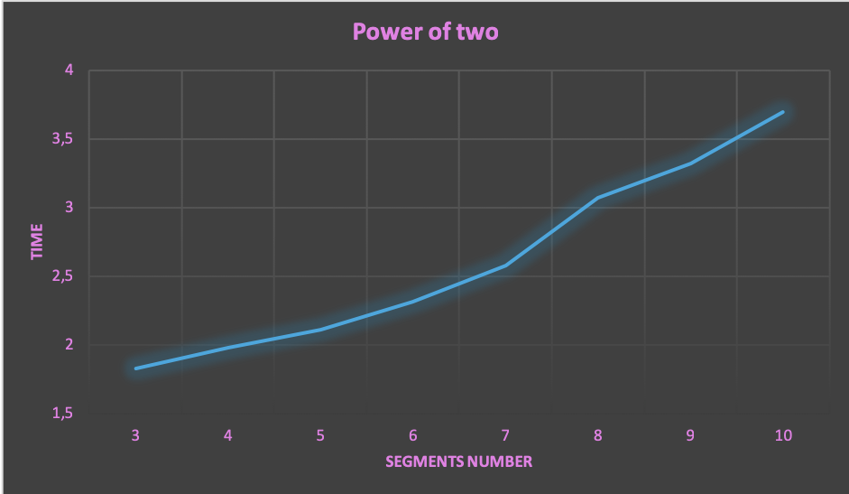
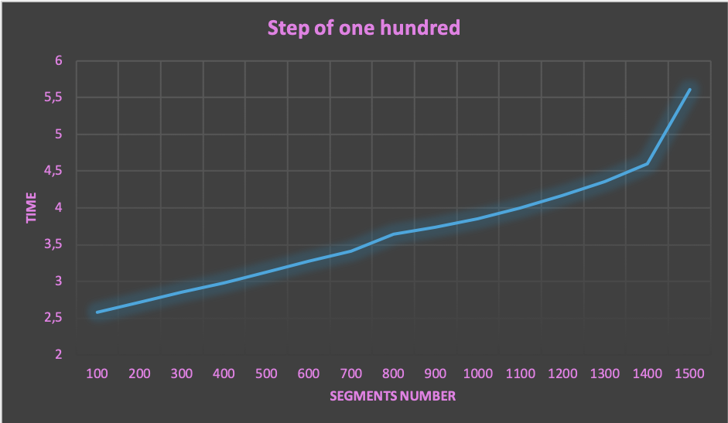
Benchmarks
Time

Slide 8
DEMO

