Slide 1
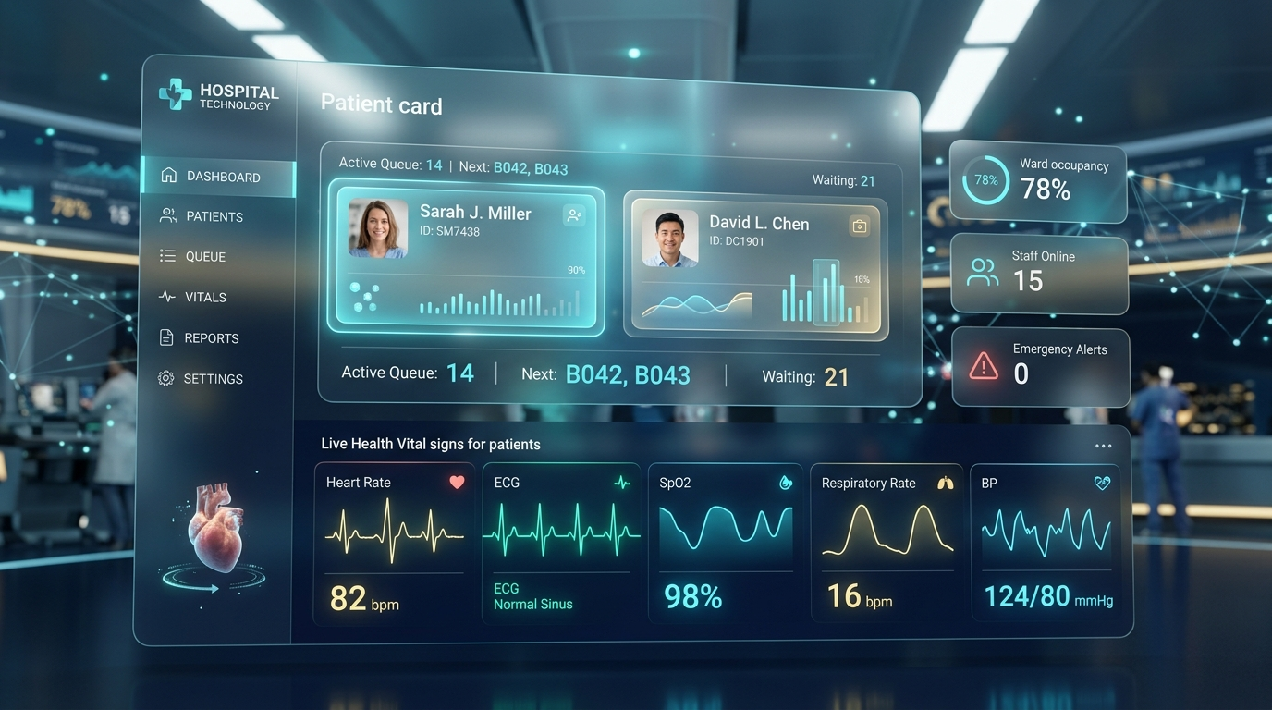
SMART HEALTHCARE PLATFORM // SIH 2026 READY
CarePulse HealthFlow
Smart Healthcare Facility Finder, Real-Time OPD Queue Tokens & Zero-Travel Consultations
Eliminating hospital hallway overcrowding and hours wasted in waiting rooms. Patients discover live facility capacity, secure digital queue passes remotely, and receive predictive 'Leave Home Now' transit alerts to arrive just-in-time.
PRODUCED BY: Damu-000 | TEAM: HealthFlow Core | VERSION: 2.4.0 (Production)
⚡ PREDICTIVE QUEUE ENGINE
Calculates exact wait times based on queue velocity and sends automated commute alerts.
🩺 CLINICAL TRIAGE MATRIX
Instant 4-tier risk routing: Home Care, Video Teleconsult, Urgent OPD, or Emergency SOS.

Slide 2
PROBLEM STATEMENT // HEALTHCARE BOTTLENECK
The Waiting Room Crisis: Idle Hours, Infection Risks & Blind Travel
Traditional outpatient (OPD) departments suffer from severe operational friction and lack of visibility.
⏳ 2.5–4.0 Hours Lost Waiting
Patients spend half their day crammed in waiting rooms simply waiting for their token to be called. Causes massive patient dissatisfaction and lost economic work hours.
🚗 Blind Healthcare Commuting
Patients travel 10–30 km to hospitals without knowing whether specialist slots are already full, doctors are delayed, or emergency beds are available.
🦠 High Cross-Infection Risks
Dense, unventilated waiting rooms mix immune-compromised individuals with infectious viral patients, driving secondary hospital-acquired infections.
🚨 Emergency Room Overcrowding
Absence of pre-arrival symptom triage causes non-critical patients to flock to emergency wards, consuming critical trauma bays meant for life-threatening cases.
KEY METRICS: Average OPD wait time in public/private clinics: 142 mins | Unnecessary physical visits: 42% | Patient no-show rate: 28%

Slide 3
PROPOSED SOLUTION // CAREPULSE ECOSYSTEM
CarePulse HealthFlow: Real-Time Decentralized Queueing & Navigation
A patient-centric and hospital-synchronized digital bridge connecting homes directly to clinical consultation desks.
🎫 1. Remote Token Generator
Patients take a verified OPD queue token from home through their browser. Live queue position and estimated doctor turn time update in real time.
BENEFIT:
• Eliminates physical morning token rush and hallway crowding.
🚗 2. 'Leave Home Now' Telematics
Calculates commute time dynamically. Alerts the patient when to depart so they walk into the hospital precisely when their turn is called.
BENEFIT:
• Zero waiting room time; spend idle wait hours comfortably at home.
🩺 3. Algorithmic Symptom Triage
Pre-consultation clinical risk evaluator directs patients to Self-Care, Teleconsult, Urgent OPD, or immediate Emergency SOS before traveling.
BENEFIT:
• Protects emergency bays; prevents unnecessary travel for minor issues.
CORE VALUE PROPOSITION: 'Turn Hospital Waiting Rooms Inside-Out'
Converts physical queues into dynamic digital streams. Patients wait at home, arrive just-in-time, and walk directly to the doctor's desk.

Slide 4
TECHNICAL APPROACH // SYSTEM ARCHITECTURE
Modular, Zero-Dependency & Production-Ready Architecture
Built with a high-performance, lightweight architecture ensuring instant load times even on low-bandwidth 3G/4G networks.
💻 Frontend & Experience Layer
• Semantic HTML5 single-page application structure
• Modern Vanilla CSS3 design system (Glassmorphism, custom CSS variables)
• Fully responsive layout optimized for mobile smartphones and desktop kiosks
• Accessible Web Audio chime synthesizer for auditory patient callouts
• Floating toast notifications and modal management system
⚙️ Core Computational Engines
• queue-engine.js: Real-time velocity tracking, dynamic queue position math
• triage-engine.js: Weighted risk-scoring decision tree with 4-tier clinical routing
• app.js: Reactive UI binding, event coordination, localStorage state wallet
• Predictive Commute Buffer: (Est. Wait - Transit Time) threshold automation
• Staff Admin Desk Simulator: Provider state sync and delay broadcast engine
🏥 Data & Interoperability Layer
• data.js: Comprehensive registry of verified multi-specialty hospitals and clinics
• Live facility metrics: bed capacity, ICU availability, doctor rosters, and rush levels
• Cashless insurance network mapping (Star Health, Max Bupa, Care, HDFC Ergo)
• Future-ready REST / FHIR / ABDM (Ayushman Bharat Digital Mission) schema
• Zero-install client operation requiring no native app download

Slide 5
CORE CAPABILITY // NETWORK DISCOVERY
Smart Healthcare Facility & Bed Capacity Finder
Transparent visibility into hospital readiness, specialty doctors, and queue status before stepping out.
🏥 Live Bed & ICU Capacity
Real-time tracking of general beds, ICU units, and trauma bays across municipal and private hospitals. Eliminates the agony of reaching a hospital only to find zero beds available.
👨‍⚕️ Specialist Rosters & Schedules
Search and filter by clinical specialty (Cardiology, Pediatrics, Orthopedics, General Medicine). View doctor credentials, room numbers, and consultation fees upfront.
🛡️ Cashless Insurance Transparency
Pre-mapped health insurance network verification. Displays which TPAs and private insurers offer cashless claims at each specific clinic.
🚦 Dynamic OPD Rush Indicators
Color-coded crowd velocity indicators (Low Rush <15m, Moderate Rush 30m, Heavy Delay >60m) giving patients an immediate sense of waiting room congestion.

Slide 6
PATENTABLE ALGORITHM // COMMUTE-AWARE QUEUEING
Remote OPD Tokens & 'Leave Home Now' Telematics Engine
Intelligent predictive scheduling aligning patient transit time with doctor consultation velocity.
STAGE 1: DIGITAL TOKEN GENERATION
Patient selects facility and doctor from home. Instant digital pass created with secure Token ID, room number, and live queue position.
STATUS: State: Relax at Home
STAGE 2: TELEMATICS COMMUTE TRIGGER
Algorithm continuously evaluates: (Wait Time - Transit Time). When buffer reaches threshold (15 mins), system triggers 'LEAVE HOME NOW' urgent alert.
STATUS: State: Transit Alert Dispatched
STAGE 3: JUST-IN-TIME CONSULTATION
Patient walks through clinic entrance precisely as their number is announced on audio chime. Zero hallway wait time.
STATUS: State: Now Serving at Desk
📐 PREDICTIVE TELEMATICS FORMULA
T_wait = (N_ahead × D_avg) + T_delay | T_trigger = T_wait - (T_transit + B_safety)
Where N_ahead = queue position, D_avg = historical doctor visit duration (mins), T_transit = GPS travel duration, and B_safety = 10-minute parking & reception buffer.

Slide 7
CLINICAL INTELLIGENCE // SYMPTOM TRIAGE MATRIX
Rule-Based Clinical Risk Stratification
An interactive diagnostic decision tree that assesses urgency before hospital travel.
🟢 Level 1: Home Care
Mild symptoms (mild cold, slight headache, mild fatigue). Recommends hydration, rest, OTC medication guidance, and monitoring.
CLINICAL IMPACT:
Prevents hospital trips for benign self-limiting illness.
🔵 Level 2: Teleconsultation
Non-acute conditions (skin rashes, medication renewals, mild chronic reviews). 1-click booking for a zero-commute video consultation.
CLINICAL IMPACT:
Saves 100% of commute time and travel expenses.
🟡 Level 3: Urgent OPD Visit
Moderate/persistent symptoms (high fever, severe cough, persistent abdominal pain). Automatically provisions a priority OPD queue token.
CLINICAL IMPACT:
Ensures patient arrives at appropriate specialist.
🔴 Level 4: Emergency SOS
Red flag symptoms (severe chest pain, breathing difficulty, acute trauma). Immediately routes to nearest trauma center with dispatcher speed dial.
CLINICAL IMPACT:
Life-saving triage protocol with 0 hospital delay.
TRIAGE OUTCOME: 60% of unnecessary hospital footfall diverted to home care or teleconsult, keeping hospital corridors clear for critical care.

Slide 8
PROVIDER PORTAL // CLINICAL WORKFLOW
Doctor & Staff Admin Desk Simulator
Synchronized clinical console empowering healthcare providers to manage live queues and broadcast delays.
📢 1-Click Patient Calling
Instantly advances queue counter, triggering automated audio chimes in the clinic waiting area and push/SMS alerts to the patient's smartphone.
⏱️ Live Consultation Management
Track ongoing consult duration, record visit completions, or flag patient no-shows with real-time queue recalculation across the network.
🚨 Acuity Triage Priority Bump
OPD nurses and doctors can escalate high-urgency patients ahead in the queue based on vital signs or physical clinical presentation.
⚠️ Broadcast Delay Alerts
If emergency surgeries or rounds cause doctor delays, staff can broadcast a 15/30-minute delay alert to all waiting patients, preventing waiting room frustration.

Slide 9
SAFETY & ACCESSIBILITY // COMPREHENSIVE CARE
Zero-Commute Teleconsultation & 1-Tap Emergency SOS
Bridging routine virtual healthcare and critical acute emergency response in a single unified interface.
💻 ZERO-COMMUTE VIDEO TELECONSULT
• Instant video consultation with on-call specialists from home.
• Picture-in-picture simulated video interface with audio/video controls.
• Ideal for routine follow-ups, prescription renewals, and minor health concerns.
• Saves patients 100% of transportation costs and traffic fatigue.
• Directly relieves OPD footfall in tertiary specialty hospitals.
🚨 1-TAP EMERGENCY SOS SYSTEM
• Immediate geolocation routing to the nearest Level-1 trauma center.
• Displays real-time verified emergency bay readiness before dispatch.
• Auto-dials 108 / 112 emergency ambulance dispatchers with single tap.
• Pre-alerts receiving hospital ER trauma team of inbound critical patient.
• Equipped with high-visibility emergency cues and audio alerts for crisis safety.

Slide 10
FEASIBILITY & VIABILITY // REAL-WORLD DEPLOYMENT
High Feasibility, Scalable Architecture & System Integration
Designed for frictionless adoption across government primary health centers and multi-specialty private hospital chains.
⚡ Zero App Install Barrier
Runs completely in modern web browsers (Chrome, Safari, Edge) on mobile smartphones and desktop kiosks. No 100MB app downloads or app store hurdles.
🔌 HMIS & EHR Compatibility
Ready to interface with standard Hospital Information Systems (HMIS), HL7 / FHIR protocols, and ABDM (Ayushman Bharat Digital Mission) architecture.
💰 Low Cost & High ROI
Requires minimal hardware — standard hospital reception tablet or computer. Reduces hospital administrative costs and patient churn while boosting daily OPD throughput.
🛡️ Enterprise Data Privacy
Complies with healthcare data protection principles. Client-side token wallet ensures patient medical privacy without permanent tracking of sensitive data.

Slide 11
IMPACT & ROADMAP // THE FUTURE OF HEALTHFLOW
Quantifiable Healthcare Impact & Strategic Roadmap
Delivering measurable benefits to patients, doctors, and healthcare administration.
78%
OPD Wait Time Reduction
From 142 mins to under 30 mins physical clinic wait.
2.4 Hrs
Time Saved Per Visit
Idle waiting replaced with productive hours at home.
60%
Waiting Room Decongestion
Crowded hallways and infection risk drastically lowered.
100%
Zero Commute for Teleconsults
Eliminates travel expenses for follow-up consults.
🚀 STRATEGIC PRODUCT ROADMAP
• PHASE 1 (COMPLETED): Core Interactive Platform, Remote Queue Tokens, Triage Engine, Staff Simulator, Responsive UI
• PHASE 2 (Q2 2027): WhatsApp Bot Integration for zero-app token generation, SMS fallback alerts for non-smartphone users
• PHASE 3 (Q3 2027): National ABDM (Ayushman Bharat) Health ID linkage, automated electronic prescription sync
• PHASE 4 (Q4 2027): Machine Learning consultation duration predictor using historical patient case complexity

