Slide 1

Performance Report
Vodacom DRC Project| 21st July to 2nd August 2024 | DRC

Slide 2
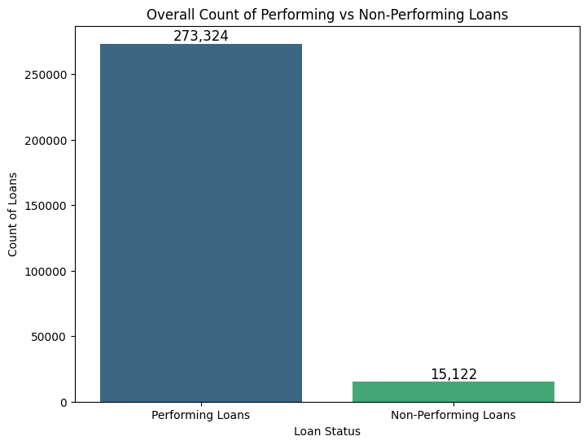
SOS Buka Project
NPL Report
This graph illustrates the total number of performing vs. non-performing loans over the period.
We can observe a relatively healthy loan performance with a default rate of 5.24%

Slide 3
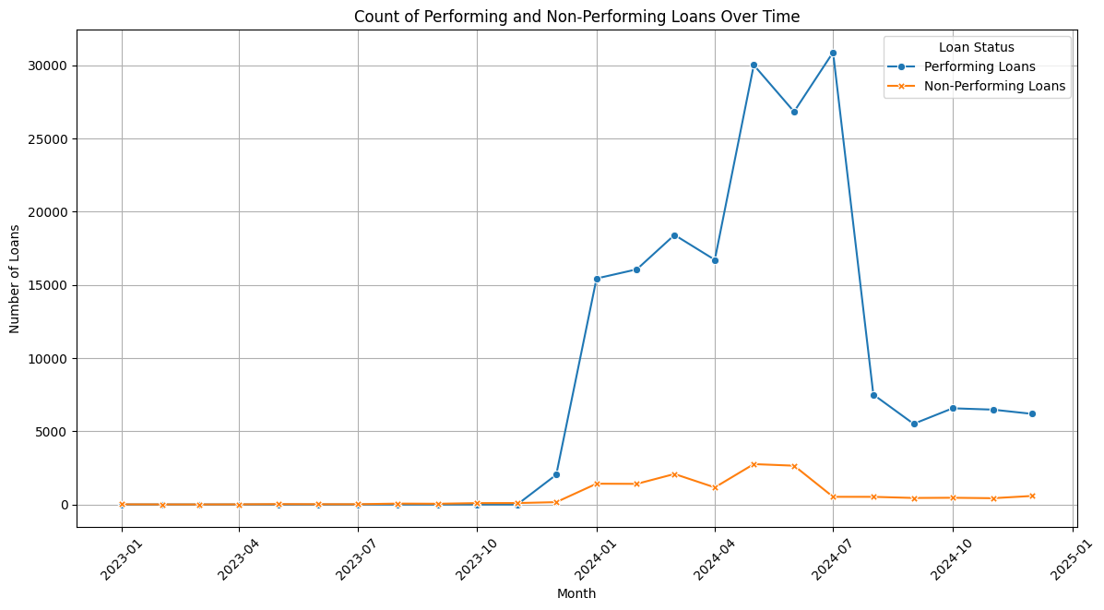
SOS Buka Project
NPL Report
This plot highlights the trend in both performing and non-performing loans from Jan 2023 to date.
The greatest spikes in # loans given out came in July-Aug 2023 and April 2024.
Before the period of highest activity Aug 2023 - Aug 2024,the average number of loans was slightly above 3,000 however after this period, this average grew to approximately 6,000.

Slide 4
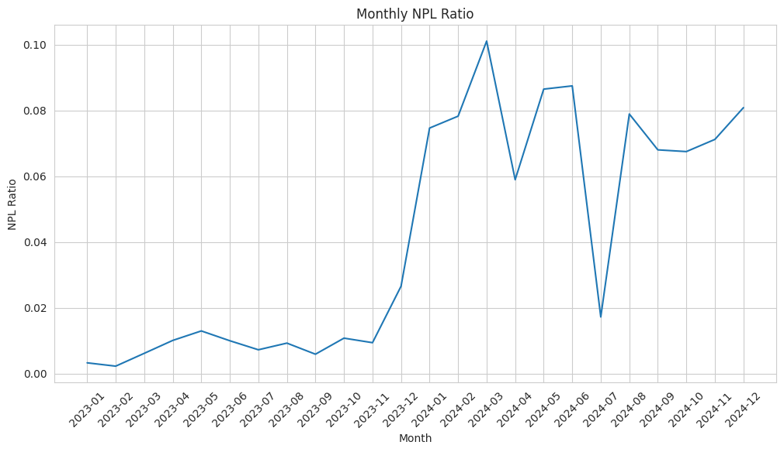
SOS Buka Project
NPL Report
This plot shows the overall monthly NPL Ratio trend for active agents over the period.
The NPL ratio peaked in March 2023 at 10%

Slide 5
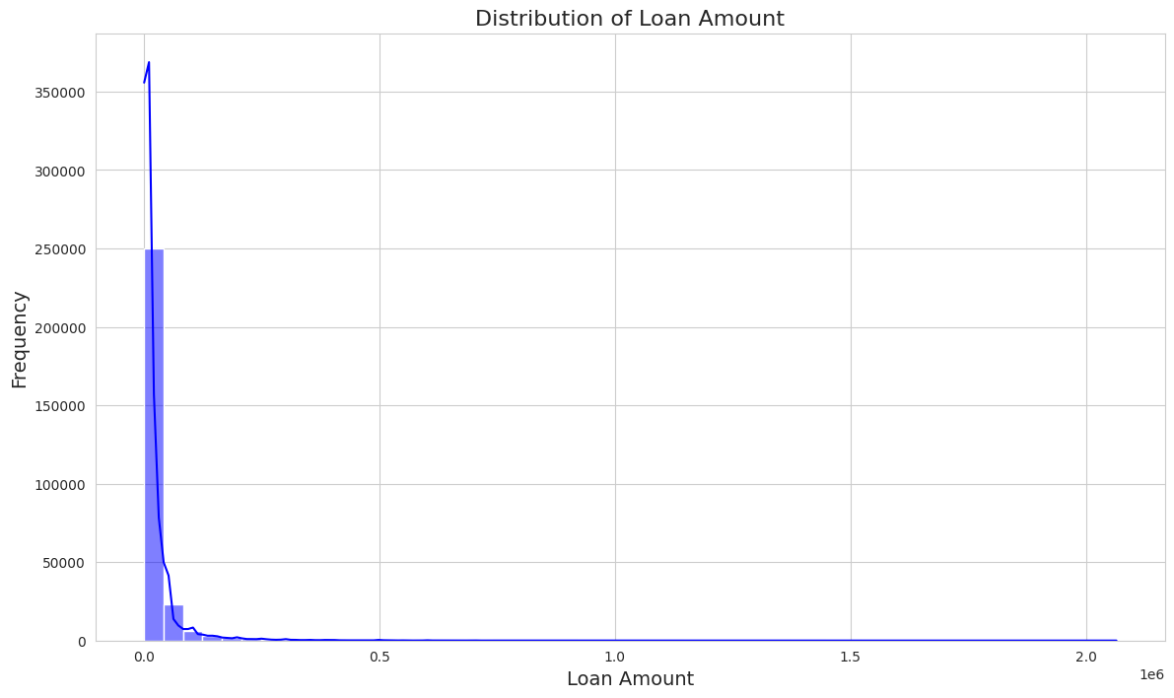
SOS Buka Project
NPL Report
The total number of loans given during the period is 288,446 with an average of 23,942.64 units.
From the distribution of loan amount plot (as well as the average) we can establish that majority of agents borrow less that 25, 000 units. (75th percentile of loans)

Slide 6
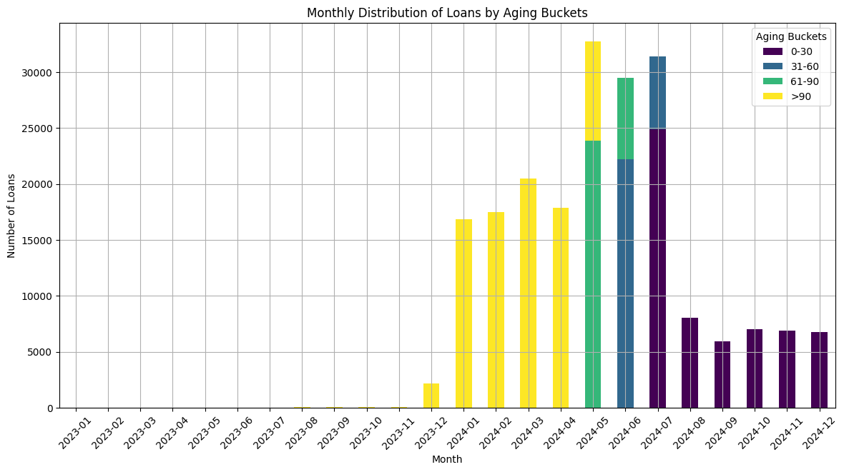
SOS Buka Project
NPL Report
This graph represents the grouping of loans with respect to number days overdue
The overdue loans Performance improved from June 2024
Days Overdue | Influential duration | Trend
0-30 | Jul 24 - Date | Spike then decrease
31-60 | Jun 24 - Jul 24 | Increase
61-90 | May 24 - Jun 24 | Increase
>90 | Dec 23 - May24 | Steady sharp rise

Slide 7
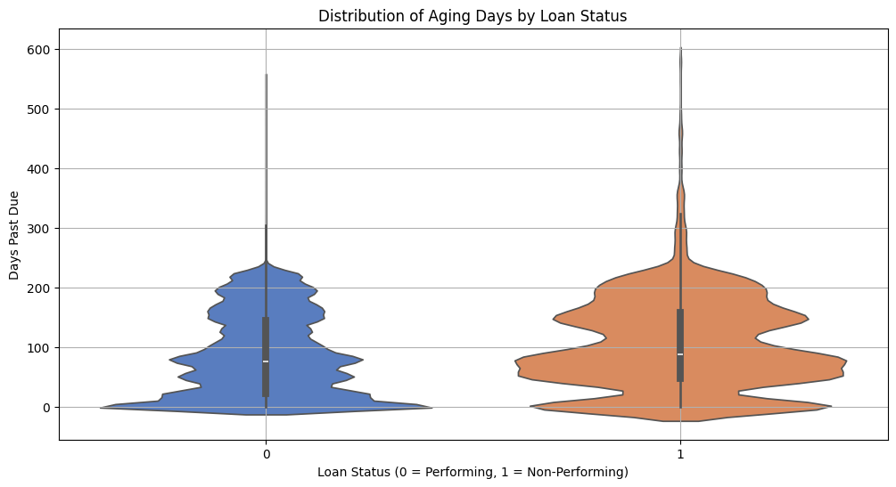
SOS Buka Project
NPL Report
This is a violin plot illustrating the distribution of overdue days with respect to loan status (i.e. performing or non-performing)

Slide 8
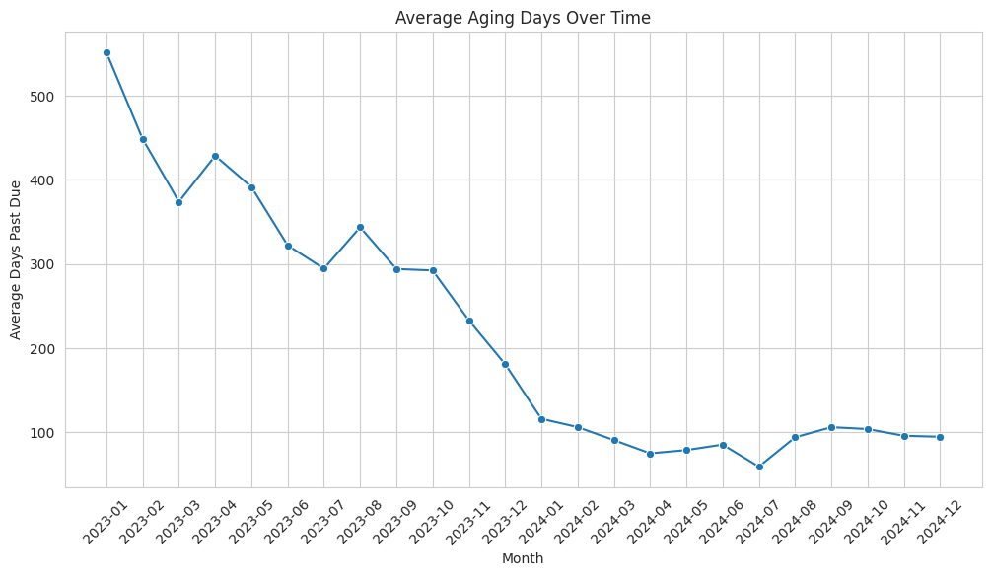
SOS Buka Project
NPL Report
The graph highlights the trend of average days overdue on a month-to-month basis.
Note the sharp decrease from the start up to Jan 2024 after which the trend shows slight decrease then relatively steady performance

Slide 9
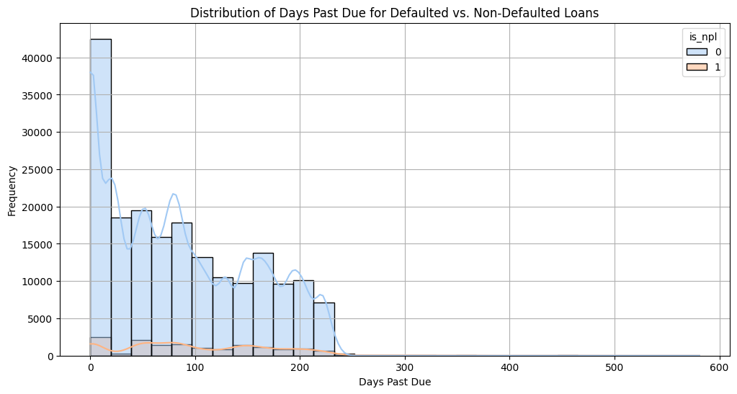
SOS Buka Project
NPL Report
This is a distribution of overdue (days) for performing and non-performing loans for the period

Slide 10
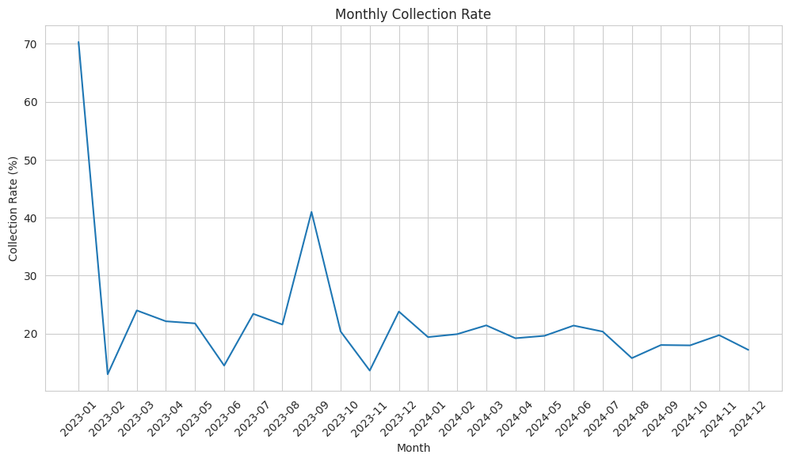
SOS Buka Project
NPL Report
This plot shows the actual revenue collected as a percentage of total revenue expected over the duration

Slide 11
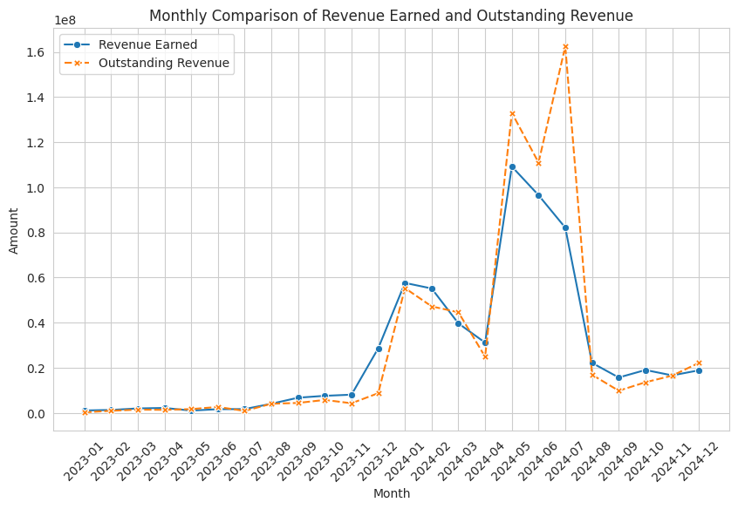
SOS Buka Project
NPL Report
This plot highlights the difference between earned and outstanding revenue for the duration
Total Revenue Earned: 630,115,675.01 units
Total Outstanding Revenue: 694,260,464.73 units

Slide 12
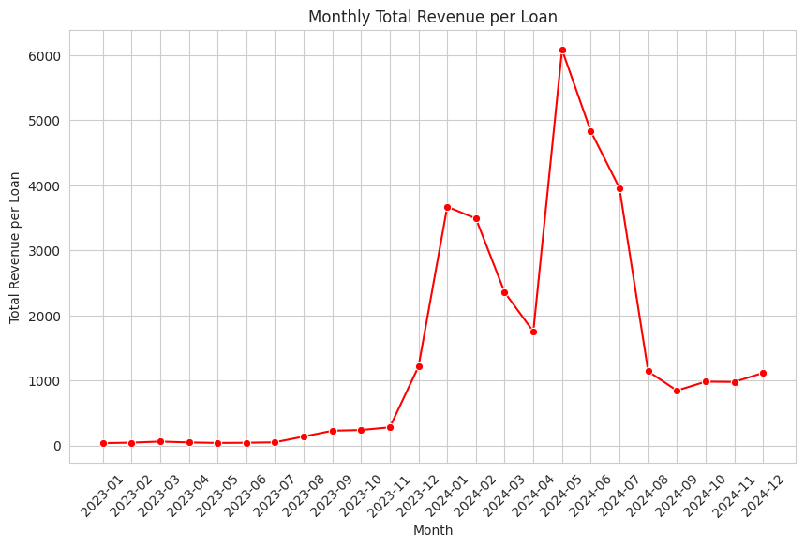
SOS Buka Project
NPL Report
This plot illustrates the monthly total revenue earned per loan
The total revenue per loan peaked in May 2024 at 6000 units per loan

Slide 13
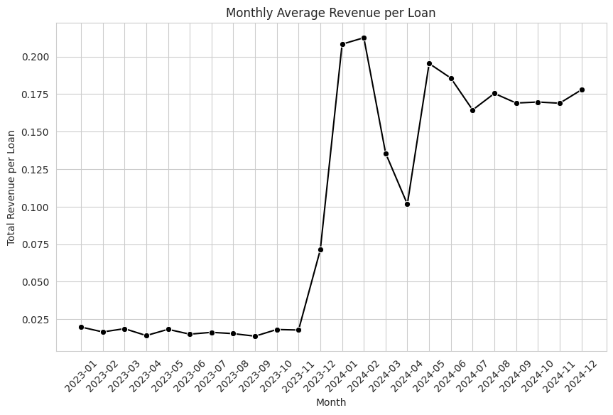
SOS Buka Project
NPL Report
This plot illustrates the monthly average revenue earned per loan

Slide 14
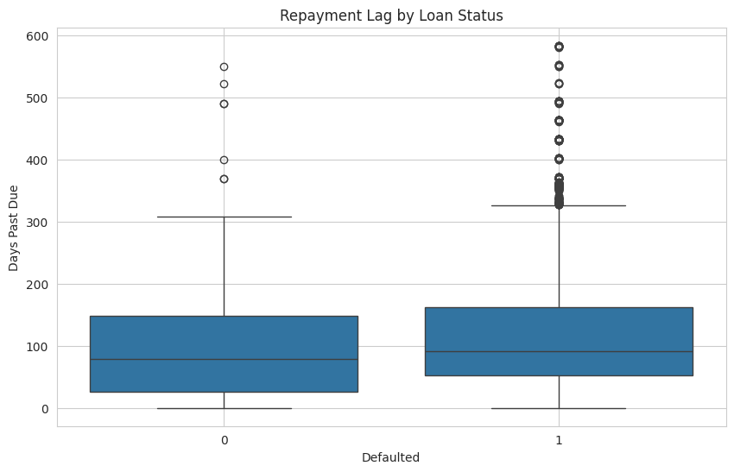
SOS Buka Project
NPL Report
This plot illustrates the spread of repayment lag for both performing and non-performing loans

Slide 15
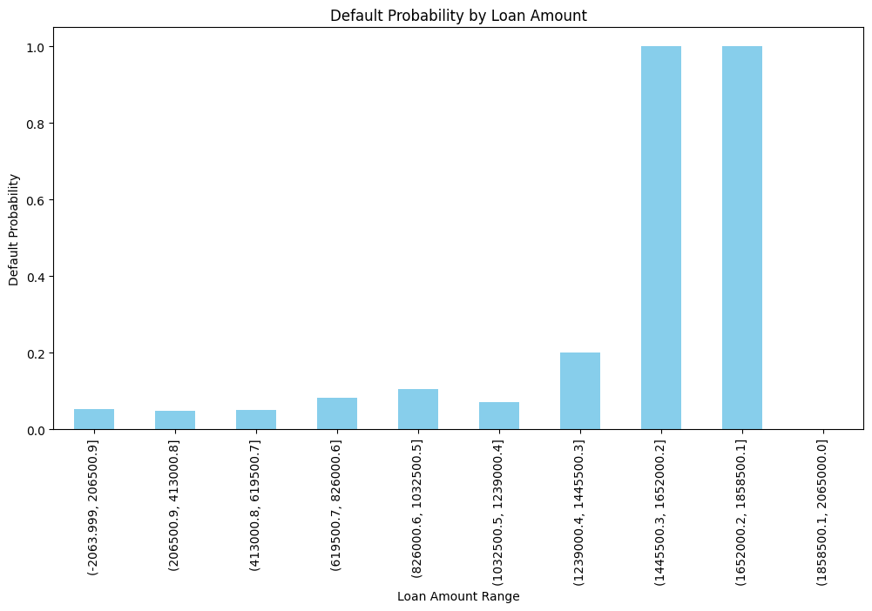
SOS Buka Project
Report
This plot highlights the probability for the Agent to default on a loan based on their loan amount.
It can be observed that loans of =>1,445,500 have a near 100% chance of default.

Slide 16
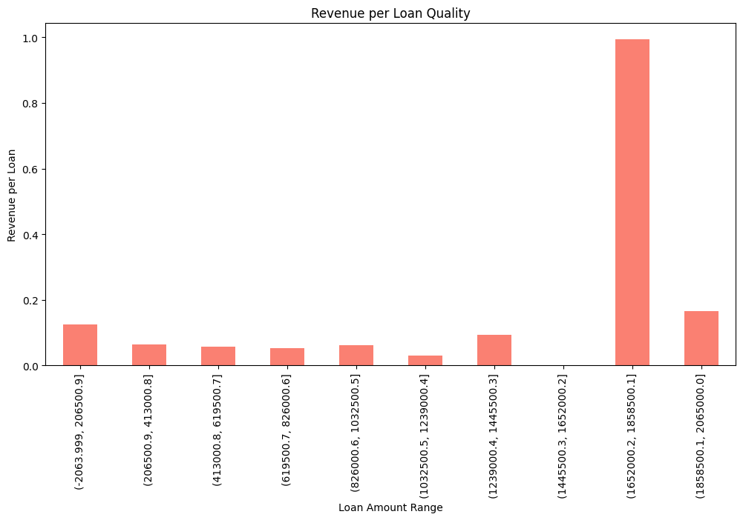
SOS Buka Project
NPL Report
This plot represents the percentage of revenue earned on a loan depending on the range of loan amount

Slide 17


Thank you
dmkirianja@gmail.com
for
https://www.turbogroupe.com/

