Slide 1
Borrower Segmentation and Credit Risk Profiling using Clustering Techniques

Slide 2
Contents
Overview
Introduction
Main Features Influencing Loan Repayment
Ranking of Important Features
Loan Customer Clusters
Clustering Visualization
Clustering Review
Recommendations
Next step(s)
Conclusion

Slide 3
Overview
Objective
Segment borrowers based on their repayment behavior and overall credit profile using unsupervised clustering.
Approach
Comprehensive data preparation and feature engineering
Application of K-means clustering and feature importance analysis
Outcome
Actionable insights for targeted risk management and tailored lending strategies
Foundation for developing early warning systems for potential loan defaults

Slide 4
INTRODUCTION
This project segments borrowers based on their repayment behavior to clearly identify credit risk levels within the business’ loan portfolio.
By grouping borrowers into low-, moderate-, and high-risk categories, we provide actionable insights to enhance risk management, tailor lending strategies, and improve loan recovery efforts.

Slide 5
Main Features influencing loan repayment
# | Feature Name | Feature Description | Correlation value
1 | Defaulted (‘is_npl’) | Binary indicator that classifies loan as performing or not | 1
2 | Age | Duration of loan in days | 0.77
3 | Days interest calculated | Number of days loan interest has been calculated | 0.75
4 | Revenue per loan | Ration of total revenue earned to the initial loan amount | 0.39
5 | Outstanding penalty fees | Penalty fees still pending payment | 0.27
6 | Outstanding daily interest | Daily interest that is yet to be paid | 0.25
7 | Penalty fees repayment | Penalty fees that has already been paid | 0.23
8 | Outstanding revenue | Sum of remaining principle, daily interest, setup fees and penalty fees yet to be paid | 0.22
9 | Loan Balance | Remaining balance of loan yet to be paid | 0.22
10 | Outstanding Setup Fees | Penalty fees that is yet to be paid | 0.2
11 | Outstanding Principle | Remaining principle amount that has not been paid | 0.19

Slide 6
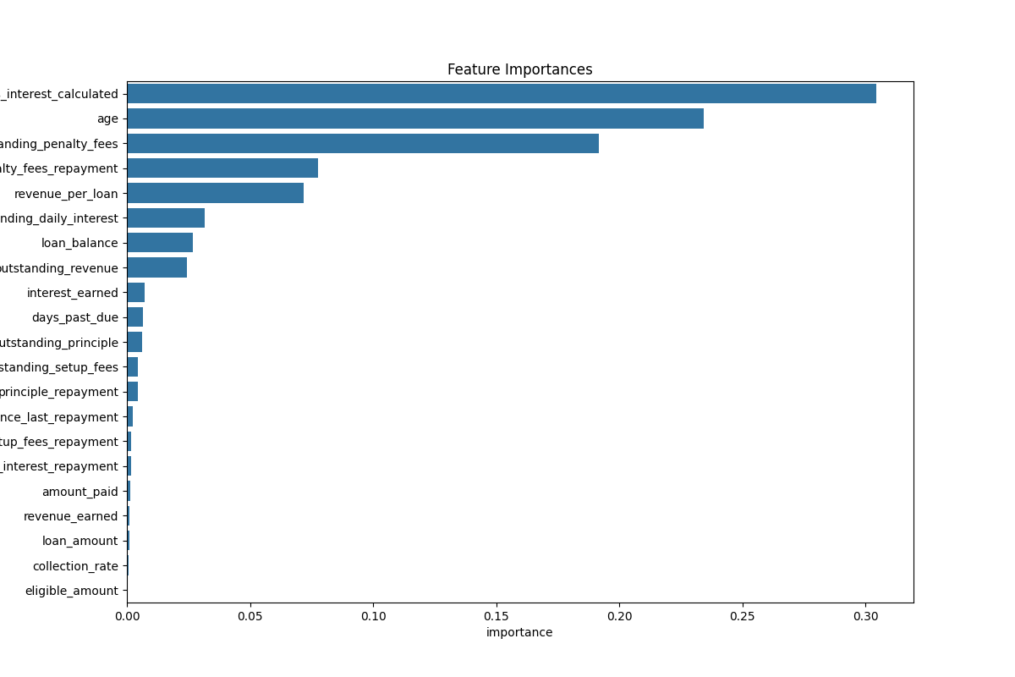
Ranking of Important Features

Slide 7
Loan Customer Clusters
The following are the four distinct segments that resulted from this analysis:
Cluster 0 (Low-risk borrowers)
Cluster 1 (High-risk Defaulters)
Cluster 2 (Moderate-risk borrowers with partial payments)
Cluster 3 (Extreme Defaulters with large loans)

Slide 8
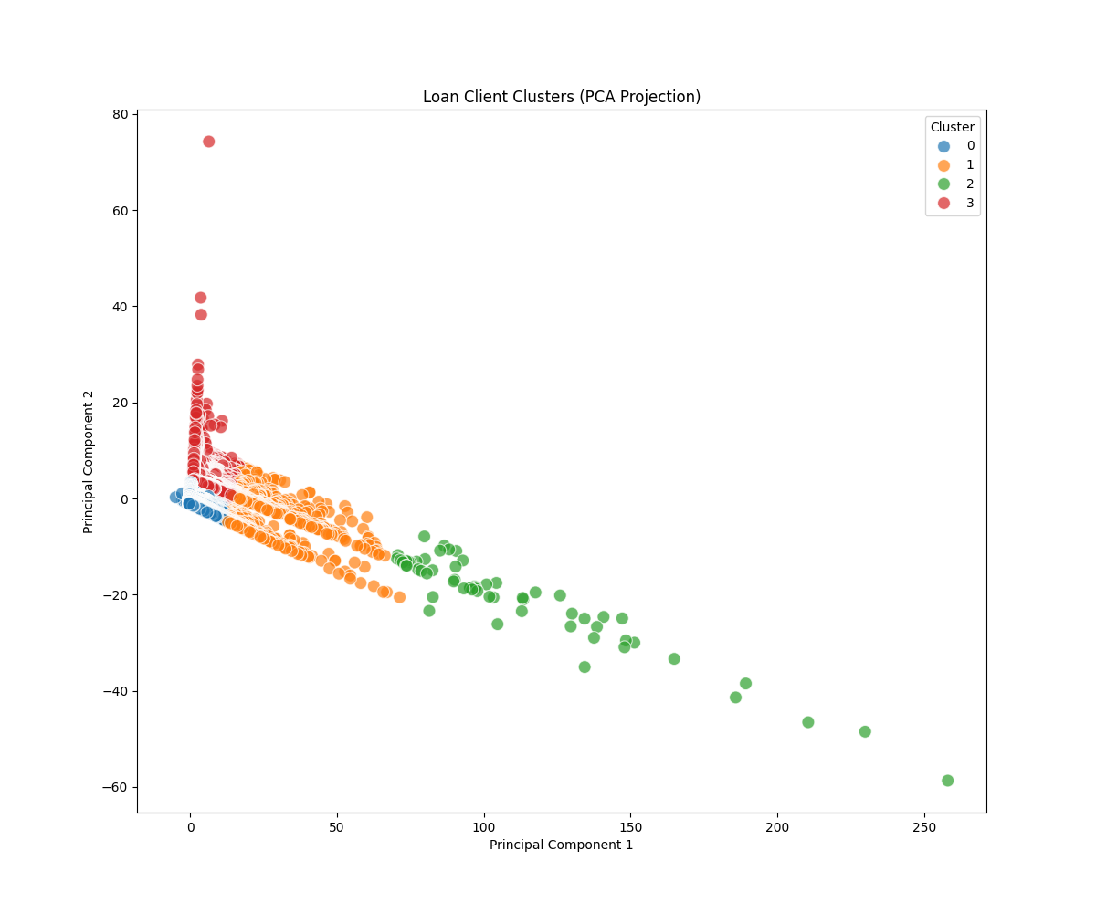
Cluster Visualization

Slide 9
Clustering Review
Cluster 0 (Low Risk Borrowers)
Short loan age
Minimal outstanding fees and low loan balances
High revenue per loan, reflecting strong repayment discipline
Cluster 1 (High Risk Defaulters)
Longer loan age and high levels of outstanding fees
Significant unpaid balances with very low revenue per loan
Indicates prolonged non-repayment behavior

Slide 10
Clusters Review
Cluster 2 (Moderate Risk Borrowers with partial payments)
Highest loan age among groups with partial repayments.
Some fee repayments observed, yet moderate outstanding balances.
Represents borrowers who are struggling but showing repayment initiative.
Cluster 3 (Extreme Defaulters with Large Loans)
Extremely high outstanding balances and fees.
Zero revenue per loan; suggests severe non-payment.
Represents the riskiest segment, potentially requiring legal action or write-offs.

Slide 11
Recommendations
Generate stricter criteria for borrowing large sums of money over extended periods(as noted in clusters 1 & 3) as this has shown to be problematic once the recovery stage is reached. These common features amongst risky borrowers should be targeted and mitigated to prevent exposure of the business to averse risk.
Generate short as well as long term strategies to recover loan book portfolio at risk. Short term strategies can include establishing incentives for early/ timely loan and fees repayments.

Slide 12
Next Step(s)
Develop an early warning loan default detection machine-learning model
Using time-series as well as sequential modelling to create a system that is able to detect and flag loans likely to go into default in the near future.

Slide 13
CONCLUSION
The analysis clearly identified distinct borrower segments—low-risk, moderate-risk, high-risk, and extremely risky—based on repayment behavior. Low-risk borrowers exhibit timely repayments and generate high revenue, while high-risk segments demonstrate prolonged non-repayment and substantial outstanding balances.
These insights enable the organization to tailor lending criteria and recovery strategies, ultimately enhancing the financial health of the loan portfolio.

Slide 14
THANK YOU
Author: David Kirianja

