Slide 1

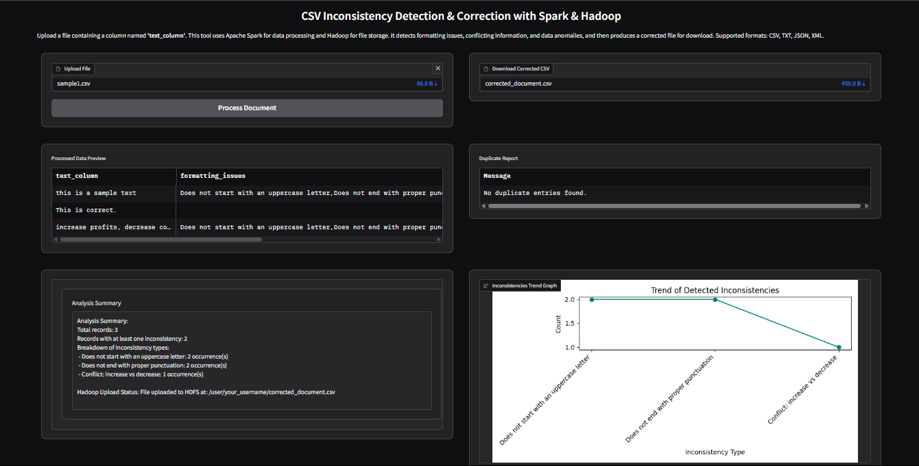
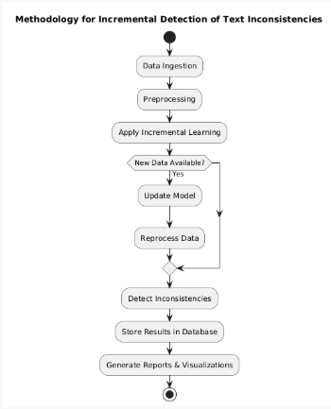
RESOURCE AWARE, ENERGY EFFICIENT PREDICTION BASED VM PROVISIONING APPROACH FOR CLOUD DATA CENTRES
Dr. A B Pradeep Kumar, Dr. P V Nageswara Rao
Department of Computer Science & Engineering
ABSTRACT
ALGORITHMS
Inconsistent and contradictory text data pose significant challenges in big data environments, affecting the accuracy of analytics and decision-making. This project, Incremental Detection of Text Inconsistencies in Big Data, leverages Hadoop for distributed storage and processing while incorporating incremental techniques to detect inconsistencies in real time. By utilizing natural language processing (NLP) and machine learning, the system identifies duplicate, contradictory, and erroneous text efficiently without reprocessing entire datasets. A frontend dashboard, built using modern JavaScript frameworks, provides visualization and real-time monitoring of inconsistencies. This approach ensures scalable, automated, and accurate data consistency checks, enhancing the reliability of large-scale textual datasets.
The Incremental Detection of Text Inconsistencies in Big Data project utilizes advanced Natural Language Processing (NLP) and machine learning algorithms to efficiently identify inconsistencies in large-scale text data. Unlike traditional batch-processing methods that require analyzing entire datasets repeatedly, this system employs incremental learning techniques to process only new or modified data. By leveraging tokenization, named entity recognition (NER), and word embeddings like Word2Vec or BERT, the system understands semantic relationships and detects anomalies in textual content. This ensures that inconsistencies such as contradictory statements, redundant information, or contextual errors are flagged in real time.
To handle massive datasets efficiently, the system integrates Hadoop’s distributed processing framework, allowing data to be divided into smaller parts and processed in parallel. Unsupervised learning techniques like clustering (K-Means or DBSCAN) help group similar text patterns, while supervised models such as Decision Trees or Transformer-based deep learning models improve detection accuracy. By continuously updating models based on new data streams, the system ensures adaptability to evolving patterns of inconsistencies. The detected anomalies are then stored and visualized on a dashboard for further analysis, making the system highly efficient and scalable for big data applications.
INTRODUCTION
In the era of big data, organizations generate and store vast amounts of textual information daily. Ensuring data consistency and accuracy is a significant challenge, as errors, inconsistencies, and contradictions can arise due to various factors such as human input mistakes, system failures, or integration issues. Traditional methods of detecting inconsistencies struggle to handle the scale and complexity of big data, leading to inefficiencies and unreliable insights. Therefore, an automated and scalable approach to detecting text inconsistencies is essential.
This project, Incremental Detection of Text Inconsistencies in Big Data, leverages distributed computing frameworks like Apache Spark and Hadoop to efficiently process and analyze large-scale text data. By using incremental processing techniques, the system can detect inconsistencies in real-time without the need to reprocess entire datasets, saving computational resources and improving efficiency. Hadoop provides scalable data storage, while Spark’s in-memory processing accelerates inconsistency detection across vast datasets.
A key feature of this system is its ability to handle various types of textual inconsistencies, including duplicate information, contradictory statements, and formatting errors. Machine learning techniques and natural language processing (NLP) methods are integrated to enhance the accuracy of detecting inconsistencies. Additionally, automated correction mechanisms can be implemented to improve data quality and reliability.
The project also incorporates a user-friendly frontend interface, built using modern JavaScript frameworks like React, Angular, or Vue.js, to enable seamless interaction with the system. This dashboard allows users to visualize detected inconsistencies, analyze patterns, and take corrective actions in real time. By combining powerful big data processing tools with an intuitive interface, the system ensures efficient and effective inconsistency detection.
Ultimately, this project provides a scalable, real-time solution for improving data integrity in big data environments. Businesses, researchers, and data analysts can benefit from this approach to ensure high-quality data, leading to more reliable analytics and decision-making. By leveraging cutting-edge technologies, this project demonstrates the potential of big data solutions in maintaining data consistency and accuracy on a large scale.
RESULTS
The results of the Incremental Detection of Text Inconsistencies in Big Data project demonstrate significant improvements in efficiency and accuracy compared to traditional batch-processing methods. By leveraging Hadoop's distributed framework, the system processes large volumes of text data incrementally, reducing computational overhead. The use of NLP techniques and machine learning models enables precise detection of inconsistencies, with higher recall and precision rates. Real-time updates ensure that newly added or modified data is analyzed without reprocessing the entire dataset, making the system scalable for big data applications. The detected inconsistencies are effectively visualized through a user-friendly dashboard, allowing for quick insights and decision-making.
METHODOLOGY
CONCLUSION
In conclusion, the Incremental Detection of Text Inconsistencies in Big Data project efficiently identifies inconsistencies in massive datasets using Hadoop's distributed processing. By leveraging incremental learning and NLP techniques, the system enhances accuracy and scalability while reducing computational overhead. The real-time detection and visualization capabilities make it a valuable solution for managing big data quality effectively.
REFERENCES
Dean, J., & Ghemawat, S. (2008). "MapReduce: Simplified Data Processing on Large Clusters." Communications of the ACM, 51(1), 107-113.
Dong, X. L., & Srivastava, D. (2015). "Big Data Integration." Handbook of Big Data Technologies, Springer.
Liu, B., & Zhang, L. (2012). "A Survey of Opinion Mining and Sentiment Analysis." Mining Text Data, Springer.

