Slide 1

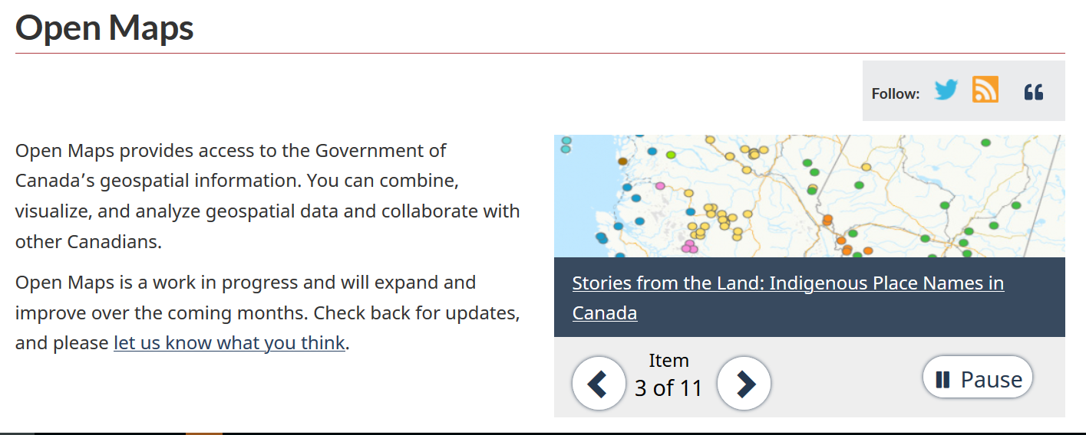







Metadata point of view
P/T Portals
Metadata processing
FGP Catalogue
Open Federal Portals
OpenMaps
Metadata Delta finder
Automated Language Translation
Metadata Model Mapping
Metadata Filtering
OSDP
Notes:
P/T portals comments:
Metadata are avalaible from P/T portal through different API/ Services. As an example, BC and QC portal are using CKAN API and AB is using OGC-CSW access point
P/T portals contain more than geospatial content and metadata are avalaible under multiple licences
Metadata processing comments:
Automated process developped using FME server tehcnology and hosted in FGP AWS Cloud infrastructure
80 % code reusability province by province
Step1 : Metadata filtering: Use to only synchronize geospatial datasets distributed under specific provincial licence (OGL-BC, OGL-AB, CC-BY)
Step2 : Metadata mapping. Transforming provincial metadata to be compliant with Federal HNAP metadata standards . Actions include new fields name, attribute values mapped to codelisted values, url fixes, default values,…
Step: 3 Metadata Delta Finder: To be more cost effective, our solution is working with Delta. The HNAP-transformed provincial metadata are compared to avalaible provincial datasets in the FGP to identify delta. (Unchanged, new metadata, removed metadata, updated metadata). ( First sycnrhonization will be all new metadata)
Step 4: Updated and new metadata are translated(English to French / French to English) using AWS Translate technology. Warnings are added in the metadata to inform user of the use of an automated translation technology, possible translation mistakes…
FGP Catalogue comments
New and updated metadata are transfered into the FGP to be added in both internal and external catalogue
Removed provincial dataset are dropped from both internal and external catalogue
Open Federal Portals:
When added in FGP portal, P/T metadata are considerered similar as Federal metadata.
Datasets are transfered to OpenMaps with FGP regular process (PUSH) . OSDP portal harvests metadata from external CSW access point.

Slide 2
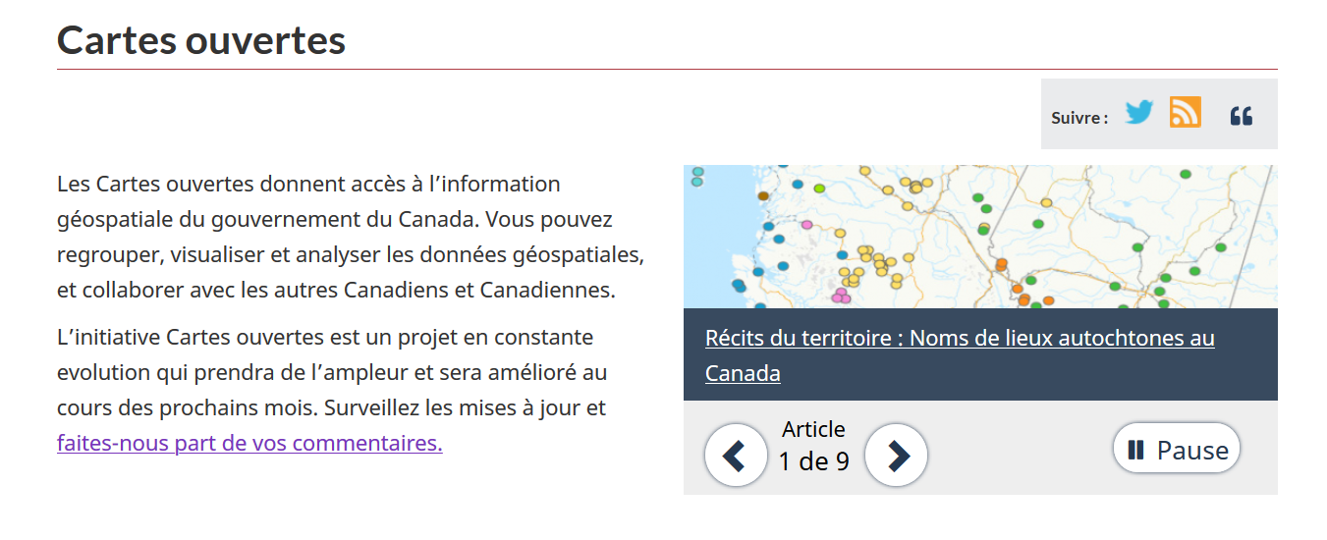




Technical details
AWS
Manual load
Traduction
Conforme HNAP
Harverter
Interne
Externe
CSW

