Slide 1
Canada’s Federated Search project
Natural Resources Canada- Federal Geospatial Platform
Nicolas Gariépy, Eng

Slide 2
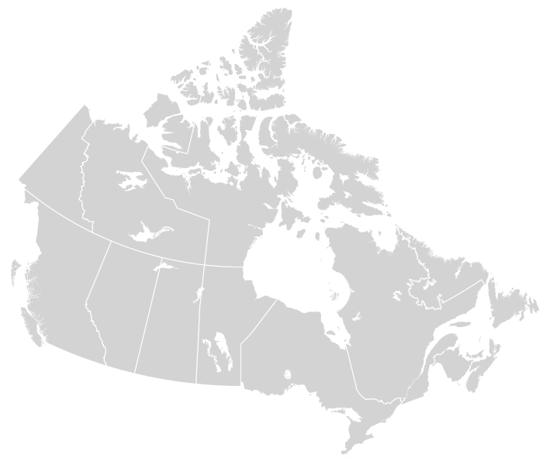
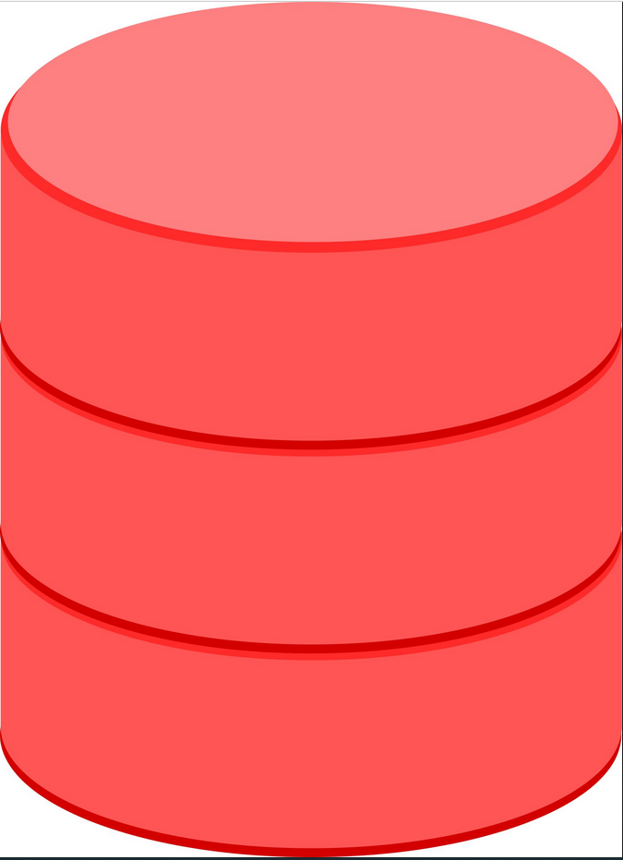
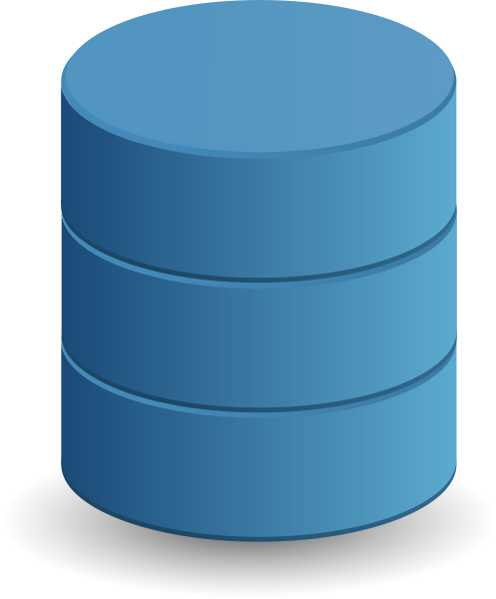

Open Data in Canada
Multiple Sources of Open Data in Canada
Federal Governement
Provincal/territorial Governments
Municipal Governments

Slide 3


User’s journey to access Open Data
Study of carpooling impacts on reducing air and water polution in St-Lawrence River.
Where can I find information? There are too many portals
Grr.. It would be easier for me if the information was at the same place

Slide 4

Federated Search, Canada’s one-stop portal for Open Data
P/T data stored in Canada’s data wharehouse
Data volume and complexity
Synchronization
Ownership
…
P/T data discoverable from Canada’s portal
Metadata injestion

Slide 5

Project: Federated Search Parameters
The data stays where it is. Only metadata is integrated into our systems
Connects to P/T medadata API
Integration of open license datasets compatible with Canada’s Open Government Licence only
Distributed with the original license
Automated process, weekly updates
Metadata automatically translated via artificial intelligence to support official languages

Slide 6
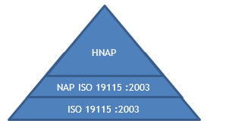
Metadata model in Canada’s portal
Support bilingual content
Geospatial content
HNAP ISO19115:2003
Regular content
CKAN-extCA (dublin core)
https://github.com/open-data/ckanext-canada

Slide 7
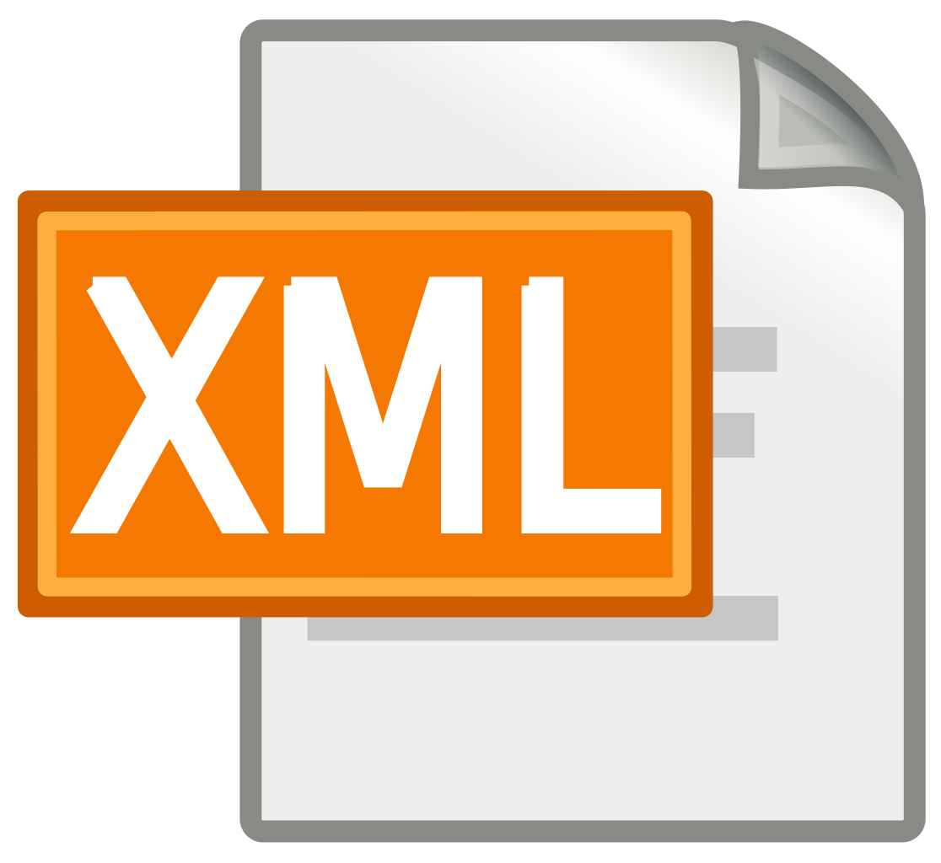





Injestion process
Working data model
PNAH-
ISO19115:2003
Provincial/ Territorial
License filtering
Geo content
Insert/ Update
Geo vs non-geo
Meta
Format
Type
ID
Unilingual model
CKAN-extCA
Non-geo content
Insert/Update
One portal/
one metadata model
Various technologies (CKAN, DKAN, Socrata…)
Geo
HNAP
Non Geo
CKAN-extCA
Delta
+
MAJ
-
Ø
Execution report
Delete
Configuration file to update
Translation
en→fr / fr→en

Slide 8
Project: Lessons Learned
Some issues to overcome
Each province has its own data model
Being compliant with standard helps interoperability
Usage vs compliance
Semi-bilingual metadata in a unilingual model
Non plain text metadata distribution

Slide 9
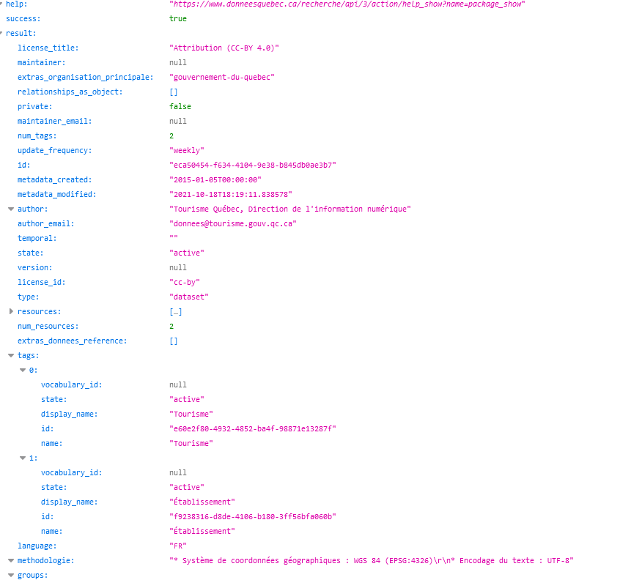
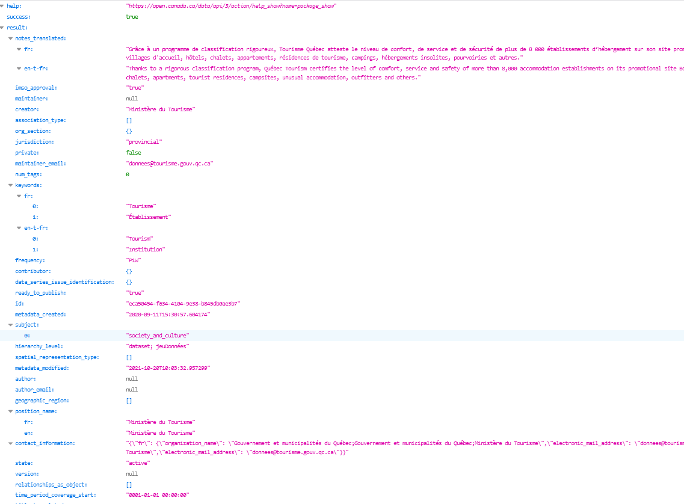
Demo
https://www.donneesquebec.ca/api/action/package_show?id=eca50454-f634-4104-9e38-b845db0ae3b7
https://open.canada.ca/data/api/action/package_show?id=eca50454-f634-4104-9e38-b845db0ae3b7

Slide 10
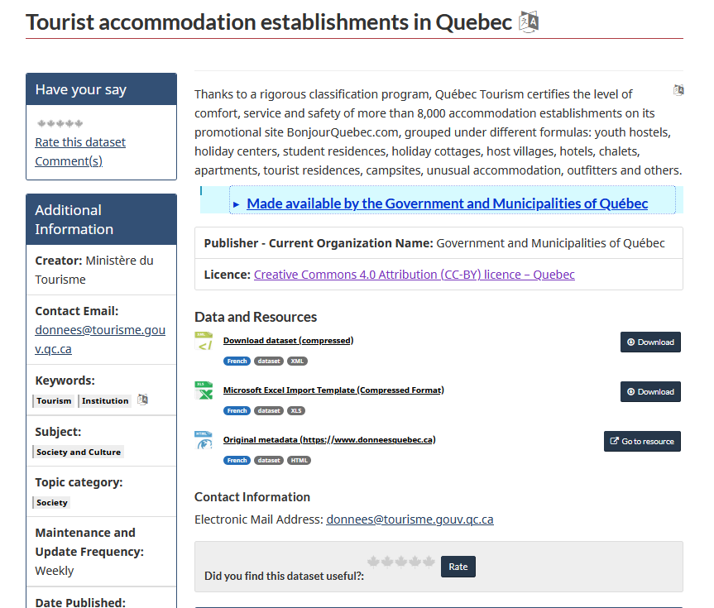
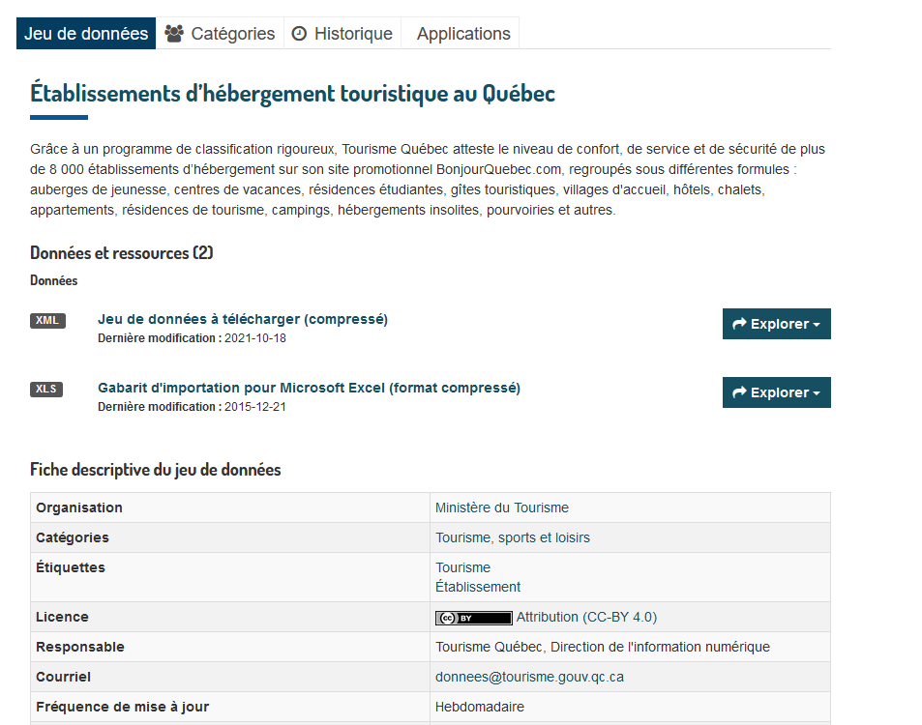

Demo
https://open.canada.ca/data/en/dataset/eca50454-f634-4104-9e38-b845db0ae3b7
https://www.donneesquebec.ca/recherche/fr/dataset/eca50454-f634-4104-9e38-b845db0ae3b7

Slide 11

Annex: Plans for full P/T inclusion
Partners | Portal | Geo integration | Non geo integration
British Columbia | https://data.gov.bc.ca | (500 +) | 2022-23
Alberta | https://open.alberta.ca/opendata | (1600 +) | 2022-23
Ontario | https://data.ontario.ca | (280 +) | (440 +)
Québec and municipalities | https://www.donneesquebec.ca | (680 +) | (540 + )
Yukon | https://open.yukon.ca/data | (490 + ) | 2021-22
New-Brunswick | https://gnb.socrata.com/ | (50 + ) | 2021-22
Nova-Scotia | https://data.novascotia.ca | 2021-22 | 2021-22
Prince Edward Island | https://data.princeedwardisland.ca | 2021-22 | 2021-22
Saskatchewan | https://geohub.saskatchewan.ca | 2021-22 | 2021-22
Manitoba | https://geoportal.gov.mb.ca | 2021-22 | 2021-22
Newfoundland and Labrador | https://opendata.gov.nl.ca | 2022-23 | 2022-23
Northwest Territories | https://www.geomatics.gov.nt.ca | 2022-23 | 2022-23
Nunavut | ? | ? | ?

Slide 12
Thank you, and connect with us!
Nicolas Gariépy, Eng
nicolas.gariepy@nrcan-rncan.gc.ca
https://open.canada.ca/en/open-data

Slide 13
© Sa Majesté la Reine du chef du Canada, représentée par le ministre des Ressources naturelles, 2021

