Slide 1
CORPORATE TAXATION I seminar
JEM203 - Public Economics - IES
Daniel Kolář
daniel.kolar@fsv.cuni.cz

Slide 2
OUtline
Exercise on tax optimisation
Data sources
CBCR
CCCTB

Slide 3
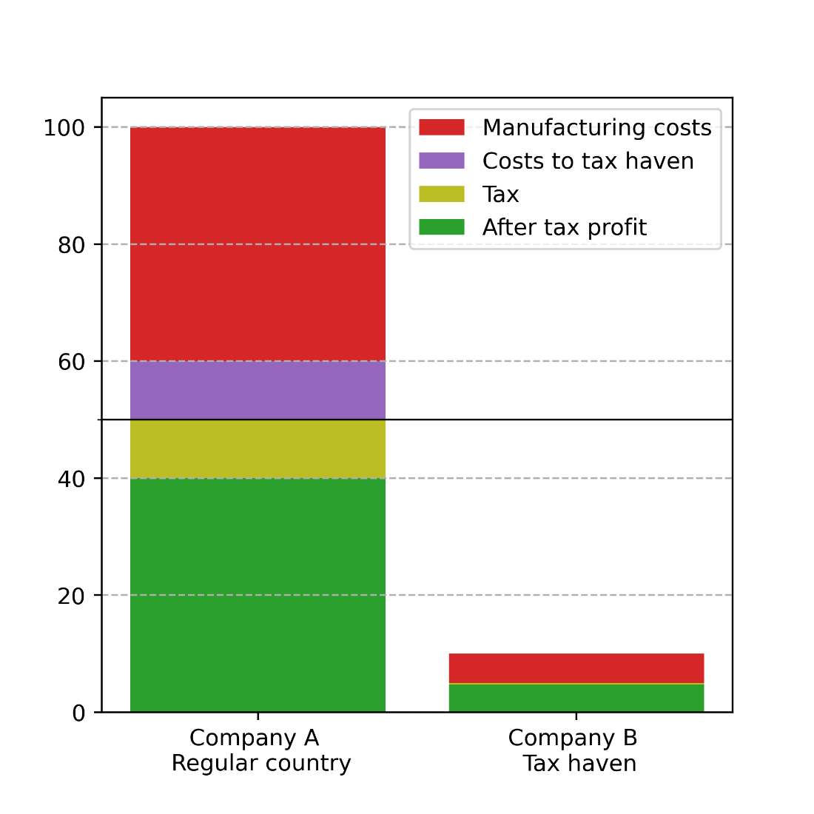
EX. 1: Tax optimisation of MNCs
Setup:
Two subsidiaries of the same parent company
Two countries: Regular and Tax haven
Tax rate in regular country: 20%
Tax rate in tax haven: 5%
Subsidiary A buys input from subsidiary B at a transfer price of 10
What would you do?
transfer price

Slide 4
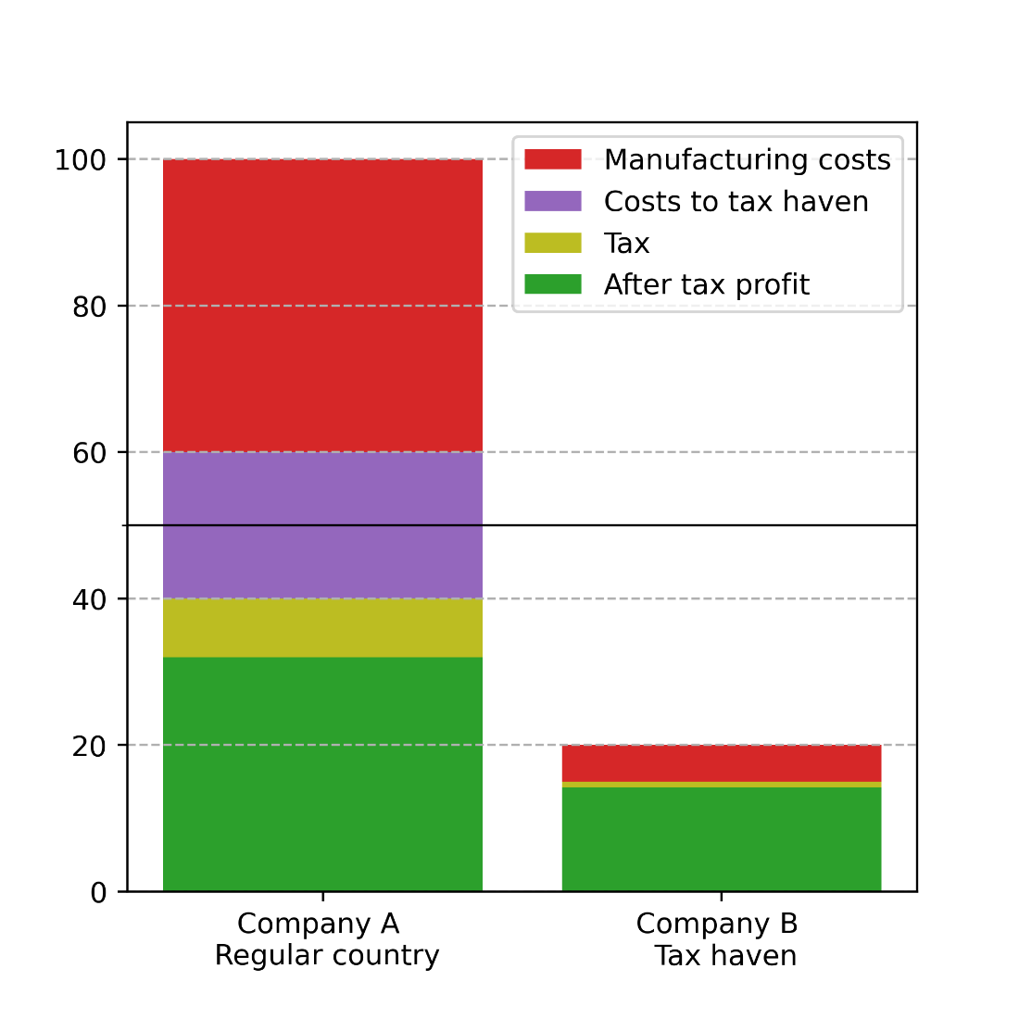
Increase transfer price FROM 10 to 20

Slide 5
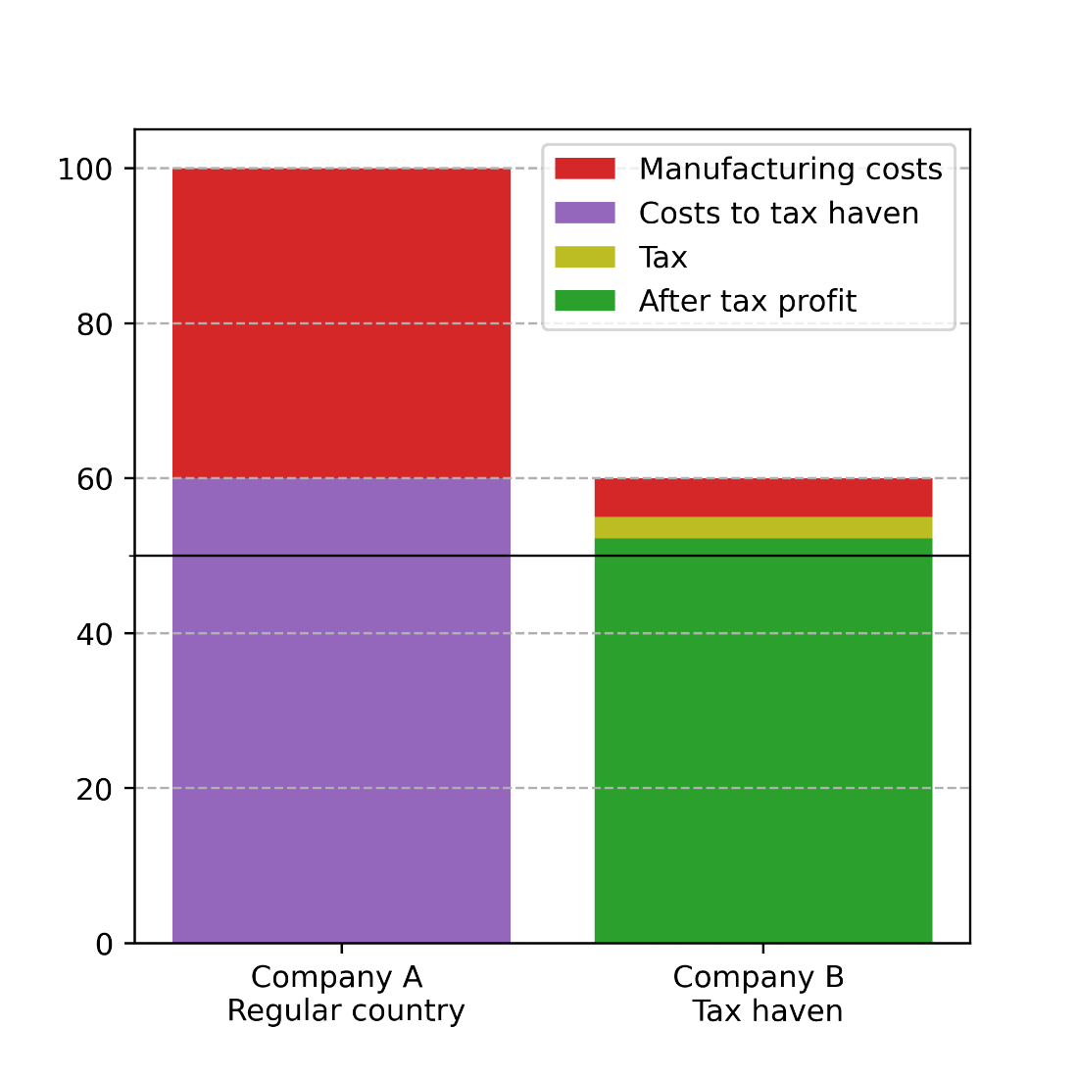
Increase transfer price FROM 10 to 60

Slide 6
Winners and losers
Losers:
Government of the Regular country: Tax revenue decline from 10 to 0
Winners:
The multinational company: Total after-tax profit increase from 44.75 to 52.25
Government of the Tax haven: Tax revenue increase from 0.25 to 2.75
“By taxing the large amount of paper profits they attract at very low rates (typically less than 5%), tax havens generate more tax revenue, as a fraction of their national income“ (Torslov et al, 2020)

Slide 7
IS profit shifting costless?
Firms may need to set up additional facilities to make transfer prices seem plausible, legal costs may be incurred, and (inefficient) intrafirm trades may take place to facilitate profit-shifting (Hines & Rice, 1994)
Note: There are two other, in principle similar ways to shift profits: intra-company loans and location of intellectual property.
See lecture, Zucman (2014) or Torslov et al (2020)

Slide 8
IS THIS LEGAL?
de iure: MNCs are required to follow the arm‘s length principle
intra-company transactions should reflect the market price (and not the tax rates)
de facto: Comparable market price may not be easily available; The principle may be difficult to enforce.
We need to look at the data

Slide 9
data to study profit shifting
Two classes of data:
company-level microdata
macrodata in the National Accounts
This seminar focuses on the former, for the latter see Torslov et al (2020)

Slide 10
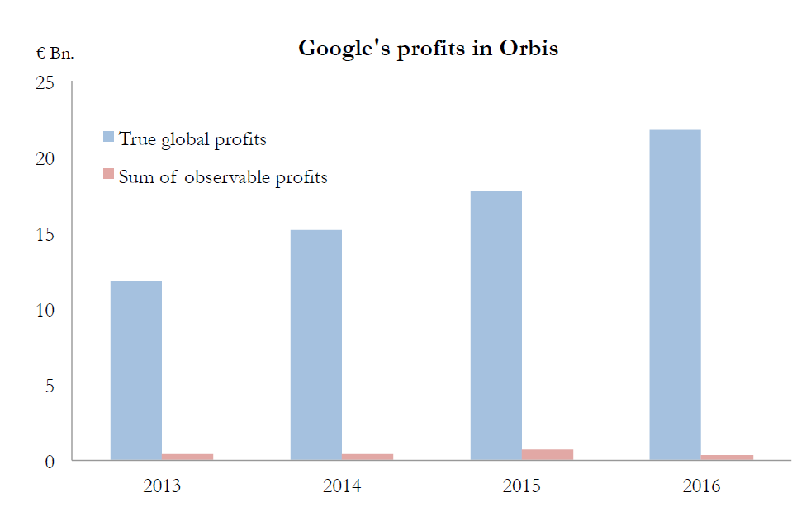
ORBIS
Database of accounting micro-data collected by Bureau van Dijk
Uses data from public business registries
Problem: Their quality varies from country to country
France: good coverage
Bermudas: no such registry exists
US, Ireland: contains no income information
Orbis useful for consolidated data, but many subsidiaries are missing
source: Torslov et al (2020)

Slide 11
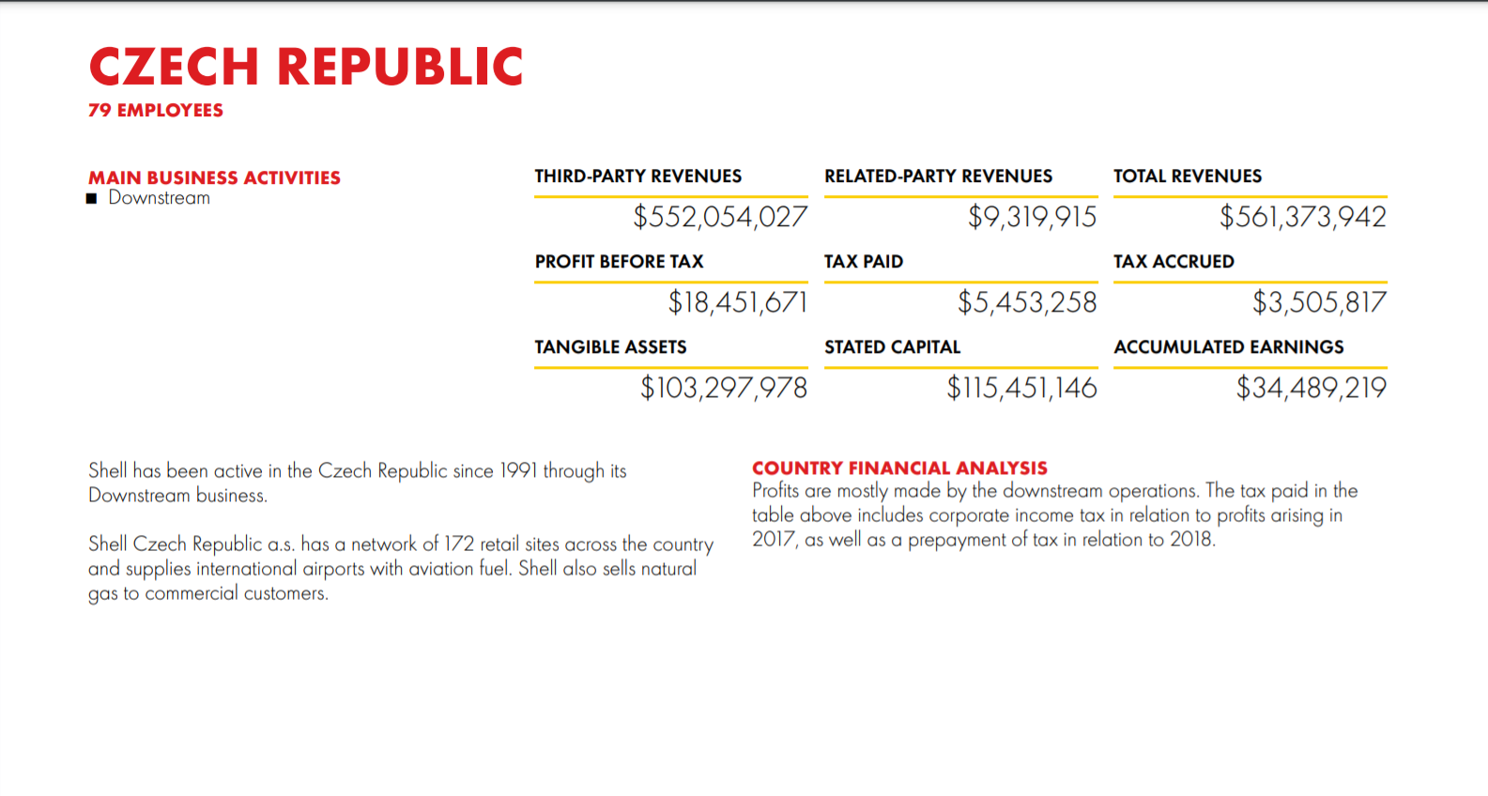
country-by-country reporting
OECD Base Erosion and Profit Shifting (BEPS)
2015 OECD initiative to fight tax evasion
Action 13 requires all large MNCs to report to tax authorities basic accounting statistics for each country separately
Third-party revenues, related-party revenues, profit, tax, stated capital, number of employees

Slide 12
CBCR Data sources
CBCR data is generally not public, with a few exceptions:
Banks and mining and forestry companies in the EU, based on industry-specific legislation
Janský (2020)
Some firms publish this information voluntarily (e.g. Shell, Vodafone)
Recently, the IRS and OECD began to publish aggregated CBCR data
Garcia-Bernando et al (2021), Garcia-Bernando & Janský (2021)
Initiative at the EU level: Public country-by-country reporting
Currently in the legislative process

Slide 13
CASe study: CBCR data of Us multinationals
Published by the IRS
https://www.irs.gov/statistics/soi-tax-stats-country-by-country-report
Aggregated for US multinationals
Separate data for subsidiaries with positive profits
Data analysis: https://github.com/Dan-Kolar/CBCR/blob/main/CBCR_Seminar_2022.ipynb
Data: https://github.com/Dan-Kolar/CBCR/blob/main/irs_cbcr.csv

Slide 14
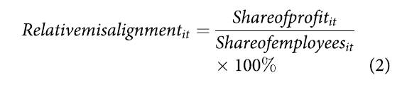
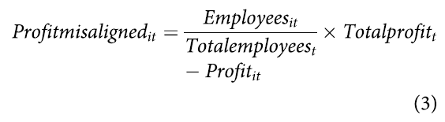
Profit misalignment models
Relative misalignment (%) (Janský, 2020):
If all profits were aligned perfectly with the number of employees, the relative misalignment would produce values of 100% for all countries.
Profit misaligned ($) (Janský, 2020):
Can also be defined as -1*formula (Garcia‑Bernando, Janský and Tørsløv, 2021)
We can use other measures of real activity, or a composite indicator

Slide 15
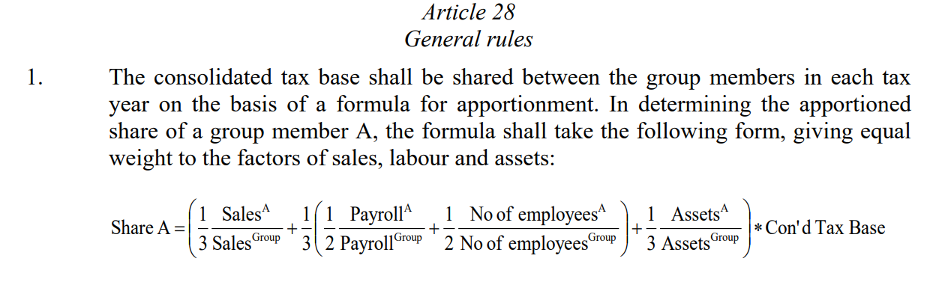
CCCTB
Common consolidated corporate tax base
Introduced by the EC in 2011, re-introduced in 2016
First step: CCTB - Common corporate tax base
i.e. common rules to calculate the tax base

Slide 16
Evaluating the ccctb
Loss consolidation - 21% decrease in profits
EU only – what about tax havens outside the EU?
Redistributive impacts will depend on the formula
e.g. Czech Republic won‘t like the wage component
zero-sum game
EU tax legislation requires unanimity at the Council of the EU (i.e. all 27 MS must vote in favor)
In contrast, accounting directives (such as public CBCR) only require qualified majority
=> off the table now

Slide 17
New proposal: GLOBE
G20/OECD project: Inclusive Framework for BEPS.
Global Anti-Base Erosion Tax
OECD Pillar Two
Setting a minimum effective tax rate
Targeting misallocated profits that are undertaxed; allocated to ultimate parent country
Approved (15 %) and on its way!
Picciotto et al (2021) For a Better GLOBE. METR: a Minimum Effective Tax Rate for Multinationals.
Misallocated profits allocated according to real economic activity instead
Does not require consensus among all states

Slide 18
References
Cobham, A., & Janský, P. (2017). Global distribution of revenue loss from tax avoidance. Re-estimation and country results (UNU-WIDER Working Paper No. 55) (pp. 1–28). Helsinki: UNU-WIDER.
Garcia-Bernando, J., & Janský, P. (2021). Profit Shifting of Multinational Corporations Worldwide. Working paper.
Garcia-Bernando, J., Janský, P., & Tørsløv, T. (2021). Multinational corporations and tax havens: evidence from country-by-country reporting. International Tax and Public Finance, 1-43.
Hines Jr, J. R., & Rice, E. M. (1994). Fiscal paradise: Foreign tax havens and American business. The Quarterly Journal of Economics, 109(1), 149-182.
Janský, P. (2020). European banks and tax havens: evidence from country-by-country reporting. Applied Economics, 52(54), 5967-5985.
Picciotto, S., Faccio, T., Kadet, J. M., Jansky, P., Cobham, A., & Garcia-Bernardo, J. (2021). For a Better GLOBE. METR: a Minimum Effective Tax Rate for Multinationals. (March 2, 2021).
Tørsløv, T. R., Wier, L. S., & Zucman, G. (2020). The missing profits of nations. Working paper.
Zucman, G. (2014). Taxing across borders: Tracking personal wealth and corporate profits. Journal of economic perspectives, 28(4), 121-48.

