Slide 1
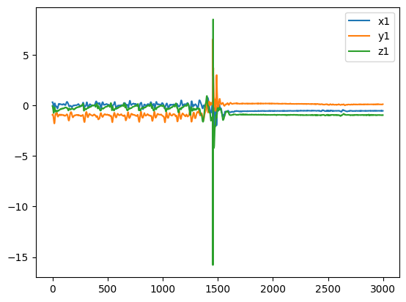
Using deep learning MLP to detect fall
Data - SisFall
- 23 adults, 15 seniors
- 20 typical daily situation (non fall)
- 15 fall situations (adults)
- 5 repeats for most situations

Slide 2
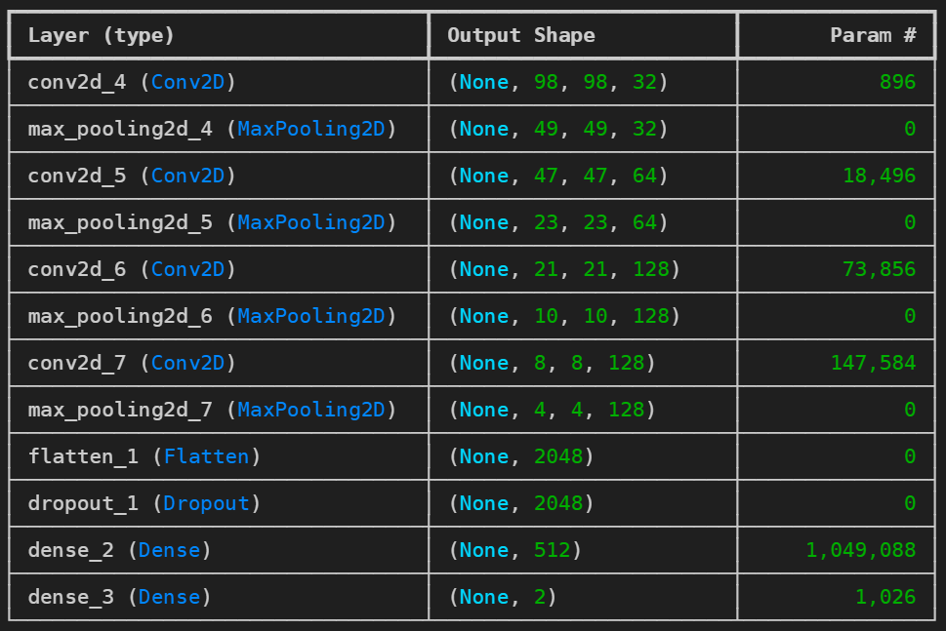
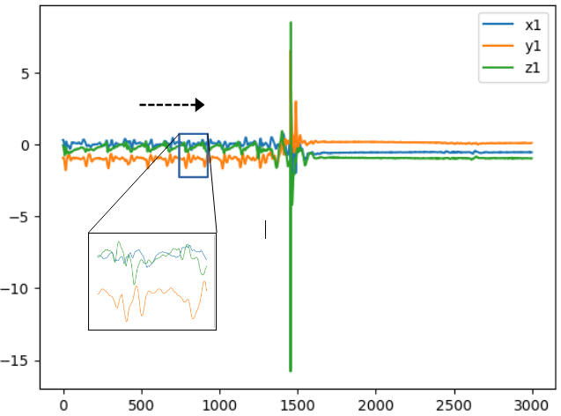
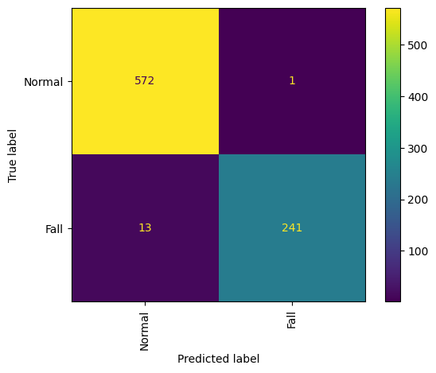
Deep learning MLP
Sliding window.
- 58 365 samples (56878 normal, 1487 falls)
- Bias adjustment (2640 normal 1487 falls):
2639 test, 661 validation 827 test set

Slide 3



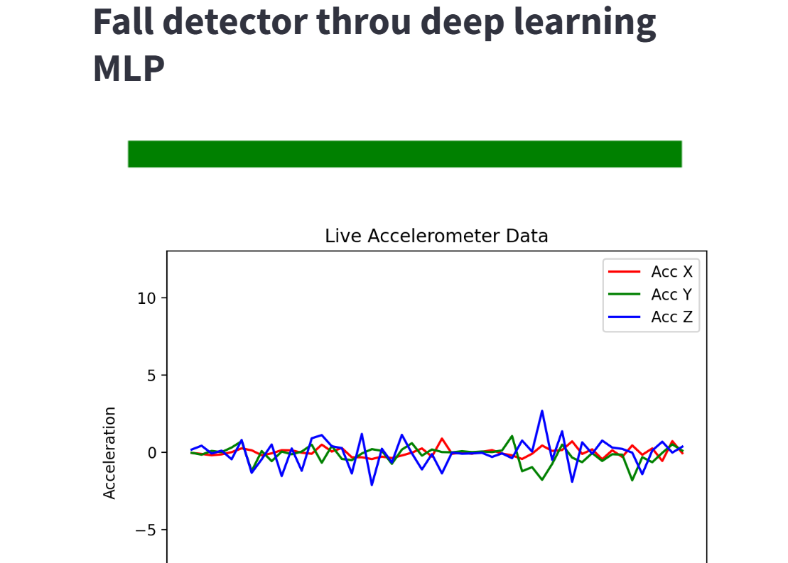


Realtime
MLP

