Slide 1
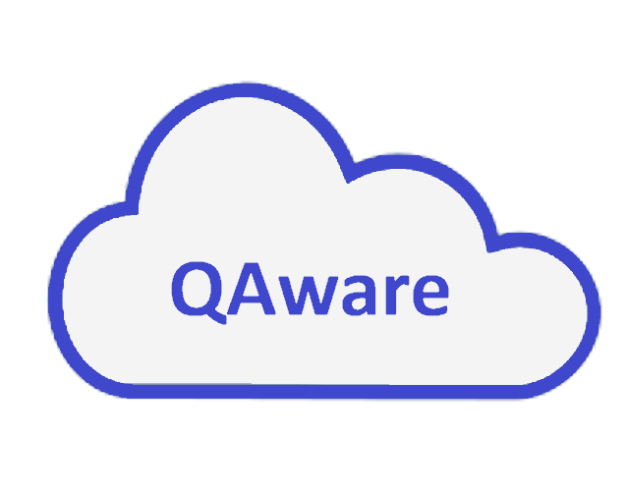
Daniel Nguyen, Shulun Sun, Momen Yacoub
QHacks
Safety in Community
7/28/2021
v1

Slide 2
Active Drowsy Driving Prevention System
1, Nothing like this on market:
lane departure warning system, autopilot, collision detection, but none actively monitors the state of the driver.
2, why we need it?
NHTSA estimates that in 2017, 91,000 police-reported crashes involved drowsy drivers. These crashes led to an estimated 50,000 people injured and nearly 800 deaths.

Slide 3


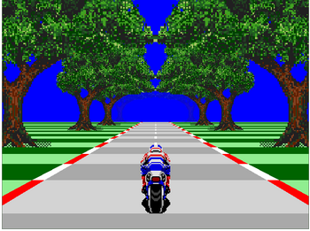

Pipeline
Video stream processing
Simulation
Face recognition
Facial landmarks
Extract eye
When the algorithm detects that the driver is falling asleep, it acts to prevent drowsy driving:
1, alarm will sound
2, automatically pulls over
Sleep detection: closed eyelids

Slide 4
Demo:
Project link: https://github.com/Dan-Yell-Nuwin/QAware
Thank you!

