Slide 1
Reinforcement learning dr. Ayal taitler Final project presentation Dani Mirkin, Itai Kohn, amit twik 318720711 209372192 302995949
4/8/2025

Slide 2
Background & Motivation
Active object localization offers iterative refinement of bounding boxes via RL agents, mimicking human visual attention
Traditional detectors perform one-shot detection
SaRLVision integrates saliency ranking with a DQN agent
but suffers from:
Discrete, coarse action space
Sparse and non-differentiable reward signals
Our goal:
Explore enhancements to the framework using modern RL methods

Slide 3
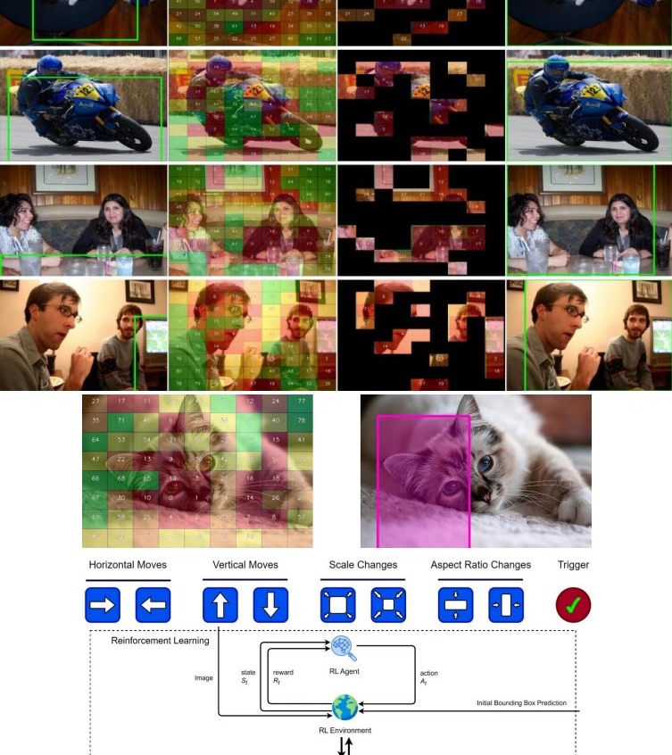
SaRLVision OVERVIEW
Two-stage architecture:
SaRa (Saliency Ranking): produces initial bounding box proposals
DQN agent: refines boxes through 9 discrete actions:
8 spatial transformations (move/scale/aspect)
+1 trigger action to stop
Key Limitations:
Discrete action space → imprecise localization
Sign-based rewards → sparse, unstable training
No support for continuous control or gradient-based feedback

Slide 4
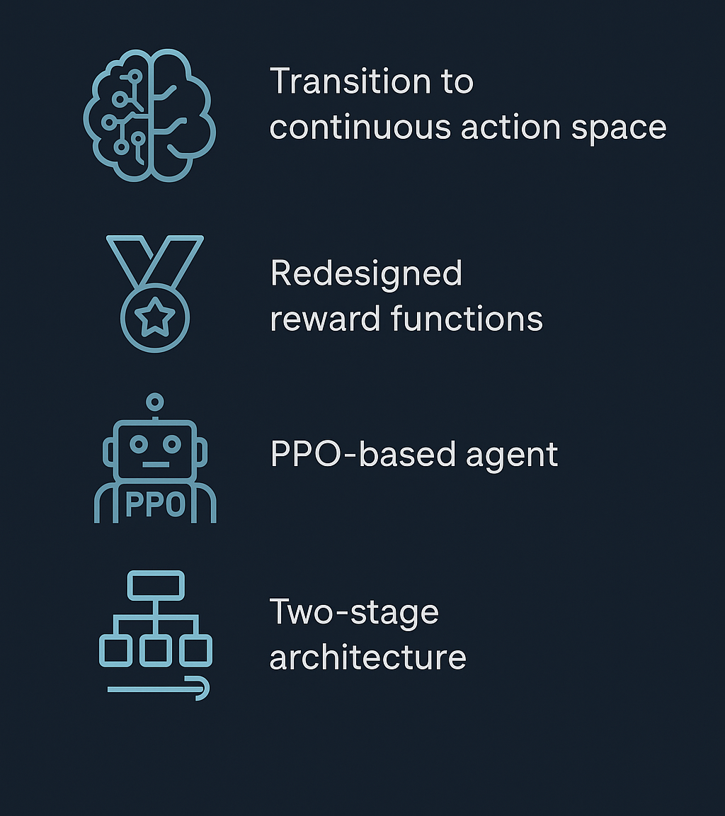
Our contributions
Replace DQN with PPO, enabling stable & expressive learning
Maintain discrete actions first, then extend to
continuous action space
Redesign reward function to be:
Continuous
Differential
Aligned with policy-gradient methods
Tested multiple architectures and reward variants under controlled settings

Slide 5
PPO & Continuous action space
PPO replaces DQN → supports policy gradient learning
Actor–Critic architecture for better stability
Initially retained discrete action space for comparability
Then extended to 5D continuous actions
Δx, Δy → translation
Δw, Δh → scaling
Trigger → termination confidence
Enabled finer bounding box control

Slide 6
Reward design variants
Original function:
Sign-based ΔIoU
Binary trigger reward
Redesigned reward types:
Continuous ΔIoU + quadratic trigger (Reward-1)
Squared IoU loss (Reward-2)
Size penalties + improvement bonus (Reward-3)
Goal: smooth, informative feedback for PPO

Slide 7
Dataset & preprocessing
Dataset:
Pascal VOC 2007 + 2012
Filtered to only "cat" class
Ensures focused and controlled evaluation
Preprocessing:
Used pretrained VGG16 / ResNet50 for feature extraction
State includes visual features + action history
Bounding boxes normalized to fixed range
Optional: SaRa module for initial bounding box proposals

Slide 8

PPO Configurations Evaluated
7 PPO configurations combining:
CNN backbone: VGG16 / ResNet50
Reward type: 0, 1, 2, 3
With / without SaRa
Discrete vs. continuous action space
All trained for 20 epochs on local CPU
Same environment & hyperparameters for fair comparison
Notes:
צריך להוסיף פה במלל אולי את כל הקונפיגורציות

Slide 9
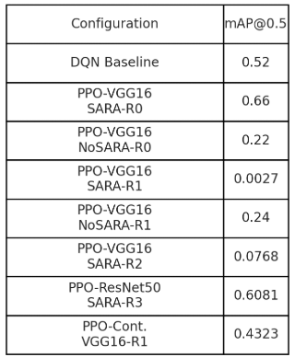
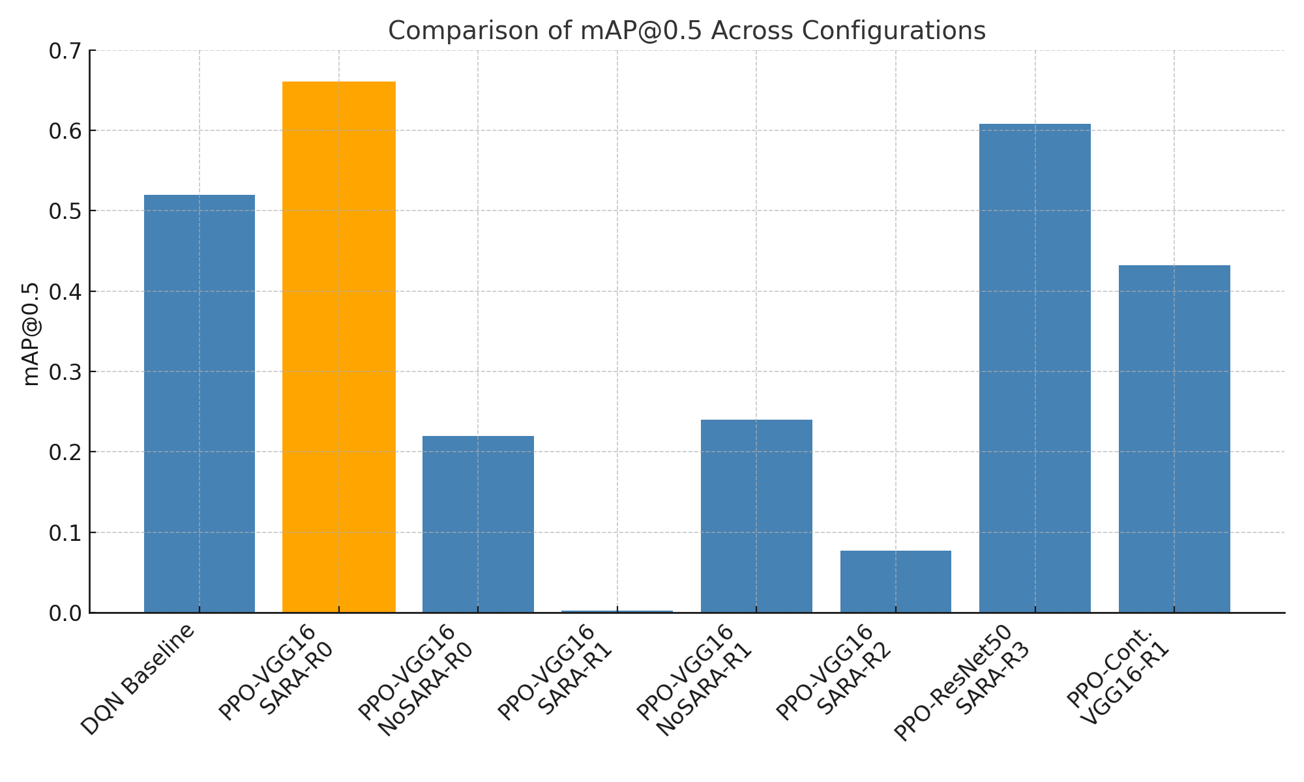
Quantitative results
Best result: PPO-VGG16-With-SARA-Reward-0 → mAP = 0.66
Comparison to DQN baseline: Baseline mAP = 0.52
PPO configs sometimes outperformed it, but not consistently
Reward-1 performed poorly in some runs
ResNet50 + Reward-3 performed consistently well

Slide 10
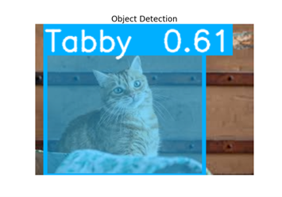
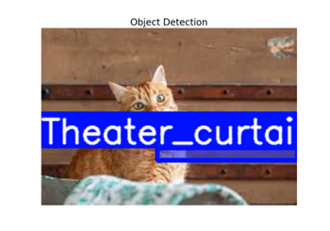
Qualitive results
PPO-VGG16-With-SARA-Reward-0
Correctly detected a Tabby cat
Confidence score: 0.61
Bounding box covers the object reasonably well, slightly oversized
PPO-VGG16-With-SARA-REWARD-1
Completely incorrect localization
Misclassified as Theater_curtain
Illustrates instability caused by poorly tuned continuous reward
Notes:
אני אוסיף שאלות ותשובות אפשריות בכל שקף, ובעיקר הסברים למה דברים לא עבדו

Slide 11
Conclusions
PPO-based agents show potential to outperform DQN in some configurations
Best result: mAP@0.66 using PPO + VGG16 + SaRa + baseline reward
Continuous action space improves flexibility but requires tuning
Reward design plays a critical role in training stability and final performance
No single configuration dominated across all metrics

Slide 12

limitations
Computational constraints:
No professional GPU access — all training done on local CPU, limiting runtime and exploration
Training instability:
Some reward configurations (e.g., loss-based) led to convergence issues
Limited hyperparameter tuning:
PPO parameters were not exhaustively optimized due to time constraints
Dataset scope & limited time:
Evaluated on a single class ("cat") and not validated on real-world noisy scenes
Notes:
צריך להוסיף פה במלל אולי את כל הקונפיגורציות

Slide 13

Future work & closing remarks
Longer training and use of real-world datasets
Explore alternative RL algorithms (e.g., SAC, TD3)
More robust ablation studies on feature extractors and state design
Multi-object extension: sequential detection of multiple instances
Optimize for real-time / embedded deployment (e.g., quantized models)
Notes:
להסביר ולגבות פה כל שורה

