Slide 1
Mastery Project No 1
Globox A/B test
In this project, we will analyze the results of an A/B test and create a report of data-driven recommendations based on our findings

Slide 2
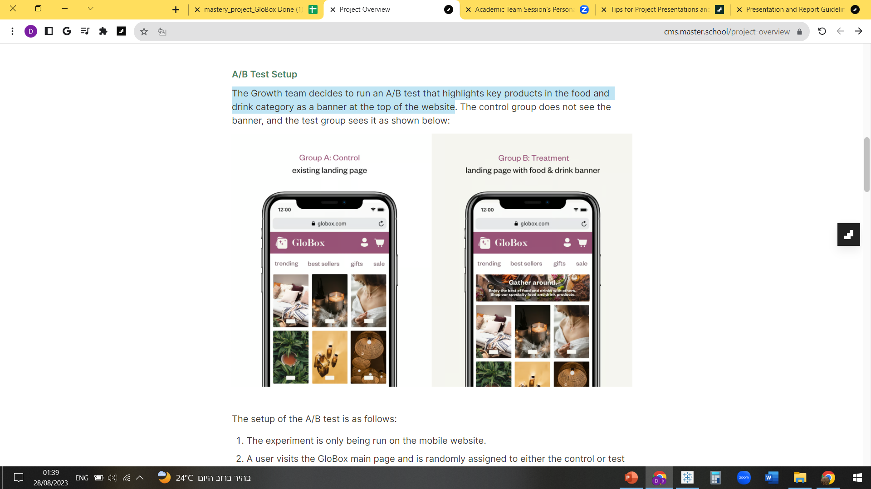
The Growth team decides to run an A/B Test
The test highlights key products in the food and drink category as a banner at the top of the website.
GloBox is primarily known amongst its customer base for boutique fashion items and high-end decor products.
The control group (24343 users) does not see the banner and the treatment group (24600 users) does.
Our goal is to increase revenue.
The test was held from the 25th of January till the 6th of February.

Slide 3
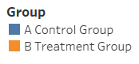
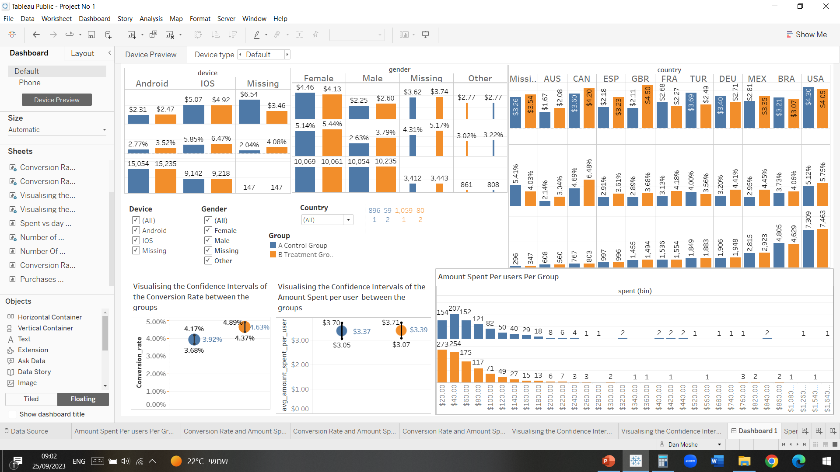
Conversion rate is higher in the treatment group
We saw a strong statistical evidence that the conversion rate was different between the control and the treatment group.
There is a 0.7% difference in favor of the treatment group over the control group.

Slide 4
No increase in avg amount spent
There is no strong evidence to distinguish between the average amount spent by the control and treatment groups.
There is no noticeable increase in revenues amongst the two groups.

Slide 5
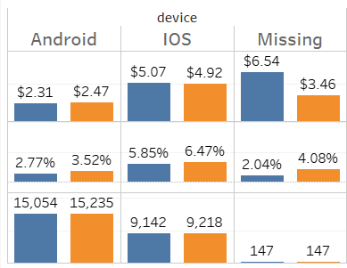
Noticeable difference between Android/IOS users
Higher avg amount spent for IOS over Android users by almost twice as much, for the control and treatment groups.
Higher conversion rate for IOS over Android users ~ 3% difference for both groups.
+0.75% conversion rate, +0.16$ avg amount spent for the treatment group on Android users.
Higher Avg amount spent for the treatment group on Android users.
+0.62% conversion rate, -0.15$ avg amount spent for the treatment group on IOS users.
30,289 Android users, 18,360 IOS users, 294 missing values.
Avg amount spent
Conversion Rate
Users

Slide 6

* Conversion rate and avg amount spent differences among the treatment and control group for female demographics is +0.3% and -0.33$. * Conversion rate and avg amount spent both ranked higher for the treatment group in male demographics +1.16% and +0.35$ . * 20,130 female users, 20,289 male users, 1669 other users, 6855 missing values for gender identification.
Cr and Avg amount spent is highest among female demographics
Avg amount spent
Conversion Rate
Users

Slide 7
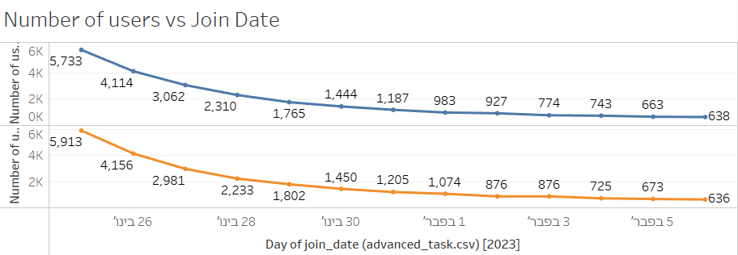
Users Traffic to the website
Most users joined the A/B test at the latest dates of January and the daily amount slowly declines for the first days of February where it stands on approx. 1200 new daily users on February 6th
Possible reason: According to Capstone Logistics: Self-Indulgent Shoppers. eBay advertising data shows that from December 24 through January 24, searches for “designer” items rose by 190 percent, and searches for “luxury” products rose 148 percent (eBay). This suggests that spending on big-ticket items—like jewelry, designer handbags, and cars—increases in January. - GloBox is primarily known amongst its customer base for boutique fashion items and high-end decor products.

Slide 8
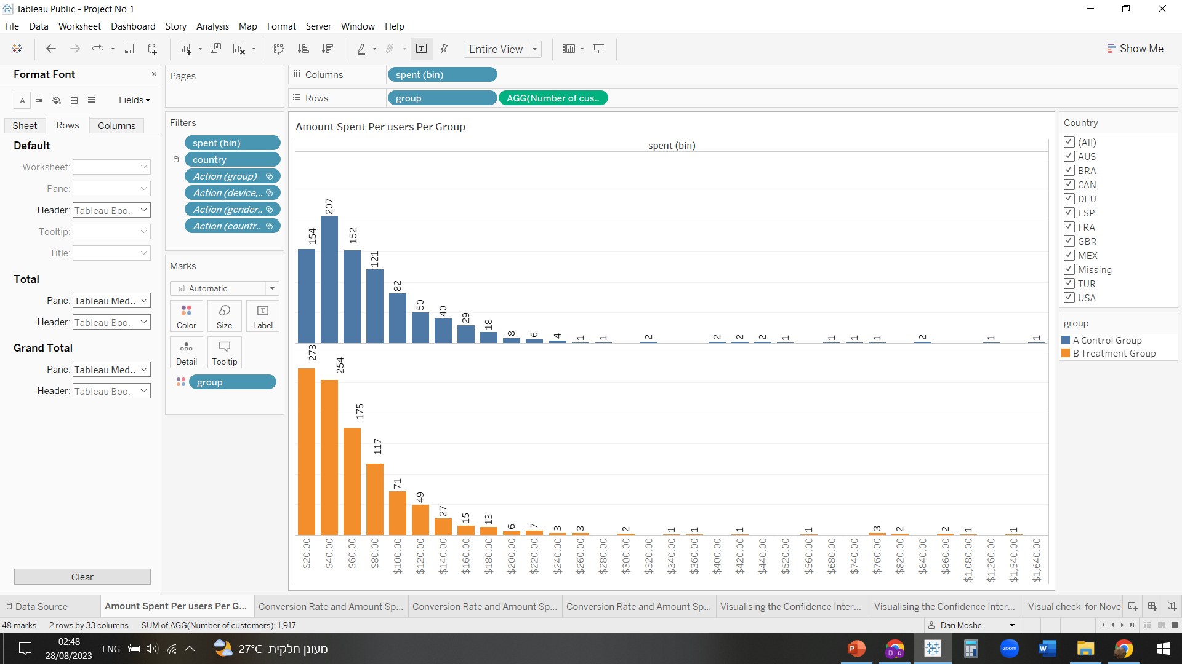
Purchase distribution
Purchases distribution sorted for 20$ bins.
Lower purchase size but higher purchases count is clearly shown for the treatment group over the control group: +77% increase in 20$ Purchases , +22% increase in 40$ purchases and a +13% increase in 60$ purchases.
This shows us the banner is working and is making users buy from the least expensive food and drinks category.

Slide 9
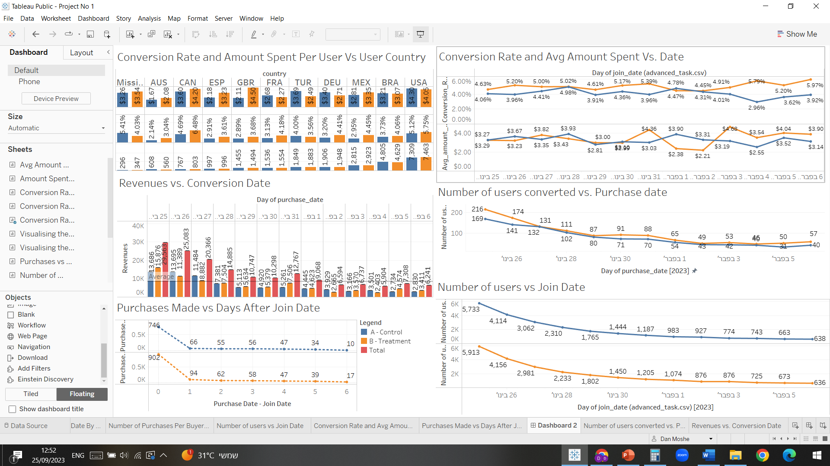
Conversion rate and avg amount spent sorted by join date
Conversion rate is higher for the treatment group for all but 3 dates: 28th of January, 1st and 2nd of February.
Avg amount spent is less straightforward but as clearly shown from the graph below from the 3rd of February onwards both conversion rate and avg amount spent is higher for the treatment group over the control group which means we have higher revenues for the treatment group.

Slide 10
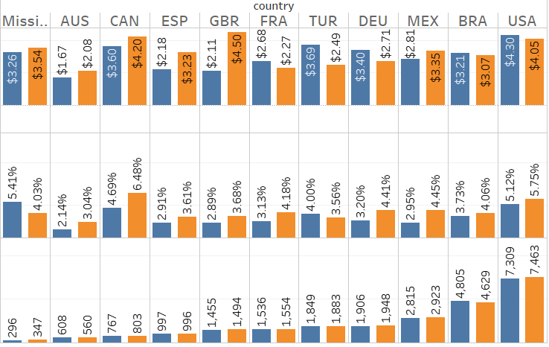
United states Brazil and Mexico are where most of the users come from
Conversion rate is higher for the treatment group in almost all countries excluding: Turkey and missing values.
Avg amount spent is higher for the treatment group in: Mexico, Great Britain, Spain, Canada and Australia.
Avg amount spent
Conversion Rate
Users

Slide 11
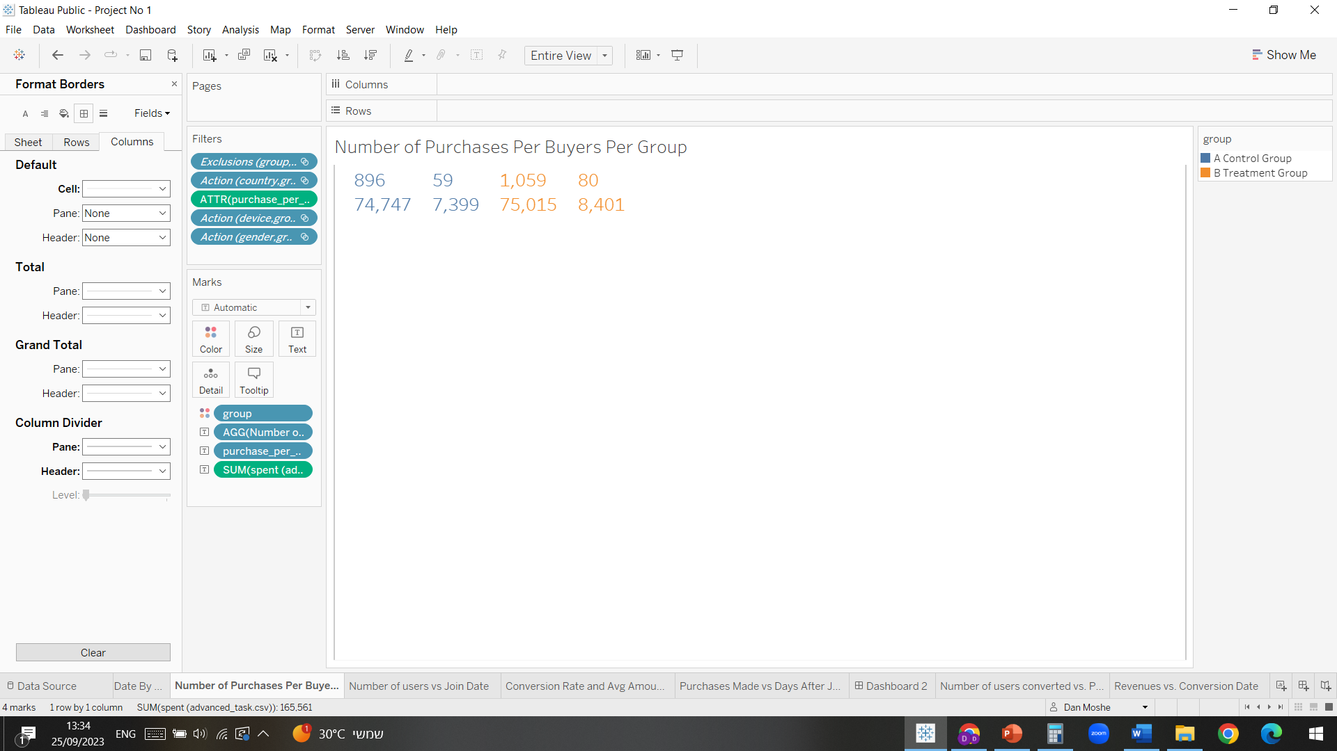
Final numbers
Treatment group total revenues is 83,416, control group total revenues is 82,146, we can clearly see that treatment did provide us with more revenues.
7% returning customers for the treatment groups over 6.17% returning customers for the control group, returning customers made 2 purchases during the experiment duration.
Overall there is an increase in conversion rate for the treatment group over the control group for gender and device used, the banner is directing customers to making more smaller scale purchases – correlates to food and drinks category prices.
No. of purchases
One
Two
One
Two
User Count
Revenues

Slide 12
Final recommendation
I recommend further prolonging of the A/B test for at least 4 weeks period to rule out the novelty effect and the specific customer behavior keen to dates accruing at the end of January (very high traffic looking for exotic goods).
We need to make sure that the banner is making enough revenues for the front-page space he is getting, there was a total of 1270$ increase in revenue for the twelve days period.
I would further go by dividing the spent column to the different categories appearing on the site to see if the banner directly effects the food and drinks category sales.

