Slide 1
Mastery Project No 2
Funnel Analysis
This project aims to analyze the customer funnel of Metrocar, a ride-sharing app (similar to Uber/Lyft), to identify areas for improvement and optimization.

Slide 2
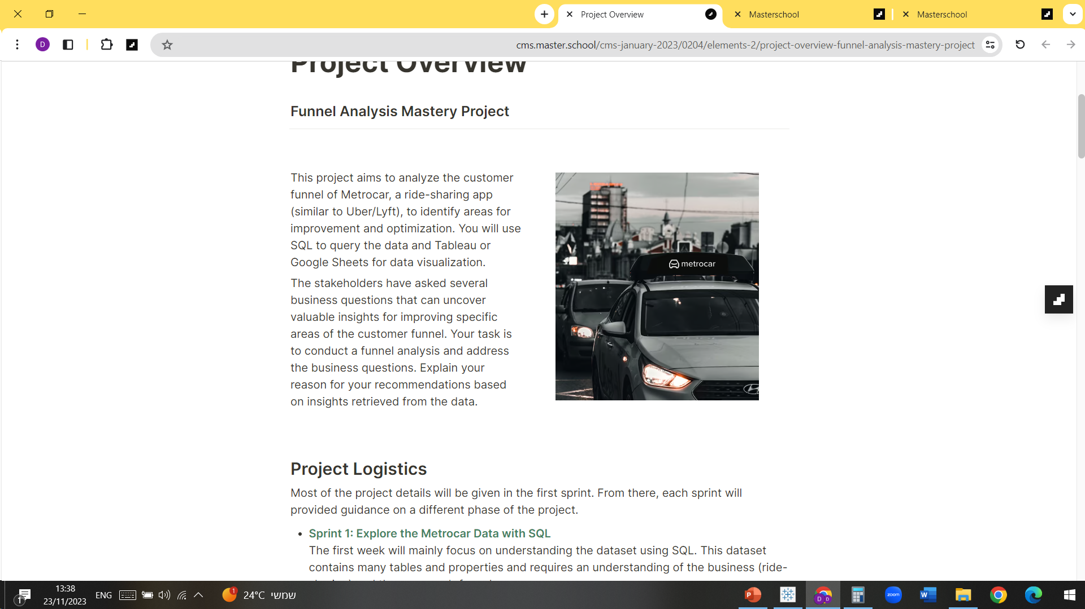
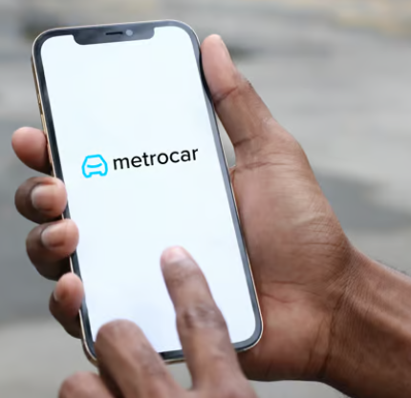
Metrocar’s Funnel
The customer funnel for Metrocar will include the following stages:
Download, Signup, Ride request, Ride accepted, Ride pickup, Ride completed, Payment, Review.
The funnel is built from two perspectives users and rides.
We will answer the business questions presented in the following slides based on the data analysis.
It is important to note that approx 30.1% of the users who signed up are of unknown age range, possibilities are:
they are 54+, younger then 18 or just haven’t filled that field.

Slide 3
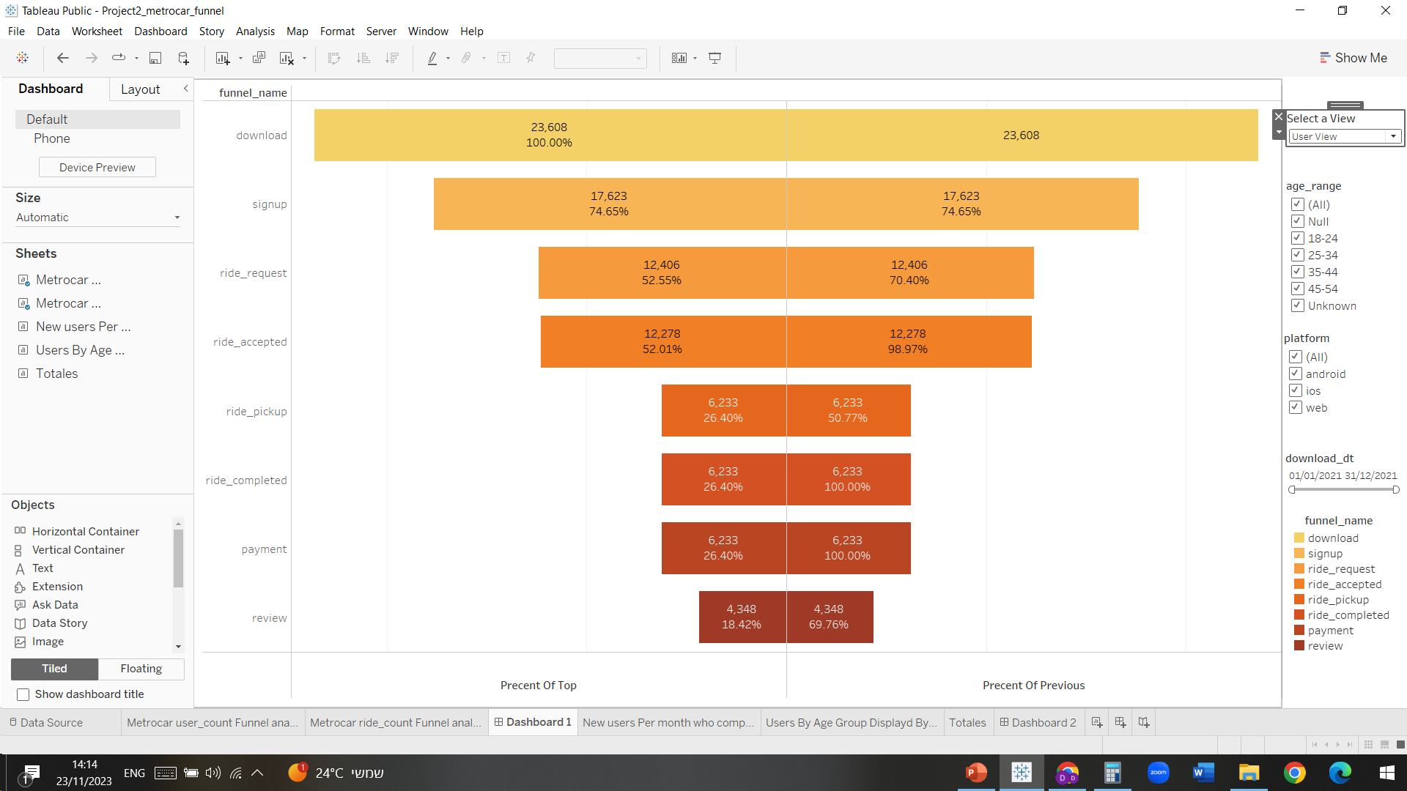
User Level Funnel Analysis key drop off points
We found three key drop off points in the user level funnel that correlates to most users lost from the process:
- download -> signup , which is a 25.35% loss which correlates to 5985 users.
- signup -> ride_request , which is a 29.6% loss which correlates to 5217 users.
- ride_accepted -> ride_pickup , which is a 49.23% loss which correlates to 6045 users.

Slide 4
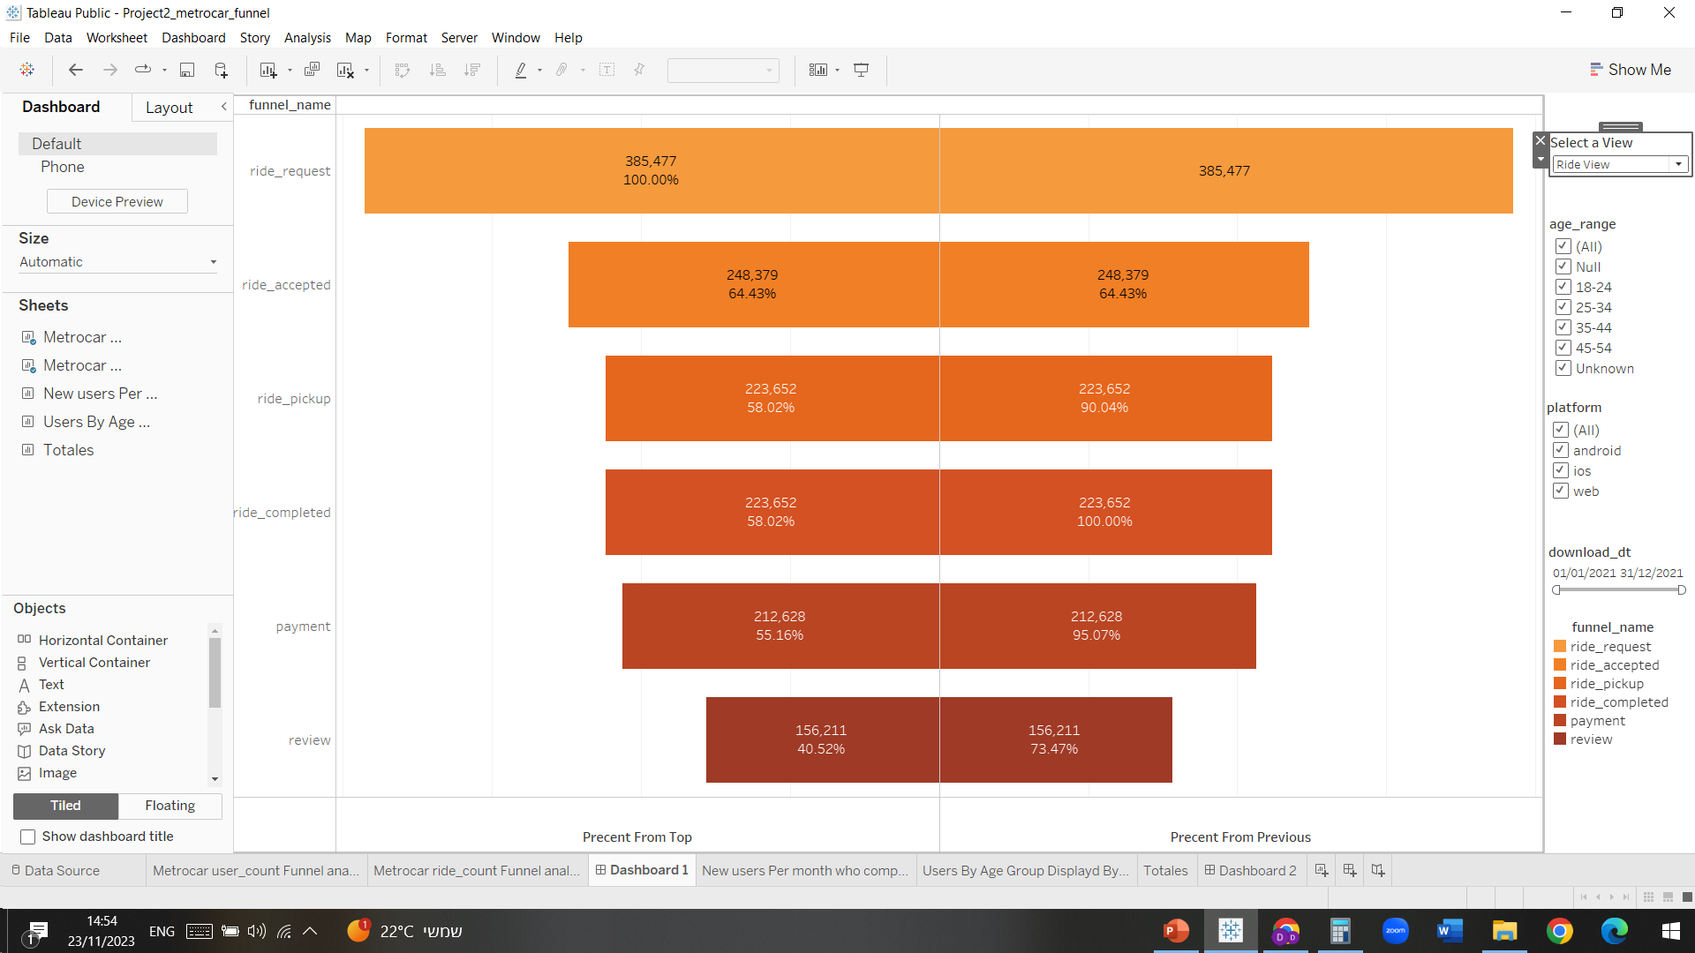
Rides Level Funnel Analysis key drop off points
We found 1 major drop off point in the rides level funnel that correlates to most rides lost from the process:
rides_requested -> rides_accepted , which is a 35.57% loss which correlates to 137089 rides drop off.
rides_accepted -> rides_pickup , which is a 9.94% loss which correlates to 15021 rides and is essentially the rides cancelation rate.
Unpaid rides : rides_completed -> payment , which is a 4.96% loss which correlates to 6759 rides.

Slide 5
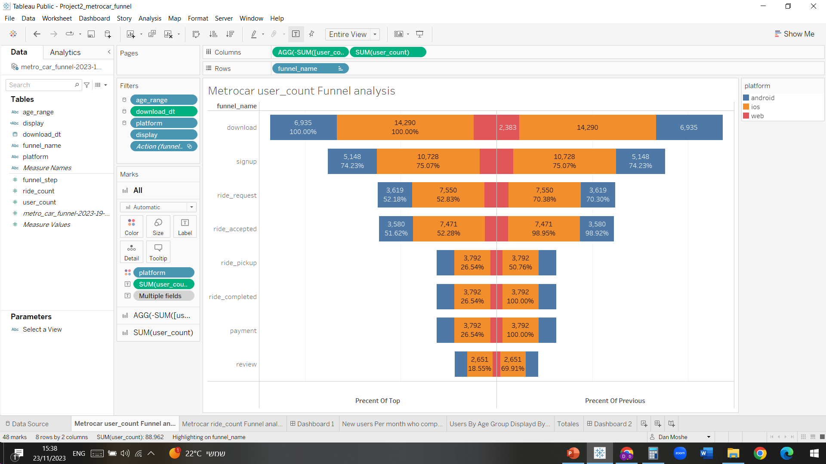

User Level platform analysis IOS > Android > Web
Conversion rates were kept through the funnel stages across the different platforms.
Out of the initial 23608 users:
- 14290 IOS users, 60.53% of overall users.
- 6935 Android users, 29.37% of overall users.
- 2383 Web users, 10.09% of overall users.

Slide 6
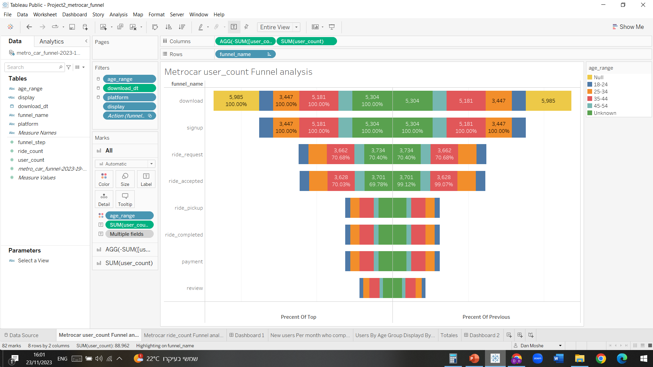

User Level Age Range analysis Unknown > 35-44 > 25-34 > 18-24 > 44-54
Conversion rates were kept through the funnel stages across the different age ranges.
Null is for users who haven’t signed up at all, 5985 users, 25.35%.
Out of the initial 23608 users:
-
Precent from total | User count | Age Range
22.46% | 5304 | Unknown
21.94% | 5181 | 35-44
14.6% | 3447 | 25-34
7.9% | 1865 | 18-24
7.73% | 1826 | 44-54

Slide 7
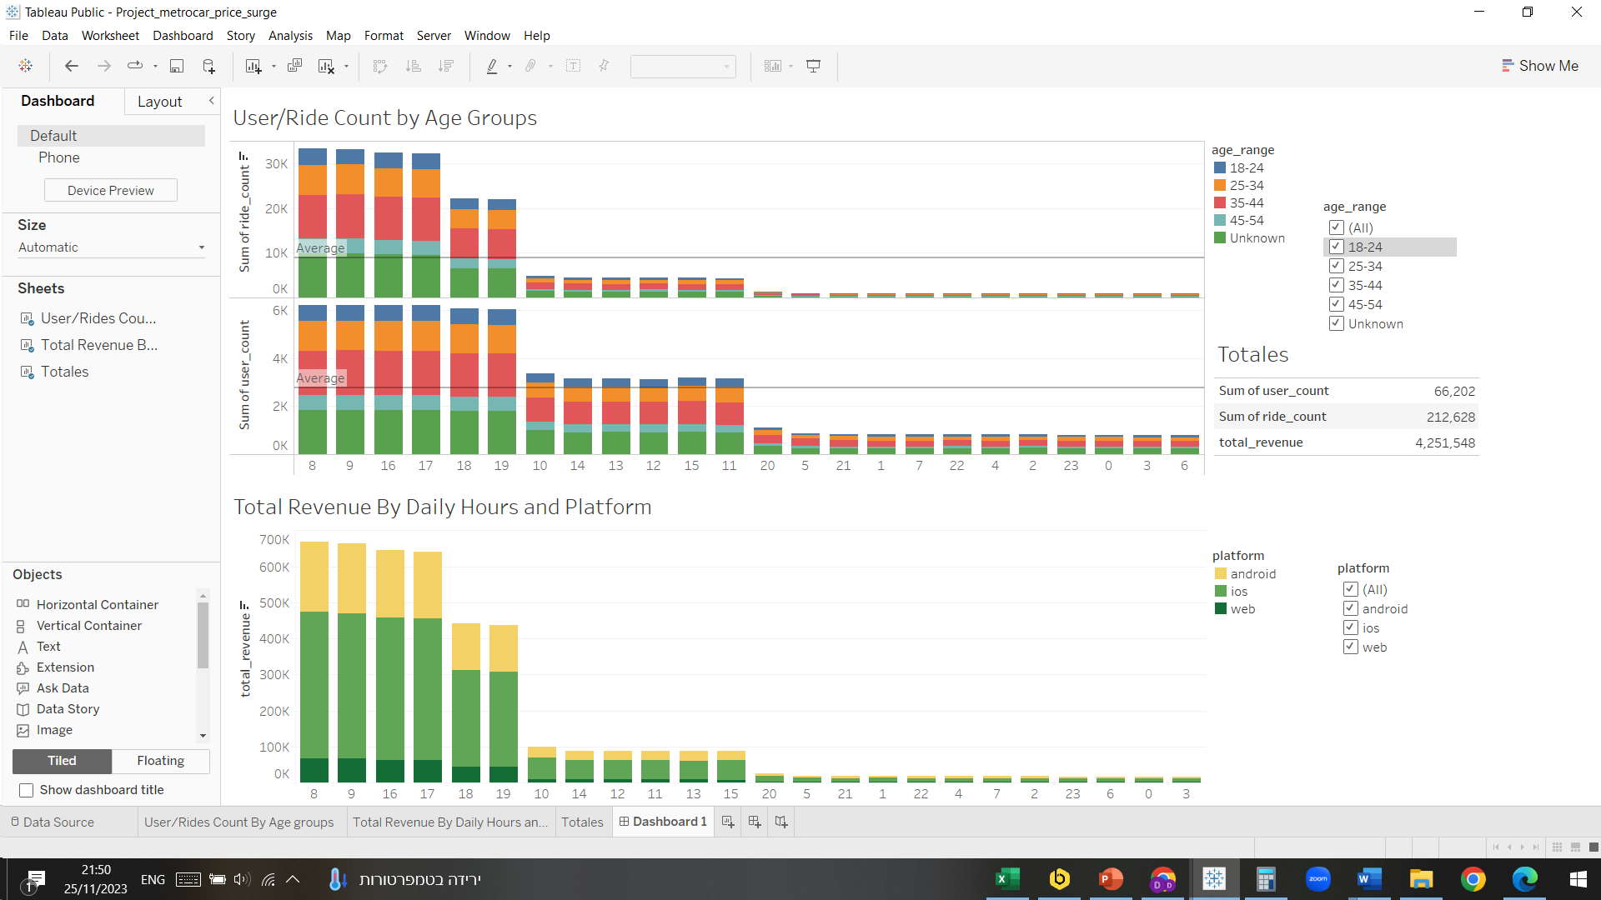
Surge Pricing Strategy – busiest hours of the day
By looking into the number of users, rides and revenues vs hour we can determine that our busiest times are:

Slide 8
Lowest conversion rate – user level funnel, rides level funnel
As mentioned in slide 3 the conversion rate from rides_accepted to ride_pickup is a little over 50% for new users, this is our lowest conversion rate and will make the biggest improvement revenue wise, possible solution:
- Cancelation fee, if a ride is being accepted and gets cancelled before the pickup occurs there might be an
option to charge for a cancelation fee, passenger or driver.
As mentioned in slide 4 the conversion rate from rides_requested to ride_accepted is 64.43%, this is our lowest conversion rate at the ride level granularity, rides drop off at this phase are 137089, possible reason:
- Not enough drivers using the app, recruit more drivers to accommodate the number of requests.
App user experience should be examined on all platforms.
Interesting stats: 34 rides on average per user, price for a ride is 20$ on average.

