Slide 1

Top TeamFight Tactics (TFT)

Slide 2
Info
TFT → 8 player game
Win → 1st place
Loss → 2nd – 8th place
League Points (LP) → points gained (1st – 4th place) or lost (5th – 8th place)
Veteran → Has played 100+ games in tier
Inactive → No longer actively plays
FreshBlood → Is new to the tier
hotStreak → 3+ wins in a row

Slide 3
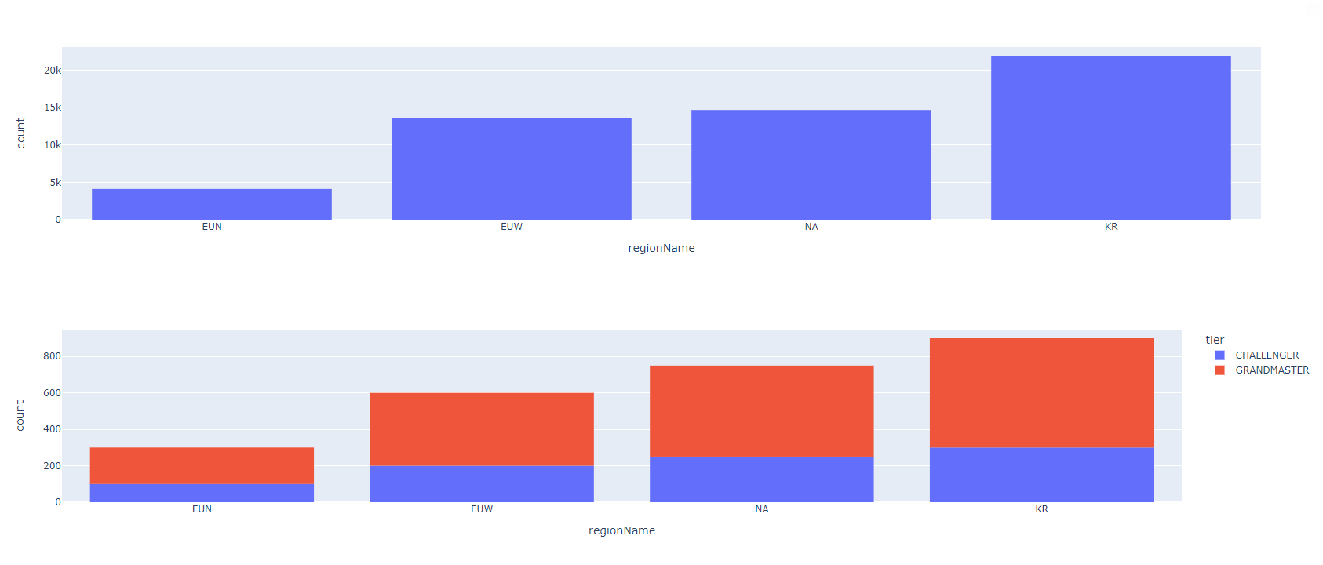
Number of players

Slide 4
Korean domination

Slide 5
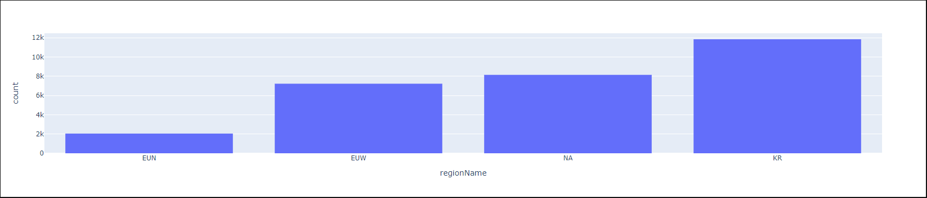
0 LP
How many of these players are inactive?
How many have more losses than wins?
What is the average of games per player?

Slide 6
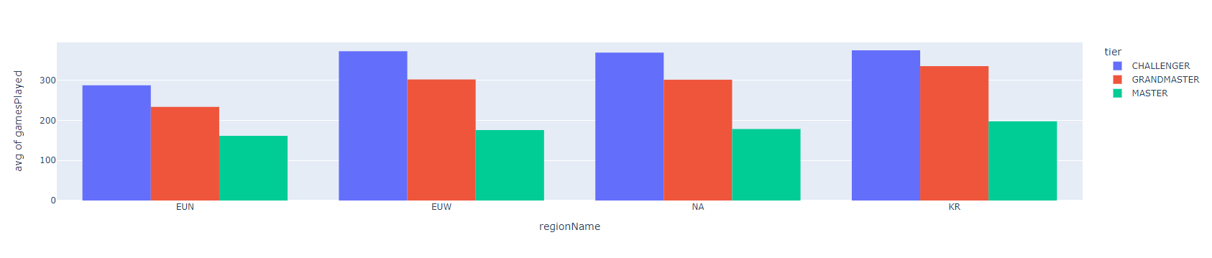
Games played

Slide 7
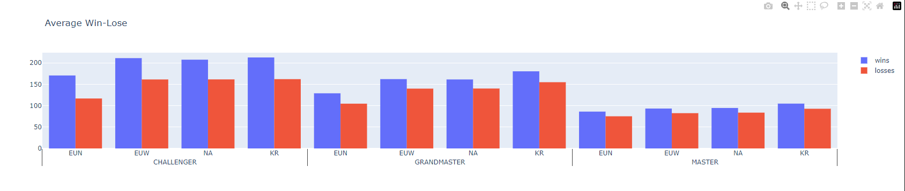
Games played

Slide 8
What more?
Major regions vs Minor regions
Active players vs all players
Korean values (w/o 0LP) vs all other regions (w/o 0LP)

