Slide 1

Top TeamFight Tactics (TFT)

Slide 2
Info
Tier → Challenger > Grandmaster > Master
Win → 1st place
Loss → 2nd – 8th place
League Points (LP) → points gained (1st – 4th place) or lost (5th – 8th place)
Veteran → Has played 100+ games in tier
Inactive → No longer actively plays
FreshBlood → Is new to the tier
hotStreak → 3+ wins in a row

Slide 3
Before we start
Data from August to November
There are other ranks below these 3
Some important information

Slide 4
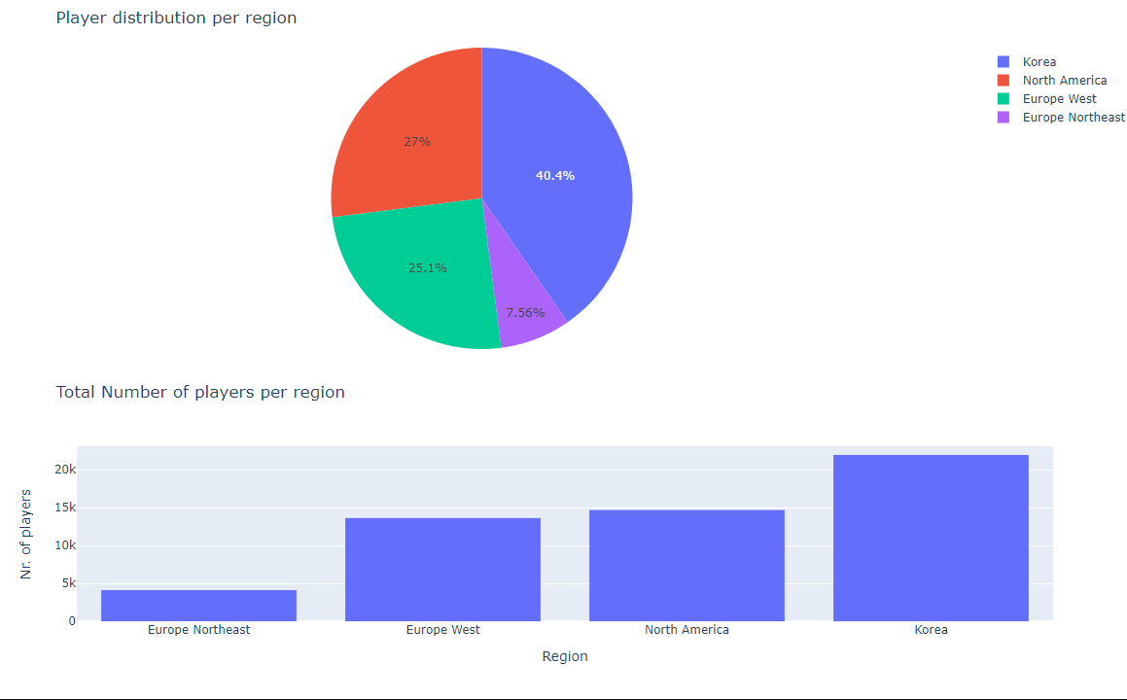

Korean domination

Slide 5
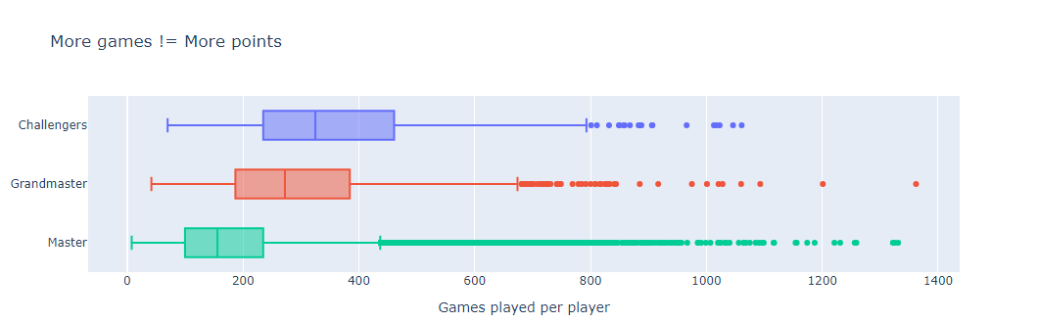
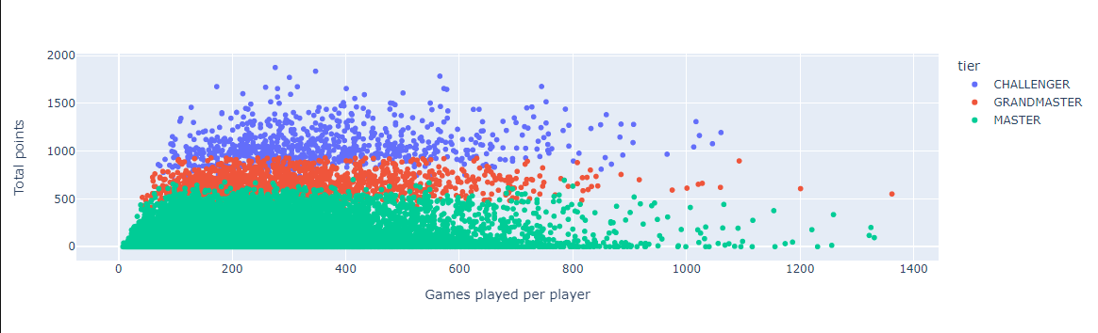
Games-Points comparison

Slide 6
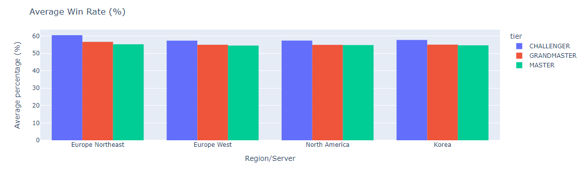
Unexpected Win Rate

Slide 7
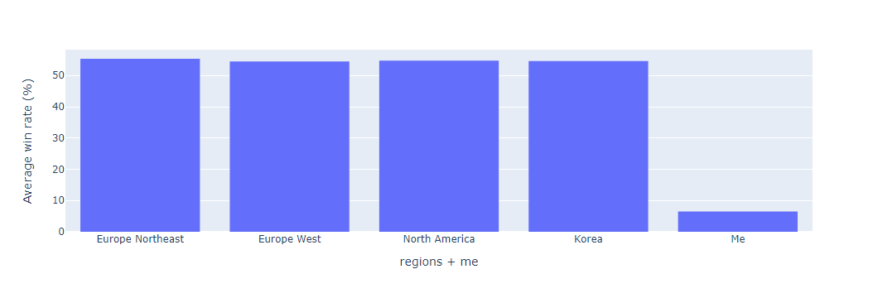
Top players vs Mid player

Slide 8
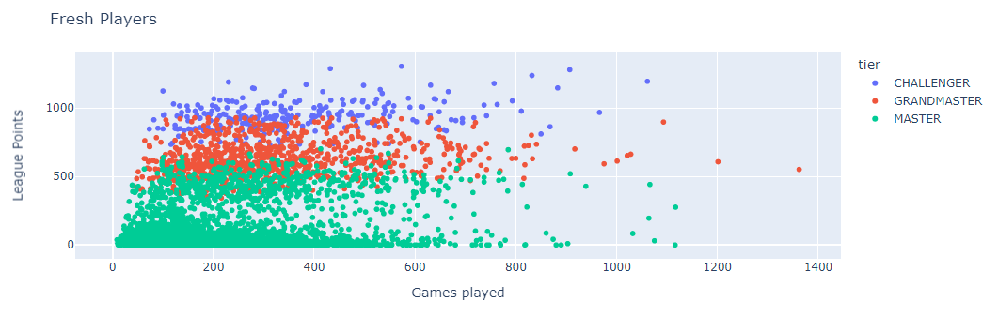
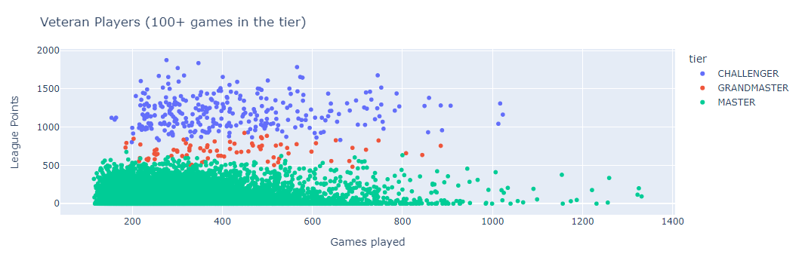
Heated competition in Grandmaster

