Slide 1
DLBDSPBDM01-Project build a data mart in SQL
use case: AirBnB
Name: Huseyin
Lastname: Ozdogan
Marticulation No: 92111877
Ozdogan-Huseyin_92111877_DLBDSPBDM_P2_S

Slide 2
Implementation procedure: accountPayable table 1/21
CREATE TABLE `accountPayable` (
`id_acctPayable` int NOT NULL AUTO_INCREMENT,
`amount` int DEFAULT NULL,
`orgName` varchar(50) DEFAULT NULL,
`address` varchar(50) DEFAULT NULL,
`create_time` timestamp NULL DEFAULT NULL,
`update_time` timestamp NULL DEFAULT NULL,
PRIMARY KEY (`id_acctPayable`)
) ENGINE=InnoDB AUTO_INCREMENT=21 DEFAULT CHARSET=utf8mb3 COMMENT='To define user as Guest or Host';
Table creation statement :
INSERT INTO `AirBnB`.`accountPayable` (`id_acctPayable`,`amount`,`orgName`,`address`,`create_time`,`update_time`) VALUES (1,8785922,'Treutel Inc','61950 Wilson Parkway Apt. 499\nSouth Sibyl, OH 0958','1995-01-05 12:55:37','1987-10-27 10:59:42');
1st/20 Insert statement :
* Data are filled to database are dummy data

Slide 3
Implementation procedure: accountReceivable table 2/21
CREATE TABLE `accountReceivable` (
`id_acctReceivable` int NOT NULL AUTO_INCREMENT,
`amount` int DEFAULT NULL,
`orgName` varchar(50) DEFAULT NULL,
`address` varchar(50) DEFAULT NULL,
`create_time` timestamp NULL DEFAULT NULL,
`update_time` timestamp NULL DEFAULT NULL,
PRIMARY KEY (`id_acctReceivable`)
) ENGINE=InnoDB AUTO_INCREMENT=21 DEFAULT CHARSET=utf8mb3 COMMENT='to keep account receivable';
Table creation statement :
INSERT INTO `AirBnB`.`accountReceivable` (`id_acctReceivable`,`amount`,`orgName`,`address`,`create_time`,`update_time`) VALUES (1,9211524,'Spinka Inc','3602 Sandra Prairie\nSouth Rosendo, NE 05968-8299','1986-12-13 07:00:17','1972-06-30 08:21:21');
1st/20 Insert statement :
* Data are filled to database are dummy data

Slide 4
Implementation procedure: bank table 3/21
CREATE TABLE `bank` (
`id_bank` int NOT NULL AUTO_INCREMENT,
`bankName` varchar(250) DEFAULT NULL,
`iban` varchar(50) DEFAULT NULL,
`accountHolderNameSurname` varchar(50) DEFAULT NULL,
`create_time` timestamp NULL DEFAULT NULL,
`update_time` timestamp NULL DEFAULT NULL,
`fk_facilityId` int DEFAULT NULL,
`fk_userRole` int DEFAULT NULL,
PRIMARY KEY (`id_bank`),
KEY `fk_bank_1_idx` (`fk_facilityId`),
KEY `fk_bank_2_idx` (`fk_userRole`),
CONSTRAINT `fk_bank_1` FOREIGN KEY (`fk_facilityId`) REFERENCES `facility` (`id_facility`),
CONSTRAINT `fk_bank_2` FOREIGN KEY (`fk_userRole`) REFERENCES `userRole` (`id_userRole`)
) ENGINE=InnoDB AUTO_INCREMENT=21 DEFAULT CHARSET=utf8mb3 COMMENT='to keep bank records';
Table creation statement :
INSERT INTO `AirBnB`.`bank` (`id_bank`,`bankName`,`iban`,`accountHolderNameSurname`,`create_time`,`update_time`,`fk_facilityId`,`fk_userRole`) VALUES (1,'Smith Group','232710582809','Prof. Jarod Adams III','1994-07-03 01:18:14','1981-08-27 17:17:20',1,1);
1st/20 Insert statement :
* Data are filled to database are dummy data

Slide 5
Implementation procedure: carrier table 4/21
CREATE TABLE `carrier` (
`id_carrier` int NOT NULL AUTO_INCREMENT,
`name` varchar(50) DEFAULT NULL,
`itemSent` varchar(45) DEFAULT NULL,
`trackingNo` varchar(25) DEFAULT NULL,
`create_time` timestamp NULL DEFAULT NULL,
`update_time` timestamp NULL DEFAULT NULL,
`fk_facilityInvoideId` int DEFAULT NULL,
`fk_userRoleId` int DEFAULT NULL,
PRIMARY KEY (`id_carrier`),
KEY `fk_carrier_2_idx` (`fk_facilityInvoideId`),
KEY `fk_carrier_3_idx` (`fk_userRoleId`),
CONSTRAINT `fk_carrier_2` FOREIGN KEY (`fk_facilityInvoideId`) REFERENCES `facilityInvoice` (`id_facilityInvoice`),
CONSTRAINT `fk_carrier_3` FOREIGN KEY (`fk_userRoleId`) REFERENCES `userRole` (`id_userRole`)
) ENGINE=InnoDB AUTO_INCREMENT=21 DEFAULT CHARSET=utf8mb3 COMMENT='to keep records of carrier that platform user can track the sent items like invoice';
Table creation statement :
INSERT INTO `AirBnB`.`carrier` (`id_carrier`,`name`,`itemSent`,`trackingNo`,`create_time`,`update_time`,`fk_facilityInvoideId`,`fk_userRoleId`) VALUES (1,'DHL',' invitation','1932617','2003-02-26 07:09:12','1989-06-25 09:00:36',1,1);
1st/20 Insert statement :
* Data are filled to database are dummy data

Slide 6
Implementation procedure: employee table 5/21
CREATE TABLE `employee` (
`id_employee` int NOT NULL AUTO_INCREMENT,
`name` varchar(50) DEFAULT NULL,
`surname` varchar(50) DEFAULT NULL,
`telephone` varchar(50) DEFAULT NULL,
`create_time` timestamp NULL DEFAULT NULL,
`update_time` timestamp NULL DEFAULT NULL,
`fk_facilityId` int DEFAULT NULL,
PRIMARY KEY (`id_employee`),
KEY `fk_employee_1_idx` (`fk_facilityId`),
CONSTRAINT `fk_employee_1` FOREIGN KEY (`fk_facilityId`) REFERENCES `facility` (`id_facility`)
) ENGINE=InnoDB AUTO_INCREMENT=21 DEFAULT CHARSET=utf8mb3 COMMENT='To define user as Guest or Host';
Table creation statement :
INSERT INTO `AirBnB`.`employee` (`id_employee`,`name`,`surname`,`telephone`,`create_time`,`update_time`,`fk_facilityId`) VALUES (1,'Peggie','Bechtelar','1-019-451-9861x0725','2012-05-10 00:31:06','1986-06-03 01:30:25',1);
1st/20 Insert statement :
* Data are filled to database are dummy data

Slide 7
Implementation procedure: expectedIncome table 6/21
CREATE TABLE `expectedIncome` (
`id_expectedIncome` int NOT NULL AUTO_INCREMENT,
`expectedIncome` int DEFAULT NULL,
`create_time` timestamp NULL DEFAULT NULL,
`update_time` timestamp NULL DEFAULT NULL,
`fk_facilityId` int DEFAULT NULL,
`fk_facilityPriceId` int DEFAULT NULL,
`fk_facilityOrderId` int DEFAULT NULL,
PRIMARY KEY (`id_expectedIncome`),
KEY `fk_expectedIncome_1_idx` (`fk_facilityId`),
KEY `fk_expectedIncome_2_idx` (`fk_facilityPriceId`),
KEY `fk_expectedIncome_3_idx` (`fk_facilityOrderId`),
CONSTRAINT `fk_expectedIncome_1` FOREIGN KEY (`fk_facilityId`) REFERENCES `facility` (`id_facility`),
CONSTRAINT `fk_expectedIncome_2` FOREIGN KEY (`fk_facilityPriceId`) REFERENCES `facilityPrice` (`id_facilityPrice`),
CONSTRAINT `fk_expectedIncome_3` FOREIGN KEY (`fk_facilityOrderId`) REFERENCES `facilityOrder` (`id_facilityOrder`)
) ENGINE=InnoDB AUTO_INCREMENT=21 DEFAULT CHARSET=utf8mb3 COMMENT='to keep record for the expected income';
Table creation statement :
INSERT INTO `AirBnB`.`expectedIncome` (`id_expectedIncome`,`expectedIncome`,`create_time`,`update_time`,`fk_facilityId`,`fk_facilityPriceId`,`fk_facilityOrderId`) VALUES (1,4558,'1986-05-14 16:31:53','1979-05-22 08:51:45',1,1,1);
1st/20 Insert statement :
* Data are filled to database are dummy data

Slide 8
Implementation procedure: facility table 7/21
CREATE TABLE `facility` (
`id_facility` int NOT NULL AUTO_INCREMENT,
`type` varchar(45) DEFAULT NULL,
`name` varchar(45) DEFAULT NULL,
`adress` varchar(45) DEFAULT NULL,
`email` varchar(45) DEFAULT NULL,
`telephone` varchar(45) DEFAULT NULL,
`create_time` timestamp NULL DEFAULT NULL,
`update_time` timestamp NULL DEFAULT NULL,
PRIMARY KEY (`id_facility`)
) ENGINE=InnoDB AUTO_INCREMENT=21 DEFAULT CHARSET=utf8mb3 COMMENT='To define facility type like Hotel, apart and etc..';
Table creation statement :
INSERT INTO `AirBnB`.`facility` (`id_facility`,`type`,`name`,`adress`,`email`,`telephone`,`create_time`,`update_time`) VALUES (1,'apartment','sint','Apt. 247','hhackett@example.com','08339197935','1974-08-31 09:18:10','1970-09-02 01:18:50');
1st/20 Insert statement :
* Data are filled to database are dummy data

Slide 9
Implementation procedure: facilityAdvantages table 8/21
CREATE TABLE `facilityAdvantages` (
`id_facilityAdvantage` int NOT NULL AUTO_INCREMENT,
`advantage` varchar(45) DEFAULT NULL,
`create_time` timestamp NULL DEFAULT NULL,
`update_time` timestamp NULL DEFAULT NULL,
`fk_facilityId` int DEFAULT NULL,
PRIMARY KEY (`id_facilityAdvantage`),
KEY `fk_facilityAdvantages_1_idx` (`fk_facilityId`),
CONSTRAINT `fk_facilityAdvantages_1` FOREIGN KEY (`fk_facilityId`) REFERENCES `facility` (`id_facility`)
) ENGINE=InnoDB AUTO_INCREMENT=21 DEFAULT CHARSET=utf8mb3 COMMENT='to keep records for the advantages of facility';
Table creation statement :
INSERT INTO `AirBnB`.`facilityAdvantages` (`id_facilityAdvantage`,`advantage`,`create_time`,`update_time`,`fk_facilityId`) VALUES (1,'Necessitatibus molestias beatae voluptates qu','1972-11-21 04:41:28','2021-06-27 16:42:03',1);
1st/20 Insert statement :
* Data are filled to database are dummy data

Slide 10
Implementation procedure: facilityArchitecture table 9/21
CREATE TABLE `facilityArchitecture` (
`id_facilityArchitecture` int NOT NULL AUTO_INCREMENT,
`hasRoom` int DEFAULT NULL,
`totalSq` int DEFAULT NULL,
`hasBalcoon` tinyint DEFAULT NULL,
`create_time` timestamp NULL DEFAULT NULL,
`update_time` timestamp NULL DEFAULT NULL,
`fk_facilityId` int DEFAULT NULL,
PRIMARY KEY (`id_facilityArchitecture`),
KEY `fk_facilityArchitecture_1_idx` (`fk_facilityId`),
CONSTRAINT `fk_facilityArchitecture_1` FOREIGN KEY (`fk_facilityId`) REFERENCES `facility` (`id_facility`)
) ENGINE=InnoDB AUTO_INCREMENT=21 DEFAULT CHARSET=utf8mb3 COMMENT='to keep record of architectural details';
Table creation statement :
INSERT INTO `AirBnB`.`facilityArchitecture` (`id_facilityArchitecture`,`hasRoom`,`totalSq`,`hasBalcoon`,`create_time`,`update_time`,`fk_facilityId`) VALUES (1,0,80,1,'2000-08-02 23:46:49','2020-05-25 15:19:00',1);
1st/20 Insert statement :
* Data are filled to database are dummy data

Slide 11
Implementation procedure: facilityAvailability table 10/21
CREATE TABLE `facilityAvailability` (
`id_facilityAvailability` int NOT NULL AUTO_INCREMENT,
`availableStartDate` timestamp NULL DEFAULT NULL,
`availableEndDate` timestamp NULL DEFAULT NULL,
`create_time` timestamp NULL DEFAULT NULL,
`update_time` timestamp NULL DEFAULT NULL,
`fk_facilityId` int DEFAULT NULL,
PRIMARY KEY (`id_facilityAvailability`),
KEY `fk_facilityAvailability_1_idx` (`fk_facilityId`),
CONSTRAINT `fk_facilityAvailability_1` FOREIGN KEY (`fk_facilityId`) REFERENCES `facility` (`id_facility`)
) ENGINE=InnoDB AUTO_INCREMENT=21 DEFAULT CHARSET=utf8mb3 COMMENT='to keep records of facility avaibality days';
Table creation statement :
INSERT INTO `AirBnB`.`facilityAvailability` (`id_facilityAvailability`,`availableStartDate`,`availableEndDate`,`create_time`,`update_time`,`fk_facilityId`) VALUES (1,'1998-02-22 00:31:23','1986-08-05 19:51:30','1971-06-17 22:59:55','1996-09-14 07:16:02',1);
1st/20 Insert statement :
* Data are filled to database are dummy data

Slide 12
Implementation procedure: facilityInvoice table 11/21
CREATE TABLE `facilityInvoice` (
`id_facilityInvoice` int NOT NULL AUTO_INCREMENT,
`stayedDay` int DEFAULT NULL,
`fk_facilityPriceId` int DEFAULT NULL,
`create_time` timestamp NULL DEFAULT NULL,
`update_time` timestamp NULL DEFAULT NULL,
`fk_facilityId` int DEFAULT NULL,
`discount` int DEFAULT NULL,
`fk_facilityTaxRateId` int DEFAULT NULL,
`invoiceAmountTotal` int DEFAULT NULL,
PRIMARY KEY (`id_facilityInvoice`),
KEY `fk_facilityInvoice_1_idx` (`fk_facilityPriceId`),
KEY `fk_facilityInvoice_2_idx` (`fk_facilityId`),
KEY `fk_facilityInvoice_3_idx` (`fk_facilityTaxRateId`),
CONSTRAINT `fk_facilityInvoice_1` FOREIGN KEY (`fk_facilityPriceId`) REFERENCES `facilityPrice` (`id_facilityPrice`) ON DELETE CASCADE ON UPDATE CASCADE,
CONSTRAINT `fk_facilityInvoice_2` FOREIGN KEY (`fk_facilityId`) REFERENCES `facility` (`id_facility`),
CONSTRAINT `fk_facilityInvoice_3` FOREIGN KEY (`fk_facilityTaxRateId`) REFERENCES `facilityTaxRate` (`id_facilityTaxRate`)
) ENGINE=InnoDB AUTO_INCREMENT=21 DEFAULT CHARSET=utf8mb3 COMMENT='to keep record of invoice belongs to guest';
Table creation statement :
INSERT INTO `AirBnB`.`facilityInvoice` (`id_facilityInvoice`,`stayedDay`,`fk_facilityPriceId`,`create_time`,`update_time`,`fk_facilityId`,`discount`,`fk_facilityTaxRateId`,`invoiceAmountTotal`) VALUES (1,8,3,'1981-07-12 22:07:08','1976-04-27 16:20:32',3,0,3,8);
1st/20 Insert statement :
* Data are filled to database are dummy data

Slide 13
Implementation procedure: facilityLocation table 12/21
CREATE TABLE `facilityLocation` (
`id_facilityLocation` int NOT NULL AUTO_INCREMENT COMMENT 'it will keep record of facility location geo coordinations',
`latitude` varchar(45) DEFAULT NULL,
`longitude` varchar(45) DEFAULT NULL,
`cityName` varchar(45) DEFAULT NULL,
`countryName` varchar(45) DEFAULT NULL,
`create_time` timestamp NULL DEFAULT NULL,
`update_time` timestamp NULL DEFAULT NULL,
`fk_facilityId` int DEFAULT NULL,
PRIMARY KEY (`id_facilityLocation`),
KEY `fk_facilityLocation_1_idx` (`fk_facilityId`),
CONSTRAINT `fk_facilityLocation_1` FOREIGN KEY (`fk_facilityId`) REFERENCES `facility` (`id_facility`) ON DELETE CASCADE
) ENGINE=InnoDB AUTO_INCREMENT=21 DEFAULT CHARSET=utf8mb3 COMMENT='to keep record geolocation of facility';
Table creation statement :
INSERT INTO `AirBnB`.`facilityLocation` (`id_facilityLocation`,`latitude`,`longitude`,`cityName`,`countryName`,`create_time`,`update_time`,`fk_facilityId`) VALUES (1,'-37.839364','-76.102502','Wittingberg','French Southern Territories','1977-09-05 06:11:34','2003-08-04 07:07:01',1);
1st/20 Insert statement :
* Data are filled to database are dummy data

Slide 14
Implementation procedure: facilityOrder table 13/21
CREATE TABLE `facilityOrder` (
`id_facilityOrder` int NOT NULL AUTO_INCREMENT,
`dayOrder` int DEFAULT NULL,
`fk_userRoleId` int DEFAULT NULL,
`create_time` timestamp NULL DEFAULT NULL,
`update_time` timestamp NULL DEFAULT NULL,
`fk_facilityId` int DEFAULT NULL,
PRIMARY KEY (`id_facilityOrder`),
KEY `fk_facilityOrders_1_idx` (`fk_userRoleId`),
KEY `fk_facilityOrder_1_idx` (`fk_facilityId`),
CONSTRAINT `fk_facilityOrder_1` FOREIGN KEY (`fk_facilityId`) REFERENCES `facility` (`id_facility`),
CONSTRAINT `fk_facilityOrders_1` FOREIGN KEY (`fk_userRoleId`) REFERENCES `userRole` (`id_userRole`) ON DELETE CASCADE ON UPDATE CASCADE
) ENGINE=InnoDB AUTO_INCREMENT=21 DEFAULT CHARSET=utf8mb3 COMMENT='to keep record of facility order of guest';
Table creation statement :
INSERT INTO `AirBnB`.`facilityOrder` (`id_facilityOrder`,`dayOrder`,`fk_userRoleId`,`create_time`,`update_time`,`fk_facilityId`) VALUES (1,2,1,'2022-04-25 21:52:01','1985-12-15 17:34:53',1);
1st/20 Insert statement :
* Data are filled to database are dummy data

Slide 15
Implementation procedure: facilityOverdayStayed table 14/21
CREATE TABLE `facilityOverDayStayed` (
`id_facilityOverDayStayed` int NOT NULL AUTO_INCREMENT,
`overDays` int DEFAULT NULL,
`create_time` timestamp NULL DEFAULT NULL,
`update_time` timestamp NULL DEFAULT NULL,
`fk_facilityId` int DEFAULT NULL,
PRIMARY KEY (`id_facilityOverDayStayed`),
KEY `fk_facilityOverDayStayed_1_idx` (`fk_facilityId`),
CONSTRAINT `fk_facilityOverDayStayed_1` FOREIGN KEY (`fk_facilityId`) REFERENCES `facility` (`id_facility`)
) ENGINE=InnoDB AUTO_INCREMENT=21 DEFAULT CHARSET=utf8mb3 COMMENT='visitor can stay longer that planned';
Table creation statement :
INSERT INTO `AirBnB`.`facilityOverDayStayed` (`id_facilityOverDayStayed`,`overDays`,`create_time`,`update_time`,`fk_facilityId`) VALUES (1,8,'1998-08-16 21:29:21','2008-11-17 08:46:25',1);
1st/20 Insert statement :
* Data are filled to database are dummy data

Slide 16
Implementation procedure: facilityPrice table 15/21
CREATE TABLE `facilityPrice` (
`id_facilityPrice` int NOT NULL AUTO_INCREMENT,
`pricePerDay` int DEFAULT NULL,
`create_time` timestamp NULL DEFAULT NULL,
`update_time` timestamp NULL DEFAULT NULL,
`fk_facilityId` int DEFAULT NULL,
PRIMARY KEY (`id_facilityPrice`),
KEY `fk_facilityPrice_1_idx` (`fk_facilityId`),
CONSTRAINT `fk_facilityPrice_1` FOREIGN KEY (`fk_facilityId`) REFERENCES `facility` (`id_facility`)
) ENGINE=InnoDB AUTO_INCREMENT=21 DEFAULT CHARSET=utf8mb3 COMMENT='to keep records of facilty price/day';
Table creation statement :
INSERT INTO `AirBnB`.`facilityPrice` (`id_facilityPrice`,`pricePerDay`,`create_time`,`update_time`,`fk_facilityId`) VALUES (1,5,'1998-05-17 20:00:03','1971-05-19 03:36:45',1);
1st/20 Insert statement :
* Data are filled to database are dummy data

Slide 17
Implementation procedure: facilityRate table 16/21
CREATE TABLE `facilityRate` (
`id_facilityRate` int NOT NULL AUTO_INCREMENT,
`rate` int DEFAULT NULL,
`create_time` timestamp NULL DEFAULT NULL,
`update_time` timestamp NULL DEFAULT NULL,
`fk_userRole` int DEFAULT NULL,
`fk_facilityId` int DEFAULT NULL,
PRIMARY KEY (`id_facilityRate`),
KEY `fk_facilityRate_2_idx` (`fk_userRole`),
KEY `fk_facilityRate_1_idx` (`fk_facilityId`),
CONSTRAINT `fk_facilityRate_1` FOREIGN KEY (`fk_facilityId`) REFERENCES `facility` (`id_facility`) ON DELETE CASCADE,
CONSTRAINT `fk_facilityRate_2` FOREIGN KEY (`fk_userRole`) REFERENCES `userRole` (`id_userRole`) ON DELETE CASCADE
) ENGINE=InnoDB AUTO_INCREMENT=21 DEFAULT CHARSET=utf8mb3 COMMENT='To keep record facility rate that user gives';
Table creation statement :
INSERT INTO `AirBnB`.`facilityRate` (`id_facilityRate`,`rate`,`create_time`,`update_time`,`fk_userRole`,`fk_facilityId`) VALUES (1,3,'2008-06-28 09:32:51','1973-01-02 22:15:27',1,1);
1st/20 Insert statement :
* Data are filled to database are dummy data

Slide 18
Implementation procedure: facilityReview table 17/21
CREATE TABLE `facilityReview` (
`id_facilityReview` int NOT NULL AUTO_INCREMENT,
`guestComment` varchar(150) DEFAULT NULL,
`create_time` timestamp NULL DEFAULT NULL,
`update_time` timestamp NULL DEFAULT NULL,
`fk_facilityId` int DEFAULT NULL,
PRIMARY KEY (`id_facilityReview`),
KEY `fk_facilityReview_1_idx` (`fk_facilityId`),
CONSTRAINT `fk_facilityReview_1` FOREIGN KEY (`fk_facilityId`) REFERENCES `facility` (`id_facility`) ON DELETE CASCADE ON UPDATE CASCADE
) ENGINE=InnoDB AUTO_INCREMENT=21 DEFAULT CHARSET=utf8mb3 COMMENT='to keep record for the comments of guest to facility';
Table creation statement :
INSERT INTO `AirBnB`.`facilityReview` (`id_facilityReview`,`guestComment`,`create_time`,`update_time`,`fk_facilityId`) VALUES (1,'I was a most extraordinary noise going on within--a constant howling and sneezing, and every now and then; such as, \'Sure, I don\'t know,\' he went on, ','2012-10-18 03:15:03','1973-03-14 21:27:37',1);
1st/20 Insert statement :
* Data are filled to database are dummy data

Slide 19
Implementation procedure: facilitySocial table 18/21
CREATE TABLE `facilitySocial` (
`id_facilitySocial` int NOT NULL AUTO_INCREMENT,
`facebookLink` varchar(150) DEFAULT NULL,
`instagramLink` varchar(150) DEFAULT NULL,
`create_time` timestamp NULL DEFAULT NULL,
`update_time` timestamp NULL DEFAULT NULL,
`fk_facilityId` int DEFAULT NULL,
PRIMARY KEY (`id_facilitySocial`),
KEY `fk_facilitySocial_1_idx` (`fk_facilityId`),
CONSTRAINT `fk_facilitySocial_1` FOREIGN KEY (`fk_facilityId`) REFERENCES `facility` (`id_facility`) ON DELETE CASCADE
) ENGINE=InnoDB AUTO_INCREMENT=21 DEFAULT CHARSET=utf8mb3 COMMENT='To keep record social network details';
Table creation statement :
INSERT INTO `AirBnB`.`facilitySocial` (`id_facilitySocial`,`facebookLink`,`instagramLink`,`create_time`,`update_time`,`fk_facilityId`) VALUES (1,'http://www.hyatt.com/','http://runolfsdottirwunsch.com/','1995-03-12 12:02:23','2019-04-08 05:17:53',1);
1st/20 Insert statement :
* Data are filled to database are dummy data

Slide 20
Implementation procedure: facilityTaxRate table 19/21
CREATE TABLE `facilityTaxRate` (
`id_facilityTaxRate` int NOT NULL AUTO_INCREMENT,
`taxRate` int DEFAULT NULL,
`create_time` timestamp NULL DEFAULT NULL,
`update_time` timestamp NULL DEFAULT NULL,
`fk_facilityId` int DEFAULT NULL,
PRIMARY KEY (`id_facilityTaxRate`),
KEY `fk_facilityTaxRate_1_idx` (`fk_facilityId`),
CONSTRAINT `fk_facilityTaxRate_1` FOREIGN KEY (`fk_facilityId`) REFERENCES `facility` (`id_facility`)
) ENGINE=InnoDB AUTO_INCREMENT=21 DEFAULT CHARSET=utf8mb3 COMMENT='each facility can have it own tax rate according to regulations';
Table creation statement :
INSERT INTO `AirBnB`.`facilityTaxRate` (`id_facilityTaxRate`,`taxRate`,`create_time`,`update_time`,`fk_facilityId`) VALUES (1,5,'1993-09-14 18:20:57','1978-08-03 16:20:00',1);
1st/20 Insert statement :
* Data are filled to database are dummy data

Slide 21
Implementation procedure: userRole table 20/21
CREATE TABLE `userRole` (
`id_userRole` int NOT NULL AUTO_INCREMENT,
`userRole` varchar(45) DEFAULT NULL,
`name` varchar(45) DEFAULT NULL,
`surname` varchar(45) DEFAULT NULL,
`email` varchar(45) DEFAULT NULL,
`telephone` varchar(45) DEFAULT NULL,
`create_time` timestamp NULL DEFAULT NULL,
`update_time` timestamp NULL DEFAULT NULL,
PRIMARY KEY (`id_userRole`)
) ENGINE=InnoDB AUTO_INCREMENT=21 DEFAULT CHARSET=utf8mb3 COMMENT='To define user as Guest or Host';
Table creation statement :
INSERT INTO `AirBnB`.`userRole` (`id_userRole`,`userRole`,`name`,`surname`,`email`,`telephone`,`create_time`,`update_time`) VALUES (1,'host','et','voluptatem','jrolfson@example.org','(606)634-1706x00704','2000-08-25 06:12:13','2004-10-18 04:12:38');
1st/20 Insert statement :
* Data are filled to database are dummy data

Slide 22
Implementation procedure: userTaxId table 21/21
CREATE TABLE `userTaxId` (
`id_userTaxId` int NOT NULL AUTO_INCREMENT,
`userTaxNo` varchar(25) DEFAULT NULL,
`create_time` timestamp NULL DEFAULT NULL,
`update_time` timestamp NULL DEFAULT NULL,
`fk_userRoleId` int DEFAULT NULL,
PRIMARY KEY (`id_userTaxId`),
KEY `fk_userTaxId_1_idx` (`fk_userRoleId`),
CONSTRAINT `fk_userTaxId_1` FOREIGN KEY (`fk_userRoleId`) REFERENCES `userRole` (`id_userRole`)
) ENGINE=InnoDB AUTO_INCREMENT=21 DEFAULT CHARSET=utf8mb3 COMMENT='to keep records of the guest tax records';
Table creation statement :
INSERT INTO `AirBnB`.`userTaxId` (`id_userTaxId`,`userTaxNo`,`create_time`,`update_time`,`fk_userRoleId`) VALUES (1,'90874-8312','2012-01-15 13:43:00','1997-12-31 05:12:11',1);
1st/20 Insert statement :
* Data are filled to database are dummy data

Slide 23
Ex. Query1: Amount need to be paid from which guest and guest stayed where?
SELECT
airbnb.facilityinvoice.create_time AS 'Invoice date', airbnb.facilityinvoice.stayedDay AS Stayed_Day, airbnb.facilityprice.pricePerDay AS 'Price/Day',
airbnb.accountpayable.amount AS Amount, airbnb.facilityinvoice.discount AS Discount, airbnb.facilityinvoice.invoiceAmountTotal AS 'Total Invoice Amount',
airbnb.facility.name AS Host_Name, airbnb.facility.adress AS Host_Address, airbnb.accountpayable.orgName AS Guest_Name,
airbnb.accountpayable.address AS Guest_Address
FROM airbnb.facilityinvoice_has_accountpayable
INNER JOIN airbnb.accountpayable ON ( airbnb.facilityinvoice_has_accountpayable.accountPayable_id_acctPayable = airbnb.accountpayable.id_acctPayable)
INNER JOIN airbnb.facilityinvoice ON ( airbnb.facilityinvoice_has_accountpayable.facilityInvoice_id_facilityInvoice = airbnb.facilityinvoice.id_facilityInvoice)
INNER JOIN airbnb.facility ON ( airbnb.facilityinvoice.fk_facilityId = airbnb.facility.id_facility)
INNER JOIN airbnb.facilityprice ON ( airbnb.facilityinvoice.fk_facilityPriceId = airbnb.facilityprice.id_facilityPrice) ;
Have joined 5 tables together. Inner join method is used to query tables,

Slide 24
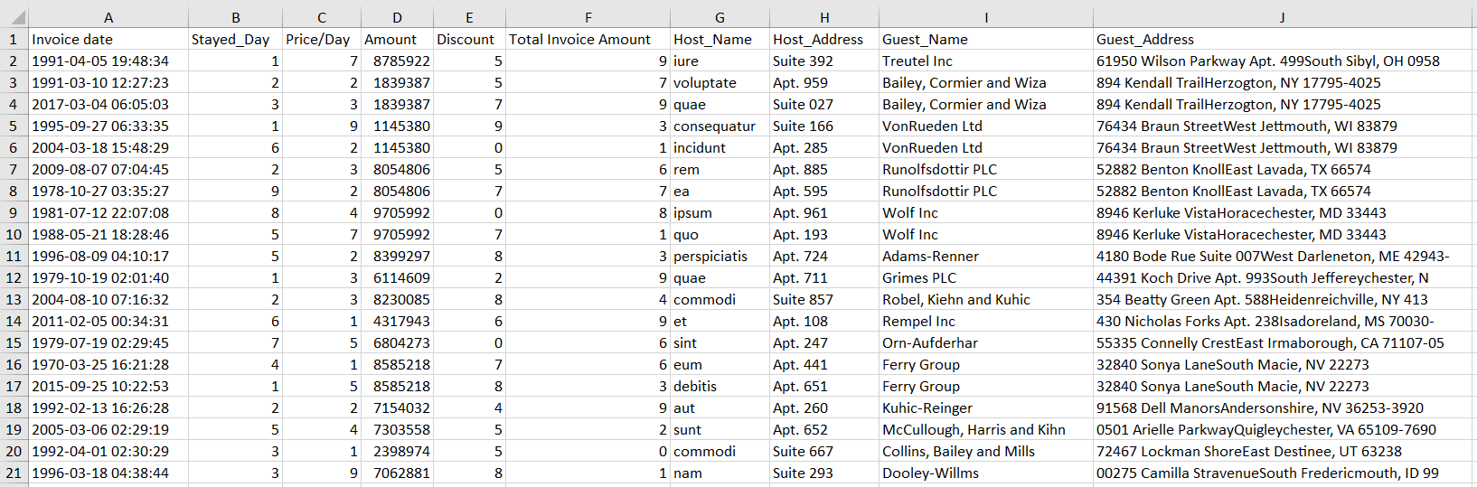
Ex. Query1 (cont.): Result

Slide 25
Ex. Query2: which facility is ordered by whom, when, reservation day, guest bank details?
SELECT
airbnb.userrole.userRole AS 'Role',
CONCAT(airbnb.userrole.name, ' ', airbnb.userrole.surname) AS USER_NAME_SURNAME,
airbnb.facility.name AS Host_Name,
airbnb.facilityorder.dayOrder AS 'Ordered/Day',
airbnb.facilityorder.create_time AS 'Order Date',
airbnb.usertaxid.userTaxNo AS Tax_ID,
airbnb.bank.bankName AS Bank_Name,
airbnb.bank.iban AS IBAN
FROM airbnb.bank
INNER JOIN airbnb.userrole ON ( airbnb.bank.fk_userRole = airbnb.userrole.id_userRole)
INNER JOIN airbnb.facility ON ( airbnb.bank.fk_facilityId = airbnb.facility.id_facility)
INNER JOIN airbnb.facilityorder ON ( airbnb.facility.id_facility = airbnb.facilityorder.fk_facilityId) , airbnb.usertaxid
WHERE airbnb.userrole.userRole = 'guest' ;
Have joined 5 tables together with where condition. Inner join method is used to query tables, CONCAT built-in function is used to merge name and surname columns

Slide 26
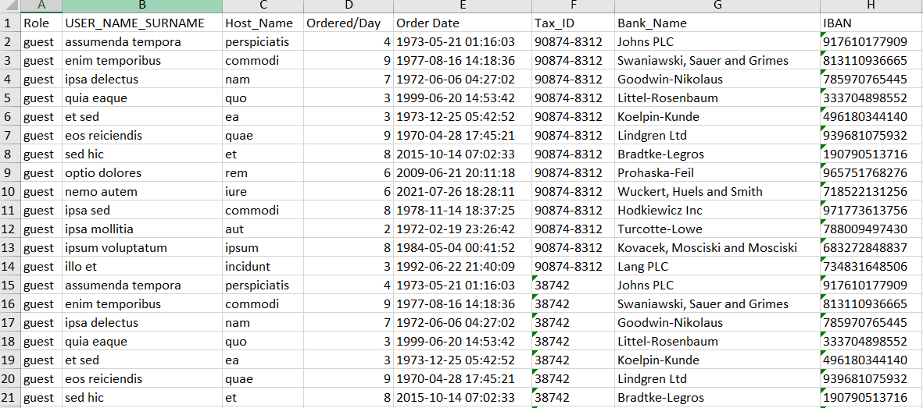
Ex. Query2 (cont.): Result

Slide 27
Ex. Query3: Host available dates and architecture details and Host type
SELECT
airbnb.facility.type AS Type, airbnb.facility.name AS Host_Name, airbnb.facility.adress AS Host_Address, airbnb.facilityarchitecture.totalSq AS Total_Sq,
airbnb.facilityarchitecture.hasBalcoon AS Has_Balcoon, airbnb.facilityarchitecture.hasRoom AS Has_Room,
airbnb.facilityavailability.availableStartDate AS Availibility_Start_Date, airbnb.facilityavailability.availableEndDate AS Availibility_End_Date
FROM airbnb.facilityarchitecture
INNER JOIN airbnb.facility ON ( airbnb.facilityarchitecture.fk_facilityId = airbnb.facility.id_facility)
INNER JOIN airbnb.facilityavailability ON ( airbnb.facility.id_facility = airbnb.facilityavailability.fk_facilityId) ;
Have joined 3 tables together. Inner join method is used to query tables,

Slide 28
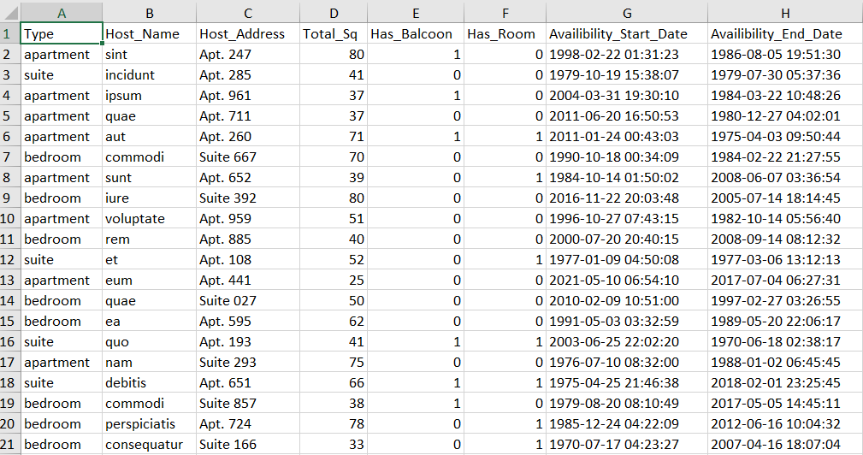
Ex. Query3 (cont.): Result

Slide 29
Thank you

