Slide 1
COS 30049 Computing Technology Innovation Project
Week6: Regression and Clustering in Machine Learning
Presented by: Hao Zhang
Semester 2

Slide 2
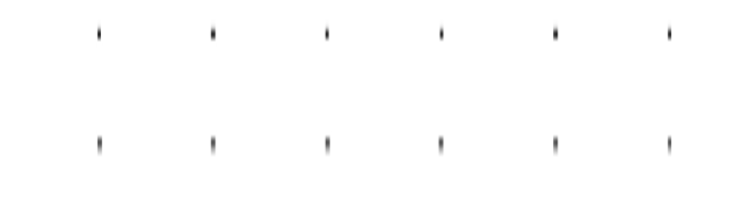

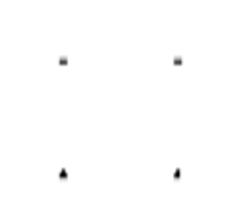
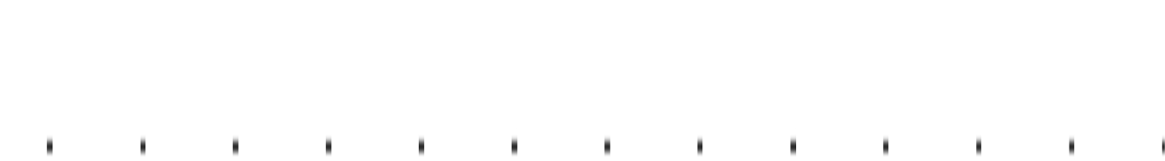
Acknowledgement of Country
We respectfully acknowledge the Wurundjeri People of the Kulin Nation, who are the Traditional Owners of the land on which Swinburne’s Australian campuses are located in Melbourne’s east and outer-east, and pay our respect to their Elders past, present and emerging.
We are honoured to recognise our connection to Wurundjeri Country, history, culture, and spirituality through these locations, and strive to ensure that we operate in a manner that respects and honours the Elders and Ancestors of these lands.
We also respectfully acknowledge Swinburne’s Aboriginal and Torres Strait Islander staff, students, alumni, partners and visitors.
We also acknowledge and respect the Traditional Owners of lands across Australia, their Elders, Ancestors, cultures, and heritage, and recognise the continuing sovereignties of all Aboriginal and Torres Strait Islander Nations.

Slide 3
Objectives: 1. Machine Learning and Related Concepts 2. Learning Regression Algorithms in Machine Learning 3. Learning How to Evaluate the Performance of Regression Algorithms 4. Learning Clustering Algorithms in Machine Learning 5. Learning How to Evaluate the Performance of Clustering Algorithms

Slide 4




Machine Learning
*What is Machine Learning?
Broadly speaking, machine learning is a method that enables machines to learn, allowing them to perform functions that cannot be accomplished through direct programming. However, in practical terms, machine learning is a method that involves using data to train a model, which is then used for prediction.
"Training" and "prediction" are the two main processes in machine learning, with the "model" being the intermediate output of these processes. "Training" produces the "model," and the "model" guides the "prediction."
History data
Experience
train
predict
results
New problem
Rules
future
New data
ML Models
Machine Learning
Human Learning

Slide 5
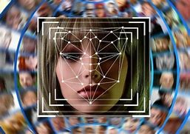



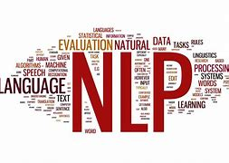
Machine Learning
Machine learning is closely related to fields like pattern recognition, statistical learning, and data mining. It also plays a crucial role in areas such as computer vision, speech recognition, and natural language processing, where it helps computers interpret and interact with the world in more human-like ways. While machine learning shares common ground with pattern recognition and data mining, its applications extend far beyond structured data to include images, audio, text, and other complex data types. This broad scope makes machine learning an essential and powerful tool across many domains, enabling advancements in technology, healthcare, finance, and countless other fields.

Slide 6
Machine Learning
Mathematical Prerequisites
1. Linear Algebra
Concepts from linear algebra are fundamental for understanding the theory behind machine learning, especially for those dealing with deep learning algorithms. When first getting into machine learning, you might not need to fully grasp linear algebra. However, as you progress and seek a deeper understanding of how different machine learning algorithms work, linear algebra becomes invaluable. It aids in making better decisions when developing machine learning systems.
2. Calculus
Calculus, particularly the computation of derivatives and their geometric and physical meanings, is central to solving most algorithms in machine learning. For instance, methods like gradient descent and Newton's method are commonly used in algorithms.
A solid understanding of the geometric significance of these concepts allows you to grasp that "gradient descent uses a plane to approximate the local area, while Newton's method uses a curved surface to approximate the local area," thereby leading to a better understanding of why and how these methods are applied.

Slide 7
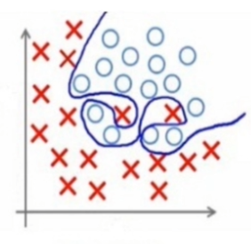
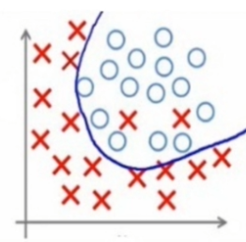
Machine Learning
*Overfitting and Underfitting
Overfitting
Overfitting occurs when a machine learning model learns not only the underlying pattern in the training data but also the noise and random fluctuations. As a result, the model performs very well on the training data but poorly on new, unseen data.
Complex Models: Using a model with too many parameters (e.g., a deep neural network with many layers) can lead to overfitting.
Insufficient Data: When the training dataset is too small, the model may learn the specific details of that dataset rather than general patterns.
Lack of Regularization: Without techniques to constrain the model, it can become overly complex.
overfitting
Good fitting

Slide 8
Machine Learning
*Overfitting and Underfitting
Overfitting
Overfitted models have low bias but high variance, meaning they are very sensitive to the specific training data and fail to generalize to new data.
This leads to poor performance on validation or test datasets, making the model unreliable for real-world applications.
Solutions:
Simplify the Model: Use a less complex model with fewer parameters to reduce the risk of overfitting.
Regularization: Apply regularization techniques to penalize overly complex models.
Increase Training Data: Collecting more data can help the model learn more general patterns rather than memorizing the training data.
Cross-Validation: Use techniques like cross-validation to ensure the model performs well on unseen data during the training process.
Early Stopping: In iterative algorithms like neural networks, stop training once the model’s performance on a validation set starts to degrade.

Slide 9
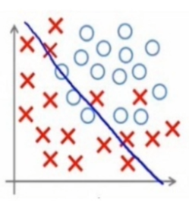
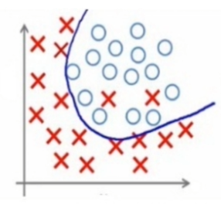
Machine Learning
Overfitting and Underfitting
*Underfitting
Underfitting happens when a model is too simple to capture the underlying pattern in the data, leading to poor performance on both the training and unseen data.
Too Simple Models: Using a model with too few parameters (e.g., a linear model for non-linear data) can lead to underfitting.
Insufficient Training: The model might not have been trained for enough time or with enough data, leading to inadequate learning.
Inappropriate Features: If the features used for training do not have enough predictive power, the model may struggle to find a meaningful pattern.
underfitting
Good fitting

Slide 10
Machine Learning
Overfitting and Underfitting
Underfitting
Underfitted models have high bias and low variance, meaning they are unable to capture the complexity of the data.
This results in poor predictions on both the training set and any new data, making the model ineffective.
Solutions:
Increase Model Complexity: Use a more complex model that can better capture the patterns in the data.
Feature Engineering: Improve the features by adding or deriving new features that better represent the underlying patterns.
Train Longer: Allow the model to train for more epochs or iterations to improve its learning.
Use More Suitable Algorithms: Choose algorithms that are better suited to the data’s structure and complexity.

Slide 11
Machine Learning
How do we assess a model's prediction accuracy? Loss Functions
Loss functions are critical in machine learning as they measure the difference between the predicted values and the actual values.
The goal of most machine learning algorithms is to minimize this loss, thereby improving the model's accuracy.
Why we need loss functions?
In machine learning, we aim to make the predicted values as close as possible to the actual values, so it's essential to minimize the difference (which is where loss functions come into play). The choice of loss function is critical in this process. In specific projects, some loss functions result in faster gradient descent, while others may lead to slower descent. Therefore, selecting the appropriate loss function is crucial.

Slide 12
Machine Learning
Loss Functions
Position of loss function in machine learning
In machine learning, we know that the input features (often referred to as x) are used by the model to predict an output y. This process is known as the forward pass. However, to improve the accuracy of the predictions by minimizing the difference between the predicted values and the actual values, we need to update the model's parameters. This updating process is called the backward pass or backpropagation. The loss function plays a crucial role in this process, as it calculates the difference between the predictions and the actual values during the forward pass, and then guides how the model's parameters should be adjusted during the backward pass to reduce this difference.
Forward propagation: Computes the output based on current parameters.
Backward propagation: Adjusts the parameters to reduce the error in future predictions.

Slide 13
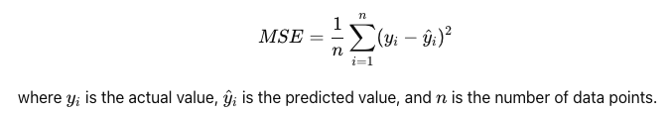
Machine Learning
Loss Functions
1. Mean Squared Error (MSE)
The Mean Squared Error (MSE) function calculates the average of the squares of the differences between the predicted values and the actual values. It's widely used in regression tasks.
MSE gives more weight to larger errors because the errors are squared. This means that MSE is sensitive to outliers.
It's a common choice for measuring the accuracy of continuous models.

Slide 14

Machine Learning
Loss Functions
2. Root Mean Squared Error (RMSE)
The Root Mean Squared Error (RMSE) is the square root of the MSE. It provides the error metric in the same units as the target variable, making it easier to interpret.
Like MSE, RMSE is also sensitive to outliers. However, it’s often preferred when the units of the error matter since it’s in the same units as the original data.
RMSE is widely used in practice due to its interpretability.

Slide 15

Machine Learning
Loss Functions
3. Mean Absolute Error (MAE):
The Mean Absolute Error (MAE) function calculates the average of the absolute differences between the predicted values and the actual values. It measures the average magnitude of errors in a set of predictions, without considering their direction.
MAE is less sensitive to outliers than MSE because it doesn’t square the errors.
MAE gives equal weight to all errors, making it a more straightforward measure of average model performance.

Slide 16
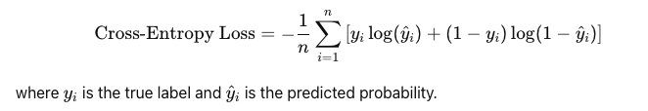
Machine Learning
Loss Functions – additional knowledge
4. Cross-Entropy Loss (Log Loss):
Used for: Classification tasks, especially binary and multi-class classification.
Cross-entropy loss measures the difference between two probability distributions: the true labels and the predicted probabilities. It is widely used because it effectively penalizes incorrect predictions with higher confidence.
(for binary classification)

Slide 17

Machine Learning
Loss Functions – additional knowledge
5. Cosine Similarity Loss:
Used for: Tasks that involve measuring the similarity between two vectors, such as in recommendation systems or text similarity tasks.
Cosine similarity loss measures the cosine of the angle between two non-zero vectors, which reflects how similar they are.

Slide 18
Regression Algorithms
Regression models are machine learning algorithms used to predict continuous numerical variables. Their main objective is to analyze and learn the relationship between input data and the target variable, thereby establishing a mathematical model to make predictions on new data.
Uses of Regression Models
1. Predicting Numerical Variables
For example, predicting house prices, temperature forecasts, sales predictions, etc.
2. Trend Analysis
For example, trend analysis in economics, price trend analysis in the stock market, etc.
3. Evaluating Influential Factors
For example, in medical research, evaluating the influence of various factors (such as age, weight, blood pressure) on a patient's condition.
Applicable Data Types
1. Numerical Data
For example, house area, sales volume, temperature, etc.
2. Labeled Data
For example, known historical house price data, past sales data, etc.

Slide 19


Linear regression
Linear regression is a basic regression algorithm used to predict continuous numerical variables. It describes the relationship between independent variables (features) and the dependent variable (target) by fitting a straight line.
The objective of a linear regression model is to find the optimal line that minimizes the error between the predicted values and the actual values.
The general formula for a linear regression model can be expressed as:
For a simple linear regression model with only one independent variable 𝑥, the formula simplifies to:
Linear regression models are simple and easy to understand, computationally efficient, and suitable for preliminary data analysis and prediction tasks, such as: Predictive analysis in economics; Quality control in engineering; Relationship modeling in medicine; Trend analysis in social sciences

Slide 20
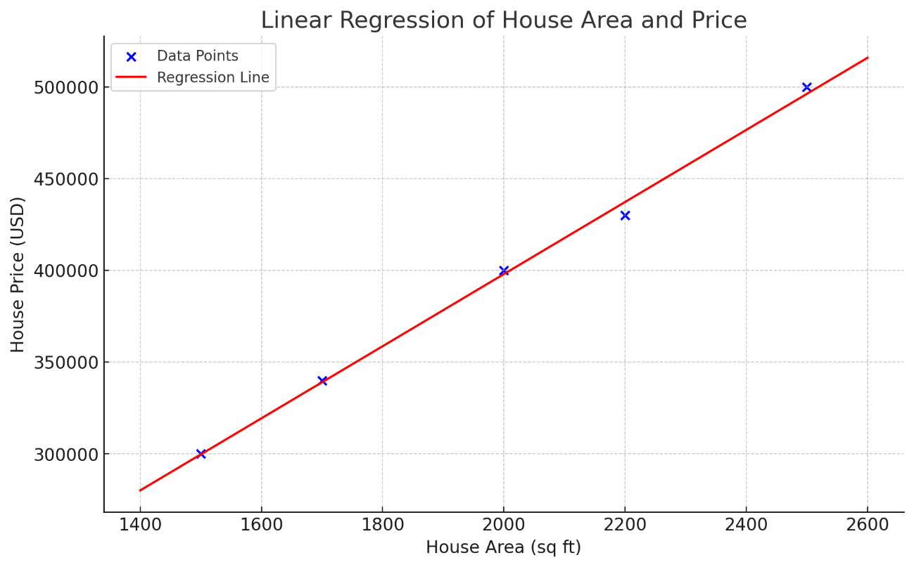
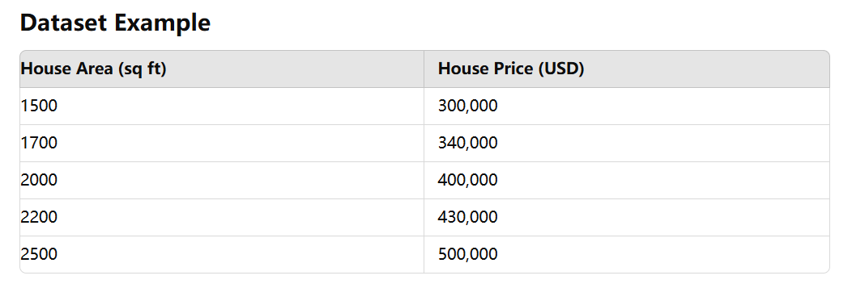
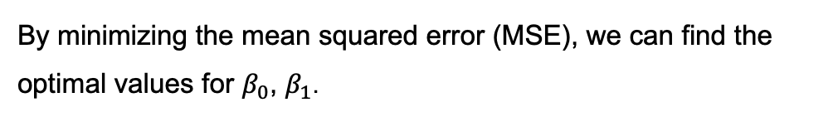
Linear regression: Example
We assume a linear relationship between house price 𝑦 and house area 𝑥, represented by the equation:
By minimizing the mean squared error (MSE), we can find the optimal values for $β_{0}$, $β_{1}$.

Slide 21

Ridge Regression
Ridge Regression, also known as L2 regularization regression, is an extension of linear regression that addresses multicollinearity issues. When independent variables are highly correlated, the coefficients estimated by Ordinary Least Squares (OLS) regression can become unstable, leading to overfitting. Ridge regression adds an L2 regularization term to the loss function, which helps to constrain the size of the regression coefficients, thus enhancing the model's stability and predictive performance.
Characteristics of Ridge Regression
Handling Multicollinearity
Ridge regression addresses multicollinearity by adding an L2 regularization term to the loss function, which constrains the size of the regression coefficients and reduces the impact of high correlation between independent variables.
Preventing Overfitting
The inclusion of the regularization term helps prevent overfitting, improving the model's generalization ability on test data.
The loss function for the ridge regression model can be expressed as:

Slide 22

Polynomial Regression
Polynomial regression is a regression algorithm used to describe the nonlinear relationship between independent variables (features) and the dependent variable (target variable).
Unlike linear regression, polynomial regression allows the model to fit more complex curves instead of just a straight line. By adding polynomial terms of the independent variables (such as square terms, cubic terms), polynomial regression can capture nonlinear patterns in the data.
The general formula for a polynomial regression model can be expressed as:
Polynomial regression is widely used in many practical applications, especially when dealing with nonlinear relationships.
For example:
Economics: Analyzing and predicting nonlinear changes in economic indicators (such as GDP growth rate, inflation rate).
Environmental Science: Predicting nonlinear trends in environmental variables (such as pollutant concentration over time).
Medicine: Studying and predicting nonlinear patterns in disease progression (such as tumor growth over time).

Slide 23

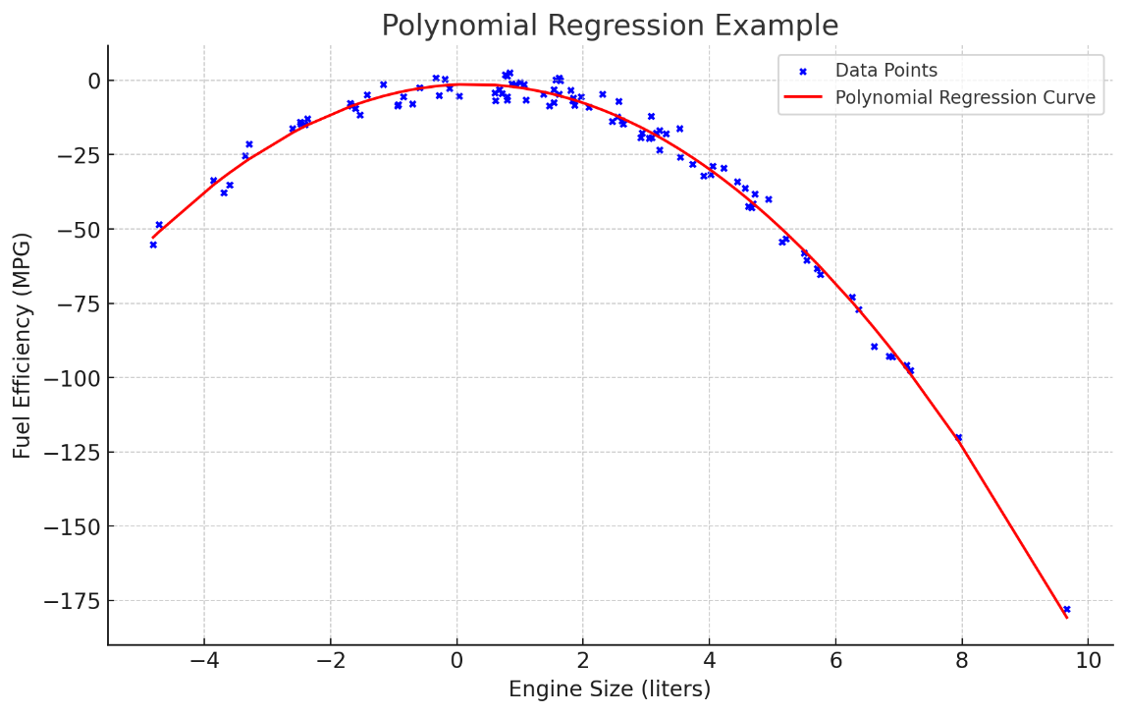
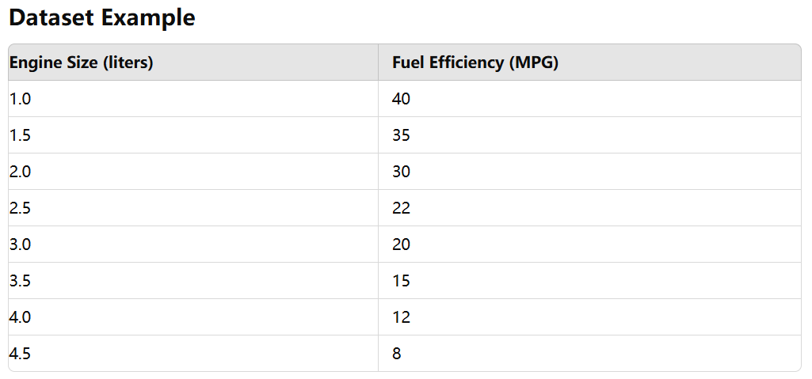
Polynomial Regression: Example
Suppose we want to model the relationship between a car's engine size (in liters) and its fuel efficiency (miles per gallon, MPG).
We assume a quadratic polynomial regression model to capture the nonlinear relationship:

Slide 24

Stepwise Regression
Stepwise regression is a method of fitting regression models in which the choice of predictive variables is carried out by an automatic procedure. This method is particularly useful when dealing with datasets that have a large number of potential explanatory variables, helping to identify the most significant ones for inclusion in the model. The procedure involves iterative addition or removal of variables based on specific criteria, such as the Akaike Information Criterion (AIC), Bayesian Information Criterion (BIC), or p-values of the coefficients.
General Procedure for Stepwise Regression Initialization
Start with an empty model (for forward selection) or a full model (for backward elimination). Iteration Forward Selection: Add the variable that provides the best fit improvement. Backward Elimination: Remove the variable that has the least significance. Stepwise Selection: At each step, add or remove variables based on their impact on the model. Termination The process stops when adding or removing a variable does not significantly improve the model.
The general formula for a polynomial regression model can be expressed as:

Slide 25


Evaluation of Regression
Overview of the common evaluation metrics for regression models – like loss functions
1. MSE
MSE is commonly used in many regression models because it heavily penalizes large errors, making it sensitive to outliers. It’s frequently applied in algorithms like Linear Regression, Ridge Regression, and Neural Networks.
Sensitive to large errors, which is beneficial when large deviations are particularly undesirable.
The penalization of large errors can lead to models that are overly sensitive to outliers.
2. Root Mean Squared Error (RMSE)
RMSE is widely used alongside MSE for its interpretability and is favored when comparing models on the same dataset. Commonly used in Linear Regression, Polynomial Regression, and Support Vector Regression (SVR).
Directly comparable to the scale of the target variable, making it easier to understand.
Like MSE, it is sensitive to outliers.

Slide 26


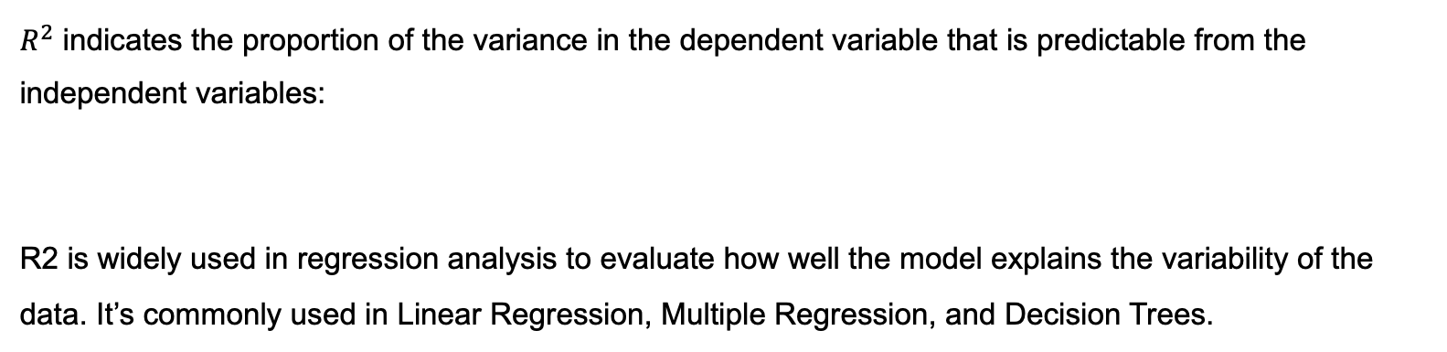
Evaluation of Regression
Overview of the common evaluation metrics for regression models – like loss functions
3. Mean Absolute Error (MAE)
MAE is useful when all errors should be treated equally, regardless of their magnitude. It’s often used in robust regression models, such as Lasso Regression, and models dealing with skewed data.
Less sensitive to outliers compared to MSE/RMSE, providing a more balanced view of error.
Does not heavily penalize large errors, potentially underestimating the impact of outliers.
4. R2 Score
$R^{2}$ indicates the proportion of the variance in the dependent variable that is predictable from the independent variables:
R2 is widely used in regression analysis to evaluate how well the model explains the variability of the data. It’s commonly used in Linear Regression, Multiple Regression, and Decision Trees.

Slide 27
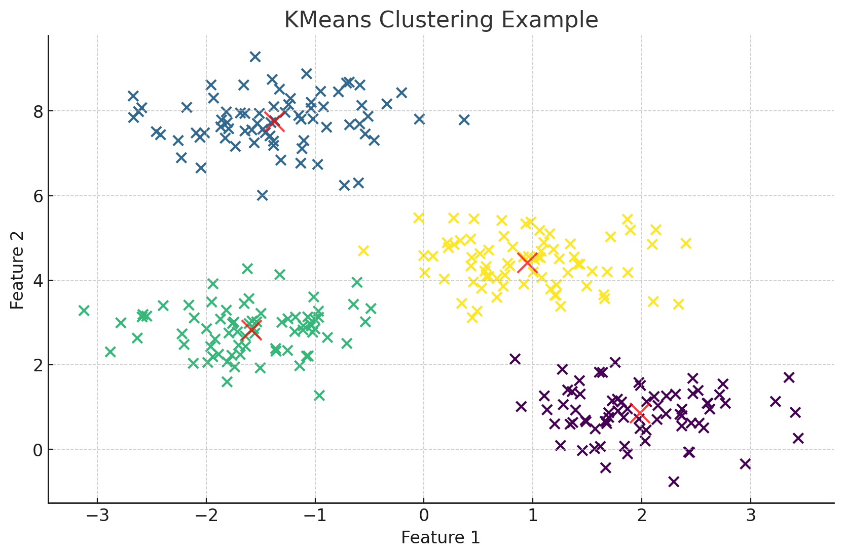
Clustering Algorithms
Clustering is an unsupervised learning method that aims to group data points in a dataset into clusters such that data points within the same cluster are similar, while data points in different clusters are dissimilar. The goal of clustering is to discover the inherent structure or patterns in the data without needing prior knowledge of the data labels.
Problems that Clustering Can Solve
Market Segmentation
By grouping customers into different segments, clustering can help identify customer groups with similar characteristics, enabling targeted marketing strategies.
Image Segmentation
Clustering can divide an image into different regions based on pixel similarity, aiding in image processing tasks such as object detection and edge detection.
Document Clustering
Clustering can group large sets of documents into topic-related clusters, facilitating text mining, information retrieval, and recommendation systems.

Slide 28

K-means
K-Means is one of the most popular and straightforward clustering algorithms. It aims to partition a dataset into 𝑘 clusters, where each data point belongs to the cluster with the nearest mean. The goal is to minimize the within-cluster sum of squares, also known as the inertia.
How K-Means Works
Initialization: Randomly select 𝑘 initial centroids from the dataset. These centroids represent the initial guess for the cluster centers.
Assignment: Assign each data point to the nearest centroid, forming 𝑘 clusters. The distance between data points and centroids is typically measured using Euclidean distance.
Update: Recalculate the centroids by taking the mean of all data points assigned to each cluster.
Repeat: Repeat the assignment and update steps until the centroids no longer change significantly, indicating convergence.
The objective function of K-Means is to minimize the following cost function:

Slide 29
K-means
Choosing the Number of Clusters 𝑘:
One common method to determine the appropriate number of clusters is the Elbow Method:
1. Run K-Means with different values of 𝑘 (e.g., from 1 to 10).
2. Calculate the within-cluster sum of squares (inertia) for each value of 𝑘.
3. Plot the inertia against the number of clusters.
4. Look for the "elbow" point in the plot where the inertia begins to decrease more slowly. This point suggests an optimal number of clusters.
Advantages and Disadvantages of K-Means
Advantages: Simple and easy to implement; Computationally efficient, especially with large datasets; Works well with spherical (globular) cluster shapes.
Disadvantages: Requires specifying the number of clusters 𝑘 in advance; Sensitive to initial centroid positions (may converge to local minima); Not suitable for clusters of varying sizes and densities; Assumes clusters are spherical and equally sized, which may not always be true.

Slide 30

Evaluation of K-means
Evaluating a K-means clustering algorithm can be challenging because clustering is an unsupervised learning task, meaning there are no predefined labels to compare the clustering results against.
However, several metrics and techniques can be used to evaluate the quality of the clusters produced by the K-means algorithm.
1. Inertia (Within-cluster Sum of Squares)
Inertia measures how tightly the clusters are packed, meaning how close the points in a cluster are to the cluster center (centroid). It’s calculated as the sum of squared distances between each point and its assigned cluster centroid.
Simple to compute and interpret, especially when determining the number of clusters.
Inertia alone can sometimes be misleading because it always decreases as the number of clusters increases, leading to overfitting.

Slide 31
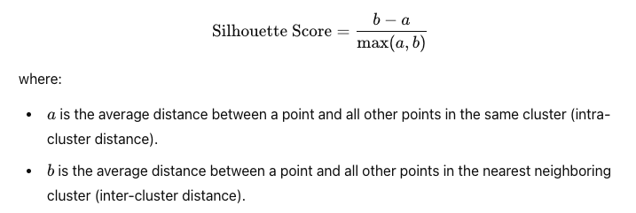
Evaluation of K-means
2. Silhouette Score
The Silhouette Score measures how similar a point is to its own cluster (cohesion) compared to other clusters (separation). It ranges from -1 to 1, where a high value indicates that the point is well clustered.
Provides a comprehensive measure of how well the clusters are separated and compact.
Can be computationally expensive, especially for large datasets.

Slide 32
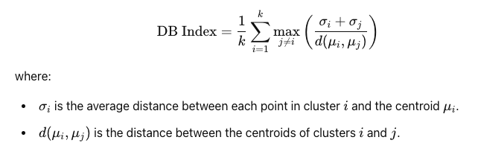
Evaluation of K-means
3. Davies-Bouldin Index
The Davies-Bouldin Index is the average similarity ratio of each cluster with its most similar cluster. A lower value indicates better clustering.
Takes into account both within-cluster scatter and between-cluster separation.
Like the Silhouette Score, it can be computationally intensive.

Slide 33
Thank you

