Slide 1
COS 30049 Computing Technology Innovation Project
Week6: Regression and Clustering in Machine Learning
Seminar
Presented by: Hao Zhang
Semester 2

Slide 2
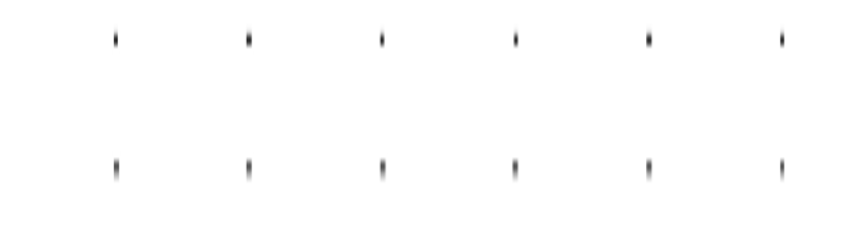

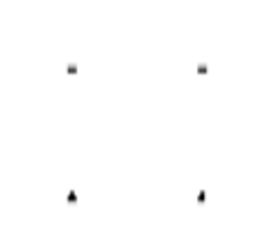
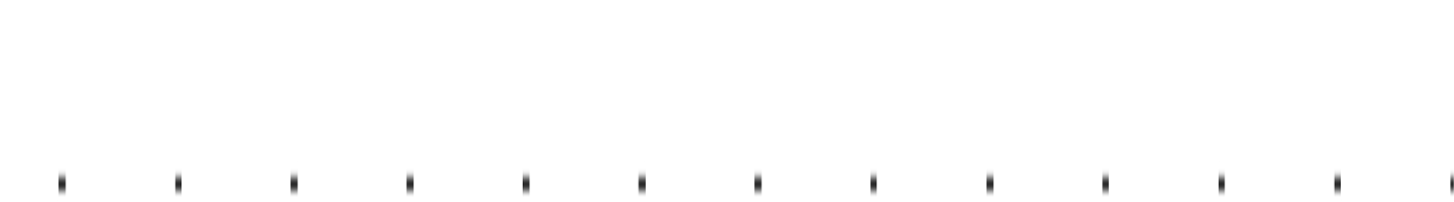
Acknowledgement of Country
We respectfully acknowledge the Wurundjeri People of the Kulin Nation, who are the Traditional Owners of the land on which Swinburne’s Australian campuses are located in Melbourne’s east and outer-east, and pay our respect to their Elders past, present and emerging.
We are honoured to recognise our connection to Wurundjeri Country, history, culture, and spirituality through these locations, and strive to ensure that we operate in a manner that respects and honours the Elders and Ancestors of these lands.
We also respectfully acknowledge Swinburne’s Aboriginal and Torres Strait Islander staff, students, alumni, partners and visitors.
We also acknowledge and respect the Traditional Owners of lands across Australia, their Elders, Ancestors, cultures, and heritage, and recognise the continuing sovereignties of all Aboriginal and Torres Strait Islander Nations.

Slide 3
Objectives: 1. Understand and learn to use Sklearn Library for Regression 2. Understand and learn to use Sklearn Library for clustering

Slide 4
Python for Machine Learning
1. Why Python for Data Science?
Python is a versatile, easy-to-learn programming language that has become the standard in the AI community.
Python offers extensive libraries and tools that are specifically designed for data analysis, machine learning, and scientific computing.
2. Python in Action
Python is used by major companies like Google, Facebook, and Netflix for data analysis, predictive modeling, and algorithm development.
The language’s simplicity allows data scientists to quickly prototype ideas and test new algorithms with less code.
3. Why Learn Python for Data Science?
Wide Adoption: Python is widely adopted across industries, making it a valuable skill for a career in data science.
Community Support: With a large and active community, Python users have access to a wealth of resources, tutorials, and forums for troubleshooting and learning.

Slide 5

Scikit-learn (sklearn)
Scikit-Learn, commonly known as sklearn
is a powerful Python library specifically designed for machine learning and data analysis. It is built on top of SciPy and provides simple and efficient tools for data mining and data analysis.
scikit-learn: machine learning in Python — scikit-learn 1.5.1 documentation
You can install scikit-learn (sklearn) with:
pip install scikit-learn
conda install scikit-learn
or

Slide 6
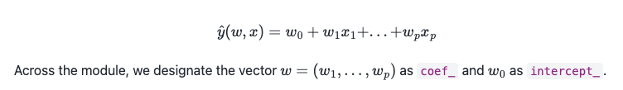
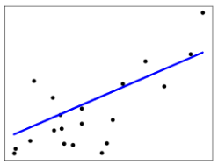


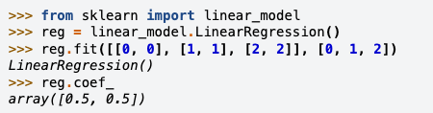
Scikit-learn (sklearn) - linear_model
1. Linear Regression
Ordinary Least Squares

Slide 7

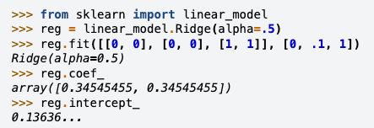
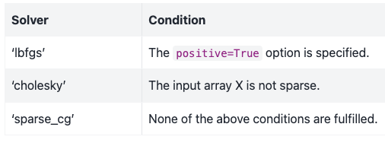
Scikit-learn (sklearn) - linear_model
2. Ridge regression
Ridge regression addresses some of the problems of Ordinary Least Squares by imposing a penalty on the size of the coefficients.
More info about sklearn and Linear Models:
1.1. Linear Models — scikit-learn 1.5.1 documentation

Slide 8
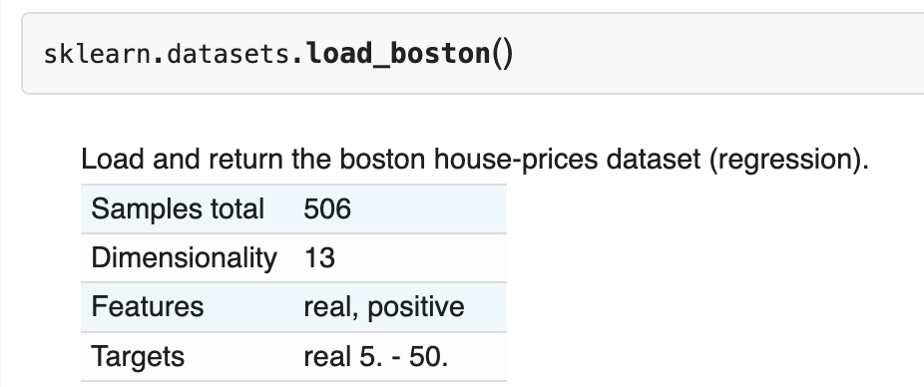
Boston Housing Dataset Overview
The Boston Housing Dataset is a well-known dataset often used for regression tasks in machine learning.
It consists of 506 samples, each representing a neighborhood in Boston, with 13 different features that describe various aspects of the housing and environmental conditions in the area.
The main objective is to predict the median value of owner-occupied homes (MEDV) using the other 13 features.
In this week’s workshop, we will specifically focus on predicting house prices using the number of rooms (RM) as the independent variable.
applications of predictive modeling.

Slide 9
Boston Housing Dataset Overview
The Boston Housing Dataset is frequently used in introductory courses on machine learning and data science to demonstrate the principles of linear regression.
It provides a practical example of how to use historical data to predict future outcomes (e.g., house prices based on certain features).
Why the Boston Housing Dataset?
The dataset is well-structured, making it an excellent example for teaching data preprocessing, feature selection, and model evaluation.
Its real-world relevance helps students understand the practical applications of predictive modeling.

Slide 10
Feature Selection for Linear Regression
Feature Selection
Feature selection is the process of identifying the most relevant variables (features) that contribute significantly to the model's predictions.
In linear regression, selecting the right features is crucial as it directly impacts the accuracy and interpretability of the model.
Example: Why Use RM (Number of Rooms) in the workshop (California)?
The MedInc feature (Median Income) is chosen as it shows a strong correlation with the target variable (MedHouseVal - Median House Value).
Median income is a key determinant of house prices, making it a valuable predictor.
Correlation Analysis:
A correlation matrix or scatter plot can be used to visually inspect the relationship between MedInc and MedHouseVal.
This helps confirm that MedInc is a strong predictor for MedHouseVal.

Slide 11
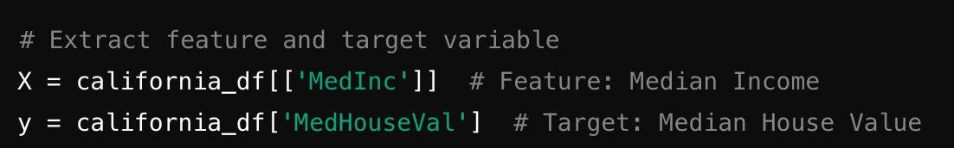
Feature Selection for Linear Regression
X represents the input feature(s) or independent variable(s) that the model will use to make predictions. In this case, X is the median income (MedInc), a feature that describes the average income of households in a given area.
y represents the output or dependent variable, which is what the model is trying to predict. Here, y is the median house value (MedHouseVal), indicating the average house price in the corresponding area.
Example:
X: A column vector (in pandas DataFrame) where each row contains the median income for a particular neighborhood.
y: A single-column vector where each row contains the corresponding median house value.

Slide 12
Splitting Data into Training and Test Sets
Importance of Splitting Data:
Splitting the dataset into training and test sets is crucial for evaluating the model's performance on unseen data.
The training set is used to build the model, while the test set is used to assess its accuracy.
Common Split Ratios:
Typically, the data is split into 80% for training and 20% for testing.
This ensures the model has sufficient data to learn from while also providing a robust evaluation on the test set.
Using train_test_split from sklearn:
The train_test_split function in sklearn is a convenient way to divide the data into training and test sets.
Setting a random_state ensures that the results are reproducible, meaning you will get the same split every time you run the code.

Slide 13
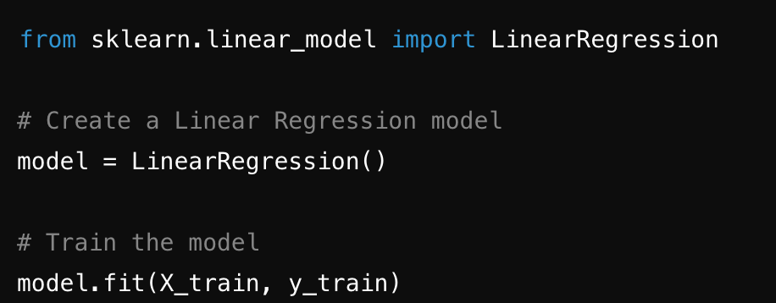
Creating and Training the Linear Regression Model
Introduction to Linear Regression in sklearn:
The LinearRegression class in sklearn allows for easy implementation of linear regression models.
This class fits a linear model to minimize the residual sum of squares between observed and predicted values.
Model Creation:
Creating a linear regression model is straightforward using LinearRegression from sklearn.
Training the Model:
Training the model involves fitting it to the training data (X_train and y_train).

Slide 14
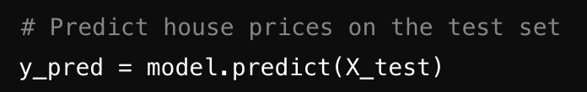
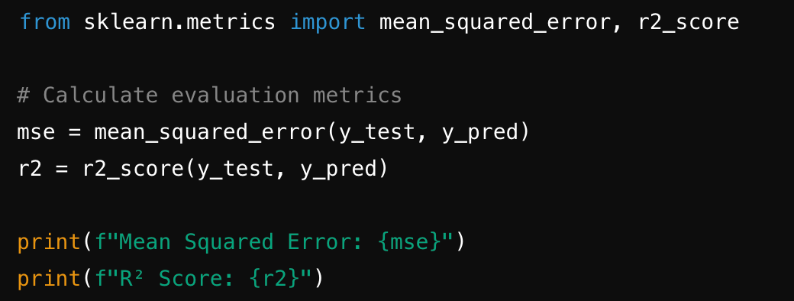
Making Predictions and Evaluating the Model
Making Predictions:
After training the model, it can be used to predict the values for the test set.
Compare the predicted values (y_pred) with the actual values (y_test) to assess the model's performance.
Model Evaluation Metrics:
Mean Squared Error (MSE): Measures the average squared difference between actual and predicted values.
R² Score: Indicates the proportion of variance in the dependent variable that is predictable from the independent variable(s).
A lower MSE indicates a better fit, and an R² score close to 1 suggests that the model explains most of the variance in the target variable.

Slide 15
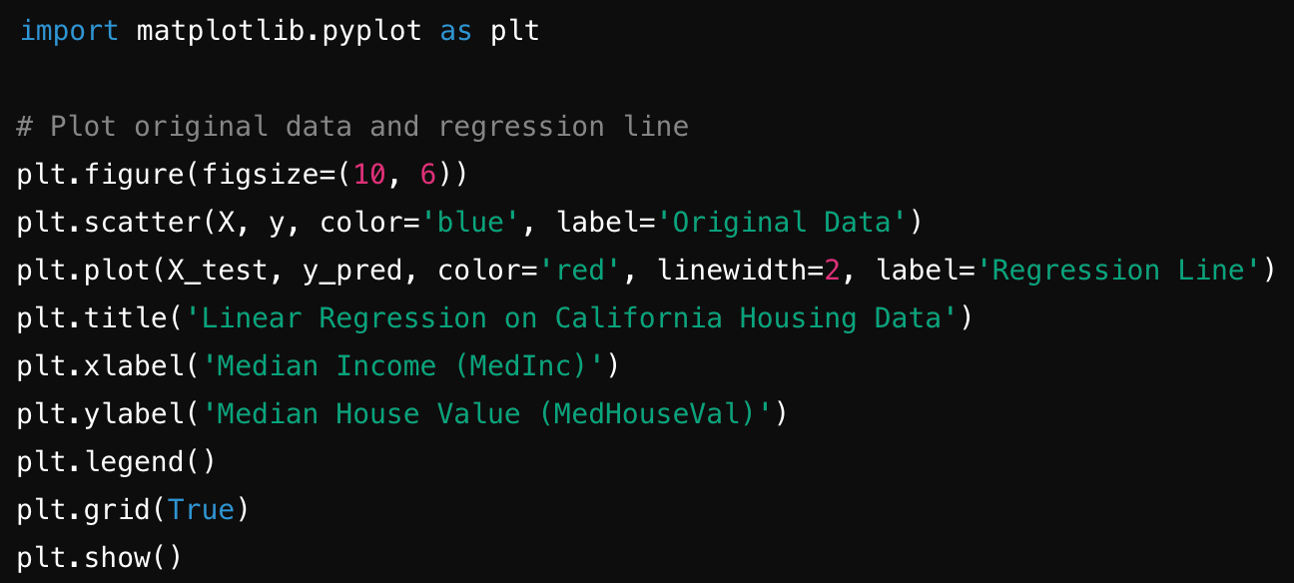
Visualizing the Regression Line
Why Visualization Matters:
Visualizing the regression line along with the actual data points provides a clear understanding of the model's fit.
It helps illustrate how well the model captures the underlying trend in the data.
Using matplotlib for Visualization:
matplotlib is a versatile library for creating static, interactive, and animated visualizations in Python.
It will be used to plot the original data and the regression line.
Plotting the Data and Regression Line:
The scatter plot shows the original data, while the regression line illustrates the model's predictions.

Slide 16
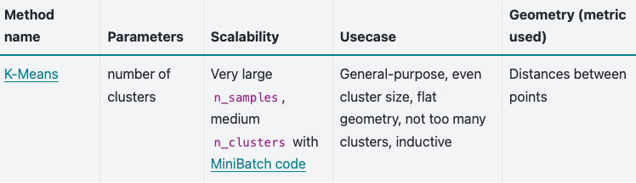
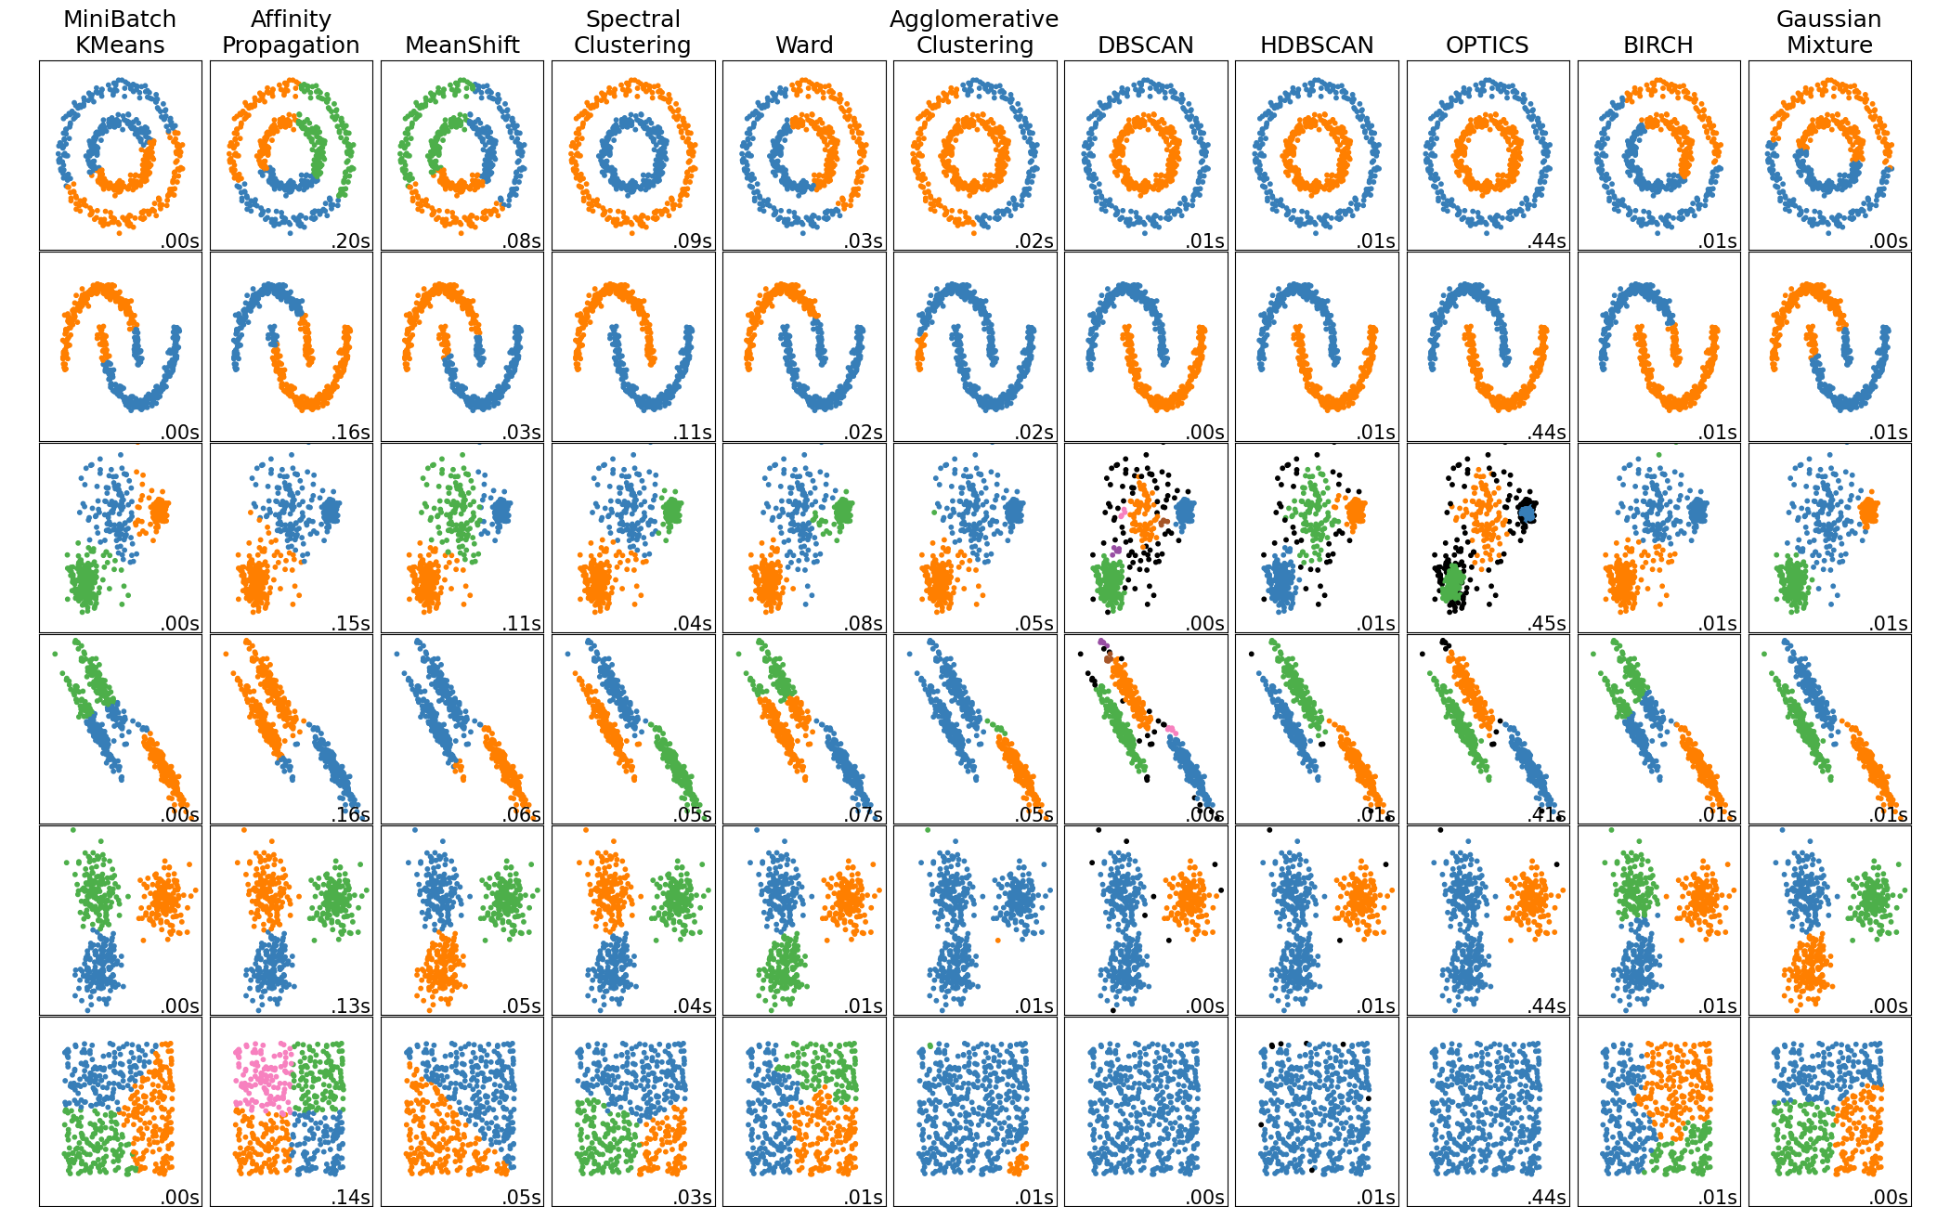
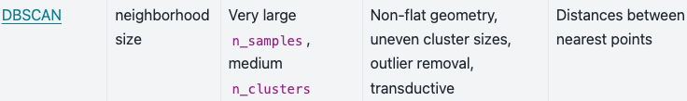
Scikit-learn (sklearn) - Clustering
Clustering of unlabeled data can be performed with the module sklearn.cluster.
More info about sklearn and clustering:
2.3. Clustering — scikit-learn 1.5.1 documentation

Slide 17

Scikit-learn (sklearn) - Clustering
1. K-means
The KMeans algorithm clusters data by trying to separate samples in n groups of equal variance, minimizing a criterion known as the inertia or within-cluster sum-of-squares (see below). This algorithm requires the number of clusters to be specified. It scales well to large numbers of samples and has been used across a large range of application areas in many different fields.
More info about instance: Clustering text documents using k-means — scikit-learn 1.5.1 documentation

Slide 18
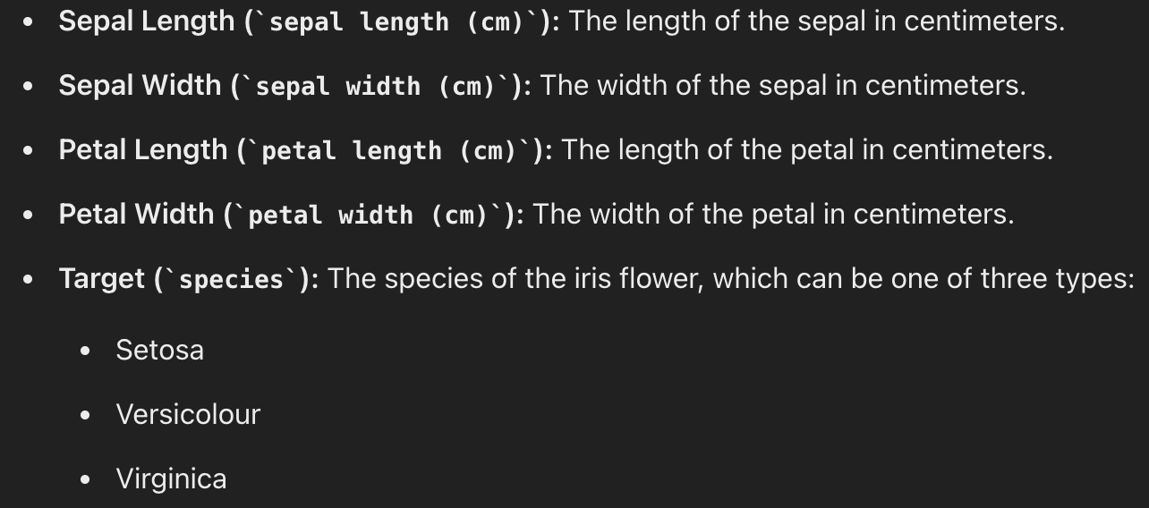
Iris Dataset Overview
The Iris dataset is one of the most famous datasets in the field of machine learning and data science, often used to demonstrate the basic concepts of classification and clustering.
It contains 150 samples, each representing a different iris flower, with four features that describe the physical characteristics of the flowers.
The goal of using the Iris dataset in this workshop is to perform clustering using the K-Means algorithm.
K-Means will partition the data into clusters, ideally corresponding to the three species of iris flowers.
Why the Iris Dataset?
The simplicity and small size of the dataset make it an excellent choice for beginners to understand key concepts like clustering.
Its real-world relevance helps students grasp how clustering can be applied to differentiate between distinct groups in a dataset.

Slide 19
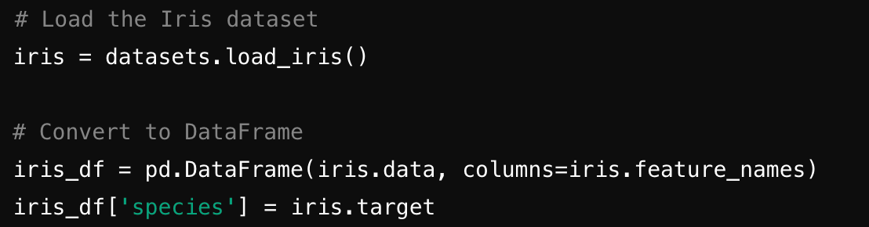
Loading and Exploring the Iris Dataset
Loading the Dataset:
The Iris dataset can be easily loaded using the datasets module from sklearn.
Once loaded, the data can be converted into a pandas DataFrame for easier manipulation and analysis.
iris_df.head(): Displays the first few rows of the DataFrame to get an overview of the data.
Plotting the Data: Visualizing the original data helps in understanding the distribution of different species across the features.

Slide 20
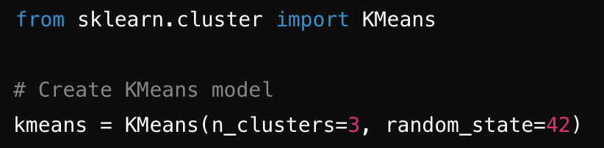
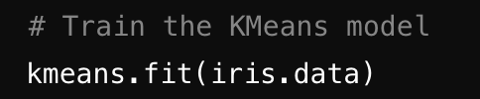
Creating and Training the KMeans Model
Introduction to K-Means Clustering:
K-Means is a popular unsupervised learning algorithm used to partition data into k clusters based on feature similarity.
The algorithm assigns each data point to the nearest cluster centroid, minimizing the variance within clusters.
Choosing the Number of Clusters (k):
For the Iris dataset, k=3 is a natural choice since there are three species of iris flowers.
Fitting the Model:
The model learns the cluster centroids by iteratively adjusting them to minimize the within-cluster variance.

Slide 21
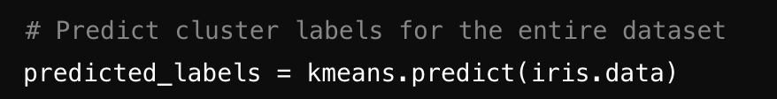
Predicting and Plotting Clustering Results
After training the K-Means model, the next step is to predict the cluster labels for each data point.
The predicted_labels array contains the cluster assignments for each sample in the Iris dataset.
Visualizing the Clustering Results Visualizing the results of the clustering helps in understanding how well the K-Means algorithm has partitioned the data.
The plot shows the data points color-coded by the cluster they have been assigned to by the K-Means algorithm.
Each cluster is expected to group similar data points together, ideally corresponding to the three species of iris flowers.

Slide 22
Real-World Applications of K-Means Clustering
Customer Segmentation: Businesses use K-Means clustering to segment customers into different groups based on purchasing behavior, demographics, or other characteristics.
Image Compression: K-Means can be used to reduce the number of colors in an image, effectively compressing the image while retaining its visual quality.
Anomaly Detection: K-Means clustering helps identify unusual patterns in data, flagging them as potential anomalies.
Document Classification: Clustering algorithms like K-Means can group similar documents together based on text features, aiding in organizing large collections of documents.

Slide 23
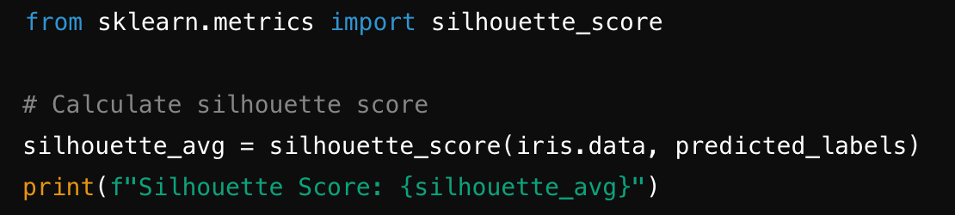
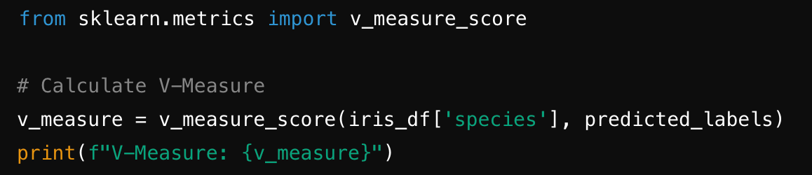
Evaluating the K-Means Model
Silhouette Score:
The silhouette score measures how similar a data point is to its own cluster compared to other clusters. It ranges from -1 to 1, where a score closer to 1 indicates that the data point is well-clustered.
A high silhouette score indicates that the clusters are well-separated and the data points are well-assigned to their respective clusters.
V-Measure
The V-Measure evaluates clustering by balancing homogeneity (clusters containing only members of a single class) and completeness (all members of a given class are assigned to the same cluster). It ranges from 0 to 1.

Slide 24
Thanks

