Slide 1
COS 30049 Computing Technology Innovation Project
Week7: Clustering and Classification Tasks in Python
Semester 2

Slide 2
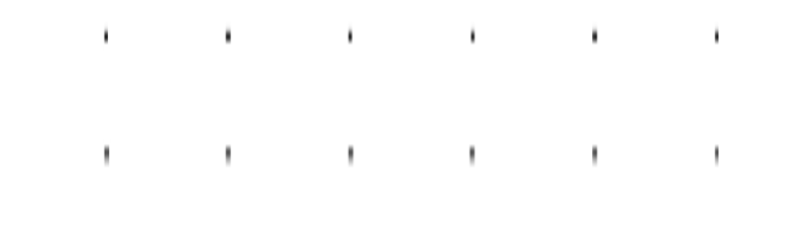

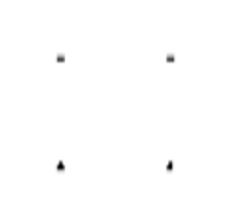

Acknowledgement of Country
We respectfully acknowledge the Wurundjeri People of the Kulin Nation, who are the Traditional Owners of the land on which Swinburne’s Australian campuses are located in Melbourne’s east and outer-east, and pay our respect to their Elders past, present and emerging.
We are honoured to recognise our connection to Wurundjeri Country, history, culture, and spirituality through these locations, and strive to ensure that we operate in a manner that respects and honours the Elders and Ancestors of these lands.
We also respectfully acknowledge Swinburne’s Aboriginal and Torres Strait Islander staff, students, alumni, partners and visitors.
We also acknowledge and respect the Traditional Owners of lands across Australia, their Elders, Ancestors, cultures, and heritage, and recognise the continuing sovereignties of all Aboriginal and Torres Strait Islander Nations.

Slide 3
Objectives: Introduction to DBSCAN implementation Practical steps in Logistic Regression Practical steps in KNN Code evaluation and visualization techniques

Slide 4
Clustering - DBSCAN
DBSCAN (Density-Based Spatial Clustering of Applications with Noise) is an unsupervised clustering algorithm. It identifies clusters in data by finding regions of high density separated by regions of low density. Unlike k-means, it doesn’t require the number of clusters to be specified beforehand.
Key Characteristics of DBSCAN:
Handles Arbitrary Shapes: DBSCAN can find clusters of any shape, which makes it powerful for datasets where the clusters are not spherical (unlike k-means).
Noise Handling: It classifies points that don’t belong to any cluster as noise, useful in datasets with outliers.
When to Use DBSCAN:
Use DBSCAN when you don’t know the number of clusters in advance.
It’s effective in datasets with non-spherical clusters and noise.
Ideal for data where the clusters are densely packed and separated by sparse regions.

Slide 5
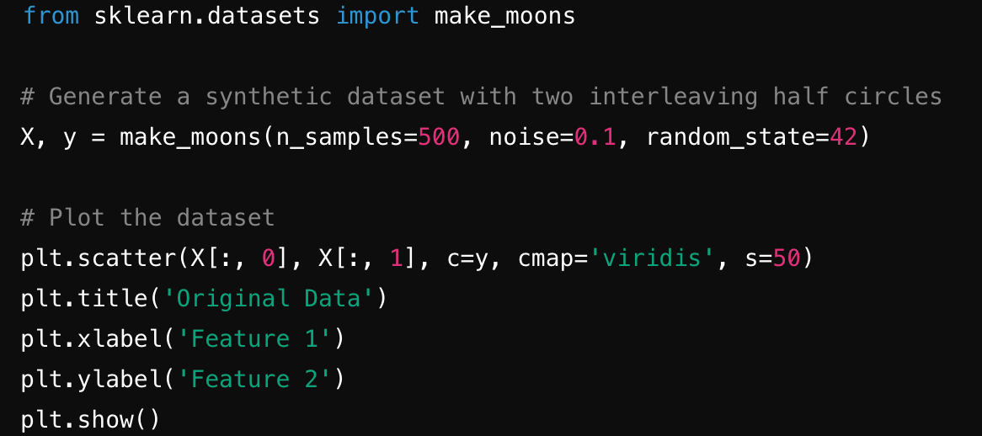
Clustering - DBSCAN
Prepare data
1. Generating Data using make_moons:
The make_moons function from sklearn.datasets generates synthetic data with two interleaving half circles. It is often used for testing clustering algorithms like DBSCAN because the clusters are not linearly separable, making them a great example for demonstrating how DBSCAN identifies arbitrary-shaped clusters.
n_samples=500: The total number of data points generated.
noise=0.1: Controls the level of noise, or deviation, from the ideal half-circle shapes.
random_state=42: Ensures reproducibility by fixing the random number generation.

Slide 6
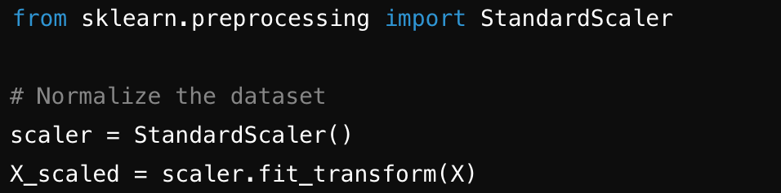
Clustering - DBSCAN
Prepare data
2. Why Use StandardScaler for Normalization?
DBSCAN is sensitive to the scale of the data. If one feature has a much larger scale than another, the algorithm will treat the larger-scale feature as more important. To avoid this, we normalize the data so that all features have the same scale.
The StandardScaler from sklearn.preprocessing transforms the data by removing the mean and scaling it to unit variance, ensuring all features contribute equally to the distance calculation in DBSCAN.
fit_transform(X): The method first calculates the mean and standard deviation of the data (fit) and then scales the data (transform) based on these values.
Normalizing ensures that features with larger ranges don’t dominate the clustering process. This is particularly important when features are on different scales, like in many real-world datasets.

Slide 7
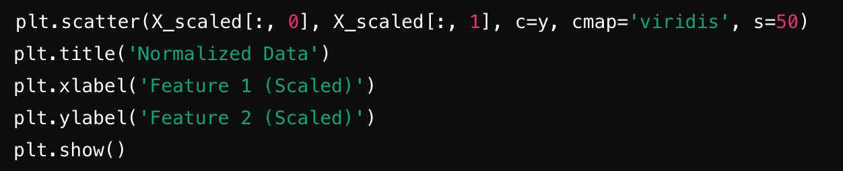
Clustering - DBSCAN
Prepare the data
3. Visualizing the Normalized Data:
After scaling, the data is plotted to confirm the transformation. This step is critical to show students how the data looks after normalization, which is a common preprocessing task in clustering.

Slide 8
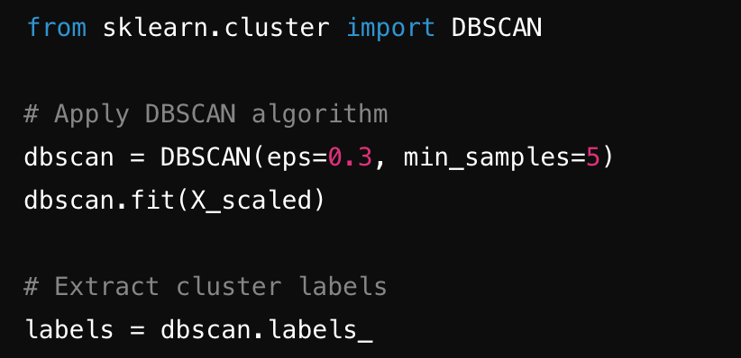
Clustering - DBSCAN
DBSCAN Implementation
3. Key Parameters in DBSCAN:
eps (Epsilon): Defines the maximum distance between two points for them to be considered as part of the same neighborhood. A smaller eps results in more clusters, while a larger eps may result in fewer clusters.
min_samples: The minimum number of points required to form a dense region (i.e., a cluster). This includes the point itself and its neighbors. If a point has fewer than min_samples points within eps distance, it is classified as noise or a border point.
DBSCAN(eps=0.3, min_samples=5): The model is initialized with an eps of 0.3 and min_samples of 5. This means any point that has at least 5 neighbors within 0.3 units of distance will form a cluster.
labels = dbscan.labels_: The .labels_ attribute contains the cluster assignments for each data point. If a point is labeled as -1, it is considered noise.

Slide 9
Clustering - DBSCAN
DBSCAN Implementation
Impact of Parameter Choices:
Choosing ε (eps): A smaller value of eps will result in more clusters, but might also treat points in dense areas as noise. A larger eps value may create fewer, larger clusters, or may even merge clusters together.
Choosing min_samples: A smaller min_samples value could lead to more, smaller clusters, including small groups of points being identified as clusters. Larger min_samples values ensure that only significant groups of points are considered clusters.
It is often recommended to experiment with different values for eps and min_samples to achieve the best clustering performance for a specific dataset.
Also, you can use some tools/methos to choose them.

Slide 10
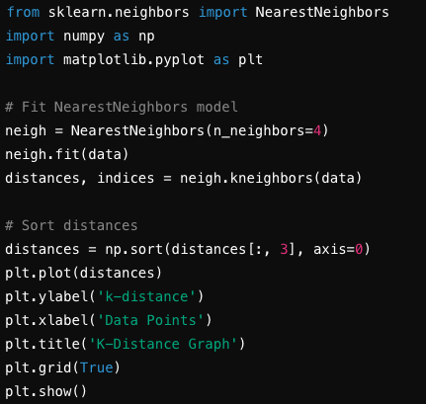
Clustering - DBSCAN
Practical Considerations for DBSCAN Parameter Selection
K-Distance Graph Example:
The k-distance graph helps visualize the optimal value for ε. Below the elbow point, data points are close to each other and belong to a dense region; above the elbow, points are more distant and sparse.
Plotting k-distance graph:

Slide 11
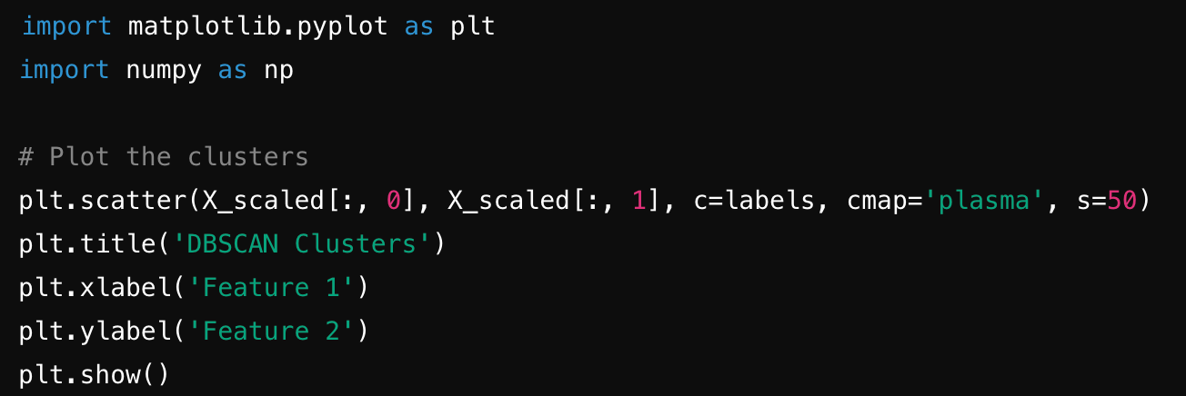
Clustering - DBSCAN
Visualization: After DBSCAN has clustered the data, the results are visualized using a scatter plot where each point is colored according to its cluster label. Noise points are usually assigned a separate color (typically labeled as -1).
The code below uses matplotlib to generate a scatter plot of the clusters. Each cluster is represented by a different color, and noise points are marked separately.
Visualization of DBSCAN Results

Slide 12
Clustering - DBSCAN
Visualization of DBSCAN Results
plt.scatter(X_scaled[:, 0], X_scaled[:, 1], c=labels, cmap='plasma', s=50): The data points are plotted on a 2D scatter plot, colored by their cluster labels (c=labels). Points assigned the same label (cluster) will have the same color.
cmap='plasma': The colormap used to display different clusters. You can change the colormap depending on the preference.Noise points (labeled -1) will have a different color, indicating that DBSCAN has identified them as outliers.

Slide 13
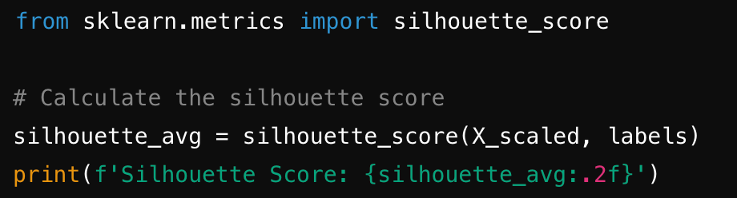
Clustering - DBSCAN
DBSCAN Evaluation
Silhouette Score as a Metric for Clustering:
The Silhouette Score is a popular metric for evaluating clustering performance. It measures how similar a point is to its own cluster compared to other clusters. The score ranges from -1 to 1:
1: The point is perfectly clustered.
0: The point lies on the boundary between clusters.
-1: The point is misclassified.
We use the silhouette_score function from sklearn.metrics to compute the score.

Slide 14
Clustering - DBSCAN
DBSCAN Evaluation
silhouette_score(X_scaled, labels): This function computes the silhouette score based on the scaled dataset and the labels assigned by DBSCAN.
silhouette_avg: The average silhouette score for all the points in the dataset. A higher score indicates better-defined clusters.

Slide 15
Clustering - DBSCAN
DBSCAN Evaluation
Interpreting the Silhouette Score
A high silhouette score (close to 1) indicates that the clusters are well-separated and the points are well-grouped within their respective clusters.
A low or negative silhouette score suggests that the clusters are poorly defined, with points either on cluster boundaries or misclassified as part of the wrong cluster.
Important Discussion Points:
The silhouette score is particularly useful when you are trying different values of eps and min_samples in DBSCAN, as it provides a quantitative way to evaluate how well the clusters are formed.
However, the silhouette score can be biased when clusters vary significantly in size or density, so it should be used along with visual analysis of the cluster shapes.

Slide 16
Clustering - DBSCAN
Effect of Noise and Outliers:
DBSCAN is particularly useful in datasets with noise and outliers. Choosing appropriate ε and MinPts values ensures that noise points are excluded from clusters.
Dataset Characteristics:
The shape and density of clusters in the data can affect parameter selection. For example, if clusters vary significantly in size or density, it may be difficult to choose a single ε value that works well across the entire dataset.
Parameter Sensitivity:
DBSCAN can be sensitive to the choice of parameters, especially when clusters have varying densities. In such cases, alternative density-based clustering methods like OPTICS may perform better.

Slide 17
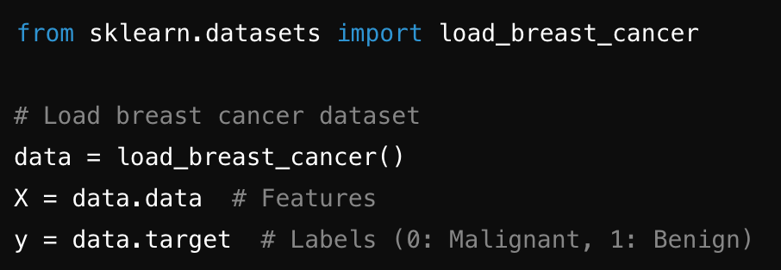
Classification - Logistic Regression
Data Preparation
Using the load_breast_cancer Dataset:
The load_breast_cancer dataset from sklearn.datasets is a built-in dataset for binary classification. It contains features related to breast cancer diagnosis (malignant or benign tumors).
X = data.data: The feature matrix with 30 features representing different characteristics of the cell nuclei.
y = data.target: The binary target labels (0 = malignant, 1 = benign).

Slide 18
Classification - Logistic Regression
Data Preparation
Dataset Splitting:
We split the dataset into training and test sets using train_test_split to evaluate the model’s performance on unseen data.
test_size=0.2: 20% of the data is reserved for testing.
random_state=42: Ensures reproducibility by fixing the randomness of the data splitting.

Slide 19
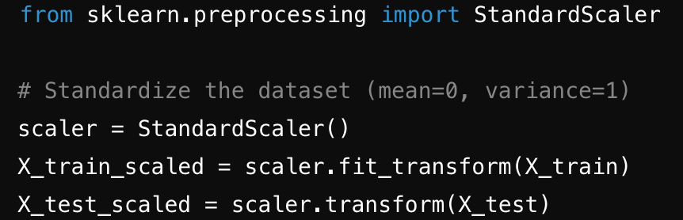
Classification - Logistic Regression
Data Preparation
Standardization with StandardScaler:
Standardization is critical for logistic regression since it assumes the input features are on a similar scale. This improves the convergence of the algorithm and helps it make better predictions.
fit_transform(X_train): Calculates the mean and standard deviation from the training set and scales the data.
transform(X_test): Uses the same scaling parameters from the training set to transform the test set, ensuring no data leakage.

Slide 20
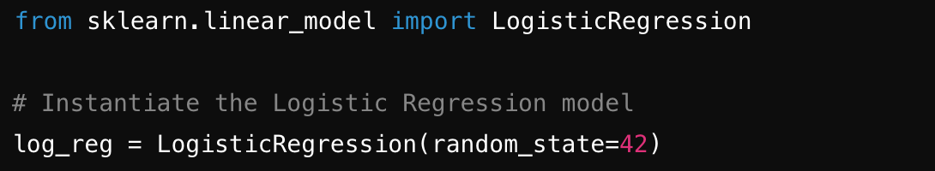
Classification - Logistic Regression
Logistic Regression Model Setup
Logistic Regression Overview:
Logistic regression is a supervised learning algorithm used for binary classification. It estimates the probability that a given input belongs to a particular class by using a logistic (sigmoid) function.
Model Instantiation:
The LogisticRegression() function from sklearn.linear_model is used to create the logistic regression model.
random_state=42: Ensures the same results are obtained each time the code is run.

Slide 21
Classification - Logistic Regression
Logistic Regression Model Setup
Key Parameters:
penalty: Specifies the type of regularization to use. Regularization helps prevent overfitting. The default is 'l2', which refers to ridge regularization.
C: Inverse of regularization strength. Smaller values specify stronger regularization. Default is 1.0.
solver: The algorithm used for optimization. Defaults to 'lbfgs', which is appropriate for small datasets. Other solvers can be used for larger datasets or different penalty types.

Slide 22

Classification - Logistic Regression
Logistic Regression: Model Fitting
How .fit() Works:
The .fit() function trains the logistic regression model by finding the optimal parameters (weights and bias) that minimize the cost function, typically the log-loss function for classification.
Code Walkthrough:
The code below fits the logistic regression model to the scaled training data
log_reg.fit(X_train_scaled, y_train): This trains the model using the scaled training data (X_train_scaled) and the corresponding labels (y_train).

Slide 23
Classification - Logistic Regression
Logistic Regression: Model Fitting
What Happens Under the Hood:
Logistic regression uses gradient descent to minimize the cost function (log loss). The optimization process updates the model’s parameters (weights and bias) until convergence or until a stopping criterion is met.
Regularization (if used) is applied during this process to penalize large coefficients, helping to prevent overfitting.
Important Point to Discuss:
The .fit() function is where the model learns from the training data. The algorithm iterates over the data multiple times, adjusting weights based on the error between predictions and actual labels.

Slide 24
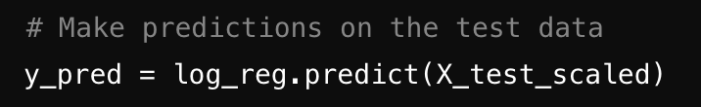
Classification - Logistic Regression
Logistic Regression: Prediction
Prediction with .predict():
After training the model, we use the .predict() function to make predictions on the test data. The logistic regression model outputs binary class labels (0 or 1) based on the learned weights and the sigmoid function.
y_pred = log_reg.predict(X_test_scaled): This function uses the trained model to predict the labels for the test data (X_test_scaled).

Slide 25
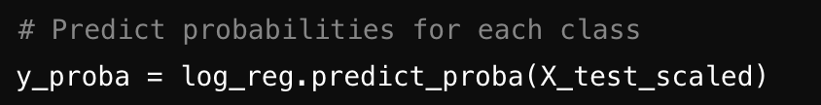
Classification - Logistic Regression
Logistic Regression: Prediction
What the Output Represents:
The .predict() method outputs binary class labels:
1: Predicted as benign (non-cancerous).
0: Predicted as malignant (cancerous).
Internally, the model calculates the probability that each data point belongs to class 1 (benign) using the logistic (sigmoid) function. If the probability is greater than 0.5, the model assigns the label 1; otherwise, it assigns the label 0.
Optional Extension:
To show how the model calculates probabilities, you can use the .predict_proba() method.
predict_proba() returns the probability of each class (class 0 and class 1). For each sample, it provides the probability of being in each class, which can give students deeper insight into how confident the model is about its predictions.

Slide 26
Classification - Logistic Regression
Logistic Regression: Prediction
What the Output Represents:
The .predict() method outputs binary class labels:
1: Predicted as benign (non-cancerous).
0: Predicted as malignant (cancerous).
Internally, the model calculates the probability that each data point belongs to class 1 (benign) using the logistic (sigmoid) function. If the probability is greater than 0.5, the model assigns the label 1; otherwise, it assigns the label 0.
Optional Extension:
To show how the model calculates probabilities, you can use the .predict_proba() method.
predict_proba() returns the probability of each class (class 0 and class 1). For each sample, it provides the probability of being in each class, which can give students deeper insight into how confident the model is about its predictions.

Slide 27
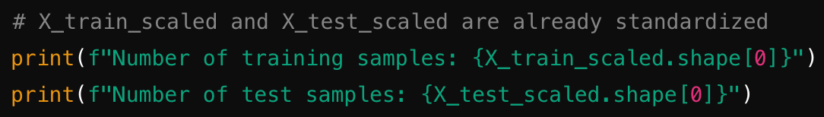
Classification
KNN: Data Preparation
Revisiting the Same Dataset:
For consistency, we will continue to use the load_breast_cancer dataset, which has been preprocessed and split into training and test sets.
Why Use the Same Dataset? It allows for a direct comparison between Logistic Regression and KNN models in terms of performance and behavior, as both algorithms will be trained on the same data.
KNN Also Uses Standardized Data:
Why Standardization is Important for KNN: KNN is a distance-based algorithm, which means it calculates the distance between data points to determine their "neighbors." If the data is not standardized, features with larger ranges will dominate the distance calculation, leading to biased predictions.
The dataset has already been scaled using StandardScaler earlier. We can directly use the standardized training and test sets (X_train_scaled and X_test_scaled).

Slide 28
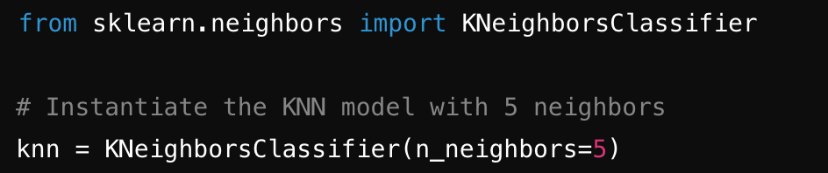
Classification
KNN Model Setup
K-Nearest Neighbors Overview:
KNN is a simple, instance-based learning algorithm. It classifies a data point based on the majority class of its nearest neighbors in the feature space.
The primary hyperparameter is n_neighbors, which controls how many neighbors are considered when making predictions.
Code Breakdown for KNN Model:
The KNeighborsClassifier() function from sklearn.neighbors is used to create the KNN model.
n_neighbors=5: This specifies that the algorithm will consider the 5 nearest neighbors to make its prediction. For example, if 3 out of 5 neighbors belong to class 1, the new data point will be classified as class 1.

Slide 29
Classification
KNN Model Setup
Key Parameter: n_neighbors:
What Does n_neighbors Control?
It defines how many neighbors should be considered when determining the class of a data point.
Small values (e.g., 1 or 3) lead to models that are more sensitive to noise but can capture local patterns better.
Larger values smooth out predictions and reduce the impact of noisy points, but they can make the model less sensitive to finer details.
Guideline for Choosing n_neighbors:
Start with an odd number (e.g., 3, 5) to avoid ties in binary classification.
Use cross-validation to experiment with different values and choose the one that gives the best results.

Slide 30
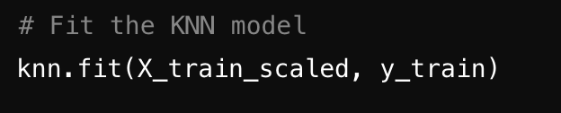
Classification
KNN: Model Fitting and Prediction
Fitting the KNN Model with .fit():Similar to Logistic Regression, we use the .fit() method to train the KNN model. However, unlike Logistic Regression, KNN does not "learn" weights during training. Instead, it simply stores the training data and computes distances at prediction time.
knn.fit(X_train_scaled, y_train): This function stores the scaled training data (X_train_scaled) and corresponding labels (y_train). No learning happens at this stage—KNN simply saves the data for later use.

Slide 31

Classification
KNN: Model Fitting and Prediction
Making Predictions with .predict():After fitting the model, we use the .predict() method to classify new (test) data points based on the nearest neighbors in the training set.
knn.predict(X_test_scaled): For each point in the test set, the algorithm calculates the distance to every point in the training set. It then finds the n_neighbors closest points and assigns the majority class among those neighbors as the prediction.

Slide 32
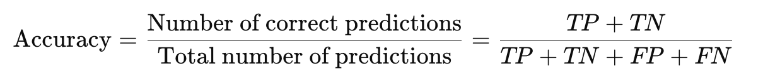
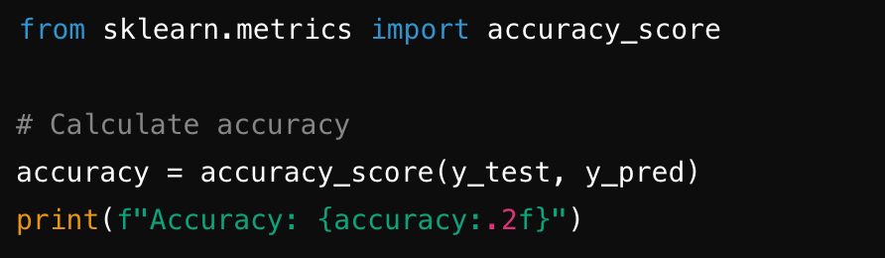
Classification
Accuracy and Precision Evaluation
Overview of Evaluation Metrics:
For classification tasks, it is important to evaluate how well the model performs. Two commonly used metrics are accuracy and precision. These metrics help understand how the model is making predictions.
accuracy_score(y_test, y_pred): This function calculates the accuracy by comparing the true labels (y_test) and the predicted labels (y_pred).

Slide 33
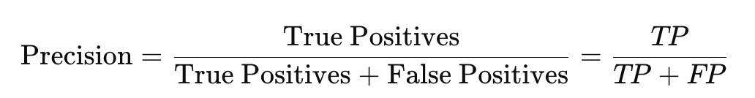
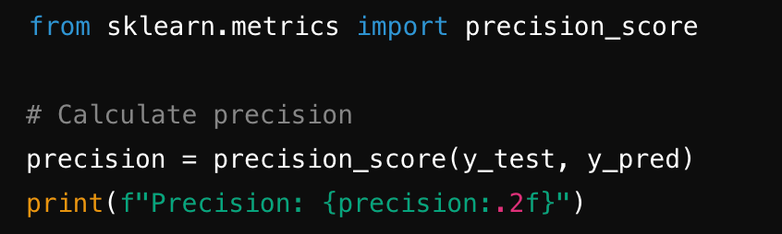
Classification
Accuracy and Precision Evaluation
Overview of Evaluation Metrics:
For classification tasks, it is important to evaluate how well the model performs. Two commonly used metrics are accuracy and precision. These metrics help understand how the model is making predictions.
precision_score(y_test, y_pred): This function calculates the precision score by comparing the true labels (y_test) and predicted labels (y_pred).

Slide 34
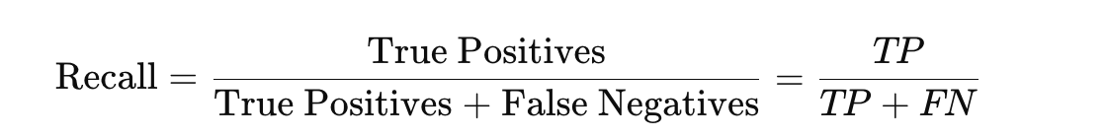
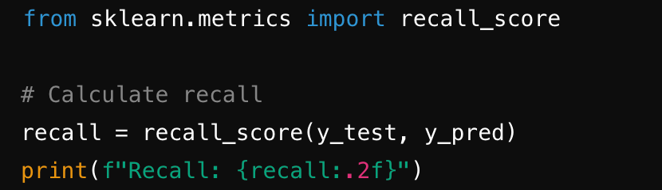
Classification
Recall and F1-Score Evaluation
Recall (also known as sensitivity or true positive rate) is the ratio of correctly predicted positive instances to all actual positive instances. It answers the question: Of all the actual positive cases, how many did we correctly predict?
recall_score(y_test, y_pred): This function calculates the recall by comparing the true labels (y_test) and predicted labels (y_pred).

Slide 35
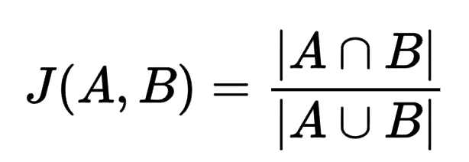
Classification
You can use accuracy to evaluate classification tasks, but sometimes accuracy may not objectively reflect the actual performance of the model.
Jaccard Score and F1 Score are two common evaluation metrics used to assess the performance of classification models.
Jaccard Score (Jaccard Index)
The Jaccard Score, also known as the Jaccard Index or Intersection over Union (IoU), measures the similarity between two sets. For classification problems, it is typically used to evaluate the overlap between predicted labels and true labels.

Slide 36
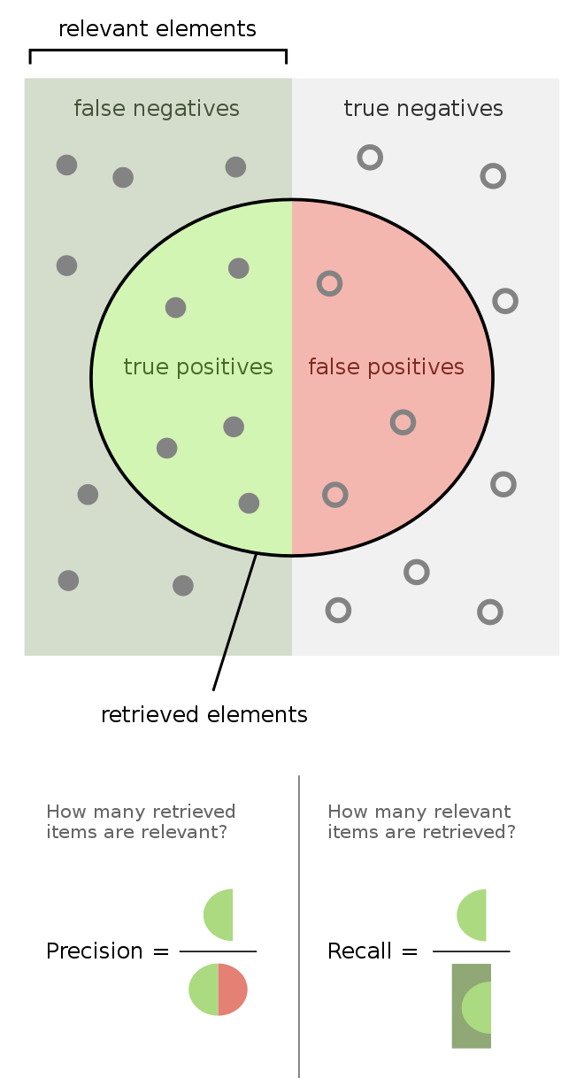
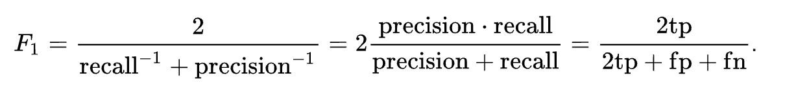
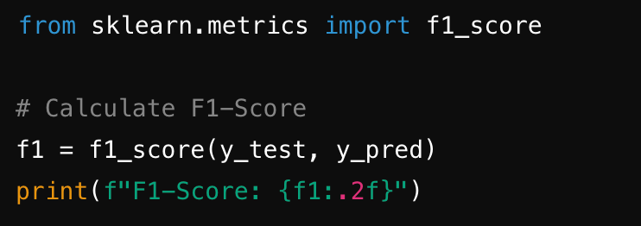
Classification
F1-score is the harmonic mean of precision and recall. It is useful when there is an uneven class distribution or when both precision and recall are important.
f1_score(y_test, y_pred): This function calculates the F1-score by considering both precision and recall.

Slide 37
Thanks

