Slide 1
COS 30049 Computing Technology Innovation Project
Week 7 : Clustering and Classification in Machine Learning

Slide 2
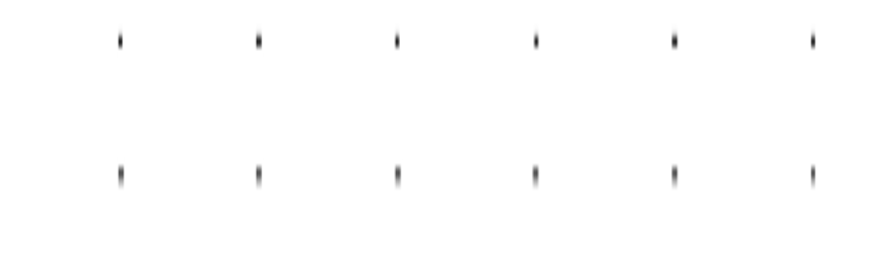

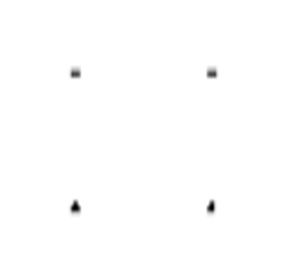
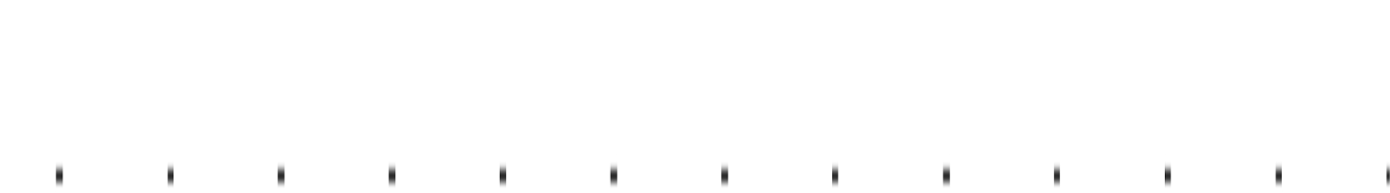
Acknowledgement of Country
We respectfully acknowledge the Wurundjeri People of the Kulin Nation, who are the Traditional Owners of the land on which Swinburne’s Australian campuses are located in Melbourne’s east and outer-east, and pay our respect to their Elders past, present and emerging.
We are honoured to recognise our connection to Wurundjeri Country, history, culture, and spirituality through these locations, and strive to ensure that we operate in a manner that respects and honours the Elders and Ancestors of these lands.
We also respectfully acknowledge Swinburne’s Aboriginal and Torres Strait Islander staff, students, alumni, partners and visitors.
We also acknowledge and respect the Traditional Owners of lands across Australia, their Elders, Ancestors, cultures, and heritage, and recognise the continuing sovereignties of all Aboriginal and Torres Strait Islander Nations.

Slide 3
Objectives: 1. Introduction to Clustering - DBSCAN 2. Understanding what is classification models 3. Learning basic knowledge about Logistic Regression 4. Learning basic knowledge about KNN 5. Additional Knowledge-Decision Tree and Random Forest

Slide 4
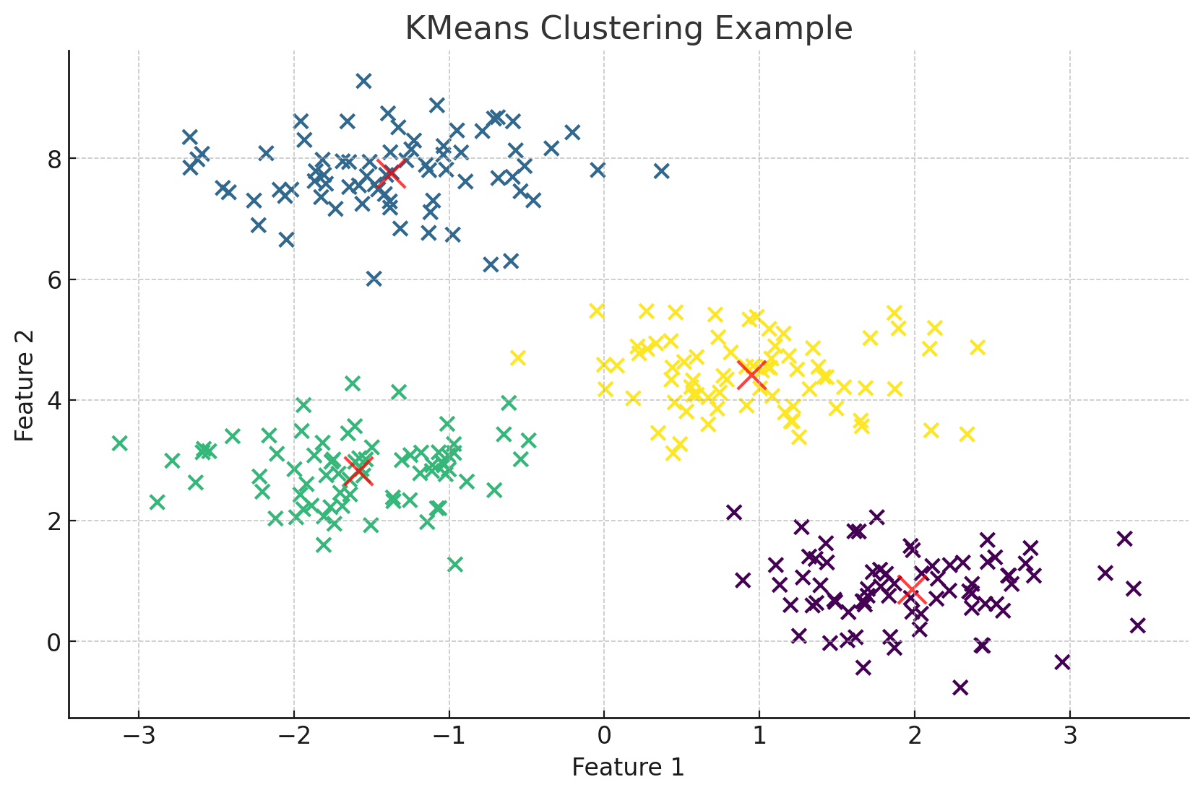
Recap Clustering Algorithms and K-means
Clustering is an unsupervised learning method that aims to group data points in a dataset into clusters such that data points within the same cluster are similar, while data points in different clusters are dissimilar. The goal of clustering is to discover the inherent structure or patterns in the data without needing prior knowledge of the data labels.
K-Means is one of the most popular and straightforward clustering algorithms. It aims to partition a dataset into 𝑘 clusters, where each data point belongs to the cluster with the nearest mean. The goal is to minimize the within-cluster sum of squares, also known as the inertia.
How K-Means Works
Initialization: Randomly select 𝑘 initial centroids from the dataset. These centroids represent the initial guess for the cluster centers.
Assignment: Assign each data point to the nearest centroid, forming 𝑘 clusters. The distance between data points and centroids is typically measured using Euclidean distance.
Update: Recalculate the centroids by taking the mean of all data points assigned to each cluster.
Repeat: Repeat the assignment and update steps until the centroids no longer change significantly, indicating convergence.

Slide 5
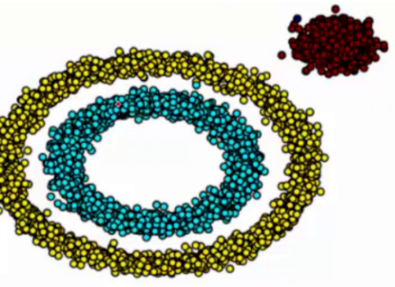
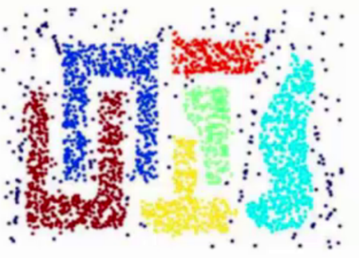


Recap Clustering Algorithms and K-means
Limitation of K-means:
1. Predefined Number of Clusters (K)
Explanation: K-Means requires the number of clusters (K) to be specified in advance, which may be difficult to determine.
Example: In real-world scenarios like customer segmentation, we may not know how many groups exist.
2. Assumes Spherical Clusters
Explanation: K-Means works best with spherical (round-shaped) clusters due to its use of Euclidean distance.
Example: K-Means will force non-spherical data into spherical shapes, leading to incorrect groupings. Real-world data often contains such irregular shapes, making K-Means unsuitable.
* Euclidean Distance Formula
Example (2D Space):
For two points p(1,2) and q(4,6) in a two-dimensional space, the Euclidean distance is:

Slide 6
Clustering - DBSCAN
Limitation of K-means:
3. Sensitive to Outliers
Explanation: K-Means includes every data point in a cluster, even outliers or noise points, which can skew results.
Example: A single extreme point can pull the centroid away, leading to poor clustering.
In reality, we often encounter clusters with various shapes, such as the ring-shaped and irregular clusters shown in the following images. In such cases, traditional clustering algorithms clearly struggle.
So, we need another algorithm that does not require specifying the number of clusters in advance, can detect clusters of any shape, and can handle noise and outliers.
DBSCAN (Density-Based Spatial Clustering of Applications with Noise)
DBSCAN is a density-based clustering algorithm designed to discover clusters of arbitrary shapes by grouping together closely packed points and marking outlier points that lie alone in low-density regions as noise.

Slide 7
Clustering - DBSCAN
Key Terminology
Epsilon (ε): The maximum radius of the neighborhood around a point. It defines how close points need to be to each other to be considered as part of the same cluster.
MinPts (Minimum Points): The minimum number of points required to form a dense region (i.e., a cluster).
Core Point: A point is considered a core point if it has at least MinPts neighbors within the ε radius.
Border Point: A point that is not a core point but is within the ε radius of a core point.
Noise Point (Outlier): A point that is neither a core point nor a border point.

Slide 8
Clustering - DBSCAN
Eps
Eps = 1
MinPts = 5
Epsilon (ε): The maximum radius of the neighborhood around a point. It defines how close points need to be to each other to be considered as part of the same cluster.
MinPts (Minimum Points): The minimum number of points required to form a dense region (i.e., a cluster).

Slide 9
Clustering - DBSCAN
Eps
Eps = 1
MinPts = 5
Core Point: A point is considered a core point if it has at least MinPts neighbors within the ε radius.
Border Point: A point that is not a core point but is within the ε radius of a core point.
Noise Point (Outlier): A point that is neither a core point nor a border point.
Notes:
https://www.naftaliharris.com/blog/visualizing-dbscan-clustering/

Slide 10
Clustering - DBSCAN
How DBSCAN Works: Steps of Implementation
Step 1: Identify Core Points
For each point in the dataset, count the number of points in its ε neighborhood (including the point itself). If the count is greater than or equal to MinPts, mark the point as a core point.
Step 2: Expand Cluster
For each core point, create a cluster by recursively visiting all points in its neighborhood and including them in the cluster if they are core or border points. Border points are added to the current cluster but do not expand it further.
Step 3: Handle Noise
Any points that are not core points or border points are considered noise and are not assigned to any cluster.
Step 4: Stop When All Points Are Processed
The algorithm terminates when all points have been either assigned to a cluster or labeled as noise.

Slide 11
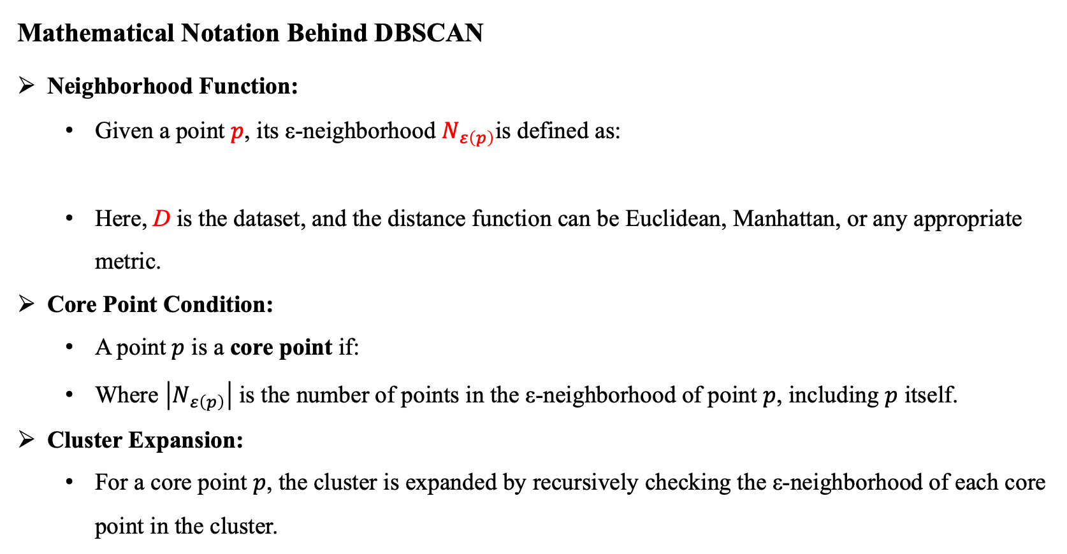
Clustering - DBSCAN
Mathematical Notation Behind DBSCAN
Neighborhood Function:
Given a point $p$, its ε-neighborhood $N_{ε\left(p\right)}$is defined as:
Here, D is the dataset, and the distance function can be Euclidean, Manhattan, or any appropriate metric.
Core Point Condition:
A point $p$ is a core point if:
Where $\left|N_{ε\left(p\right)}\right|$ is the number of points in the ε-neighborhood of point $p$, including $p$ itself.
Cluster Expansion:
For a core point $p$, the cluster is expanded by recursively checking the ε-neighborhood of each core point in the cluster.

Slide 12
Clustering - DBSCAN
DBSCAN Parameter Selection
Epsilon (ε) - Neighborhood Radius
ε defines the maximum radius of the neighborhood around a point. It determines how close points need to be to each other to be considered as part of the same cluster.
In other words, for a point to be included in a cluster, it must be within the ε distance of at least one core point.
Choosing ε:
K-Distance Graph:
One common approach for selecting ε is to use a k-distance graph. In this graph, the distances to the k-th nearest neighbor are plotted for all points in the dataset. The value of k is usually set to the MinPts parameter (typically 4 for two-dimensional data).
To determine ε, plot the sorted k-distances and look for the elbow point where the slope of the curve sharply increases. This point is typically a good choice for ε.
Interpretation:
If ε is too small, many points will be labeled as noise, and few clusters will form.
If ε is too large, points from different clusters may be incorrectly grouped together, leading to overly large or merged clusters.

Slide 13
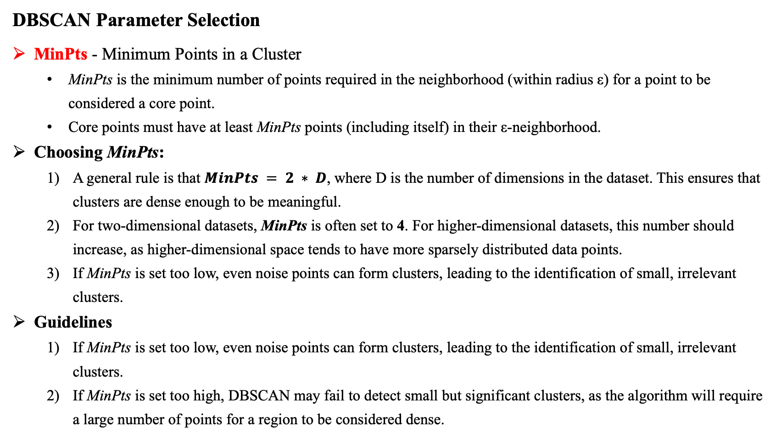
Clustering - DBSCAN
DBSCAN Parameter Selection
MinPts - Minimum Points in a Cluster
MinPts is the minimum number of points required in the neighborhood (within radius ε) for a point to be considered a core point.
Core points must have at least MinPts points (including itself) in their ε-neighborhood.
Choosing MinPts:
A general rule is that $MinPts = 2 ∗ D$, where D is the number of dimensions in the dataset. This ensures that clusters are dense enough to be meaningful.
For two-dimensional datasets, MinPts is often set to 4. For higher-dimensional datasets, this number should increase, as higher-dimensional space tends to have more sparsely distributed data points.
If MinPts is set too low, even noise points can form clusters, leading to the identification of small, irrelevant clusters.
Guidelines
If MinPts is set too low, even noise points can form clusters, leading to the identification of small, irrelevant clusters.
If MinPts is set too high, DBSCAN may fail to detect small but significant clusters, as the algorithm will require a large number of points for a region to be considered dense.

Slide 14
Clustering - DBSCAN
DBSCAN Parameter Selection
Guidelines - Best Practices
2D Data: A typical value for MinPts is 4.
3D Data: Values between 6 and 7 are common.
For higher dimensions, gradually increase MinPts based on the sparsity of the data.
Balancing ε and MinPts
Interaction Between ε and MinPts:
The values of ε and MinPts are closely related. For example: If ε is large, then a small MinPts value may still result in clusters because the larger neighborhood captures more points. If MinPts is large, ε needs to be small enough to ensure that the core regions of clusters remain well-defined.
The goal is to find a balance between ε and MinPts that appropriately captures the clusters in the data while minimizing the number of noise points.
Parameter Tuning:
The optimal values of ε and MinPts often require tuning based on the dataset. Techniques like cross-validation, grid search, or using a k-distance graph are helpful in finding suitable values.

Slide 15

Clustering - DBSCAN
Evaluation of DBSCAN
Silhouette Score:
The silhouette score measures how similar a point is to its own cluster (cohesion) compared to other clusters (separation).
The score is calculated for each data point and ranges from -1 to 1. A score close to 1 means the point is well-clustered, 0 means the point lies on or near the boundary between clusters, and negative values indicate misclassification.
For each data point iii, the silhouette score is calculated as:
a(i) is the average distance between iii and all other points in the same cluster (cohesion).
b(i) is the average distance between iii and the points in the nearest different cluster (separation).
Interpretation:
A higher silhouette score indicates better-defined clusters, while a lower score indicates that clusters may overlap or that some points are misclassified.

Slide 16

Clustering - DBSCAN
Evaluation of DBSCAN
Homogeneity Score:
Homogeneity measures whether each cluster contains only data points that are members of a single class.
It ranges from 0 to 1, where 1 indicates perfect homogeneity (all points in a cluster belong to the same true category).
H(C∣K) is the conditional entropy of the class distribution given the cluster assignments.
H(C) is the entropy of the class distribution.
Interpretation:
A homogeneity score of 1 indicates that each cluster contains only points from a single class, while lower scores indicate more mixed clusters.

Slide 17

Clustering - DBSCAN
Evaluation of DBSCAN
Completeness Score:
Completeness evaluates whether all data points that are members of a given class are assigned to the same cluster.
A completeness score of 1 means all data points of a single class are completely captured in one cluster.
H(K∣C) is the conditional entropy of the cluster distribution given the class labels.
H(K) is the entropy of the cluster distribution.
Interpretation:
A score of 1 means that all points of a particular class are grouped into the same cluster.

Slide 18
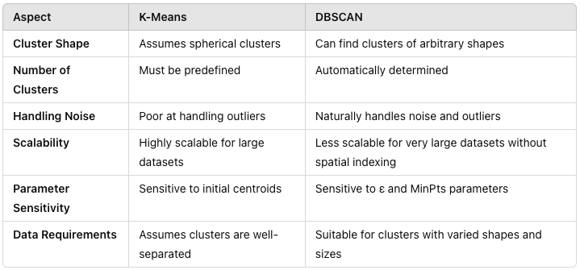
Clustering - DBSCAN
DBSCAN is a powerful clustering method when:
You do not know the number of clusters in advance.
The data contains noise or outliers.
Clusters are not well separated by distance or may have irregular shapes.

Slide 19
Classification
Classification is a type of supervised learning where the goal is to assign input data into predefined categories or classes. The model learns from labeled data, where the correct output (class) is already known.
Examples of Classification Problems:
Spam Detection: Classify emails as either "spam" or "not spam."
Medical Diagnosis: Classify a patient’s condition as "disease present" or "disease absent."
Image Recognition: Classify an image as one of several categories, such as "cat" or "dog."
Binary Classification: Only two possible output classes (e.g., "spam" or "not spam").
Multi-class Classification: More than two output classes (e.g., A system is trained to classify a movie into a genre, such as "action," "comedy," "drama," or "horror.").
Multi-label Classification: Multiple labels can be assigned to a single input (e.g., A movie might belong to multiple genres, such as both "comedy" and "romance.").

Slide 20
Classification
Common classification models:
Logistic Regression
Support Vector Machine (SVM)
Decision Tree
Random Forest
K-Nearest Neighbors (KNN)
Our course is not a theoretical one; it merely introduces these models.
Despite its name, logistic regression is a classification algorithm commonly used for binary classification problems.
Decision Boundary:
In classification, a decision boundary is a surface that separates different classes in the feature space. The classifier learns this boundary based on the training data and uses it to classify new data points.
E.g., The decision boundary in a model that classifies emails as "spam" or "not spam" is the threshold where the model decides one way or another. For example, if a certain combination of words or features pushes the email beyond that decision boundary, it will be classified as "spam."

Slide 21
Classification - Logistic Regression
Logistic Regression is a commonly used classification algorithm, despite its name suggesting it might be a regression technique. It’s particularly effective for binary classification problems, where the target variable has two possible outcomes (e.g., "spam" or "not spam").
Key Idea:
Logistic regression estimates the probability that a given input belongs to a certain class using the logistic function (also known as the sigmoid function). It models the relationship between the input features and the probability of the binary outcome.
Applications
Spam detection: Classify emails as "spam" or "not spam."
Medical diagnosis: Predict whether a patient has a certain disease ("yes" or "no").
Customer churn: Predict whether a customer will cancel a subscription.

Slide 22


Classification - Logistic Regression
How Does Logistic Regression Work?
Linear Model:
Logistic regression fits a linear equation to predict the log odds (or logit) of the probability that an instance belongs to the positive class.
The linear equation is of the form:
Sigmoid Function:
To convert the linear output z into a probability, we apply the sigmoid function:

Slide 23
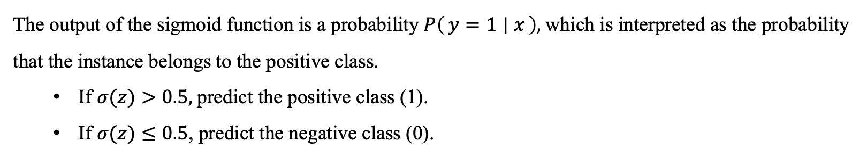
Classification - Logistic Regression
How Does Logistic Regression Work?
Sigmoid Function - continue:
To convert the linear output z into a probability, we apply the sigmoid function:
The output of the sigmoid function is a probability$P\left(y=1 ∣ x\right),$which is interpreted as the probability that the instance belongs to the positive class.
If $σ(z)>0.5,$predict the positive class (1).
If $σ(z)≤0.5$, predict the negative class (0).

Slide 24
Classification – Logistic Regression
The line here is the Decision Boundary

Slide 25
Classification - Logistic Regression
How Does Logistic Regression Work? - Example
Predicting Whether a Customer Will Buy a Product Based on Website Behavior
Imagine you are working in the marketing department of an e-commerce company, and you want to predict whether a customer will buy a product based on their behavior on the website. You collect the following data:
Time spent on the website (in minutes)
Number of product pages viewed
Whether they added a product to the cart or not (Yes/No)
These are the input variables or features. The goal is to predict a binary outcome (0 or 1):
1 = Customer bought the product
0 = Customer did not buy the product
Logistic regression is used here to estimate the probability that a customer will make a purchase. This type of model is ideal for binary outcomes like "buy" or "not buy."

Slide 26
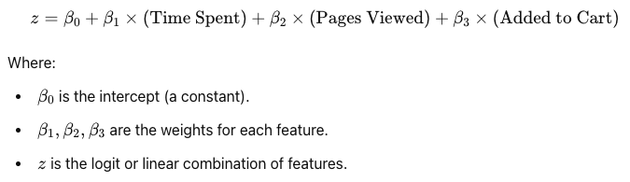

Classification - Logistic Regression
How Does Logistic Regression Work? - Example
Input Features: Logistic regression uses the input features (time on site, pages viewed, and cart action) to calculate a weighted sum, called the logit. Each feature has a corresponding weight, which is learned from the data:
2. Sigmoid Function: Logistic regression applies the sigmoid function to convert this logit value zzz into a probability:
The output $P(buy)$is the predicted probability that the customer will make a purchase. The sigmoid function ensures that the output is always between 0 and 1, representing a probability.

Slide 27
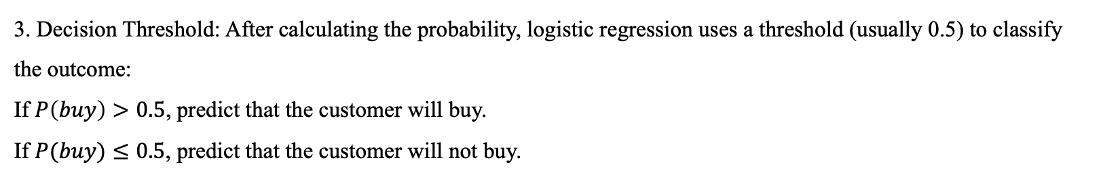
Classification - Logistic Regression
How Does Logistic Regression Work? - Example
3. Decision Threshold: After calculating the probability, logistic regression uses a threshold (usually 0.5) to classify the outcome:
If $P\left(buy\right)>0.5$, predict that the customer will buy.
If $P(buy)≤0.5$, predict that the customer will not buy.
Conclusion:
Binary Outcome: Logistic regression is ideal when the outcome is binary (e.g., buy or not buy, pass or fail).
Probability Interpretation: Instead of just predicting 0 or 1, logistic regression outputs a probability, which can be interpreted as the likelihood of an event happening.
Real-World Applications: It’s widely used in areas like marketing, medical diagnoses (predicting disease presence), and risk analysis (e.g., predicting loan defaults).

Slide 28
Classification - k-Nearest Neighbors (k-NN)
k-Nearest Neighbors (k-NN) is a supervised learning algorithm that classifies a new data point based on the majority class of its k nearest neighbors in the feature space.
It is a lazy learning algorithm because it doesn't explicitly learn a model; instead, it memorizes the training data and makes predictions only at the time of classification.
Applications:
Image recognition: Classify objects based on the most similar images in the training set.
Recommender systems: Recommend products based on the preferences of similar users.
Anomaly detection: Detect unusual patterns in data based on proximity to known patterns.

Slide 29
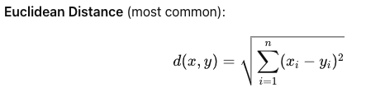
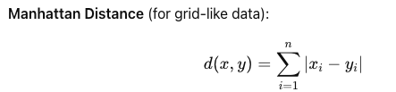
Classification - k-Nearest Neighbors (k-NN)
How Does k-NN Work?
1) Choose k (Number of Neighbors):
k is the number of nearest neighbors to consider when making a prediction. Choosing the right value of k is important because it affects the model’s accuracy and generalization.
2) Calculate Distance:
For each new data point, k-NN calculates the distance between the point and all other points in the dataset. Common distance metrics include:

Slide 30
Classification - k-Nearest Neighbors (k-NN)
How Does k-NN Work?
3) Find k Nearest Neighbors:
Identify the k data points in the training set that are closest to the new data point.
4) Vote for the Class:
The class of the new data point is determined by a majority vote of its k nearest neighbors. The class that appears most frequently among the neighbors is assigned to the new point.
Weighted k-NN: In some cases, distances can be used to weight the votes, giving more influence to closer neighbors.
Visualization of k-NN
We can visualize the k-NN algorithm using a simple 2D scatter plot, where:
x-axis: Petal length
y-axis: Petal width
Points: Represent individual flowers, colored by their species.

Slide 31
Classification - k-Nearest Neighbors (k-NN)
K =1
= 1
= 0
Result =>
K =5
= 3
= 2
Result =>

Slide 32
Classification - k-Nearest Neighbors (k-NN)
Strengths and Weaknesses of k-NN
Strengths:
Simple and Intuitive: k-NN is easy to understand and implement. It requires no training and can handle complex decision boundaries.
No Assumptions: Since k-NN is non-parametric, it makes no assumptions about the data distribution, making it flexible for many types of data.
Weaknesses:
Computationally Expensive: For large datasets, calculating distances between the new data point and all other points can be slow.
Sensitive to Feature Scaling: k-NN relies on distance metrics, so if the features are not scaled properly, the results can be skewed. It’s important to standardize or normalize the features before applying k-NN.
Curse of Dimensionality: In high-dimensional spaces, the distance between data points becomes less meaningful, which can degrade performance.

Slide 33
Classification - Evaluation
Positive and Negative in Classification
Positive and Negative refer to the two possible classes in a binary classification problem:
Positive Class: Usually the class of interest or the class we're trying to identify (e.g., "spam" in spam detection, "disease" in medical diagnosis).
Negative Class: The opposite of the positive class (e.g., "not spam" or "no disease").
In other words:
Positive: The instance belongs to the class we're interested in.
Negative: The instance does not belong to the class we're interested in.
For example, in a medical test for a disease:
Positive: The test result indicates the presence of the disease.
Negative: The test result indicates the absence of the disease.

Slide 34
Classification - Evaluation
True Positives (TP), False Positives (FP), True Negatives (TN), False Negatives (FN)
When we make predictions, there are four possible outcomes, based on the actual and predicted class of each instance. These outcomes are used to evaluate the performance of the classifier:
True Positive (TP):
Definition: The model correctly predicts the positive class.
Explanation: The instance is actually positive, and the model has correctly classified it as positive.
Example: The test correctly predicts that a patient has the disease (when the patient indeed has the disease).
False Positive (FP):
Definition: The model incorrectly predicts the positive class.
Explanation: The instance is actually negative, but the model has incorrectly classified it as positive.
Example: The test incorrectly predicts that a patient has the disease (when the patient does not have the disease). This is also known as a Type I error.

Slide 35
Classification - Evaluation
True Positives (TP), False Positives (FP), True Negatives (TN), False Negatives (FN)
True Negative (TN):
Definition: The model correctly predicts the negative class.
Explanation: The instance is actually negative, and the model has correctly classified it as negative.
Example: The test correctly predicts that a patient does not have the disease (when the patient indeed does not have the disease).
False Negative (FN):
Definition: The model incorrectly predicts the negative class.
Explanation: The instance is actually positive, but the model has incorrectly classified it as negative.
Example: The test incorrectly predicts that a patient does not have the disease (when the patient actually has the disease). This is also known as a Type II error.

Slide 36


Classification - Evaluation
Metrics
Accuracy:
Measures the proportion of correctly classified instances (both positive and negative).
Explanation: It shows how often the classifier is correct across all classes.
Precision:
Measures the proportion of true positives among all instances predicted as positive.
Explanation: Precision tells us how many of the instances classified as positive are truly positive. It's important when the cost of false positives is high.

Slide 37


Classification - Evaluation
Metrics
Recall (Sensitivity):
Measures the proportion of true positives out of all actual positive instances.
Explanation: Recall tells us how many of the actual positive instances were correctly identified by the model. It's crucial when missing positive instances (false negatives) is costly, such as in medical diagnostics.
F1-Score:
The harmonic mean of precision and recall, balancing the trade-off between them.
Explanation: F1-Score is a balanced metric that is useful when we want to consider both precision and recall, particularly when there’s an uneven class distribution.

Slide 38
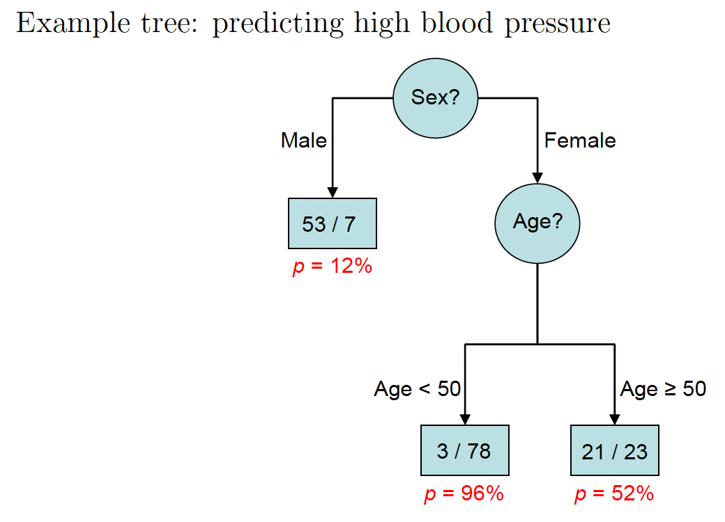
Decision Tree - additional
A decision tree is a supervised learning algorithm used for both classification and regression tasks. It models decisions as a tree-like structure of branches, where each internal node represents a feature (or attribute), and each leaf node represents the outcome (class or value).
The goal is to split the data into subsets based on feature values in such a way that the subsets become as "pure" as possible with respect to the target variable.
Decision trees | Machine Learning | Google for Developers

Slide 39
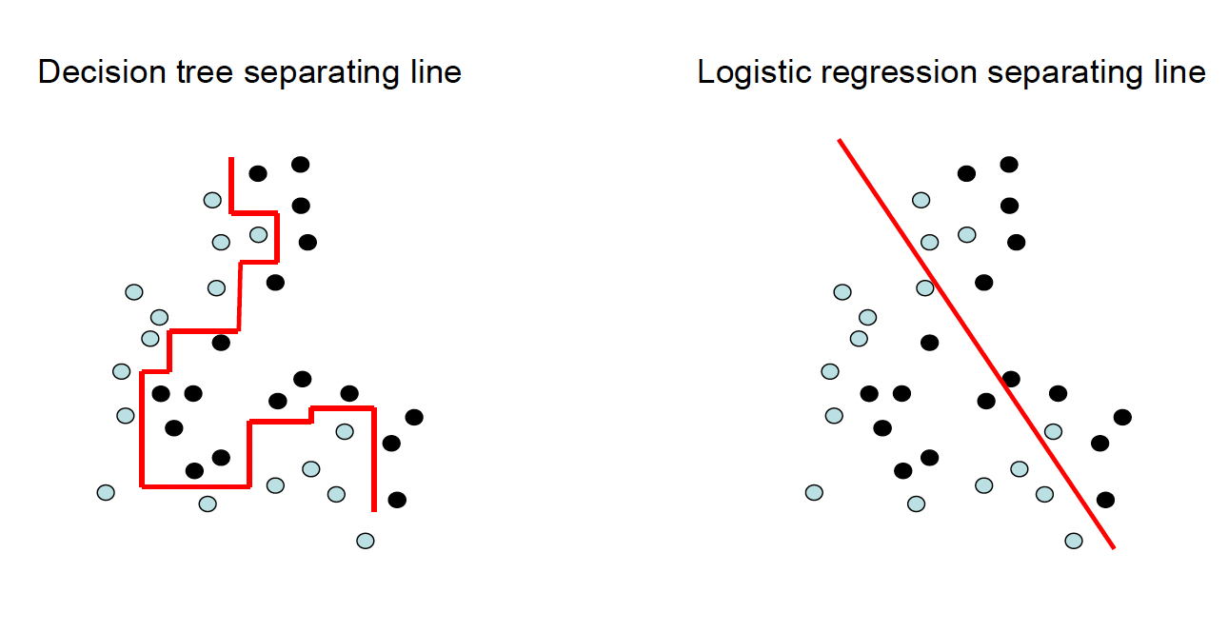
Decision Tree - additional
Strengths and Weaknesses of Decision Trees
Strengths:
Interpretability: You can easily understand the reasoning behind a prediction by following the path from the root to a leaf.
No Need for Feature Scaling: Decision trees do not require normalization or standardization of features.
Can Handle Categorical and Numerical Data: Decision trees can work with both types of data.
Weaknesses:
Overfitting: Decision trees tend to overfit the training data, especially if the tree is too deep. This can be mitigated by techniques like pruning or setting a maximum depth.
Instability: Small changes in the data can lead to a completely different tree.
Bias Towards Dominant Features: Decision trees may favor features with many levels (e.g., continuous features) because they allow more splits.
Decision trees | Machine Learning | Google for Developers

Slide 40
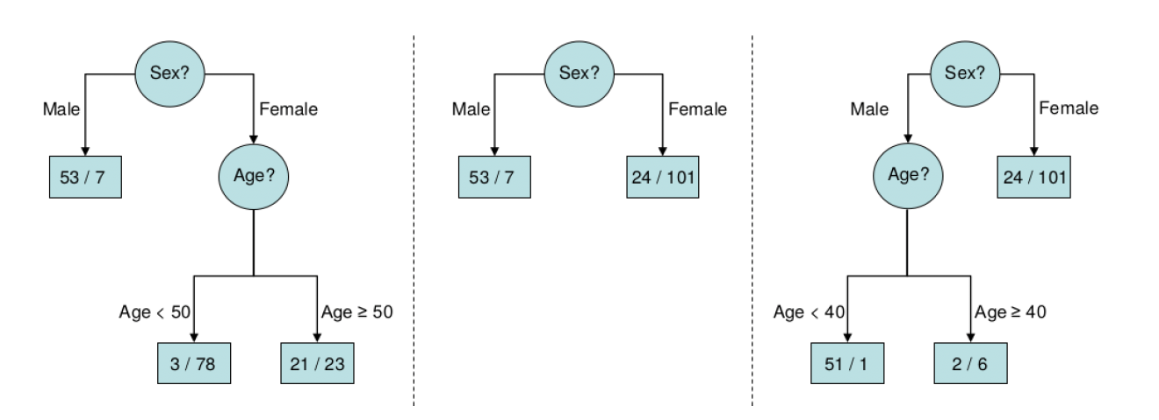
Random Forest
Random Forest is an ensemble learning algorithm that combines the predictions of multiple decision trees to produce more accurate and robust results. It is used for both classification and regression tasks.
The key idea behind Random Forest is to reduce overfitting and improve generalization by averaging or taking the majority vote of multiple decision trees, which are built on different subsets of the data.
Random Forest | Machine Learning | Google for Developers

Slide 41
Random Forest
Advantages and Disadvantages of Random Forest
Advantages:
Robust to Overfitting: By averaging the predictions of many decision trees, Random Forest is much less likely to overfit than a single decision tree.
Handles Missing Data: Random Forest can handle missing values by using different trees with different subsets of data.
Feature Importance: Random Forest provides a way to estimate the importance of features, helping you understand which features are most influential in making predictions.
High Accuracy: It typically performs better than a single decision tree due to the aggregation of multiple models.
Works with Both Types of Data: Random Forest can handle both categorical and numerical data.
Disadvantages:
Computationally Expensive: Since Random Forest trains multiple decision trees, it can be slower to train and predict, especially on very large datasets.
Less Interpretability: Although Random Forest improves prediction accuracy, it sacrifices the interpretability of a single decision tree. It can be difficult to understand the overall logic behind the predictions.
Not Ideal for High-Dimensional Sparse Data: In cases where there are many irrelevant features, Random Forest may not perform as well as other algorithms like gradient boosting.
Random Forest | Machine Learning | Google for Developers

Slide 42
Thanks

