Slide 1
COS 30049 Computing Technology Innovation Project
Week5: Data Pre-Processing in Machine Learning via Python
Lecture2
Hao Zhang
Semester 2

Slide 2
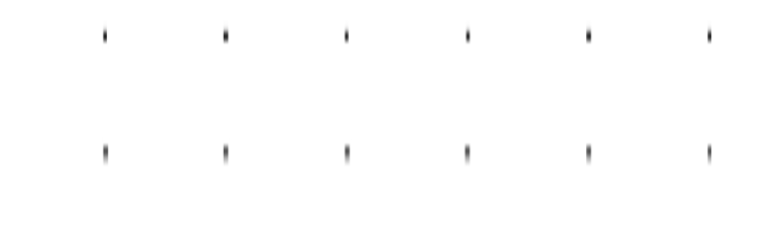

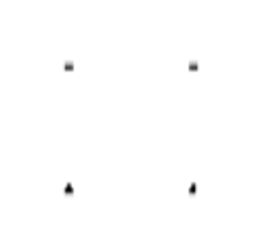

Acknowledgement of Country
We respectfully acknowledge the Wurundjeri People of the Kulin Nation, who are the Traditional Owners of the land on which Swinburne’s Australian campuses are located in Melbourne’s east and outer-east, and pay our respect to their Elders past, present and emerging.
We are honoured to recognise our connection to Wurundjeri Country, history, culture, and spirituality through these locations, and strive to ensure that we operate in a manner that respects and honours the Elders and Ancestors of these lands.
We also respectfully acknowledge Swinburne’s Aboriginal and Torres Strait Islander staff, students, alumni, partners and visitors.
We also acknowledge and respect the Traditional Owners of lands across Australia, their Elders, Ancestors, cultures, and heritage, and recognise the continuing sovereignties of all Aboriginal and Torres Strait Islander Nations.

Slide 3
Objectives: 1. Understand and learn to use Pandas Library 2. Understand and learn to use Scikit-learn Library 3. Understand and learn to use Matplotlib Library 4. Understand and learn to use Seaborn Library 5. Assignment 2

Slide 4
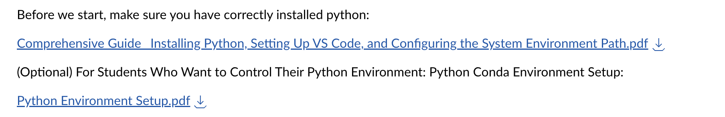
Python Installation Guide
We have provided comprehensive instructions to help students install Python and the necessary tools for their projects. For detailed steps, please refer to Module Week 5.
Optional: Install Conda for Python Environment Management
What is Conda? Conda is a package management tool from Anaconda, designed to simplify the installation, management, and updating of Python packages and other software. It also facilitates the creation of virtual environments, enabling you to isolate project dependencies, ensuring compatibility and avoiding conflicts. Conda is cross-platform, making it an ideal choice for managing Python environments efficiently.

Slide 5

Pandas
pandas - Python Data Analysis Library (pydata.org)
Pandas is a powerful Python library for data manipulation and analysis. It provides efficient and convenient data structures and data analysis tools, widely used in data cleaning, data transformation, data visualization, and machine learning.

Slide 6
Pandas
1. Prepare environment
You can install pandas with:
(x.x.x is the pandas version of you want, not necessary.)
pip install pandas
pip install pandas==x.x.x
conda install pandas
conda install pandas=1.3.3
or
If you need to check the version of pandas:
import pandas as pd
print(pd.__version__)
or
pip show pandas
If you need to uninstall pandas:
pip uninstall pandas
or
conda remove pandas

Slide 7
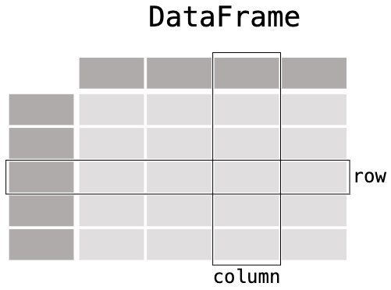
Pandas
2. Data Structure
In pandas, a data table is called a DataFrame.
A two-dimensional table-like data structure, similar to a spreadsheet or SQL data table, composed of multiple Series and capable of storing various data types.
df = pd.DataFrame(data)

Slide 8
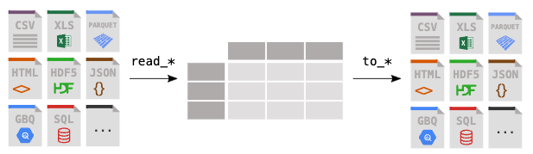
Pandas
3. Data Read & Write
titanic = pd.read_csv("data/titanic.csv")
titanic = pd.read_excel("titanic.xlsx", sheet_name="passengers")
titanic.to_excel("titanic.xlsx", sheet_name="passengers", index=False)

Slide 9
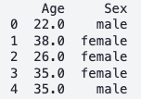
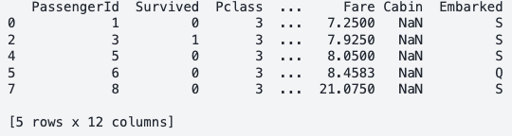
Pandas
4. Data Cleaning and Processing
Handling Missing Data: Provides methods to fill, delete, and interpolate missing data.
Data Transformation: Supports data type conversion, data sorting, data reshaping, and other operations.
type(titanic["Age"])
age_sex = titanic[["Age", "Sex"]]
pandas: A Python library for data manipulation and analysis.
core.series: Indicates the Series class within the core module of Pandas.
Series: A one-dimensional array-like data structure in Pandas, similar to a table column, capable of holding various data types.
age_sex.head()
titanic["Age"].shape
class_23 = titanic[titanic["Pclass"].isin([2, 3])]
class_23.head()
This indicates that the "Age" column contains 891 entries or rows. The comma indicates that it's a one-dimensional structure, specifically a Series with 891 elements.

Slide 10
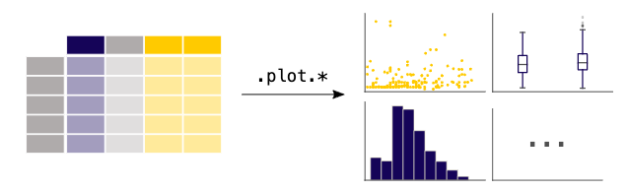
Pandas
5. Data Visualization
Integration with Matplotlib and Seaborn: Supports direct plotting of charts by integrating with visualization libraries like Matplotlib and Seaborn.

Slide 11

Scikit-learn (sklearn)
Scikit-Learn, commonly known as sklearn
is a powerful Python library specifically designed for machine learning and data analysis. It is built on top of SciPy and provides simple and efficient tools for data mining and data analysis.
scikit-learn: machine learning in Python — scikit-learn 1.5.1 documentation
You can install scikit-learn (sklearn) with:
pip install scikit-learn
conda install scikit-learn
or

Slide 12
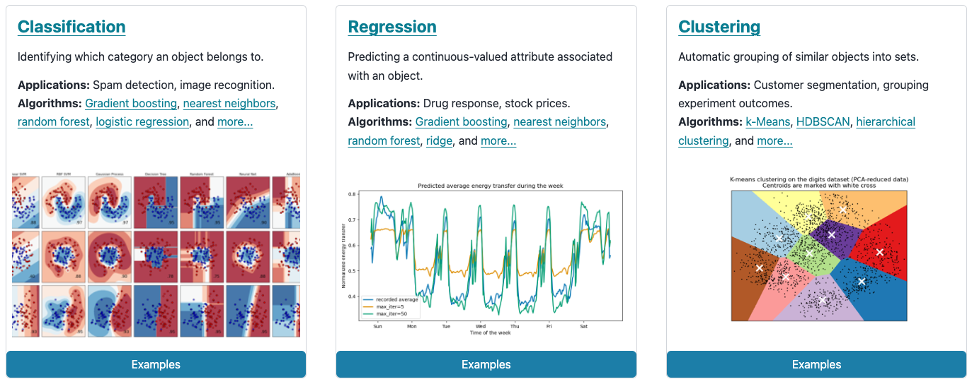
Scikit-learn (sklearn)
1. A variety of machine learning algorithms
Provides a large number of machine learning algorithms, including classification, regression, clustering, and dimensionality reduction.
Common algorithms: linear regression, logistic regression, support vector machines (SVM), decision trees, random forests, K-means clustering, etc.

Slide 13
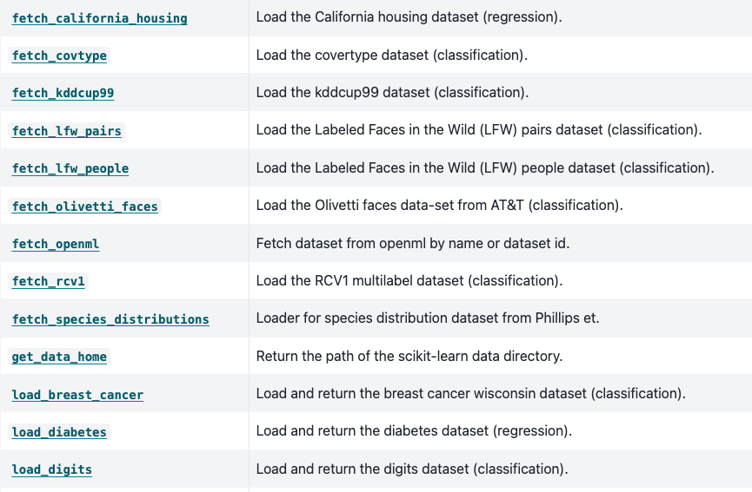
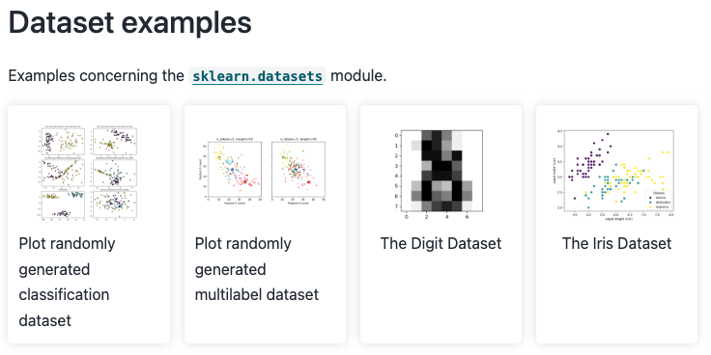
Scikit-learn (sklearn)
2. Dataset Examples
Provides some datasets which can be easily used for machine learning practice, including classification, regression, clustering, and dimensionality reduction.
from sklearn import datasets
iris = datasets.load_iris()

Slide 14
Scikit-learn (sklearn)
3. Dataset Splitting
In machine learning, splitting a dataset into training and testing subsets is a crucial step. The training set is used to train the model, and the testing set is used to evaluate its performance on unseen data. The train_test_split function is commonly used for this purpose.
sklearn.model_selection.train_test_split(*arrays, test_size=None, train_size=None, random_state=None, shuffle=True, stratify=None)
arrays: Input arrays that you want to split. These could be features (X) and target labels (y).
test_size: Proportion of the dataset to include in the test split. It can be a float (e.g., 0.33 means 33% of the data will be used for testing).
train_size: Proportion of the dataset to include in the train split (often left as None since it can be inferred from test_size).
random_state: Controls the shuffling applied to the data before splitting. Passing an integer makes the splitting reproducible.
shuffle: Whether to shuffle the data before splitting. By default, it is True.
stratify: If not None, data is split in a stratified fashion, using this as the class labels.

Slide 15
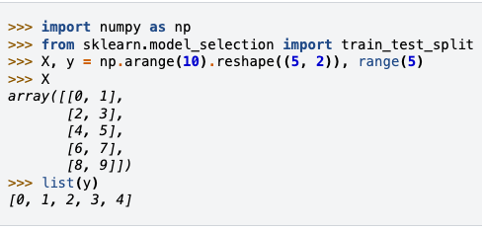
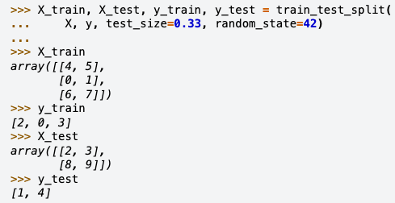

Scikit-learn (sklearn)
3. Dataset Splitting
Examples:
sklearn.model_selection.train_test_split(*arrays, test_size=None, train_size=None, random_state=None, shuffle=True, stratify=None)

Slide 16

Matplotlib
Matplotlib is a comprehensive library for creating static, animated, and interactive visualizations in Python. Matplotlib makes easy things easy and hard things possible.
https://matplotlib.org/
You can install matplotlib with:
pip install matplotlib
conda install matplotlib
or

Slide 17
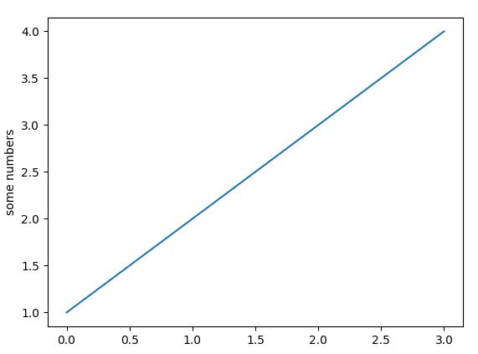
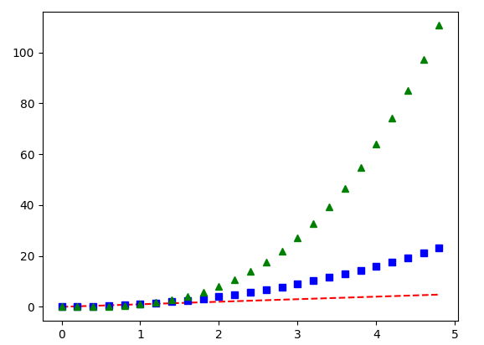
Matplotlib
Pyplot
matplotlib.pyplot is a module in the Matplotlib library that provides a set of functions to create and customize plots in Python. It allows you to build visualizations step by step, with each function modifying the plot in some way. Each pyplot function makes some change to a figure: e.g., creates a figure, creates a plotting area in a figure, plots some lines in a plotting area, decorates the plot with labels, etc.
import matplotlib.pyplot as plt
plt.plot([1, 2, 3, 4])
plt.ylabel('some numbers’)
plt.show()
import numpy as np # evenly sampled time at 200ms intervals
t = np.arange(0., 5., 0.2) # red dashes, blue squares and green triangles
plt.plot(t, t, 'r--', t, t**2, 'bs', t, t**3, 'g^’)
plt.show()

Slide 18
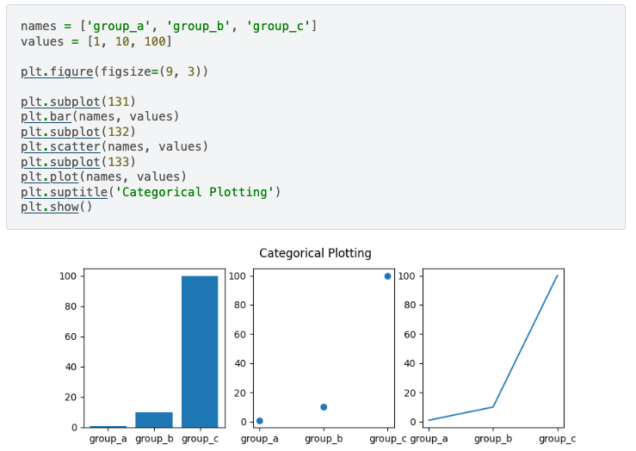
Matplotlib
Pyplot
Create a figure with three subplots, each displaying the same categorical data using different types of plots. The data consists of three groups (group_a, group_b, group_c) with corresponding values (1, 10, 100).
Analyze the code according to the plotting and tell the functions of different code lines.
bar plot. scatter plot. line plot.

Slide 19
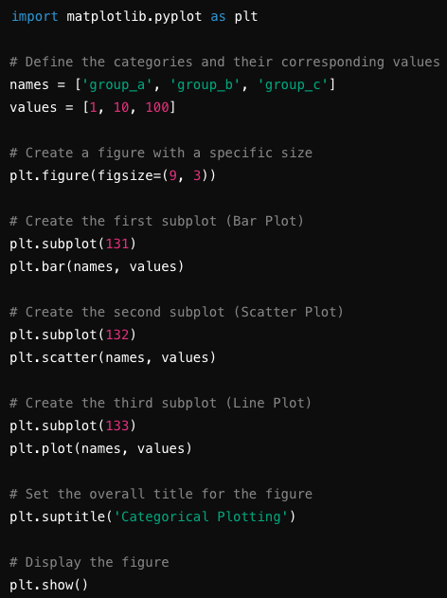
Matplotlib
Pyplot
bar plot. scatter plot. line plot.

Slide 20
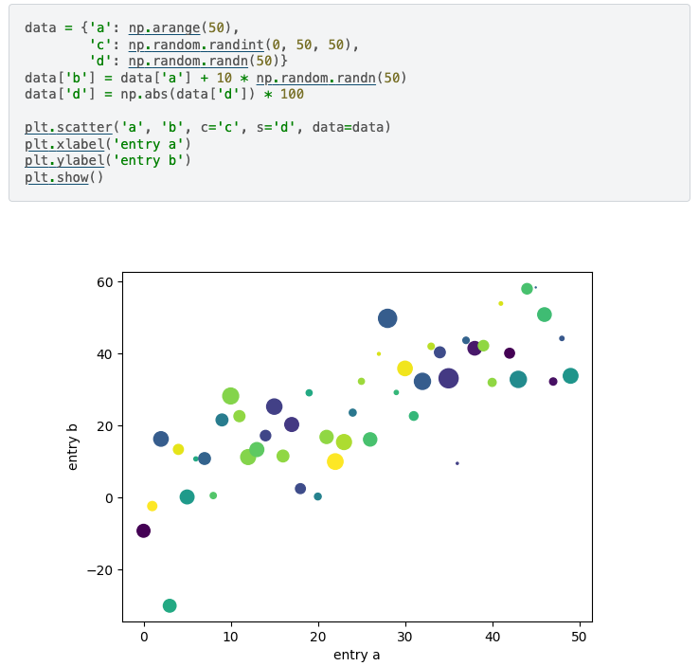
Matplotlib
Pyplot
This code generates a scatter plot with bubble sizes and colors representing additional dimensions of the data. The x-axis (a) corresponds to a sequence of numbers, while the y-axis (b) is a combination of a with some added noise. The color (c) and size (s) of each bubble are determined by random values.
Analyze the code according to the plotting and tell the functions of different code lines.

Slide 21
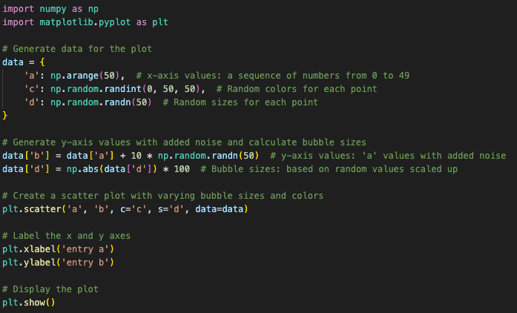
Matplotlib
Pyplot
This code generates a scatter plot where:
The x-axis represents sequential data from 0 to 49.
The y-axis is a noisy version of the x-axis values.
The color and size of each point are determined by randomly generated data.

Slide 22
Seaborn
Different between matplotlib and seaborn
Matplotlib is the most common library in Python, offering a wide range of plotting options and customization features, allowing the creation of complex and highly customized visualizations.
Seaborn is a higher-level visualization library built on top of Matplotlib, focusing on the aesthetic design of data visualizations and the creation of statistical graphics. Seaborn emphasizes data exploration and analysis, with a strong focus on aesthetic styles. However, Seaborn's underlying functionality is based on Matplotlib.
Matplotlib requires a lot of code to create detailed plots, while Seaborn offers a higher-level, more aesthetically pleasing interface, though at the cost of customization:
Seaborn provides "shortcuts" by encapsulating commonly used visualization processes into functions, making the code more concise and allowing for clear and attractive visual outputs with just one line of code. The main drawback is its limited customization capabilities, as it mainly supports predefined visualization templates.

Slide 23

Seaborn
Seaborn is a Python data visualization library based on matplotlib. It provides a high-level interface for drawing attractive and informative statistical graphics.
https://seaborn.pydata.org/
You can install seaborn with:
pip install seaborn
conda install seaborn
or

Slide 24

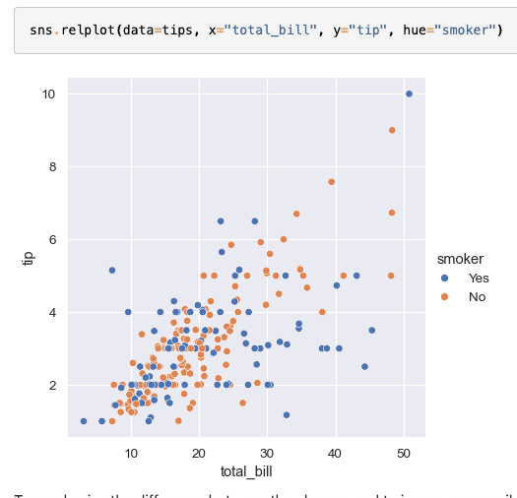
Seaborn
This code generates a scatter plot using the tips dataset, visualizing the relationship between the total bill and the tip amount, with points colored based on whether the customer was a smoker or not.
Imports and Theme Setup:
Necessary libraries (numpy, pandas, matplotlib, seaborn) are imported.
The plot theme is set to darkgrid for a clean and readable background.
Scatter Plot Creation:
A scatter plot is generated using total_bill on the x-axis and tip on the y-axis.
Points are colored by the smoker status (Yes/No).

Slide 25

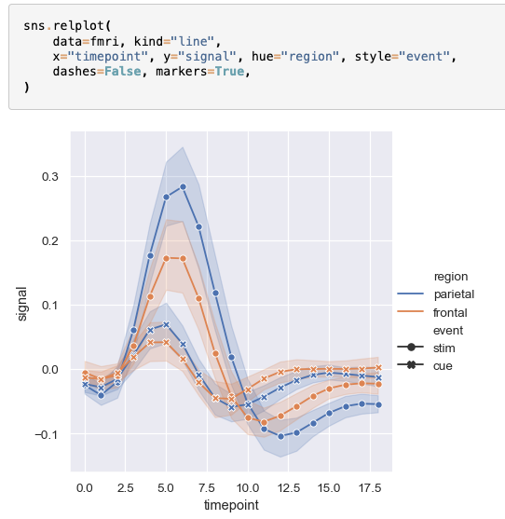
Seaborn
Use the Seaborn library to create line plots for two different datasets, visualizing relationships between variables over time.
First Plot (Dow Jones):
The dowjones dataset is loaded.
A line plot is created showing the relationship between Date and Price.
Second Plot (fMRI Data):
The fmri dataset is used.
A line plot is generated showing signal over timepoint, differentiated by region (hue) and event (style).
Markers are enabled, and dashes are disabled for the lines.

Slide 26
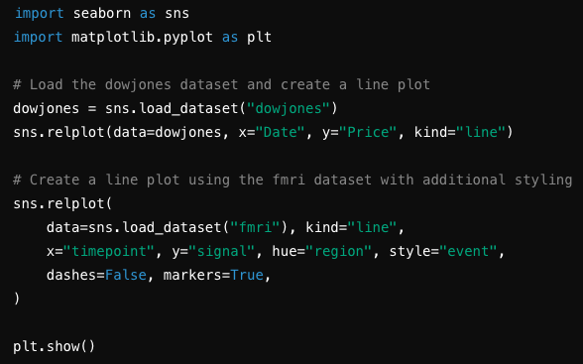
Seaborn
This code generates two distinct line plots:
one visualizing stock prices over time
and another visualizing brain activity signals over time, segmented by regions and events.

Slide 27
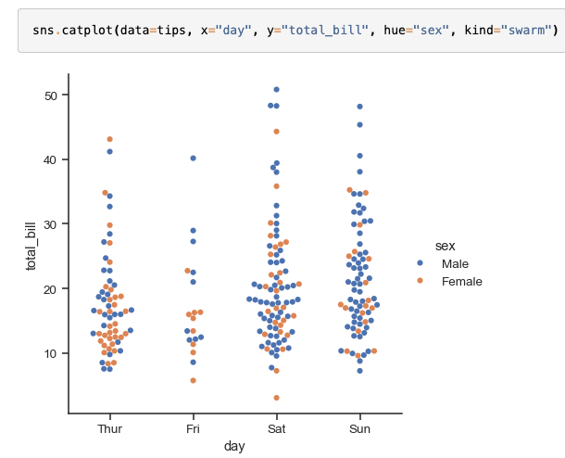
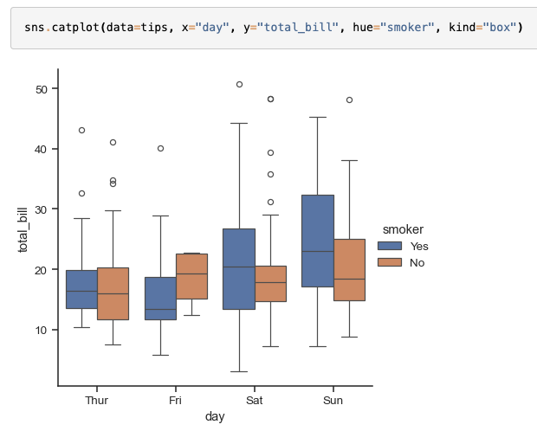
Seaborn

Slide 28
Assignment 2: 40% of total marks
Students are expected to acquire the following skills from the assignment:
Data Collection and Processing: Gathering and preprocessing data from open-source websites, ensuring that the data is clean, normalized, and ready for analysis.
Model Selection and Evaluation: Selecting appropriate machine learning models based on the problem context, and evaluating their performance using relevant metrics such as accuracy, precision, recall, and F1 score.
Technical Implementation: Gaining hands-on experience with Python and key libraries like pandas, scikit-learn, and matplotlib for data handling, modeling, and visualization.
Report Writing and Presentation: Writing a structured report that clearly communicates the project objectives, methodologies, findings, and conclusions, supported by appropriate visualizations and references.

Slide 29
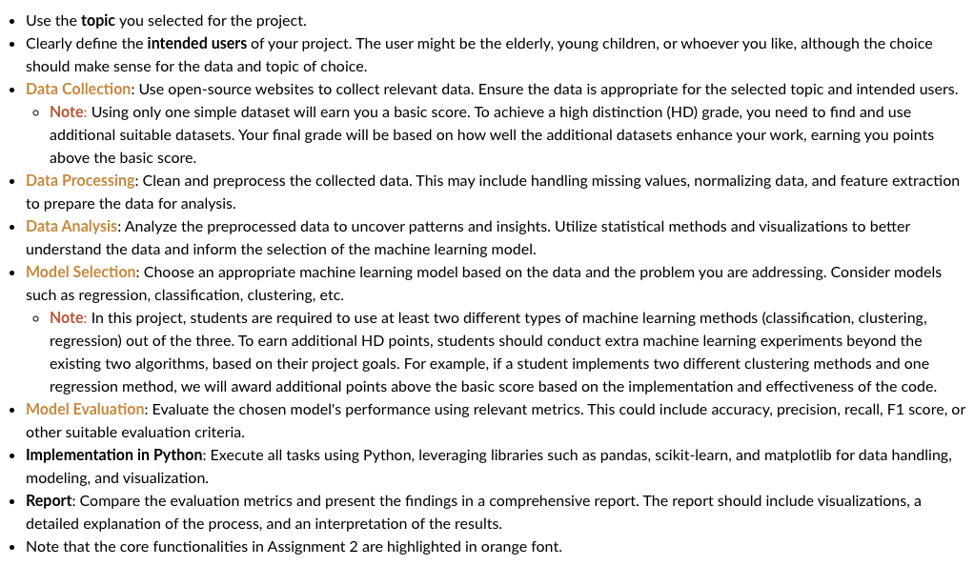
Assignment 2: 40% of total marks

Slide 30
Assignment 2: 40% of total marks
Deliverables:
A report :
Size: up to 2000 words
Format : pdf
A zip file:
Datasets that you have already processed. (JSON/CSV and so on)
Readme file (pdf/md): tell us how to run your code
Your source code （including the final models you used）
Meeting Minutes
Contribution Form
Due on Sunday AEST 11:59 pm 29/09/2024 (Week 8)

Slide 31
Thank you

