Slide 1

Diagnosing Parkinson’s disease from drawings
A machine learning approach to early diagnosis

Slide 2
Parkinson’s Disease
Degenerative disorder of the central nervous system that mainly affects the motor system
Early symptoms are shakiness, rigidity, and slowness of movement
Affects around 1% of the population over 60 and results in 120,000 annual deaths globally

Slide 3

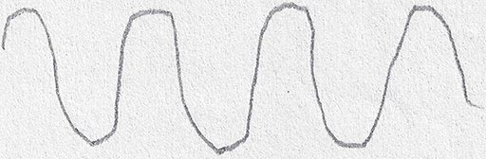
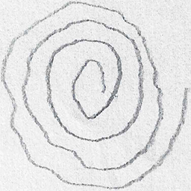
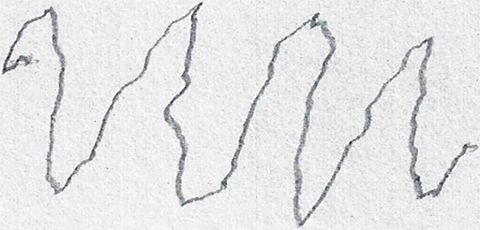
Dataset
HEALTHY PATIENT DRAWINGS
43 Spiral and Wave drawings by Parkinson’s patients
43 Spiral and Wave drawings by age matched healthy individuals
PARKINSON’S PATIENT DRAWINGS

Slide 4
Motivation
Currently requires an expert to subjectively judge drawings which acts as a bottleneck in early diagnosis

Slide 5
Related work
Distinguishing Different Stages of Parkinson’s Disease Using Composite Index of Speed and Pen-Pressure of Sketching a Spiral

Slide 6
Approach
Extract features using variety of filters
Use features to construct Neural Network, Support Vector Machine, and Random Forest to classify images

Slide 7
Evaluation
Confusion matrix
Prefer high recall to high accuracy

