Slide 1

Presentation
Lesson 2

Slide 2
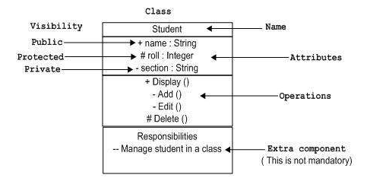
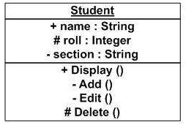
UML Notations
UML is popular for its diagrammatic notations. We all know that UML is for visualizing, specifying, constructing and documenting the components of software and non software systems. Here the Visualization is the most important part which needs to be understood and remembered by heart.
UML notations are the most important elements in modeling. Efficient and appropriate use of notations is very important for making a complete and meaningful model. The model is useless unless its purpose is depicted properly

Slide 3
Table of Contents
UML Notations
Basic Data Types
Access Modifiers
Non-access modifiers
Constructor in Java
Keyword «this»
Keyword «void»
Keyword «return»
Creation of class instances (objects)

Slide 4
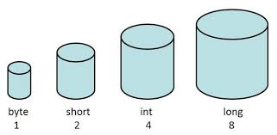
Basic data types
Based on the data type of a variable, the operating system allocates memory and decides what can be stored in the reserved memory. Therefore, by assigning different data types to variables, you can store integers, decimals, or characters in these variables.

Slide 5
Two data types available in Java:
Primitive Data Types
Byte (-128 …. 127);
Short (-32768 …. 32767);
Int (-2^31 …. 2^31);
Long (-2^63 …. 2^63 -1);
Float (single-precision 32-bit);
Double (single-precision 32-bit);
Boolean (true or false);
Char (16-bit Unicode character);
Reference/Object Data Types
Using defined constructors of classes
Reference data type
Default value of any reference variable is null
refer to any object of the declared type or any compatible type
Animal animal = new Animal("giraffe");

Slide 6
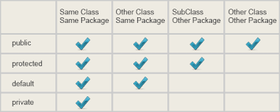
Java Access Modifiers
Visible to the package. the default. No modifiers are needed.
Visible to the class only (private).
Visible to the world (public).
Visible to the package and all subclasses (protected)

Slide 7
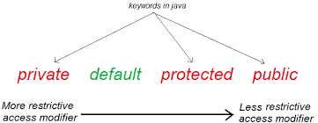
Default Access Modifier
Default access modifier means we do not explicitly declare an access modifier for a class, field, method, etc. A variable or method declared without any access control modifier is available to any other class in the same package. The fields in an interface are implicitly public static final and the methods in an interface are by default public.

Slide 8
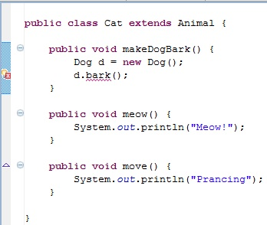
Private Access Modifier
Methods, Variables and Constructors that are declared private can only be accessed within the declared class itself.
Class and interfaces cannot be private.
Variables that are declared private can be accessed outside the class if public getter methods are present in the class.
Using the private modifier is the main way that an object encapsulates itself and hide data from the outside world.

Slide 9

Public Access Modifier
A class, method, constructor, interface etc declared public can be accessed from any other class. Therefore fields, methods, blocks declared inside a public class can be accessed from any class belonging to the Java Universe.

Slide 10
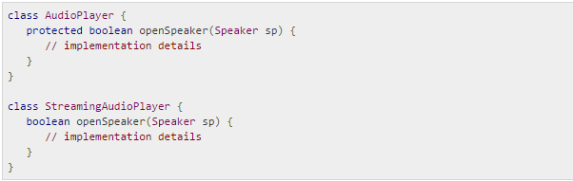
Protected Access Modifier
Variables, methods and constructors which are declared protected in a superclass can be accessed only by the subclasses in other package or any class within the package of the protected members' class.

Slide 11

Java Non Access Modifiers
The static modifier for creating class methods and variables
The final modifier for finalizing the implementations of classes, methods, and variables.
The abstract modifier for creating abstract classes and methods.
The synchronized and volatile modifiers, which are used for threads

Slide 12

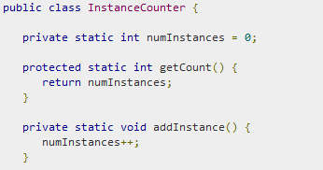
Static VS Final
Static
Static variables;
The static key word is used to create variables that will exist independently of any instances created for the class.
Static methods;
Static methods do not use any instance variables of any object of the class they are defined in. Static methods take all the data from parameters and compute something from those parameters, with no reference to variables.;
Final
Final variables;
A final variable can be explicitly initialized only once. A reference variable declared final can never be reassigned to refer to an different object.
Final methods;
A final method cannot be overridden by any subclasses. As mentioned previously the final modifier prevents a method from being modified in a subclass.
Final classes;
The main purpose of using a class being declared as final is to prevent the class from being subclassed. If a class is marked as final then no class can inherit any feature from the final class.

Slide 13
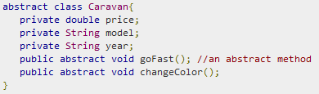


Abstract VS Synchronized
Abstract
Abstract classes;
An abstract class can never be instantiated. If a class is declared as abstract then the sole purpose is for the class to be extended.
Abstract methods;
An abstract method is a method declared with out any implementation. The methods body(implementation) is provided by the subclass. Abstract methods can never be final or strict.
Synchronized
Synchronized modifier;
The synchronized key word used to indicate that a method can be accessed by only one thread at a time. The synchronized modifier can be applied with any of the four access level modifiers.

Slide 14
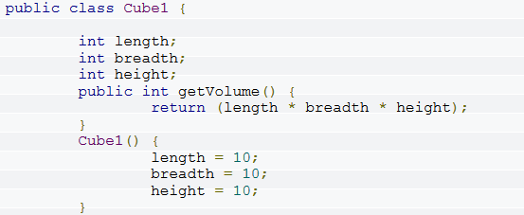
JAVA CONSTRUCTORS
A java constructor has the same name as the name of the class to which it belongs. Constructor’s syntax does not include a return type, since constructors never return a value. Constructors may include parameters of various types. When the constructor is invoked using the new operator, the types must match those that are specified in the constructor definition. Java provides a default constructor which takes no arguments and performs no special actions or initializations, when no explicit constructors are provided. Constructor arguments provide you with a way to provide parameters for the initialization of an object

Slide 15
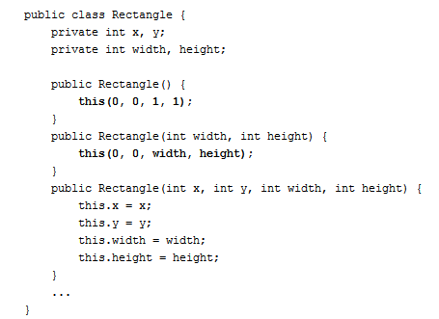
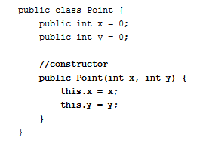
Keyword «this»
Within an instance method or a constructor, this is a reference to the current object — the object whose method or constructor is being called. You can refer to any member of the current object from within an instance method or a constructor by using this.
Simple example: Example with constructor:

Slide 16

Keyword «void»
Void is used when you are creating a class that will not return any value. Java always needs to know what to expect. So if you will get a string after to perform the action you would need to label string, if you expect a number you would label int, double, or whatever type of number will come back.

Slide 17
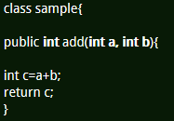
Return type in java
Used in methods
Method signature includes this return type.
we will use methods to do a particular task after completion
of task if we want to return something to the calling place
these return types will be used. Based on the type of data to be returned will mention
it as int , char ,
float double etc as return type in method signature and return statement
should be the last statement of the method body.

Slide 18
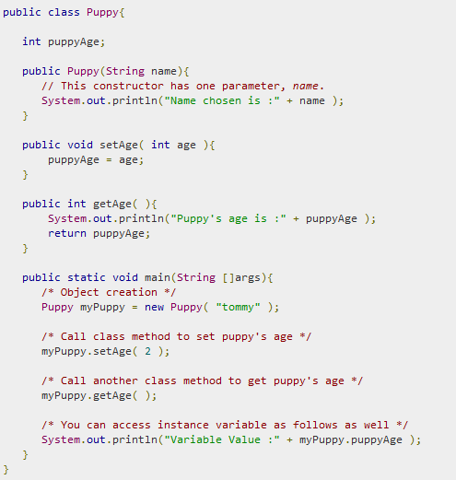
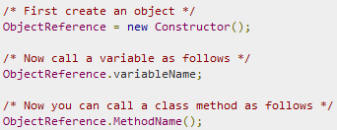
Creation of class instances(objects)
Instance variables and methods are accessed via created objects.
To access an instance variable the fully qualified
path should be as follows:
Few examples:

