Slide 1

Merch-Ent
Rico custodio * dan avery loayon * michaela Aranas * Jerome Boado
III - BSIS

Slide 2
Name: Merch-Ent WEBSITE: www.merch-ent.com Address: Brgy. Sampaloc, Apalit, Pampanga Email: wearemerchent@gmail.com

Slide 3
MISSION
VISION
To be the leading e-commerce site in providing a wide variety of entertainment collectibles.
To be the number one seller of anime, KDrama, KPop, American films and games merchandise in the Philippines.

Slide 4
OBJECTIVES
1. To be the number one seller of anime, KDrama, KPop, American films and games merchandise in the Philippines.
2. To provide a wide range of merchandise at reasonable prices.
3. To have a customer base of 1,000 by the end of the first operating year.
4. To achieve a healthy profit margin within the first year.
5. To achieve a modest profit by year two.
6. To be an active and vocal member of the anime community and Korean community in the Philippines.
7. To expand our service in some country in Asia in four-year to five-year period.
Notes:
Merch-Ent is currently selling collectibles and personalized T-shirt products online through its Wix e-commerce store with market penetration and shipping primarily in the Philippines. Listed below are the objectives of the company:

Slide 5
PRODUCTS
Collectibles
Anime
Films
Games
Kpop & Kdrama
Customized T-Shirts (future plan)

Slide 6
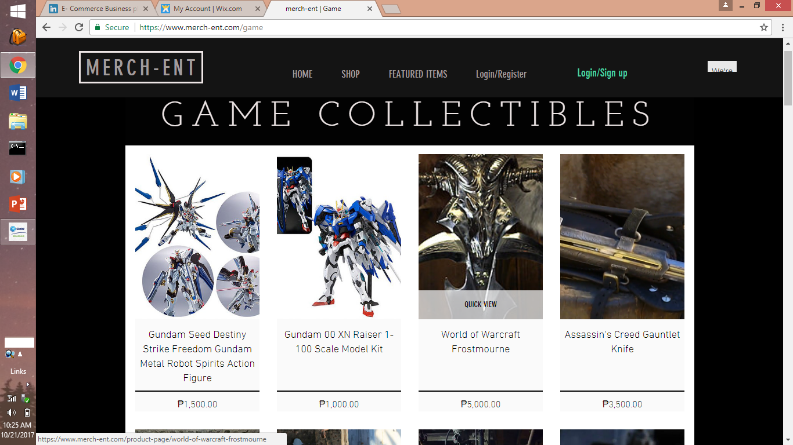

Slide 7
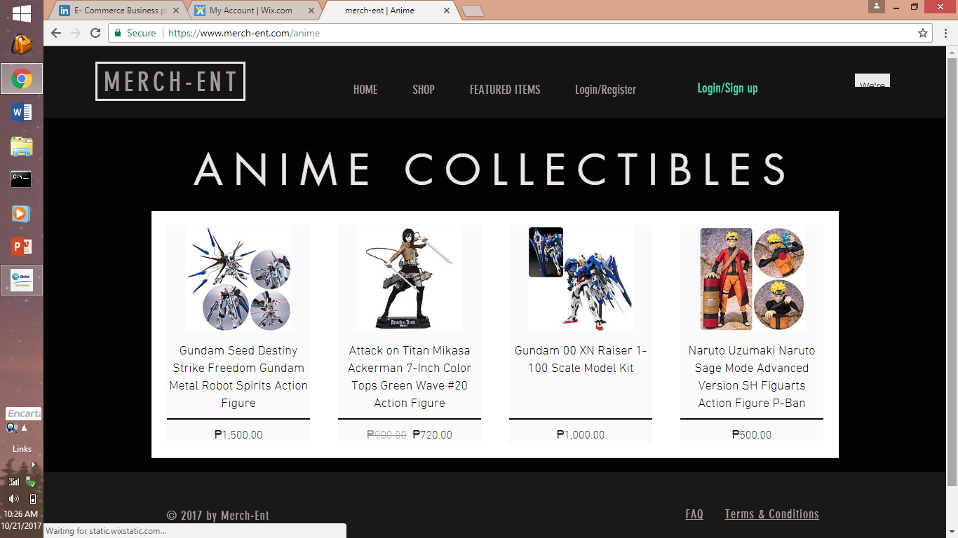

Slide 8
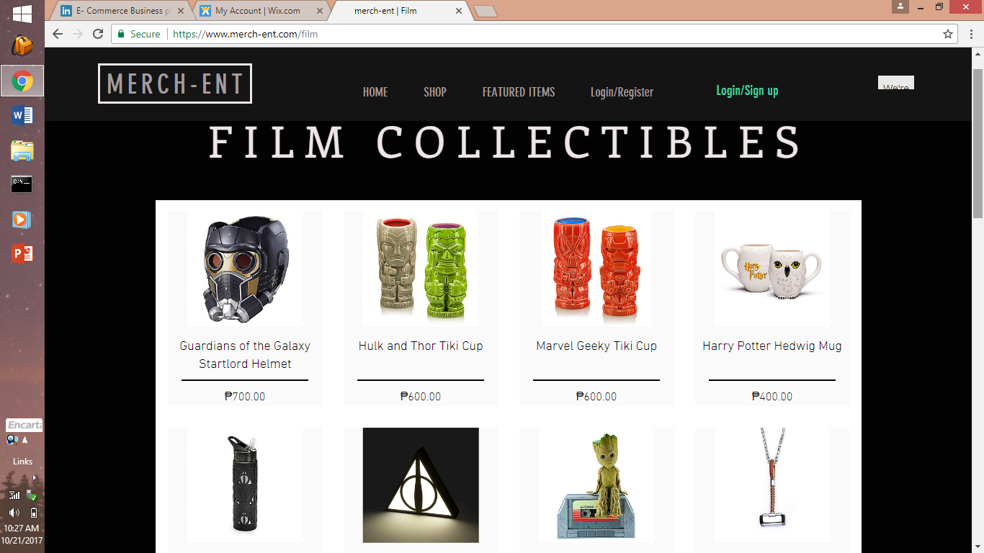

Slide 9
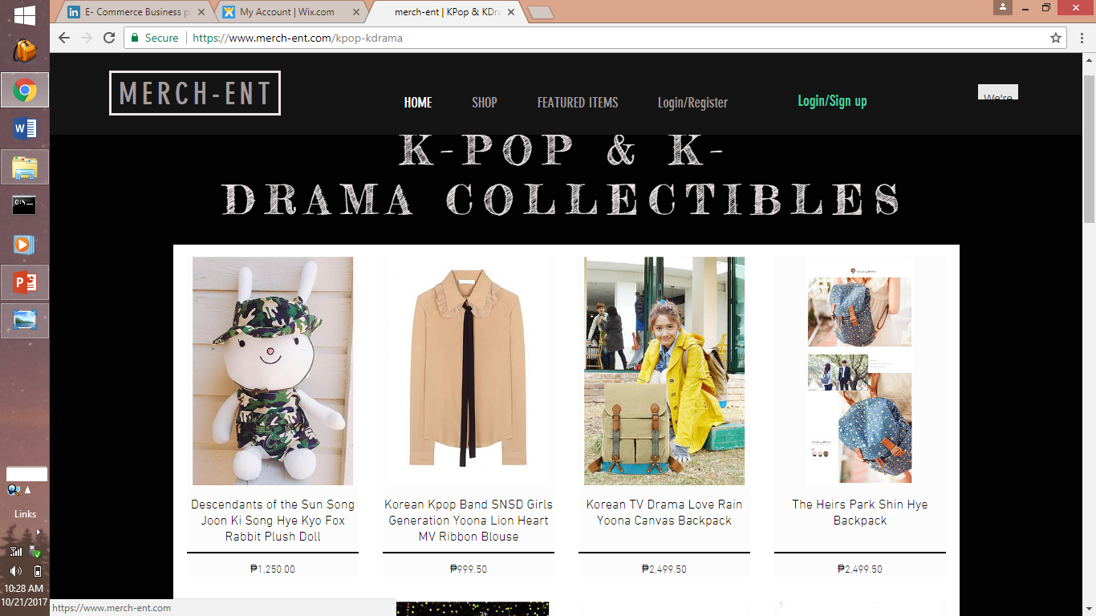

Slide 10
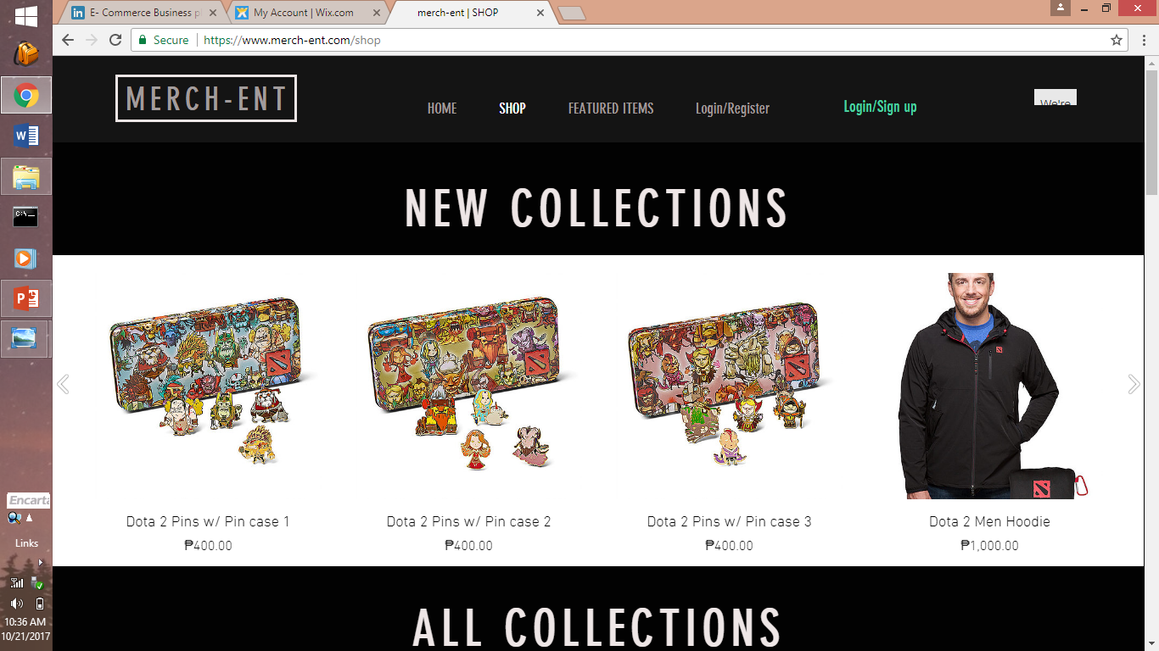

Slide 11
TARGET MARKET
Consumer Segment:
KDrama and Anime fanatics first target: Philippines
Age: 15 and above
Gender: Male and Female
Addicted to watching anime, dramas and playing games:
They always watch and anticipate KDramas and animes, fans of KPop artists, and they are heavily playing games.
Location: The beachheads for the company will be in Pampanga. However, with the ability to shop online, we’ll heavily promote ourselves throughout the entire Philippines.

Slide 12
advertising
Online advertisements about new offers in other sites.
E.g. social media sites
community
Costumer can give comments about the website, offers, services, complaints and suggestions from the Contact Us section of the website.
Then, we can improve our business after analyzing their comments

Slide 13
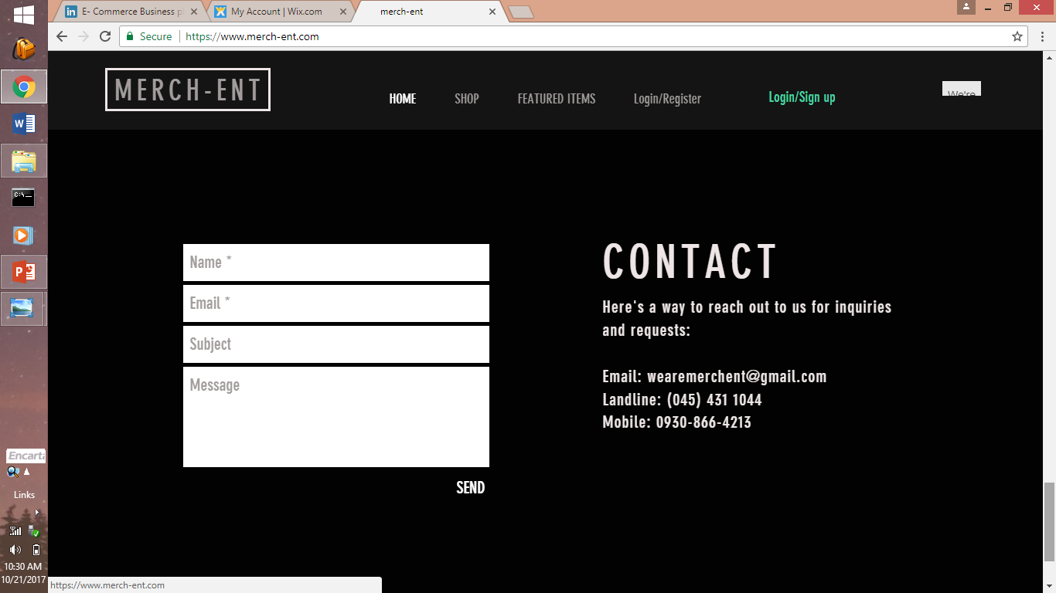

Slide 14
Brand Differentiation and Value Proposition
Unlike our first-mover competitor Comic Alley, who only sell stuff that can be seen in anime, we offer more items that can be seen on KPop, KDramas, films, and games. Our plan is to leverage to customers in embracing and expressing their inner geekiness and use a marketing strategy that is closely aligned with building personal relationships with our target market. Collectors will be enticed to buy since the company offers exclusive items.

Slide 15
Market research
Competition – who are our rivals offering collectibles
Pricing – high quality products at a reasonable price
Products – focuses on collectible categories which are selling more and identifying collectible categories with lower sales and take necessary actions
Functionality – always try to keep our online presence simple, reliable and eligible
Innovation – images of the latest products and attractive online shopping window
Notes:
Marketing research is all about falling into decisions and it Involves looking all competition, products, pricing functionality and innovation through secondary data, personal experience, word f mouth, primary market research
mar·ket re·search
the action or activity of gathering information about consumers' needs and preferences.

Slide 16
BUSINESS MODEL
Online (www.merch-ent.com)
Frequently updating the site with new arrivals for the convenience of the customers.
Payment through Paypal
Availability of Shopping Carts
Notes:
busi·ness mod·el
a design for the successful operation of a business, identifying revenue sources, customer base, products, and details of financing.

Slide 17
BUSINESS MODEL
Outsource Production
Currently, we are buying items from:
Man at Arms, Michaelethulhu, and NECA - Gaming collectibles
Hasbro – Film collectibles
Kpop Mall USA - KPop collectibles
YESASIA - KDrama collectibles
Global Sources – Anime collectibles
Competitor
- Comic Alley

Slide 18
Thanks be to god

