Slide 1
Alexa 101 Dan Bloy

Slide 2
Welcome
Intros
Notes:
Hello and welcome to this trail coding course . We here to help introduce you into the world of coding through the interactive Amazon Alexa)
My name is X and my experience is Y
I’d like this course to be a relaxed working group, please ask questions as we go, we can white board to ensure understanding.
Let’s introduce the class to all..

Slide 3
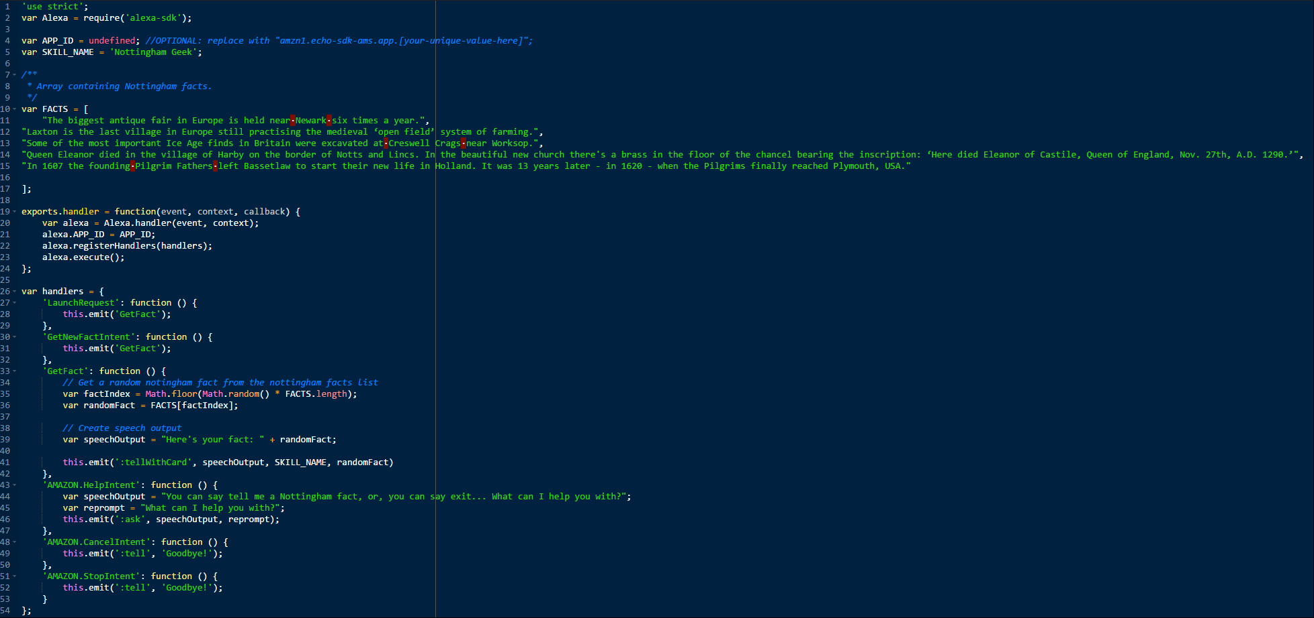
Course Overview
1.5hrs per day for 3 days
Session One:
Introduce you to and get you coding.
Deploy your skill into Development and test
Session Two:
Get you using the tooling and developer workflows
Understand the code line by line (It’s only 50 lines!)
Change the behaviour of Skill Invocation Vs Invocation with Intent
Session Three:
Data Persistence
Hosted Audio
Mobile Companion App
Automate some of our workflow via the Amazon CLI
Notes:
Walk through each bullet point.
The code shown is the LIVE code for Nottingham Geek

Slide 4
Session One

Slide 5




What is Alexa
3 -‘Display Card’
2 – Code Executed and response returned to Alexa
1 - “Alexa, open Nottingham Geek”
2 -‘LaunchRequest’
3 – “Here is your fact…”
Notes:
Talk through the core components
Explain the users experience
Demo Nottingham Geek

Slide 6



The tools
Alexa Skills Kit
Amazon Web Services
Echo Simulator
Node.js
Atom.io
developer.amazon.com
This is where we build our Alexa Skill and Interaction Model
aws.amazon.com
We shall be using Lambda to execute our Code and return information back to the Alexa Skills Kit
echosim.io
We will be using this to test our Skills using the microphone on your computer
Nodejs.org
Our code will be written in Javascript using the Node.JS platform and the Alexa SDK
Atom.io
We will write our node.js code using the Atom browser
Used in Session One
Notes:
Explain all tools and how they fit into the development framework
Explain that we will only be using the first 3 in week one.

Slide 7
Anatomy of an Alexa Skill Invocation
Alexa, Open Nottingham Geek
Wake Word
Launch Word
Invocation Name
Alexa, Ask Nottingham Geek for a fact
Wake Word
Invocation Name
Utterance
Launch Word
Connecting Word
Notes:
- Break down the phrase to introduce concepts of Wake, Invocation Name and Sample Utterances

Slide 8
Anatomy of an Alexa Skill Invocation
Alexa, Ask Nottingham Geek for a fact
Wake Word
Invocation Name
Sample Utterance
Restricted by Amazon to:
Alexa (Default)
Computer
Amazon
Echo
The Invocation name of your Alexa Skill. There are some requirements to what you use LINK
What you expect your user to say are called ‘Sample Utterances’. You must list out all the possible combinations and match these to your skill ‘Intents’
Notes:
- Go into more detail about the invocation phrase

Slide 9
Anatomy of an Alexa Skill Invocation
Alexa, Ask Nottingham Geek for a fact
Wake Word
Invocation Name
Utterance
Launch Word
Connecting Word
Alexa
Computer
Echo
Amazon
Ask
Tell
Open
Launch
Run
Load
Begin
Nottingham Geek
a fact
a Nottingham fact
tell me a fact
tell me a Nottingham fact
give me a fact
give me a Nottingham fact
tell me trivia
tell me a Nottingham trivia
give me trivia
give me a Nottingham trivia
give me some information
give me some Nottingham information
tell me something
give me something
For
About
To
Notes:
Ensure that they understand that you only have to code for the sample utterance, but you must think about what the user could say and that needs to go into your code.

Slide 10
Hands on
We are going to build a Fact Skill, based on a Template, you will customize this to make it your own.
Login to Amazon Developer Portal (developer.amazon.com)
Login to Amazon Web Services (aws.amazon.com)
We will use the sample files provided:
Sample Utterance.txt
Intent Schema.txt
Index.js

Slide 11
Hands on
In the Amazon Web Services Portal:
First – Let’s secure your AWS Account (Follow on screen)
Search for Lambda
Ensure that your in ‘Ireland’ Region (from the top right)
Click ‘Create a Lambda function’
Click ‘alexa-skill-kit-sdk-factskill’
Click on the empty dashed square box and select ‘Alexa Skills Kit’
Click Next

Slide 12
Hands on
In the Amazon Web Services Portal:
Name = [myFunctionName]
Description = [Give it a meaningful description]
Delete all the code, and paste in the contents from the index.js file
Role = ‘Create custom role’
New page will open, save the role.
‘Next’
‘Create Function’
Copy the ARN from the top right and save it in a new text file for later use. Eg. arn:aws:lambda:eu-west-1:123456789:function:alexaDeveloper

Slide 13
Hands on
In the Amazon Developer Portal:
Click on ‘Alexa’ on the top menu
‘Get Started’ on the Alexa Skills Kit
Top right, ‘Add a New Skill’
Language = English (U.K.)
Name = [Name your skill]
Invocation Name = [Your invocation Name]
‘Save’ then ‘Next’

Slide 14
Hands on
In the Amazon Developer Portal:
Copy the contents of IntentSchema.txt into the Intent Schema Box
Copy the contents of SampleUtterances.txt into the Sample Utterance Box
‘Save’ then ‘Next’

Slide 15
Hands on
In the Amazon Developer Portal:
Select AWS Lambda radio button
Select Europe only checkbox
Past in the Lambda ARN we saved from earlier
‘Save’ then ‘Next’

Slide 16
Hands on
In the Amazon Developer Portal:
Now we can test our Function using the Service Simulator
Type ‘Open’ into the Text Box
View the Request Packet and the Response Packet
Try it a few more times
Open echosim.com
Using your PC Microphone, press space bar and say “What’s the time”
If works, then say “Open [innovation name]”

Slide 17
Hands on
In the Amazon Web Services Portal:
Let’s Edit the code to make it your own
Test using the Voice Simulator
Test using Echosim.io

Slide 18
Write code from Scratch
Lesson 1 Files

Slide 19
Tooling
Node.JS (Already installed – available form https://nodejs.org)
Create a folder on your desktop called ‘Alexa-101’ and within that ‘Lambda’
Open Command Prompt (Start | Windows System)
Change Directory (Type ‘cd Desktop\Alexa-101\Lambda’)
Set project file (Type ‘npm init’)
Install Alexa-SDK (Type ‘npm install alexa-sdk’)
Open Atom, create a new file, save-as ‘index.js’ within ‘Alexa-101\Lambda\’

Slide 20
Write our code
We’ll write this together
If you get stuck ask, back-up files are stored at https://gitlab.com/danbloy/alexa-101

Slide 21
Upload and Test our code
We now have:
Index.js, node_modules (Alexa-SDK and dependant packages) in \Desktop\Alexa-101\Lambda\
Intent Schema.txt and Sample Utterances.txt
Let’s create a new Lambda Function
We need to zip the contents of \Desktop\Alexa-101\Lambda
Goto AWS, Lambda, Create a Lambda Function, Blank Function, Select Alexa Skills Kit, Next, Name and Dexcription
Code entry type = upload a zip (Upload your zip)
Choose an existing Lambda Role, Next, Create
Copy the ARN

Slide 22
Upload and Test our code
Now create the Alexa Skill
Sign in to adeveloper.amazon.com
Alexa, Alexa Skills Kit, Add a New Skill
Language = English U.K
And Name and Invocation Name
Copy and Paste Intent Schema and Sample Utterances, Next
Use ARN, Europe, Copy in the ARN from Lambda, Next
Test
OK, so this does the same as before, but we wrote it from scratch… now let’s customize it

Slide 23
Mobile Companion App
Lesson 2 Files

Slide 24
Mobile Companion App
So your uses can hear the response but maybe you want to send the information to the Alexa Mobile App… maybe you want to send extra information / pictures.
How:
We can do that using the Alexa SDK. Go here and search for ‘:tell’
https://github.com/alexa/alexa-skills-kit-sdk-for-nodejs

Slide 25
Mobile Companion App
And this is it!

Slide 26
Using Audio from S3
Lesson 3 Files

Slide 27
Customize our Greeting
We’ve built our skill that uses Lambda for the code execution and also the source of all the information that the user hears, and sees the information within the mobile app.
But maybe you want your own branded welcome message using your studio produced audio files. So let’s bring in external audio files.
How:
We need to record some audio, host it and then bring it into our code.

Slide 28
Customize our Greeting
Download and install Audacity
Open and set the Project Rate (Bottom left) to 16,000
Record your audio and edit as required
To save: File > Export Audio
Set File Type = MP3 Files
Options: Quality = 48kbps & Rate = ‘Constant’
Save

Slide 29
Customize our Greeting
In AWS navigate to S3
Create Bucket called “alexa-public-my-name” (With your name)
Next, Next
Group Permission : Everyone = Objects – Read
Next, Create
Upload your audio file, click on row, copy the link,
More > ‘Make Public’

Slide 30
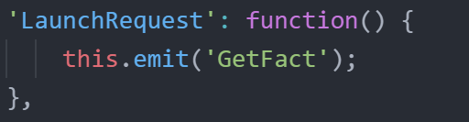
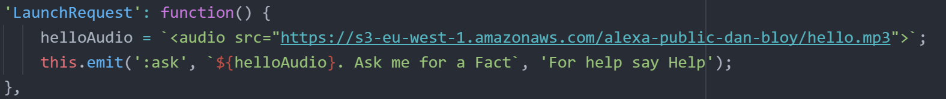
Customize our Greeting
Ok, now we need to add the file into our Lambda Code.
Open Atom, lambda.js
Change:
To:

Slide 31
Let’s Automate
Lesson 4 Files

Slide 32
Use AWS CLI and Batch file to automate
Until now, you’ve amended you code in ATOM, zip’d up the contents, uploaded to Lambda. This is all manual work that is wasted time, let’s remove this part from our workflow through simple automation.
How:
We’re going to use the AWS CLI and a Windows Batch file to automate this part.

Slide 33
Customize our user experience
Open Terminal/Cmd
Type ‘aws configure’

Slide 34
Database Integration
Lesson 4 Files

Slide 35
Customize our user experience
We have an Alexa Skill, mobile app, custom welcome message and now we’re going to customize the user experience by personalising the greeting using a database to store and retrieve the users name. So when the user interacts with our skill next time the conversation will be ‘slightly’ more pleasant.
How:
In Alexa developer portal we are going to create a new intent (to capture the name intent), update the Sample Utterances.
In AWS, we are going to amend our Lambda code to create a new database on launch, request the user to tell us their name, and check for an existing name on launch and use that in our greeting.

Slide 36
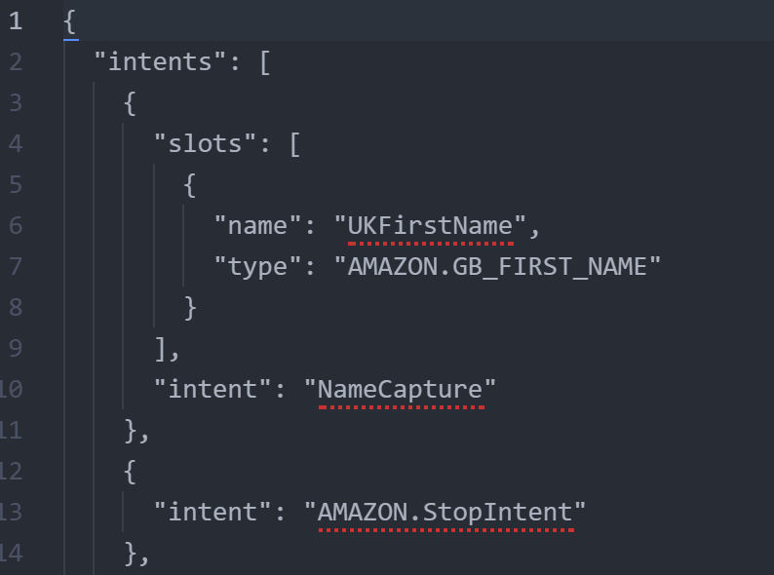
Update Alexa Schema
Add a new intent

Slide 37
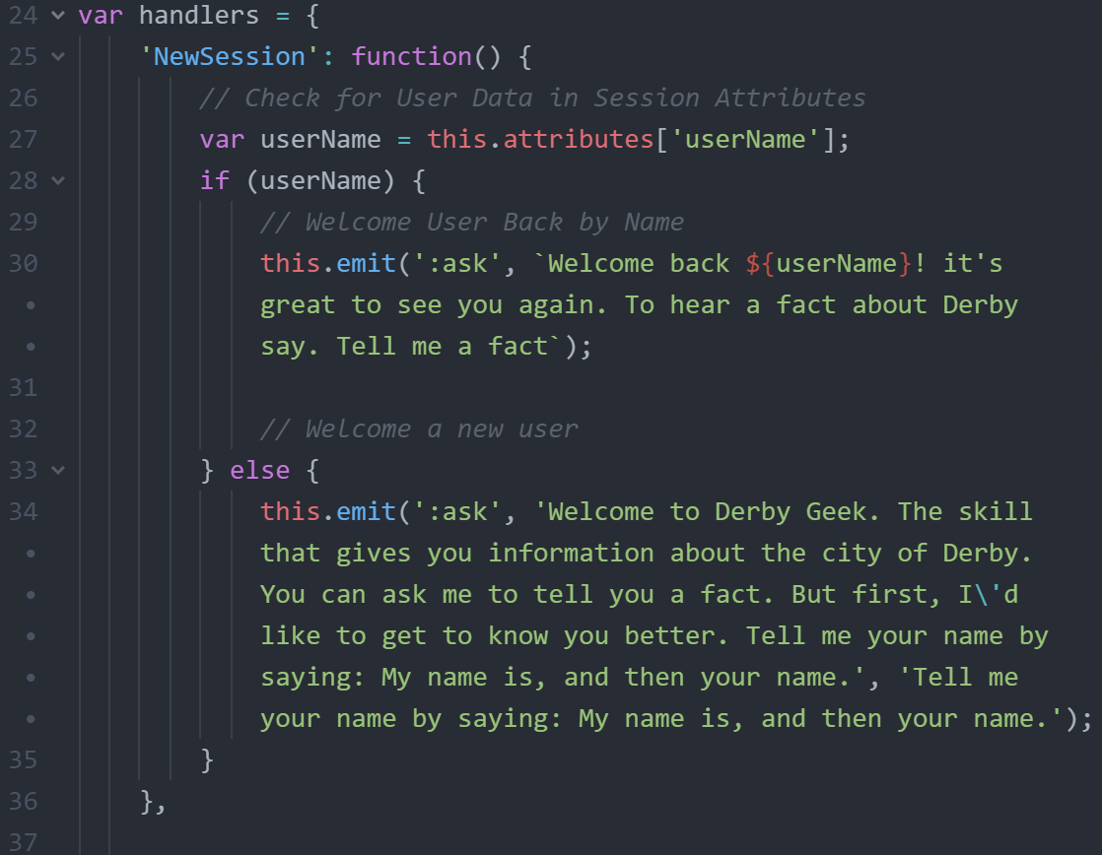
Update our code
Add DynamoDB table
Add a new handler event called NewSession
Note: One item we will need to do for the first time is too allow our IAM Role for Lambda permission to create a DynamoDB table. We do this within Lambda configuration.

Slide 38
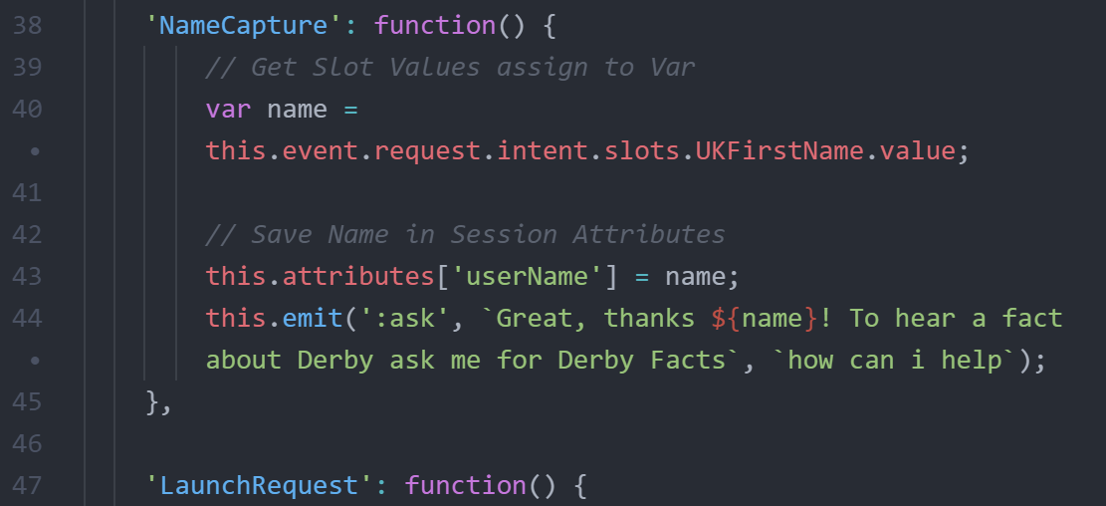
Update our code
Add a new handler event called NameCapture

Slide 39
Update our code
Update the code to Lambda and create the new IAM Role and Test
First using developer portal
Then echoism.io
Finally let’s look at the DynamoDB Table in AWS

Slide 40
Congratulations & THANK YOU
You have learned a load of new technologies and some of the pains of managing code. This has been a 101 course but don’t stop that from you building on this foundation and trying out new things! Take a look at what you’ve been introduced to!
Alexa Architecture / Anatomy
Signed into AWS and secured your account
AWS Lambda
AWS IAM
AWS DynamoDB
AWS S3
AWS CLI
Alexa Developer Portal
Alexa Skills kit
Alexa SDK
Node.js
Atom
Alexa Testing (Using the portal and echoism)
Audio Recording and Conditioning for Alexa
Coding
Automating the deployment

Slide 41
Appendix

Slide 42
Links
Blog on invocation names
Alexa SDK on GitHub
ECHOSIM.io
Alexa Skills Kit documentation
Alexa Free Swag
Alexa Free AWS Credits

