Slide 1
System design project
a.a. 2018 – 2019 Daniele Castro S253244

Slide 2

Index:
What is the project thought to be for?
Code organization
Comments organization
Command Line Interface (CLI)

Slide 3
What is the project thought to be for?
We initially thought to modify the current graphical telegram client to use SEcube as crypto-engine upon the already existing encryption mechanism of telegram.
A similar project was already done in the past but, since it was not using the standard telegram libraries, Tdlib, it does not compile anymore.
Unfortunately we immediately noticed that Tdlib does not provide any graphical API. That means that an entire new graphical client must be developed in order to use these libs.
So we came up with another solution

Slide 4
What is the project thought to be for?
We decided to make telegram-cli able to use SEcube as crypto engine
To do so we decided not to modify the source code of telegram-cli.
Instead, we decided to make an external C-written program that will be opportunely called by telegram-cli to encrypt or decrypt messages.
This is possible thanks to the fact that telegram-cli integrates the possibility to write LUA scripts that can consequently call external programs.

Slide 5
What is the project thought to be for?
This C-written program is called “SEfile-cli”
It is a command line interface that interacts with the SEcube MCU to crypt or encrypt binary files.
It works both in linux and Windows
Making a command line interface means that it can be used in scripts or by other programs.
That makes this program a powerful commandline tool
It can also be called, for instance, as a cgi-bin script from any web-browser to encrypt HTML passwords and so on

Slide 6
What is the project thought to be for?
Unfortunately, after making everything, I discovered that the development stage of telegram-cli is not giving a final stable software release
So, basically, the LUA script is not yet able to properly execute my executable
In the future, developing stages of telegram-cli probably a few bugs will be solved and telegram-cli will be able to properly run my executable

Slide 7
Code organization
Code is structured in three levels:
Command Line Interface (CLI) C functions
Wrapper C functions
SEfile APIs
The Command Line Interface functions simply implements the functions that can be requested by the CLI interface
They can all be found in “SEfile-cli.c” and “SEfile-cli.h”

Slide 8
Code organization
The Wrapper functions are a middleware between the APIs and the CLI.
I made them because many common tasks that are usually asked to these APIs like “write a cipher file from a given binary file” or “write an encrypted buffer starting from a cipher file” can, now, be done calling a single function instead of coping and pasting every time few lines of code.
They can be found in “wrapper.c” and “wrapper.h”
They are made so that most of the things you can expect to do with SEfile APIs can, now, be done with fewer lines of code without directly calling them.

Slide 9
Comments organization
This project as not only the purpose to be a command line interface for the Sefile APIs
It is also a well-written code example for those who wants to integrate these APIs in their own projects.
SEcube website proposes only few graphical applications as example for their APIs usage.
A graphical Qt application is not the best example to learn how an API works since it is supposed that you first know how GUIs backend works.

Slide 10
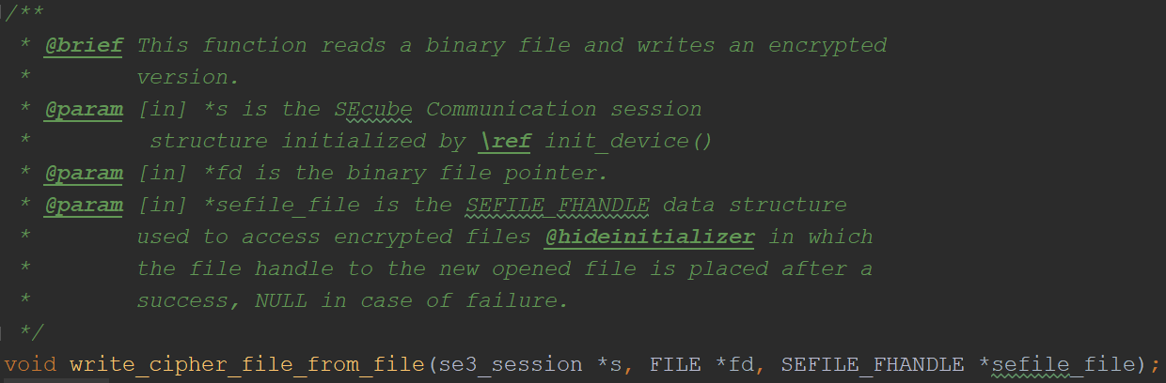
Comments organization
I made the code comments upon every function prototype explaining what every function does in “wrapper.h”
I did it with the same code-comment style of SEfile APIs.

Slide 11
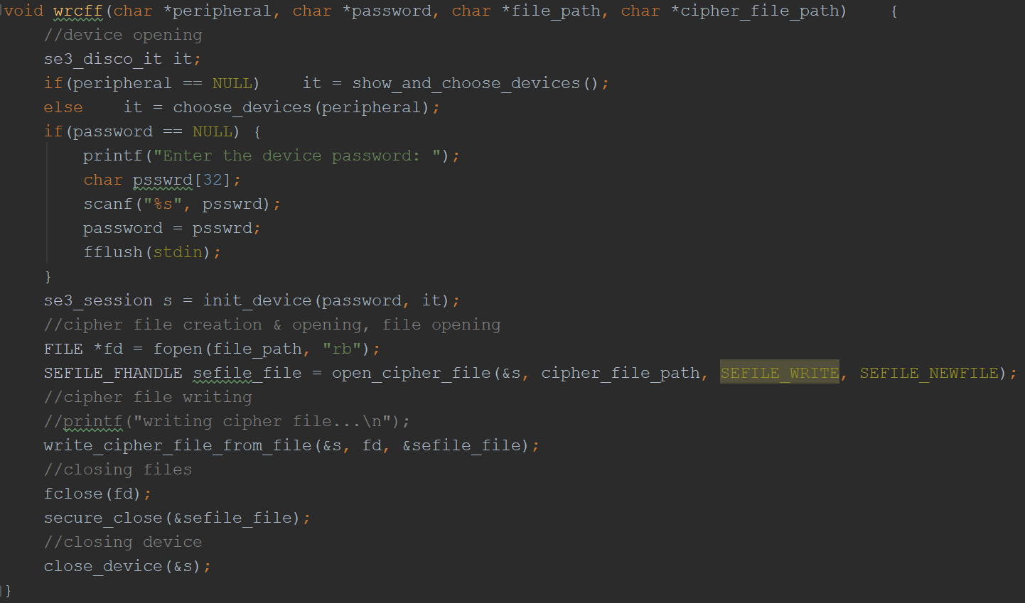
Comments organization
Code is also well commented between lines:

Slide 12
Command Line Interface (CLI)
Typing ‘SEfile-cli --help’ will display a message well explaining how to properly use the program
There are six commands:
list: list cipher files
wrcff: write cipher file from file
wrcfs: write cipher file from string
wrffc: write file from cipher
wrsfc: write string from cipher
--help: prints usage informations
Each of these commands requires some mandatory options and also optional ones.

Slide 13
Command Line Interface (CLI)
Not putting mandatory options ends in an error message and the immediate program exit.
There are six options:
-pe: stands for ‘peripheral’
-i: stands for ‘input file/string’
-o: stands for ‘output file’
-c: stands for ‘cipher file’
-pa: stands for ‘password’
-d: stands for ‘directory’
Wether an argument is mandatory or not depends on the specific command.

Slide 14
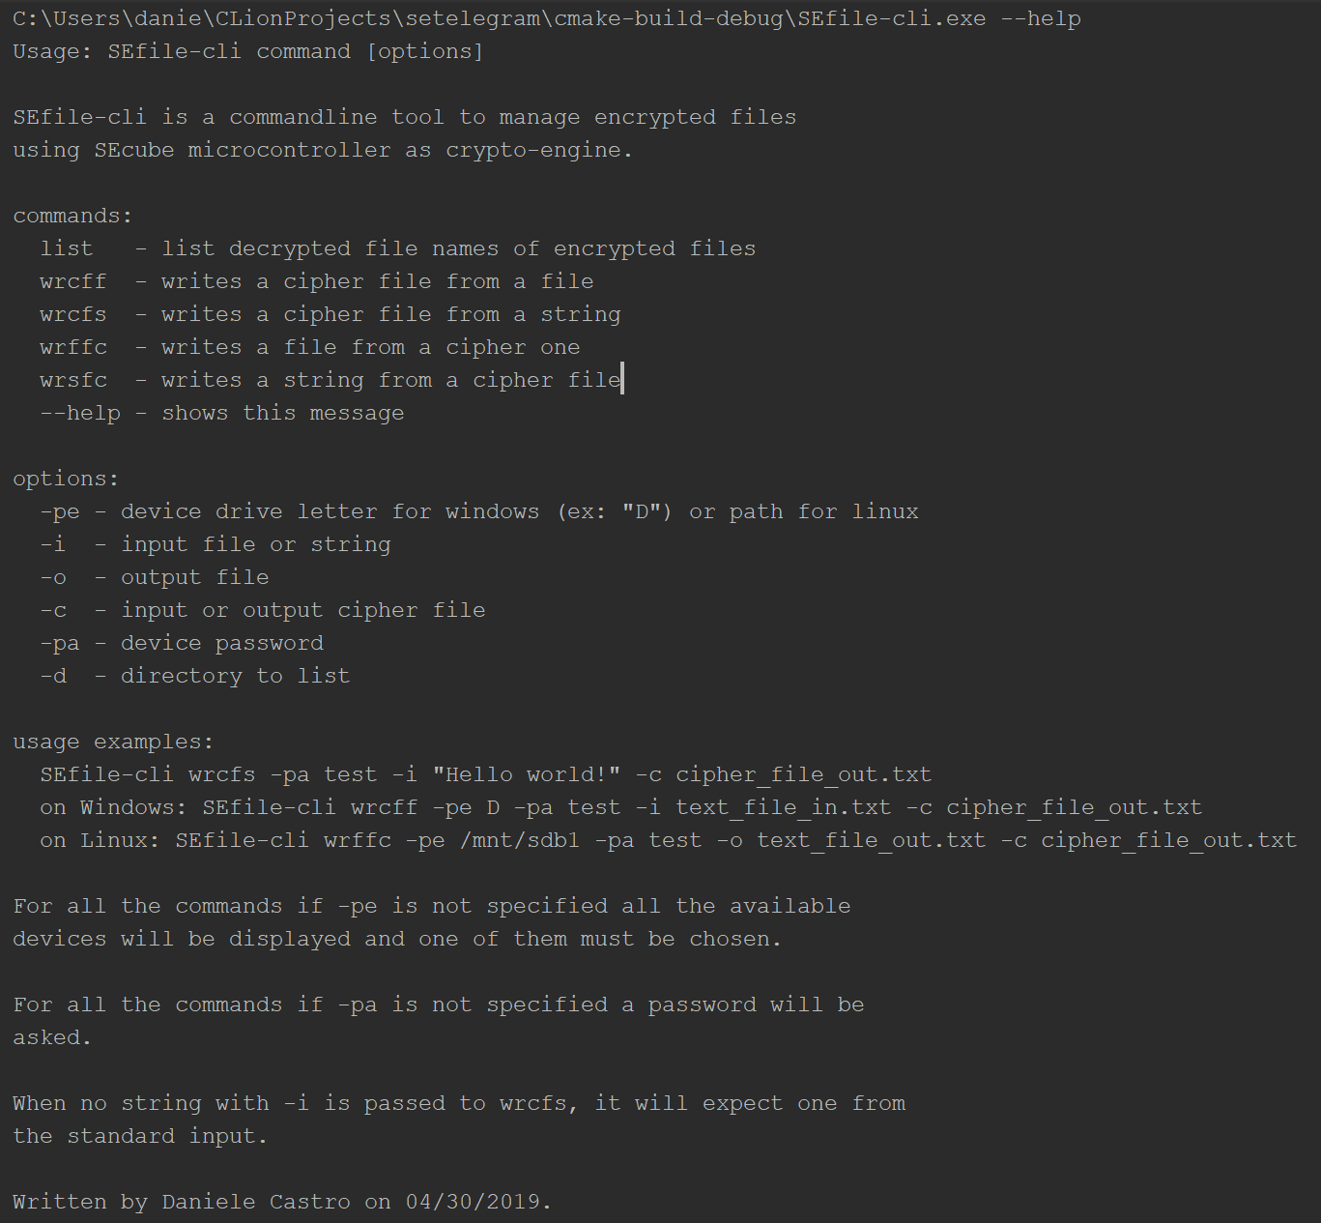
Command Line Interface (CLI)
Help message:

Slide 15
Thank you for your attention.

