Slide 1
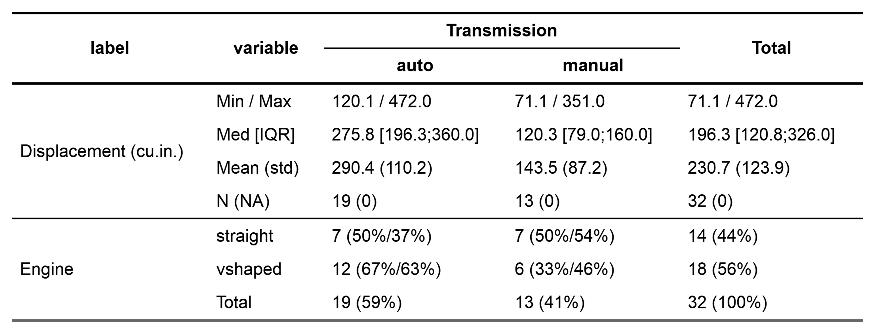
by=am
total="both" (row)
c(disp, vs)
total="both" (col)
percent_pattern="{n} ({p_row}/{p_col})«
percent_digits=0

Slide 2
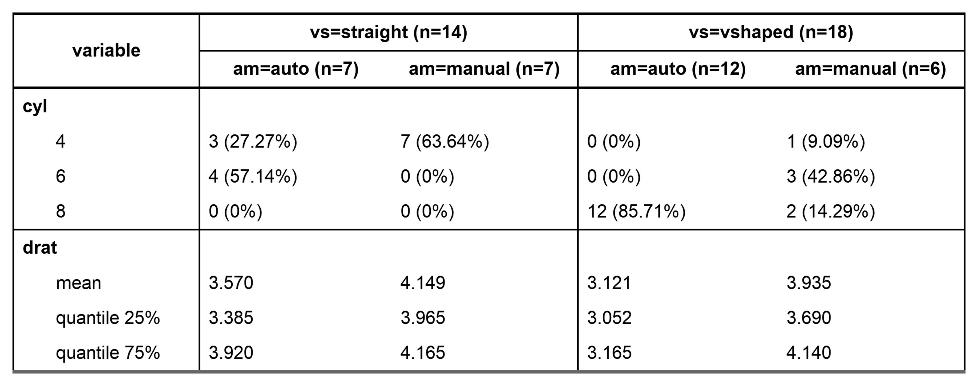
header_show_n=1:2
Shows the group size
by=c(am, vs)
starts_with("cy")
ends_with("at")
funs=c(mean, quantile)
funs_arg=list(probs=c(.25,.75))
num_digits=3

Slide 3
crosstable(mtcars2, c(disp, vs), by=am, total="both",
percent_pattern="{n} ({p_row}/{p_col})", percent_digits=0) %>%
as_flextable()
by=am
total="both" (row)
c(disp, vs)
total="both" (col)
percent_pattern="{n} ({p_row}/{p_col})«
percent_digits=0

Slide 4
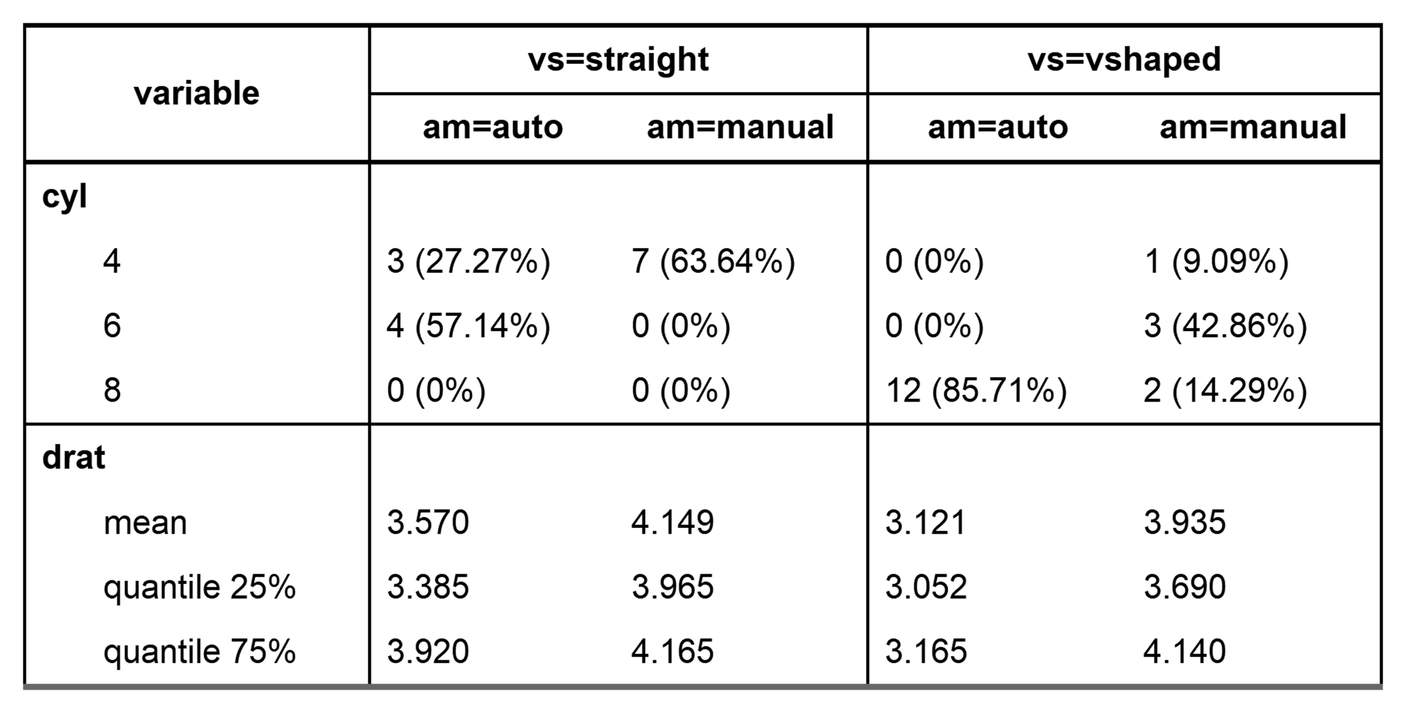
crosstable(mtcars2, c(starts_with("cy"), ends_with("at")), by=c(am, vs), label=FALSE,
funs=c(mean, quantile), funs_arg=list(probs=c(.25,.75) , num_digits=3) %>%
as_flextable(compact=TRUE)
label=FALSE
Variable name instead of label
by=c(am, vs)
starts_with("cy")
ends_with("at")
funs=c(mean, quantile)
funs_arg=list(probs=c(.25,.75))
num_digits=3

