Slide 1
HackPSU
March 28, 2015
Dan Coughlin
@dmc186
dmc186@psu.edu

Slide 2
Agenda
Session 1 – 5pm [http://docs.railsbridge.org/intro-to-rails/getting_started]
Creating a Rails App
Running your application
Creating a Migration (database updates)
Enabling CRUD with Scaffolding
Session 2 – 8pm [http://docs.railsbridge.org/intro-to-rails/setting_the_default_page]
Setting the Default Page (route configs)
Creating Relationships in Models
URL Redirects - working with controllers
Updating the Templates - Asset Pipeline, Application Layouts
Session 3 -10pm
Downvote
Authentication
Adding Rails App to a Git Repo
Posting to GitHub

Slide 3
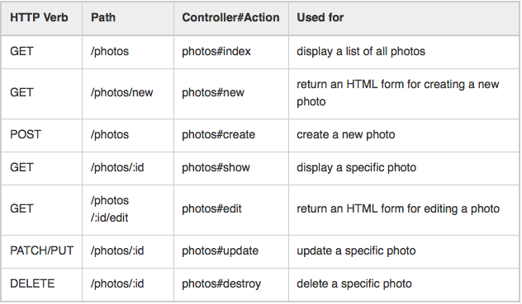
Routes (convention over configuration) config/routes.rb
resources :photos
From: http://guides.rubyonrails.org/routing.html
Notes:
Convention over configuration
Don’t repeat yourself (DRY)
Resources should never be nested more than 1 level deep.
Creates resources and paths: explain that
http://guides.rubyonrails.org/routing.html#adding-more-restful-actions
Adding member routes and resources added

Slide 4
Member Routes
Member routes imply an :id parameter, it is acting on a single member
resources :photos do
member do
get ‘preview’
end
end
http://localhost:3000/photos/1/preview

Slide 5
Layouts
Open app/views/layouts/application.html.erb
Yield
Downvote

Slide 6
Layouts
<html>
<head>
<%= yield :head %>
</head>
<body>
<%= yield %>
</body>
</html>
-----
<% content_for :head do %>
<title>A Simple Page</title>
<%end %>
<p>Hello, Rails</p>
------
<html>
<head>
<title>A Simple Page</title>
</head>
<body>
<p>Hello, Rails</p>
</body>
</html>
Example of apps/layouts/application.html.erb
Example of apps/topics/index.html.erb
Output from apps/topics/index.html.erb

Slide 7
Gemfile/bundle
Open Gemfile and add
gem ‘devise’
Save file
bundle install
Open config/environments/development.rb:
Add:
config.action_mailer.default_url_options = { host: 'localhost', port: 3000 }
Open app/views/layouts/application.html.erb
<p class="notice"><%= notice %></p>
<p class="alert"><%= alert %></p>
Notes:
dmc186@PEG-015-78:~/workspace/ruby/ist297/railsbridge/suggestotron (authN)$ rails g devise:install
create config/initializers/devise.rb
create config/locales/devise.en.yml
===============================================================================
Some setup you must do manually if you haven't yet:
1. Ensure you have defined default url options in your environments files. Here
is an example of default_url_options appropriate for a development environment
in config/environments/development.rb:
config.action_mailer.default_url_options = { host: 'localhost', port: 3000 }
In production, :host should be set to the actual host of your application.
2. Ensure you have defined root_url to *something* in your config/routes.rb.
For example:
root to: "home#index"
3. Ensure you have flash messages in app/views/layouts/application.html.erb.
For example:
<p class="notice"><%= notice %></p>
<p class="alert"><%= alert %></p>
4. If you are deploying on Heroku with Rails 3.2 only, you may want to set:
config.assets.initialize_on_precompile = false
On config/application.rb forcing your application to not access the DB
or load models when precompiling your assets.
5. You can copy Devise views (for customization) to your app by running:
rails g devise:views

Slide 8
Devise
rails g devise User
Generate model for User to hold authentication info
rails generate devise:install
rake db:migrate
Migrate the script created in rails g to update the database
Add apps/controllers/topics_controller.rb
before_filter :authenticate_user!, except: [:index, :show]
Restart rails server
Notes:
http://stackoverflow.com/questions/24196258/method-missing-undefined-method-devise-for-user-call-user-connection-to

Slide 9
Devise
Add to app/views/layouts/application.html.erb
<% if user_signed_in? %>
Logged in as <%= current_user.email %>
<%= link_to 'Edit Profile', edit_user_registration_path %>
<%= link_to 'Logout', destroy_user_session_path, method: :delete %>
<% else %>
<%= link_to 'Sign up', new_user_registration_path %>
<%= link_to 'Login', new_user_session_path %>
<% end %>

Slide 10
Devise
Add methods that require authentication to app/controllers/topics_controller.rb
before_filter :authenticate_user!, except: [:index, :show]
Notes:
http://guides.railsgirls.com/devise/
http://www.gotealeaf.com/blog/how-to-use-devise-in-rails-for-authentication
https://github.com/plataformatec/devise/wiki/How-Tos

Slide 11
Push to GitHub

