Slide 1
Bottom Up Parsing
TeachING Assistant: David Trabish

Slide 2
LR(0) Parsing
Build the derivation tree from the bottom
First build the children, then connect to the parent
Can handle left recursion
Which is common in real-world grammars

Slide 3
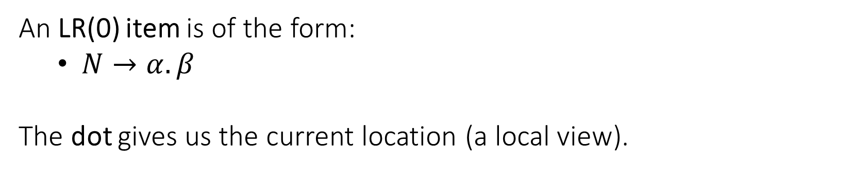
LR(0) Item
An LR(0) item is of the form:
$N→α. β$
The dot gives us the current location (a local view).

Slide 4
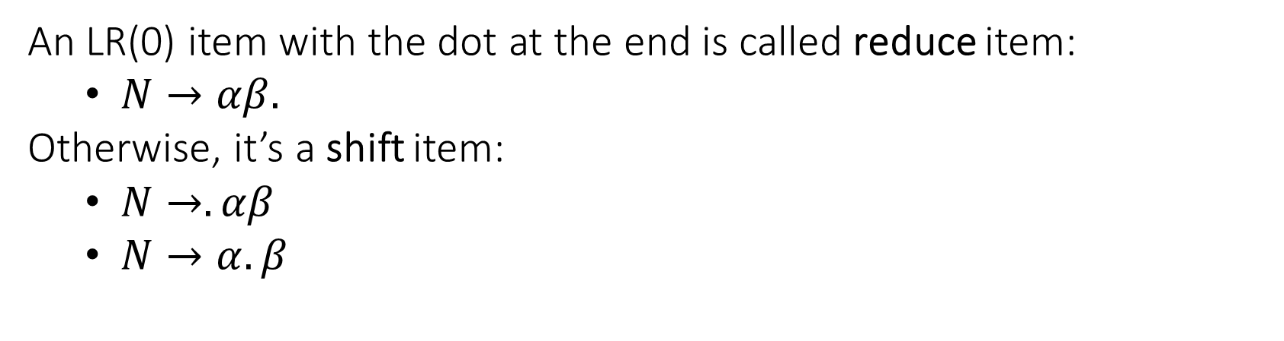
LR(0) Item
An LR(0) item with the dot at the end is called reduce item:
$N→αβ.$
Otherwise, it’s a shift item:
$N→.αβ$
$N→α.β$

Slide 5
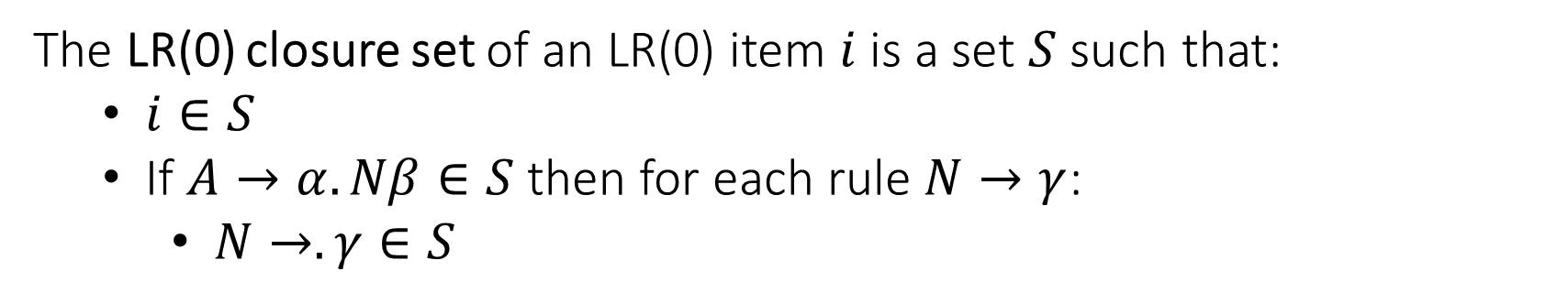
LR(0) Item Closure Set
The LR(0) closure set of an LR(0) item $i$ is a set $S$ such that:
$i∈S$
If $A→α.Nβ∈S$ then for each rule $N→γ$:
$N→.γ∈S$

Slide 6

LR(0) Item Closure Set
For example, given the following CFG:
$S→E\$$
$E→ID=X$
$E→\left\{ID\right\}$
$X→INT$
the closure set of the $S→.E\$$ contains:
$S→.E\$$
$E→.ID=X$
$E→.\{ID\}$

Slide 7

LR(0) Parsing
Consider the following CFG:
$S→E\$$
$E→ID=INT$
$E→\{L\}$
$L→E$
$L→L;E$
What will be the transition system of the LR(0) parser for this CFG?

Slide 8
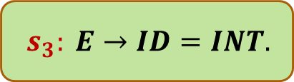
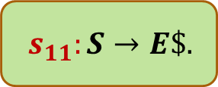
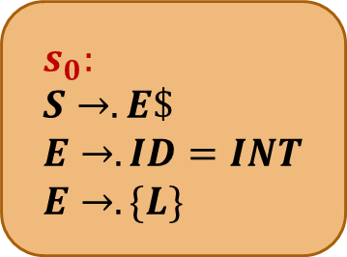
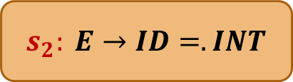
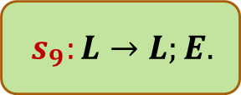

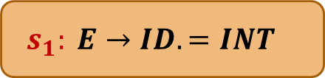
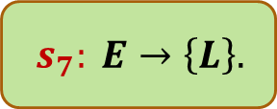
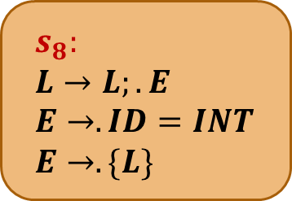

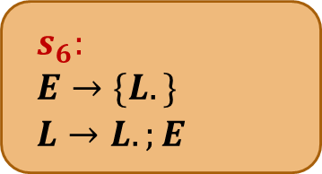
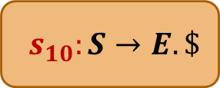
{
{
$$s_{4}:$$
$$E→\{.L\}$$
$$L→.L;E$$
$$L→.E$$
$$E→.ID=INT$$
$$E→.\{L\}$$
$$s_{0}:$$
$$S→.E\$$$
$$E→.ID=INT$$
$$E→.\{L\}$$
$$s_{8}:$$
$$L→L;.E$$
$$E→.ID=INT$$
$$E→.\{L\}$$
{
L
$$s_{6}:$$
$$E→\{L.\}$$
$$L→L.;E$$
;
ID
ID
ID
E
}
E
$$s_{1}: E→ID.=INT$$
$$s_{5}: L→E.$$
$$s_{7}: E→\left\{L\right\}.$$
$$s_{9}:L→L;E.$$
E
=
$$s_{2}: E→ID=.INT$$
$$s_{10}:S→E. \$$$
$
$$s_{11}:S→E\$.$$
INT
$$s_{3}: E→ID=INT.$$

Slide 9
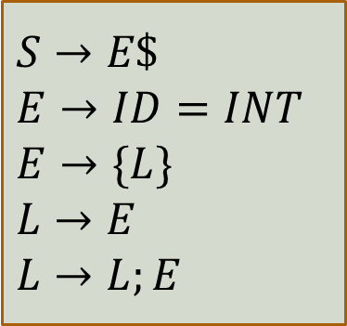
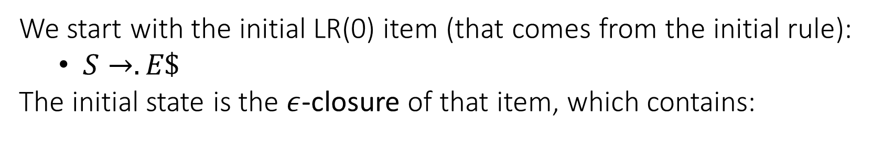
LR(0) Parser
We start with the initial LR(0) item (that comes from the initial rule):
$S→.E\$$
The initial state is the $ε$-closure of that item, which contains:
$$S→E\$$$
$$E→ID=INT$$
$$E→\{L\}$$
$$L→E$$
$$L→L;E$$

Slide 10
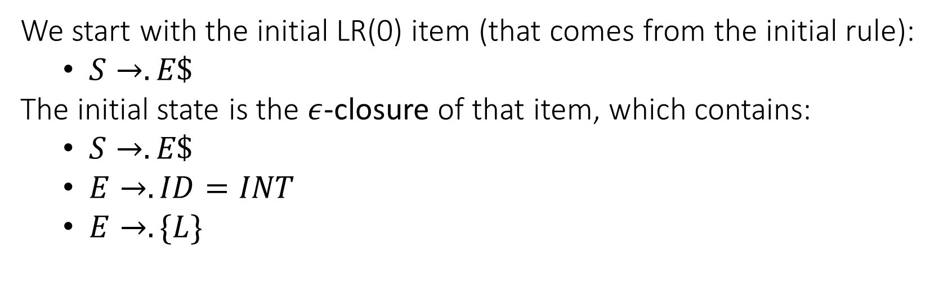
LR(0) Parser
We start with the initial LR(0) item (that comes from the initial rule):
$S→.E\$$
The initial state is the $ε$-closure of that item, which contains:
$S→.E\$$
$E→.ID=INT$
$E→.\{L\}$
$$S→E\$$$
$$E→ID=INT$$
$$E→\{L\}$$
$$L→E$$
$$L→L;E$$

Slide 11
$$s_{0}:$$
$$S→.E\$$$
$$E→.ID=INT$$
$$E→.\{L\}$$

Slide 12
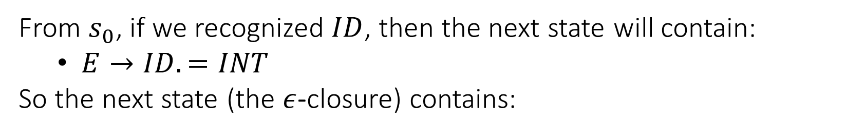
LR(0) Parser
From $s_{0}$, if we recognized $ID$, then the next state will contain:
$E→ID.=INT$
So the next state (the $ε$-closure) contains:
$$S→E\$$$
$$E→ID=INT$$
$$E→\{L\}$$
$$L→E$$
$$L→L;E$$

Slide 13
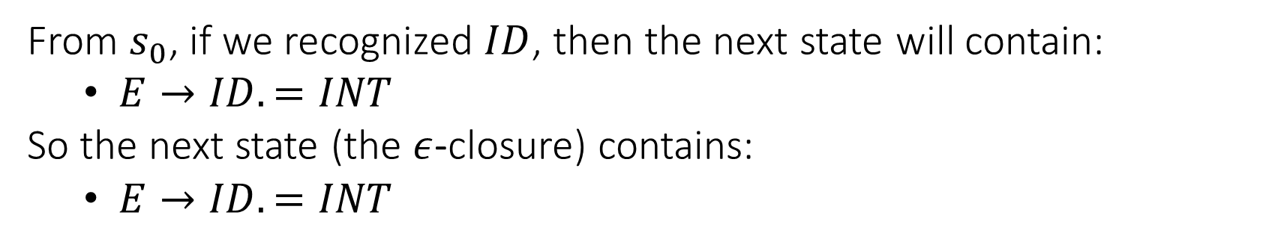
LR(0) Parser
From $s_{0}$, if we recognized $ID$, then the next state will contain:
$E→ID.=INT$
So the next state (the $ε$-closure) contains:
$E→ID.=INT$
$$S→E\$$$
$$E→ID=INT$$
$$E→\{L\}$$
$$L→E$$
$$L→L;E$$

Slide 14
$$s_{0}:$$
$$S→.E\$$$
$$E→.ID=INT$$
$$E→.\{L\}$$
ID
$$s_{1}: E→ID.=INT$$

Slide 15
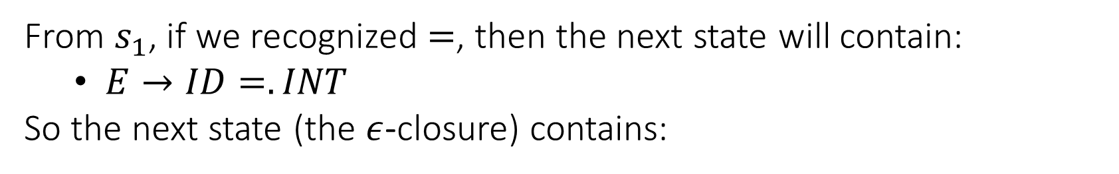
LR(0) Parser
From $s_{1}$, if we recognized $=$, then the next state will contain:
$E→ID=.INT$
So the next state (the $ε$-closure) contains:
$$S→E\$$$
$$E→ID=INT$$
$$E→\{L\}$$
$$L→E$$
$$L→L;E$$

Slide 16
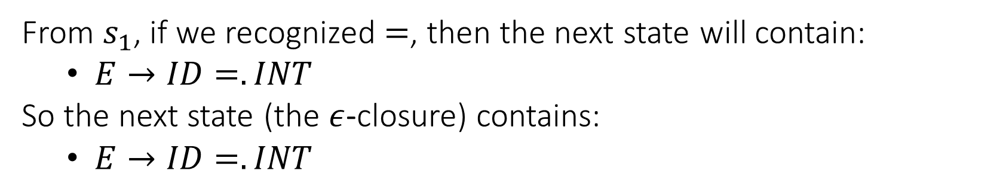
LR(0) Parser
From $s_{1}$, if we recognized $=$, then the next state will contain:
$E→ID=.INT$
So the next state (the $ε$-closure) contains:
$E→ID=.INT$
$$S→E\$$$
$$E→ID=INT$$
$$E→\{L\}$$
$$L→E$$
$$L→L;E$$

Slide 17
$$s_{0}:$$
$$S→.E\$$$
$$E→.ID=INT$$
$$E→.\{L\}$$
ID
$$s_{1}: E→ID.=INT$$
=
$$s_{2}: E→ID=.INT$$

Slide 18
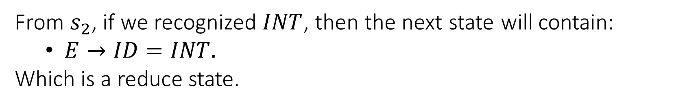
LR(0) Parser
From $s_{2}$, if we recognized $INT$, then the next state will contain:
$E→ID=INT.$
Which is a reduce state.
$$S→E\$$$
$$E→ID=INT$$
$$E→\{L\}$$
$$L→E$$
$$L→L;E$$

Slide 19
$$s_{0}:$$
$$S→.E\$$$
$$E→.ID=INT$$
$$E→.\{L\}$$
ID
ID
$$s_{1}: E→ID.=INT$$
=
$$s_{2}: E→ID=.INT$$
INT
$$s_{3}: E→ID=INT.$$

Slide 20
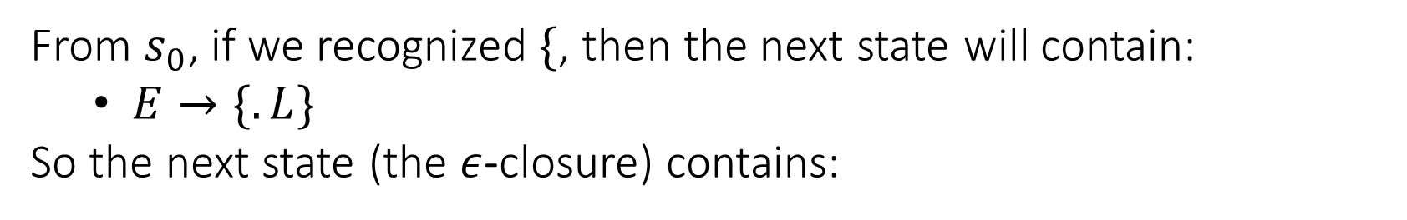
LR(0) Parser
From $s_{0}$, if we recognized $\{$, then the next state will contain:
$E→\{.L\}$
So the next state (the $ε$-closure) contains:
$$S→E\$$$
$$E→ID=INT$$
$$E→\{L\}$$
$$L→E$$
$$L→L;E$$

Slide 21

LR(0) Parser
From $s_{0}$, if we recognized $\{$, then the next state will contain:
$E→\{.L\}$
So the next state (the $ε$-closure) contains:
$E→\left\{.L\right\}$
$L→.L;E$
$L→.E$
$E→.ID=INT$
$E→.\{L\}$
$$S→E\$$$
$$E→ID=INT$$
$$E→\{L\}$$
$$L→E$$
$$L→L;E$$

Slide 22
$$s_{4}:$$
$$E→\{.L\}$$
$$L→.L;E$$
$$L→.E$$
$$E→.ID=INT$$
$$E→.\{L\}$$
$$s_{0}:$$
$$S→.E\$$$
$$E→.ID=INT$$
$$E→.\{L\}$$
{
ID
$$s_{1}: E→ID.=INT$$
=
$$s_{2}: E→ID=.INT$$
INT
$$s_{3}: E→ID=INT.$$

Slide 23
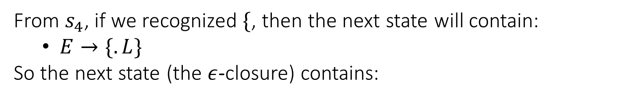
LR(0) Parser
From $s_{4}$, if we recognized $\{$, then the next state will contain:
$E→\{.L\}$
So the next state (the $ε$-closure) contains:
$$S→E\$$$
$$E→ID=INT$$
$$E→\{L\}$$
$$L→E$$
$$L→L;E$$

Slide 24

LR(0) Parser
From $s_{4}$, if we recognized $\{$, then the next state will contain:
$E→\{.L\}$
So the next state (the $ε$-closure) contains:
$E→\left\{.L\right\}$
$L→.L;E$
$L→.E$
$E→.ID=INT$
$E→.\left\{L\right\}$
which was already computed: $s_{4}$
$$S→E\$$$
$$E→ID=INT$$
$$E→\{L\}$$
$$L→E$$
$$L→L;E$$

Slide 25
{
$$s_{4}:$$
$$E→\{.L\}$$
$$L→.L;E$$
$$L→.E$$
$$E→.ID=INT$$
$$E→.\{L\}$$
$$s_{0}:$$
$$S→.E\$$$
$$E→.ID=INT$$
$$E→.\{L\}$$
{
ID
$$s_{1}: E→ID.=INT$$
=
$$s_{2}: E→ID=.INT$$
INT
$$s_{3}: E→ID=INT.$$

Slide 26
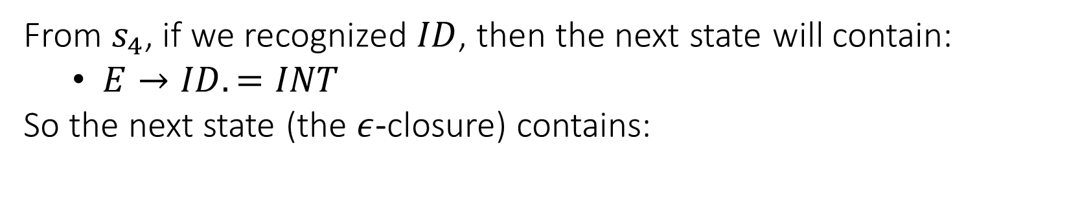
LR(0) Parser
From $s_{4}$, if we recognized $ID$, then the next state will contain:
$E→ID.=INT$
So the next state (the $ε$-closure) contains:
$$S→E\$$$
$$E→ID=INT$$
$$E→\{L\}$$
$$L→E$$
$$L→L;E$$

Slide 27
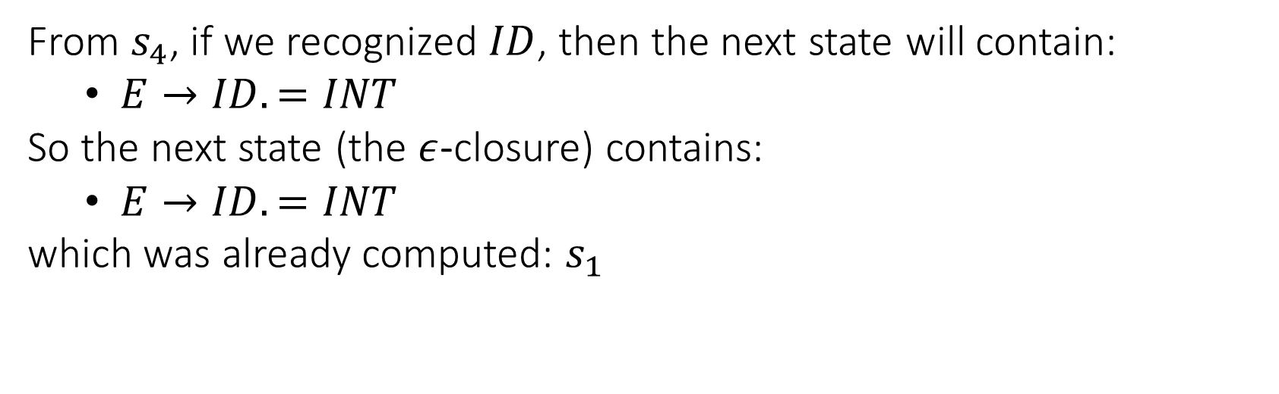
LR(0) Parser
From $s_{4}$, if we recognized $ID$, then the next state will contain:
$E→ID.=INT$
So the next state (the $ε$-closure) contains:
$E→ID.=INT$
which was already computed: $s_{1}$
$$S→E\$$$
$$E→ID=INT$$
$$E→\{L\}$$
$$L→E$$
$$L→L;E$$

Slide 28
{
$$s_{4}:$$
$$E→\{.L\}$$
$$L→.L;E$$
$$L→.E$$
$$E→.ID=INT$$
$$E→.\{L\}$$
$$s_{0}:$$
$$S→.E\$$$
$$E→.ID=INT$$
$$E→.\{L\}$$
{
ID
ID
$$s_{1}: E→ID.=INT$$
=
$$s_{2}: E→ID=.INT$$
INT
$$s_{3}: E→ID=INT.$$

Slide 29
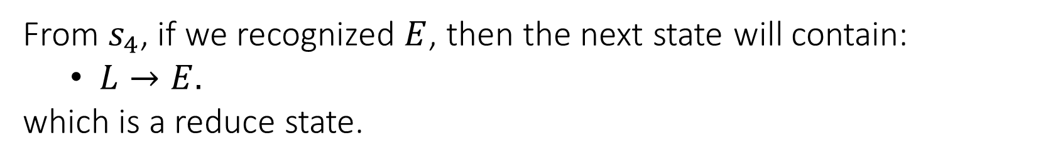
LR(0) Parser
From $s_{4}$, if we recognized $E$, then the next state will contain:
$L→E.$
which is a reduce state.
$$S→E\$$$
$$E→ID=INT$$
$$E→\{L\}$$
$$L→E$$
$$L→L;E$$

Slide 30
{
$$s_{4}:$$
$$E→\{.L\}$$
$$L→.L;E$$
$$L→.E$$
$$E→.ID=INT$$
$$E→.\{L\}$$
$$s_{0}:$$
$$S→.E\$$$
$$E→.ID=INT$$
$$E→.\{L\}$$
{
ID
ID
E
$$s_{1}: E→ID.=INT$$
$$s_{5}: L→E.$$
=
$$s_{2}: E→ID=.INT$$
INT
$$s_{3}: E→ID=INT.$$

Slide 31
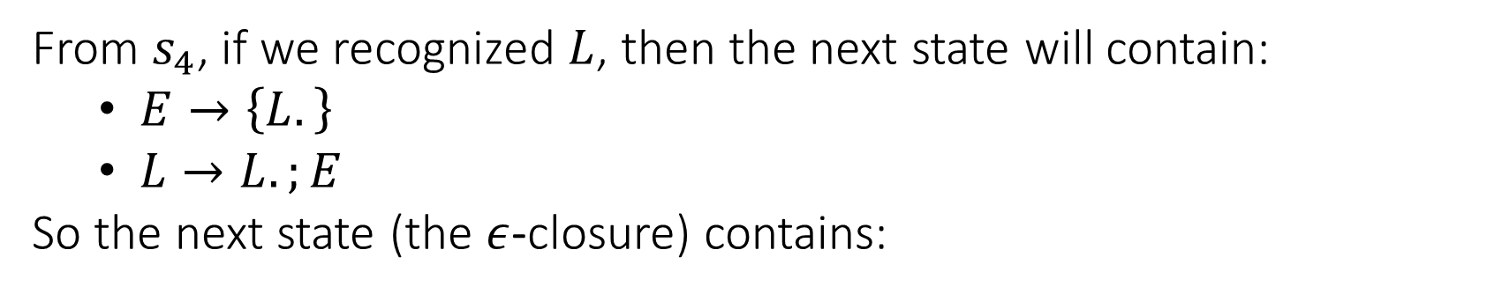
LR(0) Parser
From $s_{4}$, if we recognized $L$, then the next state will contain:
$E→\left\{L.\right\}$
$L→L.;E$
So the next state (the $ε$-closure) contains:
$$S→E\$$$
$$E→ID=INT$$
$$E→\{L\}$$
$$L→E$$
$$L→L;E$$

Slide 32
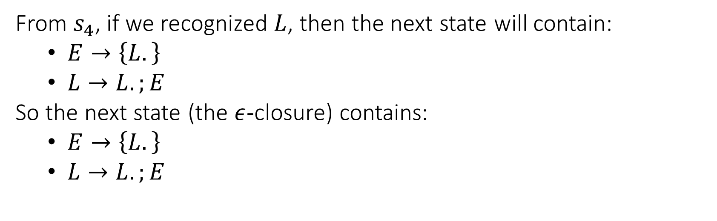
LR(0) Parser
From $s_{4}$, if we recognized $L$, then the next state will contain:
$E→\left\{L.\right\}$
$L→L.;E$
So the next state (the $ε$-closure) contains:
$E→\left\{L.\right\}$
$L→L.;E$
$$S→E\$$$
$$E→ID=INT$$
$$E→\{L\}$$
$$L→E$$
$$L→L;E$$

Slide 33
{
$$s_{4}:$$
$$E→\{.L\}$$
$$L→.L;E$$
$$L→.E$$
$$E→.ID=INT$$
$$E→.\{L\}$$
$$s_{0}:$$
$$S→.E\$$$
$$E→.ID=INT$$
$$E→.\{L\}$$
{
L
$$s_{6}:$$
$$E→\{L.\}$$
$$L→L.;E$$
ID
ID
ID
E
$$s_{1}: E→ID.=INT$$
$$s_{5}: L→E.$$
=
$$s_{2}: E→ID=.INT$$
INT
$$s_{3}: E→ID=INT.$$

Slide 34
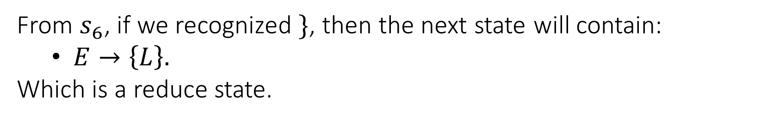
LR(0) Parser
From $s_{6}$, if we recognized $\}$, then the next state will contain:
$E→\left\{L\right\}.$
Which is a reduce state.
$$S→E\$$$
$$E→ID=INT$$
$$E→\{L\}$$
$$L→E$$
$$L→L;E$$

Slide 35
{
$$s_{4}:$$
$$E→\{.L\}$$
$$L→.L;E$$
$$L→.E$$
$$E→.ID=INT$$
$$E→.\{L\}$$
$$s_{0}:$$
$$S→.E\$$$
$$E→.ID=INT$$
$$E→.\{L\}$$
{
L
$$s_{6}:$$
$$E→\{L.\}$$
$$L→L.;E$$
ID
ID
E
}
$$s_{1}: E→ID.=INT$$
$$s_{5}: L→E.$$
$$s_{7}: E→\left\{L\right\}.$$
=
$$s_{2}: E→ID=.INT$$
INT
$$s_{3}: E→ID=INT.$$

Slide 36
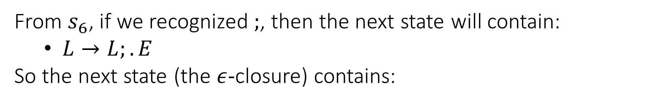
LR(0) Parser
From $s_{6}$, if we recognized $;$, then the next state will contain:
$L→L;.E$
So the next state (the $ε$-closure) contains:
$$S→E\$$$
$$E→ID=INT$$
$$E→\{L\}$$
$$L→E$$
$$L→L;E$$

Slide 37
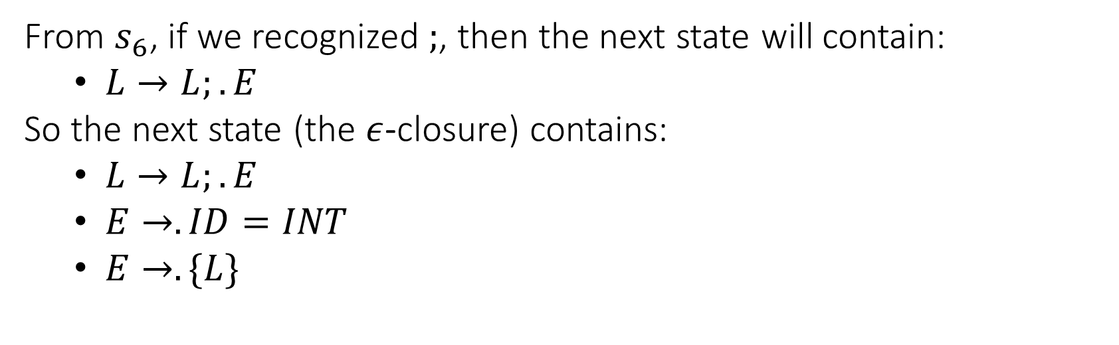
LR(0) Parser
From $s_{6}$, if we recognized $;$, then the next state will contain:
$L→L;.E$
So the next state (the $ε$-closure) contains:
$L→L;.E$
$E→.ID=INT$
$E→.\{L\}$
$$S→E\$$$
$$E→ID=INT$$
$$E→\{L\}$$
$$L→E$$
$$L→L;E$$

Slide 38
{
$$s_{4}:$$
$$E→\{.L\}$$
$$L→.L;E$$
$$L→.E$$
$$E→.ID=INT$$
$$E→.\{L\}$$
$$s_{0}:$$
$$S→.E\$$$
$$E→.ID=INT$$
$$E→.\{L\}$$
$$s_{8}:$$
$$L→L;.E$$
$$E→.ID=INT$$
$$E→.\{L\}$$
{
L
$$s_{6}:$$
$$E→\{L.\}$$
$$L→L.;E$$
;
ID
ID
ID
E
}
$$s_{1}: E→ID.=INT$$
$$s_{5}: L→E.$$
$$s_{7}: E→\left\{L\right\}.$$
=
$$s_{2}: E→ID=.INT$$
INT
$$s_{3}: E→ID=INT.$$

Slide 39
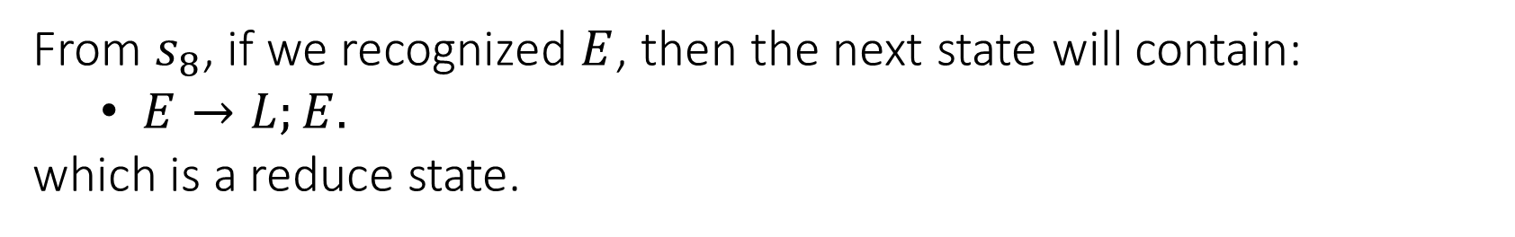
LR(0) Parser
From $s_{8}$, if we recognized $E$, then the next state will contain:
$E→L;E.$
which is a reduce state.
$$S→E\$$$
$$E→ID=INT$$
$$E→\{L\}$$
$$L→E$$
$$L→L;E$$

Slide 40
{
$$s_{4}:$$
$$E→\{.L\}$$
$$L→.L;E$$
$$L→.E$$
$$E→.ID=INT$$
$$E→.\{L\}$$
$$s_{0}:$$
$$S→.E\$$$
$$E→.ID=INT$$
$$E→.\{L\}$$
$$s_{8}:$$
$$L→L;.E$$
$$E→.ID=INT$$
$$E→.\{L\}$$
{
L
$$s_{6}:$$
$$E→\{L.\}$$
$$L→L.;E$$
;
ID
ID
E
}
E
$$s_{1}: E→ID.=INT$$
$$s_{5}: L→E.$$
$$s_{7}: E→\left\{L\right\}.$$
$$s_{9}:L→L;E.$$
=
$$s_{2}: E→ID=.INT$$
INT
$$s_{3}: E→ID=INT.$$

Slide 41
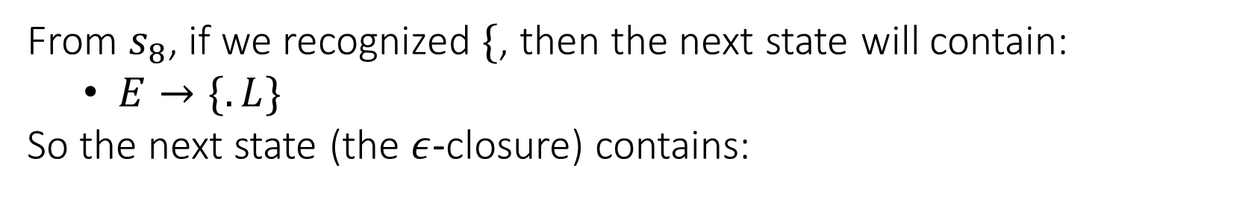
LR(0) Parser
From $s_{8}$, if we recognized $\{$, then the next state will contain:
$E→\{.L\}$
So the next state (the $ε$-closure) contains:
$$S→E\$$$
$$E→ID=INT$$
$$E→\{L\}$$
$$L→E$$
$$L→L;E$$

Slide 42

LR(0) Parser
From $s_{8}$, if we recognized $\{$, then the next state will contain:
$E→\{.L\}$
So the next state (the $ε$-closure) contains:
$E→\left\{.L\right\}$
$L→.L;E$
$L→.E$
$E→.ID=INT$
$E→.\left\{L\right\}$
which was already computed: $s_{4}$
$$S→E\$$$
$$E→ID=INT$$
$$E→\{L\}$$
$$L→E$$
$$L→L;E$$

Slide 43
{
{
$$s_{4}:$$
$$E→\{.L\}$$
$$L→.L;E$$
$$L→.E$$
$$E→.ID=INT$$
$$E→.\{L\}$$
$$s_{0}:$$
$$S→.E\$$$
$$E→.ID=INT$$
$$E→.\{L\}$$
$$s_{8}:$$
$$L→L;.E$$
$$E→.ID=INT$$
$$E→.\{L\}$$
{
L
$$s_{6}:$$
$$E→\{L.\}$$
$$L→L.;E$$
;
ID
ID
E
}
E
$$s_{1}: E→ID.=INT$$
$$s_{5}: L→E.$$
$$s_{7}: E→\left\{L\right\}.$$
$$s_{9}:L→L;E.$$
=
$$s_{2}: E→ID=.INT$$
INT
$$s_{3}: E→ID=INT.$$

Slide 44
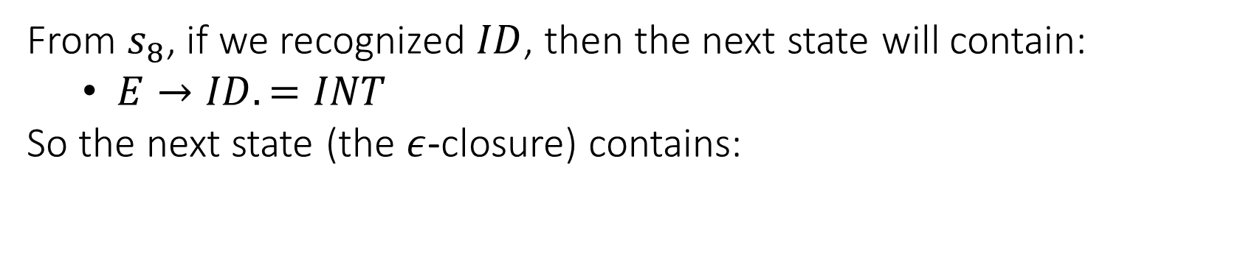
LR(0) Parser
From $s_{8}$, if we recognized $ID$, then the next state will contain:
$E→ID.=INT$
So the next state (the $ε$-closure) contains:
$$S→E\$$$
$$E→ID=INT$$
$$E→\{L\}$$
$$L→E$$
$$L→L;E$$

Slide 45
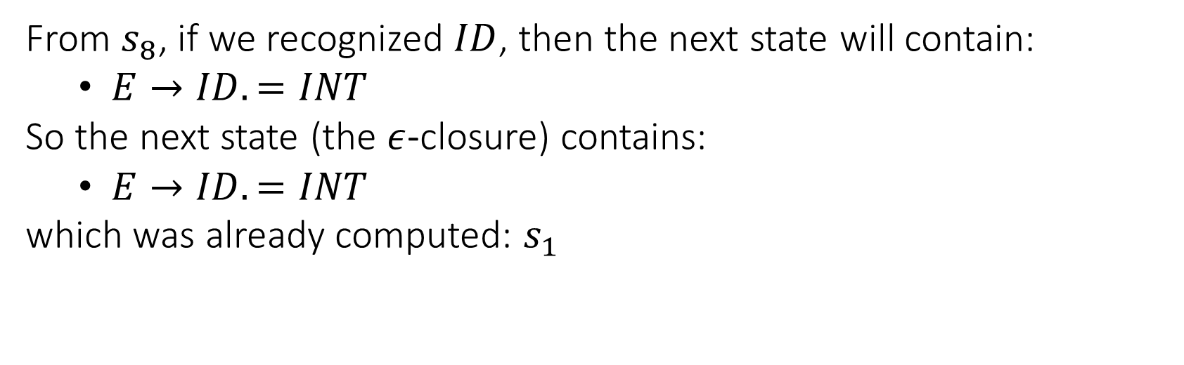
LR(0) Parser
From $s_{8}$, if we recognized $ID$, then the next state will contain:
$E→ID.=INT$
So the next state (the $ε$-closure) contains:
$E→ID.=INT$
which was already computed: $s_{1}$
$$S→E\$$$
$$E→ID=INT$$
$$E→\{L\}$$
$$L→E$$
$$L→L;E$$

Slide 46
{
{
$$s_{4}:$$
$$E→\{.L\}$$
$$L→.L;E$$
$$L→.E$$
$$E→.ID=INT$$
$$E→.\{L\}$$
$$s_{0}:$$
$$S→.E\$$$
$$E→.ID=INT$$
$$E→.\{L\}$$
$$s_{8}:$$
$$L→L;.E$$
$$E→.ID=INT$$
$$E→.\{L\}$$
{
L
$$s_{6}:$$
$$E→\{L.\}$$
$$L→L.;E$$
;
ID
ID
ID
E
}
E
$$s_{1}: E→ID.=INT$$
$$s_{5}: L→E.$$
$$s_{7}: E→\left\{L\right\}.$$
$$s_{9}:L→L;E.$$
=
$$s_{2}: E→ID=.INT$$
INT
$$s_{3}: E→ID=INT.$$

Slide 47
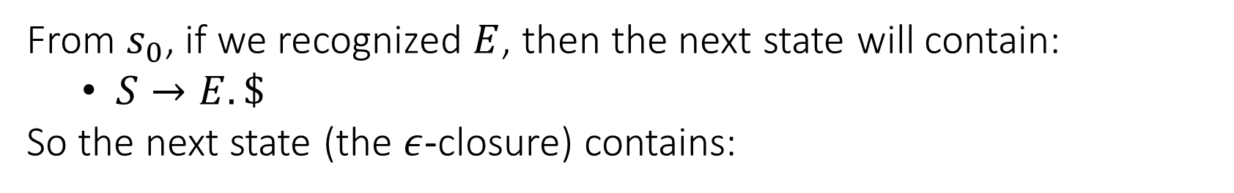
LR(0) Parser
From $s_{0}$, if we recognized $E$, then the next state will contain:
$S→E.\$$
So the next state (the $ε$-closure) contains:
$$S→E\$$$
$$E→ID=INT$$
$$E→\{L\}$$
$$L→E$$
$$L→L;E$$

Slide 48
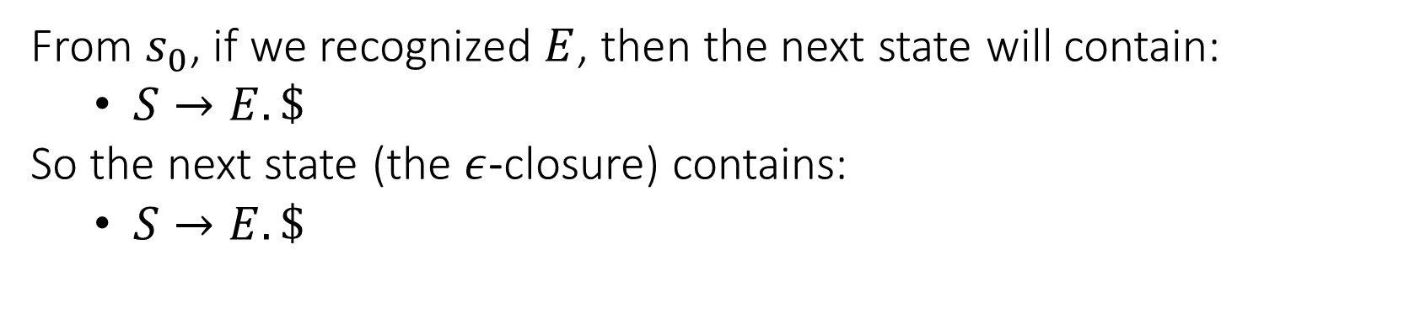
LR(0) Parser
From $s_{0}$, if we recognized $E$, then the next state will contain:
$S→E.\$$
So the next state (the $ε$-closure) contains:
$S→E.\$$
$$S→E\$$$
$$E→ID=INT$$
$$E→\{L\}$$
$$L→E$$
$$L→L;E$$

Slide 49
{
{
$$s_{4}:$$
$$E→\{.L\}$$
$$L→.L;E$$
$$L→.E$$
$$E→.ID=INT$$
$$E→.\{L\}$$
$$s_{0}:$$
$$S→.E\$$$
$$E→.ID=INT$$
$$E→.\{L\}$$
$$s_{8}:$$
$$L→L;.E$$
$$E→.ID=INT$$
$$E→.\{L\}$$
{
L
$$s_{6}:$$
$$E→\{L.\}$$
$$L→L.;E$$
;
ID
ID
ID
E
}
E
$$s_{1}: E→ID.=INT$$
$$s_{5}: L→E.$$
$$s_{7}: E→\left\{L\right\}.$$
$$s_{9}:L→L;E.$$
E
=
$$s_{2}: E→ID=.INT$$
$$s_{10}:S→E. \$$$
INT
$$s_{3}: E→ID=INT.$$

Slide 50
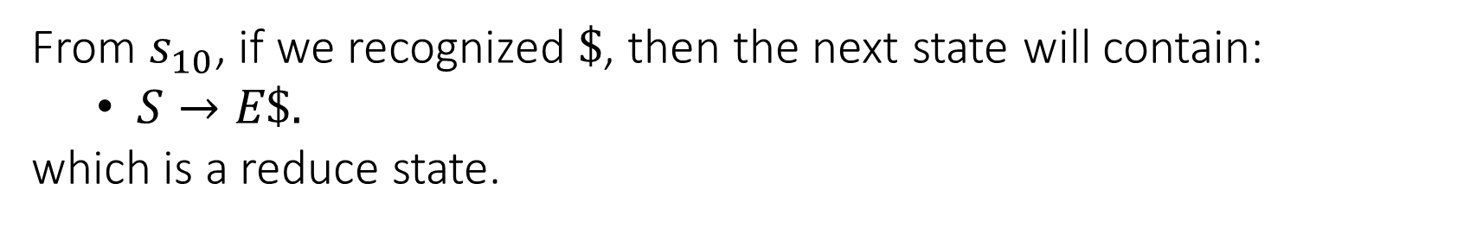
LR(0) Parser
From $s_{10}$, if we recognized $\$$, then the next state will contain:
$S→E\$.$
which is a reduce state.
$$S→E\$$$
$$E→ID=INT$$
$$E→\{L\}$$
$$L→E$$
$$L→L;E$$

Slide 51
{
{
$$s_{4}:$$
$$E→\{.L\}$$
$$L→.L;E$$
$$L→.E$$
$$E→.ID=INT$$
$$E→.\{L\}$$
$$s_{0}:$$
$$S→.E\$$$
$$E→.ID=INT$$
$$E→.\{L\}$$
$$s_{8}:$$
$$L→L;.E$$
$$E→.ID=INT$$
$$E→.\{L\}$$
{
L
$$s_{6}:$$
$$E→\{L.\}$$
$$L→L.;E$$
;
ID
ID
ID
E
}
E
$$s_{1}: E→ID.=INT$$
$$s_{5}: L→E.$$
$$s_{7}: E→\left\{L\right\}.$$
$$s_{9}:L→L;E.$$
E
=
$$s_{2}: E→ID=.INT$$
$$s_{10}:S→E. \$$$
$
$$s_{11}:S→E\$.$$
INT
$$s_{3}: E→ID=INT.$$

Slide 52
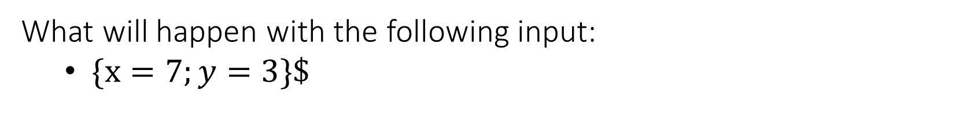
LR(0) Parser: Running Example
What will happen with the following input:
$\{x=7;y=3\}\$$

Slide 53
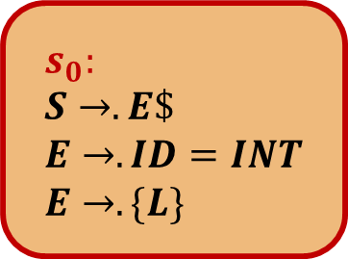
{
{
$$s_{4}:$$
$$E→\{.L\}$$
$$L→.L;E$$
$$L→.E$$
$$E→.ID=INT$$
$$E→.\{L\}$$
$$s_{0}:$$
$$S→.E\$$$
$$E→.ID=INT$$
$$E→.\{L\}$$
$$s_{8}:$$
$$L→L;.E$$
$$E→.ID=INT$$
$$E→.\{L\}$$
{
L
$$s_{6}:$$
$$E→\{L.\}$$
$$L→L.;E$$
;
ID
ID
ID
E
}
E
$$s_{1}: E→ID.=INT$$
$$s_{5}: L→E.$$
$$s_{7}: E→\left\{L\right\}.$$
$$s_{9}:L→L;E.$$
E
=
$$s_{2}: E→ID=.INT$$
$$s_{10}:S→E. \$$$
$
$$s_{11}:S→E\$.$$
INT
Input: $\{x=7;y=3\}\$$
$$s_{3}: E→ID=INT.$$
Stack: $s_{0}$

Slide 54

{
{
$$s_{4}:$$
$$E→\{.L\}$$
$$L→.L;E$$
$$L→.E$$
$$E→.ID=INT$$
$$E→.\{L\}$$
$$s_{0}:$$
$$S→.E\$$$
$$E→.ID=INT$$
$$E→.\{L\}$$
$$s_{8}:$$
$$L→L;.E$$
$$E→.ID=INT$$
$$E→.\{L\}$$
{
L
$$s_{6}:$$
$$E→\{L.\}$$
$$L→L.;E$$
;
ID
ID
ID
E
}
E
$$s_{1}: E→ID.=INT$$
$$s_{5}: L→E.$$
$$s_{7}: E→\left\{L\right\}.$$
$$s_{9}:L→L;E.$$
E
=
$$s_{2}: E→ID=.INT$$
$$s_{10}:S→E. \$$$
$
$$s_{11}:S→E\$.$$
INT
Input: $\{x=7;y=3\}\$$
$$s_{3}: E→ID=INT.$$
Stack: $s_{0} \{ s_{4}$

Slide 55
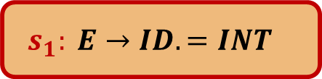
{
{
$$s_{4}:$$
$$E→\{.L\}$$
$$L→.L;E$$
$$L→.E$$
$$E→.ID=INT$$
$$E→.\{L\}$$
$$s_{0}:$$
$$S→.E\$$$
$$E→.ID=INT$$
$$E→.\{L\}$$
$$s_{8}:$$
$$L→L;.E$$
$$E→.ID=INT$$
$$E→.\{L\}$$
{
L
$$s_{6}:$$
$$E→\{L.\}$$
$$L→L.;E$$
;
ID
ID
ID
E
}
E
$$s_{1}: E→ID.=INT$$
$$s_{5}: L→E.$$
$$s_{7}: E→\left\{L\right\}.$$
$$s_{9}:L→L;E.$$
E
=
$$s_{2}: E→ID=.INT$$
$$s_{10}:S→E. \$$$
$
$$s_{11}:S→E\$.$$
INT
Input: $\{x=7;y=3\}\$$
$$s_{3}: E→ID=INT.$$
Stack: $s_{0} \{ s_{4} ID s_{1}$

Slide 56
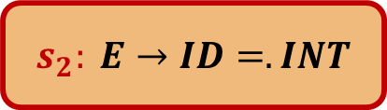
{
{
$$s_{4}:$$
$$E→\{.L\}$$
$$L→.L;E$$
$$L→.E$$
$$E→.ID=INT$$
$$E→.\{L\}$$
$$s_{0}:$$
$$S→.E\$$$
$$E→.ID=INT$$
$$E→.\{L\}$$
$$s_{8}:$$
$$L→L;.E$$
$$E→.ID=INT$$
$$E→.\{L\}$$
{
L
$$s_{6}:$$
$$E→\{L.\}$$
$$L→L.;E$$
;
ID
ID
ID
E
}
E
$$s_{1}: E→ID.=INT$$
$$s_{5}: L→E.$$
$$s_{7}: E→\left\{L\right\}.$$
$$s_{9}:L→L;E.$$
E
=
$$s_{2}: E→ID=.INT$$
$$s_{10}:S→E. \$$$
$
$$s_{11}:S→E\$.$$
INT
Input: $\{x=7;y=3\}\$$
$$s_{3}: E→ID=INT.$$
Stack: $s_{0} \{ s_{4} ID s_{1}=s_{2}$

Slide 57

{
{
$$s_{4}:$$
$$E→\{.L\}$$
$$L→.L;E$$
$$L→.E$$
$$E→.ID=INT$$
$$E→.\{L\}$$
$$s_{0}:$$
$$S→.E\$$$
$$E→.ID=INT$$
$$E→.\{L\}$$
$$s_{8}:$$
$$L→L;.E$$
$$E→.ID=INT$$
$$E→.\{L\}$$
{
L
$$s_{6}:$$
$$E→\{L.\}$$
$$L→L.;E$$
;
ID
ID
ID
E
}
E
$$s_{1}: E→ID.=INT$$
$$s_{5}: L→E.$$
$$s_{7}: E→\left\{L\right\}.$$
$$s_{9}:L→L;E.$$
E
=
$$s_{2}: E→ID=.INT$$
$$s_{10}:S→E. \$$$
$
$$s_{11}:S→E\$.$$
INT
Input: $\{x=7;y=3\}\$$
$$s_{3}: E→ID=INT.$$
Stack: $s_{0} \{ s_{4} ID s_{1}=s_{2} INT s_{3}$

Slide 58
{
{
$$s_{4}:$$
$$E→\{.L\}$$
$$L→.L;E$$
$$L→.E$$
$$E→.ID=INT$$
$$E→.\{L\}$$
$$s_{0}:$$
$$S→.E\$$$
$$E→.ID=INT$$
$$E→.\{L\}$$
$$s_{8}:$$
$$L→L;.E$$
$$E→.ID=INT$$
$$E→.\{L\}$$
{
L
$$s_{6}:$$
$$E→\{L.\}$$
$$L→L.;E$$
;
ID
ID
ID
E
}
E
$$s_{1}: E→ID.=INT$$
$$s_{5}: L→E.$$
$$s_{7}: E→\left\{L\right\}.$$
$$s_{9}:L→L;E.$$
E
=
$$s_{2}: E→ID=.INT$$
$$s_{10}:S→E. \$$$
$
$$s_{11}:S→E\$.$$
INT
Input: $\{x=7;y=3\}\$$
$$s_{3}: E→ID=INT.$$
Stack: $s_{0} \{ s_{4}$

Slide 59
{
{
$$s_{4}:$$
$$E→\{.L\}$$
$$L→.L;E$$
$$L→.E$$
$$E→.ID=INT$$
$$E→.\{L\}$$
$$s_{0}:$$
$$S→.E\$$$
$$E→.ID=INT$$
$$E→.\{L\}$$
$$s_{8}:$$
$$L→L;.E$$
$$E→.ID=INT$$
$$E→.\{L\}$$
{
L
$$s_{6}:$$
$$E→\{L.\}$$
$$L→L.;E$$
;
ID
ID
ID
E
}
E
$$s_{1}: E→ID.=INT$$
$$s_{5}: L→E.$$
$$s_{7}: E→\left\{L\right\}.$$
$$s_{9}:L→L;E.$$
E
=
$$s_{2}: E→ID=.INT$$
$$s_{10}:S→E. \$$$
$
$$s_{11}:S→E\$.$$
INT
Input: $\{x=7;y=3\}\$$
$$s_{3}: E→ID=INT.$$
Stack: $s_{0} \{ s_{4} E$

Slide 60

{
{
$$s_{4}:$$
$$E→\{.L\}$$
$$L→.L;E$$
$$L→.E$$
$$E→.ID=INT$$
$$E→.\{L\}$$
$$s_{0}:$$
$$S→.E\$$$
$$E→.ID=INT$$
$$E→.\{L\}$$
$$s_{8}:$$
$$L→L;.E$$
$$E→.ID=INT$$
$$E→.\{L\}$$
{
L
$$s_{6}:$$
$$E→\{L.\}$$
$$L→L.;E$$
;
ID
ID
ID
E
}
E
$$s_{1}: E→ID.=INT$$
$$s_{5}: L→E.$$
$$s_{7}: E→\left\{L\right\}.$$
$$s_{9}:L→L;E.$$
E
=
$$s_{2}: E→ID=.INT$$
$$s_{10}:S→E. \$$$
$
$$s_{11}:S→E\$.$$
INT
Input: $\{x=7;y=3\}\$$
$$s_{3}: E→ID=INT.$$
Stack: $s_{0} \{ s_{4} E s_{5}$

Slide 61

{
{
$$s_{4}:$$
$$E→\{.L\}$$
$$L→.L;E$$
$$L→.E$$
$$E→.ID=INT$$
$$E→.\{L\}$$
$$s_{0}:$$
$$S→.E\$$$
$$E→.ID=INT$$
$$E→.\{L\}$$
$$s_{8}:$$
$$L→L;.E$$
$$E→.ID=INT$$
$$E→.\{L\}$$
{
L
$$s_{6}:$$
$$E→\{L.\}$$
$$L→L.;E$$
;
ID
ID
ID
E
}
E
$$s_{1}: E→ID.=INT$$
$$s_{5}: L→E.$$
$$s_{7}: E→\left\{L\right\}.$$
$$s_{9}:L→L;E.$$
E
=
$$s_{2}: E→ID=.INT$$
$$s_{10}:S→E. \$$$
$
$$s_{11}:S→E\$.$$
INT
Input: $\{x=7;y=3\}\$$
$$s_{3}: E→ID=INT.$$
Stack: $s_{0} \{ s_{4} L s_{6}$

Slide 62

{
{
$$s_{4}:$$
$$E→\{.L\}$$
$$L→.L;E$$
$$L→.E$$
$$E→.ID=INT$$
$$E→.\{L\}$$
$$s_{0}:$$
$$S→.E\$$$
$$E→.ID=INT$$
$$E→.\{L\}$$
$$s_{8}:$$
$$L→L;.E$$
$$E→.ID=INT$$
$$E→.\{L\}$$
{
L
$$s_{6}:$$
$$E→\{L.\}$$
$$L→L.;E$$
;
ID
ID
ID
E
}
E
$$s_{1}: E→ID.=INT$$
$$s_{5}: L→E.$$
$$s_{7}: E→\left\{L\right\}.$$
$$s_{9}:L→L;E.$$
E
=
$$s_{2}: E→ID=.INT$$
$$s_{10}:S→E. \$$$
$
$$s_{11}:S→E\$.$$
INT
Input: $\{x=7;y=3\}\$$
$$s_{3}: E→ID=INT.$$
Stack: $s_{0} \{ s_{4} L s_{6} ;s_{8}$

Slide 63
{
{
$$s_{4}:$$
$$E→\{.L\}$$
$$L→.L;E$$
$$L→.E$$
$$E→.ID=INT$$
$$E→.\{L\}$$
$$s_{0}:$$
$$S→.E\$$$
$$E→.ID=INT$$
$$E→.\{L\}$$
$$s_{8}:$$
$$L→L;.E$$
$$E→.ID=INT$$
$$E→.\{L\}$$
{
L
$$s_{6}:$$
$$E→\{L.\}$$
$$L→L.;E$$
;
ID
ID
ID
E
}
E
$$s_{1}: E→ID.=INT$$
$$s_{5}: L→E.$$
$$s_{7}: E→\left\{L\right\}.$$
$$s_{9}:L→L;E.$$
E
=
$$s_{2}: E→ID=.INT$$
$$s_{10}:S→E. \$$$
$
$$s_{11}:S→E\$.$$
INT
Input: $\{x=7;y=3\}\$$
$$s_{3}: E→ID=INT.$$
Stack: $s_{0} \{ s_{4} L s_{6} ;s_{8} ID s_{1}$

Slide 64
{
{
$$s_{4}:$$
$$E→\{.L\}$$
$$L→.L;E$$
$$L→.E$$
$$E→.ID=INT$$
$$E→.\{L\}$$
$$s_{0}:$$
$$S→.E\$$$
$$E→.ID=INT$$
$$E→.\{L\}$$
$$s_{8}:$$
$$L→L;.E$$
$$E→.ID=INT$$
$$E→.\{L\}$$
{
L
$$s_{6}:$$
$$E→\{L.\}$$
$$L→L.;E$$
;
ID
ID
ID
E
}
E
$$s_{1}: E→ID.=INT$$
$$s_{5}: L→E.$$
$$s_{7}: E→\left\{L\right\}.$$
$$s_{9}:L→L;E.$$
E
=
$$s_{2}: E→ID=.INT$$
$$s_{10}:S→E. \$$$
$
$$s_{11}:S→E\$.$$
INT
Input: $\{x=7;y=3\}\$$
$$s_{3}: E→ID=INT.$$
Stack: $s_{0} \{ s_{4} L s_{6} ;s_{8} ID s_{1}=s_{2}$

Slide 65
{
{
$$s_{4}:$$
$$E→\{.L\}$$
$$L→.L;E$$
$$L→.E$$
$$E→.ID=INT$$
$$E→.\{L\}$$
$$s_{0}:$$
$$S→.E\$$$
$$E→.ID=INT$$
$$E→.\{L\}$$
$$s_{8}:$$
$$L→L;.E$$
$$E→.ID=INT$$
$$E→.\{L\}$$
{
L
$$s_{6}:$$
$$E→\{L.\}$$
$$L→L.;E$$
;
ID
ID
ID
E
}
E
$$s_{1}: E→ID.=INT$$
$$s_{5}: L→E.$$
$$s_{7}: E→\left\{L\right\}.$$
$$s_{9}:L→L;E.$$
E
=
$$s_{2}: E→ID=.INT$$
$$s_{10}:S→E. \$$$
$
$$s_{11}:S→E\$.$$
INT
Input: $\{x=7;y=3\}\$$
$$s_{3}: E→ID=INT.$$
Stack: $s_{0} \{ s_{4} L s_{6} ;s_{8} ID s_{1}=s_{2} INT s_{3}$

Slide 66

{
{
$$s_{4}:$$
$$E→\{.L\}$$
$$L→.L;E$$
$$L→.E$$
$$E→.ID=INT$$
$$E→.\{L\}$$
$$s_{0}:$$
$$S→.E\$$$
$$E→.ID=INT$$
$$E→.\{L\}$$
$$s_{8}:$$
$$L→L;.E$$
$$E→.ID=INT$$
$$E→.\{L\}$$
{
L
$$s_{6}:$$
$$E→\{L.\}$$
$$L→L.;E$$
;
ID
ID
ID
E
}
E
$$s_{1}: E→ID.=INT$$
$$s_{5}: L→E.$$
$$s_{7}: E→\left\{L\right\}.$$
$$s_{9}:L→L;E.$$
E
=
$$s_{2}: E→ID=.INT$$
$$s_{10}:S→E. \$$$
$
$$s_{11}:S→E\$.$$
INT
Input: $\{x=7;y=3\}\$$
$$s_{3}: E→ID=INT.$$
Stack: $s_{0} \{ s_{4} L s_{6} ;s_{8} E s_{9}$

Slide 67
{
{
$$s_{4}:$$
$$E→\{.L\}$$
$$L→.L;E$$
$$L→.E$$
$$E→.ID=INT$$
$$E→.\{L\}$$
$$s_{0}:$$
$$S→.E\$$$
$$E→.ID=INT$$
$$E→.\{L\}$$
$$s_{8}:$$
$$L→L;.E$$
$$E→.ID=INT$$
$$E→.\{L\}$$
{
L
$$s_{6}:$$
$$E→\{L.\}$$
$$L→L.;E$$
;
ID
ID
ID
E
}
E
$$s_{1}: E→ID.=INT$$
$$s_{5}: L→E.$$
$$s_{7}: E→\left\{L\right\}.$$
$$s_{9}:L→L;E.$$
E
=
$$s_{2}: E→ID=.INT$$
$$s_{10}:S→E. \$$$
$
$$s_{11}:S→E\$.$$
INT
Input: $\{x=7;y=3\}\$$
$$s_{3}: E→ID=INT.$$
Stack: $s_{0} \{ s_{4} L s_{6}$

Slide 68

{
{
$$s_{4}:$$
$$E→\{.L\}$$
$$L→.L;E$$
$$L→.E$$
$$E→.ID=INT$$
$$E→.\{L\}$$
$$s_{0}:$$
$$S→.E\$$$
$$E→.ID=INT$$
$$E→.\{L\}$$
$$s_{8}:$$
$$L→L;.E$$
$$E→.ID=INT$$
$$E→.\{L\}$$
{
L
$$s_{6}:$$
$$E→\{L.\}$$
$$L→L.;E$$
;
ID
ID
ID
E
}
E
$$s_{1}: E→ID.=INT$$
$$s_{5}: L→E.$$
$$s_{7}: E→\left\{L\right\}.$$
$$s_{9}:L→L;E.$$
E
=
$$s_{2}: E→ID=.INT$$
$$s_{10}:S→E. \$$$
$
$$s_{11}:S→E\$.$$
INT
Input: $\{x=7;y=3\}\$$
$$s_{3}: E→ID=INT.$$
Stack: $s_{0} \left\{ s_{4} L s_{6} \right\} s_{7}$

Slide 69

{
{
$$s_{4}:$$
$$E→\{.L\}$$
$$L→.L;E$$
$$L→.E$$
$$E→.ID=INT$$
$$E→.\{L\}$$
$$s_{0}:$$
$$S→.E\$$$
$$E→.ID=INT$$
$$E→.\{L\}$$
$$s_{8}:$$
$$L→L;.E$$
$$E→.ID=INT$$
$$E→.\{L\}$$
{
L
$$s_{6}:$$
$$E→\{L.\}$$
$$L→L.;E$$
;
ID
ID
ID
E
}
E
$$s_{1}: E→ID.=INT$$
$$s_{5}: L→E.$$
$$s_{7}: E→\left\{L\right\}.$$
$$s_{9}:L→L;E.$$
E
=
$$s_{2}: E→ID=.INT$$
$$s_{10}:S→E. \$$$
$
$$s_{11}:S→E\$.$$
INT
Input: $\{x=7;y=3\}\$$
$$s_{3}: E→ID=INT.$$
Stack: $s_{0} E s_{10}$

Slide 70

{
{
$$s_{4}:$$
$$E→\{.L\}$$
$$L→.L;E$$
$$L→.E$$
$$E→.ID=INT$$
$$E→.\{L\}$$
$$s_{0}:$$
$$S→.E\$$$
$$E→.ID=INT$$
$$E→.\{L\}$$
$$s_{8}:$$
$$L→L;.E$$
$$E→.ID=INT$$
$$E→.\{L\}$$
{
L
$$s_{6}:$$
$$E→\{L.\}$$
$$L→L.;E$$
;
ID
ID
ID
E
}
E
$$s_{1}: E→ID.=INT$$
$$s_{5}: L→E.$$
$$s_{7}: E→\left\{L\right\}.$$
$$s_{9}:L→L;E.$$
E
=
$$s_{2}: E→ID=.INT$$
$$s_{10}:S→E. \$$$
$
$$s_{11}:S→E\$.$$
INT
Input: $\{x=7;y=3\}\$$
$$s_{3}: E→ID=INT.$$
Stack: $s_{0} E s_{10} \$ s_{11}$

Slide 71
{
{
$$s_{4}:$$
$$E→\{.L\}$$
$$L→.L;E$$
$$L→.E$$
$$E→.ID=INT$$
$$E→.\{L\}$$
$$s_{0}:$$
$$S→.E\$$$
$$E→.ID=INT$$
$$E→.\{L\}$$
$$s_{8}:$$
$$L→L;.E$$
$$E→.ID=INT$$
$$E→.\{L\}$$
{
L
$$s_{6}:$$
$$E→\{L.\}$$
$$L→L.;E$$
;
ID
ID
ID
E
}
E
$$s_{1}: E→ID.=INT$$
$$s_{5}: L→E.$$
$$s_{7}: E→\left\{L\right\}.$$
$$s_{9}:L→L;E.$$
E
=
$$s_{2}: E→ID=.INT$$
$$s_{10}:S→E. \$$$
$
$$s_{11}:S→E\$.$$
INT
Input: $\{x=7;y=3\}\$$
$$s_{3}: E→ID=INT.$$
Stack: $s_{0} S$

Slide 72
Parsing with CUP

Slide 73
CUP
Given a user-specified grammar, generates an LALR parser
Works with JFlex, which provides the parsed tokens
Other tools:
Bison (for C)

Slide 74
CUP/JFlex Workflow
JFlex Spec
(*.lex)
CUP Spec
(*.cup)
Lexer.java
Tokens.java
Parser.java
AST.java

Slide 75
CUP Format
parser code {:
…
:}
scan with {:
…
:}
terminal …
non terminal …
start with …
<derivation rules…>
parser setup
lexer setup
grammar

Slide 76
CUP Spec: Parser Setup
parser code {:
public Lexer lexer;
public Parser(Lexer lexer) {
super(lexer);
this.lexer = lexer;
}
public void report_error(String message, Object info) {
System.exit(0);
}
:}

Slide 77
CUP Spec: Lexer Setup
scan with {:
Symbol s;
s = lexer.next_token();
// print token…
return s;
:};

Slide 78
CUP Spec: Terminals
terminal T1;
terminal T2;
terminal T3;
terminal T4;
…

Slide 79
CUP Spec: Non-Terminals
non terminal AST_NODE_1 E1;
non terminal AST_NODE_2 E2;
non terminal AST_NODE_3 E3;
…

Slide 80
CUP Spec: Operator Precedence
precedence left OP1;
precedence left OP2;
precedence left OP3;
precedence left OP4;
…
These are token names…

Slide 81
CUP Spec: Grammar
start with S;
S ::=
E1:v1 {: RESULT = new AST_NODE_CLASS_1(v1); :} ;
S ::=
E1:v1 E2:v2 {: RESULT = new AST_NODE_CLASS_2(v1, v2); :}
…

Slide 82
CUP Spec: AST Nodes
We need to decide which node types we have in our AST
We need to define the classes for these AST nodes

Slide 83

CUP Example
Consider the following CFG:
$E→INT$
$E→V$
$E→E+E$
$E→E −E$
$V→ID$
$V→V . ID$

Slide 84
CUP Example: Terminals
terminal Integer INT;
terminal String ID;
terminal PLUS;
terminal MINUS;
terminal DOT;

Slide 85
CUP Example: Non-Terminals
non terminal AST_EXP EXP;
non terminal AST_VAR VAR;

Slide 86
CUP Example: Operator Precedence
precedence left PLUS;
precedence left MINUS;

Slide 87
CUP Example: Grammar
start with EXP;
EXP ::=
INT:i {: RESULT = new AST_EXP_INT(i); :} |
VAR:v {: RESULT = new AST_EXP_VAR(v); :} |
EXP:e1 PLUS EXP:e2 {: RESULT = new AST_EXP_BINOP(e1, e2, 0); :} |
EXP:e1 MINUS EXP:e2 {: RESULT = new AST_EXP_BINOP(e1, e2, 1); :};
VAR ::=
ID:name {: RESULT = new AST_VAR_SIMPLE(name); :} |
VAR:v DOT ID:fieldName {: RESULT = new AST_VAR_FIELD(v, fieldName); :};

Slide 88
CUP Example: AST Nodes
For the non-terminal VAR:
public abstract class AST_VAR extends AST_Node {
}

Slide 89
CUP Example: AST Nodes
For the rule VAR ::= ID:name:
public class AST_VAR_SIMPLE extends AST_VAR {
public String name;
public AST_VAR_SIMPLE(String name) {
this.name = name;
}
}

Slide 90
CUP Example: AST Nodes
For the rule VAR ::= VAR:v DOT ID:fieldName :
public class AST_VAR_FIELD extends AST_VAR {
public AST_VAR var;
public String fieldName;
public AST_VAR_FIELD(AST_VAR var, String fieldName) {
this.var = var;
this.fieldName = fieldName;
}
}

Slide 91
CUP Example: AST Nodes
For the non-terminal EXP:
public abstract class AST_EXP extends AST_Node {
}

Slide 92
CUP Example: AST Nodes
For the rule EXP ::= INT:i:
public class AST_EXP_INT extends AST_EXP {
public int value;
public AST_EXP_INT(int value) {
this.value = value;
}
}

Slide 93
CUP Example: AST Nodes
For the rule EXP ::= VAR:v:
public class AST_EXP_VAR extends AST_EXP {
public AST_VAR var;
public AST_EXP_VAR(AST_VAR var) {
this.var = var;
}
}

Slide 94
CUP Example: AST Nodes
For the rule EXP ::= EXP:e1 <OP> EXP:e2 :
public class AST_EXP_BINOP extends AST_EXP {
int OP;
public AST_EXP left;
public AST_EXP right;
public AST_EXP_BINOP(AST_EXP left, AST_EXP right, int OP) {
this.left = left;
this.right = right;
this.OP = OP;
}
}

Slide 95
Class Hierarchy (Inheritance)
AST_VAR
AST_VAR_FIELD
AST_VAR_SIMPLE
AST_EXP
AST_EXP_INT
AST_EXP_VAR
AST_EXP_BINOP

Slide 96
CUP Example: Debugging
We can generate an image of the AST (using the exercise template)
For the input foo + 3 + obj.field we have:
Binop +
Binop +
EXP
VAR
EXP
VAR
INT
3
FIELD
VAR
field
SIMPLE
VAR
foo
SIMPLE
VAR
obj

Slide 97
SLR(1), LR(1)

Slide 98

LR(0) Parsing
Consider the following CFG:
$E→E+T$
$E→T$
$T→T∗F$
$T→F$
$F→N$
What will be the transition system of the LR(0) parser for this CFG?

Slide 99









E
$$s_{0}:$$
$$E→.E+T$$
$$E→.T$$
$$T→.T∗F$$
$$T→. F$$
$$F→.N$$
$$s_{3}:$$
$$E→T.$$
$$E→T.∗F$$
$$s_{6}:$$
$$E→E.+T$$
T
+
*
$$s_{7}:$$
$$E→E+.T$$
$$T→.T∗F$$
$$T→.F$$
$$F→.N$$
$$s_{4}:$$
$$T→T∗.F$$
$$F→.N$$
F
N
$$s_{1}:$$
$$T→F.$$
N
F
*
$$s_{5}:$$
$$T→T∗F.$$
T
$$s_{8}:$$
$$E→E+T.$$
$$T→T.∗F$$
$$s_{2}:$$
$$F→N.$$
N
F

Slide 100



LR(0) Conflict
The conflict occurs when the next token is: $∗$
But $E$ can be followed only by: $+\$$
$E→E+T$
$E→T$
$T→T∗F$
$T→F$
$F→N$
$$s_{3}:$$
$$E→T.$$
$$E→T.∗F$$

Slide 101


SLR(1)
Solve shift-reduce conflicts using the look-ahead token $t$
If $Follow\left(Y\right)∩First\left(β\right)=∅$
If $t∈Follow(Y)$, apply the reduce
Otherwise, apply the shift
$$X→α. β$$
$$Y→γ.$$

Slide 102


E
$$s_{0}:$$
$$E→.E+T$$
$$E→.T$$
$$T→.T∗F$$
$$T→. F$$
$$F→.N$$
$$s_{3}:$$
$$E→T. \{+\$\}$$
$$E→T.∗F$$
$$s_{6}:$$
$$E→E.+T$$
T
+
*
$$s_{7}:$$
$$E→E+.T$$
$$T→.T∗F$$
$$T→.F$$
$$F→.N$$
$$s_{4}:$$
$$T→T∗.F$$
$$F→.N$$
F
N
$$s_{1}:$$
$$T→F.$$
N
F
*
$$s_{5}:$$
$$T→T∗F.$$
T
$$s_{8}:$$
$$E→E+T. \{+\$\}$$
$$T→T.∗F$$
$$s_{2}:$$
$$F→N.$$
N
F

Slide 103

SLR(1) Parsing
Consider the following CFG:
$S→X$
$S→cb$
$X→aXb$
$X→Y$
$Y→c$
What will be the transition system of the SLR(1) parser for this CFG?

Slide 104









$$s_{0}:$$
$$S→.X$$
$$S→.cb$$
$$X→.aXb$$
$$X→. Y$$
$$Y→.c$$
$$s_{1}:$$
$$X→a.Xb$$
$$X→.aXb$$
$$X→.Y$$
$$Y→.c$$
a
a
Y
c
Y
X
X
c
$$s_{6}:$$
$$S→X.$$
$$s_{2}:$$
$$X→Y.$$
$$s_{3}:$$
$$X→aX.b$$
$$s_{5}:$$
$$Y→c.$$
b
$$s_{7}:$$
$$S→c.b$$
$$Y→c.$$
$$s_{4}:$$
$$X→aXb.$$
c
$$s_{8}:$$
$$S→cb.$$

Slide 105

$$s_{0}:$$
$$S→.X$$
$$S→.cb$$
$$X→.aXb$$
$$X→. Y$$
$$Y→.c$$
$$s_{1}:$$
$$X→a.Xb$$
$$X→.aXb$$
$$X→.Y$$
$$Y→.c$$
a
a
Y
c
Y
X
X
c
$$s_{6}:$$
$$S→X.$$
$$s_{2}:$$
$$X→Y.$$
$$s_{3}:$$
$$X→aX.b$$
$$s_{5}:$$
$$Y→c.$$
b
$$s_{7}:$$
$$S→c.b$$
$$Y→c. \{b\$\}$$
$$s_{4}:$$
$$X→aXb.$$
c
$$s_{8}:$$
$$S→cb.$$

Slide 106



SLR(1) Conflict
The conflict occurs when the next token is: $b$
Relying on $Follow(Y)$
Considers all the occurrences of $Y$ in all the states / grammar
$S→X$
$S→cb$
$X→aXb$
$X→Y$
$Y→c$
$$s_{7}:$$
$$S→c.b \{\$\}$$
$$Y→c. \{b\$\}$$

Slide 107

LR(1)
Maintain items with more precise follow sets
An LR(1) item is of the form:
$N→α. β \{σ\}$
where ${σ=t}_{1},t_{2},…$ (terminals)

Slide 108

LR(1) Item Closure Set
The LR(1) closure set of an LR(1) item $i$ is a set $S$ such that:
$i∈S$
If $A→α.Nβ \{σ\}∈S$ then for each rule $N→γ$:
$N→.γ\left\{τ\right\}∈S$, where $τ=First(β, \{σ\})$
Definition for $First\left(β, \left\{σ\right\}\right)$:
If $β$ is not nullable:
$First(β)$
Otherwise:
$\left(First\left(β\right)∪\left\{σ\right\}\right) \backslash \{ε\}$

Slide 109

LR(1) Parsing
Consider the following CFG:
$S→X$
$S→cb$
$X→aXb$
$X→Y$
$Y→c$
What will be the transition system of the LR(1) parser for this CFG?

Slide 110

$$s_{0}:$$
$$S→.X \{\$\}$$
$$S→.cb \{\$\}$$
$X→.aXb$ $\{\$\}$
$$X→. Y \{\$\}$$
$$Y→.c \{\$\}$$

Slide 111

$$s_{1}:$$
$$X→Y. \{\$\}$$
Y
$$s_{0}:$$
$$S→.X \{\$\}$$
$$S→.cb \{\$\}$$
$X→.aXb$ $\{\$\}$
$$X→. Y \{\$\}$$
$$Y→.c \{\$\}$$

Slide 112

$$s_{1}:$$
$$X→Y. \{\$\}$$
Y
$$s_{0}:$$
$$S→.X \{\$\}$$
$$S→.cb \{\$\}$$
$X→.aXb$ $\{\$\}$
$$X→. Y \{\$\}$$
$$Y→.c \{\$\}$$
X
$$s_{2}:$$
$$S→X. \{\$\}$$

Slide 113

$$s_{1}:$$
$$X→Y. \{\$\}$$
Y
$$s_{0}:$$
$$S→.X \{\$\}$$
$$S→.cb \{\$\}$$
$X→.aXb$ $\{\$\}$
$$X→. Y \{\$\}$$
$$Y→.c \{\$\}$$
a
X
c
$$s_{2}:$$
$$S→X. \{\$\}$$
$$s_{3}:$$
$$S→c.b \{\$\}$$
$$Y→c.\{\$\}$$

Slide 114

$$s_{1}:$$
$$X→Y. \{\$\}$$
Y
$$s_{0}:$$
$$S→.X \{\$\}$$
$$S→.cb \{\$\}$$
$X→.aXb$ $\{\$\}$
$$X→. Y \{\$\}$$
$$Y→.c \{\$\}$$
X
c
$$s_{2}:$$
$$S→X. \{\$\}$$
$$s_{3}:$$
$$S→c.b \{\$\}$$
$$Y→c.\{\$\}$$
b
$$s_{4}:$$
$$S→cb. \{\$\}$$

Slide 115

$$s_{1}:$$
$$X→Y. \{\$\}$$
Y
$$s_{0}:$$
$$S→.X \{\$\}$$
$$S→.cb \{\$\}$$
$X→.aXb$ $\{\$\}$
$$X→. Y \{\$\}$$
$$Y→.c \{\$\}$$
$$s_{5}:$$
$$X→a.Xb \{\$\}$$
$$X→.aXb \{b\}$$
$$X→.Y \{b\}$$
$$Y→.c \{b\}$$
a
X
c
$$s_{2}:$$
$$S→X. \{\$\}$$
$$s_{3}:$$
$$S→c.b \{\$\}$$
$$Y→c.\{\$\}$$
b
$$s_{4}:$$
$$S→cb. \{\$\}$$

Slide 116

$$s_{1}:$$
$$X→Y. \{\$\}$$
$$s_{6}:$$
$$X→Y. \{b\}$$
Y
$$s_{0}:$$
$$S→.X \{\$\}$$
$$S→.cb \{\$\}$$
$X→.aXb$ $\{\$\}$
$$X→. Y \{\$\}$$
$$Y→.c \{\$\}$$
Y
$$s_{5}:$$
$$X→a.Xb \{\$\}$$
$$X→.aXb \{b\}$$
$$X→.Y \{b\}$$
$$Y→.c \{b\}$$
a
X
c
$$s_{2}:$$
$$S→X. \{\$\}$$
$$s_{3}:$$
$$S→c.b \{\$\}$$
$$Y→c.\{\$\}$$
b
$$s_{4}:$$
$$S→cb. \{\$\}$$

Slide 117

$$s_{1}:$$
$$X→Y. \{\$\}$$
$$s_{6}:$$
$$X→Y. \{b\}$$
Y
$$s_{0}:$$
$$S→.X \{\$\}$$
$$S→.cb \{\$\}$$
$X→.aXb$ $\{\$\}$
$$X→. Y \{\$\}$$
$$Y→.c \{\$\}$$
Y
$$s_{5}:$$
$$X→a.Xb \{\$\}$$
$$X→.aXb \{b\}$$
$$X→.Y \{b\}$$
$$Y→.c \{b\}$$
a
X
X
c
$$s_{2}:$$
$$S→X. \{\$\}$$
$$s_{7}:$$
$$X→aX.b \{\$\}$$
$$s_{3}:$$
$$S→c.b \{\$\}$$
$$Y→c.\{\$\}$$
b
$$s_{4}:$$
$$S→cb. \{\$\}$$

Slide 118

$$s_{1}:$$
$$X→Y. \{\$\}$$
$$s_{6}:$$
$$X→Y. \{b\}$$
Y
$$s_{0}:$$
$$S→.X \{\$\}$$
$$S→.cb \{\$\}$$
$X→.aXb$ $\{\$\}$
$$X→. Y \{\$\}$$
$$Y→.c \{\$\}$$
Y
$$s_{5}:$$
$$X→a.Xb \{\$\}$$
$$X→.aXb \{b\}$$
$$X→.Y \{b\}$$
$$Y→.c \{b\}$$
a
X
X
c
$$s_{2}:$$
$$S→X. \{\$\}$$
$$s_{7}:$$
$$X→aX.b \{\$\}$$
$$s_{3}:$$
$$S→c.b \{\$\}$$
$$Y→c.\{\$\}$$
b
$$s_{8}:$$
$$X→aXb. \{\$\}$$
b
$$s_{4}:$$
$$S→cb. \{\$\}$$

Slide 119

$$s_{1}:$$
$$X→Y. \{\$\}$$
$$s_{6}:$$
$$X→Y. \{b\}$$
$$s_{9}:$$
$$Y→c. \{b\}$$
Y
$$s_{0}:$$
$$S→.X \{\$\}$$
$$S→.cb \{\$\}$$
$X→.aXb$ $\{\$\}$
$$X→. Y \{\$\}$$
$$Y→.c \{\$\}$$
Y
$$s_{5}:$$
$$X→a.Xb \{\$\}$$
$$X→.aXb \{b\}$$
$$X→.Y \{b\}$$
$$Y→.c \{b\}$$
c
a
X
X
c
$$s_{2}:$$
$$S→X. \{\$\}$$
$$s_{7}:$$
$$X→aX.b \{\$\}$$
$$s_{3}:$$
$$S→c.b \{\$\}$$
$$Y→c.\{\$\}$$
b
$$s_{8}:$$
$$X→aXb. \{\$\}$$
b
$$s_{4}:$$
$$S→cb. \{\$\}$$

Slide 120

$$s_{1}:$$
$$X→Y. \{\$\}$$
$$s_{6}:$$
$$X→Y. \{b\}$$
$$s_{9}:$$
$$Y→c. \{b\}$$
Y
$$s_{0}:$$
$$S→.X \{\$\}$$
$$S→.cb \{\$\}$$
$X→.aXb$ $\{\$\}$
$$X→. Y \{\$\}$$
$$Y→.c \{\$\}$$
Y
$$s_{5}:$$
$$X→a.Xb \{\$\}$$
$$X→.aXb \{b\}$$
$$X→.Y \{b\}$$
$$Y→.c \{b\}$$
c
$$s_{10}:$$
$$X→a.Xb \{b\}$$
$$X→.aXb \{b\}$$
$$X→.Y \{b\}$$
$$Y→.c \{b\}$$
a
a
X
X
c
$$s_{2}:$$
$$S→X. \{\$\}$$
$$s_{7}:$$
$$X→aX.b \{\$\}$$
$$s_{3}:$$
$$S→c.b \{\$\}$$
$$Y→c.\{\$\}$$
b
$$s_{8}:$$
$$X→aXb. \{\$\}$$
b
$$s_{4}:$$
$$S→cb. \{\$\}$$

Slide 121
$$s_{1}:$$
$$X→Y. \{\$\}$$
$$s_{6}:$$
$$X→Y. \{b\}$$
$$s_{9}:$$
$$Y→c. \{b\}$$
Y
$$s_{0}:$$
$$S→.X \{\$\}$$
$$S→.cb \{\$\}$$
$X→.aXb$ $\{\$\}$
$$X→. Y \{\$\}$$
$$Y→.c \{\$\}$$
Y
$$s_{5}:$$
$$X→a.Xb \{\$\}$$
$$X→.aXb \{b\}$$
$$X→.Y \{b\}$$
$$Y→.c \{b\}$$
c
Y
$$s_{10}:$$
$$X→a.Xb \{b\}$$
$$X→.aXb \{b\}$$
$$X→.Y \{b\}$$
$$Y→.c \{b\}$$
a
a
X
X
c
$$s_{2}:$$
$$S→X. \{\$\}$$
$$s_{7}:$$
$$X→aX.b \{\$\}$$
$$s_{3}:$$
$$S→c.b \{\$\}$$
$$Y→c.\{\$\}$$
b
$$s_{8}:$$
$$X→aXb. \{\$\}$$
b
$$s_{4}:$$
$$S→cb. \{\$\}$$

Slide 122
$$s_{1}:$$
$$X→Y. \{\$\}$$
$$s_{6}:$$
$$X→Y. \{b\}$$
$$s_{9}:$$
$$Y→c. \{b\}$$
c
Y
$$s_{0}:$$
$$S→.X \{\$\}$$
$$S→.cb \{\$\}$$
$X→.aXb$ $\{\$\}$
$$X→. Y \{\$\}$$
$$Y→.c \{\$\}$$
Y
$$s_{5}:$$
$$X→a.Xb \{\$\}$$
$$X→.aXb \{b\}$$
$$X→.Y \{b\}$$
$$Y→.c \{b\}$$
c
Y
$$s_{10}:$$
$$X→a.Xb \{b\}$$
$$X→.aXb \{b\}$$
$$X→.Y \{b\}$$
$$Y→.c \{b\}$$
a
a
X
X
c
$$s_{2}:$$
$$S→X. \{\$\}$$
$$s_{7}:$$
$$X→aX.b \{\$\}$$
$$s_{3}:$$
$$S→c.b \{\$\}$$
$$Y→c.\{\$\}$$
b
$$s_{8}:$$
$$X→aXb. \{\$\}$$
b
$$s_{4}:$$
$$S→cb. \{\$\}$$

Slide 123
$$s_{1}:$$
$$X→Y. \{\$\}$$
$$s_{6}:$$
$$X→Y. \{b\}$$
$$s_{9}:$$
$$Y→c. \{b\}$$
c
Y
$$s_{0}:$$
$$S→.X \{\$\}$$
$$S→.cb \{\$\}$$
$X→.aXb$ $\{\$\}$
$$X→. Y \{\$\}$$
$$Y→.c \{\$\}$$
Y
$$s_{5}:$$
$$X→a.Xb \{\$\}$$
$$X→.aXb \{b\}$$
$$X→.Y \{b\}$$
$$Y→.c \{b\}$$
c
Y
$$s_{10}:$$
$$X→a.Xb \{b\}$$
$$X→.aXb \{b\}$$
$$X→.Y \{b\}$$
$$Y→.c \{b\}$$
a
a
a
X
X
c
$$s_{2}:$$
$$S→X. \{\$\}$$
$$s_{7}:$$
$$X→aX.b \{\$\}$$
$$s_{3}:$$
$$S→c.b \{\$\}$$
$$Y→c.\{\$\}$$
b
$$s_{8}:$$
$$X→aXb. \{\$\}$$
b
$$s_{4}:$$
$$S→cb. \{\$\}$$

Slide 124

$$s_{1}:$$
$$X→Y. \{\$\}$$
$$s_{6}:$$
$$X→Y. \{b\}$$
$$s_{9}:$$
$$Y→c. \{b\}$$
c
Y
$$s_{0}:$$
$$S→.X \{\$\}$$
$$S→.cb \{\$\}$$
$X→.aXb$ $\{\$\}$
$$X→. Y \{\$\}$$
$$Y→.c \{\$\}$$
Y
$$s_{5}:$$
$$X→a.Xb \{\$\}$$
$$X→.aXb \{b\}$$
$$X→.Y \{b\}$$
$$Y→.c \{b\}$$
c
Y
$$s_{10}:$$
$$X→a.Xb \{b\}$$
$$X→.aXb \{b\}$$
$$X→.Y \{b\}$$
$$Y→.c \{b\}$$
a
a
a
X
X
X
c
$$s_{2}:$$
$$S→X. \{\$\}$$
$$s_{7}:$$
$$X→aX.b \{\$\}$$
$$s_{11}:$$
$$X→aX.b \{b\}$$
$$s_{3}:$$
$$S→c.b \{\$\}$$
$$Y→c.\{\$\}$$
b
$$s_{8}:$$
$$X→aXb. \{\$\}$$
b
$$s_{4}:$$
$$S→cb. \{\$\}$$

Slide 125

$$s_{1}:$$
$$X→Y. \{\$\}$$
$$s_{6}:$$
$$X→Y. \{b\}$$
$$s_{9}:$$
$$Y→c. \{b\}$$
c
Y
$$s_{0}:$$
$$S→.X \{\$\}$$
$$S→.cb \{\$\}$$
$X→.aXb$ $\{\$\}$
$$X→. Y \{\$\}$$
$$Y→.c \{\$\}$$
Y
$$s_{5}:$$
$$X→a.Xb \{\$\}$$
$$X→.aXb \{b\}$$
$$X→.Y \{b\}$$
$$Y→.c \{b\}$$
c
Y
$$s_{10}:$$
$$X→a.Xb \{b\}$$
$$X→.aXb \{b\}$$
$$X→.Y \{b\}$$
$$Y→.c \{b\}$$
a
a
a
X
X
X
c
$$s_{2}:$$
$$S→X. \{\$\}$$
$$s_{7}:$$
$$X→aX.b \{\$\}$$
$$s_{11}:$$
$$X→aX.b \{b\}$$
b
b
$$s_{3}:$$
$$S→c.b \{\$\}$$
$$Y→c.\{\$\}$$
$$s_{8}:$$
$$X→aXb. \{\$\}$$
$$s_{12}:$$
$$X→aXb. \{b\}$$
b
$$s_{4}:$$
$$S→cb. \{\$\}$$

Slide 126

Resolving Conflicts
Consider the following CFG:
$E→N$
$E→E+E$
What will be the transition system of the SLR(1) parser for this CFG?

Slide 127





$$s_{0}:$$
$$E→.N$$
$$E→.E+E$$
E
$$s_{2}:$$
$$E→E.+E$$
+
N
$$s_{3}:$$
$$E→E+.E$$
$$E→.E+E$$
$$E→.N$$
$$s_{1}:$$
$$E→N.$$
N
E
+
$$s_{4}:$$
$$E→E+E. \{+\$\}$$
$$E→E.+E$$

Slide 128

Resolving Conflicts
How will affect associativity?
$$s_{4}:$$
$$E→E+E. \{+\$\}$$
$$E→E.+E$$

Slide 129
Resolving Conflicts
How will affect associativity?
Shift:
Right associative
Reduce:
Left associative
$$s_{4}:$$
$$E→E+E. \{+\$\}$$
$$E→E.+E$$

Slide 130
Resolving Conflicts
When resolving using the reduce item:
Left associative

Slide 131




$$s_{0}:$$
$$E→.N$$
$$E→.E+E$$
E
$$s_{2}:$$
$$E→E.+E$$
+
N
$$s_{3}:$$
$$E→E+.E$$
$$E→.E+E$$
$$E→.N$$
$$s_{1}:$$
$$S→N.$$
N
E
+
$$s_{4}:$$
$$E→E+E. \{+\$\}$$
$$E→E.+E$$
Input: $1+2+3\$$
Stack: $s_{0}$

Slide 132



$$s_{0}:$$
$$E→.N$$
$$E→.E+E$$
E
$$s_{2}:$$
$$E→E.+E$$
+
N
$$s_{3}:$$
$$E→E+.E$$
$$E→.E+E$$
$$E→.N$$
$$s_{1}:$$
$$E→N.$$
N
E
+
N
$$s_{4}:$$
$$E→E+E. \{+\$\}$$
$$E→E.+E$$
Input: $1+2+3\$$
Stack: $s_{0}Ns_{1}$

Slide 133


$$s_{0}:$$
$$E→.N$$
$$E→.E+E$$
E
$$s_{2}:$$
$$E→E.+E$$
+
N
$$s_{3}:$$
$$E→E+.E$$
$$E→.E+E$$
$$E→.N$$
$$s_{1}:$$
$$E→N.$$
N
E
E
+
N
$$s_{4}:$$
$$E→E+E. \{+\$\}$$
$$E→E.+E$$
Input: $1+2+3\$$
Stack: $s_{0}Es_{2}$

Slide 134



$$s_{0}:$$
$$E→.N$$
$$E→.E+E$$
E
$$s_{2}:$$
$$E→E.+E$$
+
N
$$s_{3}:$$
$$E→E+.E$$
$$E→.E+E$$
$$E→.N$$
$$s_{1}:$$
$$E→N.$$
N
E
E
+
N
+
$$s_{4}:$$
$$E→E+E. \{+\$\}$$
$$E→E.+E$$
Input: $1+2+3\$$
Stack: $s_{0}Es_{2}+s_{3}$

Slide 135


$$s_{0}:$$
$$E→.N$$
$$E→.E+E$$
E
$$s_{2}:$$
$$E→E.+E$$
+
N
$$s_{3}:$$
$$E→E+.E$$
$$E→.E+E$$
$$E→.N$$
$$s_{1}:$$
$$E→N.$$
N
E
E
+
N
+
N
$$s_{4}:$$
$$E→E+E. \{+\$\}$$
$$E→E.+E$$
Input: $1+2+3\$$
Stack: $s_{0}Es_{2}+s_{3}Ns_{1}$

Slide 136


$$s_{0}:$$
$$E→.N$$
$$E→.E+E$$
E
$$s_{2}:$$
$$E→E.+E$$
+
N
$$s_{3}:$$
$$E→E+.E$$
$$E→.E+E$$
$$E→.N$$
$$s_{1}:$$
$$E→N.$$
N
E
E
E
+
N
+
N
$$s_{4}:$$
$$E→E+E. \{+\$\}$$
$$E→E.+E$$
Input: $1+2+3\$$
Stack: $s_{0}Es_{2}+s_{3}Es_{4}$

Slide 137
$$s_{0}:$$
$$E→.N$$
$$E→.E+E$$
E
$$s_{2}:$$
$$E→E.+E$$
+
E
N
$$s_{3}:$$
$$E→E+.E$$
$$E→.E+E$$
$$E→.N$$
$$s_{1}:$$
$$E→N.$$
N
E
E
E
+
N
+
N
$$s_{4}:$$
$$E→E+E. \{+\$\}$$
$$E→E.+E$$
Input: $1+2+3\$$
Stack: $s_{0}Es_{2}$

Slide 138

$$s_{0}:$$
$$E→.N$$
$$E→.E+E$$
E
$$s_{2}:$$
$$E→E.+E$$
+
E
N
$$s_{3}:$$
$$E→E+.E$$
$$E→.E+E$$
$$E→.N$$
$$s_{1}:$$
$$E→N.$$
N
E
E
+
E
+
N
+
N
+
$$s_{4}:$$
$$E→E+E. \{+\$\}$$
$$E→E.+E$$
Input: $1+2+3\$$
Stack: $s_{0}Es_{2}+s_{3}$

Slide 139

$$s_{0}:$$
$$E→.N$$
$$E→.E+E$$
E
$$s_{2}:$$
$$E→E.+E$$
+
E
N
$$s_{3}:$$
$$E→E+.E$$
$$E→.E+E$$
$$E→.N$$
$$s_{1}:$$
$$E→N.$$
N
E
E
E
+
N
+
N
+
N
$$s_{4}:$$
$$E→E+E. \{+\$\}$$
$$E→E.+E$$
Input: $1+2+3\$$
Stack: $s_{0}Es_{2}+s_{3}Ns_{1}$

Slide 140
$$s_{0}:$$
$$E→.N$$
$$E→.E+E$$
E
$$s_{2}:$$
$$E→E.+E$$
+
E
E
N
$$s_{3}:$$
$$E→E+.E$$
$$E→.E+E$$
$$E→.N$$
$$s_{1}:$$
$$E→N.$$
N
E
E
E
+
N
+
N
+
N
$$s_{4}:$$
$$E→E+E. \{+\$\}$$
$$E→E.+E$$
Input: $1+2+3\$$
Stack: $s_{0}Es_{2}+s_{3}Es_{4}$

Slide 141

$$s_{0}:$$
$$E→.N$$
$$E→.E+E$$
E
$$s_{2}:$$
$$E→E.+E$$
E
+
E
E
N
$$s_{3}:$$
$$E→E+.E$$
$$E→.E+E$$
$$E→.N$$
$$s_{1}:$$
$$E→N.$$
N
E
E
E
+
N
+
N
+
N
$$s_{4}:$$
$$E→E+E. \{+\$\}$$
$$E→E.+E$$
Input: $1+2+3\$$
Stack: $s_{0}E$

Slide 142

$$s_{0}:$$
$$E→.N$$
$$E→.E+E$$
E
$$s_{2}:$$
$$E→E.+E$$
E
+
E
E
N
$$s_{3}:$$
$$E→E+.E$$
$$E→.E+E$$
$$E→.N$$
$$s_{1}:$$
$$E→N.$$
N
E
E
E
+
N
+
N
+
N
$$s_{4}:$$
$$E→E+E. \{+\$\}$$
$$E→E.+E$$
Input: $1+2+3\$$
Stack: $s_{0}E$

Slide 143
Resolving Conflicts
When resolving using the shift item:
Right associative

Slide 144
$$s_{0}:$$
$$E→.N$$
$$E→.E+E$$
E
$$s_{2}:$$
$$E→E.+E$$
+
N
$$s_{3}:$$
$$E→E+.E$$
$$E→.E+E$$
$$E→.N$$
$$s_{1}:$$
$$E→N.$$
N
E
+
$$s_{4}:$$
$$E→E+E. \{+\$\}$$
$$E→E.+E$$

Slide 145
$$s_{0}:$$
$$E→.N$$
$$E→.E+E$$
E
$$s_{2}:$$
$$E→E.+E$$
+
N
$$s_{3}:$$
$$E→E+.E$$
$$E→.E+E$$
$$E→.N$$
$$s_{1}:$$
$$S→N.$$
N
E
+
$$s_{4}:$$
$$E→E+E. \{+\$\}$$
$$E→E.+E$$
Input: $1+2+3\$$
Stack: $s_{0}$

Slide 146
$$s_{0}:$$
$$E→.N$$
$$E→.E+E$$
E
$$s_{2}:$$
$$E→E.+E$$
+
N
$$s_{3}:$$
$$E→E+.E$$
$$E→.E+E$$
$$E→.N$$
$$s_{1}:$$
$$E→N.$$
N
E
+
N
$$s_{4}:$$
$$E→E+E. \{+\$\}$$
$$E→E.+E$$
Input: $1+2+3\$$
Stack: $s_{0}Ns_{1}$

Slide 147
$$s_{0}:$$
$$E→.N$$
$$E→.E+E$$
E
$$s_{2}:$$
$$E→E.+E$$
+
N
$$s_{3}:$$
$$E→E+.E$$
$$E→.E+E$$
$$E→.N$$
$$s_{1}:$$
$$E→N.$$
N
E
E
+
N
$$s_{4}:$$
$$E→E+E. \{+\$\}$$
$$E→E.+E$$
Input: $1+2+3\$$
Stack: $s_{0}Es_{2}$

Slide 148
$$s_{0}:$$
$$E→.N$$
$$E→.E+E$$
E
$$s_{2}:$$
$$E→E.+E$$
+
N
$$s_{3}:$$
$$E→E+.E$$
$$E→.E+E$$
$$E→.N$$
$$s_{1}:$$
$$E→N.$$
N
E
E
+
N
+
$$s_{4}:$$
$$E→E+E. \{+\$\}$$
$$E→E.+E$$
Input: $1+2+3\$$
Stack: $s_{0}Es_{2}+s_{3}$

Slide 149
$$s_{0}:$$
$$E→.N$$
$$E→.E+E$$
E
$$s_{2}:$$
$$E→E.+E$$
+
N
$$s_{3}:$$
$$E→E+.E$$
$$E→.E+E$$
$$E→.N$$
$$s_{1}:$$
$$E→N.$$
N
E
E
+
N
+
N
$$s_{4}:$$
$$E→E+E. \{+\$\}$$
$$E→E.+E$$
Input: $1+2+3\$$
Stack: $s_{0}Es_{2}+s_{3}Ns_{1}$

Slide 150
$$s_{0}:$$
$$E→.N$$
$$E→.E+E$$
E
$$s_{2}:$$
$$E→E.+E$$
+
N
$$s_{3}:$$
$$E→E+.E$$
$$E→.E+E$$
$$E→.N$$
$$s_{1}:$$
$$E→N.$$
N
E
E
E
+
N
+
N
$$s_{4}:$$
$$E→E+E. \{+\$\}$$
$$E→E.+E$$
shift
Input: $1+2+3\$$
Stack: $s_{0}Es_{2}+s_{3}Es_{4}$

Slide 151

$$s_{0}:$$
$$E→.N$$
$$E→.E+E$$
E
$$s_{2}:$$
$$E→E.+E$$
+
N
$$s_{3}:$$
$$E→E+.E$$
$$E→.E+E$$
$$E→.N$$
$$s_{1}:$$
$$E→N.$$
N
E
E
E
+
N
+
N
+
$$s_{4}:$$
$$E→E+E. \{+\$\}$$
$$E→E.+E$$
Input: $1+2+3\$$
Stack: $s_{0}Es_{2}+s_{3}Es_{4}+s_{3}$

Slide 152

$$s_{0}:$$
$$E→.N$$
$$E→.E+E$$
E
$$s_{2}:$$
$$E→E.+E$$
+
N
$$s_{3}:$$
$$E→E+.E$$
$$E→.E+E$$
$$E→.N$$
$$s_{1}:$$
$$E→N.$$
N
E
E
E
+
N
+
N
+
N
$$s_{4}:$$
$$E→E+E. \{+\$\}$$
$$E→E.+E$$
Input: $1+2+3\$$
Stack: $s_{0}Es_{2}+s_{3}Es_{4}+s_{3}Ns_{1}$

Slide 153

$$s_{0}:$$
$$E→.N$$
$$E→.E+E$$
E
$$s_{2}:$$
$$E→E.+E$$
+
N
$$s_{3}:$$
$$E→E+.E$$
$$E→.E+E$$
$$E→.N$$
$$s_{1}:$$
$$E→N.$$
N
E
E
E
E
+
N
+
N
+
N
$$s_{4}:$$
$$E→E+E. \{+\$\}$$
$$E→E.+E$$
reduce
Input: $1+2+3\$$
Stack: $s_{0}Es_{2}+s_{3}Es_{4}+s_{3}Es_{4}$

Slide 154
$$s_{0}:$$
$$E→.N$$
$$E→.E+E$$
E
$$s_{2}:$$
$$E→E.+E$$
+
E
N
$$s_{3}:$$
$$E→E+.E$$
$$E→.E+E$$
$$E→.N$$
$$s_{1}:$$
$$E→N.$$
N
E
E
E
E
+
N
+
N
+
N
$$s_{4}:$$
$$E→E+E. \{+\$\}$$
$$E→E.+E$$
reduce
Input: $1+2+3\$$
Stack: $s_{0}Es_{2}+s_{3}Es_{4}$

Slide 155
$$s_{0}:$$
$$E→.N$$
$$E→.E+E$$
E
$$s_{2}:$$
$$E→E.+E$$
E
+
E
N
$$s_{3}:$$
$$E→E+.E$$
$$E→.E+E$$
$$E→.N$$
$$s_{1}:$$
$$E→N.$$
N
E
E
E
E
+
N
+
N
+
N
$$s_{4}:$$
$$E→E+E. \{+\$\}$$
$$E→E.+E$$
Input: $1+2+3\$$
Stack: $s_{0}E$

Slide 156
$$s_{0}:$$
$$E→.N$$
$$E→.E+E$$
E
$$s_{2}:$$
$$E→E.+E$$
E
+
E
N
$$s_{3}:$$
$$E→E+.E$$
$$E→.E+E$$
$$E→.N$$
$$s_{1}:$$
$$E→N.$$
N
E
E
E
E
+
N
+
N
+
N
$$s_{4}:$$
$$E→E+E. \{+\$\}$$
$$E→E.+E$$
Input: $1+2+3\$$
Stack: $s_{0}E$

Slide 157

Resolving Conflicts
Consider the following CFG:
$E→N$
$E→E+E$
$E→E∗E$
What will be the transition system of the SLR(1) parser for this CFG?

Slide 158







$$s_{1}:$$
$$E→N.$$
N
N
$$s_{0}:$$
$$E→.N$$
$$E→.E+E$$
$$E→.E∗E$$
$$s_{2}:$$
$$E→E.+E$$
$$E→E.∗E$$
E
N
+
*
$$s_{3}:$$
$$E→E+.E$$
$$E→.E+E$$
$$E→.E∗E$$
$$E→.N$$
$$s_{5}:$$
$$E→E∗.E$$
$$E→.E+E$$
$$E→.E∗E$$
$$E→.N$$
+
E
E
*
$$s_{4}:$$
$$E→E+E. \{+∗\$\}$$
$$E→E.+E$$
$$E→E.∗E$$
$$s_{6}:$$
$$E→E∗E. \{+∗\$\}$$
$$E→E.+E$$
$$E→E.∗E$$

Slide 159

Resolving Conflicts
When having a shift/reduce conflict:
$E_{1}→α_{1}t_{1}β_{1}.$
$E_{2}→α_{2}.t_{2}β_{2}$
If $t_{1}$ has higher precedence, reduce
If $t_{2}$ has higher precedence, shift

Slide 160

Resolving Conflicts
In our case:
$E→E+E.$
$E→E.∗E$
Assuming that multiplication has higher precedence:
Resolve by Shift

Slide 161



$$s_{1}:$$
$$E→N.$$
N
N
$$s_{0}:$$
$$E→.N$$
$$E→.E+E$$
$$E→.E∗E$$
$$s_{2}:$$
$$E→E.+E$$
$$E→E.∗E$$
E
N
+
*
$$s_{3}:$$
$$E→E+.E$$
$$E→.E+E$$
$$E→.E∗E$$
$$E→.N$$
$$s_{5}:$$
$$E→E∗.E$$
$$E→.E+E$$
$$E→.E∗E$$
$$E→.N$$
+
E
E
*
$$s_{4}:$$
$$E→E+E. \{+∗\$\}$$
$$E→E.+E$$
$$E→E.∗E$$
$$s_{6}:$$
$$E→E∗E. \{+∗\$\}$$
$$E→E.+E$$
$$E→E.∗E$$
Input: $3+4∗8\$$
Stack: $s_{0}$

Slide 162



$$s_{1}:$$
$$E→N.$$
N
N
$$s_{0}:$$
$$E→.N$$
$$E→.E+E$$
$$E→.E∗E$$
$$s_{2}:$$
$$E→E.+E$$
$$E→E.∗E$$
E
N
+
*
$$s_{3}:$$
$$E→E+.E$$
$$E→.E+E$$
$$E→.E∗E$$
$$E→.N$$
$$s_{5}:$$
$$E→E∗.E$$
$$E→.E+E$$
$$E→.E∗E$$
$$E→.N$$
N
+
E
E
*
$$s_{4}:$$
$$E→E+E. \{+∗\$\}$$
$$E→E.+E$$
$$E→E.∗E$$
$$s_{6}:$$
$$E→E∗E. \{+∗\$\}$$
$$E→E.+E$$
$$E→E.∗E$$
Input: $3+4∗8\$$
Stack: $s_{0}Ns_{1}$

Slide 163


$$s_{1}:$$
$$E→N.$$
N
N
$$s_{0}:$$
$$E→.N$$
$$E→.E+E$$
$$E→.E∗E$$
$$s_{2}:$$
$$E→E.+E$$
$$E→E.∗E$$
E
N
+
*
$$s_{3}:$$
$$E→E+.E$$
$$E→.E+E$$
$$E→.E∗E$$
$$E→.N$$
$$s_{5}:$$
$$E→E∗.E$$
$$E→.E+E$$
$$E→.E∗E$$
$$E→.N$$
E
N
+
E
E
*
$$s_{4}:$$
$$E→E+E. \{+∗\$\}$$
$$E→E.+E$$
$$E→E.∗E$$
$$s_{6}:$$
$$E→E∗E. \{+∗\$\}$$
$$E→E.+E$$
$$E→E.∗E$$
Input: $3+4∗8\$$
Stack: $s_{0}Es_{2}$

Slide 164



$$s_{1}:$$
$$E→N.$$
N
N
$$s_{0}:$$
$$E→.N$$
$$E→.E+E$$
$$E→.E∗E$$
$$s_{2}:$$
$$E→E.+E$$
$$E→E.∗E$$
E
N
+
*
$$s_{3}:$$
$$E→E+.E$$
$$E→.E+E$$
$$E→.E∗E$$
$$E→.N$$
$$s_{5}:$$
$$E→E∗.E$$
$$E→.E+E$$
$$E→.E∗E$$
$$E→.N$$
E
N
+
+
E
E
*
$$s_{4}:$$
$$E→E+E. \{+∗\$\}$$
$$E→E.+E$$
$$E→E.∗E$$
$$s_{6}:$$
$$E→E∗E. \{+∗\$\}$$
$$E→E.+E$$
$$E→E.∗E$$
Input: $3+4∗8\$$
Stack: $s_{0}Es_{2}+s_{3}$

Slide 165


$$s_{1}:$$
$$E→N.$$
N
N
$$s_{0}:$$
$$E→.N$$
$$E→.E+E$$
$$E→.E∗E$$
$$s_{2}:$$
$$E→E.+E$$
$$E→E.∗E$$
E
N
+
*
$$s_{3}:$$
$$E→E+.E$$
$$E→.E+E$$
$$E→.E∗E$$
$$E→.N$$
$$s_{5}:$$
$$E→E∗.E$$
$$E→.E+E$$
$$E→.E∗E$$
$$E→.N$$
E
N
+
N
+
E
E
*
$$s_{4}:$$
$$E→E+E. \{+∗\$\}$$
$$E→E.+E$$
$$E→E.∗E$$
$$s_{6}:$$
$$E→E∗E. \{+∗\$\}$$
$$E→E.+E$$
$$E→E.∗E$$
Input: $3+4∗8\$$
Stack: $s_{0}Es_{2}+s_{3}Ns_{1}$

Slide 166


$$s_{1}:$$
$$E→N.$$
N
shift
N
$$s_{0}:$$
$$E→.N$$
$$E→.E+E$$
$$E→.E∗E$$
$$s_{2}:$$
$$E→E.+E$$
$$E→E.∗E$$
E
N
+
*
$$s_{3}:$$
$$E→E+.E$$
$$E→.E+E$$
$$E→.E∗E$$
$$E→.N$$
$$s_{5}:$$
$$E→E∗.E$$
$$E→.E+E$$
$$E→.E∗E$$
$$E→.N$$
E
E
N
+
N
+
E
E
*
$$s_{4}:$$
$$E→E+E. \{+∗\$\}$$
$$E→E.+E$$
$$E→E.∗E$$
$$s_{6}:$$
$$E→E∗E. \{+∗\$\}$$
$$E→E.+E$$
$$E→E.∗E$$
Input: $3+4∗8\$$
Stack: $s_{0}Es_{2}+s_{3}Es_{4}$

Slide 167



$$s_{1}:$$
$$E→N.$$
N
N
$$s_{0}:$$
$$E→.N$$
$$E→.E+E$$
$$E→.E∗E$$
$$s_{2}:$$
$$E→E.+E$$
$$E→E.∗E$$
E
N
+
*
$$s_{3}:$$
$$E→E+.E$$
$$E→.E+E$$
$$E→.E∗E$$
$$E→.N$$
$$s_{5}:$$
$$E→E∗.E$$
$$E→.E+E$$
$$E→.E∗E$$
$$E→.N$$
E
E
N
+
N
*
+
E
E
*
$$s_{4}:$$
$$E→E+E. \{+∗\$\}$$
$$E→E.+E$$
$$E→E.∗E$$
$$s_{6}:$$
$$E→E∗E. \{+∗\$\}$$
$$E→E.+E$$
$$E→E.∗E$$
Input: $3+4∗8\$$
Stack: $s_{0}Es_{2}+s_{3}Es_{4}∗s_{5}$

Slide 168


$$s_{1}:$$
$$E→N.$$
N
N
$$s_{0}:$$
$$E→.N$$
$$E→.E+E$$
$$E→.E∗E$$
$$s_{2}:$$
$$E→E.+E$$
$$E→E.∗E$$
E
N
+
*
$$s_{3}:$$
$$E→E+.E$$
$$E→.E+E$$
$$E→.E∗E$$
$$E→.N$$
$$s_{5}:$$
$$E→E∗.E$$
$$E→.E+E$$
$$E→.E∗E$$
$$E→.N$$
E
E
N
+
N
*
N
+
E
E
*
$$s_{4}:$$
$$E→E+E. \{+∗\$\}$$
$$E→E.+E$$
$$E→E.∗E$$
$$s_{6}:$$
$$E→E∗E. \{+∗\$\}$$
$$E→E.+E$$
$$E→E.∗E$$
Input: $3+4∗8\$$
Stack: $s_{0}Es_{2}+s_{3}Es_{4}∗s_{5}Ns_{1}$

Slide 169


$$s_{1}:$$
$$E→N.$$
N
reduce
N
$$s_{0}:$$
$$E→.N$$
$$E→.E+E$$
$$E→.E∗E$$
$$s_{2}:$$
$$E→E.+E$$
$$E→E.∗E$$
E
N
+
*
$$s_{3}:$$
$$E→E+.E$$
$$E→.E+E$$
$$E→.E∗E$$
$$E→.N$$
$$s_{5}:$$
$$E→E∗.E$$
$$E→.E+E$$
$$E→.E∗E$$
$$E→.N$$
E
E
E
N
+
N
*
N
+
E
E
*
$$s_{4}:$$
$$E→E+E. \{+∗\$\}$$
$$E→E.+E$$
$$E→E.∗E$$
$$s_{6}:$$
$$E→E∗E. \{+∗\$\}$$
$$E→E.+E$$
$$E→E.∗E$$
Input: $3+4∗8\$$
Stack: $s_{0}Es_{2}+s_{3}Es_{4}∗s_{5}Es_{6}$

Slide 170
$$s_{1}:$$
$$E→N.$$
N
reduce
N
$$s_{0}:$$
$$E→.N$$
$$E→.E+E$$
$$E→.E∗E$$
$$s_{2}:$$
$$E→E.+E$$
$$E→E.∗E$$
E
N
+
E
*
$$s_{3}:$$
$$E→E+.E$$
$$E→.E+E$$
$$E→.E∗E$$
$$E→.N$$
$$s_{5}:$$
$$E→E∗.E$$
$$E→.E+E$$
$$E→.E∗E$$
$$E→.N$$
E
E
E
N
+
N
*
N
+
E
E
*
$$s_{4}:$$
$$E→E+E. \{+∗\$\}$$
$$E→E.+E$$
$$E→E.∗E$$
$$s_{6}:$$
$$E→E∗E. \{+∗\$\}$$
$$E→E.+E$$
$$E→E.∗E$$
Input: $3+4∗8\$$
Stack: $s_{0}Es_{2}+s_{3}Es_{4}$

Slide 171

$$s_{1}:$$
$$E→N.$$
N
N
$$s_{0}:$$
$$E→.N$$
$$E→.E+E$$
$$E→.E∗E$$
$$s_{2}:$$
$$E→E.+E$$
$$E→E.∗E$$
E
E
N
+
E
*
$$s_{3}:$$
$$E→E+.E$$
$$E→.E+E$$
$$E→.E∗E$$
$$E→.N$$
$$s_{5}:$$
$$E→E∗.E$$
$$E→.E+E$$
$$E→.E∗E$$
$$E→.N$$
E
E
E
N
+
N
*
N
+
E
E
*
$$s_{4}:$$
$$E→E+E. \{+∗\$\}$$
$$E→E.+E$$
$$E→E.∗E$$
$$s_{6}:$$
$$E→E∗E. \{+∗\$\}$$
$$E→E.+E$$
$$E→E.∗E$$
Input: $3+4∗8\$$
Stack: $s_{0}E$

Slide 172

$$s_{1}:$$
$$E→N.$$
N
N
$$s_{0}:$$
$$E→.N$$
$$E→.E+E$$
$$E→.E∗E$$
$$s_{2}:$$
$$E→E.+E$$
$$E→E.∗E$$
E
E
N
+
E
*
$$s_{3}:$$
$$E→E+.E$$
$$E→.E+E$$
$$E→.E∗E$$
$$E→.N$$
$$s_{5}:$$
$$E→E∗.E$$
$$E→.E+E$$
$$E→.E∗E$$
$$E→.N$$
E
E
E
N
+
N
*
N
+
E
E
*
$$s_{4}:$$
$$E→E+E. \{+∗\$\}$$
$$E→E.+E$$
$$E→E.∗E$$
$$s_{6}:$$
$$E→E∗E. \{+∗\$\}$$
$$E→E.+E$$
$$E→E.∗E$$
Input: $3+4∗8\$$
Stack: $s_{0}E$

