Slide 1
Exam Questions
TeachING Assistant: David Trabish

Slide 2
Question
The program contains a string constant.
compiler construction
compiling
linking
runtime

Slide 3
Question
The program contains a string constant.
compiler construction
compiling
linking
runtime

Slide 4
Question
Every time the command x = y + 42 is executed,
the value of y is 0.
compiler construction
compiling
linking
runtime

Slide 5
Question
Every time the command x = y + 42 is executed,
the value of y is 0.
compiler construction
compiling
linking
runtime

Slide 6
Question
All the variable names start with x.
compiler construction
compiling
linking
runtime

Slide 7
Question
All the variable names start with x.
compiler construction
compiling
linking
runtime

Slide 8
Question
The program contains a nested loop.
compiler construction
compiling
linking
runtime

Slide 9
Question
The program contains a nested loop.
compiler construction
compiling
linking
runtime

Slide 10
Question
The program contains a string constant with at least 200 characters.
compiler construction
compiling
linking
runtime

Slide 11
Question
The program contains a string constant with at least 200 characters.
compiler construction
compiling
linking
runtime

Slide 12
Question
The size of the stack exceeds 400 bytes.
compiler construction
compiling
linking
runtime

Slide 13
Question
The size of the stack exceeds 400 bytes.
compiler construction
compiling
linking
runtime

Slide 14
Question
The only method invocations are of methods which are located at offset 4 in the virtual table.
compiler construction
compiling
linking
runtime

Slide 15
Question
The only method invocations are of methods which are located at offset 4 in the virtual table.
compiler construction
compiling
linking
runtime

Slide 16
Question
There is an addition operation which is never executed in any run.
compiler construction
compiling
linking
runtime

Slide 17
Question
There is an addition operation which is never executed in any run.
compiler construction
compiling
linking
runtime

Slide 18
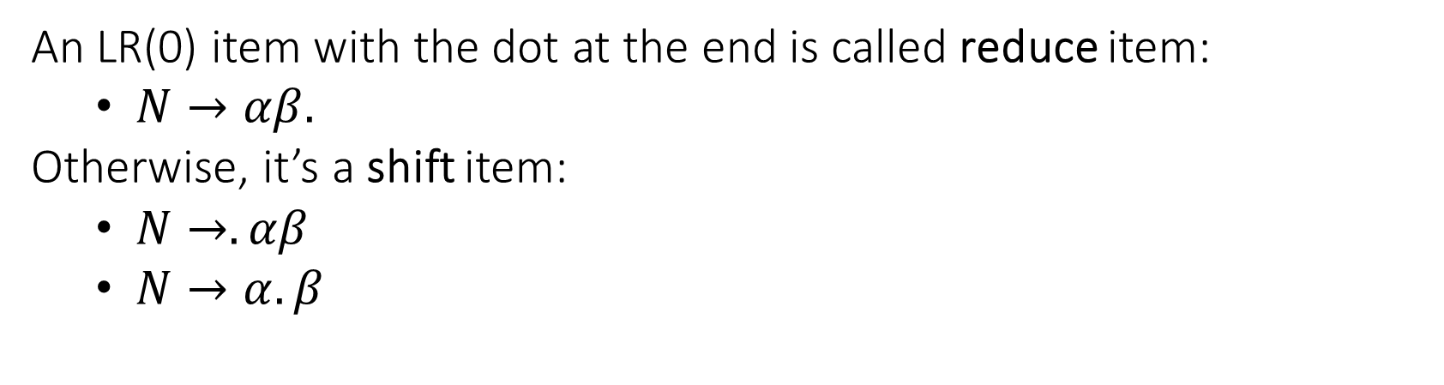
LR(0) Item
An LR(0) item with the dot at the end is called reduce item:
$N→αβ.$
Otherwise, it’s a shift item:
$N→.αβ$
$N→α.β$

Slide 19
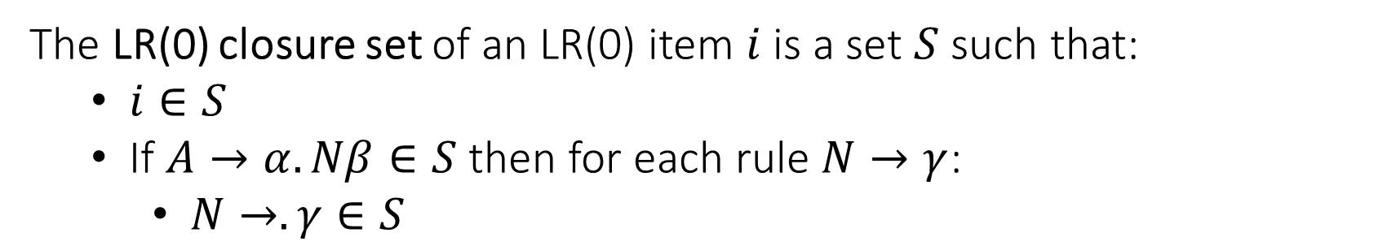
LR(0) Item Closure Set
The LR(0) closure set of an LR(0) item $i$ is a set $S$ such that:
$i∈S$
If $A→α.Nβ∈S$ then for each rule $N→γ$:
$N→.γ∈S$

Slide 20
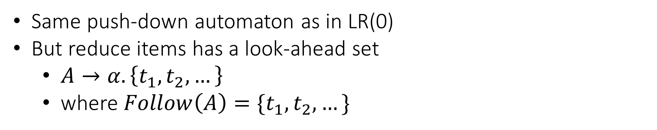
SLR(1)
Same push-down automaton as in LR(0)
But reduce items has a look-ahead set
$A→α. \left\{t_{1},t_{2},…\right\}$
where $Follow\left(A\right)=\{t_{1},t_{2},…\}$

Slide 21
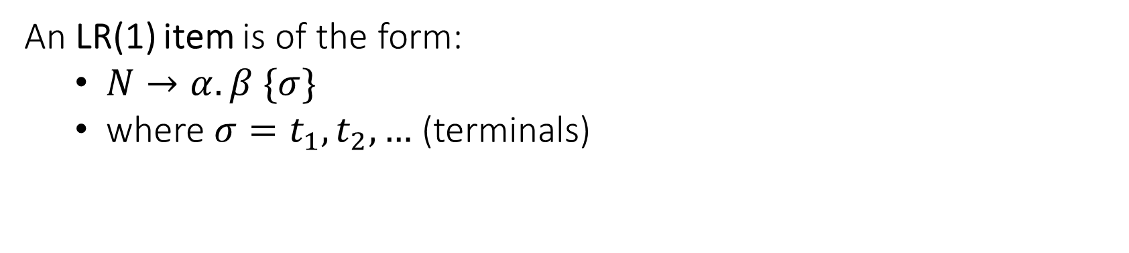
LR(1)
An LR(1) item is of the form:
$N→α. β \{σ\}$
where ${σ=t}_{1},t_{2},…$ (terminals)

Slide 22
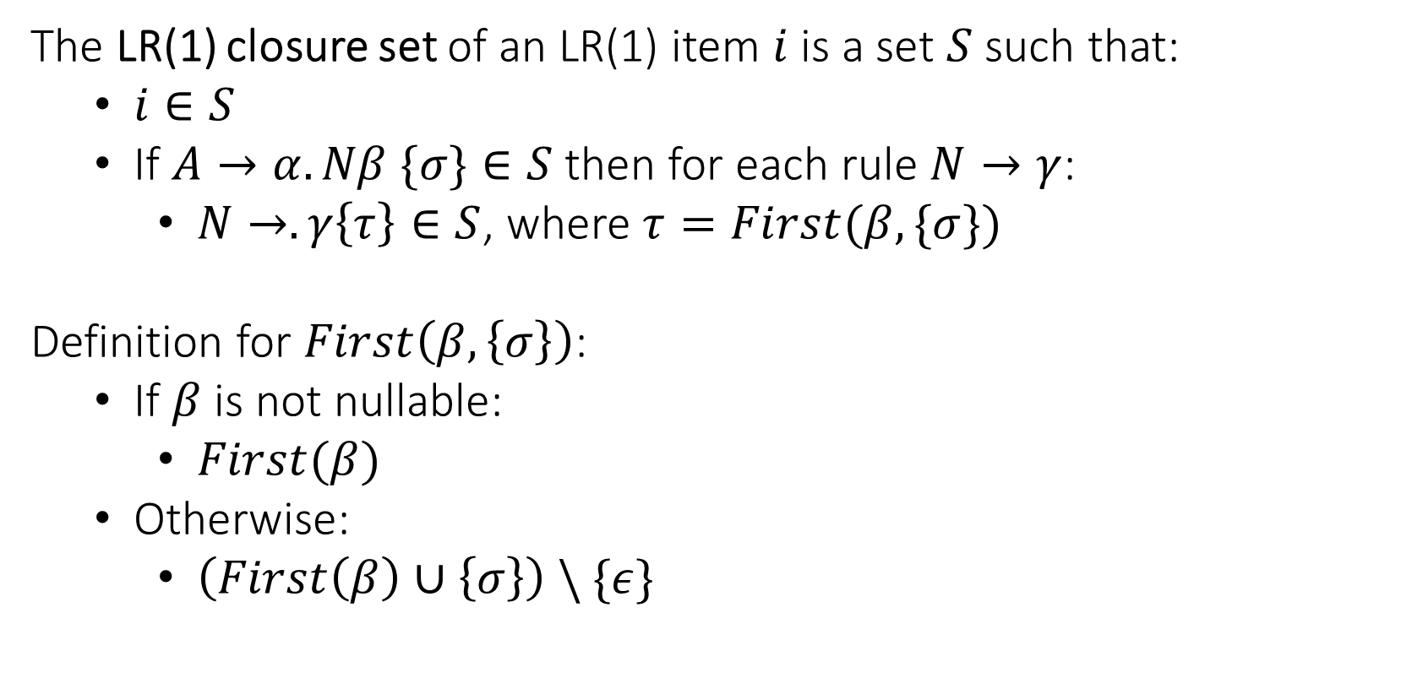
LR(1) Item Closure Set
The LR(1) closure set of an LR(1) item $i$ is a set $S$ such that:
$i∈S$
If $A→α.Nβ \{σ\}∈S$ then for each rule $N→γ$:
$N→.γ\left\{τ\right\}∈S$, where $τ=First(β, \{σ\})$
Definition for $First\left(β, \left\{σ\right\}\right)$:
If $β$ is not nullable:
$First(β)$
Otherwise:
$\left(First\left(β\right)∪\left\{σ\right\}\right) \backslash \{ε\}$

Slide 23
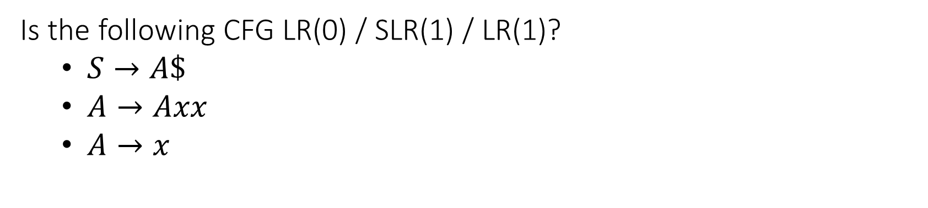
Question
Is the following CFG LR(0) / SLR(1) / LR(1)?
$S→A\$$
$A→Axx$
$A→x$

Slide 24
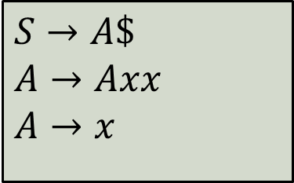
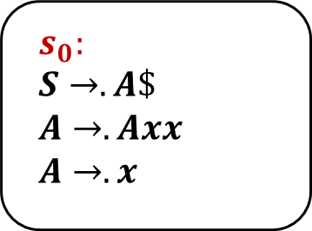
$$s_{0}:$$
$$S→.A\$$$
$$A→.Axx$$
$$A→.x$$
$$S→A\$$$
$$A→Axx$$
$$A→x$$

Slide 25
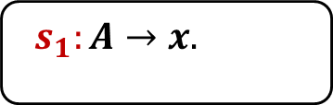
$$s_{0}:$$
$$S→.A\$$$
$$A→.Axx$$
$$A→.x$$
x
$$s_{1}:A→x.$$
$$S→A\$$$
$$A→Axx$$
$$A→x$$

Slide 26
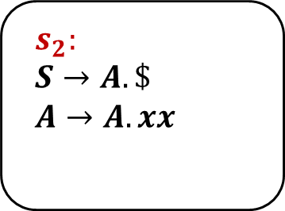
$$s_{0}:$$
$$S→.A\$$$
$$A→.Axx$$
$$A→.x$$
$$s_{2}:$$
$$S→A.\$$$
$$A→A.xx$$
A
x
$$s_{1}:A→x.$$
$$S→A\$$$
$$A→Axx$$
$$A→x$$

Slide 27
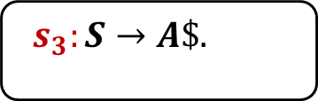
$$s_{0}:$$
$$S→.A\$$$
$$A→.Axx$$
$$A→.x$$
$$s_{2}:$$
$$S→A.\$$$
$$A→A.xx$$
A
x
$
$$s_{1}:A→x.$$
$$s_{3}:S→A\$.$$
$$S→A\$$$
$$A→Axx$$
$$A→x$$

Slide 28
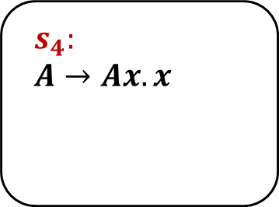
$$s_{0}:$$
$$S→.A\$$$
$$A→.Axx$$
$$A→.x$$
$$s_{2}:$$
$$S→A.\$$$
$$A→A.xx$$
$$s_{4}:$$
$$A→Ax.x$$
A
x
x
$
$$s_{1}:A→x.$$
$$s_{3}:S→A\$.$$
$$S→A\$$$
$$A→Axx$$
$$A→x$$

Slide 29
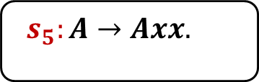
$$s_{0}:$$
$$S→.A\$$$
$$A→.Axx$$
$$A→.x$$
$$s_{2}:$$
$$S→A.\$$$
$$A→A.xx$$
$$s_{4}:$$
$$A→Ax.x$$
A
x
x
$
x
$$s_{1}:A→x.$$
$$s_{3}:S→A\$.$$
$$s_{5}:A→Axx.$$
$$S→A\$$$
$$A→Axx$$
$$A→x$$

Slide 30
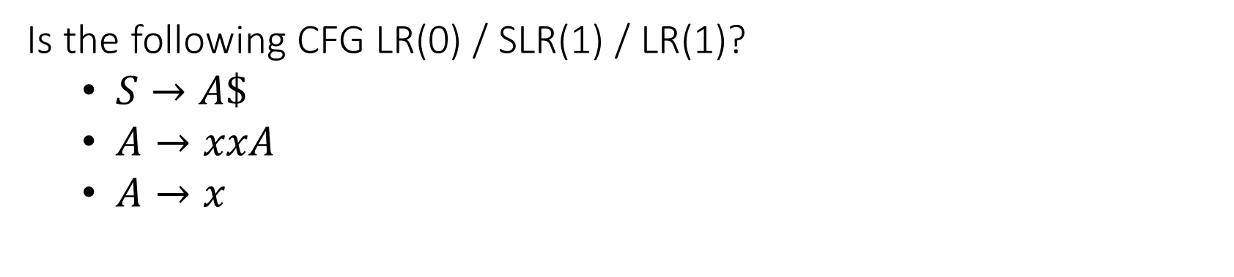
Question
Is the following CFG LR(0) / SLR(1) / LR(1)?
$S→A\$$
$A→xxA$
$A→x$

Slide 31
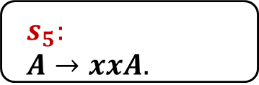
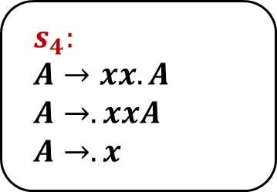
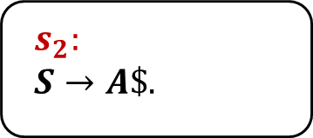
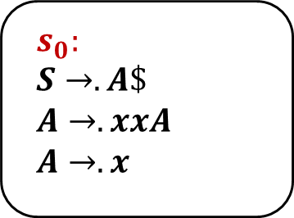
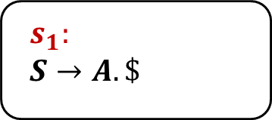
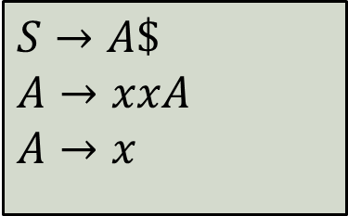
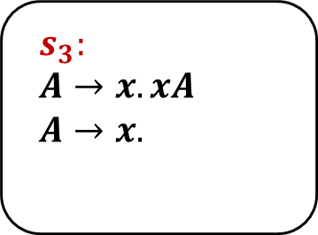
$$s_{0}:$$
$$S→.A\$$$
$$A→.xxA$$
$$A→.x$$
$$s_{3}:$$
$$A→x.xA$$
$$A→x.$$
x
A
x
$$s_{1}:$$
$$S→A.\$$$
$$s_{4}:$$
$$A→xx.A$$
$$A→.xxA$$
$$A→.x$$
$
$$s_{2}:$$
$$S→A\$.$$
A
$$s_{5}:$$
$$A→xxA.$$
$$S→A\$$$
$$A→xxA$$
$$A→x$$

Slide 32
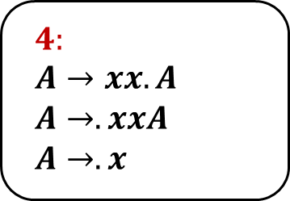
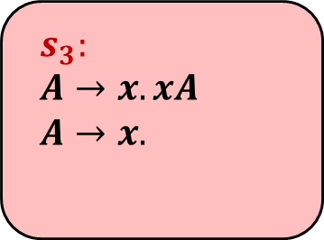
$$s_{0}:$$
$$S→.A\$$$
$$A→.xxA$$
$$A→.x$$
$$s_{3}:$$
$$A→x.xA$$
$$A→x.$$
x
A
x
x
$$s_{1}:$$
$$S→A.\$$$
$$4:$$
$$A→xx.A$$
$$A→.xxA$$
$$A→.x$$
$
$$s_{2}:$$
$$S→A\$.$$
A
$$s_{5}:$$
$$A→xxA.$$
$$S→A\$$$
$$A→xxA$$
$$A→x$$

Slide 33
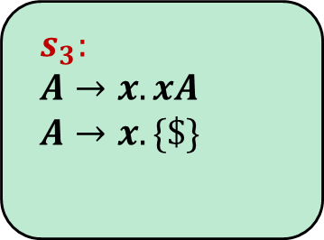

$$s_{0}:$$
$$S→.A\$$$
$$A→.xxA$$
$$A→.x$$
$$s_{3}:$$
$$A→x.xA$$
$$A→x. \{\$\}$$
x
A
x
$$Follow\left(A\right)=\{\$\}$$
$$s_{1}:$$
$$S→A.\$$$
$$4:$$
$$A→xx.A$$
$$A→.xxA$$
$$A→.x$$
$
$$s_{2}:$$
$$S→A\$.$$
A
$$s_{5}:$$
$$A→xxA.$$
$$S→A\$$$
$$A→xxA$$
$$A→x$$

Slide 34
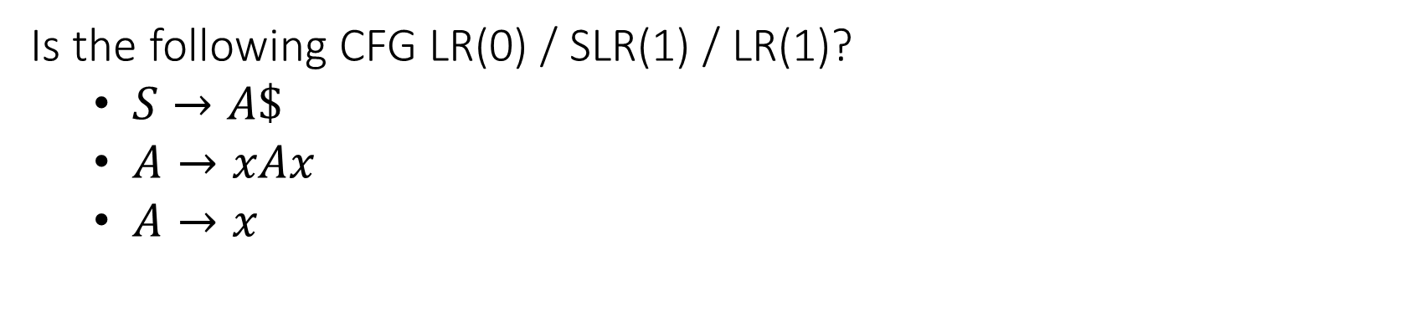
Question
Is the following CFG LR(0) / SLR(1) / LR(1)?
$S→A\$$
$A→xAx$
$A→x$

Slide 35
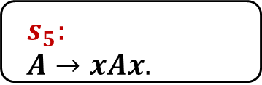
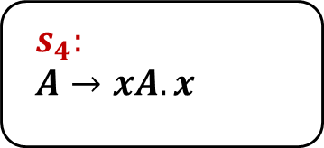

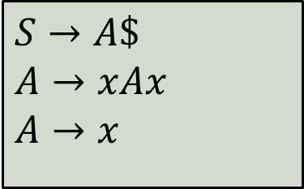
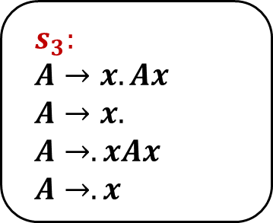
x
$$s_{0}:$$
$$S→.A\$$$
$$A→.xAx$$
$$A→.x$$
$$s_{3}:$$
$$A→x.Ax$$
$$A→x.$$
$$A→.xAx$$
$$A→.x$$
x
A
A
$$s_{1}:$$
$$S→A.\$$$
$$s_{4}:$$
$$A→xA.x$$
$
x
$$s_{2}:$$
$$S→A\$.$$
$$s_{5}:$$
$$A→xAx.$$
$$S→A\$$$
$$A→xAx$$
$$A→x$$

Slide 36
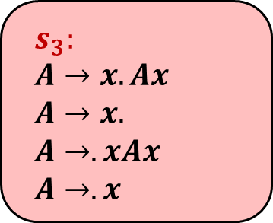
x
$$s_{0}:$$
$$S→.A\$$$
$$A→.xAx$$
$$A→.x$$
$$s_{3}:$$
$$A→x.Ax$$
$$A→x.$$
$$A→.xAx$$
$$A→.x$$
x
A
A
$$s_{1}:$$
$$S→A.\$$$
$$s_{4}:$$
$$A→xA.x$$
$
x
$$s_{2}:$$
$$S→A\$.$$
$$s_{5}:$$
$$A→xAx.$$
$$S→A\$$$
$$A→xAx$$
$$A→x$$

Slide 37

x
$$s_{0}:$$
$$S→.A\$$$
$$A→.xAx$$
$$A→.x$$
$$s_{3}:$$
$$A→x.Ax$$
$$A→x.$$
$$A→.xAx$$
$$A→.x$$
x
A
A
$$Follow\left(A\right)=\{\$,x\}$$
$$s_{1}:$$
$$S→A.\$$$
$$s_{4}:$$
$$A→xA.x$$
$
x
$$s_{2}:$$
$$S→A\$.$$
$$s_{5}:$$
$$A→xAx.$$
$$S→A\$$$
$$A→xAx$$
$$A→x$$

Slide 38
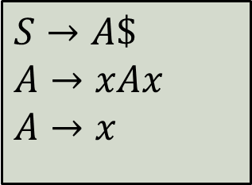
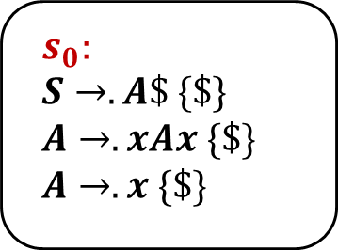
$$s_{0}:$$
$$S→.A\$ \{\$\}$$
$$A→.xAx \{\$\}$$
$$A→.x \{\$\}$$
$$S→A\$$$
$$A→xAx$$
$$A→x$$

Slide 39
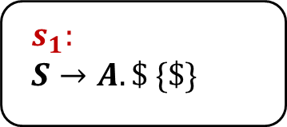
$$s_{0}:$$
$$S→.A\$ \{\$\}$$
$$A→.xAx \{\$\}$$
$$A→.x \{\$\}$$
A
$$s_{1}:$$
$S→A.\$ \{\$\}$
$$S→A\$$$
$$A→xAx$$
$$A→x$$

Slide 40
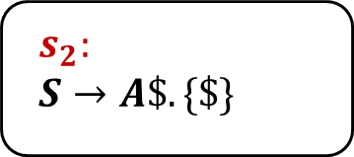
$$s_{0}:$$
$$S→.A\$ \{\$\}$$
$$A→.xAx \{\$\}$$
$$A→.x \{\$\}$$
A
$$s_{1}:$$
$S→A.\$ \{\$\}$
$
$$s_{2}:$$
$$S→A\$. \{\$\}$$
$$S→A\$$$
$$A→xAx$$
$$A→x$$

Slide 41
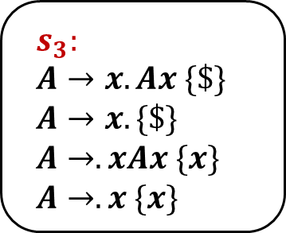
$$s_{0}:$$
$$S→.A\$ \{\$\}$$
$$A→.xAx \{\$\}$$
$$A→.x \{\$\}$$
$$s_{3}:$$
$$A→x.Ax \{\$\}$$
$$A→x. \{\$\}$$
$$A→.xAx \{x\}$$
$$A→.x \{x\}$$
x
A
$$s_{1}:$$
$S→A.\$ \{\$\}$
$
$$s_{2}:$$
$$S→A\$. \{\$\}$$
$$S→A\$$$
$$A→xAx$$
$$A→x$$

Slide 42
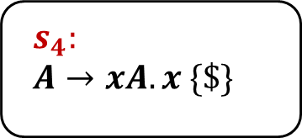
$$s_{0}:$$
$$S→.A\$ \{\$\}$$
$$A→.xAx \{\$\}$$
$$A→.x \{\$\}$$
$$s_{3}:$$
$$A→x.Ax \{\$\}$$
$$A→x. \{\$\}$$
$$A→.xAx \{x\}$$
$$A→.x \{x\}$$
x
A
A
$$s_{1}:$$
$S→A.\$ \{\$\}$
$$s_{4}:$$
$$A→xA.x \{\$\}$$
$
$$s_{2}:$$
$$S→A\$. \{\$\}$$
$$S→A\$$$
$$A→xAx$$
$$A→x$$

Slide 43
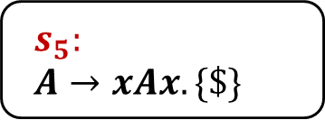
$$s_{0}:$$
$$S→.A\$ \{\$\}$$
$$A→.xAx \{\$\}$$
$$A→.x \{\$\}$$
$$s_{3}:$$
$$A→x.Ax \{\$\}$$
$$A→x. \{\$\}$$
$$A→.xAx \{x\}$$
$$A→.x \{x\}$$
x
A
A
$$s_{1}:$$
$S→A.\$ \{\$\}$
$$s_{4}:$$
$$A→xA.x \{\$\}$$
$
x
$$s_{2}:$$
$$S→A\$. \{\$\}$$
$$s_{5}:$$
$$A→xAx. \{\$\}$$
$$S→A\$$$
$$A→xAx$$
$$A→x$$

Slide 44
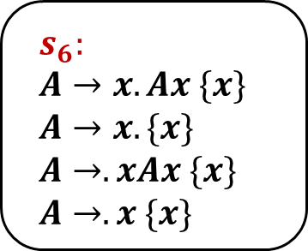
$$s_{0}:$$
$$S→.A\$ \{\$\}$$
$$A→.xAx \{\$\}$$
$$A→.x \{\$\}$$
$$s_{3}:$$
$$A→x.Ax \{\$\}$$
$$A→x. \{\$\}$$
$$A→.xAx \{x\}$$
$$A→.x \{x\}$$
$$s_{6}:$$
$$A→x.Ax \{x\}$$
$$A→x. \{x\}$$
$$A→.xAx \{x\}$$
$$A→.x \{x\}$$
x
x
A
A
$$s_{1}:$$
$S→A.\$ \{\$\}$
$$s_{4}:$$
$$A→xA.x \{\$\}$$
$
x
$$s_{2}:$$
$$S→A\$. \{\$\}$$
$$s_{5}:$$
$$A→xAx. \{\$\}$$
$$S→A\$$$
$$A→xAx$$
$$A→x$$

Slide 45
x
$$s_{0}:$$
$$S→.A\$ \{\$\}$$
$$A→.xAx \{\$\}$$
$$A→.x \{\$\}$$
$$s_{3}:$$
$$A→x.Ax \{\$\}$$
$$A→x. \{\$\}$$
$$A→.xAx \{x\}$$
$$A→.x \{x\}$$
$$s_{6}:$$
$$A→x.Ax \{x\}$$
$$A→x. \{x\}$$
$$A→.xAx \{x\}$$
$$A→.x \{x\}$$
x
x
A
A
$$s_{1}:$$
$S→A.\$ \{\$\}$
$$s_{4}:$$
$$A→xA.x \{\$\}$$
$
x
$$s_{2}:$$
$$S→A\$. \{\$\}$$
$$s_{5}:$$
$$A→xAx. \{\$\}$$
$$S→A\$$$
$$A→xAx$$
$$A→x$$

Slide 46
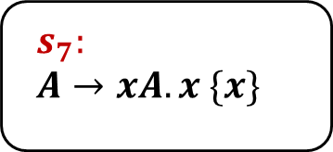
x
$$s_{0}:$$
$$S→.A\$ \{\$\}$$
$$A→.xAx \{\$\}$$
$$A→.x \{\$\}$$
$$s_{3}:$$
$$A→x.Ax \{\$\}$$
$$A→x. \{\$\}$$
$$A→.xAx \{x\}$$
$$A→.x \{x\}$$
$$s_{6}:$$
$$A→x.Ax \{x\}$$
$$A→x. \{x\}$$
$$A→.xAx \{x\}$$
$$A→.x \{x\}$$
x
x
A
A
A
$$s_{1}:$$
$S→A.\$ \{\$\}$
$$s_{4}:$$
$$A→xA.x \{\$\}$$
$$s_{7}:$$
$$A→xA.x \{x\}$$
$
x
$$s_{2}:$$
$$S→A\$. \{\$\}$$
$$s_{5}:$$
$$A→xAx. \{\$\}$$
$$S→A\$$$
$$A→xAx$$
$$A→x$$

Slide 47
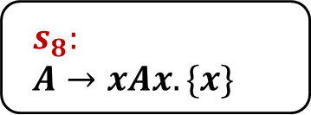
x
$$s_{0}:$$
$$S→.A\$ \{\$\}$$
$$A→.xAx \{\$\}$$
$$A→.x \{\$\}$$
$$s_{3}:$$
$$A→x.Ax \{\$\}$$
$$A→x. \{\$\}$$
$$A→.xAx \{x\}$$
$$A→.x \{x\}$$
$$s_{6}:$$
$$A→x.Ax \{x\}$$
$$A→x. \{x\}$$
$$A→.xAx \{x\}$$
$$A→.x \{x\}$$
x
x
A
A
A
$$s_{1}:$$
$S→A.\$ \{\$\}$
$$s_{4}:$$
$$A→xA.x \{\$\}$$
$$s_{7}:$$
$$A→xA.x \{x\}$$
$
x
x
$$s_{2}:$$
$$S→A\$. \{\$\}$$
$$s_{5}:$$
$$A→xAx. \{\$\}$$
$$s_{8}:$$
$$A→xAx. \{x\}$$
$$S→A\$$$
$$A→xAx$$
$$A→x$$

Slide 48
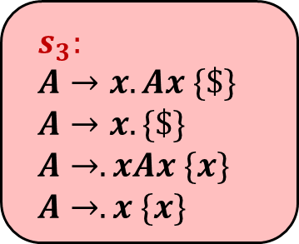
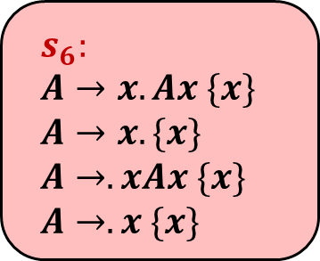
x
$$s_{0}:$$
$$S→.A\$ \{\$\}$$
$$A→.xAx \{\$\}$$
$$A→.x \{\$\}$$
$$s_{3}:$$
$$A→x.Ax \{\$\}$$
$$A→x. \{\$\}$$
$$A→.xAx \{x\}$$
$$A→.x \{x\}$$
$$s_{6}:$$
$$A→x.Ax \{x\}$$
$$A→x. \{x\}$$
$$A→.xAx \{x\}$$
$$A→.x \{x\}$$
x
x
A
A
A
$$s_{1}:$$
$S→A.\$ \{\$\}$
$$s_{4}:$$
$$A→xA.x \{\$\}$$
$$s_{7}:$$
$$A→xA.x \{x\}$$
$
x
x
$$s_{2}:$$
$$S→A\$. \{\$\}$$
$$s_{5}:$$
$$A→xAx. \{\$\}$$
$$s_{8}:$$
$$A→xAx. \{x\}$$
$$S→A\$$$
$$A→xAx$$
$$A→x$$

Slide 49
Question
We extend the language with automatic type inference:
Can use auto when the declaration has an initial value
Describe the changes required in:
Lexical analysis
Syntactic analysis
Semantic analysis
auto i := 8 + 100;
auto s := “1234”;
class A {}
A a := new A;
auto b := a;

Slide 50
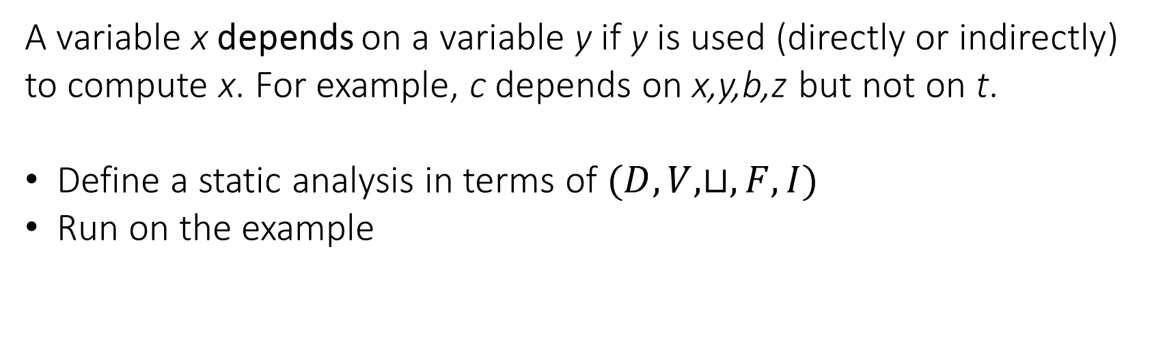
Question
A variable x depends on a variable y if y is used (directly or indirectly) to compute x. For example, c depends on x,y,b,z but not on t.
Define a static analysis in terms of $(D,V,⊔,F,I)$
Run on the example
y := t;
y := z + 5;
if (x > 0) {
x := y * 2;
} else {
x := y + b;
}
c := x;

Slide 51
Abstract Domain
We define $\left(D,V,⊔,F,I\right)$:

Slide 52

Abstract Domain
We define $\left(D,V,⊔,F,I\right)$:
Forward analysis

Slide 53
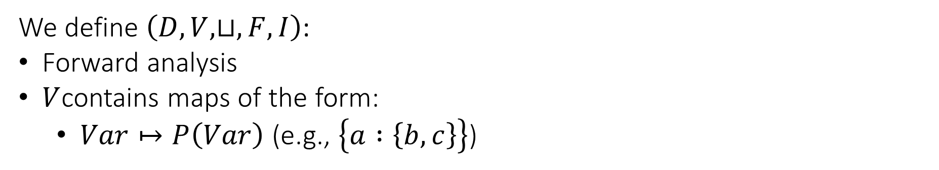
Abstract Domain
We define $\left(D,V,⊔,F,I\right)$:
Forward analysis
$V$contains maps of the form:
$Var↦P\left(Var\right)$ (e.g., $\left\{a :\left\{b,c\right\}\right\}$)

Slide 54
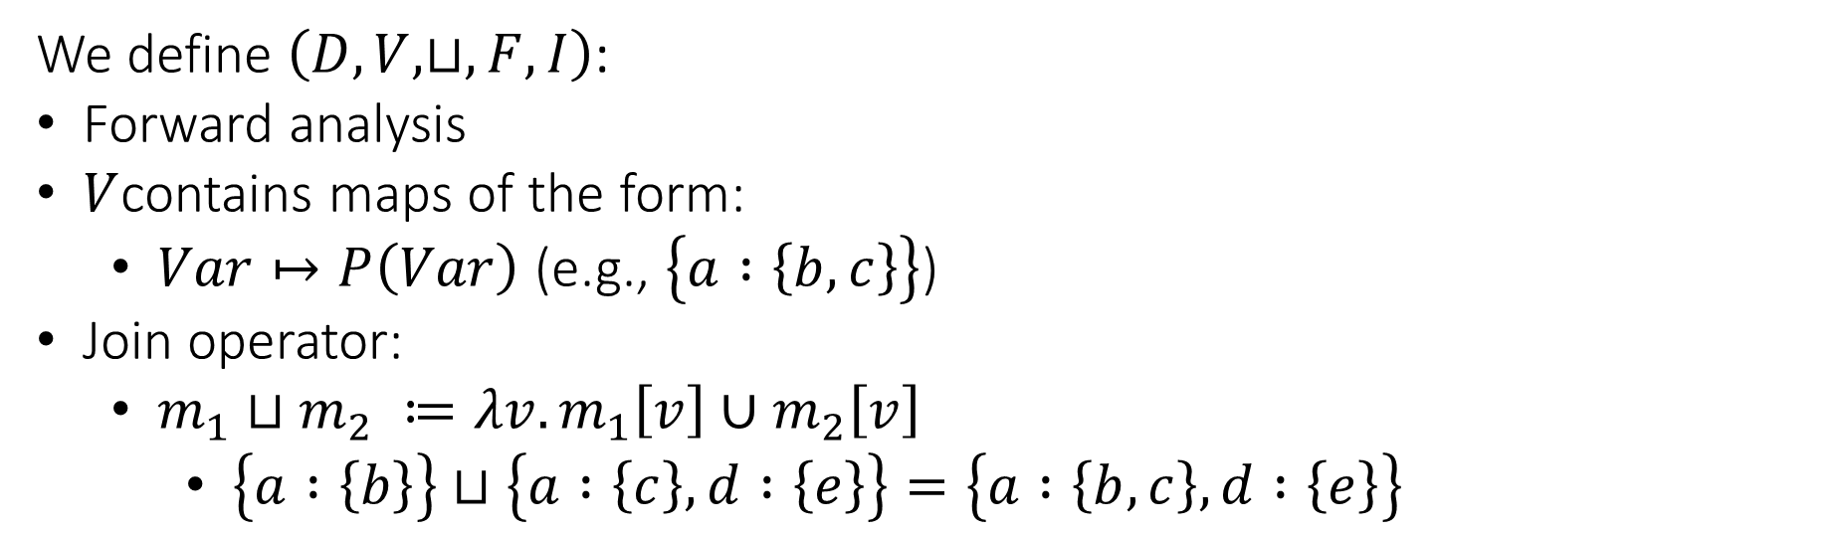
Abstract Domain
We define $\left(D,V,⊔,F,I\right)$:
Forward analysis
$V$contains maps of the form:
$Var↦P\left(Var\right)$ (e.g., $\left\{a :\left\{b,c\right\}\right\}$)
Join operator:
$m_{1}⊔m_{2} ≔λv.m_{1}\left[v\right]∪m_{2}\left[v\right]$
$\left\{a :\left\{b\right\}\right\}⊔\left\{a :\left\{c\right\}, d :\left\{e\right\}\right\}=\left\{a :\left\{b,c\right\}, d :\left\{e\right\}\right\}$

Slide 55
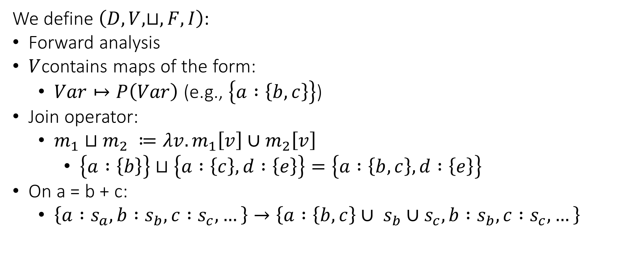
Abstract Domain
We define $\left(D,V,⊔,F,I\right)$:
Forward analysis
$V$contains maps of the form:
$Var↦P\left(Var\right)$ (e.g., $\left\{a :\left\{b,c\right\}\right\}$)
Join operator:
$m_{1}⊔m_{2} ≔λv.m_{1}\left[v\right]∪m_{2}\left[v\right]$
$\left\{a :\left\{b\right\}\right\}⊔\left\{a :\left\{c\right\}, d :\left\{e\right\}\right\}=\left\{a :\left\{b,c\right\}, d :\left\{e\right\}\right\}$
On a = b + c:
$\left\{a :s_{a}, b :s_{b}, c :s_{c},…\right\}→\left\{a :\left\{b,c\right\}∪ s_{b}∪s_{c}, b :s_{b}, c :s_{c},…\right\}$

Slide 56
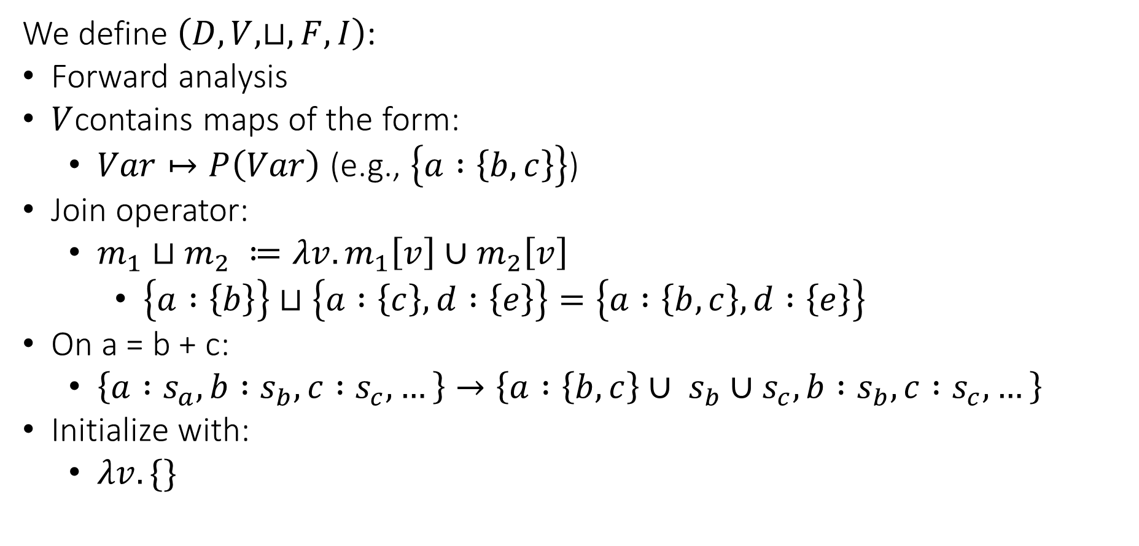
Abstract Domain
We define $\left(D,V,⊔,F,I\right)$:
Forward analysis
$V$contains maps of the form:
$Var↦P\left(Var\right)$ (e.g., $\left\{a :\left\{b,c\right\}\right\}$)
Join operator:
$m_{1}⊔m_{2} ≔λv.m_{1}\left[v\right]∪m_{2}\left[v\right]$
$\left\{a :\left\{b\right\}\right\}⊔\left\{a :\left\{c\right\}, d :\left\{e\right\}\right\}=\left\{a :\left\{b,c\right\}, d :\left\{e\right\}\right\}$
On a = b + c:
$\left\{a :s_{a}, b :s_{b}, c :s_{c},…\right\}→\left\{a :\left\{b,c\right\}∪ s_{b}∪s_{c}, b :s_{b}, c :s_{c},…\right\}$
Initialize with:
$λv. \{\}$

Slide 57
y = t
y = z + 5
x > 0
x = y + b
x = y * 2
c = x

Slide 58
y = t
{ x:{}, y:{}, z:{}, b:{}, c:{}, t:{} }
y = z + 5
{ x:{}, y:{}, z:{}, b:{}, c:{}, t:{} }
x > 0
{ x:{}, y:{}, z:{}, b:{}, c:{}, t:{} }
x = y + b
x = y * 2
{ x:{}, y:{}, z:{}, b:{}, c:{}, t:{} }
{ x:{}, y:{}, z:{}, b:{}, c:{}, t:{} }
c = x
{ x:{}, y:{}, z:{}, b:{}, c:{}, t:{} }

Slide 59
y = t
{ x:{}, y:{t}, z:{}, b:{}, c:{}, t:{} }
y = z + 5
{ x:{}, y:{}, z:{}, b:{}, c:{}, t:{} }
x > 0
{ x:{}, y:{}, z:{}, b:{}, c:{}, t:{} }
x = y + b
x = y * 2
{ x:{}, y:{}, z:{}, b:{}, c:{}, t:{} }
{ x:{}, y:{}, z:{}, b:{}, c:{}, t:{} }
c = x
{ x:{}, y:{}, z:{}, b:{}, c:{}, t:{} }

Slide 60
y = t
{ x:{}, y:{t}, z:{}, b:{}, c:{}, t:{} }
y = z + 5
{ x:{}, y:{z}, z:{}, b:{}, c:{}, t:{} }
x > 0
{ x:{}, y:{}, z:{}, b:{}, c:{}, t:{} }
x = y + b
x = y * 2
{ x:{}, y:{}, z:{}, b:{}, c:{}, t:{} }
{ x:{}, y:{}, z:{}, b:{}, c:{}, t:{} }
c = x
{ x:{}, y:{}, z:{}, b:{}, c:{}, t:{} }

Slide 61
y = t
{ x:{}, y:{t}, z:{}, b:{}, c:{}, t:{} }
y = z + 5
{ x:{}, y:{z}, z:{}, b:{}, c:{}, t:{} }
x > 0
{ x:{}, y:{z}, z:{}, b:{}, c:{}, t:{} }
x = y + b
x = y * 2
{ x:{}, y:{}, z:{}, b:{}, c:{}, t:{} }
{ x:{}, y:{}, z:{}, b:{}, c:{}, t:{} }
c = x
{ x:{}, y:{}, z:{}, b:{}, c:{}, t:{} }

Slide 62
y = t
{ x:{}, y:{t}, z:{}, b:{}, c:{}, t:{} }
y = z + 5
{ x:{}, y:{z}, z:{}, b:{}, c:{}, t:{} }
x > 0
{ x:{}, y:{z}, z:{}, b:{}, c:{}, t:{} }
x = y + b
x = y * 2
{ x:{}, y:{}, z:{}, b:{}, c:{}, t:{} }
{ x:{y,z}, y:{z}, z:{}, b:{}, c:{}, t:{} }
c = x
{ x:{}, y:{}, z:{}, b:{}, c:{}, t:{} }

Slide 63
y = t
{ x:{}, y:{t}, z:{}, b:{}, c:{}, t:{} }
y = z + 5
{ x:{}, y:{z}, z:{}, b:{}, c:{}, t:{} }
x > 0
{ x:{}, y:{z}, z:{}, b:{}, c:{}, t:{} }
x = y + b
x = y * 2
{ x:{y,b,z}, y:{z}, z:{}, b:{}, c:{}, t:{} }
{ x:{y,z}, y:{z}, z:{}, b:{}, c:{}, t:{} }
c = x
{ x:{}, y:{}, z:{}, b:{}, c:{}, t:{} }

Slide 64
y = t
{ x:{}, y:{t}, z:{}, b:{}, c:{}, t:{} }
y = z + 5
{ x:{}, y:{z}, z:{}, b:{}, c:{}, t:{} }
x > 0
{ x:{}, y:{z}, z:{}, b:{}, c:{}, t:{} }
x = y + b
x = y * 2
{ x:{y,b,z}, y:{z}, z:{}, b:{}, c:{}, t:{} }
{ x:{y,z}, y:{z}, z:{}, b:{}, c:{}, t:{} }
c = x
{ x:{y,b,z}, y:{z}, z:{}, b:{}, c:{x,y,b,z}, t:{} }

Slide 65
Question
Add support for detecting accesses to uninitialized local variables.
Describe the required changes in the code generation step.
For example:
void f() {
int x;
int y := 7;
if (y > 10) {
x := 100;
}
int z := x + 1;
}

Slide 66
Solution
High level idea:
arguments
var 1
return address
flag 1
previous fp
var 2
register backup
flag 2
local vars
…

Slide 67
Solution
Initialize each variable flag to zero on function entry
When writing to a local variable, set its flag to 1
When reading a local variable, check if its flag is 1
var 1
flag 1
var 2
flag 2
…

Slide 68
Solution
Initialize each variable flag to zero on function entry
When writing to a local variable, set its flag to 1
When reading a local variable, check if its flag is 1
prologue:
...
li $s0, 0
sw $s0, local_1_flag_offset($fp)
li $s0, 0
sw $s0, local_2_flag_offset($fp)
...
var 1
flag 1
var 2
flag 2
…

Slide 69
Solution
Initialize each variable flag to zero on function entry
When writing to a local variable, set its flag to 1
When reading a local variable, check if its flag is 1
x = t0
var 1
flag 1
var 2
sw $t0, x_offset($fp)
li $s0, 1
sw $s0, x_flag_offset($fp)
flag 2
…

Slide 70
Solution
Initialize each variable flag to zero on function entry
When writing to a local variable, set its flag to 1
When reading a local variable, check if its flag is 1
t0 = x
var 1
flag 1
var 2
lw $s0, x_flag_offset($fp)
beq $s0, 0, abort
lw $t0, x_offset($fp)
flag 2
…

Slide 71
Question
Apply the register allocation algorithm with 3 registers (R1,R2,R3)
R1 can’t hold a result of a multiplication operation.
t0 = 0
t1 = 1
t2 = 2
t3 = t2 * t1
t2 = t3
t1 = t1 + t0

Slide 72
t0 = 0
t1 = 1
t2 = 2
t3 = mul t2, t1
t2 = t3
t1 = add t1, t0

Slide 73
IN
OUT
{ }
t0 = 0
{ }
{ }
t1 = 1
{ }
{ }
t2 = 2
{ }
{ }
t3 = mul t2, t1
{ }
{ }
t2 = t3
{ }
{ }
t1 = add t1, t0
{ }
initialization

Slide 74
IN
OUT
{ }
t0 = 0
{ }
{ }
t1 = 1
{ }
{ }
t2 = 2
{ }
{ }
t3 = mul t2, t1
{ }
{ }
t2 = t3
{ }
{ t0, t1 }
t1 = add t1, t0
{ }
first iteration

Slide 75
IN
OUT
{ }
t0 = 0
{ }
{ }
t1 = 1
{ }
{ }
t2 = 2
{ }
{ }
t3 = mul t2, t1
{ }
{ t0, t1, t3 }
t2 = t3
{ t0, t1 }
{ t0, t1 }
t1 = add t1, t0
{ }
first iteration

Slide 76
IN
OUT
{ }
t0 = 0
{ }
{ }
t1 = 1
{ }
{ }
t2 = 2
{ }
{ t2, t1, t0 }
t3 = mul t2, t1
{ t0, t1, t3 }
{ t0, t1, t3 }
t2 = t3
{ t0, t1 }
{ t0, t1 }
t1 = add t1, t0
{ }
first iteration

Slide 77
IN
OUT
{ }
t0 = 0
{ }
{ }
t1 = 1
{ }
{ t1, t0 }
t2 = 2
{ t2, t1, t0 }
{ t2, t1, t0 }
t3 = mul t2, t1
{ t0, t1, t3 }
{ t0, t1, t3 }
t2 = t3
{ t0, t1 }
{ t0, t1 }
t1 = add t1, t0
{ }
first iteration

Slide 78
IN
OUT
{ }
t0 = 0
{ }
{ t0 }
t1 = 1
{ t1, t0 }
{ t1, t0 }
t2 = 2
{ t2, t1, t0 }
{ t2, t1, t0 }
t3 = mul t2, t1
{ t0, t1, t3 }
{ t0, t1, t3 }
t2 = t3
{ t0, t1 }
{ t0, t1 }
t1 = add t1, t0
{ }
first iteration

Slide 79
IN
OUT
{ }
t0 = 0
{ t0 }
{ t0 }
t1 = 1
{ t1, t0 }
{ t1, t0 }
t2 = 2
{ t2, t1, t0 }
{ t2, t1, t0 }
t3 = mul t2, t1
{ t0, t1, t3 }
{ t0, t1, t3 }
t2 = t3
{ t0, t1 }
{ t0, t1 }
t1 = add t1, t0
{ }
first iteration

Slide 80
IN
OUT
{ }
t0 = 0
{ t0 }
{ t0 }
t1 = 1
{ t1, t0 }
{ t1, t0 }
t2 = 2
{ t2, t1, t0 }
{ t2, t1, t0 }
t3 = mul t2, t1
{ t0, t1, t3 }
{ t0, t1, t3 }
t2 = t3
{ t0, t1 }
{ t0, t1 }
t1 = add t1, t0
{ }
second iteration…

Slide 81
Interference Graph
{ t0 }
{ t0, t1 }
t0
t1
{ t0, t2, t1 }
{ t0, t3 }
t2
t3
R1
R2
R3

Slide 82
Interference Graph
{ t0 }
{ t0, t1 }
t0
t1
{ t0, t2, t1 }
{ t0, t3 }
t2
t3
R1
R2
R3

Slide 83
Interference Graph
{ t0 }
{ t0, t1 }
t0
t1
{ t0, t2, t1 }
{ t0, t3 }
t0 = 0
t1 = 1
t2 = 2
t3 = t2 * t1
t2 = t3
t1 = t1 + t0
t2
t3
R1
R2
R3

Slide 84
Interference Graph
{ t0 }
{ t0, t1 }
t0
t1
{ t0, t2, t1 }
{ t0, t3 }
t0 = 0
t1 = 1
t2 = 2
t3 = t2 * t1
t2 = t3
t1 = t1 + t0
t2
t3
R1
R2
R3

Slide 85
Graph Coloring
t0
t1
t2
t3
R1
R2
R3

Slide 86
Graph Coloring
t0
t1
t2
t3
t3
R1
R2
R3

Slide 87
Graph Coloring
t0
t1
t2
t3
t0
t3
R1
R2
R3

Slide 88
Graph Coloring
t0
t1
t2
t3
t1
t0
t3
R1
R2
R3

Slide 89
Graph Coloring
t0
t1
t2
t3
t2
t1
t0
t3
R1
R2
R3

Slide 90
Graph Coloring
t0
t1
t2
t3
t1
t0
t3
R1
R2
R3

Slide 91
Graph Coloring
t0
t1
t2
t3
t1
t0
t3
R1
R2
R3

Slide 92
Graph Coloring
t0
t1
t2
t3
t0
t3
R1
R2
R3

Slide 93
Graph Coloring
t0
t1
t2
t3
t0
t3
R1
R2
R3

Slide 94
Graph Coloring
t0
t1
t2
t3
t3
R1
R2
R3

Slide 95
Graph Coloring
t0
t1
t2
t3
t3
R1
R2
R3

Slide 96
Graph Coloring
t0
t1
t2
t3
t3
R1
R2
R3

Slide 97
Graph Coloring
t0
t1
t2
t3
t3
R1
R2
R3

