Slide 1
Exam Questions
TeachING Assistant: David Trabish

Slide 2
Question
The program contains a string constant.
compiler construction
compiling
linking
runtime

Slide 3
Question
The program contains a string constant.
compiler construction
compiling
linking
runtime

Slide 4
Question
Every time the command x = y + 42 is executed,
the value of y is 0.
compiler construction
compiling
linking
runtime

Slide 5
Question
Every time the command x = y + 42 is executed,
the value of y is 0.
compiler construction
compiling
linking
runtime

Slide 6
Question
All the variable names start with x.
compiler construction
compiling
linking
runtime

Slide 7
Question
All the variable names start with x.
compiler construction
compiling
linking
runtime

Slide 8
Question
The program contains a nested loop.
compiler construction
compiling
linking
runtime

Slide 9
Question
The program contains a nested loop.
compiler construction
compiling
linking
runtime

Slide 10
Question
The program contains a string constant with at least 200 characters.
compiler construction
compiling
linking
runtime

Slide 11
Question
The program contains a string constant with at least 200 characters.
compiler construction
compiling
linking
runtime

Slide 12
Question
The size of the stack exceeds 400 bytes.
compiler construction
compiling
linking
runtime

Slide 13
Question
The size of the stack exceeds 400 bytes.
compiler construction
compiling
linking
runtime

Slide 14
Question
The code contains only invocations of methods which located at offset 4 in the virtual table.
compiler construction
compiling
linking
runtime

Slide 15
Question
The code contains only invocations of methods which located at offset 4 in the virtual table.
compiler construction
compiling
linking
runtime

Slide 16
Question
There is an addition operation which is never executed in any run.
compiler construction
compiling
linking
runtime

Slide 17
Question
There is an addition operation which is never executed in any run.
compiler construction
compiling
linking
runtime

Slide 18
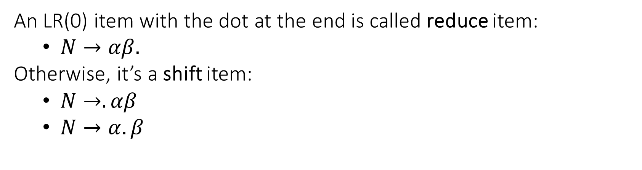
LR(0) Item
An LR(0) item with the dot at the end is called reduce item:
$N→αβ.$
Otherwise, it’s a shift item:
$N→.αβ$
$N→α.β$

Slide 19
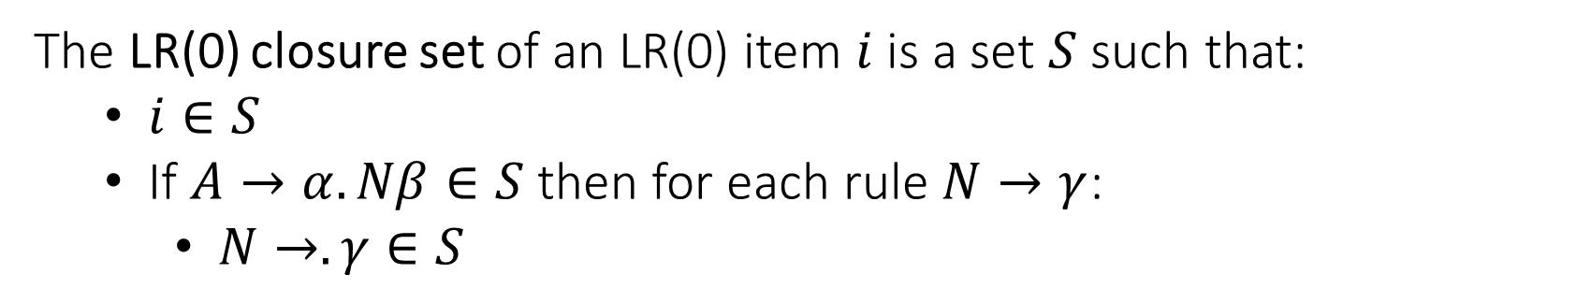
LR(0) Item Closure Set
The LR(0) closure set of an LR(0) item $i$ is a set $S$ such that:
$i∈S$
If $A→α.Nβ∈S$ then for each rule $N→γ$:
$N→.γ∈S$

Slide 20
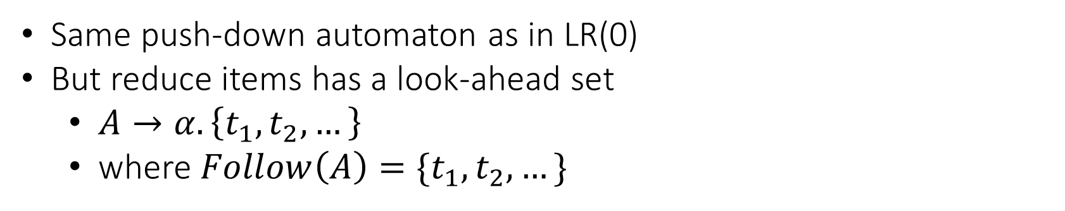
SLR(1)
Same push-down automaton as in LR(0)
But reduce items has a look-ahead set
$A→α. \left\{t_{1},t_{2},…\right\}$
where $Follow\left(A\right)=\{t_{1},t_{2},…\}$

Slide 21
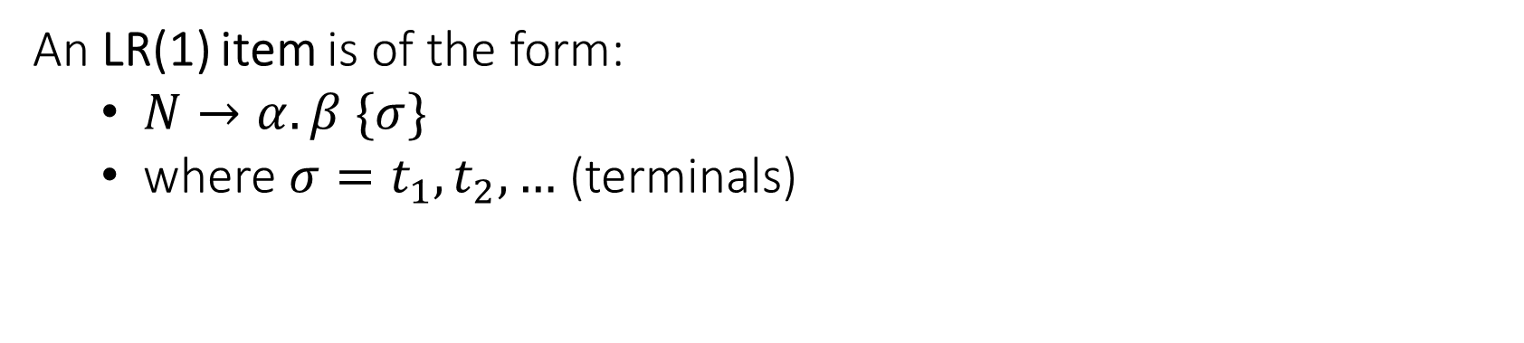
LR(1)
An LR(1) item is of the form:
$N→α. β \{σ\}$
where ${σ=t}_{1},t_{2},…$ (terminals)

Slide 22
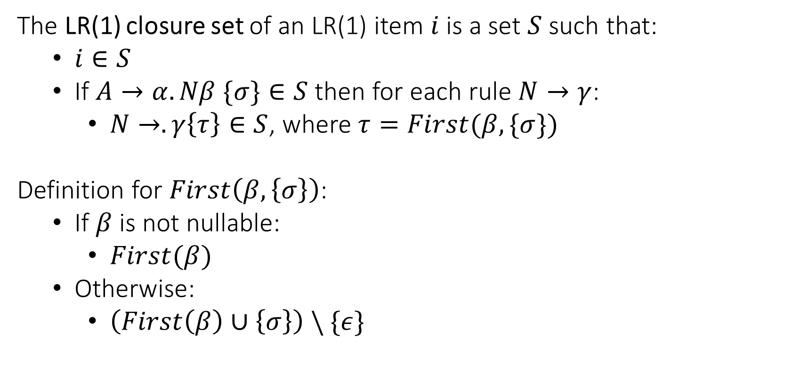
LR(1) Item Closure Set
The LR(1) closure set of an LR(1) item $i$ is a set $S$ such that:
$i∈S$
If $A→α.Nβ \{σ\}∈S$ then for each rule $N→γ$:
$N→.γ\left\{τ\right\}∈S$, where $τ=First(β, \{σ\})$
Definition for $First\left(β, \left\{σ\right\}\right)$:
If $β$ is not nullable:
$First(β)$
Otherwise:
$\left(First\left(β\right)∪\left\{σ\right\}\right) \backslash \{ε\}$

Slide 23
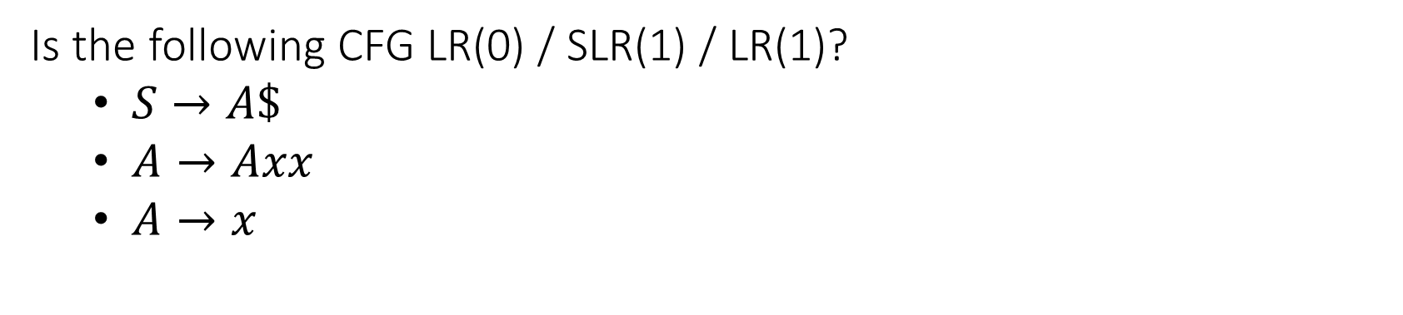
Question
Is the following CFG LR(0) / SLR(1) / LR(1)?
$S→A\$$
$A→Axx$
$A→x$

Slide 24
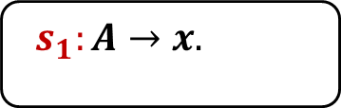
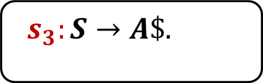
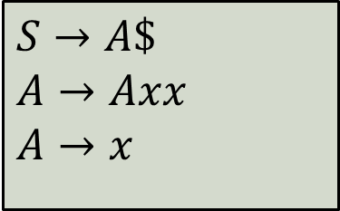
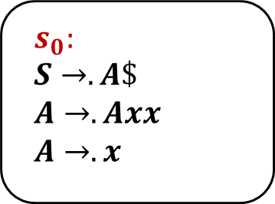
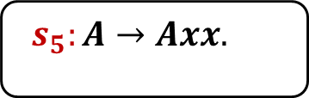
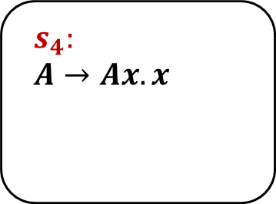
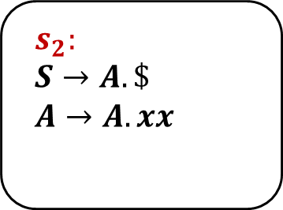
$$s_{0}:$$
$$S→.A\$$$
$$A→.Axx$$
$$A→.x$$
$$s_{2}:$$
$$S→A.\$$$
$$A→A.xx$$
$$s_{4}:$$
$$A→Ax.x$$
A
x
x
$
x
$$s_{1}:A→x.$$
$$s_{3}:S→A\$.$$
$$s_{5}:A→Axx.$$
$$S→A\$$$
$$A→Axx$$
$$A→x$$

Slide 25
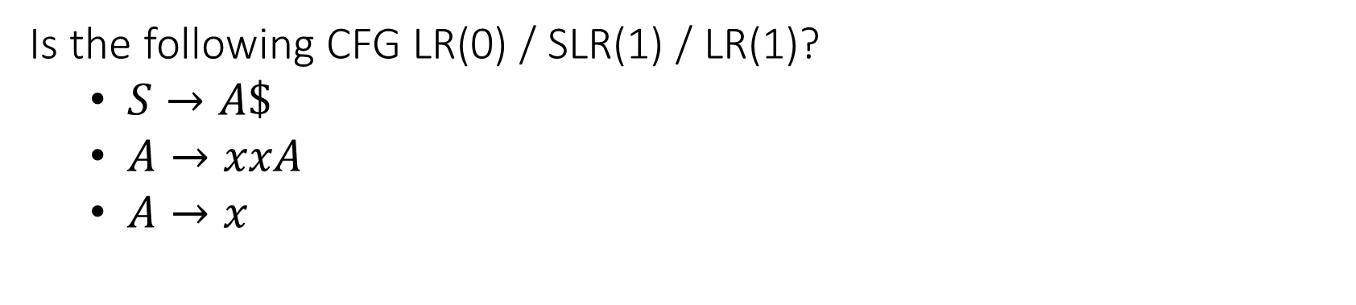
Question
Is the following CFG LR(0) / SLR(1) / LR(1)?
$S→A\$$
$A→xxA$
$A→x$

Slide 26
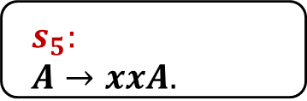
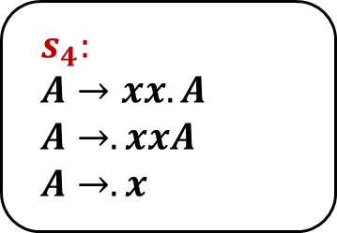
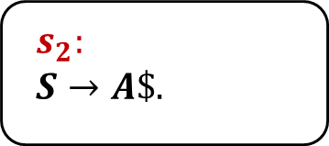
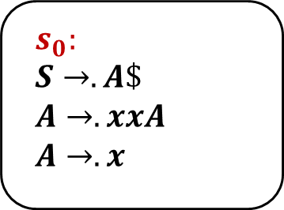
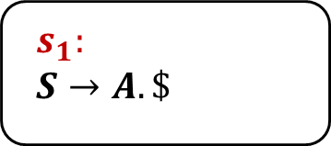
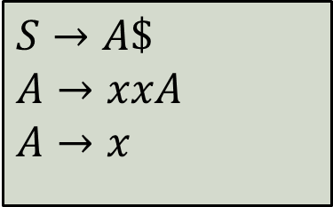
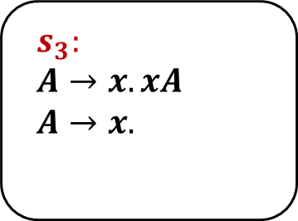
$$s_{0}:$$
$$S→.A\$$$
$$A→.xxA$$
$$A→.x$$
$$s_{3}:$$
$$A→x.xA$$
$$A→x.$$
x
A
x
$$s_{1}:$$
$$S→A.\$$$
$$s_{4}:$$
$$A→xx.A$$
$$A→.xxA$$
$$A→.x$$
$
$$s_{2}:$$
$$S→A\$.$$
A
$$s_{5}:$$
$$A→xxA.$$
$$S→A\$$$
$$A→xxA$$
$$A→x$$

Slide 27
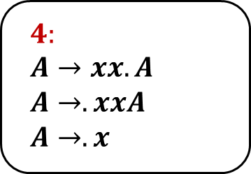
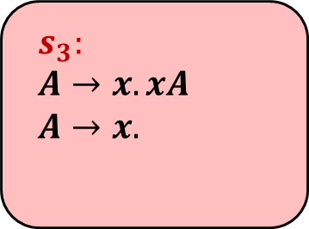
$$s_{0}:$$
$$S→.A\$$$
$$A→.xxA$$
$$A→.x$$
$$s_{3}:$$
$$A→x.xA$$
$$A→x.$$
x
A
x
x
$$s_{1}:$$
$$S→A.\$$$
$$4:$$
$$A→xx.A$$
$$A→.xxA$$
$$A→.x$$
$
$$s_{2}:$$
$$S→A\$.$$
A
$$s_{5}:$$
$$A→xxA.$$
$$S→A\$$$
$$A→xxA$$
$$A→x$$

Slide 28
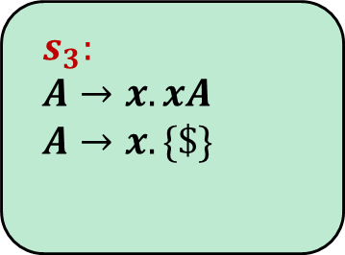

$$s_{0}:$$
$$S→.A\$$$
$$A→.xxA$$
$$A→.x$$
$$s_{3}:$$
$$A→x.xA$$
$$A→x. \{\$\}$$
x
A
x
$$Follow\left(A\right)=\{\$\}$$
$$s_{1}:$$
$$S→A.\$$$
$$4:$$
$$A→xx.A$$
$$A→.xxA$$
$$A→.x$$
$
$$s_{2}:$$
$$S→A\$.$$
A
$$s_{5}:$$
$$A→xxA.$$
$$S→A\$$$
$$A→xxA$$
$$A→x$$

Slide 29
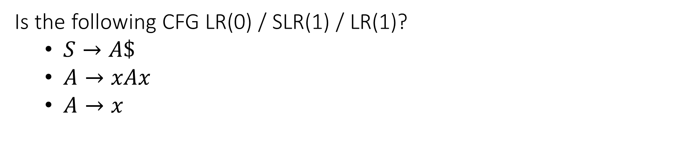
Question
Is the following CFG LR(0) / SLR(1) / LR(1)?
$S→A\$$
$A→xAx$
$A→x$

Slide 30
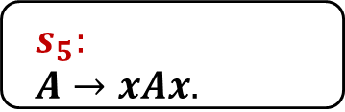
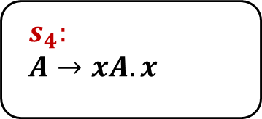

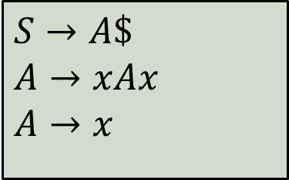
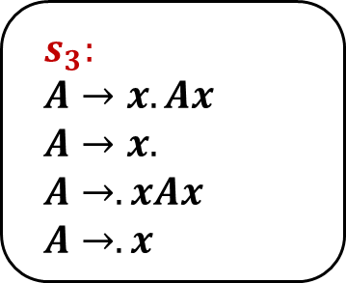
x
$$s_{0}:$$
$$S→.A\$$$
$$A→.xAx$$
$$A→.x$$
$$s_{3}:$$
$$A→x.Ax$$
$$A→x.$$
$$A→.xAx$$
$$A→.x$$
x
A
A
$$s_{1}:$$
$$S→A.\$$$
$$s_{4}:$$
$$A→xA.x$$
$
x
$$s_{2}:$$
$$S→A\$.$$
$$s_{5}:$$
$$A→xAx.$$
$$S→A\$$$
$$A→xAx$$
$$A→x$$

Slide 31
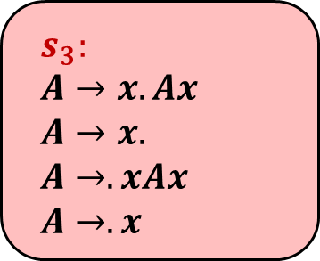
x
$$s_{0}:$$
$$S→.A\$$$
$$A→.xAx$$
$$A→.x$$
$$s_{3}:$$
$$A→x.Ax$$
$$A→x.$$
$$A→.xAx$$
$$A→.x$$
x
A
A
$$s_{1}:$$
$$S→A.\$$$
$$s_{4}:$$
$$A→xA.x$$
$
x
$$s_{2}:$$
$$S→A\$.$$
$$s_{5}:$$
$$A→xAx.$$
$$S→A\$$$
$$A→xAx$$
$$A→x$$

Slide 32

x
$$s_{0}:$$
$$S→.A\$$$
$$A→.xAx$$
$$A→.x$$
$$s_{3}:$$
$$A→x.Ax$$
$$A→x.$$
$$A→.xAx$$
$$A→.x$$
x
A
A
$$Follow\left(A\right)=\{\$,x\}$$
$$s_{1}:$$
$$S→A.\$$$
$$s_{4}:$$
$$A→xA.x$$
$
x
$$s_{2}:$$
$$S→A\$.$$
$$s_{5}:$$
$$A→xAx.$$
$$S→A\$$$
$$A→xAx$$
$$A→x$$

Slide 33
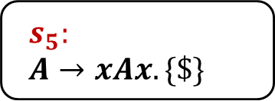
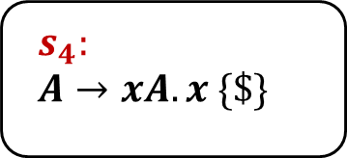
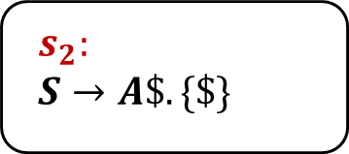
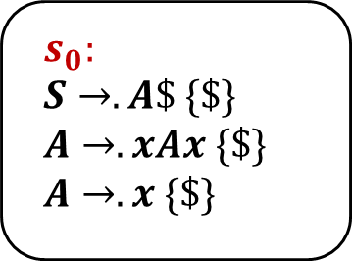
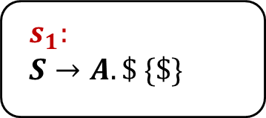
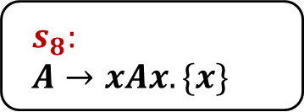
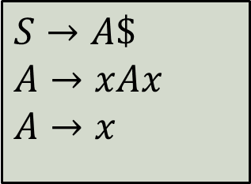
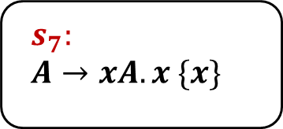
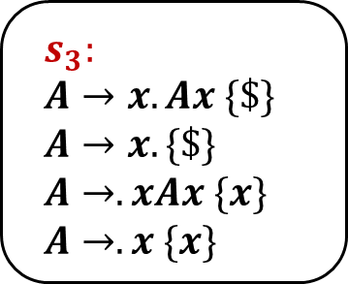
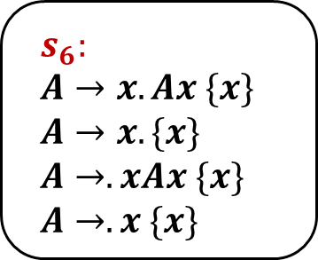
x
$$s_{0}:$$
$$S→.A\$ \{\$\}$$
$$A→.xAx \{\$\}$$
$$A→.x \{\$\}$$
$$s_{3}:$$
$$A→x.Ax \{\$\}$$
$$A→x. \{\$\}$$
$$A→.xAx \{x\}$$
$$A→.x \{x\}$$
$$s_{6}:$$
$$A→x.Ax \{x\}$$
$$A→x. \{x\}$$
$$A→.xAx \{x\}$$
$$A→.x \{x\}$$
x
x
A
A
A
$$s_{1}:$$
$S→A.\$ \{\$\}$
$$s_{4}:$$
$$A→xA.x \{\$\}$$
$$s_{7}:$$
$$A→xA.x \{x\}$$
$
x
x
$$s_{2}:$$
$$S→A\$. \{\$\}$$
$$s_{5}:$$
$$A→xAx. \{\$\}$$
$$s_{8}:$$
$$A→xAx. \{x\}$$
$$S→A\$$$
$$A→xAx$$
$$A→x$$

Slide 34
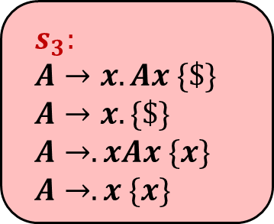
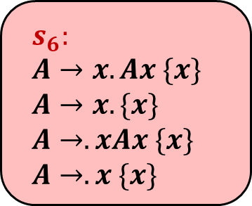
x
$$s_{0}:$$
$$S→.A\$ \{\$\}$$
$$A→.xAx \{\$\}$$
$$A→.x \{\$\}$$
$$s_{3}:$$
$$A→x.Ax \{\$\}$$
$$A→x. \{\$\}$$
$$A→.xAx \{x\}$$
$$A→.x \{x\}$$
$$s_{6}:$$
$$A→x.Ax \{x\}$$
$$A→x. \{x\}$$
$$A→.xAx \{x\}$$
$$A→.x \{x\}$$
x
x
A
A
A
$$s_{1}:$$
$S→A.\$ \{\$\}$
$$s_{4}:$$
$$A→xA.x \{\$\}$$
$$s_{7}:$$
$$A→xA.x \{x\}$$
$
x
x
$$s_{2}:$$
$$S→A\$. \{\$\}$$
$$s_{5}:$$
$$A→xAx. \{\$\}$$
$$s_{8}:$$
$$A→xAx. \{x\}$$
$$S→A\$$$
$$A→xAx$$
$$A→x$$

Slide 35
Question
We extend the language with automatic type inference:
Can use auto when the declaration has an initial value
Describe the changes required in:
Lexical analysis
Syntactic analysis
Semantic analysis
auto i := 8 + 100;
auto s := “1234”;
class A {}
A a := new A;
auto b := a;

Slide 36
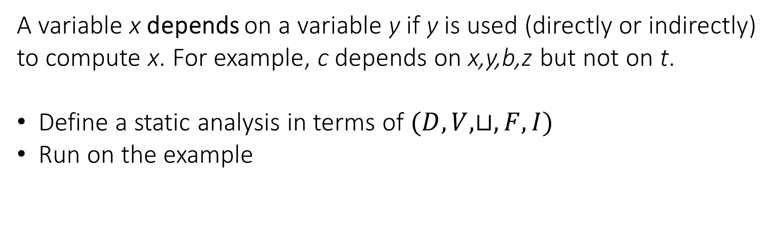
Question
A variable x depends on a variable y if y is used (directly or indirectly) to compute x. For example, c depends on x,y,b,z but not on t.
Define a static analysis in terms of $(D,V,⊔,F,I)$
Run on the example
y := t;
y := z + 5;
if (x > 0) {
x := y * 2;
} else {
x := y + b;
}
c := x;

Slide 37
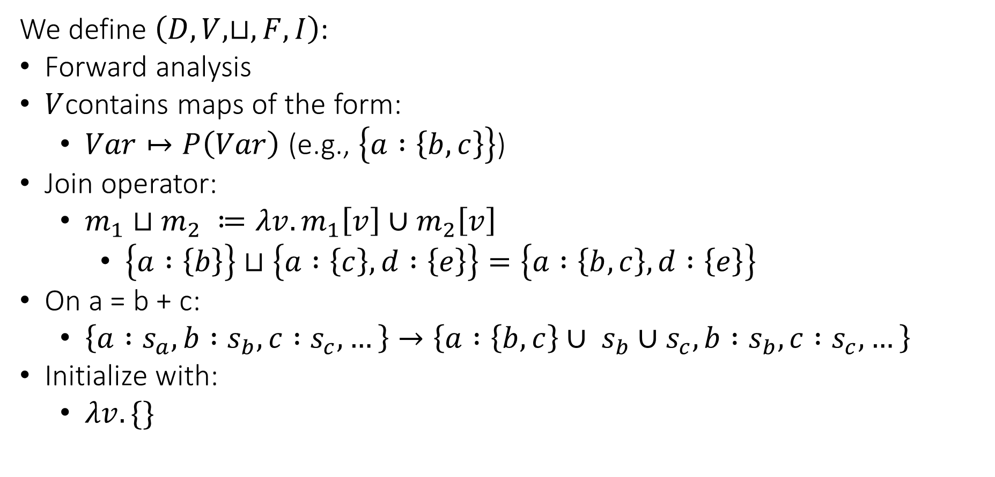
Abstract Domain
We define $\left(D,V,⊔,F,I\right)$:
Forward analysis
$V$contains maps of the form:
$Var↦P\left(Var\right)$ (e.g., $\left\{a :\left\{b,c\right\}\right\}$)
Join operator:
$m_{1}⊔m_{2} ≔λv.m_{1}\left[v\right]∪m_{2}\left[v\right]$
$\left\{a :\left\{b\right\}\right\}⊔\left\{a :\left\{c\right\}, d :\left\{e\right\}\right\}=\left\{a :\left\{b,c\right\}, d :\left\{e\right\}\right\}$
On a = b + c:
$\left\{a :s_{a}, b :s_{b}, c :s_{c},…\right\}→\left\{a :\left\{b,c\right\}∪ s_{b}∪s_{c}, b :s_{b}, c :s_{c},…\right\}$
Initialize with:
$λv. \{\}$

Slide 38
y = t
y = z + 5
x > 0
x = y + b
x = y * 2
c = x

Slide 39
y = t
{ x:{}, y:{}, z:{}, b:{}, c:{}, t:{} }
y = z + 5
{ x:{}, y:{}, z:{}, b:{}, c:{}, t:{} }
x > 0
{ x:{}, y:{}, z:{}, b:{}, c:{}, t:{} }
x = y + b
x = y * 2
{ x:{}, y:{}, z:{}, b:{}, c:{}, t:{} }
{ x:{}, y:{}, z:{}, b:{}, c:{}, t:{} }
c = x
{ x:{}, y:{}, z:{}, b:{}, c:{}, t:{} }

Slide 40
y = t
{ x:{}, y:{t}, z:{}, b:{}, c:{}, t:{} }
y = z + 5
{ x:{}, y:{}, z:{}, b:{}, c:{}, t:{} }
x > 0
{ x:{}, y:{}, z:{}, b:{}, c:{}, t:{} }
x = y + b
x = y * 2
{ x:{}, y:{}, z:{}, b:{}, c:{}, t:{} }
{ x:{}, y:{}, z:{}, b:{}, c:{}, t:{} }
c = x
{ x:{}, y:{}, z:{}, b:{}, c:{}, t:{} }

Slide 41
y = t
{ x:{}, y:{t}, z:{}, b:{}, c:{}, t:{} }
y = z + 5
{ x:{}, y:{z}, z:{}, b:{}, c:{}, t:{} }
x > 0
{ x:{}, y:{}, z:{}, b:{}, c:{}, t:{} }
x = y + b
x = y * 2
{ x:{}, y:{}, z:{}, b:{}, c:{}, t:{} }
{ x:{}, y:{}, z:{}, b:{}, c:{}, t:{} }
c = x
{ x:{}, y:{}, z:{}, b:{}, c:{}, t:{} }

Slide 42
y = t
{ x:{}, y:{t}, z:{}, b:{}, c:{}, t:{} }
y = z + 5
{ x:{}, y:{z}, z:{}, b:{}, c:{}, t:{} }
x > 0
{ x:{}, y:{z}, z:{}, b:{}, c:{}, t:{} }
x = y + b
x = y * 2
{ x:{}, y:{}, z:{}, b:{}, c:{}, t:{} }
{ x:{}, y:{}, z:{}, b:{}, c:{}, t:{} }
c = x
{ x:{}, y:{}, z:{}, b:{}, c:{}, t:{} }

Slide 43
y = t
{ x:{}, y:{t}, z:{}, b:{}, c:{}, t:{} }
y = z + 5
{ x:{}, y:{z}, z:{}, b:{}, c:{}, t:{} }
x > 0
{ x:{}, y:{z}, z:{}, b:{}, c:{}, t:{} }
x = y + b
x = y * 2
{ x:{}, y:{}, z:{}, b:{}, c:{}, t:{} }
{ x:{y,z}, y:{z}, z:{}, b:{}, c:{}, t:{} }
c = x
{ x:{}, y:{}, z:{}, b:{}, c:{}, t:{} }

Slide 44
y = t
{ x:{}, y:{t}, z:{}, b:{}, c:{}, t:{} }
y = z + 5
{ x:{}, y:{z}, z:{}, b:{}, c:{}, t:{} }
x > 0
{ x:{}, y:{z}, z:{}, b:{}, c:{}, t:{} }
x = y + b
x = y * 2
{ x:{y,b,z}, y:{z}, z:{}, b:{}, c:{}, t:{} }
{ x:{y,z}, y:{z}, z:{}, b:{}, c:{}, t:{} }
c = x
{ x:{}, y:{}, z:{}, b:{}, c:{}, t:{} }

Slide 45
y = t
{ x:{}, y:{t}, z:{}, b:{}, c:{}, t:{} }
y = z + 5
{ x:{}, y:{z}, z:{}, b:{}, c:{}, t:{} }
x > 0
{ x:{}, y:{z}, z:{}, b:{}, c:{}, t:{} }
x = y + b
x = y * 2
{ x:{y,b,z}, y:{z}, z:{}, b:{}, c:{}, t:{} }
{ x:{y,z}, y:{z}, z:{}, b:{}, c:{}, t:{} }
c = x
{ x:{y,b,z}, y:{z}, z:{}, b:{}, c:{x,y,b,z}, t:{} }

Slide 46
Question
Add support for detecting accesses to uninitialized local variables.
Describe the required changes in the code generation step.
For example:
void f() {
int x;
int y := 7;
if (y > 10) {
x := 100;
}
int z := x + 1;
}

Slide 47
Solution
High level idea:
arguments
var 1
return address
flag 1
previous fp
var 2
register backup
flag 2
local vars
…

Slide 48
Solution
Initialize each variable flag to zero on function entry
When writing to a local variable, set its flag to 1
When reading a local variable, check if its flag is 1
var 1
flag 1
var 2
flag 2
…

Slide 49
Solution
Initialize each variable flag to zero on function entry
When writing to a local variable, set its flag to 1
When reading a local variable, check if its flag is 1
prologue:
...
li $s0, 0
sw $s0, local_1_flag_offset($fp)
li $s0, 0
sw $s0, local_2_flag_offset($fp)
...
var 1
flag 1
var 2
flag 2
…

Slide 50
Solution
Initialize each variable flag to zero on function entry
When writing to a local variable, set its flag to 1
When reading a local variable, check if its flag is 1
x = t0
var 1
flag 1
var 2
sw $t0, x_offset($fp)
li $s0, 1
sw $s0, x_flag_offset($fp)
flag 2
…

Slide 51
Solution
Initialize each variable flag to zero on function entry
When writing to a local variable, set its flag to 1
When reading a local variable, check if its flag is 1
t0 = x
var 1
flag 1
var 2
lw $s0, x_flag_offset($fp)
beq $s0, 0, abort
lw $t0, x_offset($fp)
flag 2
…

Slide 52
Question
Apply the register allocation algorithm with 3 registers (R1,R2,R3)
R1 can’t hold a result of a multiplication operation.
t0 = 0
t1 = 1
t2 = 2
t3 = t2 * t1
t2 = t3
t1 = t1 + t0

Slide 53
t0 = 0
t1 = 1
t2 = 2
t3 = mul t2, t1
t2 = t3
t1 = add t1, t0

Slide 54
IN
OUT
{ }
t0 = 0
{ }
{ }
t1 = 1
{ }
{ }
t2 = 2
{ }
{ }
t3 = mul t2, t1
{ }
{ }
t2 = t3
{ }
{ }
t1 = add t1, t0
{ }
initialization

Slide 55
IN
OUT
{ }
t0 = 0
{ }
{ }
t1 = 1
{ }
{ }
t2 = 2
{ }
{ }
t3 = mul t2, t1
{ }
{ }
t2 = t3
{ }
{ t0, t1 }
t1 = add t1, t0
{ }
first iteration

Slide 56
IN
OUT
{ }
t0 = 0
{ }
{ }
t1 = 1
{ }
{ }
t2 = 2
{ }
{ }
t3 = mul t2, t1
{ }
{ t0, t1, t3 }
t2 = t3
{ t0, t1 }
{ t0, t1 }
t1 = add t1, t0
{ }
first iteration

Slide 57
IN
OUT
{ }
t0 = 0
{ }
{ }
t1 = 1
{ }
{ }
t2 = 2
{ }
{ t2, t1, t0 }
t3 = mul t2, t1
{ t0, t1, t3 }
{ t0, t1, t3 }
t2 = t3
{ t0, t1 }
{ t0, t1 }
t1 = add t1, t0
{ }
first iteration

Slide 58
IN
OUT
{ }
t0 = 0
{ }
{ }
t1 = 1
{ }
{ t1, t0 }
t2 = 2
{ t2, t1, t0 }
{ t2, t1, t0 }
t3 = mul t2, t1
{ t0, t1, t3 }
{ t0, t1, t3 }
t2 = t3
{ t0, t1 }
{ t0, t1 }
t1 = add t1, t0
{ }
first iteration

Slide 59
IN
OUT
{ }
t0 = 0
{ }
{ t0 }
t1 = 1
{ t1, t0 }
{ t1, t0 }
t2 = 2
{ t2, t1, t0 }
{ t2, t1, t0 }
t3 = mul t2, t1
{ t0, t1, t3 }
{ t0, t1, t3 }
t2 = t3
{ t0, t1 }
{ t0, t1 }
t1 = add t1, t0
{ }
first iteration

Slide 60
IN
OUT
{ }
t0 = 0
{ t0 }
{ t0 }
t1 = 1
{ t1, t0 }
{ t1, t0 }
t2 = 2
{ t2, t1, t0 }
{ t2, t1, t0 }
t3 = mul t2, t1
{ t0, t1, t3 }
{ t0, t1, t3 }
t2 = t3
{ t0, t1 }
{ t0, t1 }
t1 = add t1, t0
{ }
first iteration

Slide 61
IN
OUT
{ }
t0 = 0
{ t0 }
{ t0 }
t1 = 1
{ t1, t0 }
{ t1, t0 }
t2 = 2
{ t2, t1, t0 }
{ t2, t1, t0 }
t3 = mul t2, t1
{ t0, t1, t3 }
{ t0, t1, t3 }
t2 = t3
{ t0, t1 }
{ t0, t1 }
t1 = add t1, t0
{ }
second iteration…

Slide 62
Interference Graph
{ t0 }
{ t0, t1 }
t0
t1
{ t0, t2, t1 }
{ t0, t3 }
t2
t3
R1
R2
R3

Slide 63
Interference Graph
{ t0 }
{ t0, t1 }
t0
t1
{ t0, t2, t1 }
{ t0, t3 }
t2
t3
R1
R2
R3

Slide 64
Interference Graph
{ t0 }
{ t0, t1 }
t0
t1
{ t0, t2, t1 }
{ t0, t3 }
t0 = 0
t1 = 1
t2 = 2
t3 = t2 * t1
t2 = t3
t1 = t1 + t0
t2
t3
R1
R2
R3

Slide 65
Interference Graph
{ t0 }
{ t0, t1 }
t0
t1
{ t0, t2, t1 }
{ t0, t3 }
t0 = 0
t1 = 1
t2 = 2
t3 = t2 * t1
t2 = t3
t1 = t1 + t0
t2
t3
R1
R2
R3

Slide 66
Graph Coloring
t0
t1
t2
t3
R1
R2
R3

Slide 67
Graph Coloring
t0
t1
t2
t3
t3
R1
R2
R3

Slide 68
Graph Coloring
t0
t1
t2
t3
t0
t3
R1
R2
R3

Slide 69
Graph Coloring
t0
t1
t2
t3
t1
t0
t3
R1
R2
R3

Slide 70
Graph Coloring
t0
t1
t2
t3
t2
t1
t0
t3
R1
R2
R3

Slide 71
Graph Coloring
t0
t1
t2
t3
t1
t0
t3
R1
R2
R3

Slide 72
Graph Coloring
t0
t1
t2
t3
t1
t0
t3
R1
R2
R3

Slide 73
Graph Coloring
t0
t1
t2
t3
t0
t3
R1
R2
R3

Slide 74
Graph Coloring
t0
t1
t2
t3
t0
t3
R1
R2
R3

Slide 75
Graph Coloring
t0
t1
t2
t3
t3
R1
R2
R3

Slide 76
Graph Coloring
t0
t1
t2
t3
t3
R1
R2
R3

Slide 77
Graph Coloring
t0
t1
t2
t3
t3
R1
R2
R3

Slide 78
Graph Coloring
t0
t1
t2
t3
t3
R1
R2
R3

