Slide 1
Intermediate Representation
TeachING Assistant: David Trabish

Slide 2
Intermediate Representation
Generic representation of instructions
Allows language and machine independent optimizations
Not executable
AST
IR
Code
Machine
Code

Slide 3
IR Language
Temporary variables (IR registers)
t1, t2, … (unlimited)
Instructions
assignments, add, sub, call, return, …
Labels
label_1:

Slide 4
IR Instructions
Constant assignment:
<register> = <constant>
t1 = 7

Slide 5
IR Instructions
Read from memory:
<register> = <variable_name>
t1 = x
Write to memory:
<variable_name> = <register>
y = t2

Slide 6
IR Instructions
Arithmetic operations:
<register> = op <register> <register> …
t4 = add t1 t2
t0 = sub t0 t1

Slide 7
IR Instructions
Branches:
br <label>
br some_label
beq <register> [<constant> | <register>] <label>
beq t1 0 label_1
beq t2 t3 label_7

Slide 8
IR Instructions
Functions:
call <function_name> <args>
call bar
call foo t1 t2
<register> = call <function_name> <args>
t8 = call foo t7
return <register>
return t3

Slide 9
IR Instructions
Arrays:
<register> = new_array <register>
t0 = new_array t1
<register> = array_access <register> <register>
t0 = array_access t1 t2
array_set <register> <register> <register>
array_set t0 t1 t2

Slide 10
IR Instructions
Classes:
<register> = new_class <type_name>
t0 = new_array Base
<register> = field_access <register> <field_name>
t0 = field_access t1 name
field_set <register> <field_name> <register>
field_set t0 name t2
virtual_call <register> <method_name> <args>
virtual_call t1 foo
<register> = virtual_call <register> <method_name> <args>
t0 = virtual_call t1 foo t20, t21

Slide 11
IR Example
t1 = x
t2 = y
t3 = add t1, t2
z = t3
t4 = z
t5 = 1
t6 = add t4, t5
w = t6
t7 = w
return t7
int foo(int x, int y) {
int z = x + y;
int w = z + 1;
return w;
}

Slide 12
Translating AST to IR
Input: AST
Output: List of IR instructions
Done using AST visitor

Slide 13
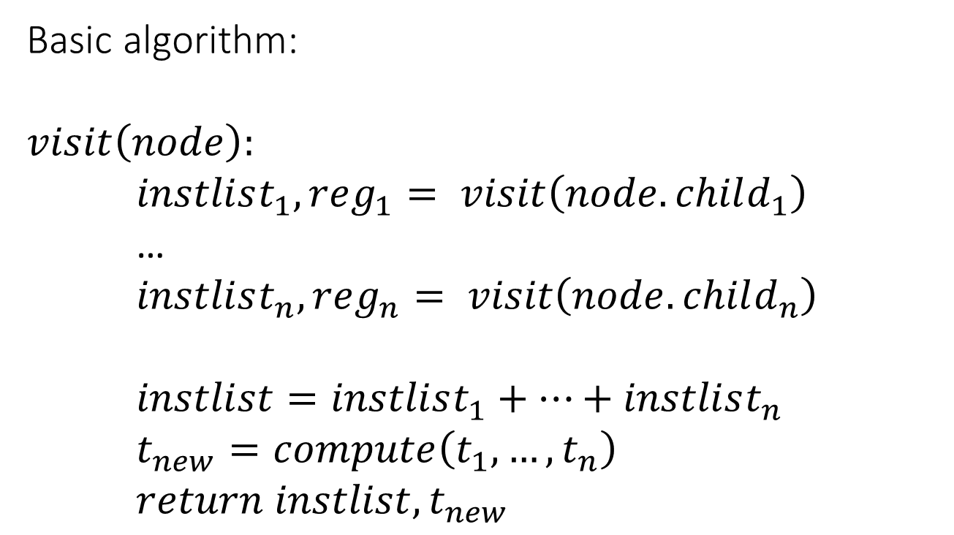
Translating Expressions
Basic algorithm:
$$visit\left(node\right):$$
$instlist_{1}, reg_{1}= visit\left(node.child_{1}\right)$
…
$instlist_{n}, reg_{n}= visit\left(node.child_{n}\right)$
$instlist=instlist_{1}+…+instlist_{n}$
$t_{new}=compute\left(t_{1},…,t_{n}\right)$
$return instlist,t_{new}$

Slide 14
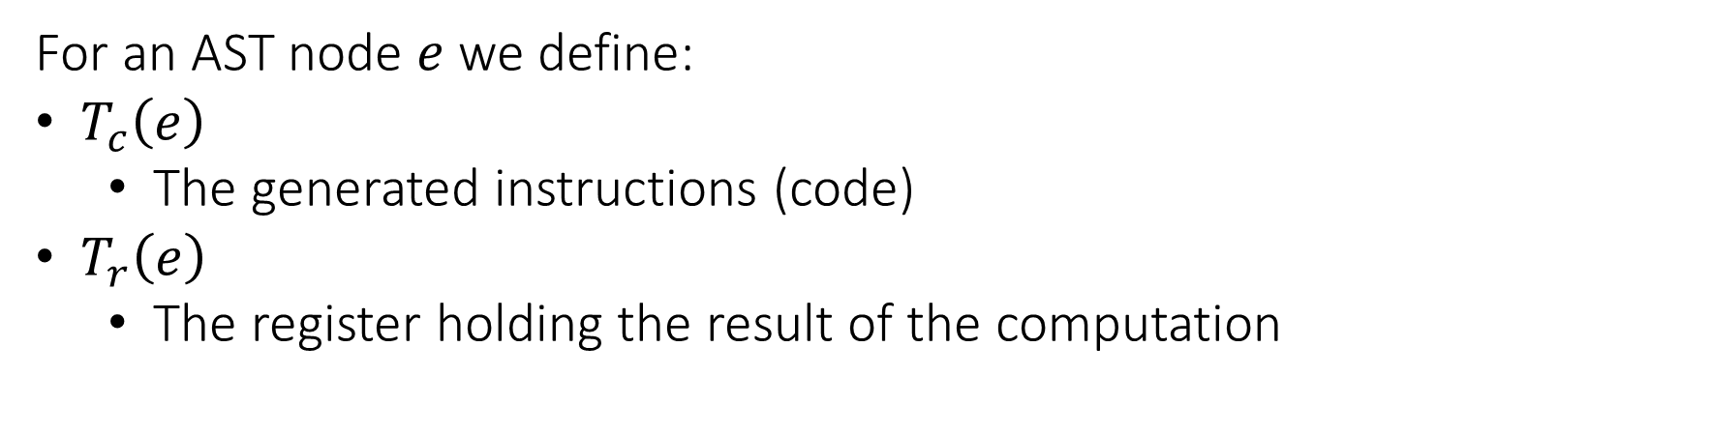
Translating Expressions
For an AST node $e$we define:
$T_{c}\left(e\right)$
The generated instructions (code)
$T_{r}\left(e\right)$
The register holding the result of the computation

Slide 15


Translating Expressions
For x + 42:
Binop
+
t1 = x
Var
x
INT
42
$$T_{c}\left(x\right)$$
t1
$$T_{r}\left(x\right)$$

Slide 16
Translating Expressions
For x + 42:
Binop
+
t1 = x
t2 = 42
Var
x
INT
42
t1
t2

Slide 17
Translating Expressions
For x + 42:
Binop
+
t1 = x
t2 = 42
t3 = add t1, t2
t3
Var
x
INT
42
t1
t2

Slide 18
Translating Expressions
For x + y + z:
Binop
+
t1 = x
Binop
+
Var
z
Var
x
Var
y
t1

Slide 19
Translating Expressions
For x + y + z:
Binop
+
t1 = x
t2 = y
Binop
+
Var
z
Var
x
Var
y
t1
t2

Slide 20
Translating Expressions
For x + y + z:
Binop
+
t1 = x
t2 = y
t3 = add t1, t2
Binop
+
Var
z
t3
Var
x
Var
y
t1
t2

Slide 21
Translating Expressions
For x + y + z:
Binop
+
t1 = x
t2 = y
t3 = add t1, t2
t4 = z
Binop
+
Var
z
t3
t4
Var
x
Var
y
t1
t2

Slide 22
Translating Expressions
For x + y + z:
Binop
+
t1 = x
t2 = y
t3 = add t1, t2
t4 = z
t5 = add t3, t4
t5
Binop
+
Var
z
t3
t4
Var
x
Var
y
t1
t2

Slide 23


Translating Expressions
For $e_{1}== e_{2}$:
...
t1 = ...
...
t2 = ...
t3 = 1
beq t1, t2, end_label
t3 = 0
end_label:
$$T_{c}(e_{1})$$
$$T_{c}(e_{2})$$
unique register
unique label

Slide 24
Translating Expressions
For a == b + 1:
t1 = a
t2 = b
t3 = 1
t4 = add t2, t3
t5 = 1
branch_eq t1, t4, end_label
t5 = 0
end_label:

Slide 25



Translating Expressions
For $e_{1} and e_{2}$:
...
t1 = ...
t3 = 0
beq t1, t3, end_label
...
t2 = ...
t3 = and t1, t2
end_label:
$$T_{c}(e_{1})$$
$$T_{r}(e_{1})$$
$$T_{c}(e_{2})$$
$$T_{r}(e_{2})$$

Slide 26
Translating Expressions
For $e_{1} or e_{2}$:
...
t1 = ...
t3 = 1
beq t1, t3, end_label
...
t2 = ...
t3 = or t1, t2
end_label:
$$T_{c}(e_{1})$$
$$T_{r}(e_{1})$$
$$T_{c}(e_{2})$$
$$T_{r}(e_{2})$$

Slide 27


Translating Expressions
For $new type[e]$:
...
t1 = ...
t2 = new_array t1
$$T_{c}(e)$$
$$T_{r}(e_{1})$$

Slide 28
Translating Expressions
For new int[k+1]:
t1 = k
t2 = 1
t3 = add t1, t2
t4 = new_array t3

Slide 29



Translating Expressions
For $e_{1}[e_{2}]$:
...
t1 = ...
...
t2 = ...
t3 = array_access t1, t2
$$T_{c}(e_{1})$$
$$T_{r}(e_{1})$$
$$T_{c}(e_{2})$$
$$T_{r}(e_{2})$$

Slide 30
Translating Expressions
For x[z+1]:
t1 = x
t2 = z
t3 = 1
t4 = add t2, t3
t5 = array_access t1, t4

Slide 31
Translating Expressions
For $new type$:
t1 = new_class type

Slide 32
Translating Expressions
For new Point:
t1 = new_class Point

Slide 33

Translating Expressions
For $e.f$:
...
t1 = ...
t2 = field_access t1, f
$$T_{c}(e)$$
$$T_{r}(e)$$

Slide 34
Translating Expressions
For x[3].foo:
t1 = x
t2 = 3
t3 = array_access t1, t2
t4 = field_access t3, foo

Slide 35
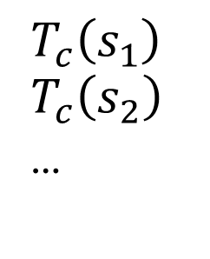
Translating Basic Block
For $s_{1};s_{2};…$:
$$T_{c}\left(s_{1}\right)$$
$$T_{c}\left(s_{2}\right)$$
…

Slide 36



Translating Statements
For $if \left(e\right) \{s\}$:
...
t1 = ...
beq t1, 0, end_label
...
...
end_label:
$$T_{c}(e)$$
$$T_{r}(e)$$
$$T_{c}(s)$$

Slide 37
Translating Statements
For if (x * y) { z = 0; }:
t1 = x
t2 = y
t3 = mul t1, t2
beq t3, 0, end_label
t4 = 0
z = t4
end_label:

Slide 38




Translating Statements
For $if \left(e\right) \left\{s_{1}\right\} else \{s_{2}\}$:
...
t1 = ...
beq t1, 0, false_label
...
...
br end_label
false_label:
...
...
end_label:
$$T_{c}(e)$$
$$T_{r}(e_{1})$$
$$T_{c}(s_{1})$$
$$T_{c}(s_{2})$$

Slide 39
Translating Statements
For if (w) { z = 0; } else { z = 100; }:
t1 = w
beq t1, 0, false_label
t2 = 0
z = t2
br end_label
false_label:
t3 = 100
z = t3
end_label:

Slide 40



Translating Statements
For $while \left(e\right) \left\{s\right\}$:
cond_label:
...
t1 = ...
beq t1, 0, end_label
...
...
br cond_label
end_label:
$$T_{c}(e)$$
$$T_{r}(e)$$
$$T_{c}(s)$$

Slide 41
Translating Statements
For while (z / x) { }:
cond_label:
t1 = z
t2 = x
t3 = div t1, t2
beq t3, 0, end_label
br cond_label
end_label:

Slide 42


Translating Statements
For $f\left(e_{1},e_{2},…\right)$:
...
t1 = ...
...
t2 = ...
...
call f, t1, t2, ...
$$T_{c}(e_{1})$$
$$T_{c}(e_{2})$$

Slide 43
Translating Statements
For func(2, x + 1):
t1 = 2
t2 = x
t3 = 1
t4 = add t2, t3
call func, t1, t4

Slide 44

Translating Statements
For $return e$:
...
t1 = ...
return t1
$$T_{c}(e)$$

Slide 45
Translating Statements
For return w * 3:
t1 = w
t2 = 3
t3 = mul t1, t2
return t3

Slide 46

Translating Statements
For $e_{1}[e_{2}]=e_{3}$:
...
t1
...
t2 = ...
...
t3 = ...
array_set t1, t2, t3
$$T_{c}(e_{1})$$
$$T_{c}(e_{2})$$
$$T_{c}(e_{3})$$

Slide 47
Translating Statements
For arr[0] = x+1:
t1 = arr
t2 = 0
t3 = x
t4 = 1
t5 = add t3, t4
field_set t1, t2, t5

Slide 48


Translating Statements
For $o.f=e$:
...
t1
...
t2 = ...
field_set t1, f, t3
$$T_{c}(o)$$
$$T_{c}(e)$$

Slide 49
Translating Statements
For obj.flag = 7:
t1 = obj
t2 = 7
field_set t1, flag, t2

Slide 50


Translating Statements
For $o.f\left(e_{1},e_{2},…\right)$:
...
t1
...
t2 = ...
...
t3 = ...
...
virtual_call t1 f t2, t3, ...
$$T_{c}(o)$$
$$T_{c}(e_{1})$$
$$T_{c}(e_{2})$$

Slide 51
Translating Statements
For obj.bar(2, x + 1):
t1 = obj
t2 = 2
t3 = x
t4 = 1
t5 = add t3, t4
virtual_call t1, func, t2, t5

Slide 52

Example
x = 42;
while (x > 0) {
x = x - 1;
}
$$T_{c}($$
x = 42;
while (x > 0) {
x = x – 1;
}
$$)$$

Slide 53
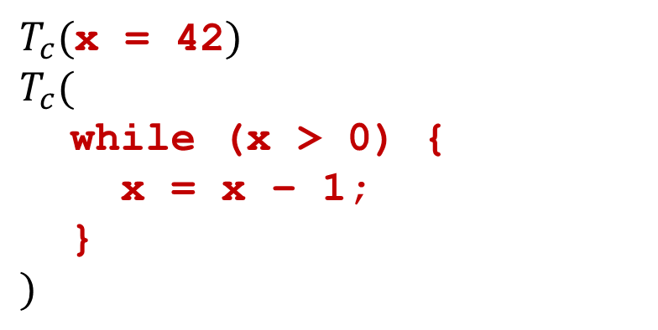
Example
x = 42;
while (x > 0) {
x = x - 1;
}
$T_{c}($x = 42$)$
$$T_{c}($$
while (x > 0) {
x = x – 1;
}
$$)$$

Slide 54

Example
x = 42;
while (x > 0) {
x = x - 1;
}
t1 = 42
x = t1
$$T_{c}($$
while (x > 0) {
x = x – 1;
}
$$)$$

Slide 55
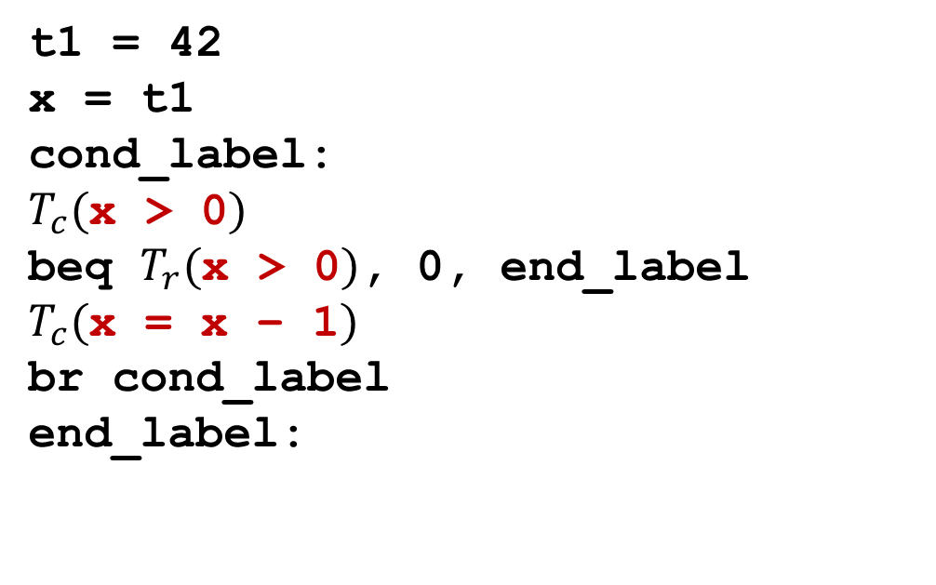
Example
x = 42;
while (x > 0) {
x = x - 1;
}
t1 = 42
x = t1
cond_label:
$T_{c}($x > 0$)$
beq $T_{r}($x > 0$)$, 0, end_label
$T_{c}($x = x – 1$)$
br cond_label
end_label:

Slide 56
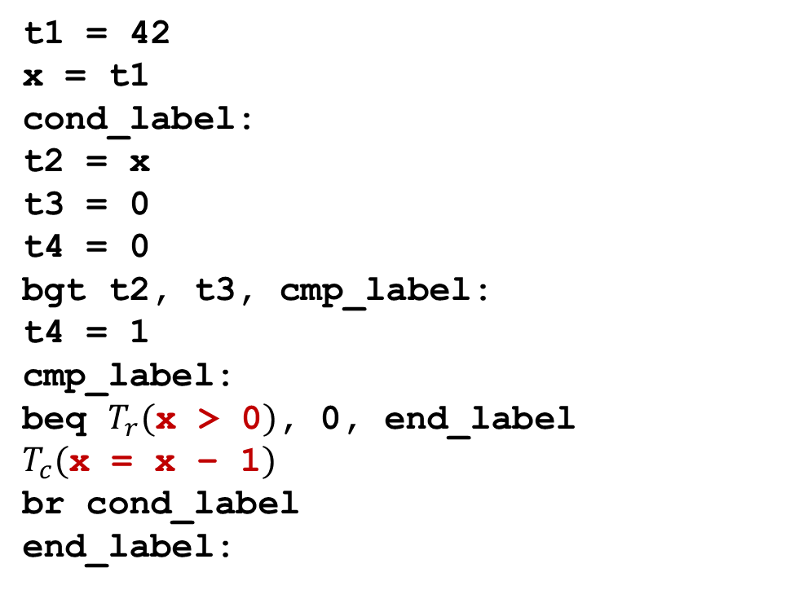
Example
t1 = 42
x = t1
cond_label:
t2 = x
t3 = 0
t4 = 0
bgt t2, t3, cmp_label:
t4 = 1
cmp_label:
beq $T_{r}($x > 0$)$, 0, end_label
$T_{c}($x = x – 1$)$
br cond_label
end_label:
x = 42;
while (x > 0) {
x = x - 1;
}

Slide 57
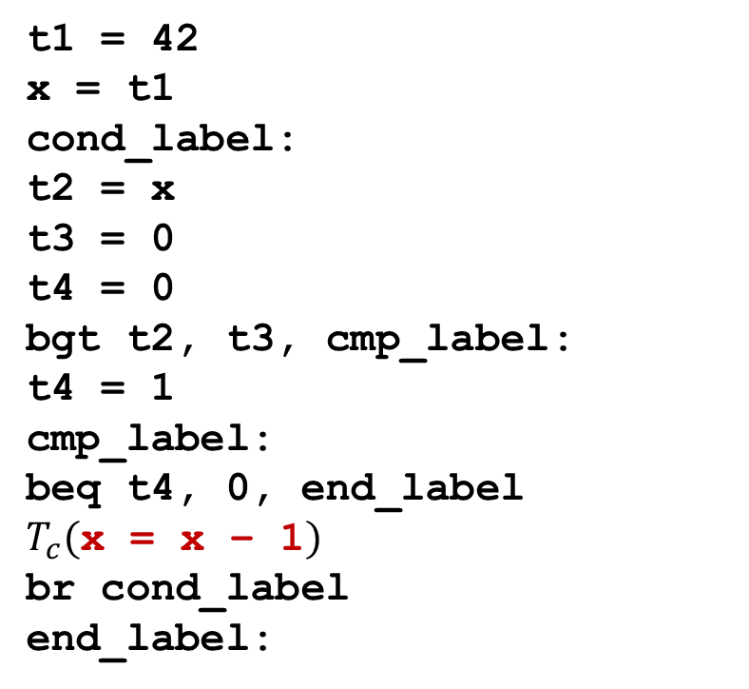
Example
t1 = 42
x = t1
cond_label:
t2 = x
t3 = 0
t4 = 0
bgt t2, t3, cmp_label:
t4 = 1
cmp_label:
beq t4, 0, end_label
$T_{c}($x = x – 1$)$
br cond_label
end_label:
x = 42;
while (x > 0) {
x = x - 1;
}

Slide 58
t1 = 42
x = t1
cond_label:
t2 = x
t3 = 0
t4 = 0
bgt t2, t3, cmp_label:
t4 = 1
cmp_label:
beq t4, 0, end_label
t5 = x
t6 = 1
t7 = sub t5, t6
x = t7
br cond_label
end_label:
Example
x = 42;
while (x > 0) {
x = x - 1;
}

Slide 59
Implementation
Classes for IR Instructions
AST Visitor
Define visitor for each node type
Returns
List of generated instructions
Result register (for expression nodes)

