Slide 1
Exam Questions
TeachING Assistant: David Trabish

Slide 2
Question
The program contains a string constant.
compiler construction
compiling
linking
runtime

Slide 3
Question
The program contains a string constant.
compiler construction
compiling
linking
runtime

Slide 4
Question
The function printf from the standard library is not found.
compiler construction
compiling
linking
runtime

Slide 5
Question
The function printf from the standard library is not found.
compiler construction
compiling
linking
runtime

Slide 6
Question
Every time the command x = y + 42 is executed,
the value of y is 0.
compiler construction
compiling
linking
runtime

Slide 7
Question
Every time the command x = y + 42 is executed,
the value of y is 0.
compiler construction
compiling
linking
runtime

Slide 8
Question
All the variable names start with x.
compiler construction
compiling
linking
runtime

Slide 9
Question
All the variable names start with x.
compiler construction
compiling
linking
runtime

Slide 10
Question
The program contains a nested loop.
compiler construction
compiling
linking
runtime

Slide 11
Question
The program contains a nested loop.
compiler construction
compiling
linking
runtime

Slide 12
Question
The program contains a string constant with at least 200 characters.
compiler construction
compiling
linking
runtime

Slide 13
Question
The program contains a string constant with at least 200 characters.
compiler construction
compiling
linking
runtime

Slide 14
Question
The size of the stack exceeds 400 bytes.
compiler construction
compiling
linking
runtime

Slide 15
Question
The size of the stack exceeds 400 bytes.
compiler construction
compiling
linking
runtime

Slide 16
Question
The code contains only invocations of methods which located at offset 4 in the virtual table.
compiler construction
compiling
linking
runtime

Slide 17
Question
The code contains only invocations of methods which located at offset 4 in the virtual table.
compiler construction
compiling
linking
runtime

Slide 18
Question
There is an addition operation which is never executed in any run.
compiler construction
compiling
linking
runtime

Slide 19
Question
There is an addition operation which is never executed in any run.
compiler construction
compiling
linking
runtime

Slide 20
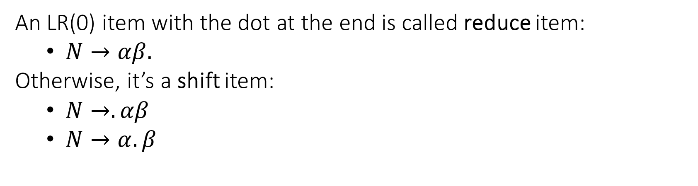
LR(0) Item
An LR(0) item with the dot at the end is called reduce item:
$N→αβ.$
Otherwise, it’s a shift item:
$N→.αβ$
$N→α.β$

Slide 21
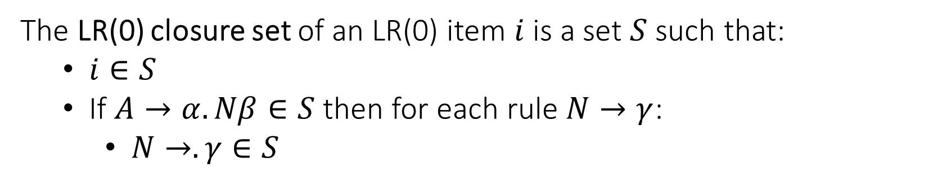
LR(0) Item Closure Set
The LR(0) closure set of an LR(0) item $i$ is a set $S$ such that:
$i∈S$
If $A→α.Nβ∈S$ then for each rule $N→γ$:
$N→.γ∈S$

Slide 22
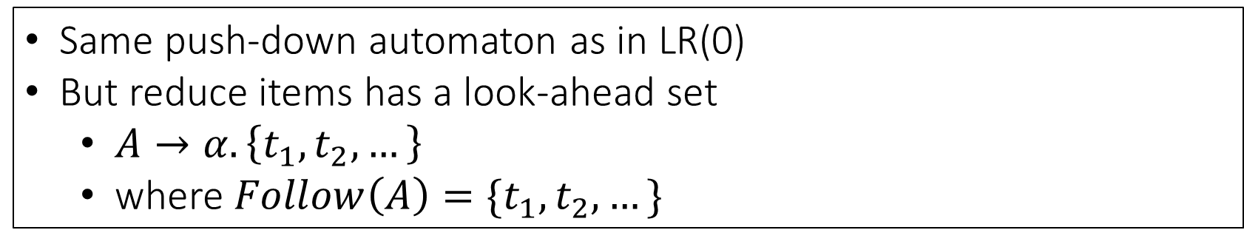
SLR(1)
Same push-down automaton as in LR(0)
But reduce items has a look-ahead set
$A→α. \left\{t_{1},t_{2},…\right\}$
where $Follow\left(A\right)=\{t_{1},t_{2},…\}$

Slide 23
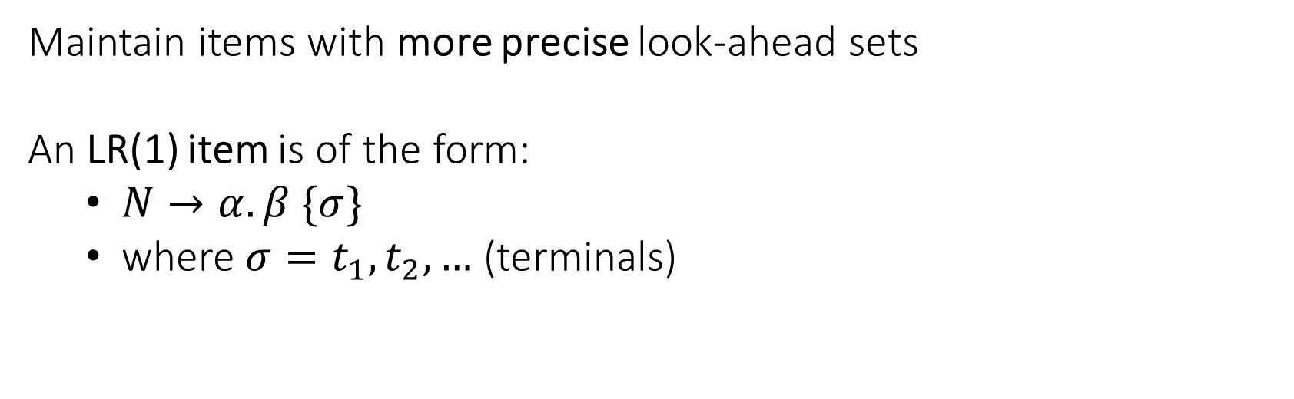
LR(1)
Maintain items with more precise look-ahead sets
An LR(1) item is of the form:
$N→α. β \{σ\}$
where ${σ=t}_{1},t_{2},…$ (terminals)

Slide 24
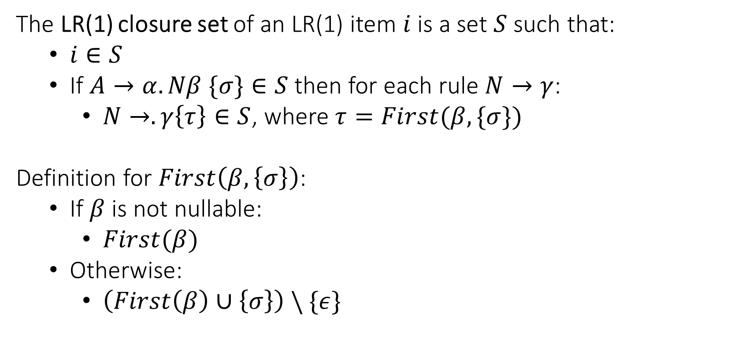
LR(1) Item Closure Set
The LR(1) closure set of an LR(1) item $i$ is a set $S$ such that:
$i∈S$
If $A→α.Nβ \{σ\}∈S$ then for each rule $N→γ$:
$N→.γ\left\{τ\right\}∈S$, where $τ=First(β, \{σ\})$
Definition for $First\left(β, \left\{σ\right\}\right)$:
If $β$ is not nullable:
$First(β)$
Otherwise:
$\left(First\left(β\right)∪\left\{σ\right\}\right) \backslash \{ε\}$

Slide 25
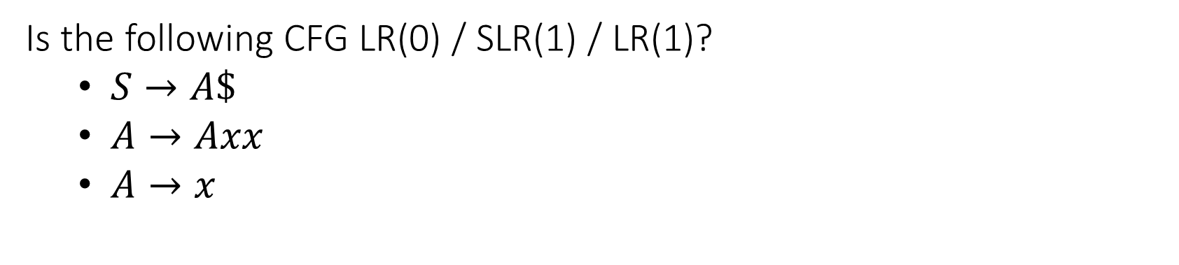
Question
Is the following CFG LR(0) / SLR(1) / LR(1)?
$S→A\$$
$A→Axx$
$A→x$

Slide 26
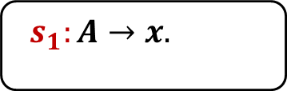
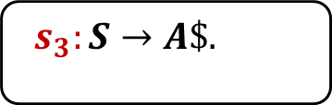
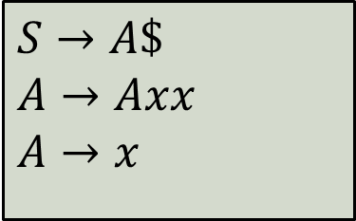
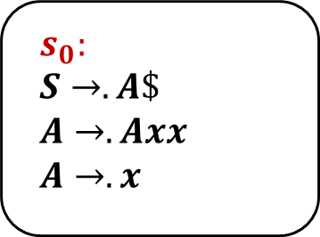
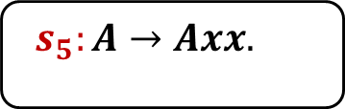
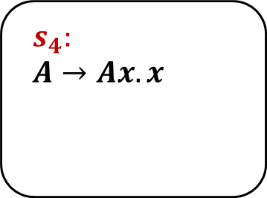
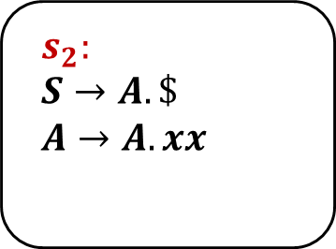
$$s_{0}:$$
$$S→.A\$$$
$$A→.Axx$$
$$A→.x$$
$$s_{2}:$$
$$S→A.\$$$
$$A→A.xx$$
$$s_{4}:$$
$$A→Ax.x$$
A
x
x
$
x
$$s_{1}:A→x.$$
$$s_{3}:S→A\$.$$
$$s_{5}:A→Axx.$$
$$S→A\$$$
$$A→Axx$$
$$A→x$$

Slide 27
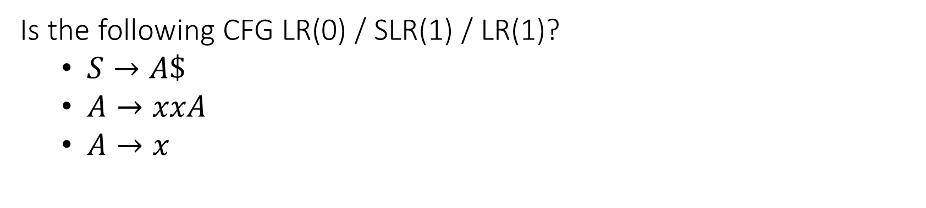
Question
Is the following CFG LR(0) / SLR(1) / LR(1)?
$S→A\$$
$A→xxA$
$A→x$

Slide 28
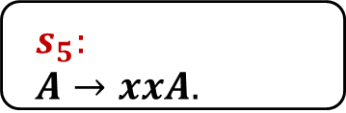
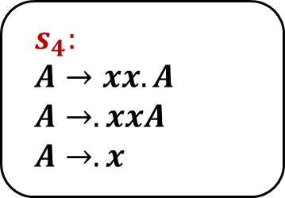
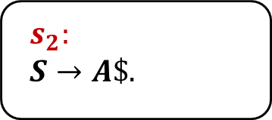
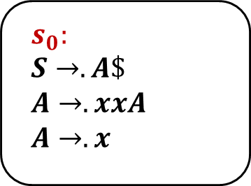
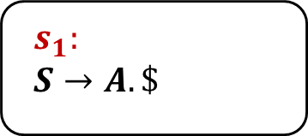
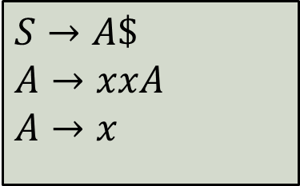
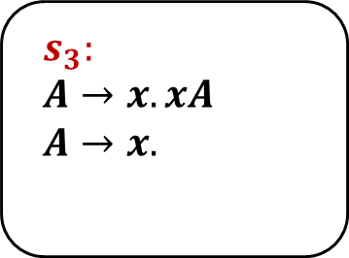
$$s_{0}:$$
$$S→.A\$$$
$$A→.xxA$$
$$A→.x$$
$$s_{3}:$$
$$A→x.xA$$
$$A→x.$$
x
A
x
$$s_{1}:$$
$$S→A.\$$$
$$s_{4}:$$
$$A→xx.A$$
$$A→.xxA$$
$$A→.x$$
$
$$s_{2}:$$
$$S→A\$.$$
A
$$s_{5}:$$
$$A→xxA.$$
$$S→A\$$$
$$A→xxA$$
$$A→x$$

Slide 29
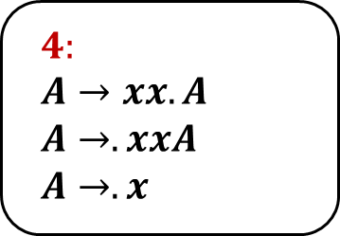
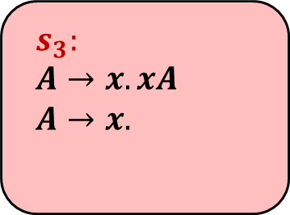
$$s_{0}:$$
$$S→.A\$$$
$$A→.xxA$$
$$A→.x$$
$$s_{3}:$$
$$A→x.xA$$
$$A→x.$$
x
A
x
x
$$s_{1}:$$
$$S→A.\$$$
$$4:$$
$$A→xx.A$$
$$A→.xxA$$
$$A→.x$$
$
$$s_{2}:$$
$$S→A\$.$$
A
$$s_{5}:$$
$$A→xxA.$$
$$S→A\$$$
$$A→xxA$$
$$A→x$$

Slide 30
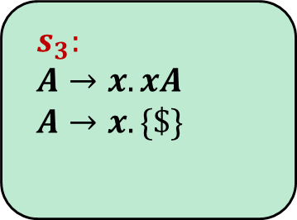

$$s_{0}:$$
$$S→.A\$$$
$$A→.xxA$$
$$A→.x$$
$$s_{3}:$$
$$A→x.xA$$
$$A→x. \{\$\}$$
x
A
x
$$Follow\left(A\right)=\{\$\}$$
$$s_{1}:$$
$$S→A.\$$$
$$4:$$
$$A→xx.A$$
$$A→.xxA$$
$$A→.x$$
$
$$s_{2}:$$
$$S→A\$.$$
A
$$s_{5}:$$
$$A→xxA.$$
$$S→A\$$$
$$A→xxA$$
$$A→x$$

Slide 31
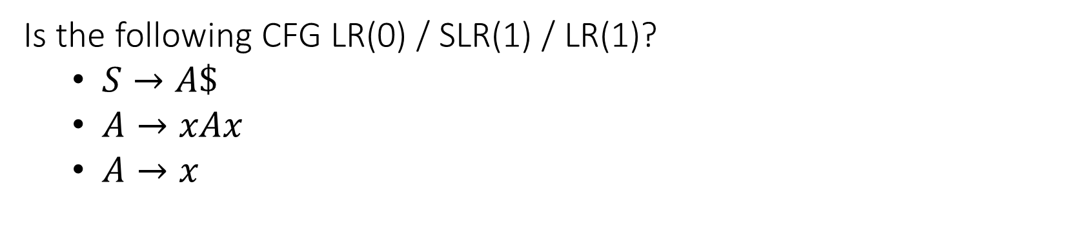
Question
Is the following CFG LR(0) / SLR(1) / LR(1)?
$S→A\$$
$A→xAx$
$A→x$

Slide 32
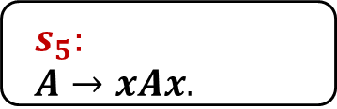
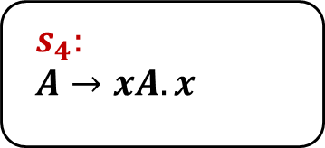

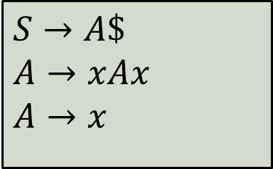
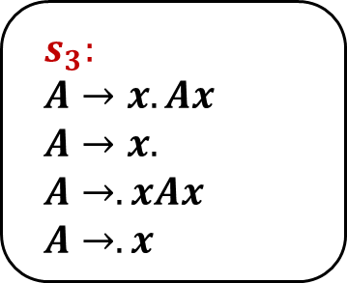
x
$$s_{0}:$$
$$S→.A\$$$
$$A→.xAx$$
$$A→.x$$
$$s_{3}:$$
$$A→x.Ax$$
$$A→x.$$
$$A→.xAx$$
$$A→.x$$
x
A
A
$$s_{1}:$$
$$S→A.\$$$
$$s_{4}:$$
$$A→xA.x$$
$
x
$$s_{2}:$$
$$S→A\$.$$
$$s_{5}:$$
$$A→xAx.$$
$$S→A\$$$
$$A→xAx$$
$$A→x$$

Slide 33
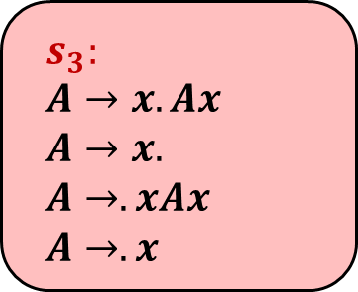
x
$$s_{0}:$$
$$S→.A\$$$
$$A→.xAx$$
$$A→.x$$
$$s_{3}:$$
$$A→x.Ax$$
$$A→x.$$
$$A→.xAx$$
$$A→.x$$
x
A
A
$$s_{1}:$$
$$S→A.\$$$
$$s_{4}:$$
$$A→xA.x$$
$
x
$$s_{2}:$$
$$S→A\$.$$
$$s_{5}:$$
$$A→xAx.$$
$$S→A\$$$
$$A→xAx$$
$$A→x$$

Slide 34

x
$$s_{0}:$$
$$S→.A\$$$
$$A→.xAx$$
$$A→.x$$
$$s_{3}:$$
$$A→x.Ax$$
$$A→x.$$
$$A→.xAx$$
$$A→.x$$
x
A
A
$$Follow\left(A\right)=\{\$,x\}$$
$$s_{1}:$$
$$S→A.\$$$
$$s_{4}:$$
$$A→xA.x$$
$
x
$$s_{2}:$$
$$S→A\$.$$
$$s_{5}:$$
$$A→xAx.$$
$$S→A\$$$
$$A→xAx$$
$$A→x$$

Slide 35
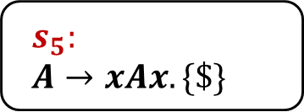
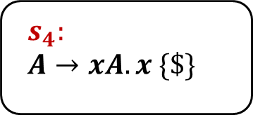
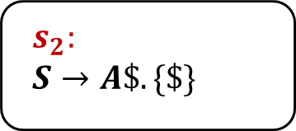
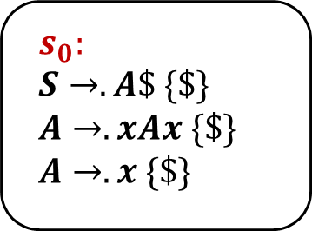
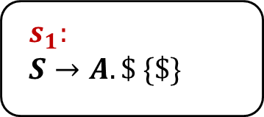
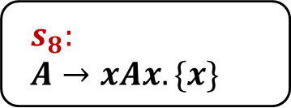
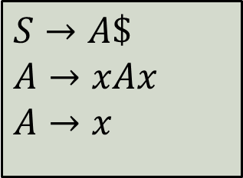
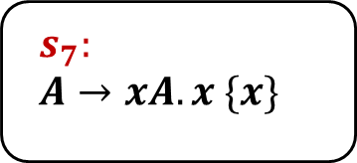
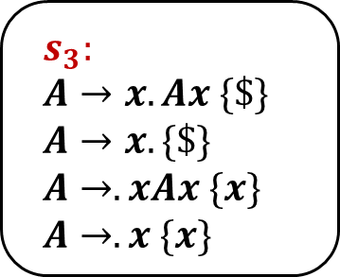
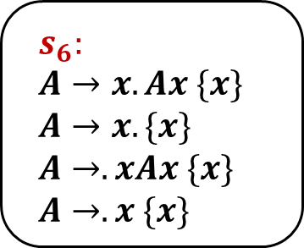
x
$$s_{0}:$$
$$S→.A\$ \{\$\}$$
$$A→.xAx \{\$\}$$
$$A→.x \{\$\}$$
$$s_{3}:$$
$$A→x.Ax \{\$\}$$
$$A→x. \{\$\}$$
$$A→.xAx \{x\}$$
$$A→.x \{x\}$$
$$s_{6}:$$
$$A→x.Ax \{x\}$$
$$A→x. \{x\}$$
$$A→.xAx \{x\}$$
$$A→.x \{x\}$$
x
x
A
A
A
$$s_{1}:$$
$S→A.\$ \{\$\}$
$$s_{4}:$$
$$A→xA.x \{\$\}$$
$$s_{7}:$$
$$A→xA.x \{x\}$$
$
x
x
$$s_{2}:$$
$$S→A\$. \{\$\}$$
$$s_{5}:$$
$$A→xAx. \{\$\}$$
$$s_{8}:$$
$$A→xAx. \{x\}$$
$$S→A\$$$
$$A→xAx$$
$$A→x$$

Slide 36
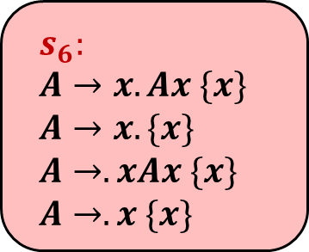
x
$$s_{0}:$$
$$S→.A\$ \{\$\}$$
$$A→.xAx \{\$\}$$
$$A→.x \{\$\}$$
$$s_{3}:$$
$$A→x.Ax \{\$\}$$
$$A→x. \{\$\}$$
$$A→.xAx \{x\}$$
$$A→.x \{x\}$$
$$s_{6}:$$
$$A→x.Ax \{x\}$$
$$A→x. \{x\}$$
$$A→.xAx \{x\}$$
$$A→.x \{x\}$$
x
x
A
A
A
$$s_{1}:$$
$S→A.\$ \{\$\}$
$$s_{4}:$$
$$A→xA.x \{\$\}$$
$$s_{7}:$$
$$A→xA.x \{x\}$$
$
x
x
$$s_{2}:$$
$$S→A\$. \{\$\}$$
$$s_{5}:$$
$$A→xAx. \{\$\}$$
$$s_{8}:$$
$$A→xAx. \{x\}$$
$$S→A\$$$
$$A→xAx$$
$$A→x$$

Slide 37
Question
We extend the language with automatic type inference:
Can use auto when the declaration has an initial value
Describe the changes required in:
Lexical analysis
Syntactic analysis
Semantic analysis
auto i := 8 + 100;
auto s := “1234”;
class A {}
A a := new A;
auto b := a;

Slide 38
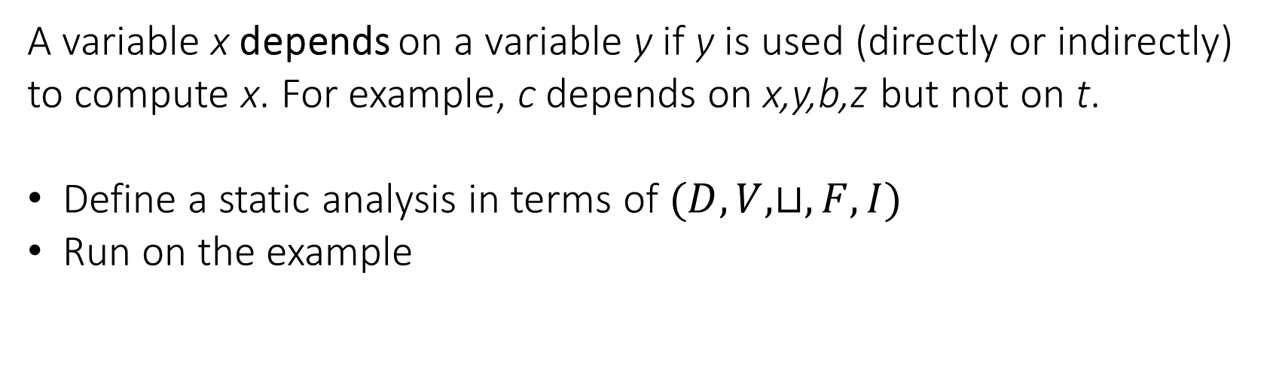
Question
A variable x depends on a variable y if y is used (directly or indirectly) to compute x. For example, c depends on x,y,b,z but not on t.
Define a static analysis in terms of $(D,V,⊔,F,I)$
Run on the example
y := t;
y := z + 5;
if (x > 0) {
x := y * 2;
} else {
x := y + b;
}
c := x;

Slide 39
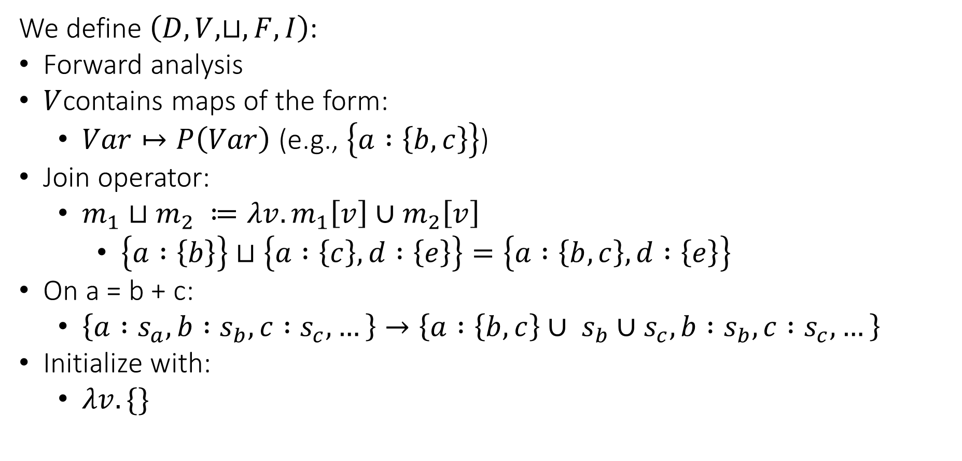
Abstract Domain
We define $\left(D,V,⊔,F,I\right)$:
Forward analysis
$V$contains maps of the form:
$Var↦P\left(Var\right)$ (e.g., $\left\{a :\left\{b,c\right\}\right\}$)
Join operator:
$m_{1}⊔m_{2} ≔λv.m_{1}\left[v\right]∪m_{2}\left[v\right]$
$\left\{a :\left\{b\right\}\right\}⊔\left\{a :\left\{c\right\}, d :\left\{e\right\}\right\}=\left\{a :\left\{b,c\right\}, d :\left\{e\right\}\right\}$
On a = b + c:
$\left\{a :s_{a}, b :s_{b}, c :s_{c},…\right\}→\left\{a :\left\{b,c\right\}∪ s_{b}∪s_{c}, b :s_{b}, c :s_{c},…\right\}$
Initialize with:
$λv. \{\}$

Slide 40
y = t
y = z + 5
x > 0
x = y + b
x = y * 2
c = x

Slide 41
y = t
{ x:{}, y:{}, z:{}, b:{}, c:{}, t:{} }
y = z + 5
{ x:{}, y:{}, z:{}, b:{}, c:{}, t:{} }
x > 0
{ x:{}, y:{}, z:{}, b:{}, c:{}, t:{} }
x = y + b
x = y * 2
{ x:{}, y:{}, z:{}, b:{}, c:{}, t:{} }
{ x:{}, y:{}, z:{}, b:{}, c:{}, t:{} }
c = x
{ x:{}, y:{}, z:{}, b:{}, c:{}, t:{} }

Slide 42
y = t
{ x:{}, y:{t}, z:{}, b:{}, c:{}, t:{} }
y = z + 5
{ x:{}, y:{}, z:{}, b:{}, c:{}, t:{} }
x > 0
{ x:{}, y:{}, z:{}, b:{}, c:{}, t:{} }
x = y + b
x = y * 2
{ x:{}, y:{}, z:{}, b:{}, c:{}, t:{} }
{ x:{}, y:{}, z:{}, b:{}, c:{}, t:{} }
c = x
{ x:{}, y:{}, z:{}, b:{}, c:{}, t:{} }

Slide 43
y = t
{ x:{}, y:{t}, z:{}, b:{}, c:{}, t:{} }
y = z + 5
{ x:{}, y:{z}, z:{}, b:{}, c:{}, t:{} }
x > 0
{ x:{}, y:{}, z:{}, b:{}, c:{}, t:{} }
x = y + b
x = y * 2
{ x:{}, y:{}, z:{}, b:{}, c:{}, t:{} }
{ x:{}, y:{}, z:{}, b:{}, c:{}, t:{} }
c = x
{ x:{}, y:{}, z:{}, b:{}, c:{}, t:{} }

Slide 44
y = t
{ x:{}, y:{t}, z:{}, b:{}, c:{}, t:{} }
y = z + 5
{ x:{}, y:{z}, z:{}, b:{}, c:{}, t:{} }
x > 0
{ x:{}, y:{z}, z:{}, b:{}, c:{}, t:{} }
x = y + b
x = y * 2
{ x:{}, y:{}, z:{}, b:{}, c:{}, t:{} }
{ x:{}, y:{}, z:{}, b:{}, c:{}, t:{} }
c = x
{ x:{}, y:{}, z:{}, b:{}, c:{}, t:{} }

Slide 45
y = t
{ x:{}, y:{t}, z:{}, b:{}, c:{}, t:{} }
y = z + 5
{ x:{}, y:{z}, z:{}, b:{}, c:{}, t:{} }
x > 0
{ x:{}, y:{z}, z:{}, b:{}, c:{}, t:{} }
x = y + b
x = y * 2
{ x:{}, y:{}, z:{}, b:{}, c:{}, t:{} }
{ x:{y,z}, y:{z}, z:{}, b:{}, c:{}, t:{} }
c = x
{ x:{}, y:{}, z:{}, b:{}, c:{}, t:{} }

Slide 46
y = t
{ x:{}, y:{t}, z:{}, b:{}, c:{}, t:{} }
y = z + 5
{ x:{}, y:{z}, z:{}, b:{}, c:{}, t:{} }
x > 0
{ x:{}, y:{z}, z:{}, b:{}, c:{}, t:{} }
x = y + b
x = y * 2
{ x:{y,b,z}, y:{z}, z:{}, b:{}, c:{}, t:{} }
{ x:{y,z}, y:{z}, z:{}, b:{}, c:{}, t:{} }
c = x
{ x:{}, y:{}, z:{}, b:{}, c:{}, t:{} }

Slide 47
y = t
{ x:{}, y:{t}, z:{}, b:{}, c:{}, t:{} }
y = z + 5
{ x:{}, y:{z}, z:{}, b:{}, c:{}, t:{} }
x > 0
{ x:{}, y:{z}, z:{}, b:{}, c:{}, t:{} }
x = y + b
x = y * 2
{ x:{y,b,z}, y:{z}, z:{}, b:{}, c:{}, t:{} }
{ x:{y,z}, y:{z}, z:{}, b:{}, c:{}, t:{} }
c = x
{ x:{y,b,z}, y:{z}, z:{}, b:{}, c:{x,y,b,z}, t:{} }

Slide 48
Question
Add support for detecting accesses to uninitialized local variables.
Describe the required changes in the code generation step.
For example:
void f() {
int x;
int y := 7;
if (y > 10) {
x := 100;
}
int z := x + 1;
}

Slide 49
Solution
High level idea:
arguments
var 1
return address
flag 1
previous fp
var 2
register backup
flag 2
local vars
…

Slide 50
Solution
Initialize each variable flag to zero on function entry
When writing to a local variable, set its flag to 1
When reading a local variable, check if its flag is 1
var 1
flag 1
var 2
flag 2
…

Slide 51
Solution
Initialize each variable flag to zero on function entry
When writing to a local variable, set its flag to 1
When reading a local variable, check if its flag is 1
prologue:
...
li $s0, 0
sw $s0, local_1_flag_offset($fp)
li $s0, 0
sw $s0, local_2_flag_offset($fp)
...
var 1
flag 1
var 2
flag 2
…

Slide 52
Solution
Initialize each variable flag to zero on function entry
When writing to a local variable, set its flag to 1
When reading a local variable, check if its flag is 1
x = t0
var 1
flag 1
var 2
sw $t0, x_offset($fp)
li $s0, 1
sw $s0, x_flag_offset($fp)
flag 2
…

Slide 53
Solution
Initialize each variable flag to zero on function entry
When writing to a local variable, set its flag to 1
When reading a local variable, check if its flag is 1
t0 = x
var 1
flag 1
var 2
lw $s0, x_flag_offset($fp)
beq $s0, 0, abort
lw $t0, x_offset($fp)
flag 2
…

Slide 54
Question
Apply the register allocation algorithm with 3 registers (R1,R2,R3)
R1 can’t hold a result of a multiplication operation.
t0 = 0
t1 = 1
t2 = 2
t3 = t2 * t1
t2 = t3
t1 = t1 + t0

Slide 55
t0 = 0
t1 = 1
t2 = 2
t3 = mul t2, t1
t2 = t3
t1 = add t1, t0

Slide 56
IN
OUT
{ }
t0 = 0
{ }
{ }
t1 = 1
{ }
{ }
t2 = 2
{ }
{ }
t3 = mul t2, t1
{ }
{ }
t2 = t3
{ }
{ }
t1 = add t1, t0
{ }
initialization

Slide 57
IN
OUT
{ }
t0 = 0
{ }
{ }
t1 = 1
{ }
{ }
t2 = 2
{ }
{ }
t3 = mul t2, t1
{ }
{ }
t2 = t3
{ }
{ t0, t1 }
t1 = add t1, t0
{ }
first iteration

Slide 58
IN
OUT
{ }
t0 = 0
{ }
{ }
t1 = 1
{ }
{ }
t2 = 2
{ }
{ }
t3 = mul t2, t1
{ }
{ t0, t1, t3 }
t2 = t3
{ t0, t1 }
{ t0, t1 }
t1 = add t1, t0
{ }
first iteration

Slide 59
IN
OUT
{ }
t0 = 0
{ }
{ }
t1 = 1
{ }
{ }
t2 = 2
{ }
{ t2, t1, t0 }
t3 = mul t2, t1
{ t0, t1, t3 }
{ t0, t1, t3 }
t2 = t3
{ t0, t1 }
{ t0, t1 }
t1 = add t1, t0
{ }
first iteration

Slide 60
IN
OUT
{ }
t0 = 0
{ }
{ }
t1 = 1
{ }
{ t1, t0 }
t2 = 2
{ t2, t1, t0 }
{ t2, t1, t0 }
t3 = mul t2, t1
{ t0, t1, t3 }
{ t0, t1, t3 }
t2 = t3
{ t0, t1 }
{ t0, t1 }
t1 = add t1, t0
{ }
first iteration

Slide 61
IN
OUT
{ }
t0 = 0
{ }
{ t0 }
t1 = 1
{ t1, t0 }
{ t1, t0 }
t2 = 2
{ t2, t1, t0 }
{ t2, t1, t0 }
t3 = mul t2, t1
{ t0, t1, t3 }
{ t0, t1, t3 }
t2 = t3
{ t0, t1 }
{ t0, t1 }
t1 = add t1, t0
{ }
first iteration

Slide 62
IN
OUT
{ }
t0 = 0
{ t0 }
{ t0 }
t1 = 1
{ t1, t0 }
{ t1, t0 }
t2 = 2
{ t2, t1, t0 }
{ t2, t1, t0 }
t3 = mul t2, t1
{ t0, t1, t3 }
{ t0, t1, t3 }
t2 = t3
{ t0, t1 }
{ t0, t1 }
t1 = add t1, t0
{ }
first iteration

Slide 63
IN
OUT
{ }
t0 = 0
{ t0 }
{ t0 }
t1 = 1
{ t1, t0 }
{ t1, t0 }
t2 = 2
{ t2, t1, t0 }
{ t2, t1, t0 }
t3 = mul t2, t1
{ t0, t1, t3 }
{ t0, t1, t3 }
t2 = t3
{ t0, t1 }
{ t0, t1 }
t1 = add t1, t0
{ }
second iteration…

Slide 64
Interference Graph
{ t0 }
{ t0, t1 }
t0
t1
{ t0, t2, t1 }
{ t0, t3 }
t2
t3
R1
R2
R3

Slide 65
Interference Graph
{ t0 }
{ t0, t1 }
t0
t1
{ t0, t2, t1 }
{ t0, t3 }
t2
t3
R1
R2
R3

Slide 66
Interference Graph
{ t0 }
{ t0, t1 }
t0
t1
{ t0, t2, t1 }
{ t0, t3 }
t0 = 0
t1 = 1
t2 = 2
t3 = t2 * t1
t2 = t3
t1 = t1 + t0
t2
t3
R1
R2
R3

Slide 67
Interference Graph
{ t0 }
{ t0, t1 }
t0
t1
{ t0, t2, t1 }
{ t0, t3 }
t0 = 0
t1 = 1
t2 = 2
t3 = t2 * t1
t2 = t3
t1 = t1 + t0
t2
t3
R1
R2
R3

Slide 68
Graph Coloring
t0
t1
t2
t3
R1
R2
R3

Slide 69
Graph Coloring
t0
t1
t2
t3
t3
R1
R2
R3

Slide 70
Graph Coloring
t0
t1
t2
t3
t0
t3
R1
R2
R3

Slide 71
Graph Coloring
t0
t1
t2
t3
t1
t0
t3
R1
R2
R3

Slide 72
Graph Coloring
t0
t1
t2
t3
t2
t1
t0
t3
R1
R2
R3

Slide 73
Graph Coloring
t0
t1
t2
t3
t1
t0
t3
R1
R2
R3

Slide 74
Graph Coloring
t0
t1
t2
t3
t1
t0
t3
R1
R2
R3

Slide 75
Graph Coloring
t0
t1
t2
t3
t0
t3
R1
R2
R3

Slide 76
Graph Coloring
t0
t1
t2
t3
t0
t3
R1
R2
R3

Slide 77
Graph Coloring
t0
t1
t2
t3
t3
R1
R2
R3

Slide 78
Graph Coloring
t0
t1
t2
t3
t3
R1
R2
R3

Slide 79
Graph Coloring
t0
t1
t2
t3
t3
R1
R2
R3

Slide 80
Graph Coloring
t0
t1
t2
t3
t3
R1
R2
R3

