Slide 1
Local, Real-Time Toric Decoder
Daniel Sun & Yaodong Li
Khemani Group, Geballe Laboratory for Advanced Materials, Stanford University

Slide 2
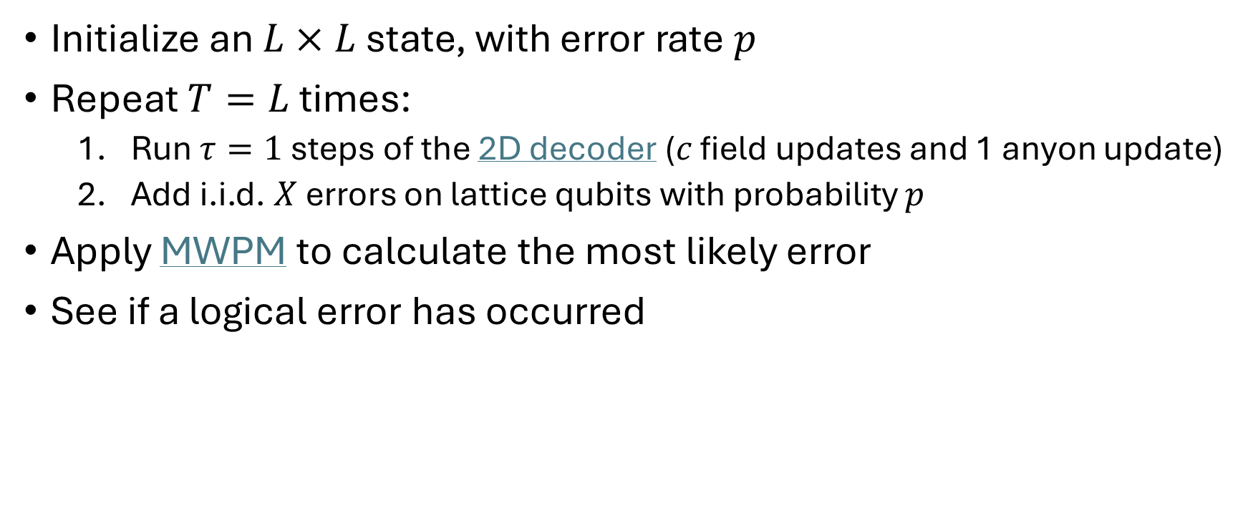
Algorithm
Initialize an $L×L$ state, with error rate $p$
Repeat $T=L$ times:
Run $τ=1$ steps of the 2D decoder ($c$ field updates and 1 anyon update)
Add i.i.d. $X$ errors on lattice qubits with probability $p$
Apply MWPM to calculate the most likely error
See if a logical error has occurred

Slide 3

Run 1 – no intermediate errors
$L∈\{20,40,60,80,100\}$
$c∈\{2,4,8,16,32\}$
$T=L$
$p_{\text{initial}}=0.05$
$p_{\text{intermediate}}=0$
$η=0.1$
10000 shots
1 hour, 4 CPUs / task

Slide 4
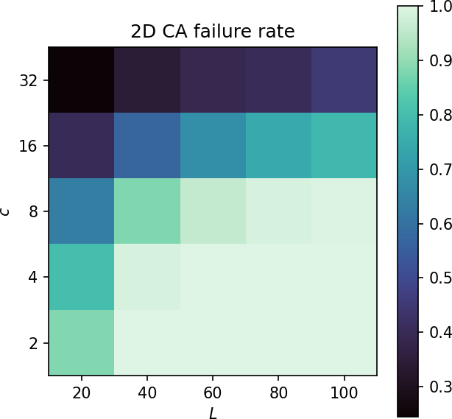
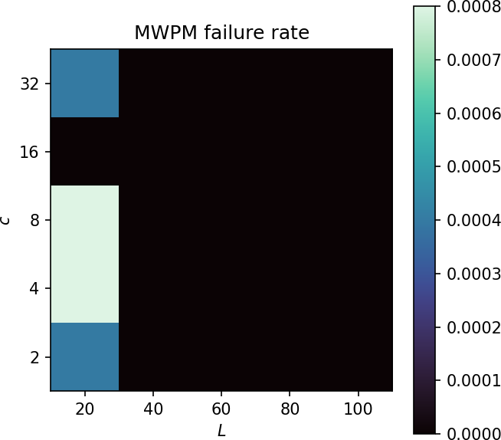
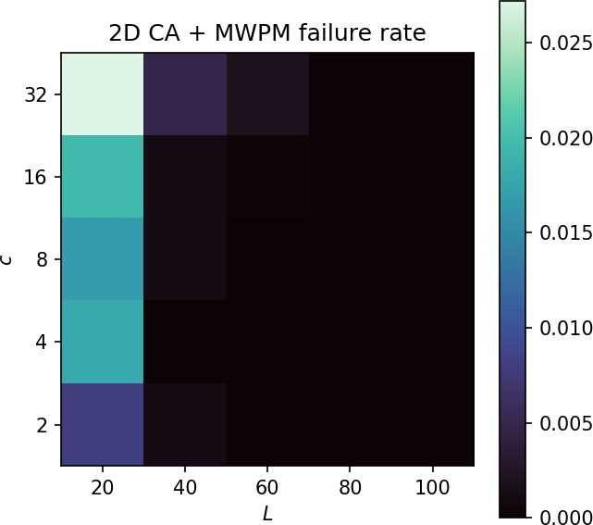
Run 1

Slide 5

Run 2 – intermediate errors
$L∈\{20,40,60,…,200\}$
$c∈\{2,4,8,…,64\}$
$T=L$
$p=0.05$
$η=0.1$
10000 shots
4 hours, 8 CPUs / task

Slide 6
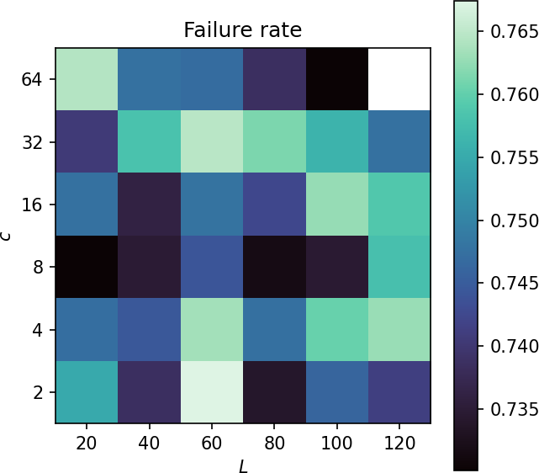
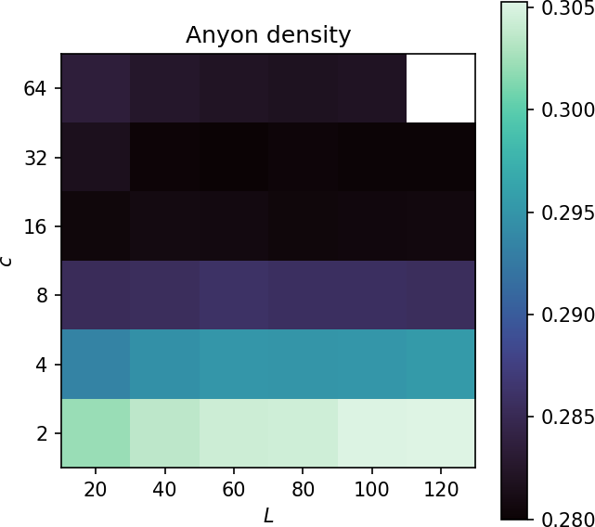
Run 2

Slide 7
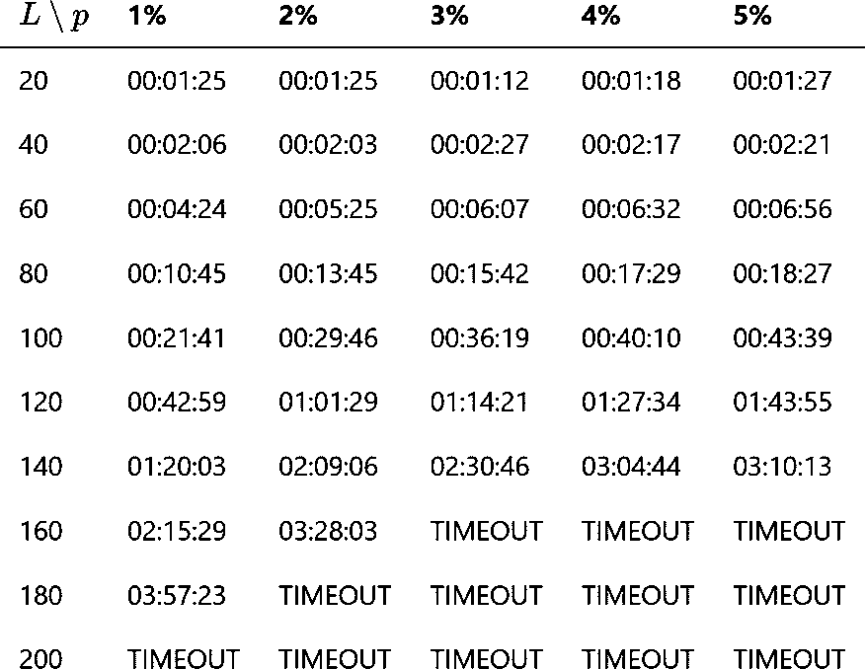


Run 3 – smaller $p$
$L∈\{20,40,60,…,200\}$
$c=16$
$T=L$
$p∈\{0.01,0.02,0.03,…,0.05\}$
$η=0.1$
10000 shots
4 hours, 8 CPUs / task

Slide 8
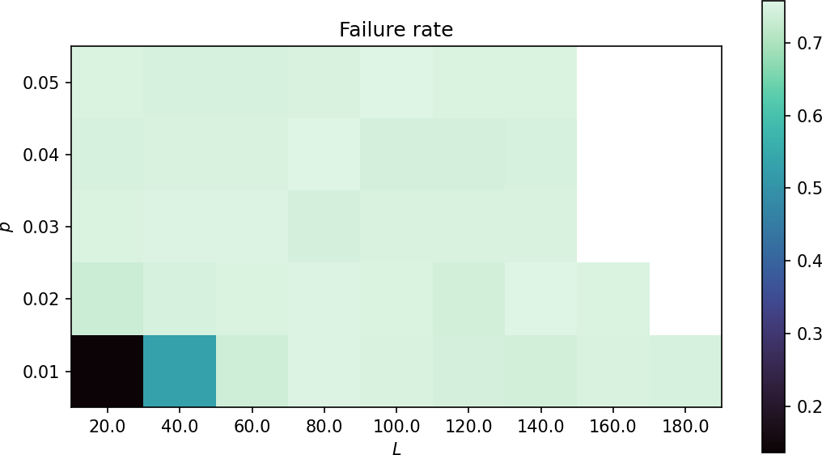
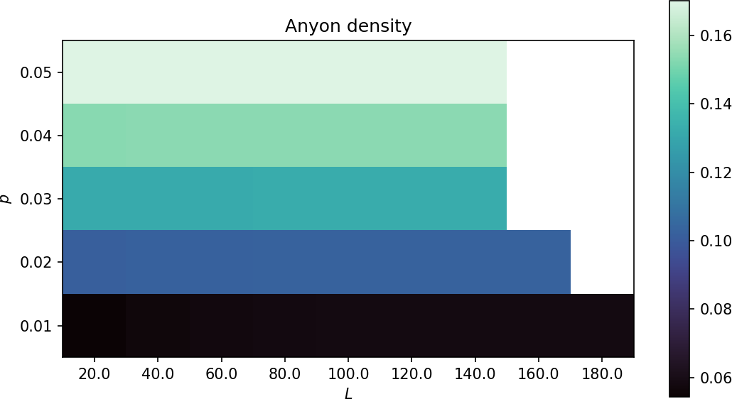
Run 3

Slide 9
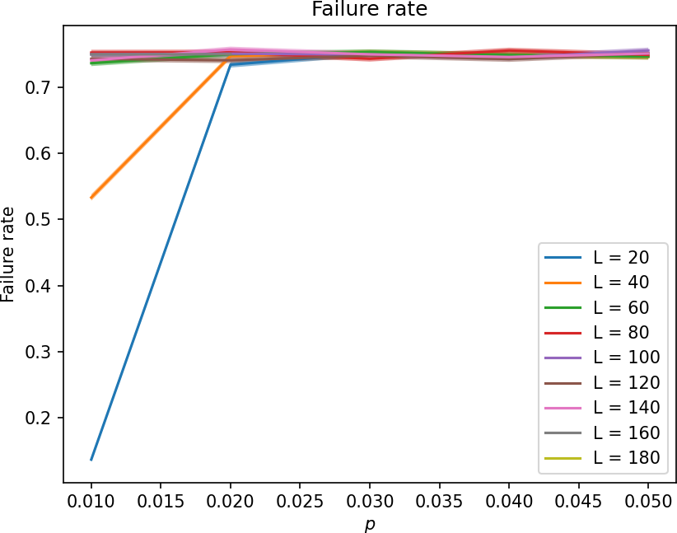
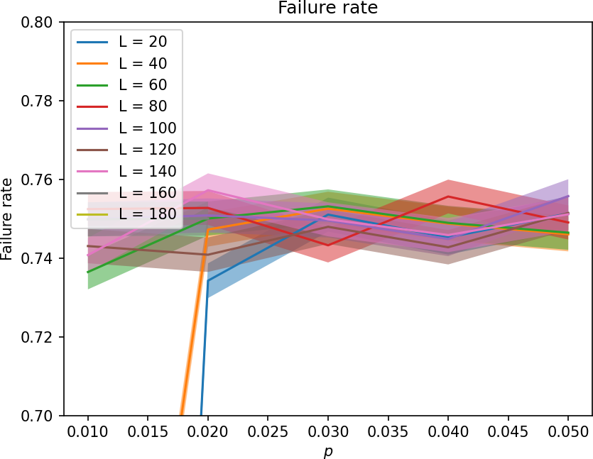
Run 3

Slide 10
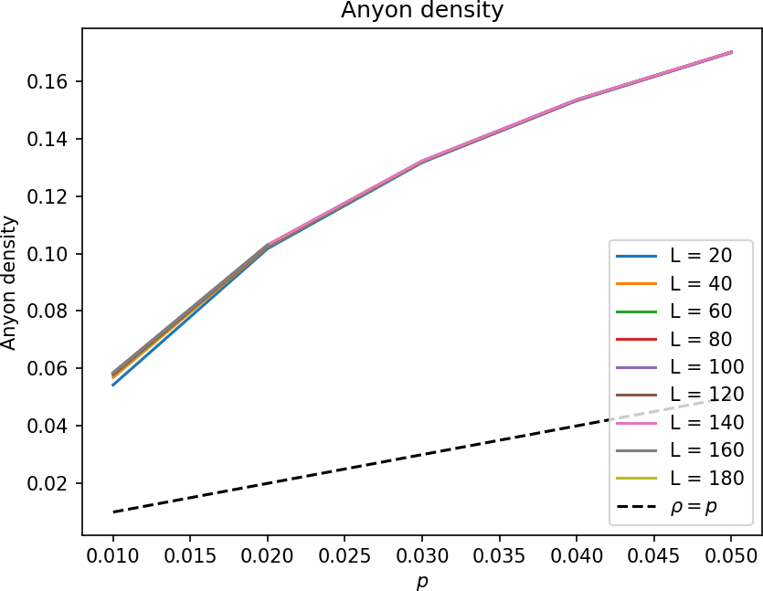
Run 3

Slide 11
Intermission – PyMatching Benchmarking
L | Anyon density | Overhead | Time per shot | Std. dev.
100 | 1% | 11 ms | 1 ms
100 | 5% |  | 2.25 ms
100 | 20% |  | 63.9 ms | 16.5 ms
200 | 1% | 37 ms | 3.11 ms
200 | 5% |  | 8.69 ms
200 | 20% |  | 10.8 s | 16 s
400 | 1% | 165 ms | 12.1 ms
400 | 5% |  | 54 ms
400 | 20% |  | TIMEOUT
PyMatching struggles & performs inconsistently with high values of anyon density.

Slide 12
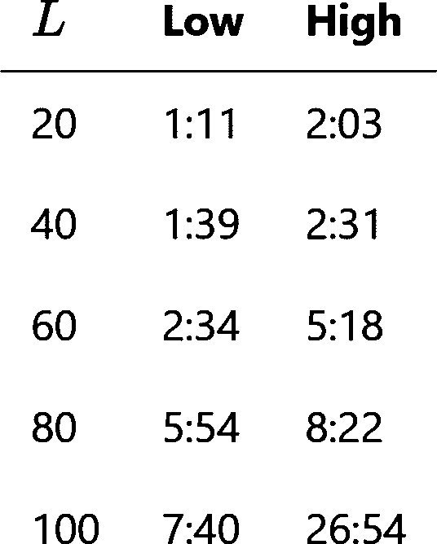


Run 4 – even smaller $p$
$L∈\{20,40,60,…,100\}$
$c=16$
$T=L$
$p∈\{2^{−6},2^{−7},2^{−8},…,2^{−10}\}$
$η=0.1$
10000 shots
1 hour, 8 CPUs / task

Slide 13
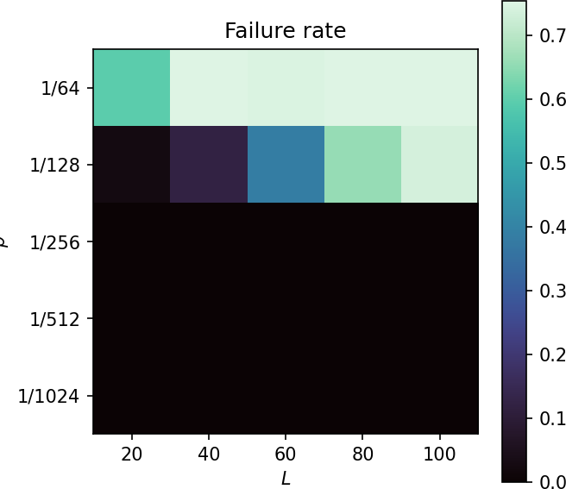
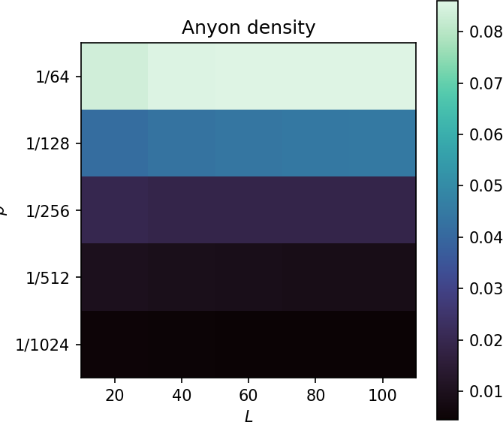
Run 4

Slide 14
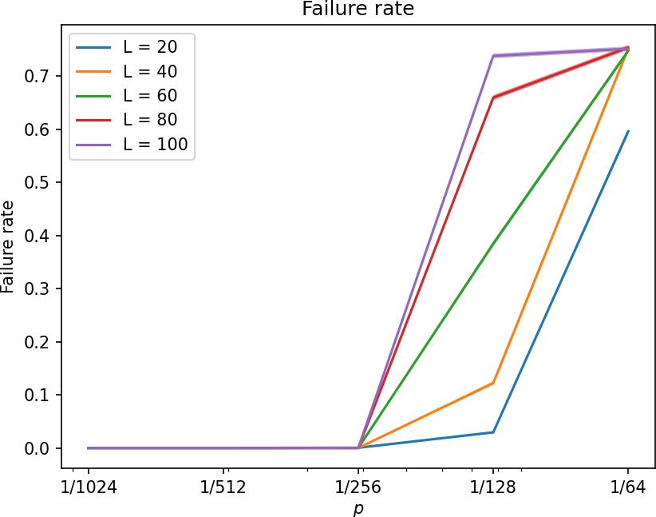
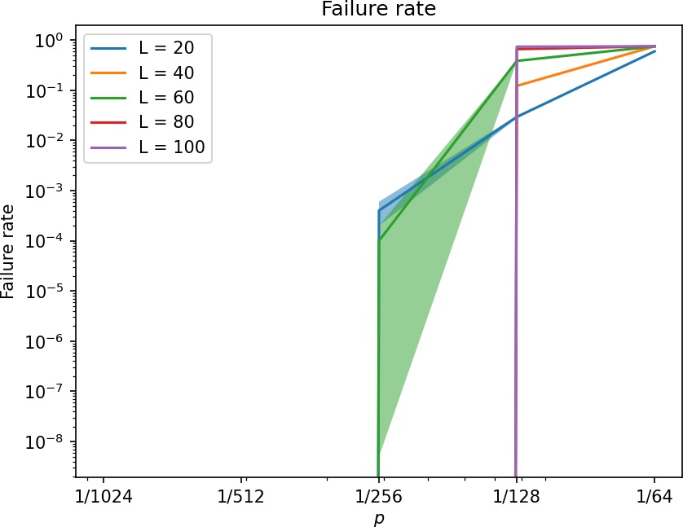
Run 4

Slide 15
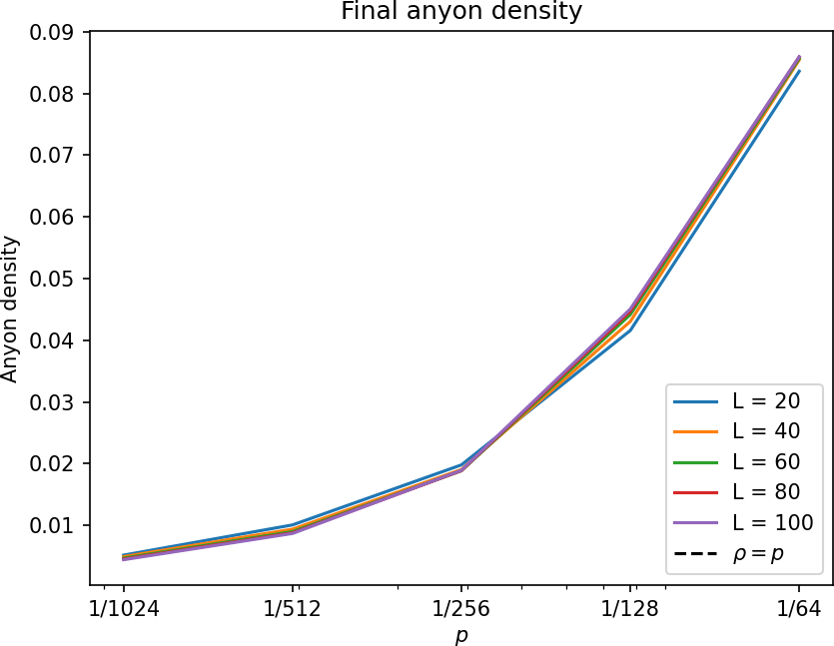
Run 4

Slide 16
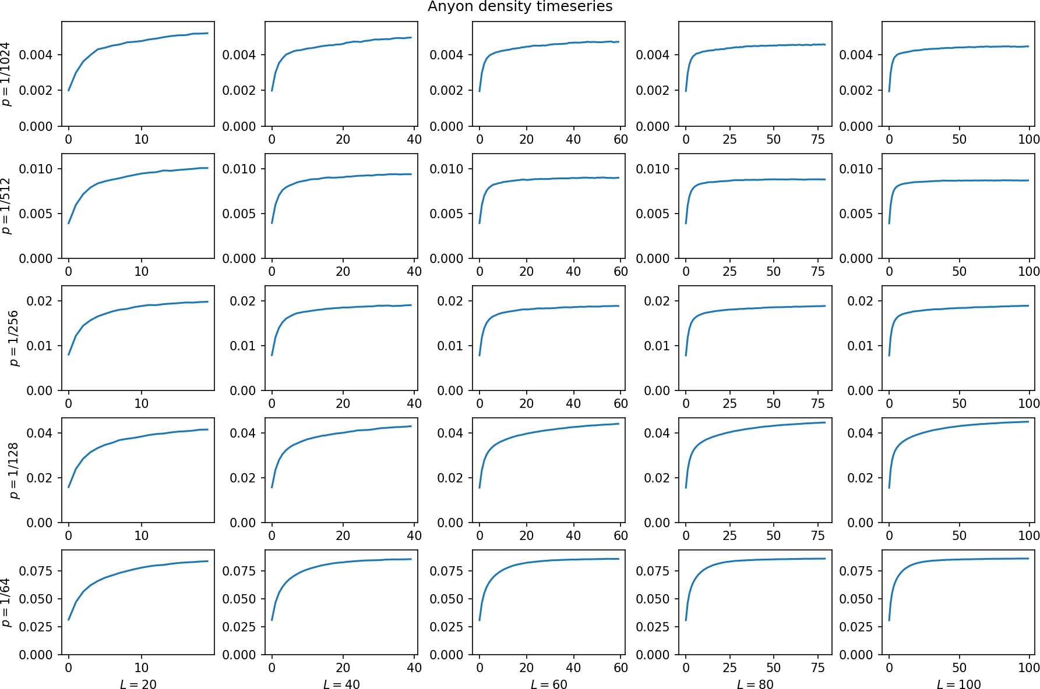
Run 4

Slide 17
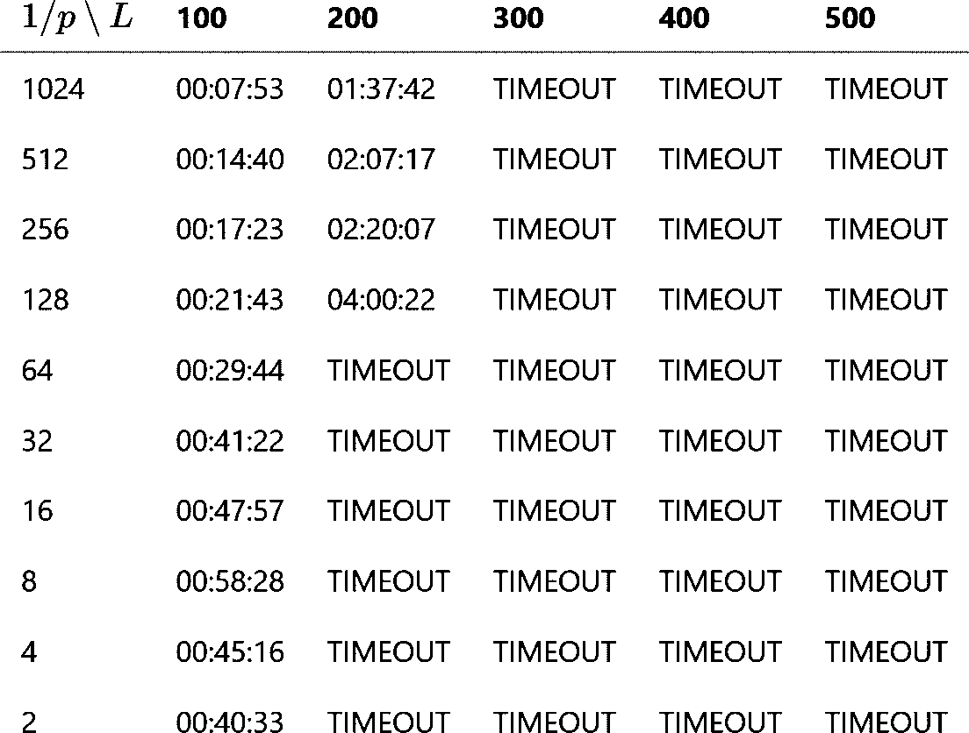

Run 5 – anyon density
$L∈\{100,200,300,…,500\}$
$c=16$
$T=L$
$p∈\{2^{−1},2^{−2},2^{−3},…,2^{−10}\}$
$η=0.1$
10000 shots
4 hours, 8 CPUs / task

Slide 18
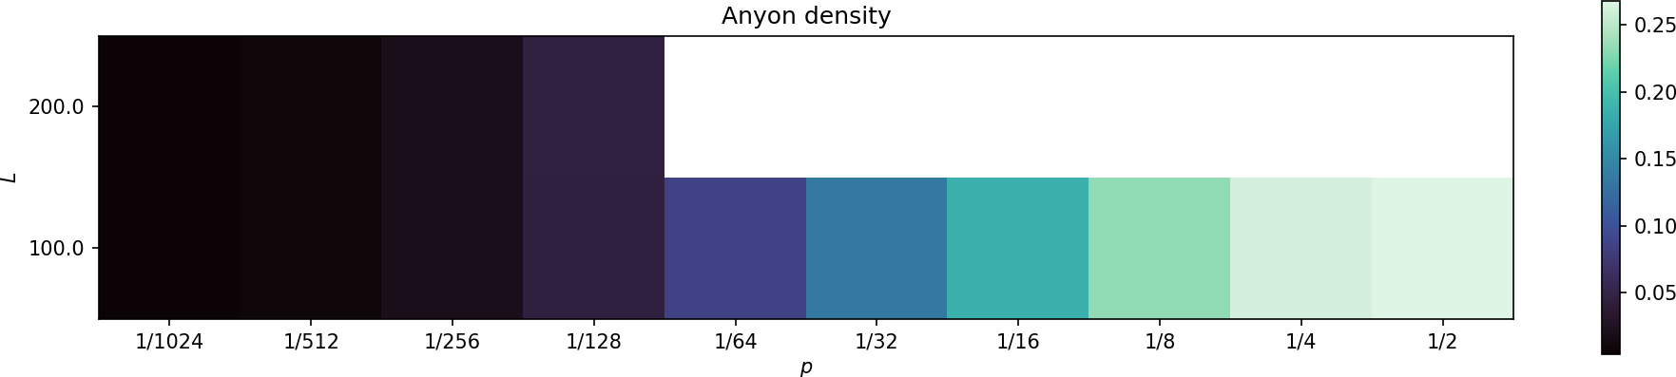
Run 5

Slide 19
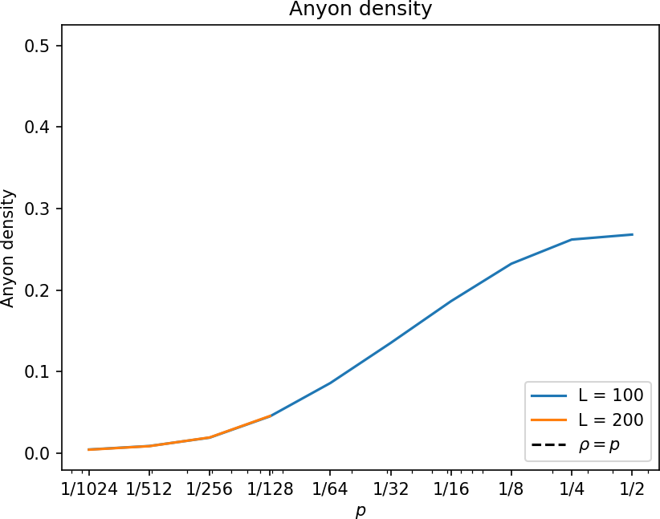
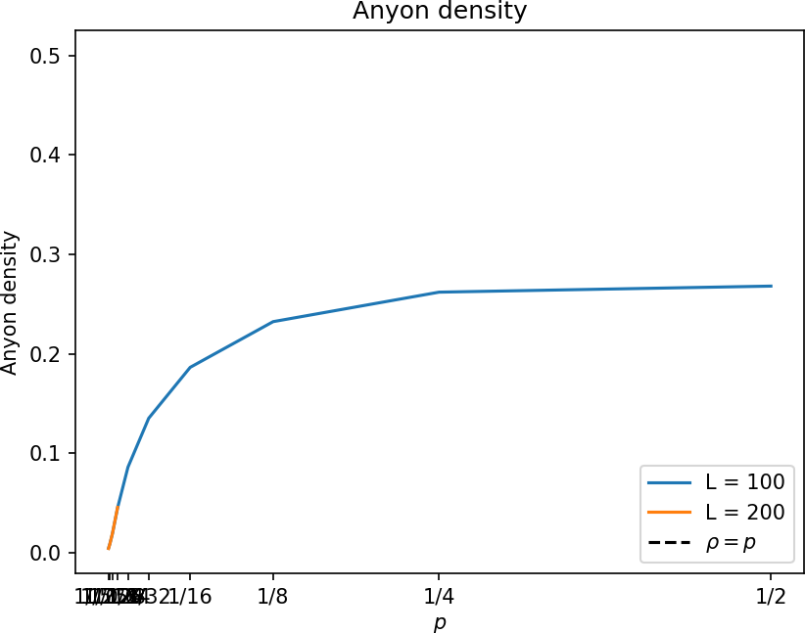
Run 5

Slide 20
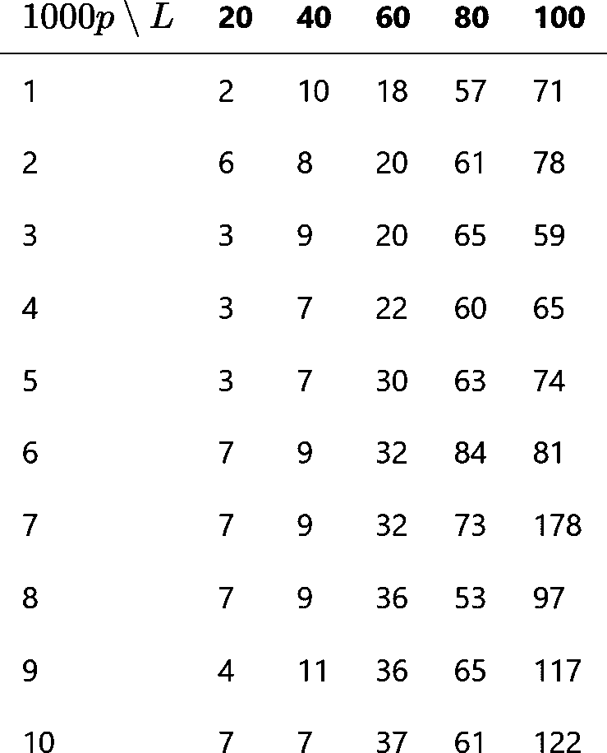

Run 6 – increase sensitivity
$L∈\{20,40,60,…,100\}$
$c=16$
$T=L$
$p∈\{0.001,0.002,0.003,…,0.010\}$
$η=0.1$
100000 shots
4 hours, 8 CPUs / task

Slide 21
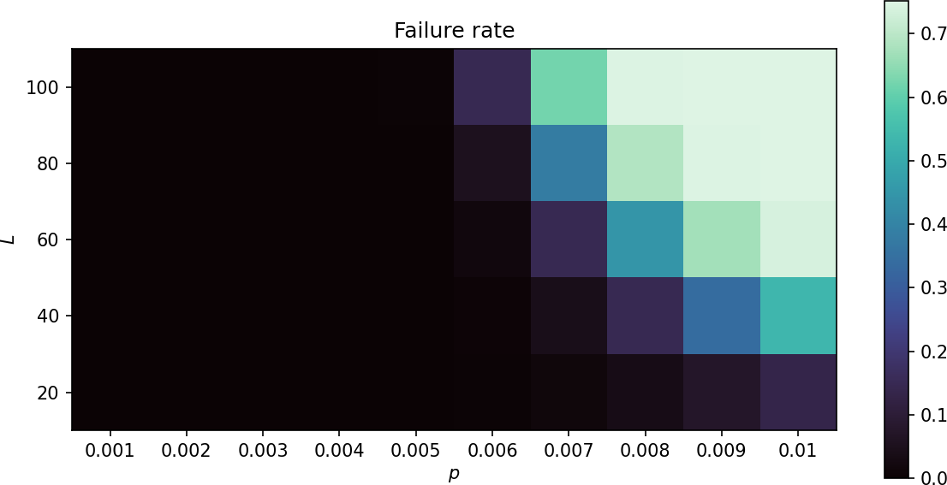
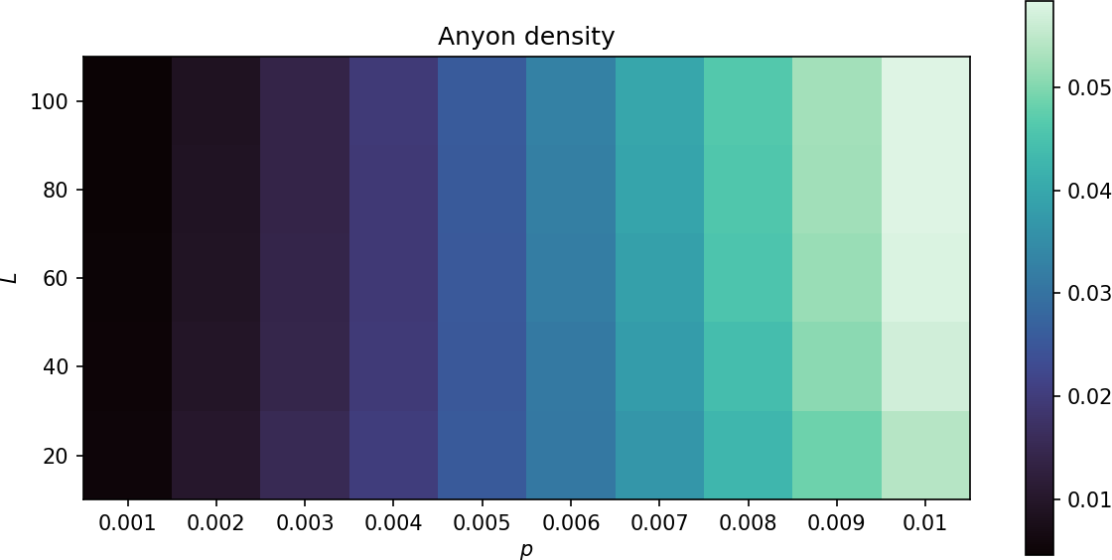
Run 6

Slide 22
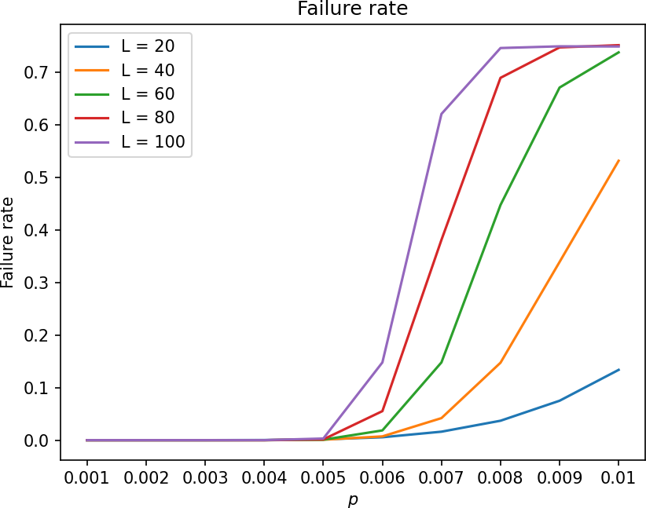
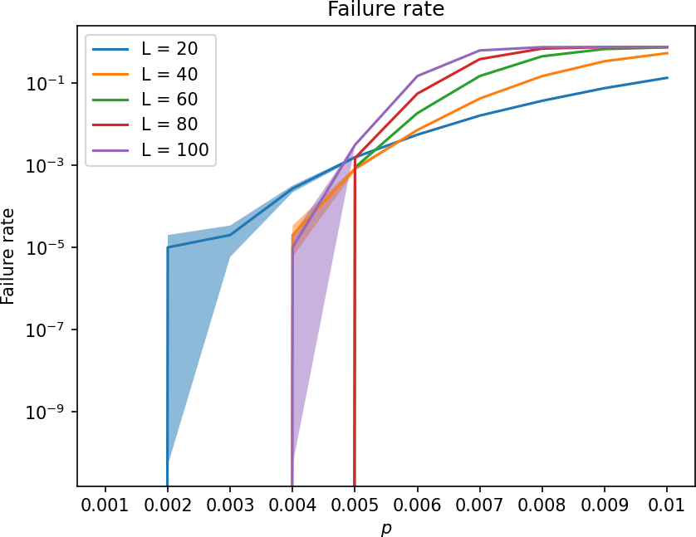
Run 6

Slide 23
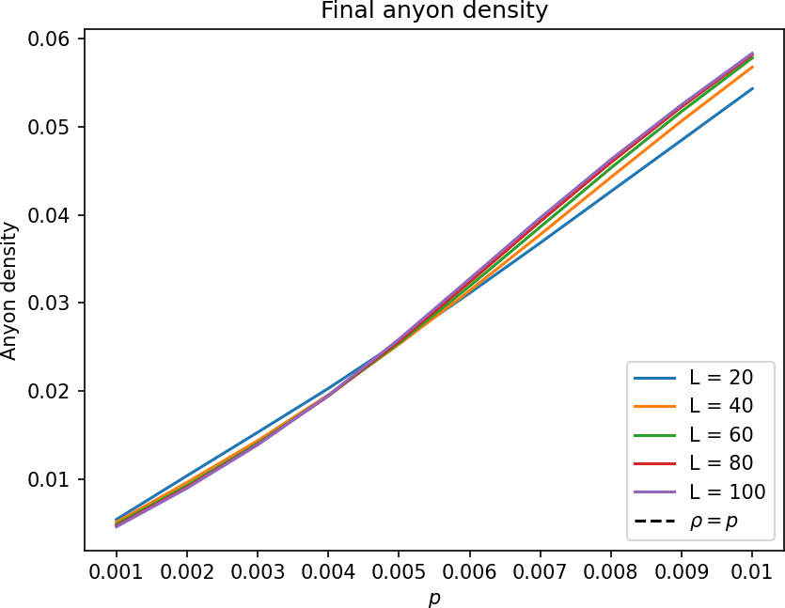
Run 6
Crossing?
Or effect of small L?

Slide 24
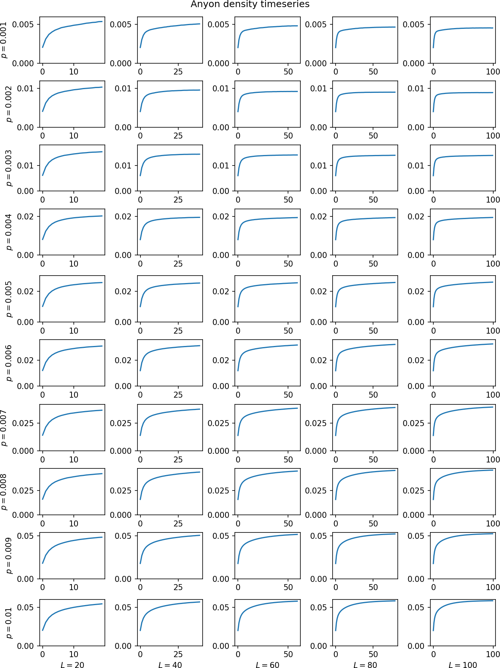
Run 6

Slide 25
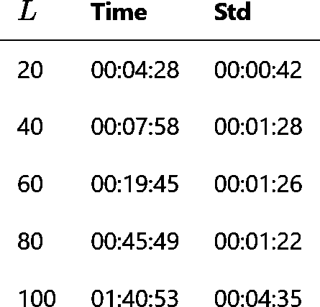

Run 7 – look for below-threshold behavior
$L∈\{20,40,60,…,100\}$
$c=16$
$T=L$
$p=0.004$
$η=0.1$
1000000 shots
2 hours, 8 CPUs / task

Slide 26
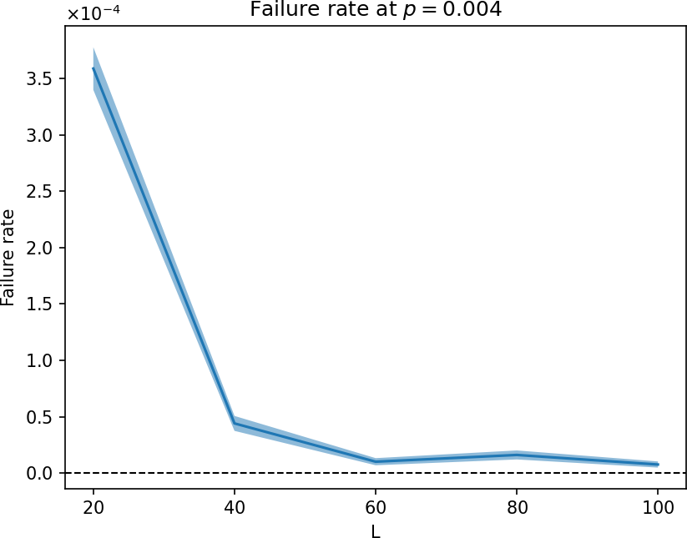
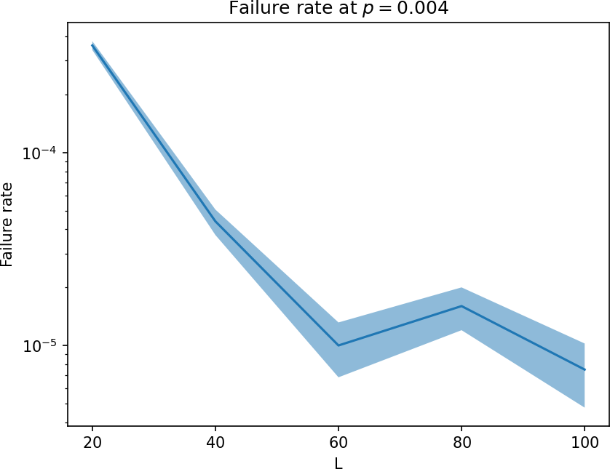
Run 7

Slide 27
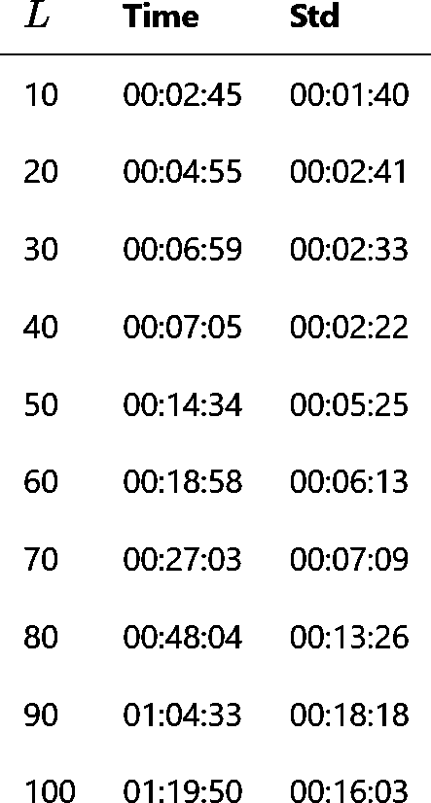

Run 8 – Refine run 7
$L∈\{10,20,30,…,100\}$
$c=16$
$T=L$
$p=0.004$
$η=0.1$
${10}^{7}$ shots (100000 x 100)
2 hours, 10 CPUs / task

Slide 28
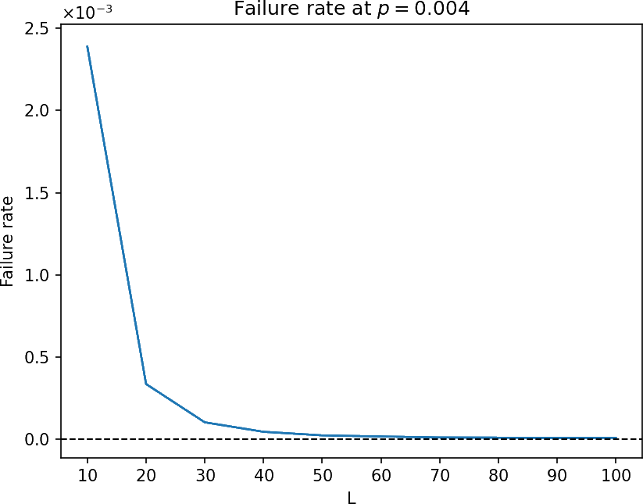
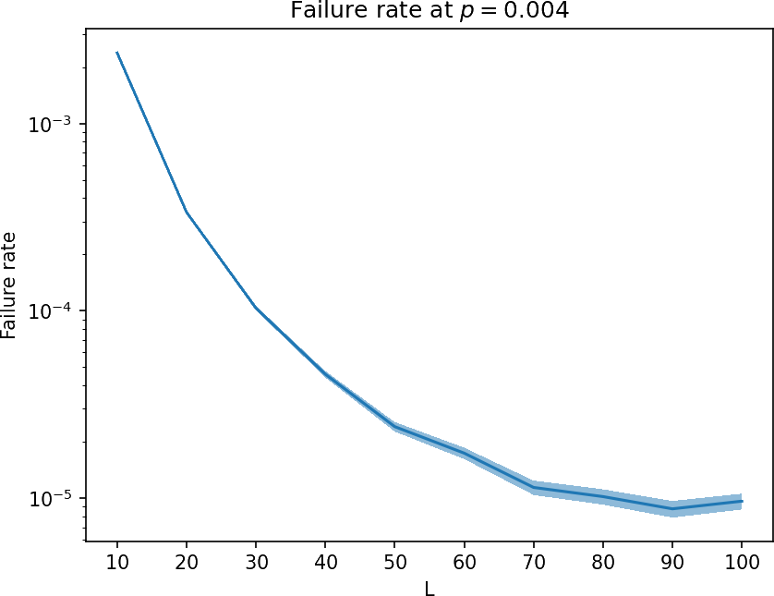
Run 8

Slide 29
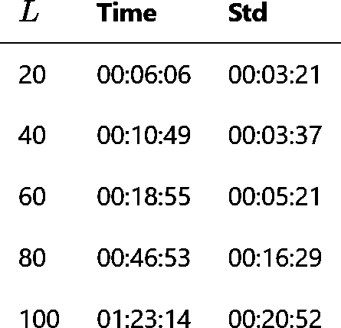
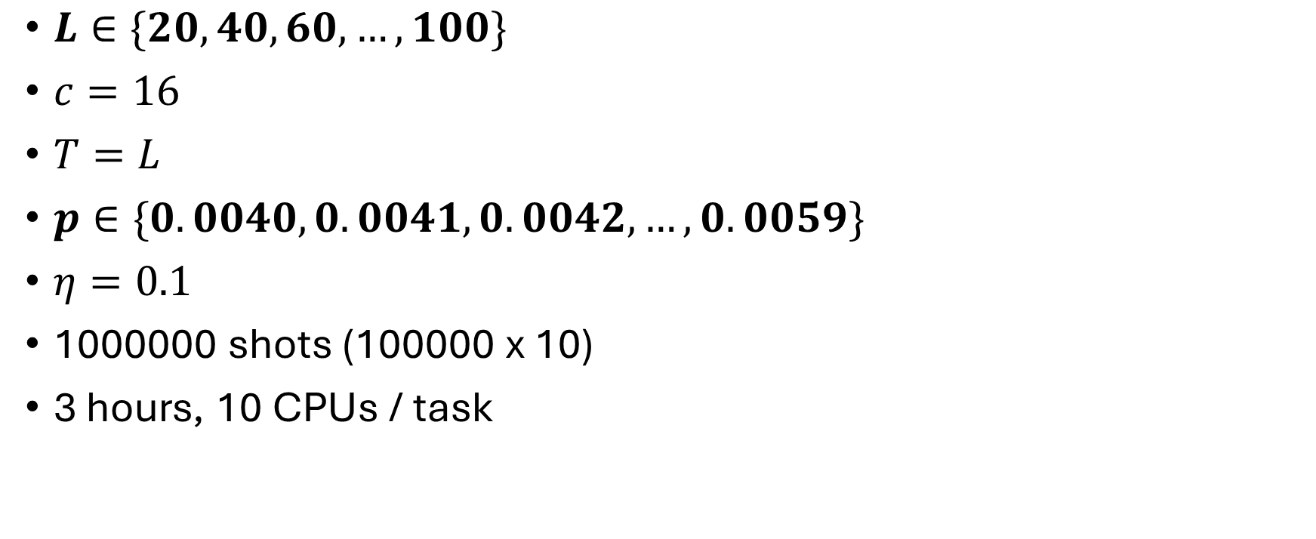
Run 9 – look for crossing
$L∈\{20,40,60,…,100\}$
$c=16$
$T=L$
$p∈\{0.0040,0.0041,0.0042,…,0.0059\}$
$η=0.1$
1000000 shots (100000 x 10)
3 hours, 10 CPUs / task

Slide 30
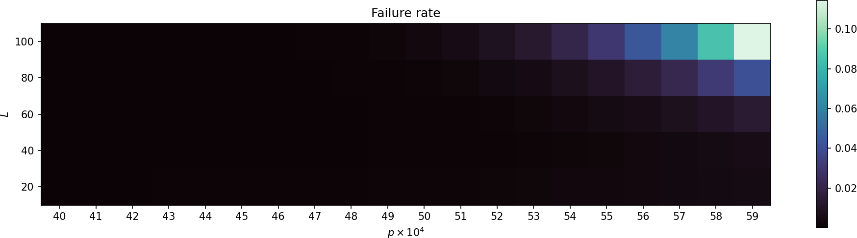
Run 9

Slide 31
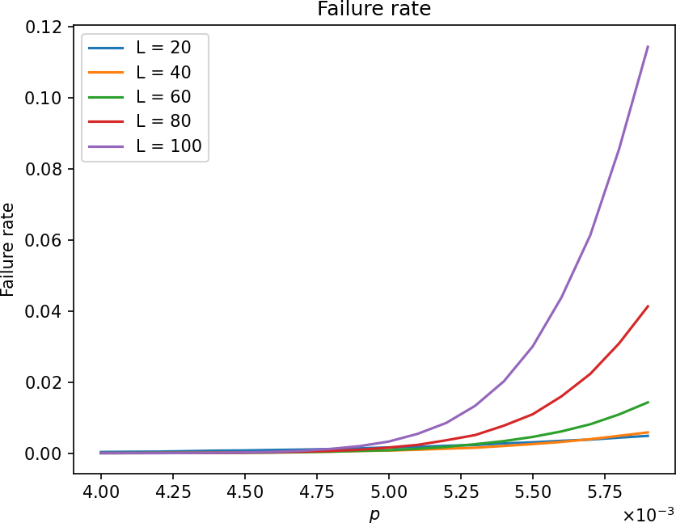
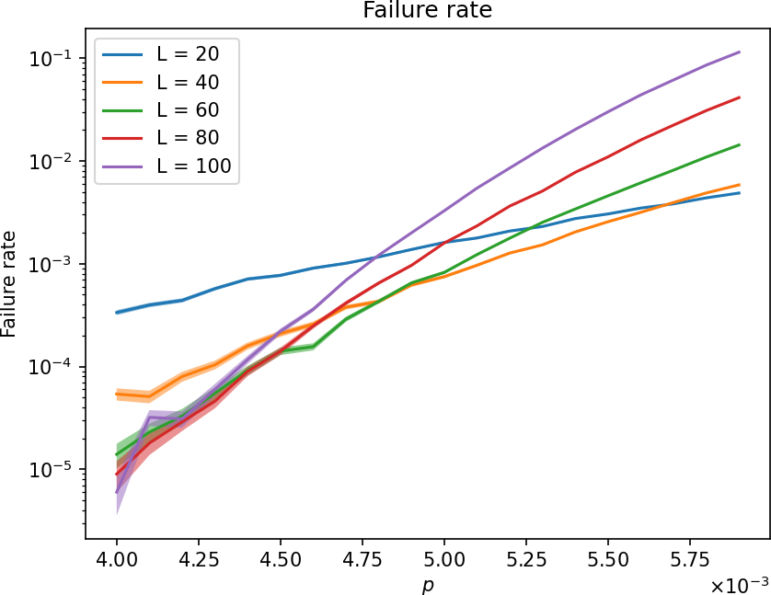
Run 9

Slide 32

Run 10 – more crossing
$L∈\{100,200,300,…,500\}$
$c=16$
$T=L$
$p∈\{0.0035,0.0036,0.0037,…,0.0045\}$
$η=0.1$
1.5 hours, 1 GPU / task

Slide 33

Run 10

Slide 34


Run 10

Slide 35

Run 11
$L∈\{100,200,300,…,500\}$
$c=16$
$T=L$
$p=0.0035$
$η=0.1$
1.5 hours, 1 GPU / task

Slide 36


Run 11

Slide 37

Run 12
$L∈\{100,200,300,…,500\}$
$c=16$
$T=L$
$p∈\{0.0035,0.0036,0.0037,…,0.0045\}$
$η=0.1$
12 hours, 1 GPU / task

Slide 38

Run 12

Slide 39


Run 12

Slide 40

Run 12

Slide 41

Run 13
$L∈\{50, 100, 150, …, 250\}$
$c=16$
$T=L$
$p∈\{0.00400,0.00401,0.00402,…,0.00419\}$
$η=0.1$
12 hours x 10, 1 GPU / task

Slide 42

Run 13

Slide 43


Run 13

